Slide 1
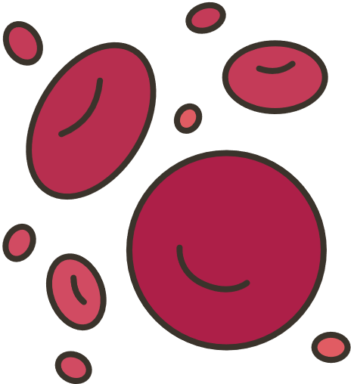
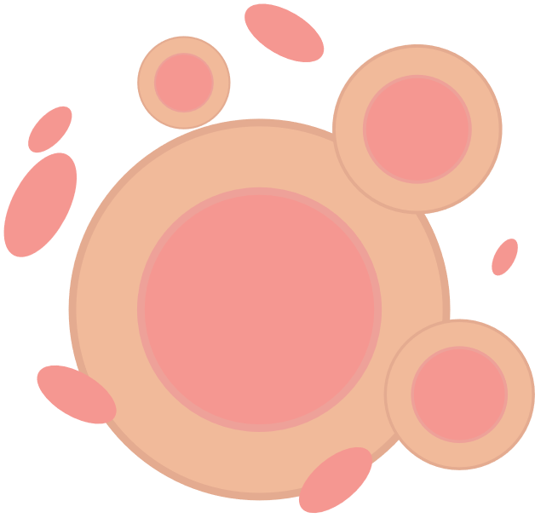
Albuquerque Central Biorepository
RISK ASSESSMENT
You can bank on it!
Using a RISK ASSESSMENT helps us reduce chance, identify and evaluate potential adverse events, and improve our decision-making abilities.
Examples of Key Risks in Clinical Trials
CSP2004
P445
P555
CSP407
Biohazard exposure
PHI/PII
Shipping
Fitness for Purpose
Pandemic research
Importance of pre-planning
Associated data
Legacy specimens
Tech/regulatory changes
Risk Assessment Example
pLAN
dO
2
Years
Risk assessments
Identified risks
How risk assessment is part of each step in the cycle of continuous improvement
Initial
Assessment
Apply controls
and identify
new risks
21
Cycle of
continuous
Improvement
109
ACT
CHECK
update risk assessment
Evaluate risk assessment
Acknowledgement/funding: This research was supported in part by the Department of Veterans Affairs, Veterans Health Administration, Office of Research and Development, Cooperative Studies Program using resources and facilities at the VA Cooperative Studies Program Clinical Research Pharmacy Coordinating Center.
Authors: Dianne Peterson, Steven Micklos, Robert Ringer, Paul Hicks, Vera Tso, Carla Winebark
Contents are expressed by the authors and do not represent the views of the Department of Veterans Affairs or the United States Government.
Albuquerque Central Biorepository

