Slide 1

Site Budget Training
Cooperative Studies Program
Budget Subdomain
November 14 and 16 , 2018

Slide 2
Reminder of Major Changes
The Current Account Status section was deleted from the Annual Budget Request Form.
You will receive an email in 3rd QTR requesting your site to review CSP Study accounts balances in preparation for an excess funds withdraw.
Beginning FY20 the Annual Budget Request Forms will be processed through the CSP Requests for Budgetary Support SharePoint Site.

Slide 3
Starting the Site Budget
Populated budget forms and Instructional memo will be uploaded to the CSP Annual Budget Request Portal by November 23, 2018.
Site AO, ACOS and Investigator will review, complete and sign the budgetary form by January 11, 2019.

Slide 5
The highlighted areas are where you can input your data. The non-highlighted areas automatically calculate the total benefits, actual salary and benefits and populate the subtotals under each program type as well as populate the actual current year ITA.

Slide 6
COOPERATIVE STUDIES PROGRAM, REQUEST FOR BUDGETARY SUPPORT, FY 20XX
VA STATION NAME
STATION NO.
Palo Alto
640
COOPERATIVE STUDY NAME
STUDY NO.
"Budgeting for Effective Study Totals BEST"
123
INVESTIGATOR'S NAME
ANTICIPATED FUNDING END DATE
Bee Wise
9/30/2022
The information in the top section of the form will be pre-filled. It will include the anticipated funding end date.

Slide 7
Use the drop-down buttons to show the status of the Investigator. An Investigator must have a 5/8th VA Appointment in order to serve on the study or a waiver by CSP CO is required.

Slide 8
Enter the name, grade and step of the personnel anticipated to be working on the study. Contact the HR Department to find the GS level of the employee if unknown.

Slide 9
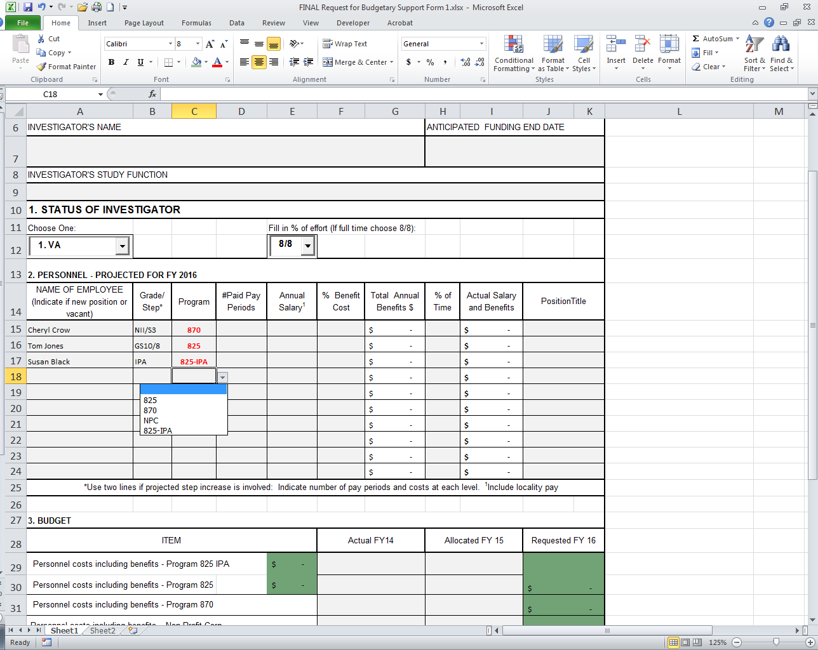
Choose the Program Type from the drop down list:
Program 825 Funds – Non-Clinical Study Personnel
Program 870 Funds – Clinical Care Personnel
NPC – Non-Profit Corporation (These funds should only be requested upon direction of the CSP Center)
Program 825-IPA – Study Personnel paid pursuant to an IPA, on contract or Fee for Service Agreement (FFS)

Slide 10
Program Type Classification by Title
Title 5 (Program 825) | Title 38 (Program 870)
Administrative | Physicians
Professional | Dentists
Clerical | Podiatrists
Technical | Optometrists
Wage Grade | Chiropractors
 | Registered Nurses
 | Nurse Anesthetists
 | Nurse Practitioners
 | Clinical Nurse Specialists
 | Physician Assistants
 | Expanded Function Dental Auxiliaries
 | Genomic Research Staff
 | Hybrid 38
 | Pharmacist
 | Licensed Practical Nurses
 | Licensed Vocational Nurses
 | Occupational Therapists
 | Physical Therapists
 | Occupational Therapists
 | Certified Respiratory Therapists
 | Registered Respiratory Therapist

Slide 11
IPA PERSONNEL
If consideration is being given to hiring personnel using an Intergovernment Personnel Act (IPA), it should be noted that the agreement cannot exceed a four-year period without a one year break regardless of the percentage of time and effort. Being assigned to a new study after another study has ended will not start the four-year period over again.
An employee of a non-Federal organization must be employed by that organization for at least 90 days in a career position before entering into an IPA Agreement.
Terms of an IPA can be found at the following website: https://www.opm.gov/policy-data-oversight/hiring-authorities/intergovernment-personnel-act/#url=Provisions

Slide 12
Locating Budgeting Resources
Use this site for Nurse Locality Pay Schedules
http://vaww.va.gov/OHRM/Pay/index.asp#T38
Use this site for General (GS) Locality Pay Tables
http://vaww.va.gov/OHRM/Pay/index.asp#GS
Use this site for pay period calendars
http://vaww.fscdirect.fsc.va.gov/payroll.asp

Slide 13
2. PERSONNEL - PROJECTED FOR FY 20XX
NAME OF EMPLOYEE
Grade/
#Paid Pay
Annual
% Benefit
Total Annual
% of
Actual Salary
(Indicate if new position or
Step*
Program
Periods
Salary
Position Title
vacant)
1
Cost
Benefits $
Time
and Benefits
Cheryl Crow
NII/S3
870
26.0
$
-
$
-
Indicate the number of pay periods each employee will be paid. Use 26 pay periods for VA employees employed the full year. For studies starting or ending during the fiscal year, count the number of pay periods the individual is to be paid.
For IPAs working the full year, the number of pay periods is assumed to be 26.
Tom Jones
GS10/8
825
13.0
$
-
$
-
Susan Black
IPA
825-IPA
26.0
$
-
$
-
$
-
$
-
$
-
$
-
$
-
$
-
$
-
$
-
$
-
$
-
$
-
$
-
$
-
$
-
*Use two lines if projected step increase is involved: Indicate number of pay periods and costs at each level.
1
Include locality pay

Slide 14
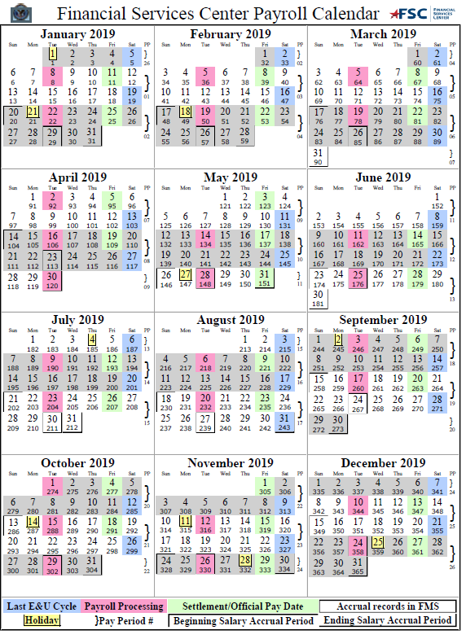

Slide 15
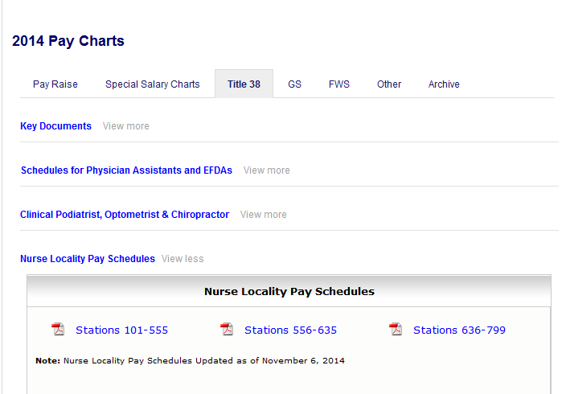
Site to find Nurse Coordinator Salary
Click on the range that includes the station number. Example: To choose station 640, the third range should be selected.

Slide 16
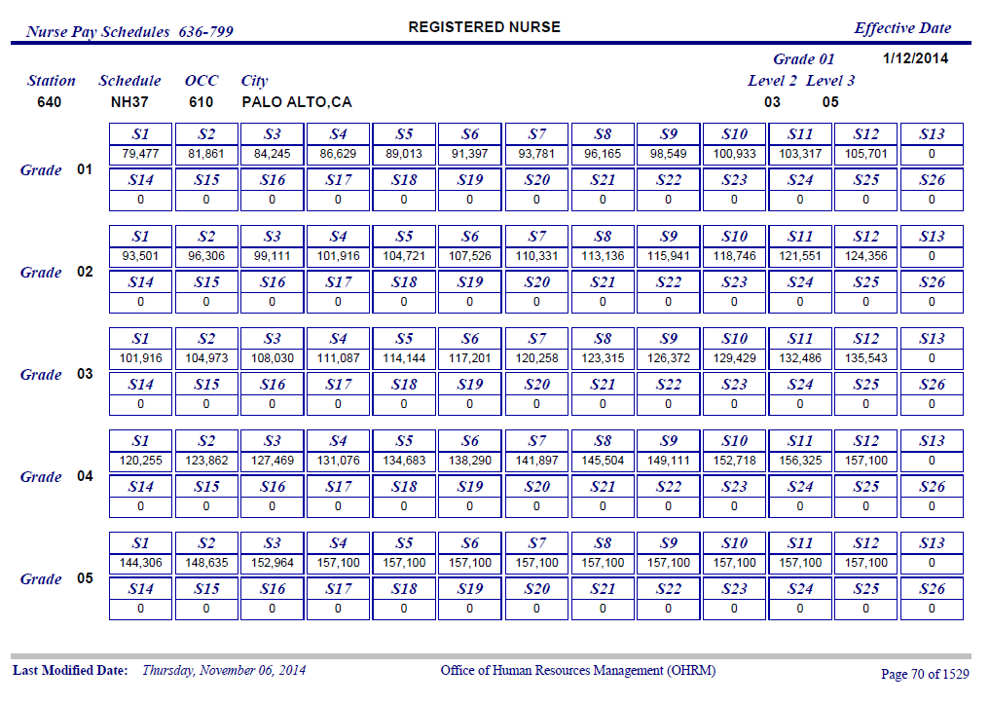

Slide 17
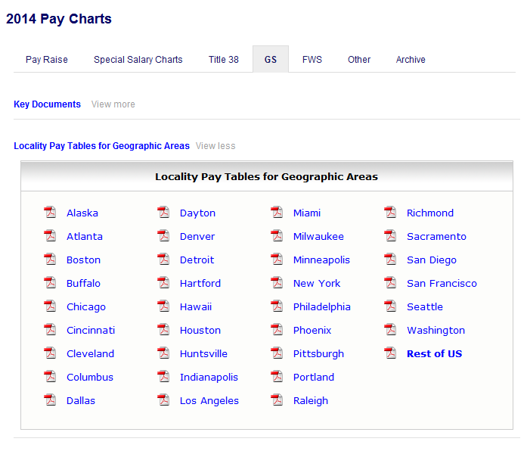
1. Click on “GS”
2. Click on Locality Pay Tables for . Geographic Areas
3. Click on appropriate …..locality table

Slide 18
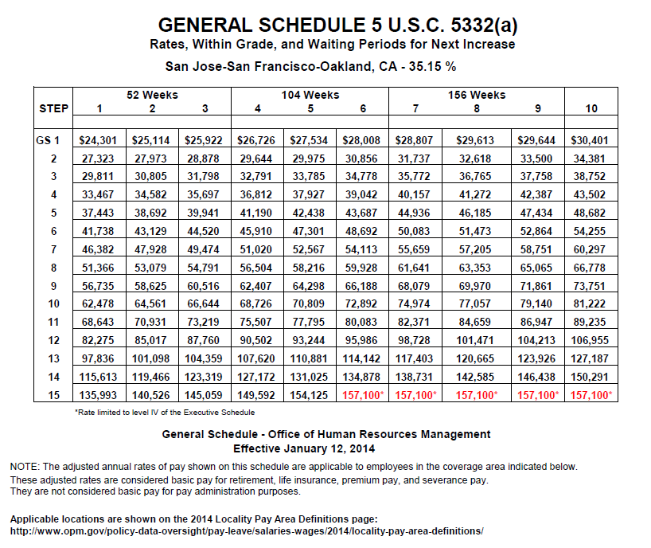

Slide 19
2. PERSONNEL - PROJECTED FOR FY 20XX
NAME OF EMPLOYEE
Grade/
#Paid Pay
Annual
% Benefit
Total Annual
% of
Actual Salary
(Indicate if new position or
Step*
Program
Periods
Salary
Benefits $
and Benefits
PositionTitle
vacant)
1
Cost
Time
Cheryl Crow
NII/S3
870
26.0
$
99,111
$
-
$
-
Tom Jones
GS10/8
825
13.0
$
77,057
$
-
$
-
Susan Black
IPA
825-IPA
26.0
$
83,429
$
-
$
-
Indicate the yearly salary of the employee. For VA employees this should be based on the locality pay table. If unsure, consult your HR Department.
For IPAs, the salary is based on the agreement.
$
-
$
-
$
-
$
-
$
-
$
-
$
-
$
-
$
-
$
-
$
-
$
-
$
-
$
-
*Use two lines if projected step increase is involved: Indicate number of pay periods and costs at each level. Include locality pay.
1

Slide 20
Indicate the percent of the actual benefit rate. If the actual rate is not available, use 30%. The Total Annual Benefit will calculate automatically.
2. PERSONNEL - PROJECTED FOR FY 2017
NAME OF EMPLOYEE
Grade/
Program
#Paid Pay
Annual
% Benefit
Total Annual
% of
Actual Salary
(Indicate if new position or
Step*
Periods
Salary
Position Title
vacant)
1
Cost
Benefits $
Time
and Benefits
Cheryl Crow
NII/S3
870
26.0
$
28%
99,111
$
27,751
$
-
Tom Jones
GS10/8
825
13.0
$
77,057
30%
23,117
$
$
-
Susan Black
IPA
825-IPA
26.0
83,429
0%
$
$
-
$
-
$
-
$
-
$
-
$
-
$
-
$
-
$
-
$
-
$
-
$
-
$
-
$
-
$
-
$
-
*Use two lines if projected step increase is involved: Indicate number of pay periods and costs at each level.
Include locality pay
1

Slide 21
Indicate the percent of time each employee will work on the study based on the current approved budget. Requests for additional FTE need to be approved by CSP CO and submitted through the CSP Center.
The Actual Salary and Benefits will calculate automatically.
2. PERSONNEL - PROJECTED FOR FY 2016
NAME OF EMPLOYEE (Indicate if new position or vacant) | Grade/ Step* | Program | #Paid Pay Periods | Annual Salary¹ | % Benefit Cost | Total Annual Benefits $ | % of Time | Actual Salary and Benefits | PositionTitle
Cheryl Crow |  | 870 | 26.0 | $ 99,111 | 28% | $ 27,751 | 20% | $ 25,372
Tom Jones |  | 825 | 13.0 | $ 77,057 | 30% | $ 23,117 | 25% | $ 12,522
Susan Black |  | 825-IPA | 26.0 | $ 83,429 | 0% | $ - | 5% | $ 4,171
 |  |  |  |  |  | $ - |  | $ -
 |  |  |  |  |  | $ - |  | $ -
 |  |  |  |  |  | $ - |  | $ -
 |  |  |  |  |  | $ - |  | $ -
 |  |  |  |  |  | $ - |  | $ -
 |  |  |  |  |  | $ - |  | $ -
 |  |  |  |  |  | $ - |  | $ -
*Use two lines if projected step increase is involved: Indicate number of pay periods and costs at each level. ¹Include locality pay

Slide 22
Indicate the Title for each employee.
2. PERSONNEL - PROJECTED FOR FY 20XX
NAME OF EMPLOYEE (Indicate if new position or vacant) | Grade/ Step* | Program | #Paid Pay Periods | Annual Salary¹ | % Benefit Cost | Total Annual Benefits $ | % of Time | Actual Salary and Benefits | PositionTitle
Cheryl Crow |  | 870 | 26.0 | $ 99,111 | 28% | $ 27,751 | 20% | $ 25,372 | Nurse Coordinator
Tom Jones |  | 825 | 13.0 | $ 77,057 | 30% | $ 23,117 | 25% | $ 12,522 | Study Coordinator
Susan Black |  | 825-IPA | 26.0 | $ 83,429 | 0% | $ - | 5% | $ 4,171 | Research Assistant
 |  |  |  |  |  | $ - |  | $ -
 |  |  |  |  |  | $ - |  | $ -
 |  |  |  |  |  | $ - |  | $ -
 |  |  |  |  |  | $ - |  | $ -
 |  |  |  |  |  | $ - |  | $ -
 |  |  |  |  |  | $ - |  | $ -
 |  |  |  |  |  | $ - |  | $ -
*Use two lines if projected step increase is involved: Indicate number of pay periods and costs at each level. ¹Include locality pay

Slide 23
The cells highlighted in dark green will calculate automatically based on the information entered in the Personnel section.
3. BUDGET
ITEM |  |  | Actual FY15 | Allocated FY 16 | Requested FY 17
Personnel costs including benefits - Program 825 IPA |  | $ 4,171 |  |  | $ 16,693
Personnel costs including benefits - Program 825 |  | $ 12,522
Personnel costs including benefits - Program 870 |  |  |  |  | $ 25,372
Personnel costs including benefits – Non-Profit Corp. |  |  |  |  | $ -
IT costs (to include salary and all other IT expenses)
All other costs (including supplies and equipment) (Specify equipment in Remarks)
Total |  |  | $ - | $ - | $ 42,066
REMARKS (Use overleaf if necessary)
The cells highlighted in light green will calculate automatically based on the information in this Budget section.
Enter the appropriate costs in the cells not highlighted.

Slide 24
For existing studies, the columns Actual FY18 and Allocated FY19 are pre-populated by the Center Budget Analyst.
3. BUDGET
ITEM |  |  | Actual FY18 | Allocated FY 19 | Requested FY 20
Personnel costs including benefits - Program 825 IPA |  | $ 4,171 |  |  | $ 16,693
Personnel costs including benefits - Program 825 |  | $ 12,522
Personnel costs including benefits - Program 870 |  |  |  |  | $ 25,372
Personnel costs including benefits – Non-Profit Corp. |  |  |  |  | $ -
IT costs (to include salary and all other IT expenses)
All other costs (including supplies and equipment) (Specify equipment in Remarks)
Total |  |  | $ - | $ - | $ 42,066
REMARKS (Use overleaf if necessary)

Slide 25
Use two lines for an employee due for a grade or step increase. Example: A step increase is expected on January 10th. Count the number of pay periods covered before the step increase (in this example, 7.2 pay periods). Enter the number of pay periods and Annual Salary before the step increase.
2. PERSONNEL - PROJECTED FOR FY 2020
NAME OF EMPLOYEE
Grade/
#Paid Pay
Annual
% Benefit
Total Annual
% of
Actual Salary
(Indicate if new position
Or Vacant)
Step*
Program
Periods
Salary
PositionTitle
1
Cost
Benefits $
Time
and Benefits
Cheryl Crow
NII/S3
870
7.2
$
99,111
28%
$
27,751
100%
$
35,131
Nurse Coordinator
Cheryl Crow
NII/S4
870
18.8
$
101,916
28%
$
28,536
100%
$
94,327
Nurse Coordinator
$
-
$
-
$
-
$
-
$
-
$
-
$
-
$
-
To calculate the number of pay periods covered after the increase, subtract the number of pay periods before increase from 26 (26 - 7.2 = 18.8). Enter the number of pay periods and Annual Salary after the step increase.

Slide 26
The salary and benefit based on the step increase in the middle of the year is automatically populated under the related program type.

Slide 27
How Different is the Submitted Budget Compared to the Approved CSSEC Study Budget?
CSSEC Budget- Nurse II, Step 3, .50 FTE $63,431
Proposed Budget (from slide 22) $42,066
Variance is favorable $21,365
($63,431-$42,066=$21,365)
This means that the proposed budget is lower than the CSSEC Budget.

Slide 28
The Remarks section should be used to communicate any additional costs outside the approved budget and/or to detail the “All Other Costs”. As an example, some studies have patient reimbursement and lab costs that are outside the standard of care. The budget for these items may appear as partially allocated to different sites (front-loaded) with the remainder included as one lump sum for all stations in the study budget summary sheet. Funds approved in the CSSEC budget not included on this form should be requested via fund request through your CSP Center. This section is reviewed by the Centers and adjusted accordingly.

Slide 29
All budget requests will be signed digitally by the Site Investigator and the ACOS for Research and the date.
SIGNATURE OF INVESTIGATOR |  |  |  | SIGNATURE OF ACOS FOR RESEARCH
Phone No. |  | Date |  | Phone No. |  | Date

Slide 30
Other Budgeting Notes:
Study Budgets are consolidated with CSP Center Budgets and submitted to CSP Central Office in early February.
CSP Central Office reviews and approves the consolidated budgets and prepares the ITAs over the summer.
CSP Central Office sends Program 870 ITA funds to the stations.
CSP Central Office sends Program 825 current year ITA funds after the Continuing Resolution (CR).
After receiving the ITA in October, inform the CSP Budget Analyst of any funding discrepancies.
Throughout the fiscal year, inform the CSP Budget Analyst of changes in personnel, salary requirements, or any fiscal issues.

Slide 31
Wrap Up
Questions and Comments ?
Your CSP Center Budget Analyst and Project Manager are available to help!
Thank you for your time

