Slide 1
Human Subjects Protection Training: For VA Personnel Conducting Expanded Access Program Activities for the Treatment of Patients with Monkeypox (May be Used in Lieu of CITI Modules for ORD-Required Training in Human Subjects Ethical Protections)
Human Subjects Protection Training For VA Personnel Conducting FDA-Regulated Expanded Access Program Activities for the Treatment of Patients with Monkeypox
July 28, 2022
(May be Used in Lieu of CITI Modules for ORD-Required Training in Human Subjects Ethical Protections)
July 28, 2022

Slide 2
Training Objectives
By completing the review of this training slide deck, you will gain an understanding of:
key events in history that influenced the current ethical protections governing research involving human subjects;
key regulations and requirements that govern VA research involving human subjects;
key responsibilities of the investigator and the main entities involved in the review and approval of VA research; and
pathways for accessing drugs and biologics through FDA’s Expanded Access Program.

Slide 3
This Training Meets ORD’s Training Requirements in Human Subjects Protections for the Following Purpose:
This training meets the VHA Office of Research and Development’s training requirement in VHA Directive 1200.05, Paragraph 26 requiring all individuals involved in conducting VA human subjects research to complete training in ethical principles if the following criterion is met:
The VA Activity is an expanded access program regulated by the U.S. Food and Drug Administration involving investigational drugs, biologics, or medical devices for the treatment of Monkeypox.

Slide 4
Historical Perspective on Research Involving Human Subjects

Slide 5
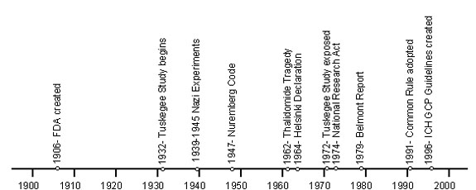
Key Historical Events Impacting Research Involving Human Subjects
From the 1930s to 1970s a number of significant events occurred that have influenced how research is conducted today.
2018 – Revised Common Rule effective July 2018
2020

Slide 6
Historical Perspective on Research Involving Human Subjects
Nazi war crimes
Used unconsenting concentration camp victims as subjects and subjected them to great pain, suffering, disfigurement, and death. These were not therapeutic trials.
Led to the development of the Nuremburg Code: a set of ethical principles developed by U.S. military tribunal post WWII (1949)
Consent; Right to withdraw; Weighing of risks and benefits
Thalidomide
Use in pregnant women resulted in thousands of babies born with malformed limbs
Lead to 1962 Drug Amendments Act – prove efficacy not just safety

Slide 7
Historical Perspective on Research Involving Human Subjects (continued)
Declaration of Helsinki
Issued by the World Medical Association (1964, amended 7x, 2013 most recent)
Well-being of the human subject should take precedence over the interests of science and society
Physician’s responsibility is to safeguard the health of the people
Medical research should be subject to review, approval, and oversight of an independent ethics committee

Slide 8
Historical Perspective on Research Involving Human Subjects (continued)
Willowbrook Case
Injected isolated strains of hepatitis into institutionalized children with intellectual disabilities to understand the natural history of the disease and effects of gamma globulin
Jewish Chronic Disease Hospital Case
Injected live cancer cells into patients without informing them
US Public Health Service Syphilis Study at Tuskegee
40-year research study designed to gain an understanding of the natural history of untreated latent syphilis
During course of study, penicillin was identified to be effective treatment but subjects were denied access to treatment

Slide 9
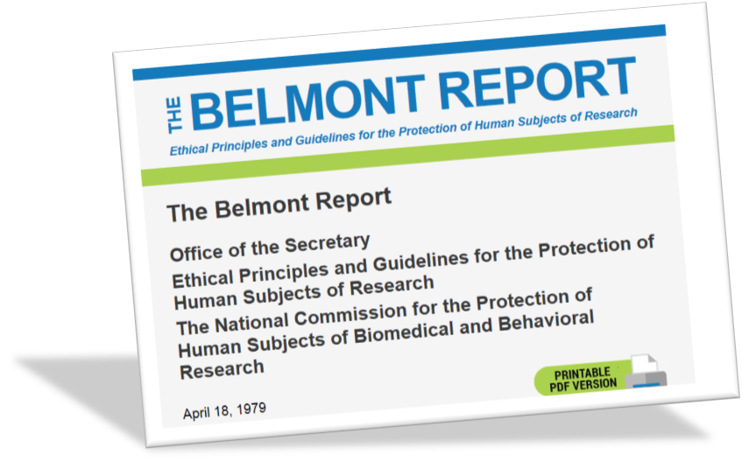
The Belmont Report: Basic Ethical Principles
National Research Act
Mandated regulations to protect human subjects
Created National Commission to examine ethical issues
National Commission published the Belmont Report in 1979
summarizes the ethical principles and guidelines for research involving human subjects
Respect for persons: operationalized by obtaining informed consent
Beneficence: minimizing possible harms and maximizing possible benefits
Justice: fair or equitable selection of subjects

Slide 10
Regulations and Requirements for Conducting VA Human Subjects Research

Slide 11
Key Regulations and Requirements Governing VA Research Involving Human Subjects
The Federal Policy for the Protection of Human Subjects (aka The Common Rule)
38 CFR 16
US Food and Drug Administration (FDA) regulations for research involving human subjects subject to FDA regs
21 CFR 50/56: Protection of Human Subjects/Institutional Review Boards
21 CFR 312: Investigational New Drug Applications
21 CFR 812: Investigational Device Exemptions
VA Policy governing research involving human subjects:
VHA Directive 1200.05: Requirements for the Protection of Human Subjects in Research
VHA Directive 1200.01: Research and Development Committee
VHA Directive 1058.01: Research Compliance Reporting Requirements

Slide 12
VA Research Program Infrastructure and Federalwide Assurance (FWAs)
VA policy requires any VA Facility conducting human subjects research to have the following:
Research Program – Infrastructure that includes at a minimum
Its own Institutional Review Board (IRB) or ability to use another institution’s IRB
Its own Research and Development Committee or ability to use another institution’s R&D Committee
Key positions – Associate Chief of Staff for Research and Development, Administrative Officer for Research and Development, and Research Compliance Officer
Federalwide Assurance
An institutional commitment signed by the institutional official (VA Medical Center Director) approved by the Office for Human Subjects Protections (OHRP) and the VHA Office of Research Oversight that will follow the federal policy for the protection of human subjects (38 CFR Part 16).

Slide 13
IRB Responsibilities
The IRB is responsible for the approval and ethical oversight of non-exempt research involving human subjects and for performing limited IRB review of exempt research requiring limited IRB review as a condition of the exemption.
The IRB conducts initial and continuing review of research; reviews modifications to approved research; reviews unanticipated problems involving risks to subjects or others; reviews reports of serious or continuing noncompliance; and suspends or terminates research. Findings and actions are reported to the investigator, R&D Committee, and the institution that relies upon it.
The IRB performs a review of the research and ensures that:
all IRB approval criteria specified in 38 CFR 16.111 and VHA Directive 1200.05 are met;
Informed consent is obtained, unless the study meets the criteria for a waiver of informed consent;
Research involving investigational drugs and devices is reviewed in accordance with applicable FDA regulations.

Slide 14
Informed Consent: Obtaining Legally Effective Informed Consent
With very few exceptions, FDA regulations require that investigators obtain the legally effective informed consent of the subject or the subject’s legally authorized representative (LAR) prior to involving a human being as a subject in research.
Informed consent should only be sought under circumstances that provide the prospective subject or their LAR sufficient opportunity to discuss and consider whether or not to participate in the research and that minimizes the possibility of coercion or undue influence.
The information provided must be in language understandable to the subject or the LAR.
Note: In the case of the CDC’s IND Expanded Access Tecorivimat (TPOXX) for Monkeypox, if the patient is not able to give his or her consent (such as physical incapacitation), and no LAR is available, the treating physician and another physician not involved in the treatment of the patient may document informed consent on the CDC-IRB approved informed consent document.

Slide 15
Informed Consent: Obtaining Legally Effective Informed Consent (continued)
The prospective subject must be provided with the information a reasonable person would want to have in order to make an informed decision about whether to participate, and an opportunity to discuss that information.
The informed consent process must begin with a concise and focused presentation of the key information that is most likely to assist a prospective subject in deciding whether they wish to participate in the research or not.
The informed consent process may not include any exculpatory language through which the subject or the LAR waives or appears to waive any of their legal rights or releases or appears to release the investigator, sponsor, institution, or its agents from liability for negligence.

Slide 16
Information System Security Officer and Privacy Officer Responsibilities
The Information System Security Officer (ISSO) and Privacy Officer (PO) is responsible for ensuring that all proposed research complies with information security requirements for VA sensitive information.
Note: In the case of the CDC’s IND Expanded Access Tecorivimat (TPOXX) for Monkeypox, central ISSO and PO reviews have been completed; no local submission or review is needed.

Slide 17
FDA’s Expanded Access Program for Investigational Drugs and Biologics

Slide 18
FDA Regulated Research Studies: Common Pathways for Use of Drugs and Biologics
U.S. Drugs and Biologics
Approved Drugs and Biologics
Investigational Drugs and Biologics
(Non-Approved)
Use According to FDA Marketed Label
Off Label Use of Approved Drug
Commercial and
Non-Commercial Investigational New Drug Applications
Expanded Access
Right to Try

Slide 19
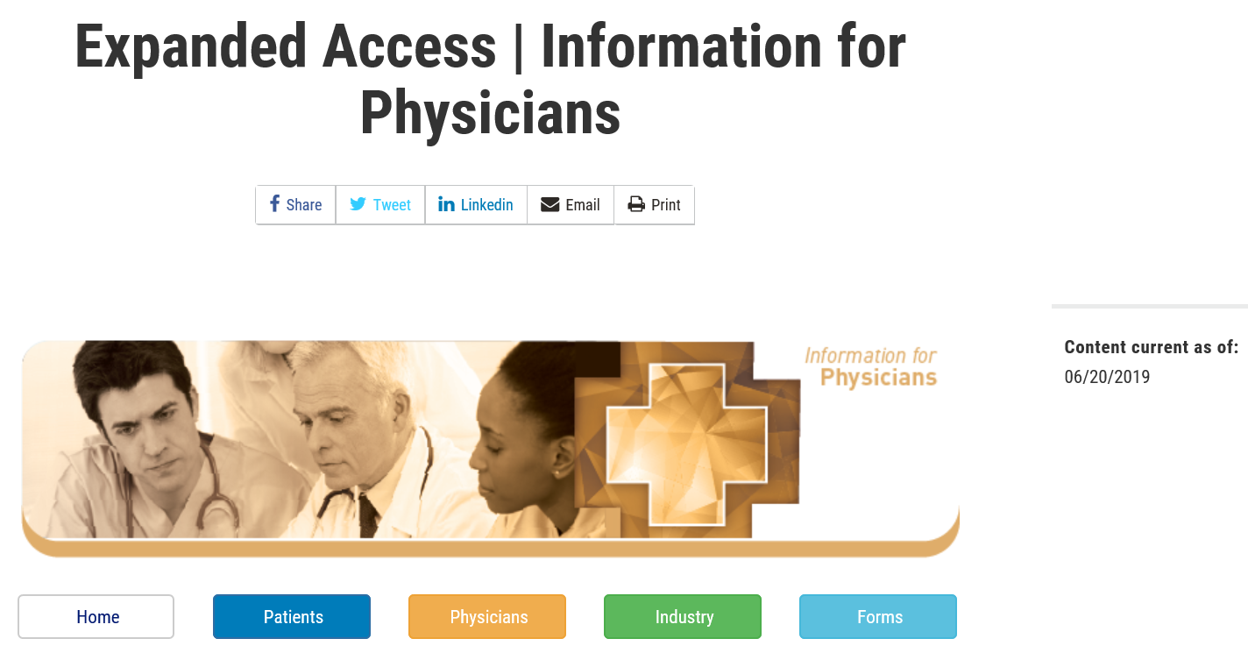
When Investigational Drugs or Biologics Are Used Under FDA’s Expanded Access Regulations
Sometimes called “compassionate use”, expanded access is a potential pathway for a patient to gain access to an investigational drug or biologic for treatment outside of clinical trials
Reference: https://www.fda.gov/news-events/expanded-access/expanded-access-information-physicians

Slide 20
Expanded Access Uses of Investigational Drugs or Biologics
Expanded access uses are not designed to replace clinical trials.
Industry/sponsors are not required to supply investigational drugs or biologics for expanded access uses; FDA does not make the decision.
The industry/sponsor decides what type of expanded access will be used for the investigational drug or biologic supplied.
All expanded access uses of investigational drugs or biologics either require IRB prospective approval or retrospective IRB notification and informed consent from the subject or subject’s legally authorized representative, except in emergency use if specific federal regulations are met.
Non-emergency use (prospective IRB approval)
Emergency use (IRB notification 5 working days after the initial use of the investigational drug or biologic)
Note: In the case of the CDC’s IND Expanded Access Tecorivimat (TPOXX) for Monkeypox, prospective IRB approval is required.

Slide 21
Summary of Different Types of Expanded Access: Drugs and Biologics
Source: https://www.fda.gov/news-events/expanded-access/expanded-access-how-submit-request-forms

Slide 22
Most Common Types of Expanded Access Uses for Drugs and Biologics
Most treating physicians utilizing expanded access involves uses involving emergency use IND (single patient), intermediate size population IND, intermediate size population protocol, or treatment INDs. Intermediate size population INDs, intermediate size population protocols, and treatment INDs allow use by multiple institutions for multiple patients.
Unless it is an emergency use IND, expanded access involving drugs or devices usually involves utilizing a sponsor’s IND under a defined protocol or program. The protocol or program is approved prospectively by an IRB.
In the case of the CDC’s IND Expanded Access Tecorivimat (TPOXX) for Monkeypox, it is an expanded access intermediate size population IND protocol.

Slide 23
Summary of Expanded Access Requirements
Expanded Access Programs require either retrospective or prospective IRB approval. The CDC IND Expanded Access Tecovirimat Program for Monkeypox requires prospective IRB approval.
Treating physicians using expanded access test articles (drugs, devices, or biologics) must follow FDA requirements regarding expanded access uses.
If you as a treating physician or staff supporting an expanded access activity have questions regarding requirements at your institution regarding an expanded access program, please consult your VA Facility’s research office.

Slide 24
YOU HAVE COMPLETED THIS TRAINING COURSE
No test is associated with this training.
Please enter your name and the date you have completed reviewing this course on the certificate following this slide.
Send a copy of your training certificate to the applicable individuals at your VA Facility.
For VA personnel at VA Facilities without FWAs, please send a copy of your training certificate to covidexpandedcoord@va.gov.

Slide 25
Certificate of Completion
This certifies that
[Enter full name here]
Has successfully completed
The VHA Research and Development Course:
Human Subjects Protection Training:
For VA Research Personnel: For VA Research Personnel Conducting Expanded Access Program Activities for the Treatment of Patients with Monkeypox
On
[Enter date here]

