Slide 1
Differentiating Institutional Review Board (IRB) vs. Research & Development (R&D) Committee vs. Institutional Responsibilities in the Review and Approval of Research
Molly Klote, MD, CIP
C. Karen Jeans, PhD, CCRN, CIP
VHA Office of Research and Development (ORD)
2023 IRB and R&D Committee Chair Workshop
February 7, 2023

Slide 2
Objectives
Differentiate key conceptual differences in roles and responsibilities among Institutional Review Boards (IRBs), VA Facility Research and Development (R&D) Committees, and VA Facility Institutions in the review and approval of human subjects research.
Describe examples of Institutional, R&D Committee, and IRB “requirements” exceeding national VA or VHA policy or federal regulations.
Identify institutional, VA R&D Committee, and IRB roles and responsibilities in two common scenarios:
Flagging medical records for VA subject participation
Non-research determinations and “approvals”

Slide 3
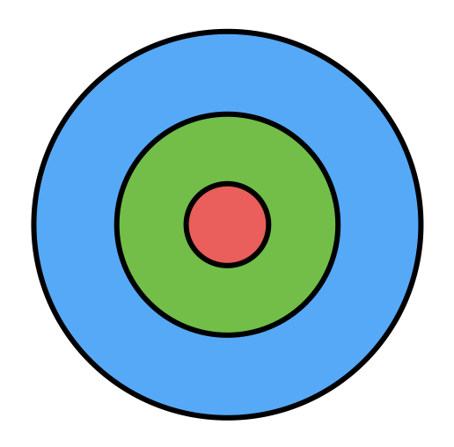
VA Facility, VA R&D Committee, and IRB Relationships
Which Picture Represents their Relationship to Each Other?
A
B
C

Slide 4
Traditional View of the Relationship Between VA Facilities, VA Facility R&D Committees, and IRBs
VA Facility
VA R&D Committee
VA Facility IRBs of
Record

Slide 5
Key Roles and Responsibilities of VA Facility, VA R&D Committee, and IRB: VA Medical Facility Director
Each VA Medical Facility Director is responsible for:
(1) Serving as the Institutional Official (IO) responsible for all aspects of the research program, including but not limited to protection of human subjects, the care and use of animals in research, privacy and security of VA data, biosecurity, and biosafety.
(2) Establishing the facility’s R&D Committee, or retaining institutional responsibility for the research program if the facility’s R&D Committee of Record is that of another VA facility.
(3) Appointing members of the R&D Committee and its subcommittees in writing.
(4) Ensuring that research in which the facility is engaged is approved by the appropriate R&D Committee and subcommittees.
Reference: VHA Directive 1200.01(1), Paragraph 5.f.(1-4)

Slide 6
Key Roles and Responsibilities of VA Facility, VA R&D Committee, and IRB: VA Medical Facility Director (cont.)
Each VA medical facility Director is responsible for:
Overseeing the facility’s research program by
Ensuring that any IRB operated by the VA facility is established in accordance with the requirements of VHA Directive 1200.05(2) and registered through ORO with the HHS OHRP.
When the facility engages the services of another entity’s IRB as its IRB of Record, the IO is responsible for:
Establishing and signing a Memorandum of Understanding (MOU) or Authorizing Agreement with other VA facilities or external organization(s) providing IRB services; and
Ensuring that external IRBs of Record used by the VA facility hold current IRB registrations with FDA/OHRP and provide updates to membership as required by VHA Handbook 1058.03.
Reference: VHA Directive 1200.05(2), Paragraph 5.f.(2), f.(8)(d)

Slide 7
Bottom Line: VA Medical Facility Director: Responsible for the Legal Entity

Slide 8
Key Roles and Responsibilities of VA Facility, VA R&D Committee, and IRB: VA Facility R&D Committee
The R&D Committee is responsible for:
(1) Assisting the medical facility Director in fulfilling responsibilities for the facility’s research program by making recommendations regarding personnel, space and other resource needs of the research program.
(2) Reviewing research proposals and approving the research, requiring modifications to obtain approval, or disapproving the research.
(3) Ensuring the effective operation of the facility research program through oversight of all R&D Committee subcommittees and the facility’s research portfolio.
(4) Ensuring that all research in which the facility is engaged is consistent with the VA mission and complies with all applicable statutory and regulatory requirements.
Reference: VHA Directive 1200.01(1), Paragraph 5.h.(1-4)

Slide 9
Key Roles and Responsibilities of VA Facility, VA R&D Committee, and IRB: VA Facility R&D Committee (cont.)
The R&D Committee is responsible for:
(7) Determining whether the facility should participate in a study and ensuring that the appropriate Institutional Review Board (IRB) agreements are in place; and
(8) Establishing procedures to ensure that all research in which the facility is to be engaged has been reviewed and approved for high scientific quality, the protection of human subjects and research staff, the welfare of animal subjects, the safety of all involved in research, the security of research laboratories, and the security of VA Data and sensitive information.
Reference: VHA Directive 1200.01(1), Paragraph 5.h.(7-8)

Slide 10
Bottom Line: VA Research and Development Committee: Institutional Research Governance
Specific to the Department of Veterans Affairs.
Composition and determinations based upon VHA policies.
Determinations required to be made by an R&D Committee can only be made by the R&D Committee.
Referenced in VA regulations in 38 §17.85 Treatment of research-related injuries to human subjects.
(a) VA medical facilities shall provide necessary medical treatment to a research subject injured as a result of participation in a research project approved by a VA Research and Development Committee and conducted under the supervision of one or more VA employees. This section does not apply to:
(1) Treatment for injuries due to noncompliance by a subject with study procedures, or
(2) Research conducted for VA under a contract with an individual or a non-VA institution.

Slide 11
Key Roles and Responsibilities of VA Facility, VA R&D Committee, and IRB: IRB
An institution’s IRB of Record must:
Review and have authority to approve, require modifications in (to secure approval), or disapprove all research activities covered by ORD policies in VHA Directive 1200.05(2),except when noted in the policy, including exempt research for which limited IRB review is a condition of exemption.
An IRB has authority to:
Suspend or terminate approval of research that is not being conducted in accordance with the IRB’s requirements, or that has been associated with unexpected serious harm to human subjects.
Reference: VHA Directive 1200.05(2), Paragraph 9.a; Paragraph 14

Slide 12
Bottom Line: IRB: Ethical Review Committee
Composition and review criteria originates from federal human subjects regulations rather than policy.
VA codified the Federal Policy for the Protections of Human Subjects (“Common Rule”) as 38 CFR Part 16.
All VA human subjects research is subject to the Common Rule when it meets the definition of human subject research.
VA follows applicable FDA regulations when human subjects research involves FDA-regulated research.
Additional review and determination requirements described in VHA policies.

Slide 13
IRBs and R&D Committees Have the Ability to Exceed What is Required as Part of Committee Reviews and Determinations IF:
It does not conflict with the applicable regulations or policies for the respective committees, and
It does conflict not with applicable federal law.
However, another consideration needs to be included . . .

Slide 14
Can Your IRB or R&D Committee Address this Question: Why?
Be able to describe why the respective committee is doing “x” if it exceeds policy, regulation, or law.
R&D Committees and IRBs have wide variances in flexibility in their policies and procedures, requirements, which are often based upon
An event occurrence or “near miss”,
Anticipated need,
A software/program requirement, or
other reasons.
Avoid a rationale that uses the following: “we’re doing it this way because this is the way it has always been”.

Slide 15
Examples of IRB or R&D “Requirements” Not Mandated by VHA Policies or Federal Regulations: Institution vs. R&D Committee vs. IRB
1. Placing expiration dates on informed consent documents.
2. IRBs having IRB oversight of exempt studies.
3. Requiring investigators to submit copies of current IRB-approved informed consent documents and protocol at continuing review (for studies requiring continuing review by an IRB).
4. Submitting FDA Form 1572s to IRBs and R&D Committees for review and “approval”.
5. Requiring Good Clinical Practice (GCP) training for all VA employees conducting human subjects research.

Slide 16
Examples of Some IRB or R&D “Requirements Not Mandated by VHA Policies or Federal Regulations: Institution vs. R&D Committee vs. IRB
Requiring DMAPs (Data Management Access Plans) to be submitted for all studies, regardless of whether it involves an investigator receiving a federal funded award.
Requiring review of any study involving drawing of blood (such as in a clinical care area at a VA Facility) by the Subcommittee on Research Safety (SRS) even though no VA research laboratory is involved.
8. Requiring use of VA Form 10-3203: Consent for Production and Use of Verbal or Written Statements, Photographs, Digital Images, and/or Video or Audio Recording by VA in excess of ORD requirements in VHA Directive 1200.05(2), Paragraph 17.(k).

Slide 17
Flagging Medical Records For VA Subject Participation
Until 2010, ORD policy in VHA Handbook 1200.05 required IRBs to make the determination as to whether a Category 2 flag (flagging) was required for human subjects studies.
ORD removed the requirement in 2010 following multiple discussions with a variety of stakeholders at the local and national levels (including other federal agencies) due to multiple issues including
Lack of data supporting an increase in patient safety when subjects’ charts were flagged;
Threats to patient care from excessive flagging because of the sheer volume of flags when clinicians accessed patients’ charts (including flags not being taken down;
Multiple instances were documented when flagging was being used as a substitute for other more effective means of communication; and
Outcome discussions regarding differentiation of responsibilities for IRBs vs. institutions.

Slide 18
Flagging Medical Records For VA Subject Participation (cont.)
Some VA Facilities require determinations of flagging to be included as part of the IRB evaluations.
This creates issues from an ORD position as ORD cannot mandate as part of national MOUs executed between VA Facilities and non-VA institutional IRBs (or other federal agency IRBs) that local VA requirements not found in national VHA policies or federal regulations be followed.
Issues are also created when the R&D Committee is responsible for some determinations of flagging VA subjects’ records (non-VA IRBs) vs. VA IRBs.

Slide 19
Flagging Medical Records For VA Subject Participation
Which Picture Represents the “Ideal” Relationship to Each Other for the Purpose of Determining When Flagging is Required?
A
B
C

Slide 20
Challenge Question:
For each study in which flagging is being required, is the reviewing committee considering the following:
What is being communicated with the clinical care team?
Discussion of Recent Example

Slide 21
Non-Research Determinations and “Approvals”
IRB and R&D Committees are recognized across all of VHA as experts in making research determinations.
This expertise can lead to unexpected complications, misapplications, and misinterpretations.

Slide 22
Non-Research Determinations and “Approvals”
Which Picture Represents their Relationship to Each Other for Purposes of Making Non-Research Determinations and Approvals?
A
B
C

Slide 23
True or False: Non-Research Determinations
True or False:
The R&D Committee is Required to Document All Non-Research Determinations.

Slide 24
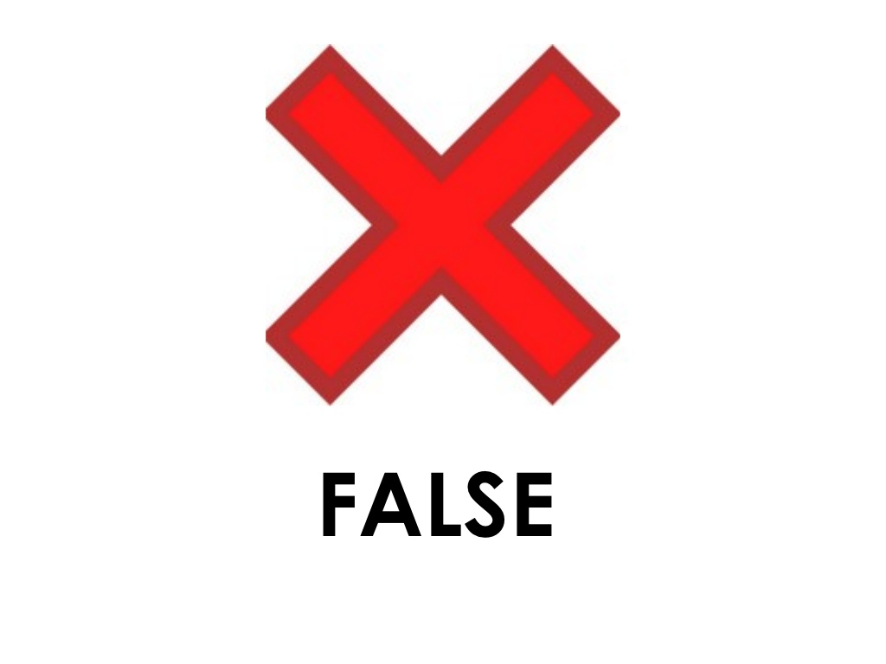
Answer is False: Non-Research Determinations
The R&D Committee is NOT Required to Document All Non-Research Determinations.
ORD policy is silent on what individuals or groups can make non-research determinations.
However, the person responsible (proposing) the activity should not make the determination unless it is clearly a case of non-research.

Slide 25
True or False: R&D Committee Approval of Non-Research
A VA Facility Research and Development Committee can approve a non-research activity.

Slide 26
Answer is False: R&D Committee Approval of Non-Research
A VA Facility Research and Development Committee can approve a non-research activity.
The VA Facility’s R&D Committee is not an approval body for non-research activities, such as quality improvement.
Expanded access is a unique scenario.
VA R&D Committee approval is obtained for non-emergency uses of a test article as part of the approval process required by ORD;
IRB approval for non-emergency uses is required as per FDA regulations.

Slide 27
Activities that IRBs and R&D Committees are Often Consulted on for Non-Research Determinations
Case reports
Case reports of one, two, or three patients is not human subjects research.
Student projects
Dissertations are research
Capstone projects are usually non-research (quality improvement)
ORD recommends querying whether the project is IRB approved at the students’ University when the project is presented to VA as a non-research activity
Program evaluations for internal VA Facility use
QUERI projects

Slide 28
Non-Research Determinations and “Approvals”:
Challenge Question:
What advice do you give when you have made a determination of non-research following a query, and the next question by the individual is,
“Is that all I have to do to present at a conference next week?”

Slide 29
Summary
VA Medical Centers, VA R&D Committees, and IRBs each have roles and responsibilities that originate in VA and VHA policy and/or federal regulations.
While some roles and responsibilities may have overlapping committee and institutional components, there are usually clear distinctions that can be made in a role or responsibility between different committees. RBs are required by the Common Rule to have written policies and procedures for the conduct of continuing review.
VA Facilities have the ability to exceed what is required for their own institutional, R&D Committee, and IRBs to meet the needs of their VA Facilities.
ORD encourages VA Facilities and their respective committees to evaluate the rationale for VA Facility specific requirements and ensure that roles and responsibilities are not being given to committees that represent mission creep or is outside of their authority.

Slide 30
Contact Information
ORD Regulatory Box: VHACOORDREGULATORY@VA.GOV

Slide 31
References
VHA Directive 1200.01(1): Research and Development Committee (issued January 24, 2019; amended January 8, 2021) at VHA Publications
VHA Directive 1200.05(2): Requirements for the Protection of Human Subjects in Research (issued January 7, 2019; amended March 3, 2020 and January 8, 2021) at VHA Publications
ORD Program Guide: VHA Operations Activities That May Constitute Research (January 9, 2019) located at https://www.research.va.gov/resources/policies/ProgramGuide-1200-21-VHA-Operations-Activities.pdf

