Slide 1

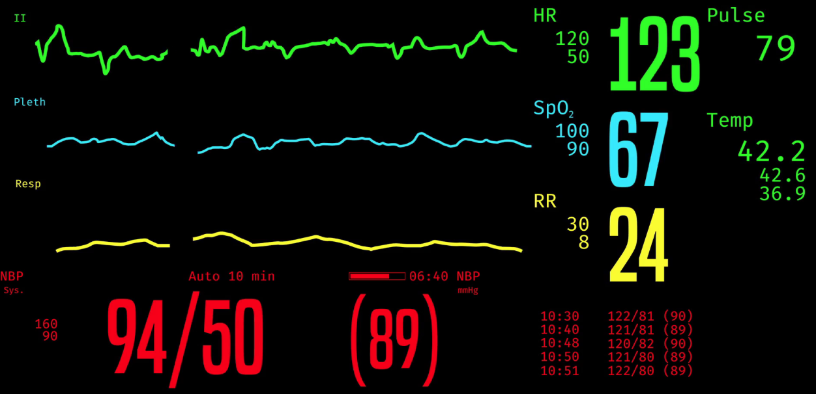

DaVINCI: DoD Direct Care
Clinical Result Data
Vitals, Imms, Rad Results, Chem, Micro, Pathology

Slide 2

Objectives
Attendees will be able to:
Describe the available DaVINCI clinical result tables and their characteristics
Describe similarities and differences with VA CDW tables
What data elements should you select or avoid when performing operational or research studies

Slide 3
DoD Clinical Data Tables Available for VA Analysts in DaVINCI
Table | Content | Status
Vitals | Alcohol and tobacco use, blood pressure, height/weight/body mass index, respiratory rate, tobacco usage, pulse oximetry, and more | On RB02
Immunizations | One record per vaccine a DaVINCI patient has received. | On RB02
Radiology Results | Inpatient and Outpatient Radiology Results data, representing the radiologist final free-text report. | On DBS101
Chemistry Results | Direct care chemistry lab tests, result values, and specimens. | On DBS101
Microbiology Results | Each record represents a direct care Microbiology lab result (free text). | Awaiting transfer from DoD
Microbiology Susceptibility | Each record represents the susceptibility of a single microorganism to an antibiotic. | Awaiting transfer from DoD
Pathology Results | Each record represents a direct care Pathology lab result (a final diagnosis). | Awaiting transfer from DoD
Clinical data is available in DaVINCI for FY09 forward

Slide 4
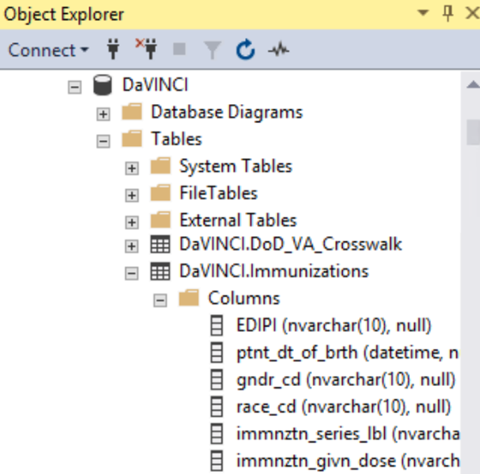
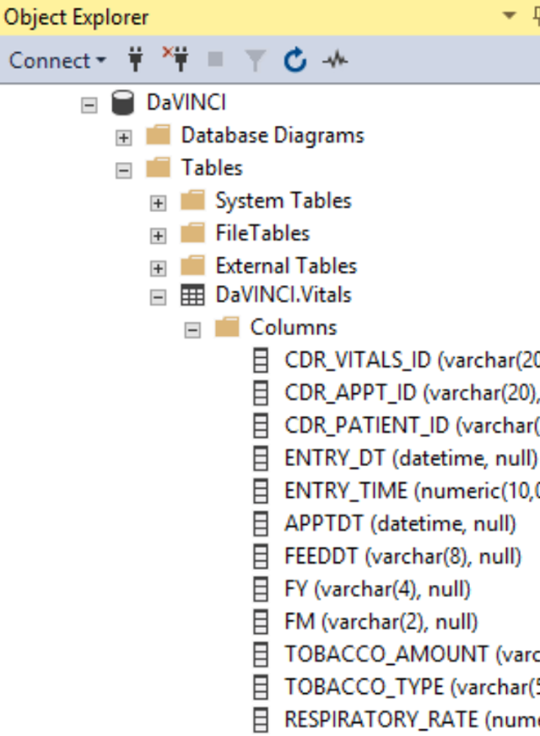
Table Locations in DaVINCI
Location of Immunizations and Vitals Results Tables in DaVINCI:
VHACDWRB02 \ Databases \ DaVINCI \ Tables \ DaVINCI.Immunizations
VHACDWRB02 \ Databases \ DaVINCI \ Tables \ DaVINCI.Vitals

Slide 5
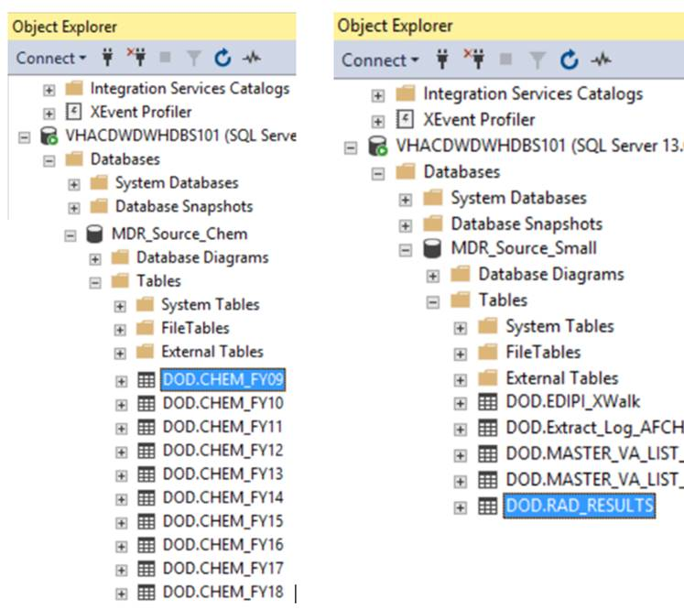
Table Locations in DaVINCI
Location of Chemistry and Radiology Results Tables in DaVINCI:
VHACDWDWHDBS101 \ Databases \ MDR_Source_Chem \ Tables \ DOD.CHEM_FY<##>
VHACDWDWHDBS101 \ Databases \ MDR_Source_Small \ Tables \ DOD.RAD_RESULTS
* Request to VINCI DBAs has been made to copy these tables to RB02
** Microbiology and Pathology are yet to be transferred to DaVINCI from DoD.

Slide 6
Where does this clinical data originate?
Data generated by the Armed Forces Health Longitudinal Technology Application (AHLTA), or CHCS based data copied into AHLTA. Cerner based data is coming soon!
Data typically describes direct care outpatient encounters, particularly when AHLTA is used
  ex. Vitals data is entered in AHLTA ‘Vitals Signs Entry’ Module
Lab/Rad Results data may have been ordered from AHLTA or CHCS, and results are viewed from the AHLTA GUI
Data entered in AHLTA is stored in the Clinical Data Repository (CDR), and Oracle db
CDR data is sent daily to the MDR, where it is transformed (ETL) into these analytic tables
All data and screenshots in the following slides are mocked up and changed for illustrative purposes only

Slide 7


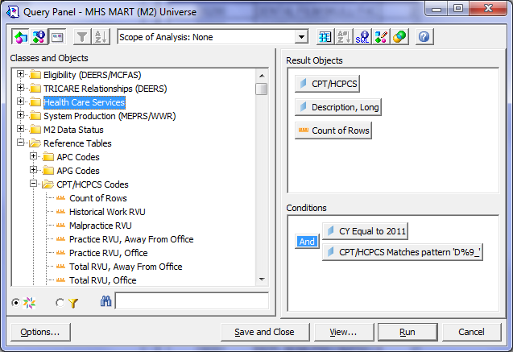






Data flow to DaVINCI
Operational DoD Sources
CHCS / AHLTA CDR
M2
(Datamart)
PDTS
MDR
(Data Warehouse)
extracts
DEERS
HSDW
DAVINCI
TRICARE claims
extracts

Slide 8
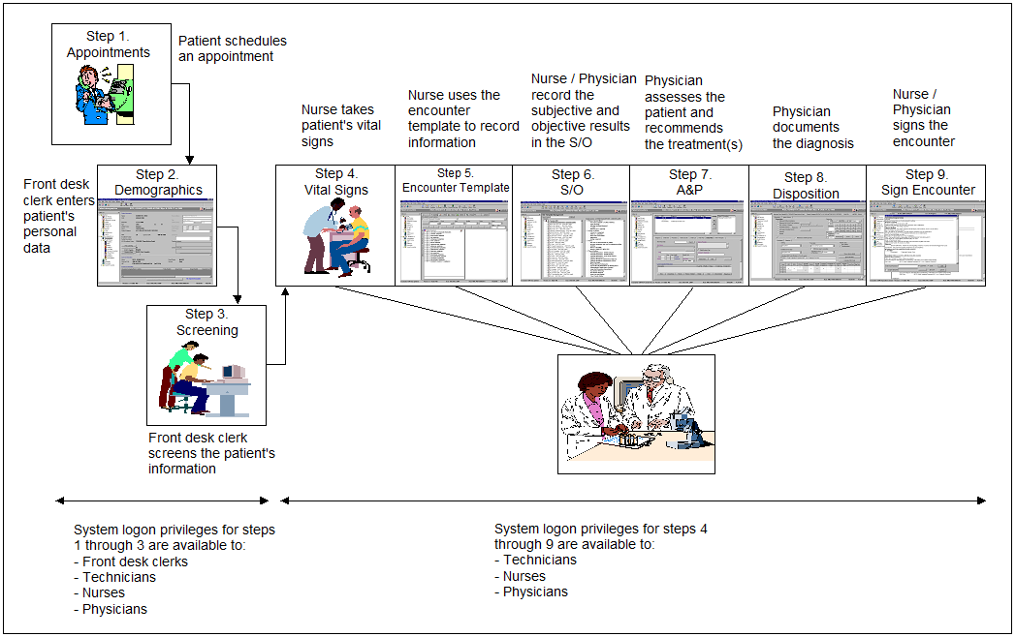
Typical AHLTA (or Cerner) clinic workflow

Slide 9
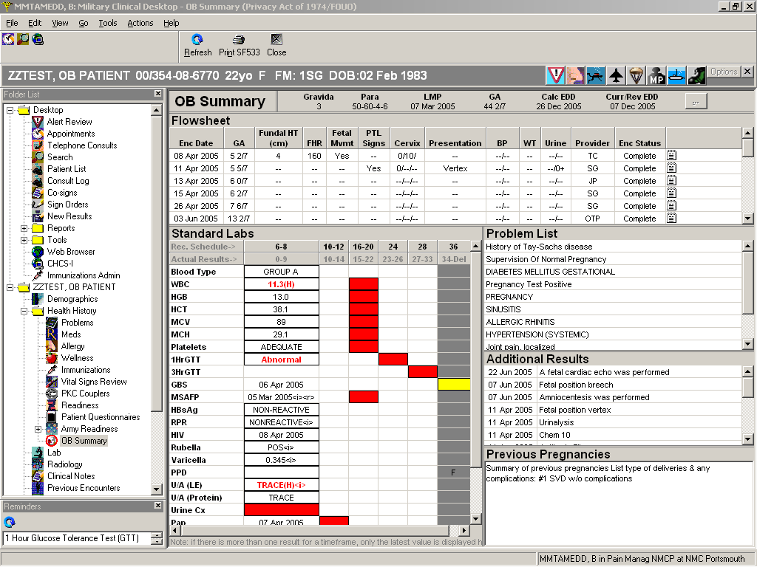
AHLTA Lab Results screenshot

Slide 10
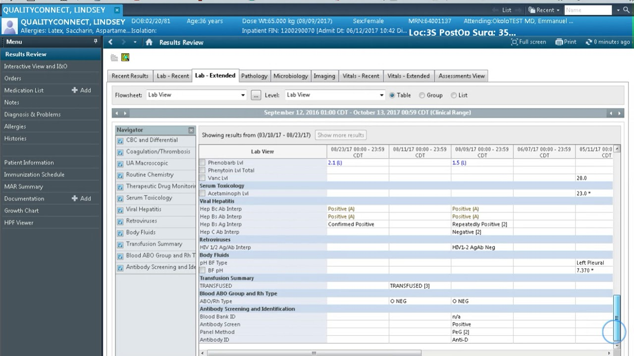
Cerner PowerChart Lab Results screenshot

Slide 11
What’s in the Vitals Table?
Record Definition: Vital signs recorded in AHLTA at an MTF appointment
Content: Person Identifier (EDIPI), Appointment Date, MTF, Appointment IEN, Blood Pressure, Height, Weight, Pulse, Oxygen Sat, Tobacco Usage, etc.
Potential Uses: Calculate BMI, develop lists of smokers and non-smokers. Study effects of treatments on blood pressure, etc.
Refresh Frequency: MDR: Weekly; DaVINCI: Quarterly
Comment: Very valuable file

Slide 12
What fields are in the Vitals Table?
Person Identifier (EDIPI)
Treatment DMIS ID
Appointment Date, Vitals Entry Date
Appointment IEN
Height and Weight
Blood pressure
Heart rate
Temperature
Tobacco usage
Alcohol usage
Pain scale
Added variables (e.g. Bencat, Age Group, Enrollment Site, etc.)
And many more – see DaVINCI Data Dictionary for full listing

Slide 13
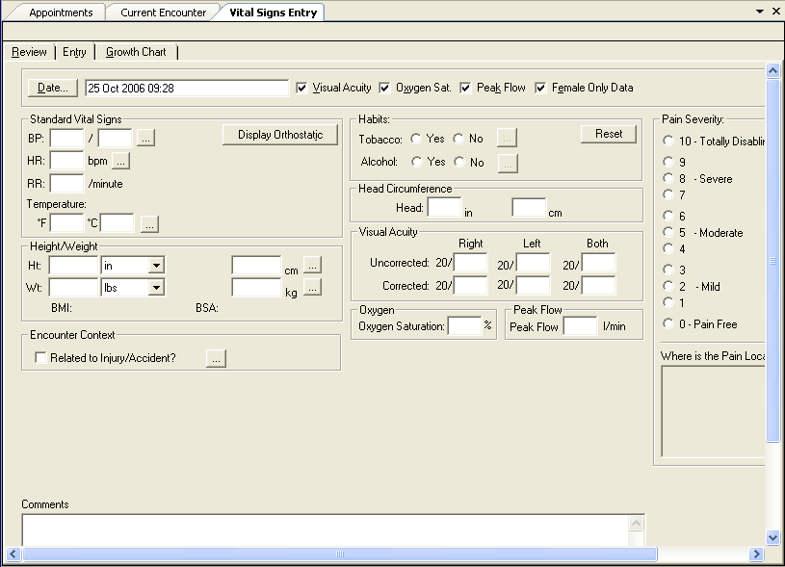
AHLTA Vitals Module
Notes:
Image from AHLTA Release 3.3 User’s Manual

Slide 14
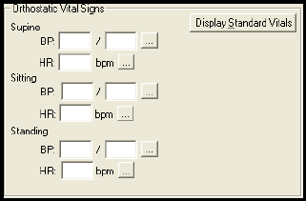
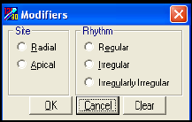
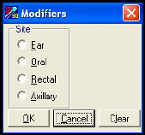
Additional Vitals Entry Options
Blood Pressure
Heart Rhythm
Temperature Site
Notes:
Images from AHLTA Release 3.3 User’s Manual

Slide 15
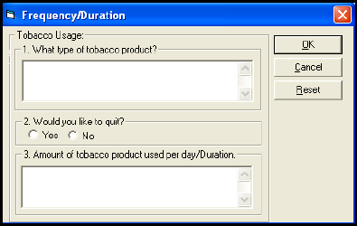
Tobacco (Amount, Type, Desire to Quit)
Commonly find these free text entries for the tobacco frequency records.
Notes:
Image from AHLTA Release 3.3 User’s Manual

Slide 16
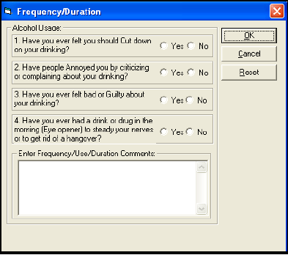
Alcohol (CAGE Questions)
Notes:
Image from AHLTA Release 3.3 User’s Manual

Slide 17
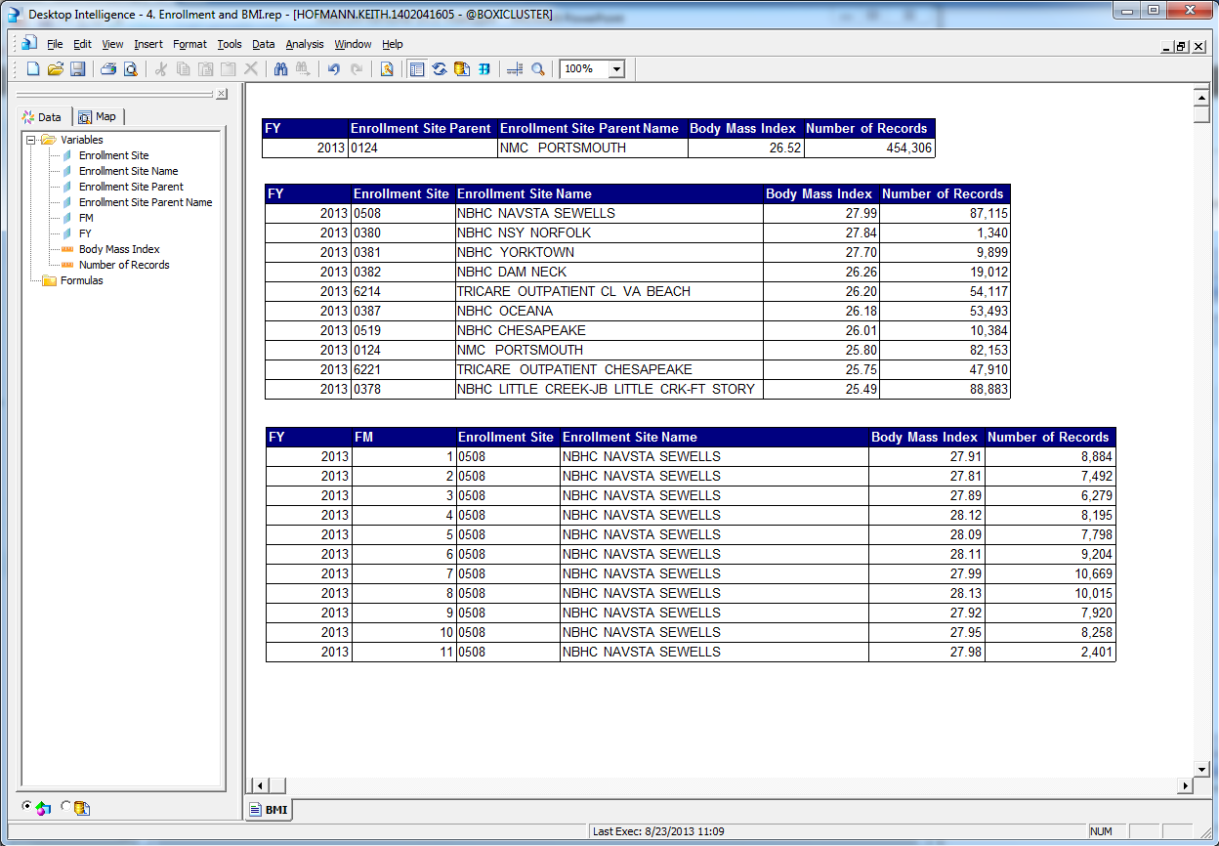
BMI for Enrollees to Portsmouth

Slide 18
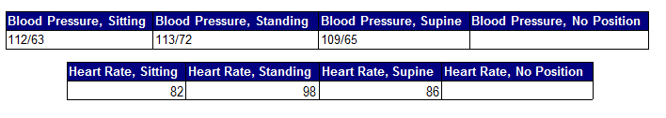

Select Individual Record Values
Height | Weight | Body Mass Index | Temperature | Temperature Site
58 | 155 | 32.39 | 98 | O

Slide 19
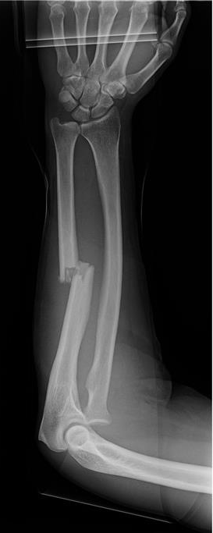
Radiology Results
Radiology Results Table:
  Record Definition: Each record is a version of the result of a radiology exam
  Content: Order ID, CHCS Host, Patient ID (EDIPI), Test Name, Free Text Result
  Potential Uses: Critical clinical information
  Refresh Frequency: MDR: Weekly, DaVINCI: Quarterly
  Comment: Result is free text, which can be difficult to analyze

Slide 20
Radiology Results Fields, Example
Main Columns in the Radiology results table:
  Order ID
  CHCS Exam Number
  Radiology Result ID
  Radiology Test ID (Not standardized)
  Standardized HDD Test
  Result Code
  Result Text – 4,000 character free text example below:
CHCS 11034027 ^LEFT KNEE X-RAYS 6/4/2011 ^HISTORY: TWISTED, NOW PAIN. ^COMPARISON: 9/7/2010 LEFT KNEE X-RAYS. ^FINDINGS: POSTOPERATIVE CHANGES FROM ACL REPAIR ARE AGAIN NOTED, WITHOUT SIGNIFICANT CHANGE. THERE IS NO ACUTE FRACTURE OR DISLOCATION DEMONSTRATED. DEGENERATIVE CHANGES ARE AGAIN NOTED MOSTLY INVOLVING THE PATELLOFEMORAL JOINT IS SOME CALCIFICATIONS APPEARING TO INVOLVE HOFFA'S FAT PAD. THERE IS A QUESTIONABLE KNEE JOINT EFFUSION, SIMILAR TO THE PRIOR EXAM. ^IMPRESSION: STABLE APPEARANCE OF THE LEFT KNEE WITH POSTOPERATIVE AND DEGENERATIVE CHANGES AND FINDINGS SUGGESTING A KNEE JOINT EFFUSION.

Slide 21
Laboratory Orders Example
Example Lab Orders Records (select fields):
DMISID | LAB ORDER ID | LAB TEST NCID | LAB TEST NAME | ORDER DATE | SPECIMEN | PRIORITY
0052 | 110129-15362 | 16149953 | ICU PANEL | 20110130 | SERUM | ROUTINE
0052 | 110129-15363 | 14622087 | HEMOGLOBIN A1C | 20110130 | BLOOD | ROUTINE
0052 | 110129-15364 | 14622512 | THYROID STIMULATING HORMONE | 20110130 | SERUM | ROUTINE
0052 | 110129-15365 | 14730823 | LIPIDS & GLUCOSE | 20110130 | SERUM | ROUTINE
0052 | 110129-15366 | 94106 | CBC W/O DIFF | 20110130 | BLOOD | ROUTINE
0052 | 110129-15525 | 14622055 | GLUCOSE GLUCOMETER | 20110130 | BLOOD | STAT
0052 | 110129-15253 | 14609013 | COMPREHENSIVE METABOLIC PANEL | 20110130 | PLASMA | STAT

Slide 22
Chemistry Lab Results
Chemistry Table:
  Record Definition: Each record represents a chemistry lab procedure and results at an MTF. Includes inpatient and outpatient
  Content: Patient, Appointment ID, Date Collected, Date Result, Numeric Result, Abnormal Flag, Priority, etc.
  Potential Uses: To provide MTF lab result information.
  Refresh Frequency: Weekly for MDR, Quarterly for DaVINCI
  Comment: Very important data for clinical research

Slide 23
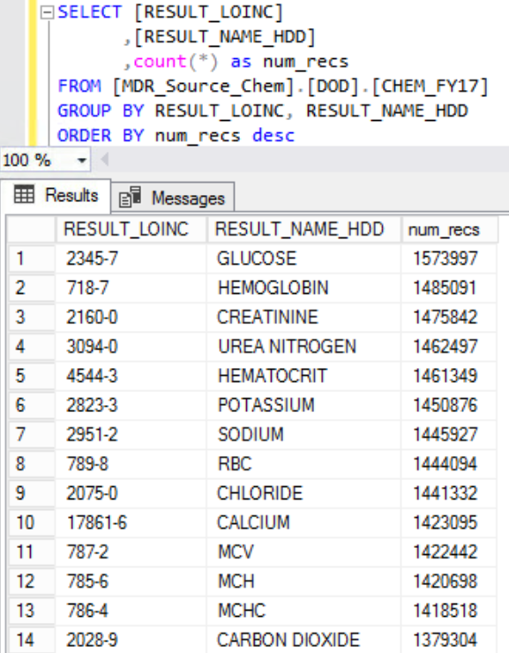
DaVINCI Top Chemistry Labs

Slide 24
Chemistry Lab Results Example
Example Comprehensive Metabolic Panel Records (select fields):
EVENT_ID | ABNORMAL IND | LAB_RESULT _NCID | RESULT_ NUMERIC | UNITS | RANGE | LOINC | LOINC_NAME | TEST_NAME
4112362063 |  | 5867 | 10 |  | (10-20) | 1863-0 | ANION GAP 4:SCNC:PT:SER/PLAS:QN: | ANION GAP WITH K+
4112362063 |  | 6079 | 102 | MMOL/L | (98-107) | 2075-0 | CHLORIDE:SCNC:PT:SER/PLAS:QN: | CHLORIDE
4112362063 |  | 6164 | 1.2 | MG/DL | (0.8-1.3) | 2160-0 | CREATININE:MCNC:PT:SER/PLAS:QN: | CREATININE
4112362063 | LOW | 6827 | 3.4 | MMOL/L | (3.5-5.1) | 2823-3 | POTASSIUM:SCNC:PT:SER/PLAS:QN: | POTASSIUM
4112362063 |  | 20410 | 18 | MG/DL | (7-18) | 3094-0 | UREA NITROGEN:MCNC:PT:SER/PLAS:QN: | UREA NITROGEN
4112362063 |  | 20411 | 139 | MMOL/L | (136-145) | 2951-2 | SODIUM:SCNC:PT:SER/PLAS:QN: | SODIUM
4112362063 |  | 20413 | 7.7 | GM/DL | (6.4-8.2) | 2885-2 | PROTEIN:MCNC:PT:SER/PLAS:QN: | TOTAL PROTEIN
4112362063 |  | 20414 | 4 | GM/DL | (3.4-5.0) | 1751-7 | ALBUMIN:MCNC:PT:SER/PLAS:QN: | ALBUMIN
4112362063 |  | 20419 | 57 | U/L | (30-65) | 1742-6 | ALANINE AMINOTRANSFERASE:CCNC:PT:SER/PLAS:QN: | ALANINE AMINOTRANSFERASE
4112362063 |  | 20717 | 0.36 | MG/DL | (0-1.00) | 1975-2 | BILIRUBIN:MCNC:PT:SER/PLAS:QN: | BILIRUBIN
4112362063 |  | 20771 | 30 | MMOL/L | (21-32) | 2028-9 | CARBON DIOXIDE:SCNC:PT:SER/PLAS:QN: | CO2
4112362063 |  | 22585 | 95 | MG/DL | (70-110) | 2345-7 | GLUCOSE:MCNC:PT:SER/PLAS:QN: | GLUCOSE
4112362063 |  | 42525 | 8.8 | MG/DL | (8.5-10.1) | 17861-6 | CALCIUM:MCNC:PT:SER/PLAS:QN: | CALCIUM
4112362063 |  | 53207 | 270 | MOSM/KG | (265-285) | 18182-6 | OSMOLALITY:OSMOL:PT:SER/PLAS:QN:CALCULATED | CALCULATED OSMO

Slide 25
Pathology Lab Results
Pathology Table:
  Record Definition: Each record represents a pathology lab result at an MTF. Includes inpatient and outpatient.
  Content: Patient, Appointment ID, Date Collected, Date Result, Specimen, Diagnosis, etc.
  Potential Uses: Teratoma research.
  Refresh Frequency: MDR: Weekly; DaVINCI: Quarterly
  Comment: Can be linked to a CPT lookup table to see additional tests performed. Diagnosis is free text, which can be difficult to analyze.

Slide 26
Pathology Lab Results Example
Example Cytology Report and Tissue Exam records (select fields):
EVENT_ID | LAB_TEST_ NCID | TEST_NAME | CPT | RESULT_ STATUS | FINAL_DIAGNOSIS
13663645 | 14511105 | TISSUE EXAM | 88307 | CERTIFY | GASTRIC POLYPS, BIOPSIES (SPECIMEN A):^ BENIGN FUNDIC GLAND POLYPS (4).^ ALCIAN YELLOW STAIN IS NEGATIVE FOR HELICOBACTER PYLORI.^^^ STOMACH, ANTRUM, BIOPSY (SPECIMEN B):^ NONFUNDIC MUCOSA WITH NO SIGNIFICANT HISTOPATHOLOGIC ALTERATIONS.^ ESOPHAGUS, 36 CM, BIOPSY (SPECIMEN C):^ SQUAMOUS MUCOSA SHOWING MILD INFLAMMATION AND REACTIVE EPITHELIAL CHANGE^ SUGGESTIVE OF REFLUX.^ FRAGMENTS OF SQUAMOCOLUMNAR JUNCTIONAL MUCOSA WITH NO SIGNIFICANT^ HISTOPATHOLOGIC ALTERATIONS.^ NO INTESTINAL METAPLASIA, NO DYSPLASIA IDENTIFIED.^^^ ALTERATIONS.^ NO SQUAMOCOLUMNAR JUNCTIONAL MUCOSA IS INCLUDED IN THE BIOPSY.^
41618601 | 154757 | CYTOLOGY, GYN | 88142 | CERTIFY | LBC CERVICAL (WITH REFLEX HPV):^ SATISFACTORY FOR EVALUATION, ENDOCERVICAL COMPONENT SEEN.^ ATYPICAL SQUAMOUS CELLS OF UNDETERMINED SIGNIFICANCE.^ HPV TESTING WILL BE PERFORMED ON THIS SPECIMEN. FOR PATIENTS <21^ YEARS OLD, REPEAT PAP IN 12 MONTHS.^ This Pap test was evaluated with the assistance of the Thin Prep Test^ Imaging System. Due to cytologic findings at the Imager microscope or^ selection of the case for QC, comprehensive manual re-screening by a^ cytotechnologist was required.^
36689337 | 106298 | CYTOLOGY, NON-GYN REPORT | 88104 | CERTIFY | THYROID FNA:^ SATISFACTORY FOR EVALUATION.^ COLLOID AND UNREMARKABLE THYROID FOLLICULAR CELL CLUSTERS.^ MANY UNREMARKABLE LYMPHOCYTES, SOME IN CLUSTERS; SUGGESTIVE OF BENIGN^ LYMPH NODE VERSUS LYMPHOCYTIC THYROIDITIS.^ NO MALIGNANT CELLS IDENTIFIED.^
36689337 | 106298 | CYTOLOGY, NON-GYN REPORT | 88104 | AMENDED | PAROTID GLAND, RIGHT, FNA:^ SATISFACTORY FOR EVALUATION.^ MUCIN AND UNREMARKABLE ACINIC CELL CLUSTERS.^ MANY UNREMARKABLE LYMPHOCYTES, SOME IN CLUSTERS; SUGGESTIVE OF BENIGN^ LYMPHOEPITHELIAL LESION (FAVORED) VERSUS CHRONIC SIALADENITIS.^ NO MALIGNANT CELLS IDENTIFIED.^^^ AMENDMENT COMMENT: this case was erroneously accessioned as^ "thyroid fna" rather than "parotid fna". Slides were retrospectively^ reviewed and corrected for anatomic site (mucin had been erroneously^ interpreted as colloid, three dimensional clusters of cells were^ interpreted as thyroid follicular cells rather than salivary gland acinic^ follicles). The differential of parotid aspirate with many lymphocytes^ includes benign lymphoepithelial lesion, chronic sialadenitis, Warthin^ tumor, and lymphoma. The cytologic appearance of benign lymphoepithelial^ lesion resembles aspirate of a reactive lymph node with abundant^ polymorphous lymphocytes. Sialadentitis can have a similar appearance,^ but is usually less cellular. Abundant oncocytes characteristic of Warthin^ tumor are not present in this specimen, and the lymphocytes demonstrate^ more variability than would be seen in lymphoma.^

Slide 27
Microbiology Lab Results
Microbiology Table:
  Record Definition: Each record represents a microbiology lab result at an MTF. Includes inpatient and outpatient.
  Content: Patient, Appointment ID, Date Collected, Date Result, Organisms, Bacteriology Result, Gram Stain Result, Mycology Result, Virology Result, Other Result, Result Comment, etc.
  Potential Uses: Researching multi-drug resistant organisms
  Refresh Frequency: MDR: Weekly; DaVINCI: Quarterly
  Comment: Can be linked to a Susceptibility lookup table to see whether organisms are susceptible to various antibiotics. Results are free text, which can be difficult to analyze.

Slide 28
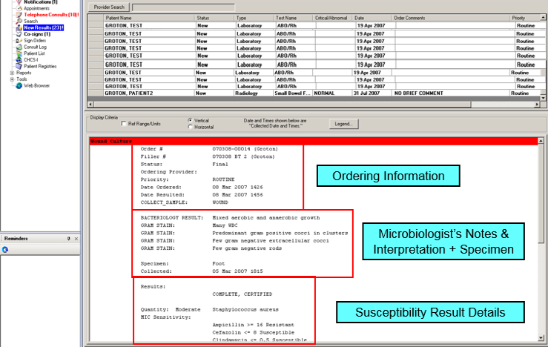
Microbiology Results Example

Slide 29
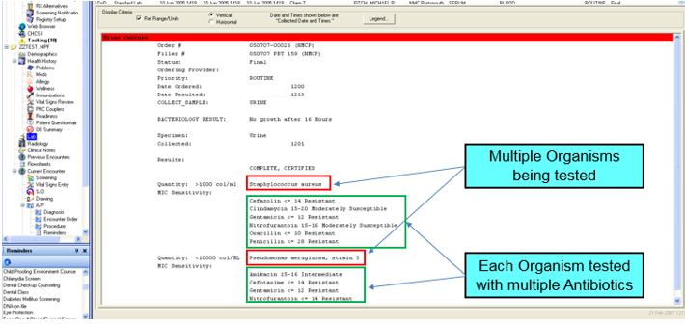
Microbiology Lab Results Example

Slide 30
Microbiology Lab Results Example
Example records for the micro_results dataset; just selected fields.
Each record represents the “header” information, and interpretation. No susceptibility result detail.

Slide 31
Microbiology Susceptibility Results
Example records for the suscept_detail dataset; just selected fields.
Each record represtents the susceptibility of a microorganism to an antibiotic.
Must use the MICRO_EVENT_ID field to link this detail to the header & interpretation

Slide 32

Immunizations
  Record Definition: Immunization information recorded in AHLTA at an MTF appointment.
  Content: Patient, Immunization, Date Given, Manufacturer, Lot, Series #, Reaction Indicator, Route, Site of Immunization
  Potential Uses: To provide MTF immunization information about beneficiaries.
  Refresh Frequency: MDR: Weekly, DaVINCI: Quarterly
  Comment: These data are likely not complete as patients receive immunizations in a variety of settings.

Slide 33
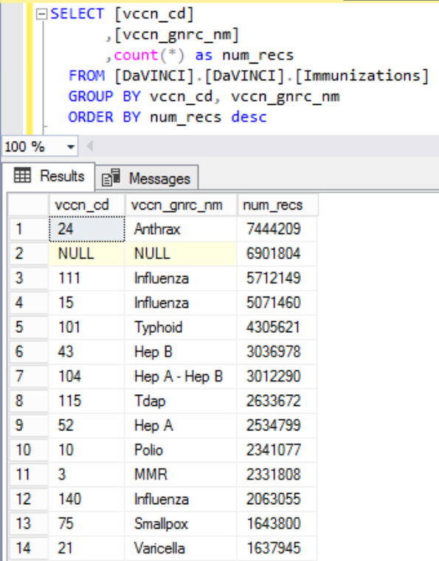
DaVINCI Top Immunizations

Slide 34
Healthcare Data Dictionary (HDD)
  The HDD is a proprietary 3M product and a key component within AHLTA for the proper interpretation of all the MHS clinical data
  A copy of the HDD resides in /mdr/restricted and is used to help process the raw feeds, mapping “NCIDs” to English terms and other coded values (ex. LOINCs)
AHLTA CDR Healthcare Data Dictionary
AHLTA
CDR Extract
MDR Ingest
MDR
CDR
Process
Process
3M
HDD
3M
HDD
SNOMED
-
CT
DRG
3M
HDD
ICD
-
10
LOINC
CPT
FDB/NDC
MHS Ontology
VA Ontology
HCPCS

Slide 35
Questions

