Slide 1
MHS Data Overview
Wendy Funk
Kennell and Associates
October 2018

Slide 2
Objectives
Attendees can:
Describe the major operational systems used by the MHS.
  Legacy vs. MHS Genesis
  Identify key strengths and weaknesses of operational data.
  Discuss data feeds coming from MHS Operational Systems
Discuss the MHS Data Repository
  Describe the available data in the MDR
  Identify major enhancements to MHS data in the MDR
Describe the data flow to DaVINCI from “Cradle to Grave”

Slide 3

Operational Systems Used by the MHS

Slide 4
Operational Systems
The MHS has relied and/or does rely upon many operational systems
  A Benefits System to keep track of who is eligible for care and why
  A Human Resources System, to keep track of staff assignments and hours worked at MTFs
  Several separate Clinical and Administrative systems being replaced by MHS Genesis
  A Claims Processing System
  Pharmacy Drug Utilization Review System
  Others

Slide 5

DMDC/DEERS

Slide 6
Eligibility and Enrollment Data

Slide 7
DMDC/DEERS
Defense Manpower Data Center is a DoD component that tracks personnel information.
  Who is on active duty, guard/reserve status, retirement information, separations, deployments, what benefits members have, sponsorship of family members, etc.
The Defense Eligibility and Enrollment System (DEERS) is a very important branch of DMDC – the legal source of health benefit information for the MHS
  DEERS is not operated by the MHS, but rather is a personnel system.
DEERS data are crucially important to the MHS.
  DEERS data are proliferated throughout the MHS via interfaces such as the DEERS eligibility checks and enrollment transactions.
Notes:
Stress here that DEERS is always legally correct, even when inaccurate. It’s important that DEERS be right.

Slide 8
DMDC/DEERS
DEERS has offices at service installations and around the world where needed so that active duty and others can be added/updated.
DEERS also provides web-interfaces for some types of updates.
When information is updated in DEERS, it must come from an official source.
  The Services, birth certificates, death certificates, Social Security Administration, marriage certificates, Medicare, etc.
Active Duty Service Member information is generally of high quality because the Services keep it up to date.
Beneficiary data may not be as high of quality because much of it is self-reported. Even though information is vetted, when something changes the beneficiaries do not always tell DEERS.
https://en.wikipedia.org/wiki/Real-Time_Automated_Personnel_Identification_System
Notes:
Provide the example of someone who moves across town but doesn’t let DEERS know of the move. People aren’t always motivated to tell DEERS things unless there is a reason, such as having a child…

Slide 9

DMDC/DEERS
Types of Health Benefits Maintained by DEERS:
Direct Care Eligibility (treatment at a military hospital)
  TRICARE Plus Empanelment: preferred access to space available primary care at MTFs.
Health Plans:
  Select: Indemnity/PPO insurance. Replaced Standard/Extra in Jan 2018
  Prime: 4.5+ million member Health Maintenance Organization
  Designated Provider: A Prime program in 6 areas of the US
  Reserve Select/Retiree Reserve Select: Guard/Reserve plans to purchased TRICARE Select or historically Standard/Extra. Would not otherwise have eligiblity
  Young Adult: Select/Standard/Extra or Prime coverage up to age 26 for family members. Would not otherwise have eligibility.
  TRICARE for Life: Free Medicare supplement for dual-eligibles who buy Medicare Part B.
https://www.congress.gov/bill/114th-congress/house-bill/4909/text
Notes:
Just very briefly describe the programs. Note that the URL describes changes associated with the replacement of Standard with Select.

Slide 10
DMDC/DEERS
DEERS Checks
When an MHS Beneficiary needs to access care, DEERS is checked to assess eligibility and priority and to determine coverage for “purchased care”
Requestors ask DEERS for healthcare coverage information, and DEERS sends that back, along with an update of DEERS data for the requesting system.
Sometimes the transactions break, so that local data in the requesting systems is not as high of quality as that which comes directly from DEERS.
  This is mitigated in data processed in the MHS Data Repository
Notes:
This is why it’s important for DEERS to be right – it determines the coverage for a beneficiary.

Slide 11
DMDC/DEERS
Consider the types of data needed to manage health benefits
Employer Information (Service) & Status (Active, Retired, etc)
Who is covered? Sponsor and family members
Why is the beneficiary covered?
Demographics
Contact information and residence location
Health Plan Information (Start/Stop Dates, PCM, Plan, etc)
Other Health Insurance / Coverage (no VA information)
Catastrophic Cap
Etc…

Slide 12
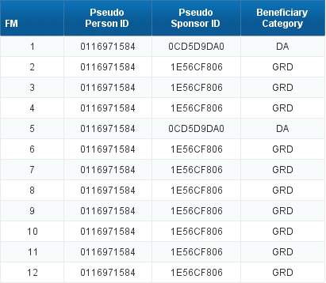
DMDC/DEERS
Some beneficiaries have more than one reason for eligibility
  Two-sponsor families (retiree married to active duty, children of two AD, children of an AD and retiree, etc…)
  Guard/Reserve Members married to Active Duty Service Members
The DEERS Person ID (EDIPN) will stay the same for the person, even when other data changes.
One individual in DEERS reported over 12 fiscal months -- a Guard member who is married to an active duty service member

Slide 13
DMDC/DEERS
Strengths and Weaknesses of the Operational Data in DEERS
  The MHS can see DEERS data operationally through a variety of tools, such as through a General Inquiry to DEERS or when real time DEERS data are passed to other MHS Systems when checking eligibility or doing an enrollment.
  The raw operational data is not available to the MHS for analysis purposes in real time.
  DEERS data is always in a state of incompleteness, by the nature of the data.
  Parents have 60 days to register newborns.
  Patients die and DEERS won’t learn of the deaths until later and sometimes not at all.
  Patients get married and divorce and DEERS learns of it retroactively.
  Patients are allowed 90 days to change enrollments and those changes can be retroactive.
  Using DEERS data operationally is important for the “here and now”, but will understate the actual membership until about 3 months have passed.
Notes:
Really stress the lateness of the data, that it should not be considered ‘accurate’ for 3 months. This is a big problem with the user community, people always wanting the freshest data, not realizing it’s not as accurate as it could be.

Slide 14
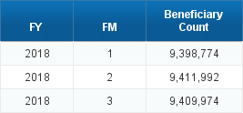
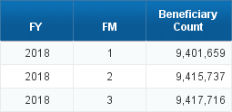
DEERS Eligible Beneficiaries
Measured in January
Measured in September
Newborns added, deaths removed.
For the DaVINCI cohort, the newborns are not relevant.
However, need to ensure enough time has passed when using DEERS data so that deaths can be reported.

Slide 15
Deployment Data

Slide 16
Deployment Data
DMDC sends the MHS a deployment file each month
  Comes from the Contingency Tracking System (CTS)
  DMDC collects this information from the Services (orders) and from the Defense Finance and Accounting Service (DFAS)
Includes deployments for overseas contingency operations only.
  Since 9/11/2001
Includes DEERS Person ID, Start Date, Stop Date
  No location of deployment is available.

Slide 17
Deployment Data
Deployment history is very important for understanding what type of data would be available for a beneficiary.
When deployed, healthcare data will typically shows up in the Theater Medical Data Store (TMDS) files. Except:
  R & R
  Short excursions to medical facilities outside of the theater zone (i.e. transfer to Landstuhl for medical care)
If deployed Service members are included in a study, then TMDS data must also be included or the results will be severely censored.

Slide 18
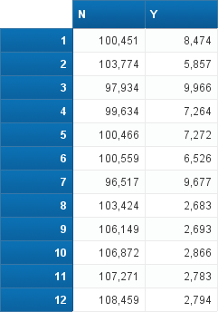
Deployment Data
Deployment data is important for cohort development
Can be used to identify who went to war
But is also important for understanding geographic patterns of healthcare utilization.
  DEERS does not change the address of a service member when deployed.
  These beneficiaries still show up as living near their home MTF.
Active Duty/Guard by Deployment Status and fiscal month; listed as living near San Diego

Slide 19
Separation Data

Slide 20
Separation Data
DMDC provides the MHS a separation file on a monthly basis.
Each record represents a:
  Change in pay grade (officer vs enlisted vs warrant)
  A separation of an Active Duty Service Member from active service, or
  A separation from a Guard/Reserve Member from the Guard or Reserve.
This file does not contain information about Guard or Reserve who go off of active duty.
  Information about that cohort can be obtained from the DEERS Personnel Entitlement Condition Code, but that data was not provided to DaVINCI.

Slide 21
Separation Data
This is a very important file for understanding who transitions from the DoD to the VA.
File content includes:
  Person Identifiers
  Component / Service Branch
  Separation Date
  Death Flag
  Pay Grade
  Separation Code – reason for separation
  Death Flag

Slide 22
Separation Data
Top Separation Reasons for 2018

Slide 23
DMHRS

Slide 24

Defense Medical Human Resource System
DMHRS:
  Defense Medical Human Resources System (DMHRS)
  Timekeeping: Used to collect timesheet information from staff working at MTFs.
    Includes doctors, other professionals, nurses, technicians and administrative staff
    Military, civilians, contractors, volunteers, etc.
    Loaned and borrowed labor
  Staffing information: MTF, Clinic or Ward
  Important to understand staffing, provider/support staff ratios, productivity, where people are assigned and work, etc.
  Some issues with the quality of timesheet reporting, especially for military personnel

Slide 25
Clinical and Administrative Systems at Military Treatment Facilities

Slide 26

Clinical and Administrative Systems
The MHS is in transition with respect to clinical and administrative information systems.
Historical legacy systems are being replaced by MHS Genesis.
  All MTFs are still on legacy systems except for the Puget Sound area.
Legacy systems being replaced by MHS Genesis include:
  Administrative operational system (Composite Healthcare System, or CHCS)
  Electronic Health Record systems (AHLTA and Essentris)
  Dental System (CDA)
Significant, multi-billion dollar undertaking that will take many years
  Initial schedule has been delayed while problems with the Initial Operating Capability (IOC) Sites are resolved.
Notes:
The patchwork quilt represents how providers have to piece information together in legacy systems to come up with a patient’s health history. Imagine trying to pull Service health history for a VA disability exam.

Slide 27

CHCS

Slide 28
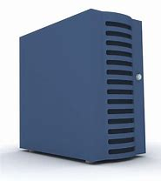
Composite Health Care System
The Composite Health Care System (CHCS):
  Primary system used at each MTF to conduct operational and many clinical activities.
  Appointing, registration, scheduling, ordering, results reviewing, etc…
  CHCS is the only local system that communicates with DEERS
  100+ CHCS Host Servers house local CHCS data.
  Local CHCS Hosts only have visibility of data collected within the host itself.
  Data quality problems occur because of the lack of connectivity across CHCS servers
  CHCS is not an electronic health record system.

Slide 29
CHCS
CHCS contains many important data files that can be queried locally using “Fileman”
  Patient File
  National Enrollment Database
  Ambulatory Data Module
  Admit, Discharge and Transfer Files
  Lab, Rad Orders and Results
  Pharmacy Files
  Provider File
  Provider Schedules
  Appointment File
  Referral File
  Consult File, Etc….
Much of this data will be stored in the Joint Legacy Viewer

Slide 30
CHCS
Most of the data in CHCS is updated in an operational manner. That is, when the system is used to automate an activity, the system is automatically updated.
  Use the system to book an appointment, the appointment file is updated. Use the system to order a lab, the lab system is updated, etc..
Some updates occur outside of operational activities.
  Updates to “close out” activities. Such as updating an appointment status code with what happened, or reporting that results have been received from referrals to outside providers.
Some updates come directly from DEERS.
  Update of patient and enrollment files
  Occurs when a DEERS check is done, and only updates the site doing the DEERS check.

Slide 31
Record Keys
CHCS uses a series of “internal entry numbers” to identify records.
  These IENs work well to tie records together that are associated with the same event.
  There is a session later to discuss the way that CHCS data links.
These IENs tend to play a role in updating data files.
Internal entry numbers are also created for patients and providers.
  These IENs are unique to each CHCS host. Cannot use these variables to combine data across CHCS.
  Not all patients have DEERS Person IDs or SSNs.
  Not all providers have NPIs.
  Identifying patients and providers can be tricky.
  The identification of providers has been somewhat of a problem on the DaVINCI project.

Slide 32

Example of Data Quality Problem Caused by Lack of Connectivity in CHCS
Family Member Prefix is a CHCS-unique data field and is important to CHCS.
Sponsor SSN/FMP are used to store medical records at military treatment facilities.
Some users use these fields to identify a person in studies, but this is not a unique identifier.
FMP values include sponsor, 1st spouse, 2nd spouse, 3rd spouse (etc.), 1st child, 2nd child, etc…
MTFs cannot see how other MTFs have assigned FMP values unless the MTFs are on the same CHCS Server.
1st child? Or the order in which the children show up at the MTF?
What happens when families like the Brady’s get married?

Slide 33

Native Data Capture
DEERS
CHCS
Eligibility
Enrollment
Service Information
Family Members
Demographics
Registration
Providers
Schedules
Inpatient Dx and Px
Some ambulatory Dx and Px
Lab
Rad
Pharmacy
Etc…
Notes:
These images are here to sort of show what is collected in each system and whether or not they communicate. We’ll build on this as we go along.

Slide 34
CHCS
Real-time, raw nature of CHCS data is a significant advantage.
  Data are available here and now, when needed at MTF Level.
Some limitations in CHCS:
  No central access. Local data only. Users who need global data must maintain 100+ separate accounts to retrieve worldwide data.
  Demographic and enrollment update processes are not fail-safe.
  Inconsistent data across CHCS servers
  Difficult to query
  Built in the 1980s – missing many important features that modern healthcare systems rely upon.

Slide 35
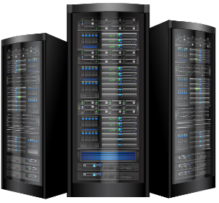
AHLTA
MHS Unique, office-based electronic health record system.
AHLTA contains many of the features of commercial EHRs.
Only used in offices; other types of care are not generally in AHLTA.
  This is a significant limitation resulting in incomplete healthcare data when querying AHLTA. Must use with other sources for most studies.
AHLTA stores data in the Clinical Data Repository.

Slide 36
AHLTA
Much of the data in AHLTA originates in CHCS
  Patient File
  Appointment File
  Lab, Rad, and Pharmacy Files
  Provider File
  Consults
Additional clinical data captured in AHLTA
  SO/AP Notes
  Immunizations
  Historical Procedures
  Vital Signs
  Questionnaires

Slide 37
AHLTA
Providers use AHLTA to electronically document healthcare.
Ability to use structured notes for easier readability. Called Tri-Service Work Flow forms.
Data are received or coded in AHLTA and normalized into a third order normal database.
Everything is stored in codes, and a hierarchical data dictionary is used to decode data prior to display or when extracted.
(Similar to OMOP)

Slide 38
Data Flows between CHCS, AHLTA and DEERS
Patient/Provider
Appointments
Ancillary Services
Consults, Ambulatory Data Module, etc
DEERS
CHCS
AHLTA
Eligibility Checks
Demographic Updates
PCM Assignments
Coded Professional Encounter Records
Notes:
Note the directionality of the arrows.

Slide 39
Data Flows between CHCS, AHLTA and DEERS
Patient/Provider
Appointments
Ancillary Services
Consults, Ambulatory Data Module, etc
DEERS
CHCS
AHLTA
Eligibility Checks
Demographic Updates
PCM Assignments
Coded Professional Encounter Records
Patient Information Transfer Errors
Write Back Errors
Notes:
Note the directionality of the arrows.

Slide 40

Communication Errors
Writeback Errors:
  Most encounters are documented in AHLTA.
  Some are coded in the CHCS Ambulatory Data Module (ADM)
  AHLTA sends coded records to ADM.
  ADM = CHCS coded + AHLTA coded, unless the “writeback” from AHLTA to CHCS fails.
Patient Information Transfer Errors (PIT):
  DEERS adds and updates patient information during DEERS checks.
  PIT errors occur when CHCS fails to accept a DEERS transmission.
  Results in incorrect demographic and enrollment data locally.
Both are caused by mismatches between sending and receiving systems
Both are big data quality problems.
Both are actively managed by MTFs.

Slide 41
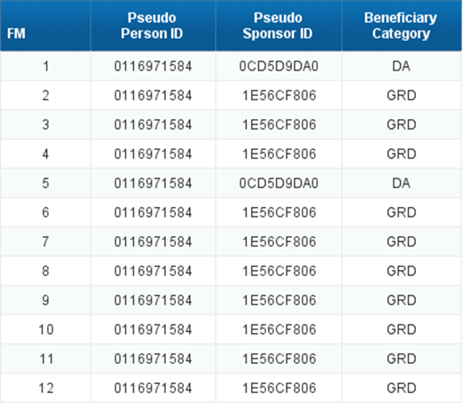
AHLTA
Fundamental flaw in design related to identification of a person.
CDR concatenates the CHCS Patient Files (organized by sponsor social and FMP) across all hosts and assigns a CDR Unit ID to each row.
Since there is more than one sponsor social and FMP for each person, there is also more than one CDR Unit ID for each person.
The DEERS Person ID is also corrupt in that only one of a person’s multiple records get the EDIPN.
While the CDR Patient file does contain the SSN, when the database is normalized the only patient identifier available in the data files is the CDR Unit ID.
Makes the data very difficult to use properly.
Impacts a very large number of beneficiaries.
Raw data from AHLTA/CDR must be cleaned prior to use.
Remember this chart?

Slide 42
Native data capture
DEERS
CHCS
AHLTA
Eligibility
Enrollment
Service Information
Family Members
Demographics
Registration
Providers
Schedules
Inpatient Dx and Px
Some ambulatory Dx and Px
Lab
Rad
Pharmacy
Etc…
Electronic Notes
Vital Signs
Historical Procedures
Most ambulatory CPT and DX
Tri Service Work Flow Forms
Tobacco/Alcohol History
Immunization History
Etc.

Slide 43
AHLTA/CDR and Essentris
Since AHLTA doesn’t work outside of office-settings, MTFs also run a second Electronic Health Record system to capture clinical notes: Essentris
  Inpatient, SDS, etc.
Essentris was not initially implemented centrally and is not connected to DEERS, CHCS or AHLTA/CDR.
No central Essentris data stores, must access locally
Providers document care in Essentris but the MTF still must also record in CHCS in order for data to flow centrally.
  Professional services information does not consistently flow from Essentris to other systems.
  Outpatient, ER and SDS are usually well captured, but inpatient professional services data are incomplete. This is a large “hole” in MHS data

Slide 44
Native data capture
DEERS
CHCS
AHLTA
Essentris
Eligibility
Enrollment
Service Information
Family Members
Registration
Providers
Schedules
Inpatient Dx and Px
Some ambulatory Dx and Px
Lab
Rad
Pharmacy
Etc…
IP Electronic Notes
IP Vital Signs
Etc.
Electronic Notes
Vital Signs
Historical Procedures
Most ambulatory CPT and DX
Tri Service Work Flow Forms
Tobacco/Alcohol History
Immunization History
Etc.

Slide 45
Data flows between CHCS, AHLTA, DEERS and Essentris
DEERS
CHCS
Patient/Provider
Appointments
Ancillary Services
AHLTA
Eligibility Checks
Demographic Updates
PCM Assignments
Essentris
Coded Professional Encounter Records
No connectivity to anything!
Notes:
This slide is important because it explains why inpatient professional services data are not complete and really makes the point as to how important Genesis is to make work.

Slide 46
MHS Genesis
  The need for MHS Genesis is obvious, with partial data in three different locations and communication problems between them.
  MHS Genesis will replace CHCS, AHLTA and Essentris.
  Data collection will occur on one system (dental will be separate from medical, still)
    Less of a chance for inconsistencies.
    Better patient safety with full direct care health information available.
    Cleaner person identification
  Has proven to be a major paradigm shift in daily operations.
  Go Live Dates:
    Fairchild AFB: 2/8/2017
    NH Oak Harbor: 7/14/2017
    NH Bremerton: 9/23/2017
    Madigan AMC: 10/21/2017

Slide 47
MHS Genesis Data Domains
  Anatomical Pathology
  Blood Bank
  Clinical Events
  Documentation
  Encounters
  General Laboratory
  Maternity
  Pharmacy
  Procedure/Diagnosis
  Schedules
  Social History
  Surgery
  Anesthesia
  Care Mgmt
  Case Notes
  Family History
  Question
  Power Note
  Health Plan
  Radiology
  Micro
  Orders
Notes:
Can pick out a few areas and note that the data are there.

Slide 48
MHS Genesis Data in the MDR
The MHS Genesis database is similar in construct to CDR.
Relies upon “concept codes” except for dates, numeric values and natural language text.
That is, the system makes up a new code set for nearly every variable in Genesis.
The example below shows beneficiary category in Genesis.
  Genesis users (and PI EDW users) would actually see “Active Duty” but 109900757 is how the data coming from Genesis looks.
Beneficiary Category

Slide 49
MHS Genesis Data
Sample data fields in MHS Genesis feeds from the Scheduling data
Scheduled Loc contains the “Nurse Unit Location Code”; kind of like DMIS ID / MEPRS Code (or a clinic stop for VA)
Dates are stored in UTC format and need to be converted
Appointment state is like appointment status from CHCS
Even diagnosis and procedure codes are assigned “concept codes”.

Slide 50
MHS Genesis Data
The MDR:
  Applies reference code sets to convert the concept codes to meaningful values.
  Converts to local time zones
Feed Data
After processing

Slide 51
MHS Genesis Data
The Location File in MHS Genesis is very important.
  It is one of the first things that need to be addressed to get the system running.
  Legacy CHCS Location files were reviewed carefully and modified to “fit” with Genesis.
  Nurse Unit Location Codes were assigned to the locations that remained.
  The Cerner team maps those codes to MEPRS Codes, so that the financial accounting and personnel systems can compare costs with workload and staff.
  Cerner has resisted using the mappings in MHS Genesis so that clinicians are not seeing the same code sets that the business people are.
  Mappings are applied by other systems after the data leaves Genesis.
  Some of the uses of Nurse Unit Locations are inconsistent with the way the DoD has used MEPRS Codes, causing some problems with interfaces.

Slide 52


MHS Genesis Data Marts
MHS Genesis
Power Insight EDW
PI EDW is a Business Objects based data mart containing data from Genesis alone.
There are very few users of PI EDW due to lack of available training.
Data to PI EDW:
33 subject areas consisting of:
187 Data Files
100 Reference Files
3,500+ Code Sets
Millenium Wire Diagram
Millenium → PI-EDW Mapping
(wire diagram and mapping tables not unique to MHS. Includes the superset of all fields/files that Cerner uses for any customer.

Slide 53
MHS Genesis Data Marts
The MHS has also purchased “Healthe Intent”
  Intended for local users who need to access near real-time Genesis data. Will also replace much of what is contained in “Carepoint” – a HEDIS reporting and Metrics display system.
  Is said to enable inclusion of data other than Genesis.
  Data in Healthe Intent is transformed, not raw.
  “Tool Light”. SQL, Tableau and Business Objects are available.
  The MHS did not purchase any statistical packages for users.
  Requirements for the system have yet to be finalized.

Slide 54
MHS Genesis
Data Gains with Genesis
  All of the Electronic Health Record data in one location.
  Better provider identification. MHS Genesis has a unique identifier for every provider that documents care.
  Easier to manage DEERS interface, since it is only with one database, rather than 100.
  Every patient will receive a DEERS Person ID, regardless of whether the patient is eligible for care.
  Solid process for discerning the identities of same gender multiples.
  Better obstetrics data collection.
  Better surgical data collection
  More process oriented data, with date/time stamps on many types of activities
  Better episode of care (event) tracking than CHCS or AHLTA.

Slide 55
MHS Genesis
While there will be many gains with MHS Genesis, there are also some information losses
  The system does not support provider assignment information
  Some CHCS unique fields are no longer available, such as family member prefix or countable visit flag. Other systems have to be modified to accommodate.
  Workload capture for inpatient care is only supported at a very high level (OB, Med, Surg, Psych, etc).
  Identification of special items not ordinarily found in commercial EHRs is not straightforward and hasn’t always worked as well as it should.
  Test records are intermingled in the production system and not marked as such.

Slide 56

Purchased Care

Slide 57
TRICARE Purchased Care Data
TRICARE Claims represent more than half of the care provided to MHS beneficiaries.
Particularly important for those who live near small MTFs and for those who don’t have priority at MTFs, such as retirees or Medicare eligibles.
When TRICARE services are used in the private sector, claims are filed with a fiscal intermediary.
  The FI sends an extract of claims, called “TRICARE Encounter Data” to DHA.
  The TRICARE Operational Data Store (ODS) system validates, accepts and processes the claims.
Only administrative data is available, similar to what would be available for Medicare claims.

Slide 58
TRICARE Purchased Care Data
TRICARE Claims include items such as:
  Physician Services
  Hospital Stays or Services
  Ancillary Services
  Emergency Room
  Durable Medical Equipment
  Pharmacy
  Home Health
  Hospice
  Others
When patients have other health insurance, TRICARE pays second (except Medicaid and IHS)
If 100% of the allowed amount is paid by another payor, TRICARE is blind to the fact that the care occurred.
Significant issue with Medicare data

Slide 59
Pharmacy Utilization Review

Slide 60

Pharmacy Data Transaction Service
Real-Time Drug Utilization Review System
Entities filling prescriptions for MHS Beneficiaries use PDTS to see if it is safe to dispense the drug.
Includes programs related to opiod abuse
Used by MTFs, Private Sector pharmacies, the mail order program, the VA (on dual eligible patients), and “line” units (such as shipboard pharmacies).
Only used for outpatient prescriptions
Required at MTFs and if TRICARE is paying a claim.
Does not include overseas private sector fills (but does include overseas when operated by DoD).

Slide 61
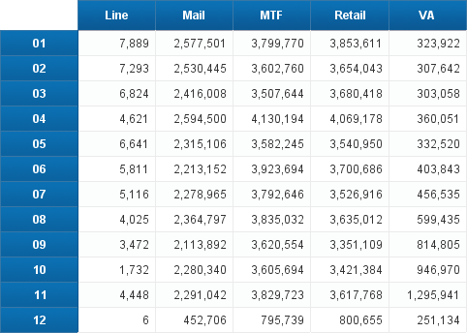
Pharmacy Data Transaction Service
FY 2018 PDTS Prescriptions
Note that Line and VA data are more sporadic than the other sources.

Slide 62
Other Operational Systems
Selected Other Operational Systems:
  Theater Medical Data Store: Data collection for healthcare provided in line units, such as Navy Ships or combat support hospitals.
  Referral Management System (RMS): Central place for direct and purchased care referral tracking and action.
  Coding and Compliance Editor: Used to identify poorly coded direct care records and to group inpatient stays by DRG.
  S3 (Surgical Scheduling System): Used to schedule and manage the operating rooms at MTFs.

Slide 63
Central Information Systems and their Role in Supporting Business

Slide 64
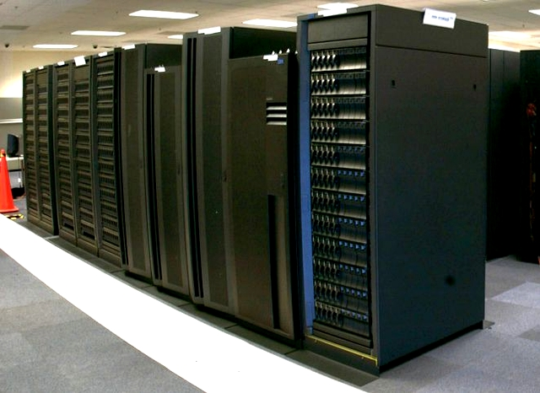
MHS Data Repository

Slide 65
MHS Data Repository
MHS Data Repository was developed in 2000 to:
  Put direct care data in one place
  Add in remaining relevant data sources from other MHS and non-MHS systems, such as claims, DEERS, deployments, etc.
  Append fields that standardize or add new information, such as RVUs, Beneficiary Categories, etc.
  Correct known errors in data, such as the AHLTA person identification problem
  Reduce costs of maintaining multiple systems
  Provide a secure processing environment with advanced programming capabilities for users
  Improve quality of data, and
  Create an environment conducive to successful audits and interactions with other civilian and federal agencies.

Slide 66
Inpatient Record Flow (post-MDR)
M
M2
T
MDR
F
Feed
C
Node
H
C
Other Data
Marts or
Systems
S
Simplicity……….
Notes:
The MDR was built after that. A functional office (what is not Decision Support Division) developed replacement files for legacy systems so that business could go on. That system became the MDR, built in 90 days with no new funding, and it still operates today, 19 years later.
Send data to one location, process it once and push it out….

Slide 67

MHS Data Repository
What is the MDR?
  Receives data from all of the sources discussed in this brief, and more
  Direct Care, Purchased Care, DEERS, Line Data, Deployments, Separations, Behavioral Health Data Portal, and more
  Serves as a central data processing hub
  Cleans data by adding new fields with improved content from what was sent by the source where possible
  Standardizes and enhances data
  Provides a secure analytic platform for users
  Provides data to other systems
  The MDR is the most robust source of MHS data centrally available.

Slide 68
MHS Data Repository
Features of MDR Processing.
  Person identification enhancements. Correct known errors, add missing information.
    Corrects the person identification problems with data coming from AHLTA, for example
  Addition of demographic attributes from DEERS, such as beneficiary category, enrollment information or sponsor branch of service.
    Corrects known problems with management of DEERS information, especially at MTFs where the CHCS-DEERS interface requires active management of errors
    Ensures that timing differences do not result in “apples and oranges”
    Includes retroactive corrections where indicated
  Addition of MTF characteristics such as multi-service market areas, command structure, service branch, etc.
    Enables a standardized approach to grouping of healthcare data into organizational structures
Notes:
When we talk about retroactive corrections, ask the audience to consider what was said about DEERS data not being complete. Updates of DEERS data are crucial to knowing your population.

Slide 69
MHS Data Repository
Features of MDR Processing.
  Addition of geographic attributes to assist in narrowing down beneficiary location or in identifying healthcare services provided near or at MTFs
    Used for recapture questions (enrollee or purchased care)
  Application of TRICARE groupers (DRG, APC)
  Application of workload weights
    Such as Relative Value Units, used to measure provider efficiency
  Application of estimated direct care costs
    MEPRS data is only available at clinic/ward level. This application enables each case to have an assigned cost
  Development of some types of episodes of care
    Enables grouping records together that are associated with a single event.

Slide 70
MHS Data Repository
Features of MDR Processing.
  Application of deployment history
  Development of disease/condition history files
  Application of financial risk scores to assess costliness of beneficiaries
  Addition of AHRQ Prevention Quality Indicators
  Appending useful fields from one file to another (such as adding in provider assignment information onto encounters)
  Application of NYU Emergency Room to review appropriateness of ER cases.
  Application of updates of records from the source systems
  And more, and more, and more…..

Slide 71
MDR Enhancements
The idea behind the MDR enhancements is:
  Get the most accurate data available to the users
  Apply consistent tools/logic to the data
  Make the data easy to use
  Develop quickly and correctly
  Transparency, transparency, transparency
  All processing and business rules are documented and available at the URL below. A data dictionary is also available.
https://health.mil/Military-Health-Topics/Technology/Support-Areas/MDR-M2-ICD-Functional-References-and-Specification-Documents

Slide 72
Basic Data Flow
Data sent to MDR 24/7
TED
MDR Feed Node
MDR File Storage & Limited Access
Batches
CHCS/AHLTA
Weekly Monthly
DEERS
PDTS
M2 and Other Data Systems
MHS-G
User Access in Data Marts
Others
Notes:
High level depiction of the data flow.

Slide 73
MHS Data Repository
The MDR:
  Saves every version of every file visible to MDR Users.
  Creates an environment where auditors can access the same data that DHA uses for work with major financial or policy implications
  Provides the ability to save detailed logs of every program run. These logs trace through programs in a manner that is acceptable to auditors.
  Has thorough and detailed documentation that specifies all processing done from “cradle to grave”.
  Provides an offline environment to store important files so that older files can always be retrieved.

Slide 74
Types of Data in the MDR
There are many types of data in the MDR. All of the data described so far ends up in MDR.
Person Data:

Slide 75
CHCS/AHLTA Data Products in the MDR
Notes:
I don’t tend to spend a lot of time on these slides. Just a sentence of two about what the files are..

Slide 76
MHS Genesis Data Files in MDR (so far)

Slide 77
Other Data Products in the MDR
Notes:
Usually just tell people we’ll go over all of this in subsequent slides.

Slide 78
MHS Data Repository and M2
What is M2?
  M2 is the “data mart” of the MDR
  Contains many of the data files from the MDR, but fewer years of data and not all of the fields.
  Primary system used by the business community in the MHS.
  Is easy to use with a Business Objects point and click interface. The MDR requires programming expertise.
  Enables ad-hoc use of the data but also has standard reports.
  There are users of M2 at all levels of the organization. The number of analysts with user accounts is approaching 2000 but those analysts support the entire organization
  If there is data of interest to you in the MDR, you can check your local M2 users to see if the information can be obtained from M2 for you.

Slide 79
Carepoint/MHS Dashboard

Slide 80
Carepoint and MHS Dashboard
Carepoint is a system that provides prepared reports and actionable information to MTFs.
  Includes HEDIS reports and action lists intended to assist MTFs in managing the Prime population.
  Calculation of some AHRQ measures
  Prepared metrics for performance dashboards
  Disease registries
  Others
Data in Carepoint primarily comes from the MDR, but there is some raw data there as well.
Raw data can be useful when real-time or near real-time data are needed, but is “dirty” compared with the MDR processed data.

Slide 81
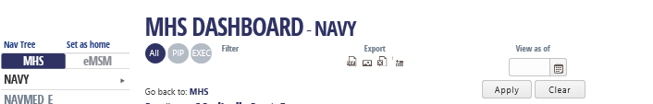
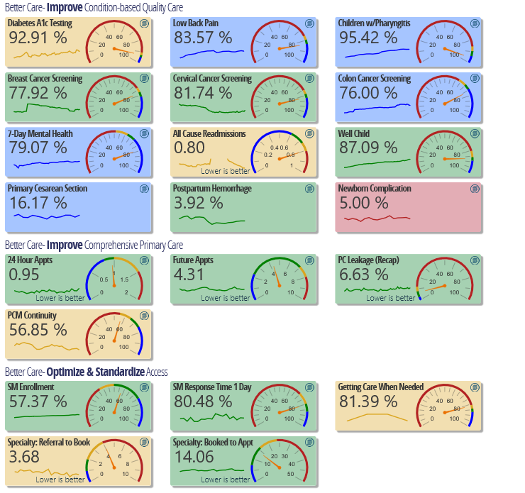
Example Report

Slide 82

Basic Data Flow
Cohort
MDR
Designated Provider
Other Data Sets as Needed
HSDW
Others
M2
Subsets of MDR files in M2
Prepared reports for the MHS Dashboard
Carepoint, Dashboard and Other Users
Notes:
High level depiction of the data flow.

Slide 83
Basic Data Flow
Cohort
DaVINCI
MDR
Designated Provider
Other Data Sets as Needed
HSDW
Others
M2
Subsets of MDR files in M2
Prepared reports for the MHS Dashboard
Carepoint, Dashboard and Other Users
Data for DaVINCI comes from MDR/M2. HSDW passes the data forward.
Notes:
High level depiction of the data flow.

Slide 84
DaVINCI Data
DaVINCI Data Flow
  Nearly all of the data provided to DaVINCI originates in the MDR.
  Unfortunately, DHA chose to use data from the data mart, M2, for most of DaVINCI.
  The data mart only receives a subset of fields and files so not all of the available data is going to DaVINCI.
  The HSDW team must important additional data files from MDR when needed.

Slide 85
RECAP
Operational systems are critical to a functioning business.
  MHS relies heavily upon these systems
  CHCS, AHLTA, MHS Genesis, DEERS, TEDs, etc
  Data in operational systems can be “dirty” but is extremely important for real-time activities
Central systems are also critical for large integrated healthcare organizations
  MHS cleans operational data and makes it more useful in the MDR
  Other central systems are also used and generally receive data from MDR.

Slide 86

Discussion/Questions?
Notes:
Time-permitting, questions can be answered and other discussion pursued.

