Slide 1
Common Healthcare Terminology
Veronika Pav
Kennell & Associates

Slide 2
Common Terminology
Context for this session:
Introduction of terminology common to one or more M2/MDR files
Availability of data elements by file
Data Dictionaries Overview
Will use these concepts throughout the rest of the course.
More detailed instruction on some topics later, as well.
Take notes on your Quick Guide!
Notes:
2
Set the context.. Present common terminology now, will re-inforce later

Slide 3
Common Healthcare Terminology
The attendee can identify the following using M2 data:
Who provided the care?
  National Provider ID, HIPAA Taxonomy, Treatment DMISID, MEPRS Code
What type of care?
  ICD-10 Codes, CPT/HCPCS Codes
  CCS Category, MS-DRG, APC, MDC
When was the care provided?
  FY, FM, Service Date, Begin Date, End Date, etc.
How much care?
  Admissions, Dispositions, Day, Visits/Encounters
How “hard” is the care?
  RVUs, RWPs, APC Weights
How complete are the data?
  Inferred Records, Raw vs. Total
For Whom was the care provided?
  Sponsor, Patient Information
Notes:
3
Objectives == lots of them

Slide 4
Who Provided the Care?

Slide 5


Who Provided the Care?
National Provider ID (NPI)
  Organizational NPI: Used for facilities, pharmacies and others (type 2)
  Individual NPI: Used by individual providers or practitioners (type 1)
  Applies to both direct (e.g. SIDR, CAPER) and purchased care (e.g. TED-NI, TED-I).
    (N/A for non-US purchased care providers) and some overseas direct care providers.
    Not usually available for technicians and other similar practitioners.
    >99% populated for doctors/independent providers in direct care.

Slide 6
Who Provided the Care?
The NPI directory from HHS includes:
  Provider Name and Contact Information
  HIPAA Taxonomy Codes (Provider Specialty)
In processing on the MDR, append:
  Provider EDI PN, if a direct care provider
  Most recently assigned MTF
  Geographic information about where the provider is located.

Slide 7

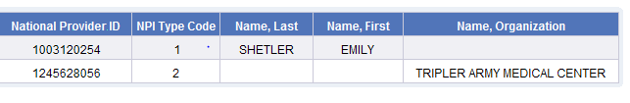
Who Provided the Care?
National Provider ID (NPI)
NPI Type 1 = Individuals
NPI Type 2 = Organizations
Example NPIs from M2 NPI Directory

Slide 8
Who Provided the Care?
HIPAA Taxonomy Code
  Indicates the type of provider.
  Includes both individual and organizational providers.
  Used in both direct and purchased care. Excellent for doing studies that include both.
  For individual providers, indicates the specialty code.
  For organizational providers, indicates the type of facility/organization.
Example Taxonomy Codes

Slide 9
Who Provided the Care?
HIPAA Taxonomy Code
  Categories of codes (Provider Type)

Slide 10
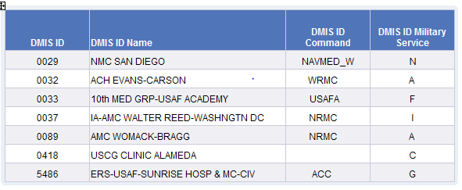
Who Provided the Care?
Treatment DMISID
  Defense Medical Information System Identifier
  Used for reporting of direct care data, including external resource sharing (ERSA) provider workload. DMIS IDs are used in other contexts, more later.
  Represents the facility where care is provided or where the ERSA provider is assigned.
  4 character code, it is customary to keep all 4 characters
  There is a DMISID reference table in M2.
  Service, Command, Parent, MSMA, Region
Example DMISIDs

Slide 11
Who Provided the Care?
Tmt DMISID Hierarchy | Description | Comment
DHP Code | Indicates whether or not the MTF is operated using DHP funds. | Y=DHP Funded, N=Not DHP Funded
Parent DMISID | Larger MTF through which smaller MTFs may report data.
Multi-Service Market Area (MSMA) | Geographic areas with more than one MTF of different services. eMSM definitions are in M2. | 10 different areas in the US, 6 of which are considered eMSMs.
Command | DMIS ID Major Command
Military Service | Service or Department that operates the MTF | Also has values for R/S and Line
HSSC Region | TRICARE Region (legacy) of MTF
T-3 Region | TRICARE Region of MTF

Slide 12
Treatment DMISID Military Service
Indicates the department that operates the MTF.
RS = Resource Sharing.
  When an MTF provider delivers care in a private sector facility or VA facility.
  The provider submits a direct care encounter record using a Resource Sharing DMIS ID.
There are also values for non-MTFs, such as C=Coast Guard.
I = Inactive
Service | DHP | Civilian RS | VA RS | Line
Army | A | B | 1 | D
Air Force | F | G | 3 | L
Navy | N | R | 2 | Q
NCR | P | 5 | 6 | N/A

Slide 13
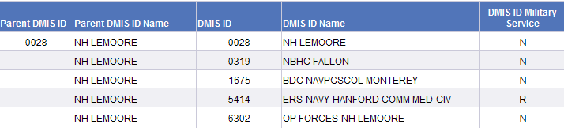
Parents and Children
“Tmt Site” vs. “Tmt Site Parent”.
Treatment Parent DMIS ID
  Contains DMISID of primary entity responsible for reporting data for one or more MTFs.
  Parent/Child relationships determined by Services.
  Example:
    Child DMISIDs (outlying clinics) as part of a parent.
    Resource sharing DMISIDs, associated with a parent.
The difference between parent and child level reporting can be extreme!

Slide 14
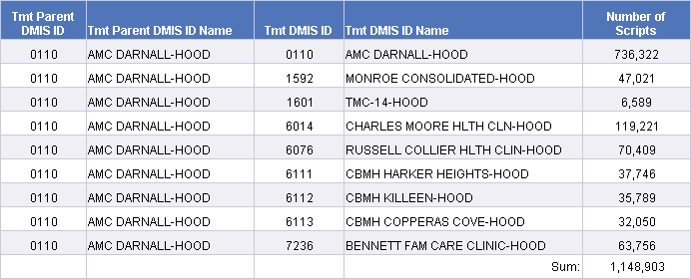
Parents and Children
Prescriptions from PDTS for Fort Hood Parent DMIS ID, by Tmt DMIS ID for FY 2016
Note how the parent and Tmt DMIS ID 0110 have the same name.
Be sure to understand whether you are being asked to retrieve parent or “child” level data.

Slide 15
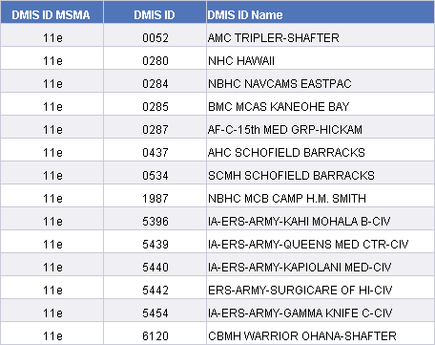
Multi-Service Market Areas
10 US locations with numerous MTFs in the same area.
Enhanced MSMAs have an “e” at the end of their code value.
Examples: San Antonio, National Capital Area, Colorado Springs, Tidewater, etc.
FY2016 Hawaii eMSM DMIS IDs

Slide 16
Files containing Treatment DMISIDs and NPIs
Table | Org NPI | Ind NPI | Tmt DMISID
SIDR |  |  | x
CAPER |  | Up to 4 | X
Ancillary |  |  | X
Vitals |  |  | X
MEPRS |  |  | X
Dental |  |  | X
Pharmacy | X | Ordering | X
DMISID Index |  |  | X
TED-I | X
TED-N | X | x
NPI Directory | x | x

Slide 17

Who Provided the Care?
MEPRS Codes
  Represents an accounting entity at an MTF
  Only applies to MTF data. No direct equivalent in purchased care
Often, a place or type of care (not always)
4 digit hierarchical code; e.g. MEPRS1 Code= A, MEPRS2 Code =AA, MEPRS3 Code= AAA, MEPRS4 Code = AAAA
MEPRS1 Code – MEPRS4 Code
  Summary accounts: MEPRS1 Code
MEPRS1 Code | Represents
A | Inpatient Care
B | Ambulatory Care
C | Dental Care
D | Ancillary Care
E | Support Expenses
F | Special Program Expenses
G | Readiness Expenses

Slide 18
MEPRS Codes at MTFs
MEPRS2 Cd: More detailed than MEPRS1 Code
Example: Retrieve records for care provided in the OB/GYN clinic at your MTF:
MEPRS2 Code = “BC”
Clinical Area | Inpatient | Ambulatory
Medicine | AA | BA
Surgery | AB | BB
OB/GYN | AC | BC
Pediatrics | AD | BD
Orthopedics | AE | BE
Mental Health | AF | BF
Family Practice | AG | BG
Notes:
Adding a second digit gives more detail.. Note that the A and B represent inpatient and ambulatory, while the 2nd digit represents the clinical area

Slide 19
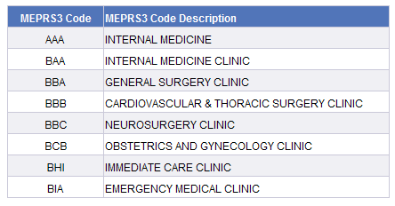
MEPRS Codes in MTF Data
MEPRS3 Cd
  Commonly used level of reporting
  DoD Standard, across services (supposed to be)
  Places of services, housekeeping, depreciation, etc.
  Descriptions in DD or in reference table
www.meprs.info
QUICK QUIZ: What do you think MEPRS Code “ABA” means?
Notes:
And with a third digit, you can tell which ambulatory clinic!

Slide 20
MEPRS Codes in MTF Data
MEPRS4 Code
  1st three characters are standardized, 4th digit is unique to each MTF
  Allows for tracking of special items.
  Some 4th digits are standardized.
    Some Medical Homes use B*Z* but not all
MEPRS4 Code | MEPRS4 Code Description
BFE2 | SRP SOCIAL WORK CARE MANAGERS
BFEA | SOCIAL WORK CLINIC
BFEC | WTU SOCIAL WORK CLINIC
BFED | CAPES SOCIAL WORK CLINIC
BFEF | SOCIAL WORK-MARRIAGE AND FAMILY THERAPY
BFET | TBI 1 SOCIAL WORK CLINIC
BFEY | R & R SOCIAL WORK

Slide 21
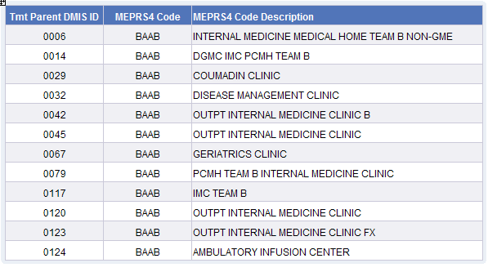
MEPRS Codes in MTF Data
MEPRS4 Code can mean different things across different MTFs.
Example of MEPRS Code BAAB and different meanings of it.

Slide 22
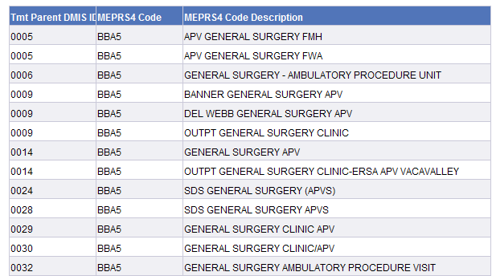
MEPRS Codes in MTF Data
Some MEPRS4 codes are standardized. B**5 represents ambulatory procedure units.
Example of MEPRS4 Code BBA5

Slide 23
What Type of Care was Provided?

Slide 24

Medical Documentation
Diagnosis and Procedure Codes
  Providers are taught to take “notes” to document patient care.
  Subjective, Objective, Assessment and Plan of Care
  Notes are usually translated into diagnosis and procedure codes
    Needed for billing
    Very useful for analytics
ICD-9 CM Diagnosis and Procedure Codes (historically)
ICD-10 CM Diagnosis and Procedure Codes
CPT/HCPCS Procedure Codes

Slide 25
Medical Documentation
Primary Diagnosis (Diagnosis 1):
  Provider’s view of the reason the patient came for healthcare.
  Use to address “why” a patient came for care.
  Secondary diagnoses (Diagnoses 2 – n) often indicate co-morbidities
  Search all positions of diagnosis codes to look for people with a particular condition.
  Search only the first position to determine for questions about why the patient sought medical care.
Principal Procedure (Procedure 1):
  Main procedure conducted, applies only to inpatient care.
  Secondary procedures (procedures 2 – n) indicate additional services
  Search all positions of procedure codes for evidence a procedure was conducted.

Slide 26

Medical Documentation
The US switched from using ICD-9 CM Diagnosis and Procedure Codes to ICD-10 CM Diagnosis and Procedure Codes at the beginning of FY2016.
The same fields are used to hold ICD-9 codes as are used to hold ICD-10 codes.
The date of service discerns the difference in the code sets (though there is almost no overlap in them).
Both ICD-9 and ICD-10 diagnosis codes have DoD Specific Codes
  We’ll cover those in the later

Slide 27
CPT/HCPCS Codes

Slide 28
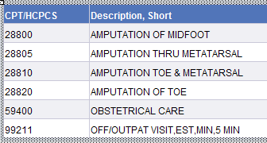
CPT/HCPCS Codes
HCPCS* Codes are used for procedure reporting except by hospitals/institutions
Not impacted by transition to ICD-10
HCPCS + Modifier + Unit of Service describe the care provided
CPT4 Codes (Level I HCPCS*)
  Level I: Codes designed for payment of providers
  Procedure Codes (not 1-1 w/ICD-9-CM or ICD-10)
  Evaluation and Management & Other Medical Codes
  AMA “Owns”
*HCPCS: Health Care Common Procedure Coding System
Notes:
AMA is responsible for creating and maintaining the code set for the types of care that doctors provide. Other provider use CPT codes too.
Look at amputation codes, indicating method and location.. The office visit code, and the big all-inclusive delivery code

Slide 29
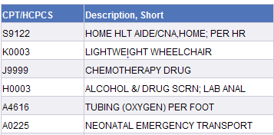
CPT/HCPCS Codes
Level II HCPCS
  Created by Medicare
  Intended for use for billing for items not “done by doctors”
  Always start with a letter
*HCPCS: Health Care Common Procedure Coding System
Notes:
AMA is responsible for creating and maintaining the code set for the types of care that doctors provide. Other provider use CPT codes too.
Look at amputation codes, indicating method and location.. The office visit code, and the big all-inclusive delivery code

Slide 30
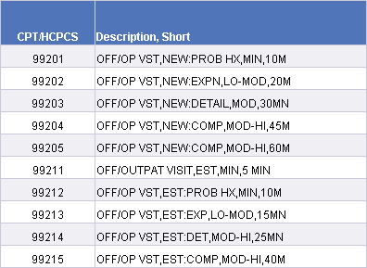
Selected Types of CPT/HCPCS Codes
Evaluation and Management Codes (E&M)
  Describe the nature of patient to provider contact
  Each code indicates complexity, setting, estimated time for the visit and often new vs. established patient.
  Most common type of code recorded in the MHS.
  Very common use is to record office visits where no separately billable procedures are conducted.
  Not generally allowed to be used when procedures are also coded.
Selected E&M Codes

Slide 31
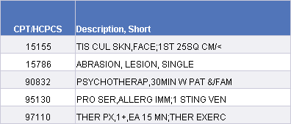
Selected Types of CPT/HCPCS Codes
Increment codes:
  Codes that represent an increment (usually time), rather than an encounter
  Each 15, Each 30, Each 24 hours, Each square centimeter, etc.
  Used with units of service to indicate the amount of work.
  CPT 97110 with units of service 4 = 1 hour of therapy

Slide 32
CPT/HCPCS Codes
Bundling:
  Some CPT/HCPCS codes represent more than one service.
  Each reported code is intended to represent care provided to include all routine care associated with a procedure.
  Some items may not be separately reported
  Examples of bundling:
    Pre and Post Procedure care in a surgical code
    Suturing and other necessary activities included in surgical codes
    Lab panels
Bundling software is used by payors to ensure payments are made for care that should have been reported bundled.
  TRICARE requires the use of this for claims payment.
  Bundling software is not applied to direct care data and pre and post operative visits are not bundled.

Slide 33
CPT/HCPCS Codes
Global codes are surgical/procedural codes that include the post operative (and sometimes pre) care provided associated with the procedure.
Global period is a lockout period where providers cannot bill for related care
MTFs do record separate pre and post op care while private sector providers cannot.

Slide 34

CPT/HCPCS Codes
Global procedures
  In the private sector, a provider can only bill once for a global code during the global period.
  Any other related claims submitted for standard of care during the global period are rejected.
  https://www.cms.gov/Outreach-and-Education/Medicare-Learning-Network-MLN/MLNProducts/downloads/GloballSurgery-ICN907166.pdf
Private sector providers do keep track of utilization of their patients, just not via claims.
If there is a break in continuity, CPT modifiers are used in the private sector to discern that.
In purchased care, covers the entire surgical episode of care when no modifier is present.

Slide 35
HCPCS Code Modifiers
Modifier:
  Provides additional information about the reported CPT/HCPCS
  Important for payment
  Sometimes just informational
Selected Modifiers
Notes:
Not usually populated, except for rad.
Professional or technical component (32) are extremely important. Professional: radiologist reading x-ray, technical: technician taking it

Slide 36
HCPCS Code Modifiers
Units of Service indicates how many times the supply or service (indicated by the CPT/HCPCS code and modifier) is provided
  CPT/HCPCS codes can mean different things.
  A data element called “Unit of Measure” is typically collected along with the unit of service in the private sector
  (Required element on a HIPAA claim)
  Unit of Measure is not in M2/MDR data
Notes:
Not usually populated, except for rad.
Professional or technical component (32) are extremely important. Professional: radiologist reading x-ray, technical: technician taking it

Slide 37
Example of HCPCS Codes and Units of Measure
Code | Description | Unit of Measure
99213 | Office/Outpatient Vist of Low to Moderate Complexity | Visit
97761 | Prosthetic Training; Upper and/or Lower Extremity; each 15 min | 15 min of a visit
A0021 | Ambulance, out of state, per mile | Mile
73020 | Radiology exam, shoulder; 1 view | Picture
23600 | Tx of proximal humeral fracture | Setting + Follow Up Care
59400 | Vaginal delivery, pre and post partum care | Delivery, Pre and Post Partum Care
15111 | Skin Graft | Size of graft
33510 | Coronary Artery Bypass, Vein only, single graft | Procedure + pre and post op
Take caution when adding units of service! Unit of measures must be consistent!

Slide 38
CPT/HCPCS
Example coding:
Mental health counseling for an hour
Bilateral ear drum opening
Modifier 50: Bilateral Service
69436 indicates opening one ear.
Using modifier 50 indicates both eardrums were opened.

Slide 39

CPT/HCPCS
Example coding:
Bilateral screening mammogram, professional and technical component.
  Modifier 50: Bilateral Service is not used bc the code itself is bilateral
Provision of new crutches

Slide 40

CPT/HCPCS Codes
Selected private sector claims
The unmodified record indicates the entire global package was provided.
The modified records indicate a split in the services included in the global.

Slide 41
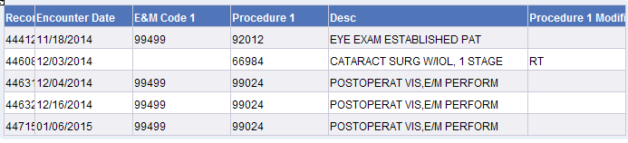
CPT/HCPCS
Direct care coding practice is different.
In direct care, globals are split across multiple records.
DC Coding
PC Coding

Slide 42
Coding Rules
Direct Care coding based on MHS Coding Rules
  Similar to private sector, not the same
  Tri-Service coding workgroup
  http://www.tricare.mil/ocfo/bea/ubu/coding_guidelines.cfm
Private Sector (TED) coding like Medicare
  Some differences, but not many
  Must generally follow Medicare’s Correct Coding Initiative
  More comprehensive coding, generally; but only for what is covered.
  http://www.cms.gov/Medicare/Coding/NationalCorrectCodInitEd/index.html
Biggest differences:
  Coding of pre and post operative care
  Billing focus vs. encounter focus.
  Administrative records are often coded in direct care and not in purchased care.
Notes:
After first bullet, note that CPT/HCPCS are not on inpatient data!

Slide 43
Coding Quality
The MHS has an active Data Quality Management Control Program for MTFs
  http://www.tricare.mil/ocfo/mcfs/dqmcp.cfm
There is a reason for this!
Includes internal and external record audits, required reporting by MTF Commanders.
In the latest coding audit report, the MHS was 80% accurate for inpatient care and 60% accurate for professional care.
Consider that the codes you see on data records will not always be correct.
Rule-out diagnosis, up-coding, non-specific coding , misuse of new patient E&M Codes, missing professional service records.
Purchased care data quality is probably better than MTF quality, but is still not perfect by any means!
Note: Many analysts look for confirmatory diagnoses for reporting on chronic conditions. (See ccwdata.org)
Notes:
After first bullet, note that CPT/HCPCS are not on inpatient data!

Slide 44
When Was the Care was Provided?

Slide 45
Dates in M2 Tables
Data Table | FY,FM, CY, CM | Also
SIDR | Discharge Date (Disposition) | Admission Date
CAPER | Encounter Date (Encounter)
TED-I | End Date of Care | Begin Date of Care, Admission Date
TED-N | End Date of Care | Begin Date of Care
PDTS | Issue Date (Entry)
LAB | Certification Date
RAD | Certification Date
Referral | Referral Date (Issued) | Can link to get date of appt
DEERS | 1st of Reported Month
CDR Vitals | Entry Date | Appointment Data
Appointment | Appointment Date | Appointment Made Date
**Any date related to a person below the level of year may be considered PHI.
Notes:
There are many dates available.
This table indicates the types of dates available in each data type

Slide 46
How Much Care was Provided?

Slide 47
Common Basic Reporting Measures
Admission: Act of formally admitting a patient into a bed at an institution
Bed Day: Patient in a hospital bed at census time (usually midnight)
Disposition:
  Removal of a patient from the census
  Similar to a “discharge” (deaths, left AMA)
Encounter: Kept appointment or provision of ambulatory health care services (including documented telephone consults). In many cases encounters are simply administrative records.
Visits: Subset of encounters, deemed visit-worthy by each MTF. Only applies to MTFs. Visits are simply not measurable globally in purchased care.
Notes:
Visits will be covered a bit more thoroughly in WWR and MEPRS sections. Not too valuable a data element (not well defined) so not stressed in WISDOM

Slide 48
How Resource Intensive was the Care Provided?

Slide 49
Workload Weights
Workload weights are an important feature of healthcare data.
Enables analysts to factor in the expected resource intensity of care.
Used for reimbursement, budgeting and analytics.
There are three common ways to look at weighted workload in M2.
Type of Care | Basis | Weight
Inpatient Facility | MS-DRG | Relative Weight
Outpatient Facility | APC | APC Weight
Professional | CPT/HCPCS | Relative Value Units
**The relative weight is a major component of the relative weighted product.

Slide 50
Relative Value Units

Slide 51
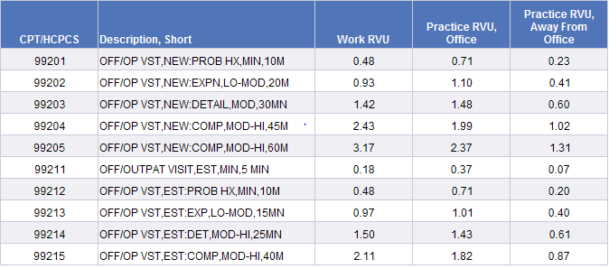
Relative Value Units
Example CY 2015 HCPCS Codes and Relative Value Units for MTFs

Slide 52
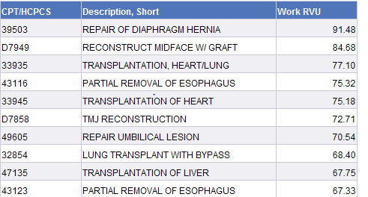
Relative Value Units
Highest Weighted Direct Care CPT/HCPCS Codes

Slide 53

Relative Value Units
The MHS usually uses weights from Medicare
  These weights are based on private sector coding rules (like purchased care)
  Adjustments must be made to RVUs for use in direct care due to coding differences between direct and purchased care.
  Weight are assigned for use in direct care to some otherwise unweighted codes.
Example of otherwise unweighted codes

Slide 54

Relative Value Units
Accommodation of coding differences of globals
  Can’t give full CMS weight to global codes in direct care, since pre and post-ops are recorded separately.
  The CMS weight table provides %s of the weights for the pre-ops, post-ops and surgery itself.
  The MHS uses the “intra-op %” to adjust the global weight.
  The MHS also has it’s own “follow up visit” weight to use to separately credit the follow up visits associated with a global CPT/HCPCS code. (99024 has a work RVU of 0.63
From CMS Table
8.52 * 70% = 5.96

Slide 55
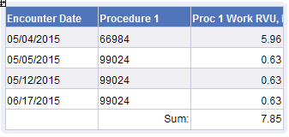

Relative Value Units
Example
4 follow up visits are recommended for cataract surgery within the global period.
0.63 * 4 = 2.52 credit for follow up.
5.96 + 2.52 = 8.48
A pre-op is allowed for this proc on the day before the proc, so ophthalmologists in direct care may receive more than in purchased care for this proc.
If all follow ups and pre-ops not done, won’t reach the full PC weight.
From MHS Weight Table

Slide 56
How Complete are the Data about the Care Provided?

Slide 57


Completion Estimates
Reporting lag associated with coded health care data.
M2 provides data to users as soon as it is available --- may not be complete!
  Amount of lag varies by type of data
  Cannot assume a total cost or workload amount for a time period is complete
  Much like your ATM balance! ☺
Analysts must be cautious to not misinterpret missing data as a trend
What you see in your ATM balance isn’t really what you have to spend…..

Slide 58
Completion Estimates
Completion attempts are only made for medical records that are coded.
  SIDR, CAPER, TED-I, TED-N
Different methods are used to estimate data to completion
  Direct care: Operational information is used to determine when a CAPER or SIDR should have been coded.
  Purchased care: There is no operational information available. Standard actuarial techniques are used.
Direct Care: Compliance Status¹
Purchased Care: Raw vs. Total
¹: The terminology Raw/Total is also used in direct care summary files, but is based on compliance status

Slide 59
Completeness of M2 Data (based on 2013 data)

Slide 60
Completeness of M2 Data
Using data estimated to completion is recommended for most business questions.
Using “raw” data can be especially problematic b/c different data types complete at different rates. You could introduce bias into your work when using multiple data types.
There is no right answer to “how long do I need to wait for data to be complete”
Using only coded records is appropriate in certain situations, however.
  Record level data
  Attempts to incentivize

Slide 61
For whom was the care provided?

Slide 62

Person Identifiers
Who is the patient?
Person ID, Sponsor ID, Beneficiary ID, Date of Birth and Beneficiary Name are all protected under the Privacy Act and HIPAA.
Data Field | Description
Person ID | DEERS assigned identifier. Only available for DEERS eligible, currently.
Sponsor ID | Usually contains the SSN of the sponsor. Note that beneficiaries can have more than one sponsor.
Beneficiary ID | Usually contains the SSN of the beneficiary. May contain a temporary CHCS assigned ID for newborns.
Beneficiary Name | Name of beneficiary
Date of Birth | Beneficiary’s date of birth
Use pseudo-identifiers when possible

Slide 63
Basic Demographics
Gender (M/F, Unknown)
Race & Race/Ethnicity: Unreliable, and poorly populated except for sponsors
Marital Status (Married/Single)
Sponsor Service Aggregate
  A: Army
  F: Air Force
  M: Marines
  N: Navy
  V: Navy Afloat
  C: Coast Guard

Slide 64
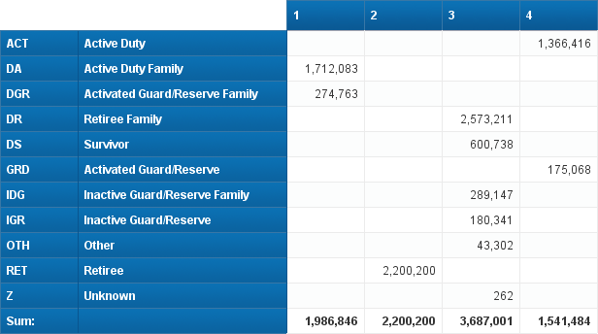
Beneficiary Category
Beneficiary category is an extremely important variable in the MHS, especially with varying benefits based upon it.
Beneficiary category is the most granular.
Bencat Common is what is most commonly used.
  1: AD family, 2: Retirees, 3: All Others, 4: AD
FY 2017, FM 12 MHS Eligible Population
Communicate clearly! (for example, when you say “Active Duty”, did you include GRD?)

Slide 65
Enrollment

Slide 66

Health Plan and Enrollment Information
The MHS offers a variety of Health Plans.
Direct care is viewed as default coverage.
DEERS manages enrollments for the MHS.
Health Insurance Plans:
  TRICARE Standard/Extra: Ends in 2018
  TRICARE Select: Begins in 2018
  TRICARE for Life: Began in 2001
  TRICARE Reserve Select: Began in 2005
  TRICARE Retiree Reserve Select: Began in 2011
  TRICARE Young Adult – Standard/Select Coverage: Began in 2011
Health Maintenance Organizations:
  TRICARE Prime
  Designated Provider
TRICARE Plus: Space Available program for preferred access to primary care. Not generally used that way, though.

Slide 67
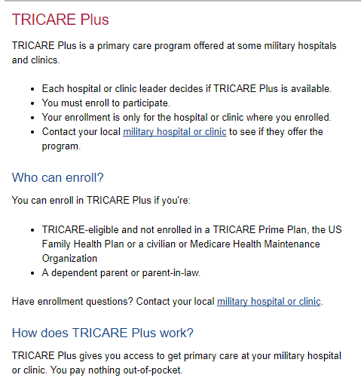
Health Plan and Enrollment Information
TRICARE Plus is not considered a health plan under the ACA.
https://tricare.mil/Plans/SpecialPrograms/Plus

Slide 68
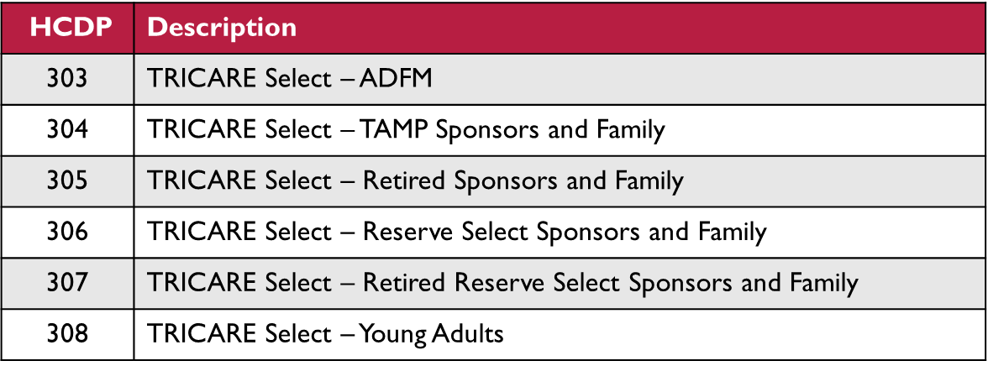
Enrollment & Eligibility
DEERS uses the Health Care Delivery Program Code (HCDP) to manage enrollments and entitlements.
As of January 1, 2018, all DEERS HCDP Codes changed.
  Collapsed into categories that represent the same benefit structure.
  Your queries will need to use different values depending on the dates of the data you are retrieving.
HCDP – Assigned:
  Indicates the beneficiary’s default healthcare coverage before enrollment
  Values for direct care and TFL.
HCDP – Enrolled
  Indicates the beneficiary’s enrollment program and beneficiary category.
  Examples →

Slide 69
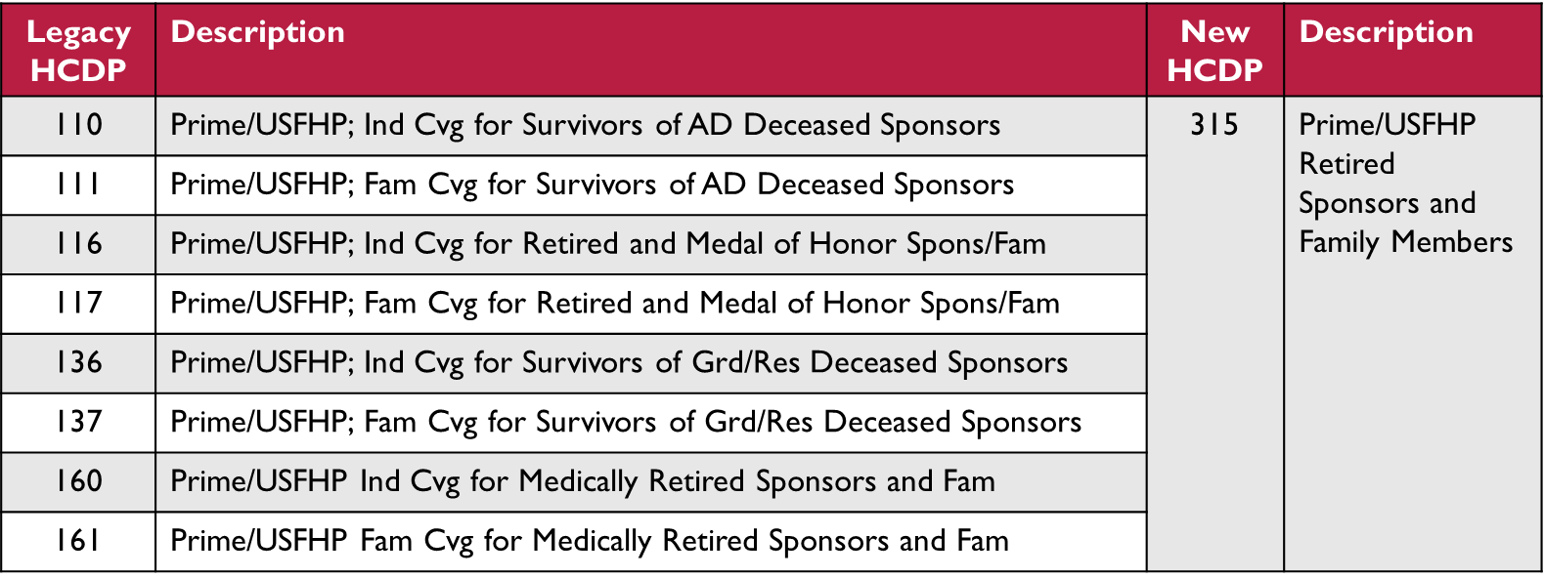
Enrollment & Eligibility
Example of legacy HCDPs collapsing into a new category

Slide 70
Eligibility group
This field characterizes eligibility
Code | Description | Comment
L | TRICARE for Life | Medicare Wraparound
S | TRICARE Reserve Select | Guard/Reserve Program
R | TRICARE Retiree Reserve Select | Retired Guard/Reserve Program
Y | TRICARE Young Adult | Family members up the age of 26
C | Continuing Healthcare Benefit Program | COBRA-like
E* | Entitled, non TRICARE for Life | Select/Prime/Direct Care Only
Z | None | No program
* Will be separating DCO into a new value (D) in the future.

Slide 71
Enrollment group
This field characterizes enrollment
ACV no longer populated as of 1/1/18
ACV Group still available until 12/31/2018.
Enrollment Group will be the main way to discern enrollment programs.
Enrollment Group, together with Enrollment PCM Type are very helpful.
Code | Description
P | TRICARE Prime
U | Designated Provider
S | TRICARE Select
L | TRICARE Plus
D | Direct Care Only
Z | No Enrollment Program

Slide 72
Enrollment PCM Type
This field characterizes the affiliation of the PCM.
Can be used to identify MTF Prime, Civilian Prime, etc.
Code | Description | Comment
U | Designated Provider PCM | Not eligible for direct/purchased care
C | Civilian Prime PCM, Non Remote
R | Civilian Prime PCM, Remote | TRICARE Prime Remote
O | Operational Forces PCM | Only for Navy
M | MTF PCM | Only for Prime. All Plus also have MTF PCMs. Plus will be included and populated retroactively when complete.
N | No PCM | Will not be assigned to a DMIS ID or associated attributes.
Z | Not enrolled | Plus, but you can assume that Plus have MTF PCMs

Slide 73
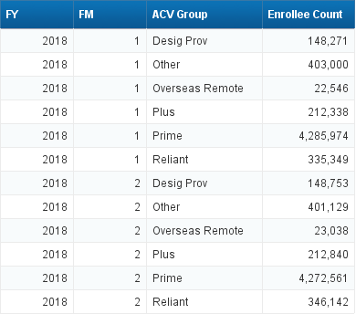
ACV Group
Legacy field used to identify enrollment programs
Reliant includes Active Duty not elsewhere classified
Other: TRR, TRS
There are significant differences in the benefits associated with enrollment.
For example, TRICARE Prime has access guarantees while many of the other programs do not.
Be sure when you use the word “enrollment” that you are communicating well which categories you mean.
FY 2018, FM 1 MHS Eligible Population by ACV Group

Slide 74
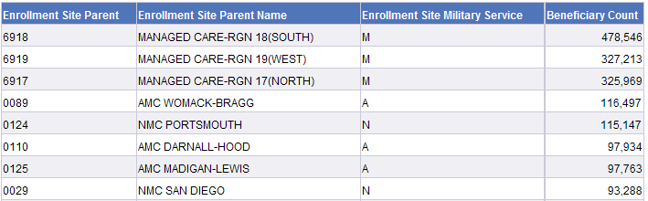
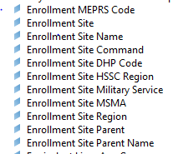
Enrollment
DMISIDs are used to identify enrollment entities where applicable
Enrollment Site will contain an MTF DMISID if the beneficiary is enrolled to an MTF. Enrollment Site hierarchy is also available
If the beneficiary is enrolled to a purchased care provider, the enrollment site will contain one of the following:
  69xx: Indicates a regular network Prime enrollee
  79xx: Indicates a TRICARE Prime remote network enrollee
  The xx refers to which region the private sector PCM is located in
Use Enrollment Service “M” to identify network Prime
FY 2016, FM 12 MHS Eligible Population with a Prime ACV

Slide 75
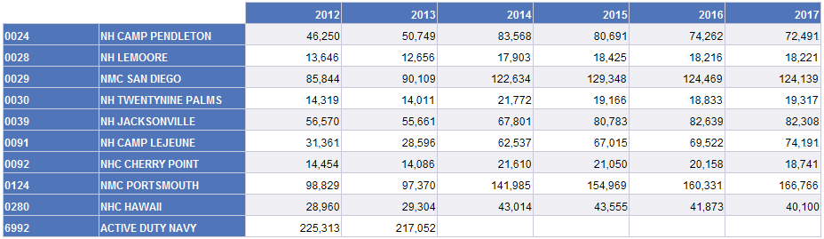
Navy Operational Forces DMIS IDs
The Army and Air Force leave service members enrolled to their home MTF when they are deployed or otherwise have imbedded medical assets available with their unit.
The Navy has operational forces DMIS IDs (63xx) that are used to keep these enrollees.
Up until 2014, these DMIS IDs rolled up to active duty Navy (6992) but thereafter are rolled up to the nearby parent MTF.
Selected Navy Parent MTF AD Enrollment
Data represent FM 1

Slide 76
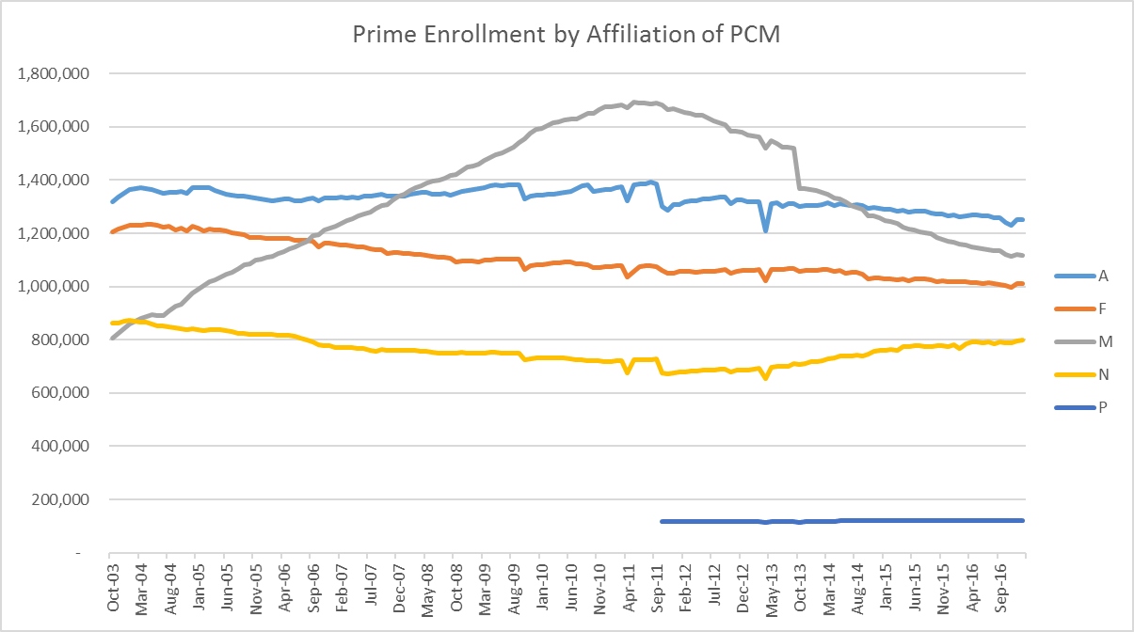
Trends: Enrollees by Service of Enrollment Location
Historical growth in MCSC enrollees.
Reversal is largely a function of declining end strengths and change in eligibility requirements for non AD/ADFM for Prime.
Minimal change in MTF enrollment (except Navy).

Slide 77
Enrollment
PCM ID:
  Identifier representing the PCM.
  If the beneficiary is MTF enrolled, 96% of the time the PCM ID is a “Person ID”.
  This is the field people use to look at the 1100:1 enrollment mandate from HA.
Enrollment MEPRS Code
  For MTF enrollees, identifies the clinic that the PCM is assigned to.
  If an enrollment MEPRS code is blank for an MTF enrollee, this means that the MTF has CHCS data that is inconsistent with DEERS for that particular enrollee for that month.
  Most MTFs have under a 5% discordant rate. For MTFs with a high rate of blank enrollment MEPRS codes, the enrollment MEPRS code variable will not be helpful.
  Enrollment MEPRS codes can be used to identify those enrolled/empaneled to PCMH sites.
To determine your discordant rate, compare the number of enrollees with a blank MEPRS code vs all of your enrollees

Slide 78
Geography

Slide 79
Geography
Zip codes are commonly used in business to identify potential customers
Zip codes:
  Primary method for identifying geographic locations of beneficiaries or providers.
  APOs and FPOs exist for many overseas residents; but some have unknown zip codes.
  Zip code data can be of poor quality if beneficiaries don’t provide updated information to DEERS when they move.
Content of beneficiary zip codes in M2:
  Usually based on beneficiary residence.
  Except for AD in DEERS files, where it represents where the AD member is assigned.
There are also provider zip codes in M2/MDR to identify locations of care.
Beneficiary zip codes are protected under HIPAA.
  Any geographic construct for a beneficiary with <20,000 eligibles in the zip code, OR
  Any geographic construct below the level of State.
  Take caution of cell sizes when using geographic data.

Slide 80
Geography
Zip codes are also “rolled up” into categories for easier reporting
MTF Areas:
  Coded with DMISID of surrounding MTF
  If you retrieve records for a catchment area, you will get those for patients who live near the MTF
  If not near an MTF, there are DMISIDs that represent areas outside of a 40 mile radius of an MTF. (077x, 078x, 09xx)
Type of Area | Radius | Inpatient MTFs | Ambulatory Clinics
Catchment Area | 40 mile | x
PRISM Area | 20 mile | x | x
MTF Service Area | 40 mile | x | x

Slide 81
Geography
When a beneficiary lives near more than one MTF:
  Beneficiaries are not double counted.
  M2 automatically assigns a beneficiary to one catchment area. The beneficiary does not know where they are assigned.
  Automatic assignment is somewhat arbitrary and may not reflect where a beneficiary seeks healthcare.
  Enrollment is usually a better indicator that a beneficiary may seek healthcare at an MTF, than simply living near it since beneficiaries choose where they enroll.
  Geography is best to use for unenrolled patients, or for provider location.
When determining if MTF areas overlap, catchment area logic only considers inpatient MTFs, while PRISM and MTF Service Area look at inpatient and ambulatory MTFs.

Slide 82
Geography
Allocation of beneficiaries in overlap areas is based on:
  Type of MTF and Market Concept
  Proximity to each MTF
  Service of beneficiary compared with service of each MTFs
General rule, beneficiaries assigned to:
  Closest MTF of same service
  Unless that results in an extra 10 mile drive, then to closest MTF
This assignment is based on an old requirement about when beneficiaries needed “Non-Availability Statements”

Slide 83
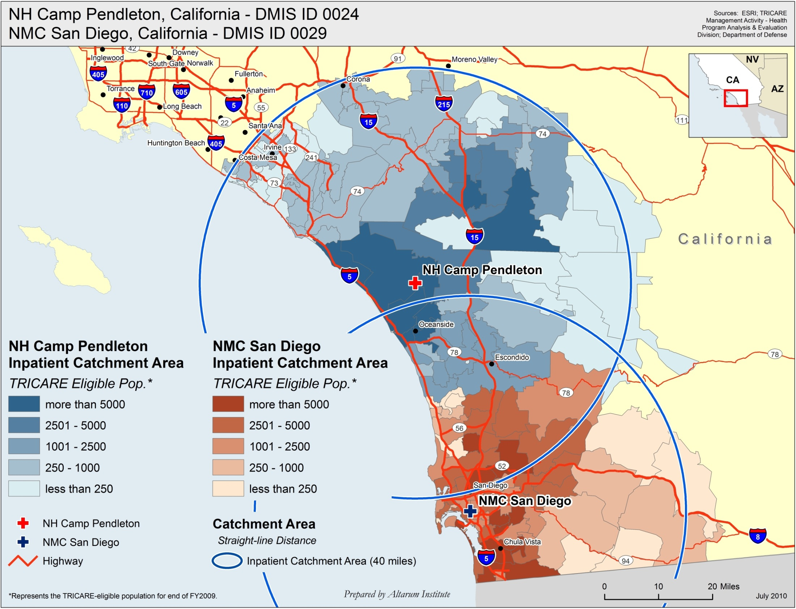
Example of overlapping catchment areas of the same service

Slide 84
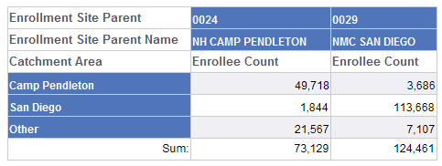
Example of Enrollment (Child Level) DMISID vs. Catchment DMISID
FY 2016, FM 12, enrolled to San Diego or Camp Pendleton
Notes:
Most of the “Other” are non-catchment Southern California. Pendleton even gets some enrollees into the Yuma area.

Slide 85
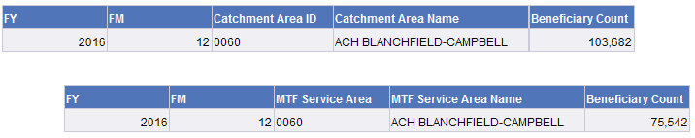
Catchment Area vs MTF Service Area
Since both catchment area and MTF Service Area both represent 40 mile radii, why do they not yield the same results?
The different results because only inpatient facilities are considered “overlapping” for catchment area; while ambulatory clinics are considered for MTF Service Area.

Slide 86
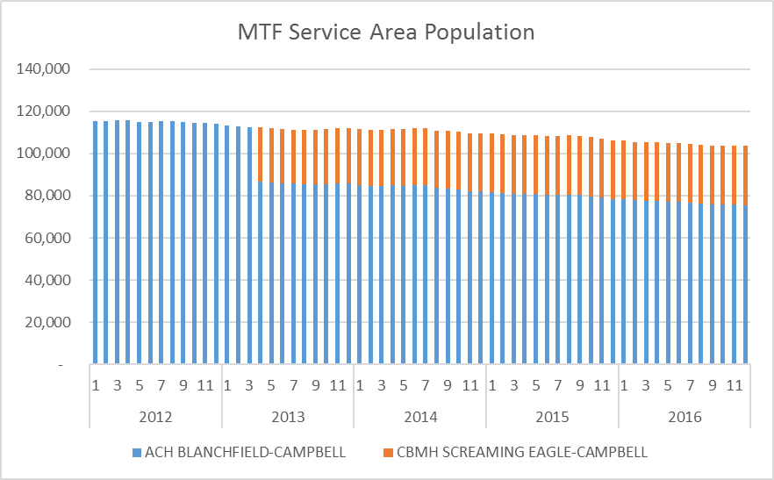
Geographic Location Data
The PCMH MTF is also located within the Fort Campbell Catchment Area.
This site only has OP care, so it’s not an “overlap” for catchment area but is for MTF Service Area.
Note the trend over time. It’s obvious when the separate PCMH MTF was created.

Slide 87
Additional Market Area Concepts
Market Area ID
  TRO Specific Definitions.
  Markets recognized by MCSCs as Prime Service Areas; that is, where beneficiaries can enroll in Prime.
  Contact TRO for more information.
Prime Service Areas & TRICARE Prime Remote Flags:
  Indicates whether Prime or TPR should be offered.

Slide 88
Deployment

Slide 89
Deployment Information
Data elements related to deployment are available in all detail files
OCO Deployment Flag:
  Indicates that the person is in a deployed status as of the date of the record:
  Members generally do not receive healthcare services from MTFs during deployments. (R&R, Landstuhl)
  Very important for counting persons. Many enrollees and eligible beneficiaries will not show up for healthcare because they are fighting wars overseas.
  Use this when doing “per person” or “per enrollee” work.

Slide 90
% of AD Deployed in FM1 of Each Year

Slide 91
Deployment Information
Ever Deployed Flag:
  Indicates that the member has been deployed at some time prior to the date of the record.
Days Since Most Recent OCO Deployment:
  Number of days between the time the member returned from deployment and the day the data was last processed.
  For finding members who recently returned.
Cumulative OCO Deployed Days:
  Cumulative number of days in deployed status.
  Interesting for research studies.

Slide 92
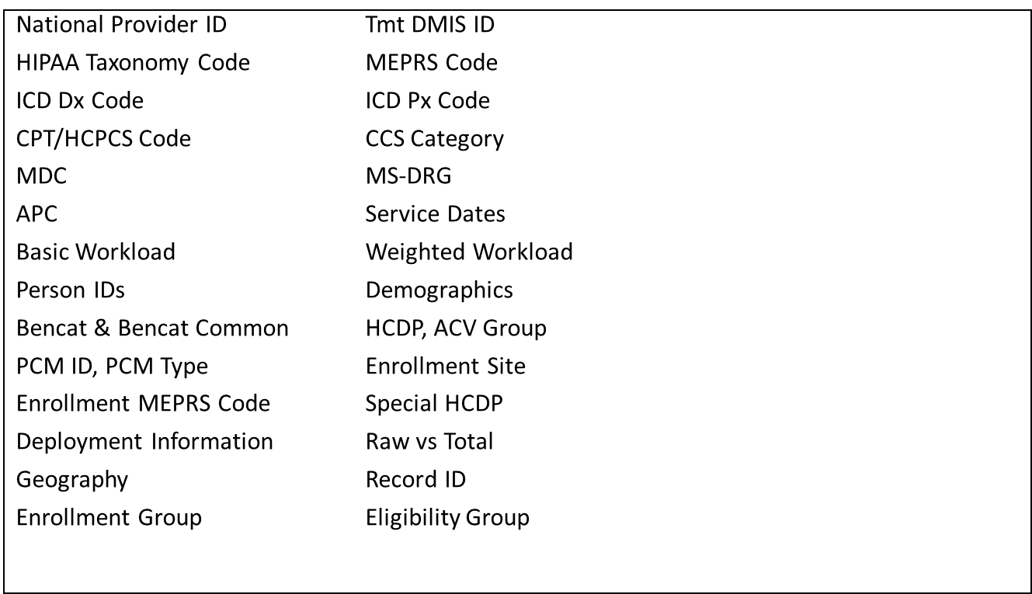

Common Terms

Slide 93

Key Takeaways
National Provider ID is a great way to identify providers and HIPAA taxonomy codes are the best way to identify a specialty.
Be sure to consider whether child-level or parent-level DMIS ID information is needed.
Facility: MS-DRGs and RWP (Acute Care Inpatient) and APCs and APC weights (hospital outpatient)
Provider: CPTs and work RVUs. Total RVUs to include practice expense.
Total workload measures are usually more appropriate for analysis.

Slide 94
Takeaways
Ben Cat Common: 1 = ADFM, 2 = RET, 3 = OTH, 4 = ADSM
Enrollment Group and PCM Type
ACV Group: Prime, Plus, Reliant, Desig Prov,
Overseas Remote, Other
Sponsor Service Aggregate: A = Army, F = Air Force,
M = Marines, N = Navy, V = Navy Afloat, C = Coast Guard
Catchment vs. PRISM vs. MTF Service Area
Type of Area | Radius | Inpatient MTFs | Ambulatory Clinics
Catchment Area | 40 mile | x
PRISM Area | 20 mile | x | x
MTF Service Area | 40 mile | x | x

