Slide 1




DaVINCI: DoD Direct Care
Ancillary Data
Laboratory and Radiology

Slide 2

Objectives
Describe the DaVINCI table characteristics
Describe similarities and differences with VA CDW tables
What data elements should you select or avoid when performing operational or research studies

Slide 3
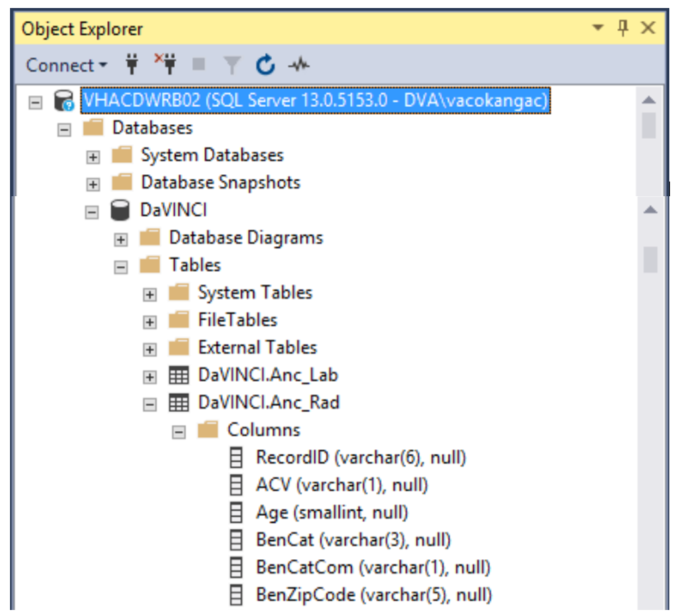
Table Location in DaVINCI
Location of Lab and Rad Tables in DaVINCI:
VHACDWRB02 \ Databases \ DaVINCI \ Tables \ DaVINCI.Anc_Lab & DaVINCI.Anc_Rad

Slide 4
What’s in the Ancillary Tables
Each record represents a “certified” entry into CHCS
  Granularity: CHCS Order -- CPT -- Modifier
Represents the ordered test, does not contain the “results”
Only have data FY05 and forward
One or two records per test/exam
      Lab – almost always only 1
      Rad – almost always 2 records
<FY12: only those ordered from MEPRS B, C, D and FC
FY12: ordered from any MEPRS Code, including A (Inpatient)

Slide 5
Record Counts by 1st Level MEPRS Code
A=Inpatient; B=Ambulatory; C=Dental; D=Ancillary; F=Svcs Support; Other=errors

Slide 6
Background: MHS Ordering Process
Excellent short (5 min) video tutorials on placing Lab and Rad Orders in various MHS data systems (Cerner and AHLTA):
  Entering Lab orders in Cerner: https://www.youtube.com/watch?v=7XI9njWmUOM
  Entering Lab and Rad orders in AHLTA starting @9:50: https://www.youtube.com/watch?v=brOXPmmwX0I
  Reviewing Lab results in Cerner: https://www.youtube.com/watch?v=SA3BSOD69hQ

Slide 7
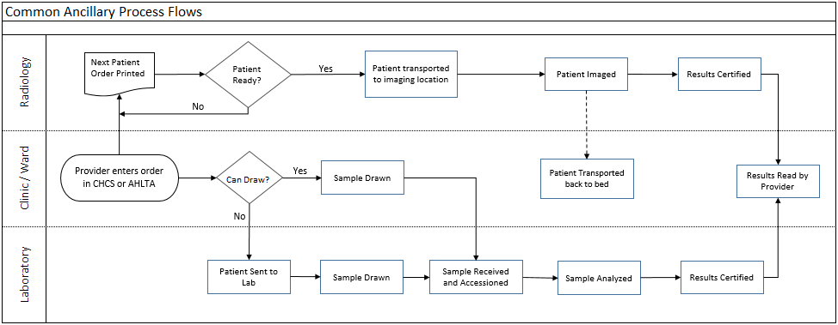
Background: Common Ancillary Process Flows

Slide 8

Types of Questions for DC Ancillary
What were the top 10 most commonly ordered labs at the Womack AMC Emergency Dept. the past 6 months?
What imaging procedures contribute the highest full cost at NMC San Diego, and which clinics are ordering them?

Slide 9
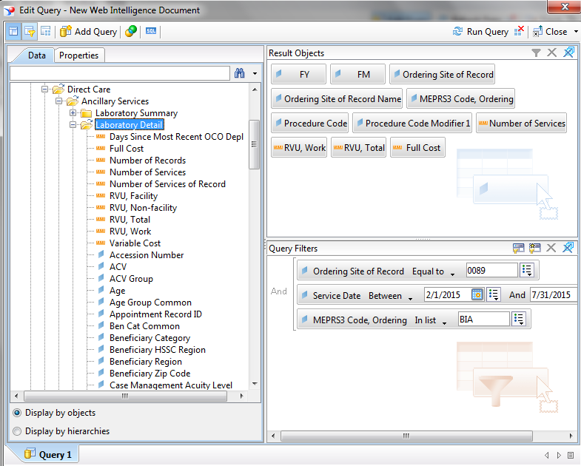
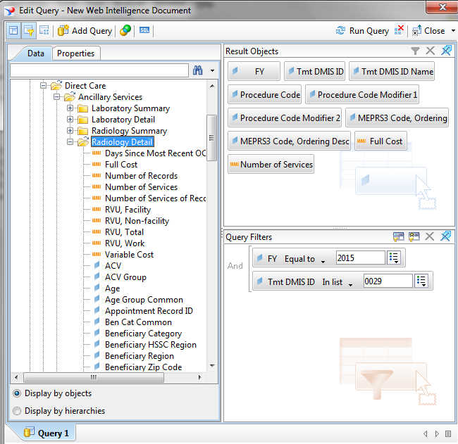
Generate Queries (M2 example)
Womack ED Labs: San Diego Rad costs:

Slide 10
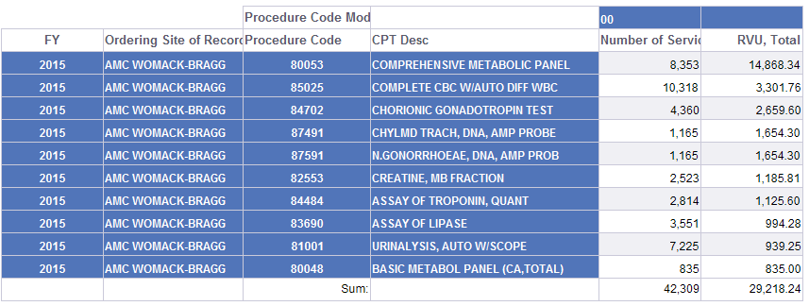
Results #1
Top 10 Womack-Ft. Bragg ED Labs:

Slide 11
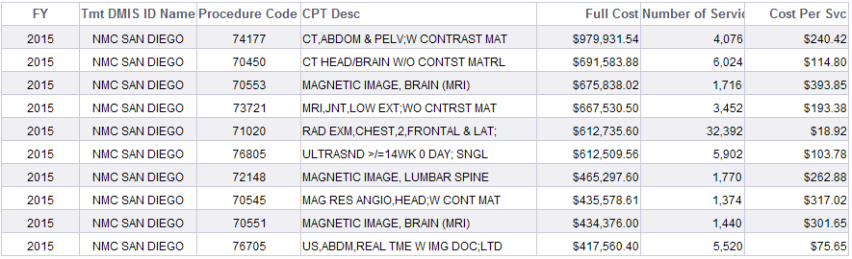
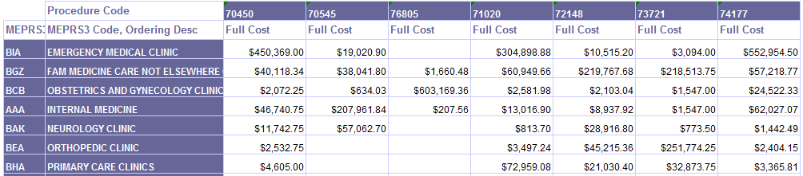
Results #2
Top 10 San Diego Rad by Full Cost:
Sliced by Ordering Clinic:

Slide 12
Common Terms
National Provider ID Tmt DMIS ID
HIPAA Taxonomy Code MEPRS Code
ICD Diagnosis Code ICD Procedure Code
CPT/HCPCS Code CCS Category
MDC MS-DRG
APC Service Dates
Basic Workload Weighted Workload (RVUs)
Person ID (EDIPI) Demographics
Bencat/Bencat Common ACV & ACV Group
PCM ID Enrollment Site
Enrollment MEPRS Code Special HCDP
Deployment Information Raw vs Total
Geography Record ID
Case Manager ID Case Manager DMISID

Slide 13
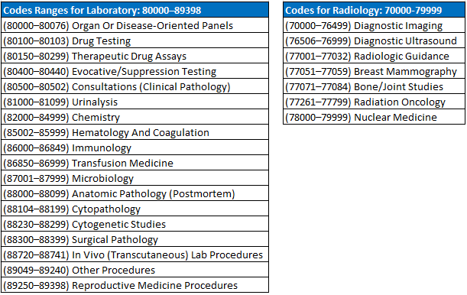
Procedure Codes (CPT)
Coded with CPT codes with Modifiers

Slide 14
CPT Modifiers for Laboratory
Procedure Code Modifier 1:
  00 = Technical Component for in-house work (specimen collected and test performed at MTF)
  26 = Professional Component (Pathologist interpretation, do not expect to have many)
  32 = Technical Component for referral work (specimen collected somewhere else, test performed at MTF, use to identify lab done at the MHS reference labs)
  90 = External Laboratory (specimen collected at MTF, sent to civilian reference lab)

Slide 15
CPT Modifiers for Radiology
Procedure Code Modifier 1:
  26 = Professional Component (PC)
  TC = Technical Component (TC)
  Most exams will have 1 record for each modifier
Procedure Code Modifier 2 (Military Unique Use):
  50 = Bilateral with 26
  51 = Bilateral with TC
  99 = Multiple Modifiers
  2nd modifier may or may not be present

Slide 16
2 Records represent 1 exam
Radiology – how many chest X-rays are performed?
  Condition on Modifier 1 = TC and you will catch the vast majority of them
Laboratory – how many CBCs do I do?

Slide 17
Radiology examples
Bilateral issue: Number of Services of Record is the original number; Number of Services is the corrected data
The computation of the RVU fields uses Number of Services (the corrected value)
Professional Component (26) gets mostly work RVUs (their salary), but a little non-facility (has to have somewhere to do the work)
Technical Component (TC) gets only non-facility RVUs (salary of rad tech, cost of the machinery, cost of the building, etc.)
One exam produced 1.03 RVU (0.35 + 0.68)

Slide 18
Bilateral Issue
Number of Services of Record = Data from CHCS (investigating coding practices)
Number of Services = Corrected data for double counting bilaterals (use for analyses)
Appears to have been corrected in FY12+ for Professional component

Slide 19
Fields of Interest
Dates
Service Date = Date of radiology exam or lab testing
FY/FM based on this date
Provider Data
Ordering Site of Record vs. Tmt DMISID
MEPRS Code is the ordering clinic

Slide 20
Fields of Interest
Inpatient Indicator: indicates whether or not the ancillary was for a patient in the hospital; or that the record has an inpatient ID populated
Treatment DMISID + Inpatient Record ID
  Directly join to SIDR
Treatment DMIS ID + Appointment Record ID
  Directly join to CAPER

Slide 21
Odds and Ends
No diagnosis codes (although the empty fields exist)
  Cannot directly answer “what kind of lab tests do we do on patients with X?” (e.g., diabetes) from the Ancillary data alone
“How many ultrasounds performed?” Need to check both Ancillary Rad and CAPER
Anatomical Pathology departments using CoPath system do not pass workload into CHCS so some workload is missing (pap smears, biopsies)

Slide 22
Exercise
Using both VA and DoD DaVINCI laboratory data, determine how many diabetic patients received the same lab tests in FY16 in both departments

Slide 23
Questions

