Slide 1
Summary of ORO Interim Guidance on Research Data Disclosures for “Collaborative” Studies July 27, 2011* * Supersedes all previous ORO guidance on this subject (slides updated: September 8, 2011)

Slide 2
Challenges & Opportunities Related to “Collaborative” Research with Affiliates
Challenges
Federal Records Retention Requirements
Privacy/Confidentiality Requirements
Privacy Act, HIPAA Privacy Rule, etc
Data Ownership Issues
VA Data Security Requirements
Dual Appointment Investigator Issues

Slide 3
Challenges & Opportunities Related to “Collaborative” Research with Affiliates
Opportunities
AAMC Working Group on Information Technology Security and Privacy in VA and NIH-Sponsored Research
The Working Group report describes:
Disclosure of PHI
Pursuant to a request from the affiliate
For use in non-VA research conducted by the affiliate
ORO’s Interim Guidance
Assumes (pending clarification in VA policy) that the Working Group report also applies to “collaborative” research in which VA data are combined with affiliate data

Slide 4
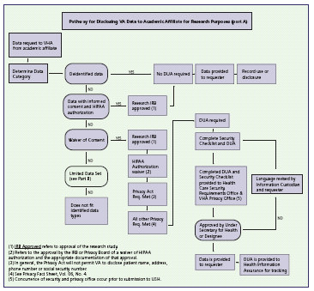
Working Group Report

Slide 5
Record Retention Requirements
VA research data must be maintained per Federal records retention and other requirements
A Records Control Schedule approved by National Archives and Records Administration (NARA) is required to destroy Federal records
Records Control Schedule for VA facility-level research records is currently under development
VA facilities must retain data from VA research pending approval of an applicable Records Control Schedule

Slide 6
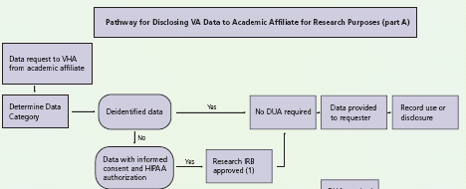
Working Group Report – Disclosure Under HIPAA Authorization (Appendix A)

Slide 7
Disclosure Under HIPAA Authorization
Subject’s HIPAA authorization permits VA to disclose subject’s data for research as described in the authorization
No Data Use Agreement required per Working Group
Authorization, informed consent document, study protocol, and CRADA (where applicable) must be consistent as to data and purpose
Authorization and consent must include all required elements and permit informed decision by subject
Research data repository (per VHA Handbook 1200.12) must be established if use or disclosure by VA for future research (ie, outside study for which the data were collected) is anticipated

Slide 8
Disclosure Under HIPAA Authorization – Data Ownership & Information Security
Valid informed consent and HIPAA authorization are required
Informed consent and HIPAA authorization requirements apply to all VA PHI and individually identifiable private information that are used/disclosed for research
Includes clinical data used in research for “control” or “comparison” groups
VA must retain a complete record (original or copy) of the disclosed data

Slide 9
Disclosure Under HIPAA Authorization – Data Ownership & Information Security
The record retained by VA is:
Owned by VA
Subject to VA information security requirements
Once the disclosed copy is held by the Affiliate, VA may no longer be able to:
Control the disclosed copy
Enforce VA information security requirements

Slide 10
Disclosure Under HIPAA Authorization – Policy Clarification Desirable
Working Group describes disclosure pursuant to a request from the affiliate vs “collaborative research”
Not clear that disclosure under a HIPAA authorization necessarily transfers ownership
Without a DUA or other legal agreement, it would seem problematic, for VA to exert ownership of the disclosed copy of any data provided to the affiliate/collaborator
A DUA or other legal agreement would seem to be advisable if VA wishes to exercise ownership or control of disclosed data

Slide 11
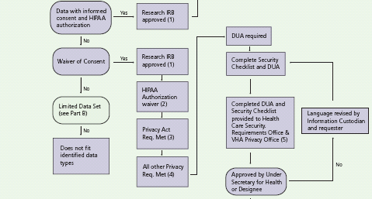
Working Group Report – Disclosure without Authorization and Consent (Appendix A)

Slide 12
“Working Group” Report Disclosure Without HIPAA Authorization and/or Informed Consent
Requirements are fact-specific
ORO strongly recommends consulting ORD, the VHA Privacy Office, and Regional Counsel prior to such disclosures

Slide 13
VA Information Security Requirements
Apply to all research data owned by VA
If maintained electronically and containing VA Sensitive Information (VASI) must reside on VA-owned equipment unless:
A waiver has been approved by the VA CIO or
A valid Memorandum of Understanding / System Interconnection Agreement (MUA/SIA) has been approved or
Where appropriate, a valid contract with VA’s security clause and security requirements has been established to permit alternate arrangements.

Slide 14
Investigators Holding Dual Appointments
Critical to separate and document:
VA activities on VA time vs
Affiliate activities on affiliate time
Documentation should clarify:
VA duties
VA duty locations
VA tours of duty or time allocations
Data ownership issues
Data security requirements
Separation of VA activities/research from affiliate activities/research is critical for studies combining VA data with affiliate data

Slide 15
Combining VA Data with Affiliate Data for “Collaborative” Studies
VA data are data collected:
By a VA investigator
On VA time
Under a protocol approved by the VA IRB of Record and the VA R&D Committee
Affiliate data are data collected:
By an Affiliate investigator
On affiliate time
Under a protocol approved by the affiliate IRB

Slide 16
Combining VA Data with Affiliate Data for “Collaborative” Studies -- Separate Activities Defined for Each Site
The “collaborative” study should be implemented as a multi-site study with activities clearly defined for each site
Critical factors:
Data collection should typically take place at the VA site on VA time and at the affiliate/collaborator site on affiliate/collaborator time as separate activities that can be clearly distinguished by the IRB and the R&DC
The status “off-site” VA research taking place at an affiliate site on VA time should be clarified through a written agreement with the affiliate addressing data ownership and responsibility for research-related injury
The R&D Committee must only approve the VA research

Slide 17
Combining VA Data with Affiliate Data for “Collaborative” Studies When Affiliate IRB is VA IRB of Record
Each facility exercises latitude in administrative management of its research projects
If the Affiliate IRB serves as the VA IRB of Record, the IRB may either:
Approve two separate “protocols” – one for the VA research and one for the Affiliate research
or
Approve a single “protocol” under which the VA research activities are clearly separated from the affiliate research activities

Slide 18
Combining VA Data with Affiliate Data for “Collaborative” Studies When Affiliate IRB is VA IRB of Record
For existing “collaborative” studies with a single “protocol,” ORO suggests:
Separation of VA vs Affiliate research at applicable continuing reviews occurring after December 31, 2011
By appropriately amending the informed consent documents and HIPAA authorizations

Slide 19
Combining VA Data with Affiliate Data for “Collaborative” Studies When Affiliate IRB is VA IRB of Record
For new “collaborative” studies with a single “protocol,” ORO suggests:
Separation of VA vs Affiliate research at initial reviews occurring after December 31, 2011
In addition to informed consent documents and HIPAA authorizations, relevant areas of separation may include:
Recruitment procedures/strategies/advertisements
Research related procedures
Data collection/storage/uses/disclosures
VA researchers/personnel/staff
VA Clinics/Units/Labs/Locations involved
Results of VA ISO and PO reviews

Slide 20
Combining VA Data with Affiliate Data for “Collaborative” Studies
Protocols, consent documents, and authorizations for both sites must include:
Use of data in a multi-site study combining VA data and affiliate data
Data will be disclosed to study Coordinating Center
Location of Coordinating Center

Slide 21
Combining VA Data with Affiliate Data for “Collaborative” Studies
If Coordinating Center is at the VA site, the VA research described in the “protocol” must include:
Interaction/intervention and data collection activities at VA
Activities of the Coordinating Center

Slide 22
Combining VA Data with Affiliate Data for “Collaborative” Studies
If Coordinating Center is at the Affiliate Site :
A dual appointment investigator should not conduct research using the combined data set while on VA time unless data ownership issues have been clarified in writing
ORO strongly recommends consultation with ORD and Regional Counsel regarding data ownership clarifications

Slide 23
Combining VA Data with Affiliate Data for “Collaborative” Studies Related Documents
ORO Interim Guidance on Research Data Disclosures for “Collaborative” Studies (July 27, 2011)
AAMC Working Group on Information Technology Security and Privacy in VA and NIH-Sponsored Research
Available at: http://vaww.vha.vaco.portal.va.gov/sites/ORO/RCO/default.aspx
(click on: Memoranda, Clarifications, and Guidance)

