Slide 1
CPIA Exam Study Session
Dept. of Veterans Affairs
Policy on Research with Animals
February 27, 2023
Alice Huang, PhD
Deputy for IACUC Guidance
Office of the Chief Veterinary Medical Officer
Alice.Huang@va.gov

Slide 2
VA Policy: Research with Animals
VA recognizes the ethical imperative to minimize the pain and distress that animal subjects experience, while also supporting the use of animals in research when it’s scientifically necessary
The devil is in the details of how to show that we’re doing that (compliance with applicable rules)
Notes:
Ask attendees to identify ethical and regulatory requirements that apply:
Ethical imperatives
Nuremberg Code of 1947
US Government Principles
Regulatory requirements
VA policy about use of animals in research
Set by ORD
ORO oversees VA compliance to VA policy
(including VA policy about use of animals in research)
PHS/OLAW – focus on animals research funded by NIH
Special arrangement for OLAW to oversee VA research as well
USDA – regulates transportation and use of most animals in the US
Includes exhibition, commerce, and pets as well as research
(Specific exclusions
horses for uses other than research
farm animals
animals for food and fiber
research rats and mice)
The Guide – best practices for use of animals in research,
PHS policy requires that institutions base their animal research programs on this
AVMA Guidelines for Euthanasia (2013)
AAALACi – accreditation of animal research programs, required by VA policy
Bottom line: lots of regs, coming from lots of different sources
Largely consistent with each other -- All aimed at ensuring that ethical requirements are met, and assuring the public that they have been met
Note that all of these apply because of the scale and scope of VA animal research

Slide 3
Sources of Requirements
VA Policy
1200.07, 1058.01
PHS Policy
US Principles
AAALAC Rules of Accreditation
USDA AWAR
The Guide
AVMA Guidelines
Ethical Conduct of Research
1
2
3
4
5
6
7
8

Slide 4
What Is the Connection
Between
Compliance with Requirements and
Ethical Conduct of Research?

Slide 5
Demonstrate to the Public:
VA Research is Ethically Responsible
USDA registration
PHS Assurance
AAALACi accreditation
Notes:
Useful to have these oversight mechanisms backing you up
when you say that of course you are being responsible

Slide 6
The Rules
USDA Registration
PHS Assurance
AAALAC
Program Description
IACUC
Oversight
Ethical Conduct of Research

Slide 7
Who Makes Up an IACUC?
IACUC
NSM
(Chair)
NAM
AV
Scientist
1
2
3
4
5

Slide 8
Who Else is Involved?

Slide 9
Regulatory Requirements
USDA Reg
PHS Assurance
AAALAC Accreditation
IO/CEO/Director
RCO
Veterinarian
R&D Committee/
ACOS
SRS
IACUC
AV
Scientist
Vet Techs
Oversight of VA Research
PI
PI
Oversight of Research with Animals
Vet Care
VMU Supervisor
Protocol Review
Facilities Management
AO
Project
Husbandry
IACUC Coordinator
Animal Care Techs
Ethical Research
1
2
3
4
5
6
7
8
9
10
11

Slide 10
Outcomes
Protocol Review
Approve
RMSA
Withhold approval

Slide 11
IACUC Determination
Summary of the individual recommendations of all members, by …
FCR
DMR

Slide 12
VA-Specific Requirements
After Approval is Granted
Signatures
Notify PI
Notify R&D Committee
Secondary Review
PAM

Slide 13
Semiannual Evaluations

Slide 14
VA Semiannual Report Forms https://www.research.va.gov/programs/animal_research/documents.cfm
Part 1 – Checklists
  Section A – what is intended
  Section B – what is happening
Part 2 – Table of Deficiencies and Departures
Part 3 – Post-Review Documentation

Slide 15
Openness is Critical
Trust is difficult to build, easy to lose, and very difficult to re-build.
Worst response: the appearance of a cover-up
To avoid the appearance of a cover-up: promptly self-report non-compliance and corrective actions
Notes:
Between Murphy’s Law and FOIA
– someone will always find out if something goes wrong
That makes transparency critical
1 -- Over the last 50 years, public opinion on the use of animals in research
has gone from strongly in favor, to about 50:50
Details of surveys show large variations related to:
Species
perceived value of the study
degree of suffering involved
Bottom line: increasing skepticism/doubt
Congress, public media, and animal rights groups
- very interested in failures to meet ethical/regulatory expectations
Need to rebuild trust, and not lose more
2 –
3 – so the IACUC and the regulatory agencies can
support your efforts
reassure the public

Slide 16
Reporting Requirements
ORO
Anything the Public Might Ask
VA to Explain
OLAW
Noncompliance with PHS Policy
USDA
AAALAC
Problems with the “State of the Program”
1
2
3
4

Slide 17
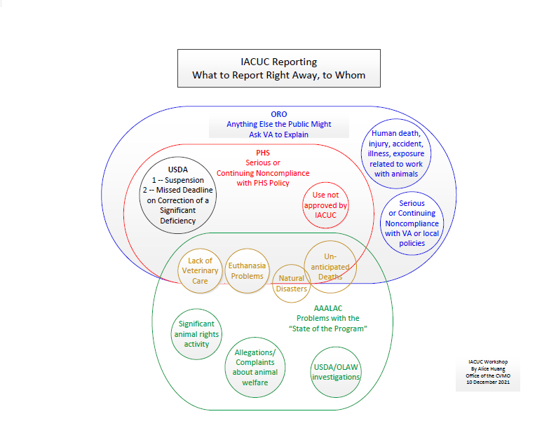
Reporting Requirements

Slide 18
Timeline for Reportable Matters
DECISION
IACUC
DIR
ORO
!
-5 days-
-60 days-
-5 days-
-5 days-

Slide 19
VA Collaborations with Non-VA Institutions
Require Written Agreements
Investigator/project specific collaborations
Broad framework for managing shared oversight of collaborative work involving resources of both institutions (funding, facilities, personnel)
Arrangements for another institution to provide support services for a VA program of research with animals

Slide 20
VA-Specific Application of the Rules
PHS Policy applies to all VA research – regardless of funding source
USDA AWR applies to all VA research – including with rats and mice
AAALAC Rules of Accreditation apply to all facilities where VA research with animals is done
Responsibilities of the IO and CEO apply to the MCD even if affiliate personnel serve as IO and CEO

Slide 21
VA-Specific Requirements
Protocol Review
Veterinary pre-consult for every protocol
Two primary reviewers for any protocol
Secondary review by the office of the CVMO
Signatures on approved protocols
Roles: R&D Committee, ACOS, AO, SRS, RCO
Notify R&D Committee of IACUC approval
Semiannual Reports
Protocol document audit
Inspect locations for housing > 12 hours, or surgery is done
Annual overheat test
Document audit of 5% of active protocols (at least 3)
Semiannual report must be reviewed with and signed by MCD, in a meeting with IACUC and Research Administrators
Semiannual report signed by MCD must be submitted to CVMO

Slide 22
More VA-Specific Requirements
Self-Reporting
Self-reporting to ORO
Preliminary pre-decisional notifications to CVMO and ORO
ORO self-reporting timeline
Collaboration with Non-VA Institutions
Collaborative Work with Animals
Collaborative Oversight

Slide 23
Questions?

