Slide 1
1200.07
VA Research with Animals
AALAS National Meeting 2023
The New Directive and Its Companion Guide
October 24, 2023
Alice Huang, PhD
Deputy for IACUC Guidance
Office of the CVMO
Alice.Huang@va.gov

Slide 2
VHA Directive 1200.07
Available on-line
https://www.research.va.gov/
programs/animal_research/documents.cfm

Slide 3
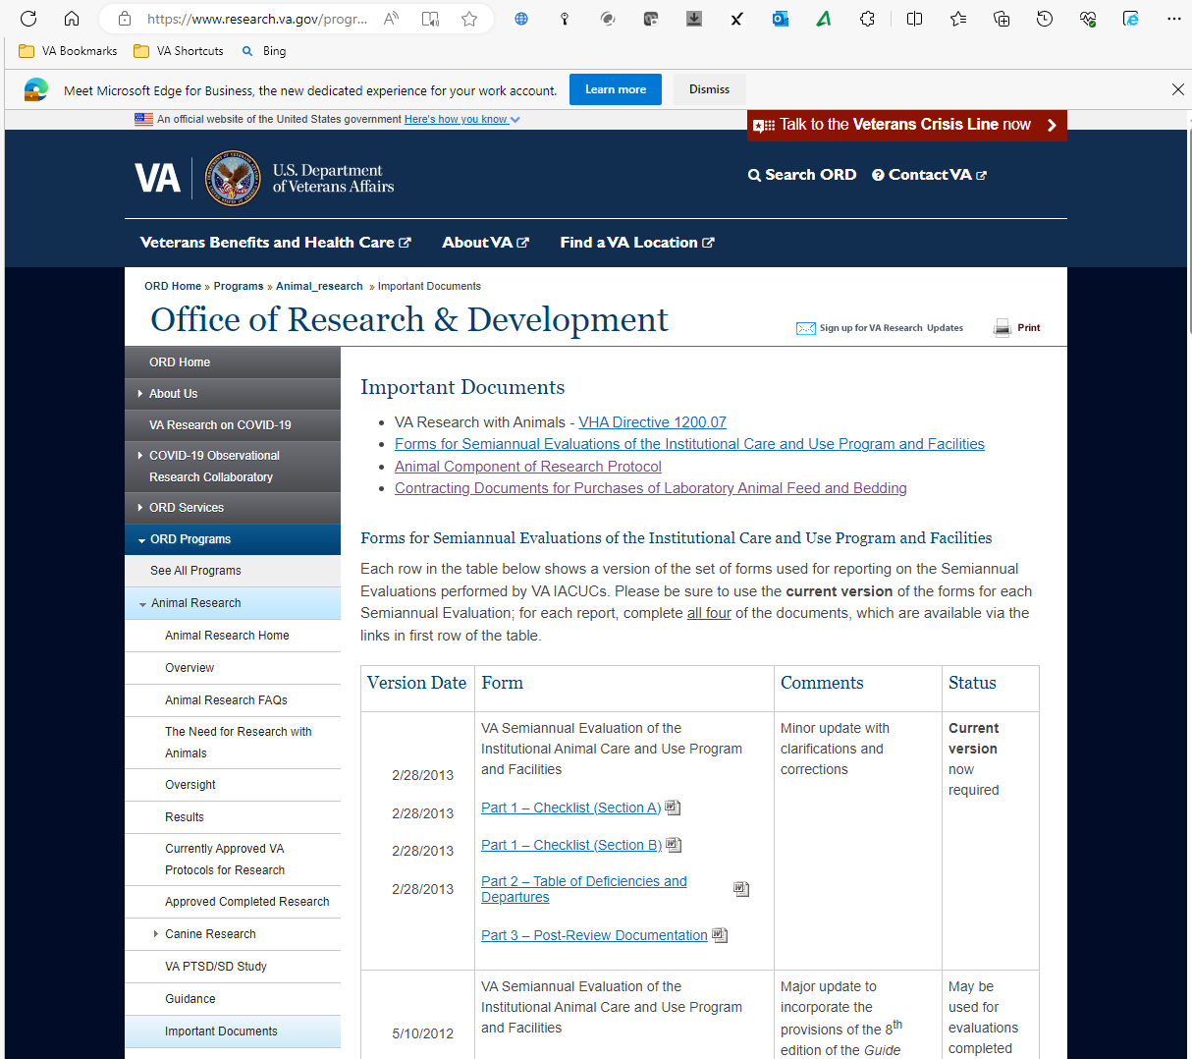

Slide 4
VHA Directive 1200.07
Available on-line
https://www.research.va.gov/
programs/animal_research/documents.cfm
Explicit statements
Enforceable policy
Specific to VA research involving animals
Emphasis on performance standards

Slide 5
Guidance for VHA Directive 1200.07
Annotations and Specific References
  USDA AWR
  PHS Policy / OLAW Guidance
  AAALAC Rules of Accreditation
  The Guide
  Other relevant VA and VHA policies
Guidance for Implementation
  Suggestions for meeting performance standards
  Considerations related to local circumstances
Available online: Guidance Document AR2023-002
https://www.research.va.gov/
programs/animal_research/guidance.cfm

Slide 6
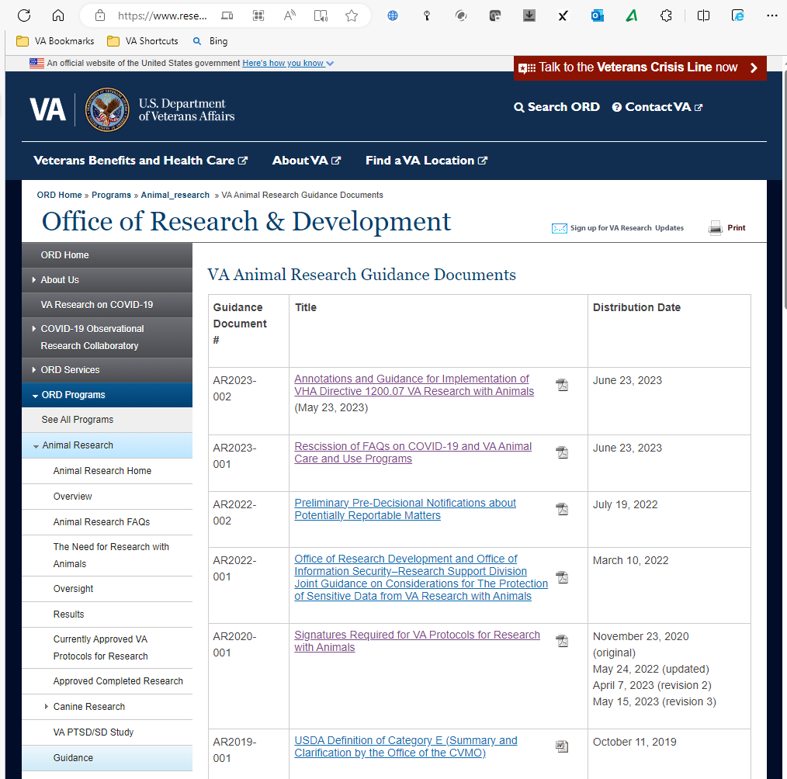

Slide 7
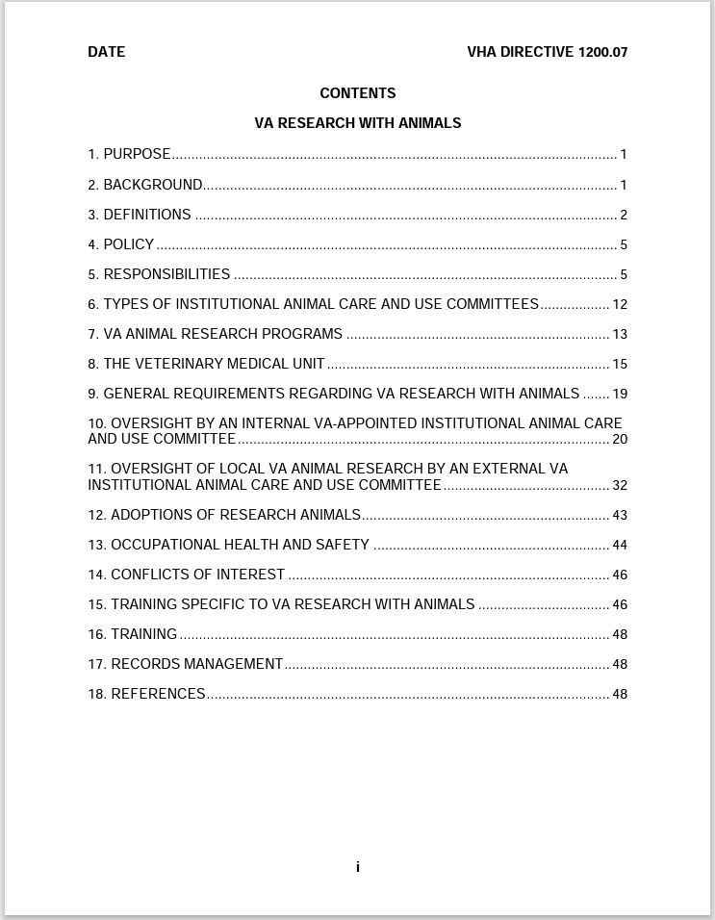
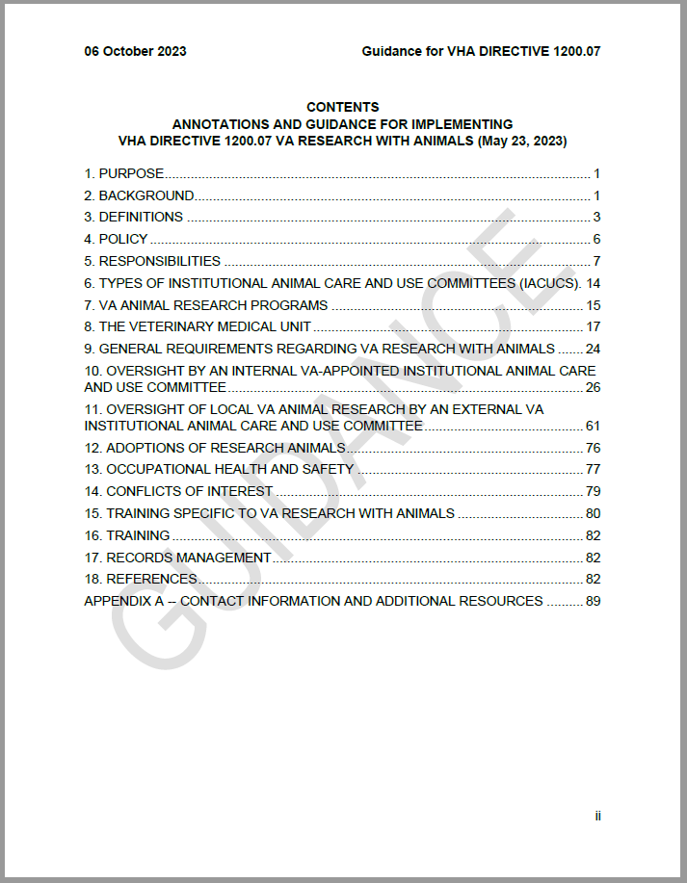

Slide 8
1. PURPOSE
Directive
This Veterans Health Administration (VHA) directive sets forth the compliance requirements for all animal research that is considered Department of Veterans Affairs (VA) research and the minimum standards for the facilities, husbandry, veterinary care and oversight of any VA research involving animal subjects. AUTHORITY: 38 U.S.C. § 7303.

Slide 9
1. PURPOSE
Directive
This Veterans Health Administration (VHA) directive sets forth the compliance requirements for all animal research that is considered Department of Veterans Affairs (VA) research and the minimum standards for the facilities, husbandry, veterinary care and oversight of any VA research involving animal subjects. AUTHORITY: 38 U.S.C. § 7303.

Slide 10
1. PURPOSE
Directive
This Veterans Health Administration (VHA) directive sets forth the compliance requirements for all animal research that is considered Department of Veterans Affairs (VA) research and the minimum standards for the facilities, husbandry, veterinary care and oversight of any VA research involving animal subjects. AUTHORITY: 38 U.S.C. § 7303.
Guidance
Veterans Health Administration (VHA) Directive 1200.07 (dated May 23, 2023) sets forth the compliance requirements that apply to all animal research that is considered Department of Veterans Affairs (VA) research and the minimum standards for the facilities, husbandry, veterinary care, and oversight of any VA research involving animal subjects. AUTHORITY: 38 U.S.C. § 7303. VHA Directive 1200.07 is limited to establishing VA policy requirements that are specific to VA research with animals. It does not reiterate regulatory and policy requirements that also apply but are established by other VA or VHA documents or by others. This guidance document is to assist those responsible for implementing compliance with all applicable requirements, by integrating the most commonly relevant and important requirements from all sources. All references in this guidance to information from those other sources are current at the time of the release of this guidance

Slide 11
2. BACKGROUND
Directive
  a. Foundational principles
  b. Federal regulatory and policy documents
Guidance
  a. Foundational principles
  b. Federal regulatory and policy documents

Slide 12
2. BACKGROUND
Directive
  a. Foundational principles – commitment to moral, ethical, legal standards for humans and animals
  b. Federal regulatory and policy documents – list what applies
Guidance
  How to use the Guidance
  a. Foundational principles – Nuremberg Code, Declaration of Helsinki, US Govt Principles
  b. Federal regulatory and policy documents -- comments
  c. Authority to interpret

Slide 13
3. DEFINITIONS
Directive
Guidance
  The definitions given here apply to how these terms are used in VHA Directive 1200.07. For terms for which VA adopts the definitions established by others, the guidance provided here reflects the definitions in use by those others at the time of the release of this guidance. Terms that are not specifically defined, are to be interpreted as in common usage.

Slide 14
3. DEFINITIONS
Directive
  a. Affiliate. Affiliate refers to any non-VA institution involved in interinstitutional collaboration with a local VA program, related to research with animals. Such an affiliate may or may not also have a formal relationship with the VA medical facility for purposes of clinical training.
  b. Animal. VHA adopts the definitions of “animal” established in the PHS policy and the USDA AWR, with no additions or exceptions. NOTE: For PHS policy and the USDA AWR see references paragraph.
Guidance
  a. Affiliate. [No additional guidance]
  b. Animal. VA adopts the definitions used in PHS Policy (III.A, “Any live, vertebrate animal used or intended for use in research, research training, experimentation, or biological testing or for related purposes”) and in the AWR (§1.1, “live … warm-blooded animal … used or intended for use for research, teaching, testing, experimentation”). “Related purposes” is understood to include teaching of personnel to perform clinical procedures, as well as training personnel to perform procedures related to the care and use of animals. NOTE: For species regulated by USDA, the definition includes dead animals, but that is for AWR requirements related to sale of animals, and does not apply to research.

Slide 15
3. Definitions (cont.)
Directive
  q. Just-in-Time
  r. VA Sensitive Species
Guidance
  q. Just-in-Time
  r. VA Sensitive Species

Slide 16
3. Definitions (cont.)
Directive
  q. Just-in-Time
  r. VA Sensitive Species
Guidance
  q. Just-in-Time
  q+. Public Health Service (PHS) Assurance
  q++. PHS Policy. “PHS Policy” vs “PHS policy”
  q+++. VA Research. Defined by 1200.01
  r. VA Sensitive Species

Slide 17
4. POLICY meet/exceed accepted standards
5. RESPONSIBILITIES who does what
6. TYPES OF IACUCS
7. VA ANIMAL RESEARCH PROGRAMS starting, closing, sharing oversight, contact CVMO
8. THE VMU policies about facilities
9. GENERAL REQUIREMENTS PVC, PHS Assurance, USDA Registration, AVMC Guidelines

Slide 18
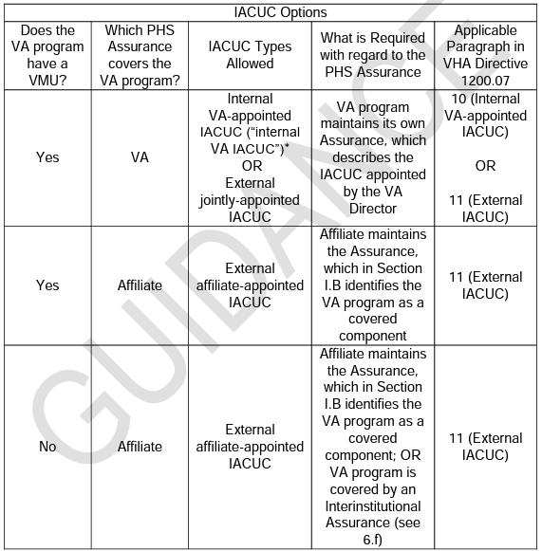

Slide 19
IACUC Specifics
10. Internal IACUCs
11. External IACUCs

Slide 20
ADOPTIONS
OCC HEALTH
CONFLICTS OF INTEREST
TRAINING SPECIFIC TO VA RESEARCH WITH ANIMALS
(TRAINING)
RECORDS MANAGEMENT
REFERENCES

Slide 21
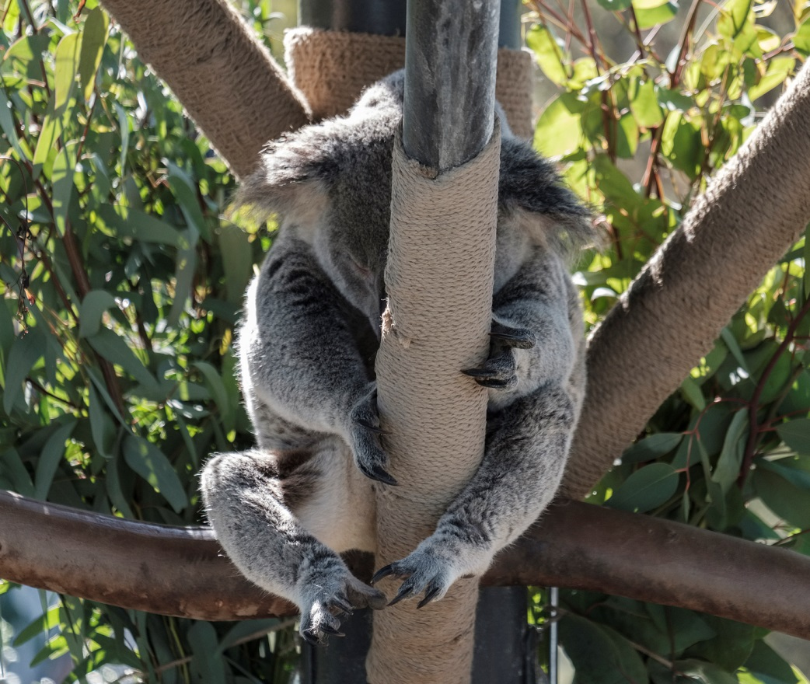
Done.
Questions?

