Slide 1


VA Luncheon
National AALAS - Charlotte
Dr. Michael Fallon
Dr. Alice Huang
Dr. M A McCrackin
Dr. Joan Richerson

Slide 2
Office of CVMO
Core Function
To help the field manage research
that involves animals,
With minimal
hassle and aggravation,
while ensuring compliance with ethical and regulatory requirements

Slide 3
Guidance
To enhance
the effectiveness and efficiency
of the IACUC
in carrying out
its responsibilities

Slide 4

CVMO Update
Interaction with ORO Research Safety and Animal Welfare team- CVMO’s office is working to make sure ORD and ORO are in agreement on animal research topics.
AAALAC Contract- new contract covering accreditation costs of all VA animal research programs will be in place after first of year. No real changes.
Handbook 1200.07, “Use of Animals in Research”: work has begun on new version- goal is less text, and more complete reliance on PHS Policy and USDA AWAR. A guidance document will contain more detailed information.

Slide 5
Semiannual Evaluation Process
Alice Huang, PhD, CPIA
Deputy, IACUC Guidance

Slide 6
Why Bother?
Regulatory requirement

Slide 7
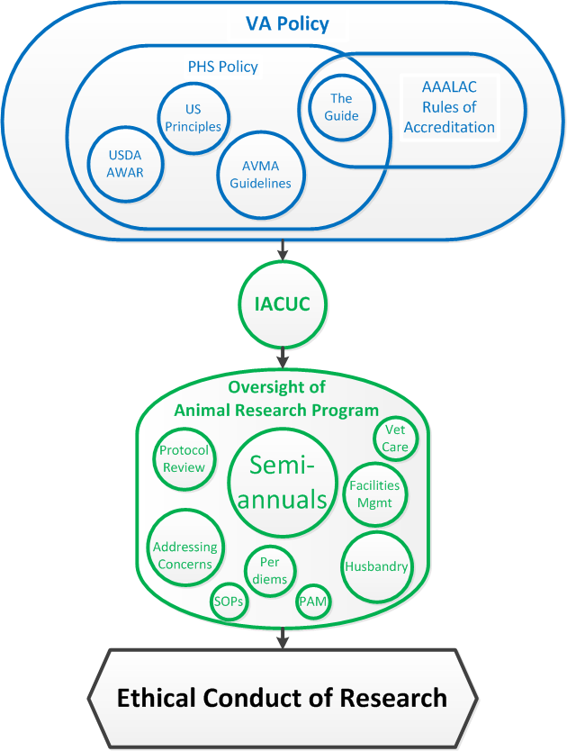

Slide 8
Why Bother?
Regulatory requirement
A useful tool for making sure that ethical requirements continue to be met as things change over time

Slide 9
Evaluation Teams
≥ 2 IACUC members
“Fresh eyes”
Non-member guests

Slide 10
Semiannual Report Forms
Part 1 – Checklists
  Section A – what is intended
  Section B – what is happening
Part 2 – Table of Deficiencies
    and Departures
Part 3 – Post-Review
    Documentation

Slide 11
Working Through the Checklists
Checklist items are prompts
Note anything that may be of concern
Check on items that were incomplete on the last report
“Significant” = “in the judgment of the IACUC and the IO, is or may be a threat to the health or the safety of the animals” (USDA)
“Minor” = anything else
“Minor” ≠ “Unimportant”

Slide 12
What to Do with Deficiencies
Analyze root causes
Decide on appropriate corrective actions
Perfectly okay to correct in stages
  Immediate – to address “significant” deficiency
  Short-term – longer lasting
  Long-term – to prevent recurrence

Slide 13
Documentation
Part 1 and Part 2 to make follow up easy
Part 3 puts findings into perspective
Minority opinions – any submitted have to be included
Report is final when signed by majority of members
Discuss with Director, Director’s signature required

Slide 14

Semiannual Evaluation Process – Specifics
Joan T Richerson, DVM, CPIA
Assistant CVMO

Slide 15
Why do it?
. Because it is always better to find your own problems and correct them than to have an outside party find them for you!
But sometimes IACUCs get off on the wrong path.

Slide 16
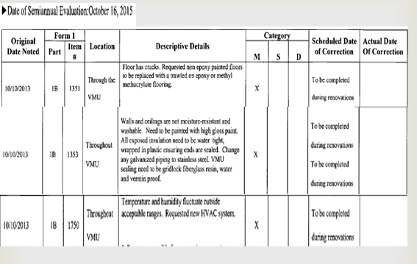
Semiannual gone awry

Slide 17
Missed opportunity
Provide a summary overview of the programmatic and facility deficiencies :
“There are several minor deficiencies at the ______VMU. These deficiencies are scheduled to be corrected during the renovation of the VMU.”

Slide 18
What’s wrong with this picture?
No specific dates of correction.
No specific plan of correction.
Citing items that are not actual deficiencies (i.e. replace a galvanized piping with stainless steel).
Summary of the programmatic and facilities deficiencies does not give a realistic overview of the state of the program and facilities.

Slide 19

Top 5 findings by Dr. MA McCrackin
#5 No dates of completion for items requiring dates (e.g., regulatory annual reports, most recent overheat test, most recent SOP review) are left blank.
#4 Incomplete list of IACUC members on the signature page incomplete or the role of a member varies within the report. Most serious is confusion about whether IACUC members are qualified to hold the roles of NSM and NAM.

Slide 20
Top 5 findings continued
#3 Summary of the state of program and facilities provided to Director (IO) is missing or lacks detail.
#2 Lingering deficiencies do not have clear completion dates or the deficiency resurfaces at later date without explaining if it was resolved the first time.

Slide 21

Top 5 findings continued
Ambiguity in deficiency descriptions, corrective plan, and date of completion.

Slide 22
Remember!
If a deficiency is cited make sure it really is a deficiency and clearly describe it.
Corrective plan of action – be specific! It’s OK to have an interim corrective action while working toward a long time solution.
Do not blindly make up proposed completion dates. Consult and involve other institutional departments in determining realistic timetables for date(s) of correction.

Slide 23


