Slide 1
Make any IACUC More Effective:
A VA Perspective
Workshop A3
1 April 2016
Notes:
Connect in 30 minutes prior to webinar.
Dial in info: 888.632.5060; PIN: 80951254
URL: http://fsevent.peachnewmedia.com/control/event.php?role=presenter&topic=72310
To refresh for presentation issues: press F5.
Goal: present at least 60 minutes
Moderator: Marley Thrasher

Slide 2
Who We Are
Office of the Chief Veterinary Medical Officer
Office of Research and Development
Department of Veterans Affairs
Alice Huang, PhD, CPIA
Staff Scientist and Deputy for IACUC Guidance
MA McCrackin, DVM, PhD, DACVS, DACLAM, CMAR
Special Consultant on Regulatory Affairs
Joan T Richerson, MS, DVM, MS, DACLAM, CPIA
Assistant Chief Veterinary Medical Officer

Slide 3
Disclosure of Conflicts of Interest
Alice Huang, MA McCrackin, and Joan Richerson
have no relevant personal/professional/financial relationship(s) with respect to this educational activity

Slide 4
Learning Objectives
Addressing and documenting deficiencies
Managing potential Guide deviations
Recent hot button issues in AAALAC site visits
VA updates (brief)

Slide 5
What Do We Do with Deficiencies That We Find?
Alice Huang, PhD, CPIA
Notes:
Connect in 30 minutes prior to webinar.
Dial in info: 888.632.5060; PIN: 80951254
URL: http://fsevent.peachnewmedia.com/control/event.php?role=presenter&topic=72310
To refresh for presentation issues: press F5.
Goal: present at least 60 minutes
Moderator: Marley Thrasher

Slide 6
The Regulatory Requirement
Nearly identical wording in USDA AWAR and PHS Policy
  Identify departures from AWAR, PHS Policy, and the Guide (departures ≠ “departures”)
  State the reasons for the departures
  “minor” vs. “significant”
  Reasonable and specific plan and schedule for correction

Slide 7
What’s the Point?
A tool for improvement
NOT
  Forced confession
  Busy work

Slide 8
Consider …
A member of the semiannual inspection team enters a post-op recovery room and sees a pile of bloody surgical towels on the floor, and a puddle of clear liquid nearby.
There are no research personnel present
What should the inspection team do?

Slide 9
VA Forms for Semiannual Reports
Available online
http://www.research.va.gov/programs/
animal_research/documents.cfm
Forms for Semiannual Evaluations of the Institutional Care and Use Program and Facilities
www.primr.org/IACUC16
The PRIM&R IACUC16 Conference Portal

Slide 10
Part 1 Checklist
Section B Inspection of the Facilities
Item 1822 “Primary enclosures …, animal holding rooms, support spaces, etc. are cleaned and disinfected on a regular schedule consistent with the use of the area and nature of contamination”
Item 1351 “Floor surfaces are … clean and sanitized”

Slide 11
Part 2
Table of Deficiencies and Departures
Original Date Noted | Form 1 |  | Location | Descriptive Details | Category |  |  | Scheduled Date of Correction | Actual Date Of Correction
 | Part | Item # |  |  | M | S | D
 |  |  |  | ►Person responsible for overseeing correction:
 |  |  |  | ►Person responsible for overseeing correction:

Slide 12
Descriptive Details
Deficiency: “bloody towels and puddle on floor”
Corrective action: “towels removed, puddle wiped up”
But note instructions: “include sufficient detail … to recognize when it has been corrected, a description of any underlying programmatic or systemic conditions that may have led to the deficiency, and a description of the plans for correcting the deficiency and for addressing underlying factors so as to prevent recurrence”

Slide 13
Look for a cure, don’t just treat the symptoms
Identify specific factors that led to the deficiency
Focus on the factors that the institution can do something about
Find these by considering the bigger picture – what is the context of the deficiency?

Slide 14
What if …
Another member of the inspection team had entered the room a moment earlier and witnessed a member of a research team leaving the room with a post-op animal and its water bowl, to return the animal to its home cage?

Slide 15
What if …
The room was dark when the door was opened, and the calendar in the room showed that the last scheduled use of the room was a week ago?

Slide 16
In all depends on context …
Whether the observation reflects a deficiency
The significance of the deficiency
The appropriate corrective action
The appropriate timeline for correction

Slide 17
Next up …
Documenting potential “departures” from the Guide
Joan T Richerson, MS, DVM, MS, DACLAM, CPIA

Slide 18

Protocol challenges – What should the IACUC do?
The following presentation has been reviewed for consistency with PHS Policy by OLAW
JT Richerson, DVM

Slide 19
Protocol challenges – What should the IACUC do?
IACUC Issue:
The Hometown VA - IACUC is struggling with a Guide “should” statement regarding surgical site preparation for nonsurvival surgeries. On page 118, the Guide states
“It may not be necessary to follow all the techniques outlined in this section if nonsurvival surgery is performed but, at a minimum, the surgical site should be clipped, the surgeon should wear gloves, and the instruments and surrounding area should be clean (Slattum et al. 1991).”
Notes:
Mina
Thanks for joining us today.
The objectives we plan to address in today’s webinar include:
-Sharing information about challenges in putting together an educational program for IRB members
-Sharing some methods for providing IRB member education, spanning from initial training to ongoing
-Discuss education opportunities for smaller institutions and/or those with limited internal resources
-Share methodologies for evaluating education programs.

Slide 20
IACUC Issue continued…
A few members of the IACUC are advocating for a policy that would not require hair/fur clipping for acute terminal procedures. The IACUC Chair asked how will we justify not clipping the surgical site when the Guide clearly states it is required for nonsurvival surgery.

Slide 21
Consideration # 1
Could the IACUC justify approving a deviation from a “should” statement in the Guide (i.e. an approved departure) to allow nonsurvival surgery to be performed without clipping the surgical site?
Note: A performance standard has not been established by the IACUC.

Slide 22
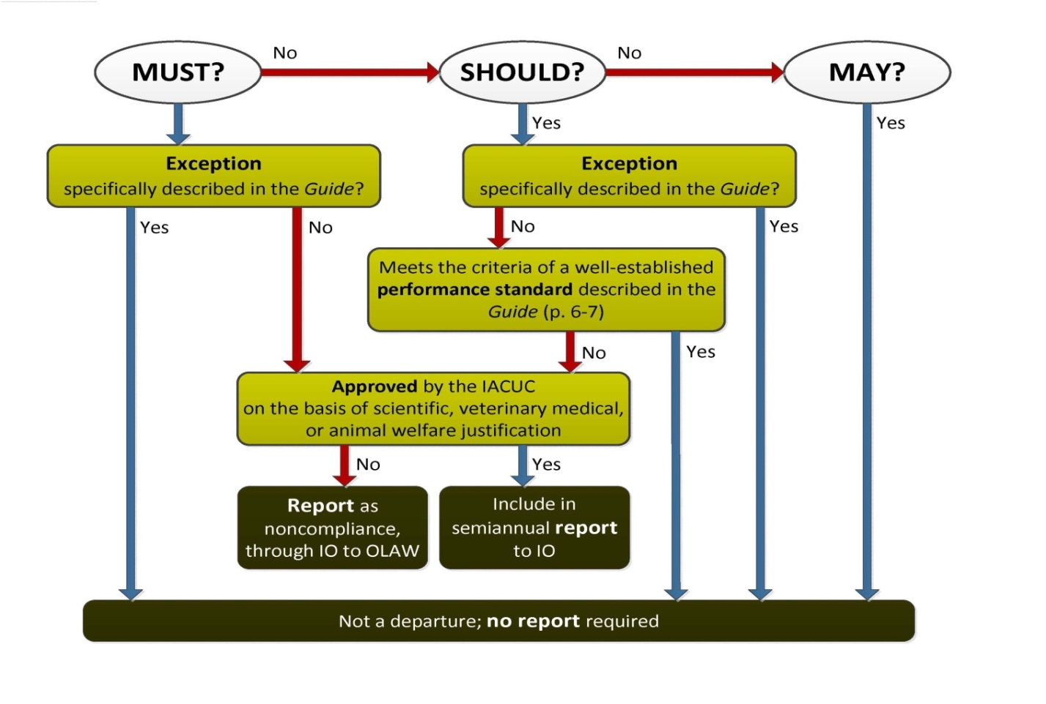


Consideration #1
Doesn’t meet this criteria.

Slide 23
Consideration #1
Conclusion: The IACUC cannot support an approved departure for not clipping the surgical site when a non-survival surgery is performed because of a lack of justification on a scientific, veterinary medical or animal welfare basis.

Slide 24
Consideration #2
“Should” statements in the Guide often involve performance standards.
Should the IACUC investigate the applicability of a performance standard in relation to nonsurvival surgery and not clipping the surgery site?

Slide 25

Consideration #2
If a performance standard can be established.

Slide 26
Well-Established Performance Standards
Meet the following criteria:
supports scientific objectives;
supports the health and welfare of the animal;
includes a justified performance index; and
has associated outcome criteria.

Slide 27
Development of a Performance Standard
The objective is to determine if there is a difference in outcome between clipping the surgical site versus not clipping the surgical site for nonsurvival surgery when examined under prescribed conditions.
a) Collection of liver samples from anesthetized rabbits; liver samples are used to prepare hepatocyte cultures.
b) Samples are collected in 5 minutes or less from the anesthetized rabbit.

Slide 28
Development of a Performance Standard continued…
c) Samples are collected in the identical manner except in experimental group A the fur is clipped and in experimental group B the fur is not clipped.
d) Anesthesia protocol and the monitoring procedures are appropriate for the species.
e) Performance indices may include number of viable hepatocytes recovered, bacteria or fungal contamination, and other applicable criteria deemed appropriate.

Slide 29
Development of a Performance Standard continued…
Negligible, if any differences were detected in the hepatocyte cultures prepared from animals in experimental group A (clipped surgical site) versus experimental group B (unclipped surgical site). The performance outcome was essentially the same.

Slide 30
Consideration #2
Conclusion: In this case, the IACUC could approve a deviation from a “should” statement (nonsurvival surgery for tissue sample collection without fur clipping) because it follows a well-established performance standard, which is not a departure from the Guide, and has no reporting requirements.

Slide 31
Take home point:
Performance standards may be described in:
a Standard Operating Procedure
or
a protocol depending on the circumstances.

Slide 32
Next up …
AAALAC Site Visits – Perspectives of an Ad hoc Member of Site Visit Teams
MA McCrackin
  DVM, PhD, DACVS, DACLAM, CMAR

Slide 33

AAALAC Site Visits:
HOT BUTTON ISSUES
MA McCrackin
DVM, PhD, DACVS, DACLAM, CMAR
Notes:
Connect in 30 minutes prior to webinar.
Dial in info: 888.632.5060; PIN: 80951254
URL: http://fsevent.peachnewmedia.com/control/event.php?role=presenter&topic=72310
To refresh for presentation issues: press F5.
Goal: present at least 60 minutes
Moderator: Marley Thrasher

Slide 34
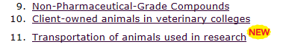
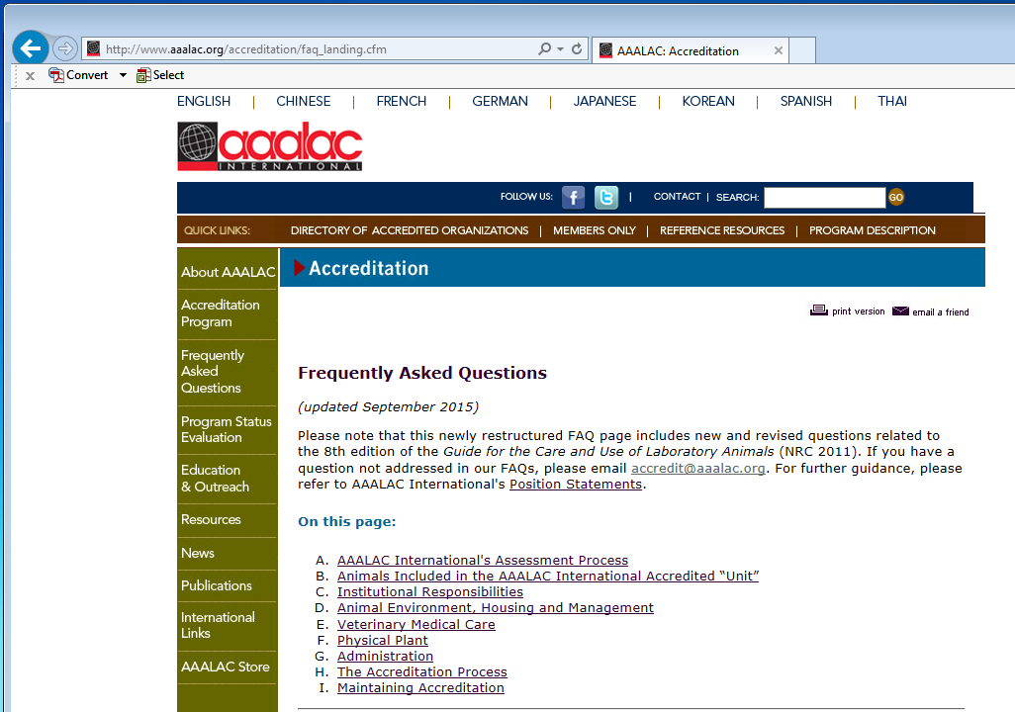
Identification of Hot Buttons
AAALAC FAQ web page
  Items marked
  All others
Networking
Listserv
Hard knocks (aka, experience)
AAALAC ad hoc
  NEW

Slide 35
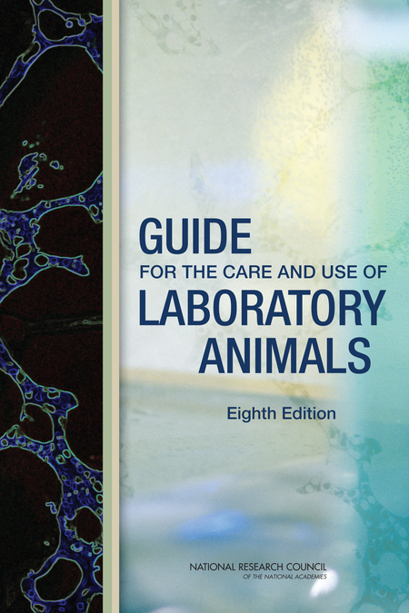
Ad hoc Experience
Council members lead visit
Ad hocs participate
Learn current trends by observation, discussion, osmosis
Opinions today are mine – not AAALAC’s
Many findings can be traced back to the Guide
Credit:http://images.nap.edu/images/cover.php?id=12910&type=covers450

Slide 36

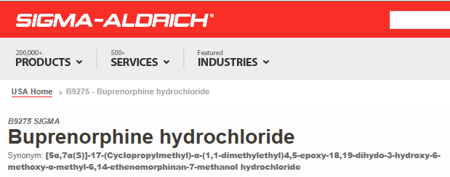
Animal Care and Use Program
Biological and chemical hazard signage
  Post only while hazard present unless local regulations require other
Constitution of IACUC
  Non-scientific (NSM) & Non-affiliated (NAM) members must be qualified
Credit:http://d35gqh05wwjv5k.cloudfront.net/media/catalog/product/B/i/Biohazard-Signs-&-Labels-FA3-002-lg.png
Pharmaceutical grade drugs
  Chemical grade compounds– only with IACUC approval
Credit:http://www.sigmaaldrich.com/catalog/product/sigma/b9275?lang=en&region=US

Slide 37
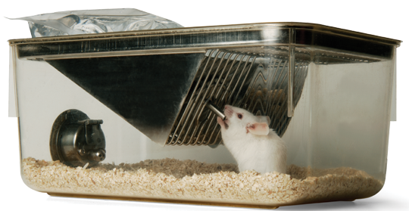

Environment, Housing & Management
Social housing
  Default
  Single housing only with IACUC approval or veterinary directive
  Includes sentinels
Normal postural movements
  Microenvironment must allow
  Terrestrial & aquatic
Credit: http://www.edstrom.com/assets/1/7/MouseUsingSipperSackTP15_Path.png
Credit:http://www.techagesite.com/despicable-me/despicable-me-2-minions-desktop-wallpaper-hd-1920x1080-crowd.jpg

Slide 38
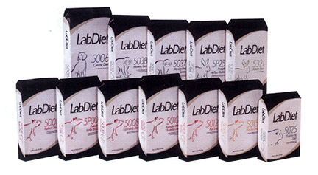

Environment, Housing & Management
Food storage temps
  Natural ingredient diets
  Chemically defined diets
Deviations from the Guide
  Need performance data generated locally
  Example: caging accessory frequency of sanitation
  Guide: should sanitize every 2 weeks – less frequent may be approved by IACUC if performance standards are established & met
< 70ºF
Credit:http://www.labdiet.com/cs/groups/lolweb/documents/web_content/mdrf/mdyw/~edisp/ducm04_060205.jpg
< 39ºF
Credit:http://www.testdiet.com/cs/groups/public/@testdiet/documents/web_content/mdrf/mdu2/~edisp/ducm04_056801.jpg

Slide 39
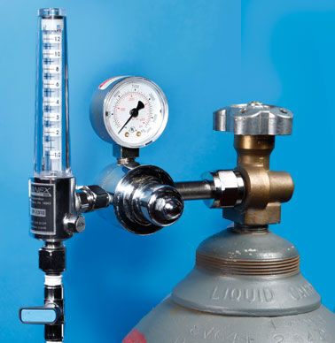
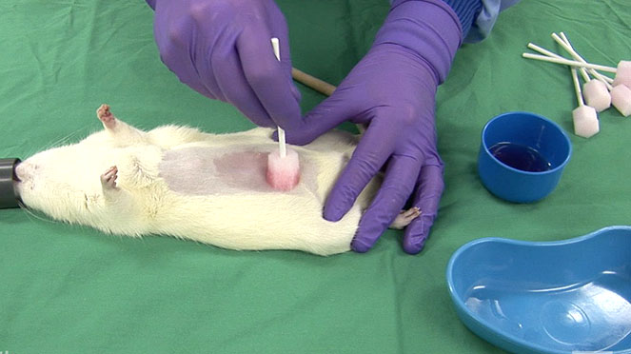
Veterinary Care
CO₂ rodent euthanasia
  Pressurized tank
  Flow meter
  Home cage, if possible
PI laboratories: rodent survival surgery
  Aseptic technique
  Autoclaved instruments
  Instruments sterilized between animals (e.g., glass beads)
Credit: http://www.euthanex.com/smartbox/images/EP-PS50_0.jpg
Credit: http://www.procedureswithcare.org.uk/as2.jpg

Slide 40
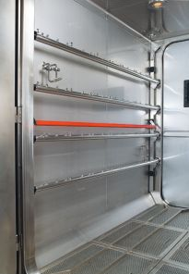
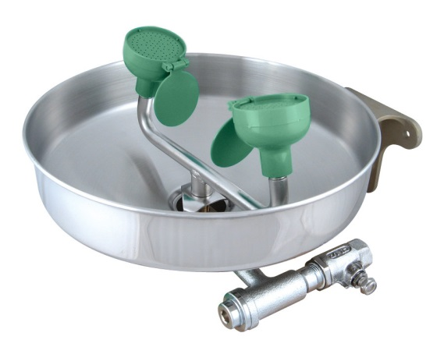
Physical Plant
HVAC
Safe egress / training
  Cage and rack washers
  Walk-in bulk autoclaves
  SIGNAGE
    Inside AND outside units
Eyewash stations
  Ease of access
  Near hazard(s)
Credit:http://tse1.mm.bing.net/th?&id=OIP.M71b6adeb8c293aef84f2d4b3e042526eo0&w=161&h=217&c=0&pid=1.9&rs=0&p=0
Credit:http://tse1.mm.bing.net/th?&id=OIP.M59faa93bce433cd7fc0e2d831efde846o0&w=300&h=300&c=0&pid=1.9&rs=0&p=0

Slide 41
Next up …
A few VA updates
Alice Huang
  PhD, CPIA

Slide 42
VA Updates
Renewal interval for Animal Research training is now THREE years.
Records Control Schedule for VA ORD released, effective 7/10/15 (DAA-0015-2015-0004) -- Many locally specific details require consultation with local VHA Records Manager
  identification of which records must be retained,
  proper procedures for storage and destruction
Notes:
Mina
Thanks for joining us today.
The objectives we plan to address in today’s webinar include:
-Sharing information about challenges in putting together an educational program for IRB members
-Sharing some methods for providing IRB member education, spanning from initial training to ongoing
-Discuss education opportunities for smaller institutions and/or those with limited internal resources
-Share methodologies for evaluating education programs.

Slide 43
Generally, Requirements for Records Retention
  Most to be held for 3-6 years after they are no longer in effect
Copies (labeled as such) do not have to be retained
Paper records may be digitalized and retained in digitized form

Slide 44
Questions?

Slide 45
Thank you!

