Slide 1
A15: Current Animal Research Topics
Doing Right by the Animals to Serve Veterans
Michael Fallon, DVM, PhD, DACLAM CPIA
Susan Harper, DVM, MS, DACLAM, DACVPM
Alice Huang, Ph.D, CPIA
Joan Richerson, MS, DVM, MS, DACLAM, CPIA

Slide 2
PRIM&R’s Principles and Expectations for Participation in Conferences
The objective of PRIM&R’s conferences is to provide a safe and respectful environment for attendees to increase their knowledge and understanding of ethical and regulatory requirements, learn best practices, grapple with both late-breaking and longstanding challenges, and confer with peers and experts in the research ethics field in a constructive way.
To that end, PRIM&R will not tolerate the disruptions that result in:
The inability for learning objectives of sessions to be met;
The inability for dialogue, discussion, debate, learning, and/or networking to take place;
Harassment, badgering, or verbal threats;
The use or threat of physical force by any individual or group of individuals against another; and/or
Destruction of property.
In the interest of promoting learning for all participants, please keep questions and comments brief and on-point to the session topic, identify yourself when you ask your question, and be mindful of others who wish to participate in the discussion.
For more information on this policy, please visit www.primr.org/principles.

Slide 3
Topics for Today's Session
VA Office of Research and Development Update
  Ordering Feed/Bedding
  Missed USDA Annual Reviews
IACUC Review by VVC
Guide Deviations and Departures
VA Office of Research Oversight Update
Q&A / Discussion

Slide 4
National Contracting Documents Available- Feed and Bedding
Instructions on how to most efficiently order common feed and bedding products are available on the ORD animal research web page for the following vendors:
- Harlan/Teklad - NEPCO
- Purina - PJ Murphy
- Bio-Serve - Biofresh
- The Andersons - Ancare

Slide 5
USDA Annual Reviews
USDA AWAR, § 2.31 - Institutional Animal Care and Use Committee (IACUC), item (d)(5):
"The IACUC shall conduct continuing reviews of activities covered by this subchapter at appropriate intervals as determined by the IACUC, but not less than annually;"

Slide 6
Assumptions
If an annual review for a regulated species is not approved within 365 days of initial approval of the last annual review approval:
All work on the protocol must stop until the IACUC approves the annual review (no non-compliance ocurred)
If work continues, the IACUC must report to VA that unapproved work was conducted and report to USDA that work had to be suspended (non-compliance incurred; reporting to USDA and any Federal agency funding the work per USDA AWAR 2.31(d)(7))

Slide 7
Previous Assumption | Clarification
Failure of the IACUC to complete an annual review means that IACUC approval of the protocol has lapsed, and work must stop on the protocol. | Failure of the IACUC to complete an annual review does NOT mean approval of the protocol has lapsed, and work may continue.
If investigator continues work, IACUC must suspend and report to ORO, ORD, and USDA | If investigator continues work, USDA does not consider that to be a reportable matter. Due to VA Handbook 1058.01, must still report to ORO
The IACUC must "approve" annual reports. | The IACUC must "review" annual reports per 2.31(d)(7).
If the IACUC fails to compete the continuing review in time (recently interpreted by USDA to mean by the end of the month in which the anniversary date falls), it might have to be reported because the protocol would be suspended. | Failure to complete the annual continuing review on time is failure to comply with AWAR, but it is not reportable to USDA, and no suspension is needed (a VMO could cite it during a visit, but such visits are rare for VA).
-Changes to a protocol incorporated into the annual review form must be approved by the IACUC before being implemented. -Late PHS trienniel reviews are reportable | No change.

Slide 8
USDA Annual Reviews
Contact: Dr. Nicolette Petervery
Regional Animal Care Specialist
USDA APHIS Animal Care Eastern Region
Moving forward: if all VA stakeholders clear, guidance will be released

Slide 9
VVC
What is VVC?
and
When Does It Come into Play?

Slide 10
What is VVC?
Veterinary Verification & Consultation
For changes in an IACUC-approved protocol
IACUC-approved policy must be in place for the change requested
Veterinarian determines whether IACUC-approved policy is applicable

Slide 11
IACUC-Approved Policies
May be in the form of
  Guidance documents
  Standard Operating Procedures (SOPs)
  Drug formularies
Must be reviewed for accuracy and appropriateness, and re-approved by IACUC at least every 3 years, to stay in effect

Slide 12
What Does the Veterinarian Do with the Policy?
Review the change proposed
Evaluate whether the proposed change is covered by an IACUC-approved policy
Make a professional judgment as to whether it is appropriate to apply the policy in this specific case

Slide 13
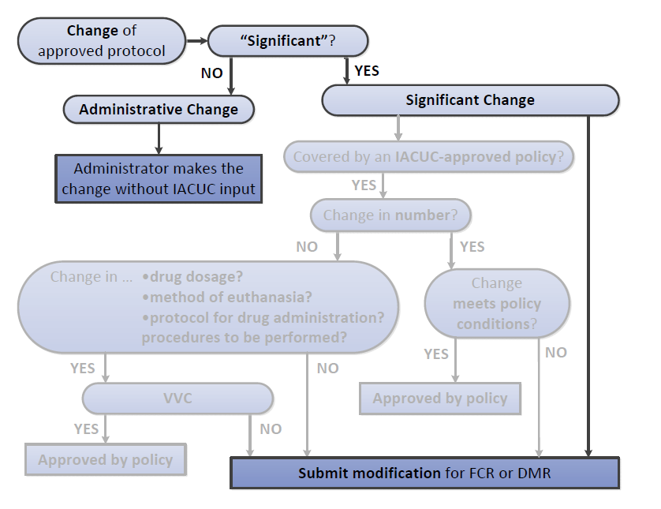
Notes:
In the past, changes in approved protocols were handled by one of two mechanisms
If “significant” – submit modification for FCR or DMR
If not significant – administrative change
Now, new guidance from OLAW allows another mechanism (middle section of flow chart)

Slide 14
When Does VVC Come Into Play?
A Familiar Scenario …
Work is proceeding according to protocol
Something unexpected happens
The investigator needs to respond by doing something different from what is in protocol
How should this be handled?

Slide 15
A Specific Example …
Dr. Zauberfinger, the PI
Dr. Tierartzt, the veterinarian
The IACUC
Notes:
Read the story

Slide 16
Question 1
Is it compliant with regulatory requirements if Dr. Zauberfinger switches to isoflurane anesthesia for this animal, when his IACUC-approved protocol makes no mention of isoflurane?

Slide 17
It is the veterinarian’s responsibility “to oversee the well-being and clinical care … and promoting animal well-being at all times” (Guide, p. 105)
The change to isoflurane …
Is for the well-being of the animal
According to the professional judgment of the veterinarian
So, no IACUC approval is required

Slide 18
Question 2
What if Dr. Zauberfinger wants to switch to isoflurane routinely, without having to ask the veterinarian, if any animal on the protocol turns out to need more than 2 anesthetic supplements?
Notes:
Veterinarian might not be available to ask next time

Slide 19
Change in Approved Protocol
(familiar mechanisms)
Significant Changes
generally will have, or have the potential to have, negative impacts on animal welfare or personnel safety
Procedures
Locations
Species
Objectives
PI
Increased numbers
(require IACUC approval)
Other Changes
are mainly related to documentation or
project management
Corrections of typos/grammar
Updates of contact information
Personnel other than PI
(do not require IACUC approval)

Slide 20
Change in Approved Protocol
Significant Changes
generally will have, or have the potential to have, negative impacts on animal welfare or personnel safety
Procedures (including changes in anesthesia)
Locations
Species
Objectives
PI
Increased numbers
(require IACUC approval)
Other Changes
are mainly related to documentation or
project management
Corrections of typos/grammar
Updates of contact information
Personnel other than PI
(do not require IACUC approval)

Slide 21
Question 3
What if the IACUC determines that it is generally acceptable for protocols that involve ketamine/xylazine anesthesia to be modified to allow switching to isoflurane after two supplementary doses of the injectable anesthetic?

Slide 22
Significant Changes
Require IACUC Approval
Familiar
DMR or FCR required
Amendment must be submitted for IACUC review
Nonsurvival→Survival surgery
↑ pain, distress, invasiveness
Move to housing not already under IACUC oversight
Δ species
Δ study objectives
Δ PI
*NEW*
Eligible for VVC
Only if DMR/FCR is not specifically required, and if IACUC-approved policy is in place
Δ anesthesia, analgesia, sedation, or experimental substances
Δ euthanasia to method approved by AVMA
Δ duration, frequency, type, or number of procedures

Slide 23
Significant Changes
Require IACUC Approval
DMR or FCR required
Amendment must be submitted for review
Nonsurvival→Survival surgery
↑ pain, distress, invasiveness
Move to housing not already under IACUC oversight
Δ species
Δ study objectives
Δ PI
Eligible for VVC
Only if DMR/FCR is not specifically required, and if IACUC-approved policy is in place
Δ anesthesia, analgesia, sedation, or experimental substances
Δ euthanasia to method approved by AVMA
Δ duration, frequency, type, or number of procedures

Slide 24
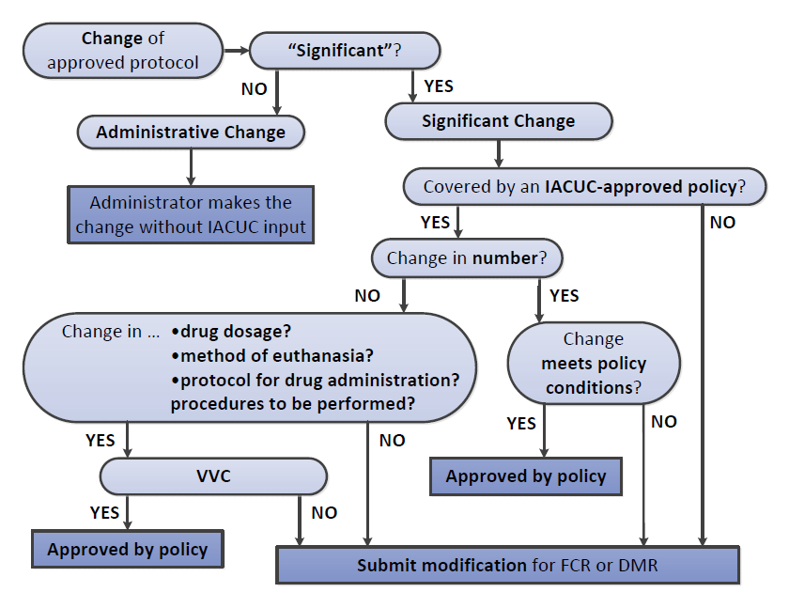

Slide 25
Keep in mind …
It’s up to the IACUC to decide what policies to establish – draft with care
“Veterinarian” may be any veterinarian acceptable to the IACUC – is not performing DMR
Approval is granted by the IACUC, in approving the policy (not by the veterinarian)
Veterinarian may decide not to apply the policy
All changes in an approved protocol must be documented

Slide 26

Guide Deviations & Departures
Still Confused?
Presented
By
Joan Richerson, MS, DVM, MS, DACLAM, CPIA
Assistant CVMO
This presentation has been reviewed by OLAW and found to be consistent with PHS Policy .

Slide 27
Proposed Research Study
Dr. Sarah Bennett has developed a new experimental drug (BPL-23) that appears to be effective in lowering blood pressure and seems to have fewer side effects than other drugs in use. She will be testing BPL-23 in a transgenic line of mice that she has developed over the last five years; her meticulous records show that trio-breeding has resulted in a higher conception rate and higher pup survival.

Slide 28
Continued…
Once the mice are weaned, hypertension is induced by feeding a high salt diet and adding a hypertensive compound (pharmaceutical grade) in their drinking water. The mice will also have a radiotelemetry device implanted to record blood pressure and will be individually housed until their surgical incisions heal. Before and after BPL-23 administration, mice are housed singly in metabolic cages with wire mesh floors for the collection of 24 hour urine samples to assess urine volume, Na excretion, and K excretion over 5 days.

Slide 29
IACUC Concerns
1. Non-pharmaceutical grade drug
2. Trio-breeding
3. Metabolic cages with wire mesh floors
4. Compound in drinking water to induce hypertension
5. Single housing post-surgery and for 24 hour urine collection for 5 days

Slide 30
Investigator questions
Dr. Bennett has asked you to look over her protocol before she submits it to the IACUC office. She remembers that you have previously told her that the use of non-pharmaceutical agents (IACUC concern 1) and trio breeding (IACUC concern 2) are specifically established exceptions to the Guide. Dr. Bennett explains the rationale behind each deviation using the VA flowchart.

Slide 31
1. Non-pharmaceutical grade drug
Pg. 31- “The use of non-pharmaceutical -grade chemicals or substances should be described and justified in the animal use protocol and be approved by the IACUC…; for example the use of a non-pharmaceutical-grade chemical or substance may be necessary to meet the scientific goals of a project or when a veterinary of human pharmaceutical-grade product is unavailable.”
Specifically established Guide exception based on scientific justification that has been reviewed and approved by the IACUC; has no reporting requirements.

Slide 32
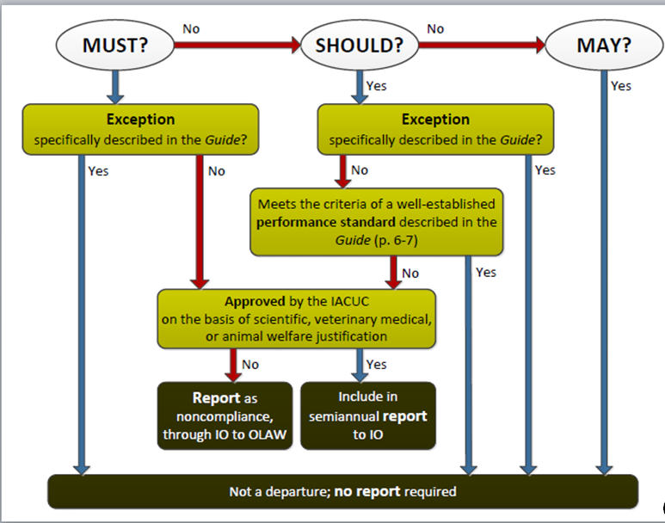




1. Non-pharmaceutical grade drug
$$√$$
$$√$$
$$√$$

Slide 33
2. Trio breeding
Pg. 56 – “The space recommendations presented here are based on professional judgment and experience. Adjustments to the amount and arrangement of space recommended in the following tables should be review and approved by the IACUC and should be based on performance indices related to animal well-being and research quality…”
Specifically established Guide exception based on a performance standard and has no reporting requirements.

Slide 34


2. Trio breeding

Slide 35
IACUC Concerns 3.-5.
Dr. Bennett is not so confident about how to categorize concerns 3.-5; she thinks they may be approved departures. Her confusion comes from some of the statements in the Guide; she shows you these statements and asks for your help:
3. Metabolic cages with wire mesh floors
4. Compound in drinking water to induce hypertension
5. Single housing post-surgery and for 24 hour urine collection for 5 days.

Slide 36
Guide excerpts Related to
3. Metabolic cages with wire mesh
Pg. 51 – “Flooring should be solid, perforated, or slatted with a slip-resistant surface. If wire-mesh flooring is used, a solid resting area may be beneficial, as this floor type can induce foot lesions in rodents and rabbits (Drescher 1993; Fullerton and Gilliatt 1967: Rommers and Meijerhof 1996).”
Pg. 52 – “Animals should have adequate bedding substrate and/or structures for resting and sleeping…Moreover, it absorbs urine and feces to facilitate cleaning and sanitation.”

Slide 37
3. Metabolic cages w/ wire mesh
Pg. 51 – “Flooring should be solid, perforated, or slatted with a slip-resistant surface. If wire-mesh flooring is used, a solid resting area may be beneficial, as this floor type can induce foot lesions in rodents and rabbits.”
Not really applicable, but flooring will be slip resistant and there is an optional “may” statement.
Pg. 52 – “Animals should have adequate bedding substrate and/or structures for resting and sleeping…Moreover, it absorbs urine and feces to facilitate cleaning and sanitation.”
Based upon general scientific justification …no deviation.

Slide 38
Guide excerpts related to
3. Metabolic cages w/ wire mesh…continued
Pg. 121 [Distress] “For example, an injection requiring brief immobilization may produce acute stress lasting only seconds, while long-term individual housing of a social species in a metabolic cage may produce chronic distress.”
Not applicable because the mice are only held in metabolic cages for 5 days.

Slide 39


3. Metabolic cages with wire mesh
$$√$$
$$√$$

Slide 40
Guide excerpts related to
4. Compound in drinking water to induce hypertension
Pg. 25 – “The following topics should be considered in the preparation of the protocol by the researcher and its review by the IACUC:
nonstandard housing and husbandry requirements.”
Pg. 67 – “Animals should have access to potable, uncontaminated drinking water according to their particular requirements.”

Slide 41
4. Compound in drinking water to induce hypertension
Pg. 25 – “The following topics should be considered in the preparation of the protocol by the researcher and its review by the IACUC:
nonstandard housing and husbandry requirements.”
The investigator and IACUC will consider those topics…no deviation.
Pg. 67 – “Animals should have access to potable, uncontaminated drinking water according to their particular requirements.”
The animals will have access to potable water per their (IACUC-approved) requirements…no deviation.

Slide 42
4. Compound in drinking water to induce hypertension
No deviation from the Guide

Slide 43
5. Single housing post-surgery and for 24 hour urine collection
All excerpts (Pg. 51, 60, and 64) are applicable but Pg. 60 is probably the most applicable. “If necessary to house animals singly – for example, when justified for experimental purposes,…this arrangement should be for the shortest duration possible.”
Specifically established Guide exception based on scientific justification that has been reviewed and approved by the IACUC; has no reporting requirements.

Slide 44
Guide excerpts related to
5. Single housing post-surgery and for 24 hour urine collection
Pg. 51 – “Social animals should be housed in stable pairs or groups of compatible individuals unless they must be housed alone for experimental reasons or because of social incompatibility.”
Pg. 60 – “If necessary to house animals singly – for example, when justified for experimental purposes, for provision of veterinary care, or for incompatible animals – this arrangement should be for the shortest duration possible.”

Slide 45
Guide excerpts related to
5. Single housing post-surgery and for 24 hour urine collection
Pg. 64 – “Appropriate social interactions among members of the same species are essential to normal development and well-being….single housing of social species should be the exception and justified based on experimental requirements or veterinary related concerns about animal well-being.”

Slide 46



5. Single housing post-surgery and 24 hour urine collection
$$√$$
$$√$$
$$√$$

Slide 47
5. Single housing post-surgery and for 24 hour urine collection
All excerpts (Pg. 51, 60, and 64) are applicable but Pg. 60 is probably the most applicable. “If necessary to house animals singly – for example, when justified for experimental purposes,…this arrangement should be for the shortest duration possible.”
Specifically established Guide exception based on scientific justification that has been reviewed and approved by the IACUC; has no reporting requirements.

Slide 48
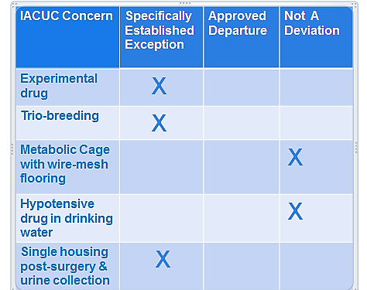
Summary

Slide 49

Outcome
Dr. Bennett submitted her protocol to the IACUC, the IACUC reviewed and approved the protocol, there were no reporting requirements, and everyone was happy!

Slide 50
The moral to this story
The Guide contains a number of should or must that have established exceptions; these are deviations (not departures) and have no reporting requirements.
May statements are not deviations and do not have reporting requirements.
Ask OLAW if you are not sure.

Slide 51
Next….ORO Update

