Slide 1

Getting it just right
Microsoft clipart, the three bears - Bing images
Joan T Richerson, MS, DVM, MS, DACLAM
Assistant Chief Veterinary Medical Officer
10/19/21 – AALAS National Meeting – Kansas City, MO

Slide 2
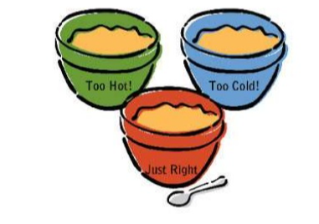
Getting it just right
How is the children’s story of the three bears like an animal use protocol?
Porridge
Animal Use Protocol
Too much and too specific information
Too little and too vague information
Just the right amount of information
Microsoft clipart, the three bears and their porridge - Bing images

Slide 3
Getting it just right
Example 1: Intravenous injection
Mice will be anesthetized. The tail is secured; a needle and syringe are used to inject the experimental drug. Once the mice are awake, they are returned to their home cages.

Slide 4
Getting it just right
Example 2: Intravenous injection
Mice will be anesthetized with isoflurane (2-5%)via nose cone inhalation with a rodent anesthesia machine. Alternatively, injectable ketamine or ketamine in combination with other injectable anesthetics maybe used (see: Appendix 3). Once the mouse ceases movement, assessment of the toe pinch reflex and respiratory rate/depth will ensure adequate anesthesia. The tail will be cleaned using a disinfectant solution (e.g., isopropyl alcohol, betadine, or chlorhexidine). The tail is restrained while occluding one of the two lateral tail veins by applying gentle pressure. A 26-30 G needle will be inserted into the tail vein and the correct location confirmed by a flash of blood in the hub when negative pressure is applied to the syringe. The vein is released, and the experimental drug B139 is injected (see Appendix 3 for dose range). The needle is withdrawn, and gentle pressure is applied until the bleeding has stopped. Mice will be observed to ensure adequate hemostasis, and until the mice are ambulatory.

Slide 5
Getting it just right
Example 3: Intravenous injection
Mice will be anesthetized with 3% isoflurane via nose cone inhalation with a SomnoSuite™ Low-Flow anesthesia machine. Once the mouse ceases movement, assessment of the toe pinch reflex and respiratory rate/depth will ensure adequate anesthesia. The tail will be cleaned using 70% isopropyl alcohol applied with a cotton-tipped applicator. The tail will then be restrained with the ring-finger of the hand holding the mouse; the left lateral tail vein will be occluded by applying gentle pressure. A 1ml syringe with a 27G X1/2” needle will be inserted into the left lateral tail vein and the correct location confirmed by a flash of blood in the hub when negative pressure is applied to the syringe. The vein is then released, and 10 mg/kg of the experimental drug B139 is injected into the vein. The needle is withdrawn, and gentle pressure is applied for 5 minutes using a 2”X2” sterile gauze. Thereafter, mice will be observed every 5 minutes for 20 minutes to ensure recovery from anesthesia.

Slide 6
Getting it just right
Example 3: Intravenous injection – What’s the problem?
Mice will be anesthetized with 3% isoflurane via nose cone inhalation with a SomnoSuite™ Low-Flow anesthesia machine. Once the mouse ceases movement, assessment of the toe pinch reflex and respiratory rate/depth will ensure adequate anesthesia. The tail will be cleaned using 70% isopropyl alcohol applied with a cotton-tipped applicator. The tail will then be restrained with the ring-finger of the hand holding the mice; the left lateral tail vein will be occluded by applying gentle pressure. A 1ml syringe with a 27G X1/2” needle will be inserted into the left lateral tail vein and the correct location confirmed by a flash of blood in the hub when negative pressure is applied to the syringe. The vein is then released, and 10 mg/kg of the experimental drug B139 is injected into the vein. The needle is withdrawn, and gentle pressure is applied for 5 minutes using a 2”X2” sterile gauze. Thereafter, mice will be observed every 5 minutes for 20 minutes to ensure recovery from anesthesia.

Slide 7
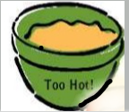
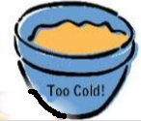

Getting it just right
Being too specific sets an IACUC up for self-made compliance problems, which could have reporting requirements. Don’t paint yourself into a corner!
Being too vague is also not good but has less risk of self-made compliance problems but potentially at the expense of humane care and use.
Being descriptive without being too restrictive provides flexibility with adequate detail to assure humane animal care and use.

Slide 8
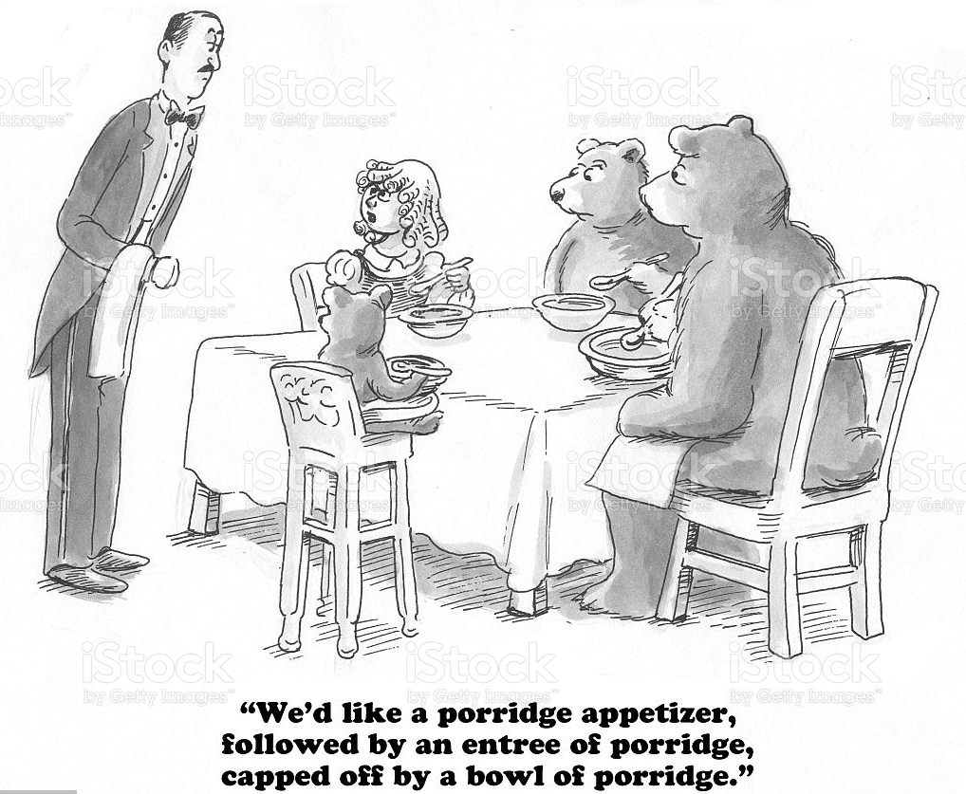
Getting it just right thank you for your kind attention!
porridge-illustration-id543212456 (1024×869) (istockphoto.com)

