Slide 1


VA Luncheon
National AALAS -Denver 10/15/19
Dr. Michael Fallon
Dr. Alice Huang
Dr. Joan Richerson

Slide 2

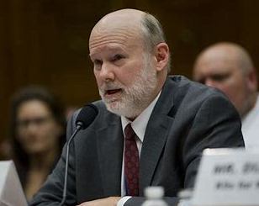
CVMO Update
Michael Fallon, DVM

Slide 3
Which Category?
Joan Richerson, DVM
Assistant CVMO

Slide 4
Which Category?
Dr. Patrick O’Keefe uses guinea pigs to study the relationship between sleep and memory/cognitive function at the Hometown VAMC.
He has scheduled an appointment to meet with Dr. Diaz, the Attending Veterinarian, about his two new ACORPs.
He thinks both protocols involve category C procedures.

Slide 5
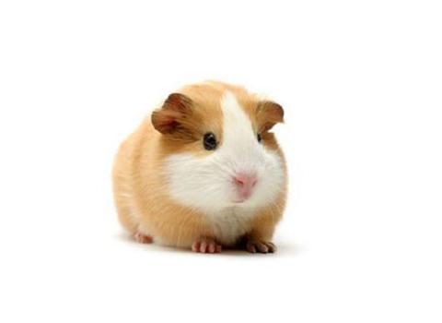
What Category?
ACORP 91-2019
40
female GPs
20 Exp
6 hour SD
NOR & Y-maze testing
before & after
SD
20 control
no SD
NOR & Y-Maze testing
before & after
SD
The sleep deprived(SD)guinea pigs (GPs) will be kept awake for six hours by gentle handling during the light phase.

Slide 6
What Category?
ACORP 92-2019
40
female GPs
20 Exp
SD for 30sec; every 3 hour; for 12hr
NOR & Y-maze testing followed by MRI
before & after
SD
20 control
no SD
NOR & Y-Maze testing followed by MRI
before & after
SD
The SD GPs will be awakened for 30 seconds every 3 hours during the 12 hour light phase by tapping on the side of the cage.

Slide 7
What Category?
Why Category C?
Dr. O’Keefe’s rationale:
NOR and Y-maze testing is not stressful to GPs.
91-2019 – 6 hr. SD is relatively brief, not repeated, and causes no clinical signs of distress. Look like control GPs.
92-2019 - SD GPs can sleep a full 12 hours but with very brief interruption four times during the light phase. Look like control GPs.
GPs have been trained to be calm and still in the MRI. No sedatives or anesthetics will be given.

Slide 8

What Category ?
Maybe C?
Do you agree with Dr. O’Keefe that the GPs used in both of his protocols should be assigned to category C?
What will Dr. Diaz think?
If she doesn’t agree, what is her rationale?

Slide 9
What Category?
ACORP 91-2019
Points to consider regarding the 6 hr. SD GPs protocol:
The corticosterone level of animals that were kept awake with tapping on the cage had levels comparable to control animals but handled animals’ levels were 3X times higher.
Anxiolytic drugs, antidepressants, and NSAIDs - all affect memory and/or cognition. Can’t be given for experimental reasons.
Fits the definition of a Category E procedure.

Slide 10
What Category
ACORP 92-2019
Points to consider regarding the 30 sec. intermittent sleep interruption (4 times in 12 hrs.) protocol:
Sleep deprivation per say did not occur.
Corticosterone levels similar to control animals because cage tapping is used to awaken.
GPs were acclimated to MRI and frequently napped during imaging.
Fits the definition of a category C procedure.

Slide 11
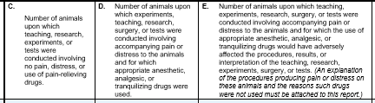
What Category?
How to decide
Closely adhere to text of USDA-AWAR 2.36

Slide 12
Images Acknowledgement
Guinea pig photo - This Photo by Unknown Author is licensed under CC BY-NC-ND
Thinking ? - This Photo by Unknown Author is licensed under CC BY-NC-ND
USDA Annual Report of Research Facility https://www.aphis.usda.gov/library/forms/pdf/APHIS_7023.pdf

Slide 13

Where Can I Find That … and Why Would I Want To?
Alice Huang, PhD
Deputy for IACUC Guidance

Slide 14
The Website
VA’s website on research with animals
www.research.va.gov
►ORD Programs
►Animal Research
Animal Research Home

Slide 15
Other Resources
https://www.research.va.gov/about/history.cfm
OR
www.research.va.gov
►About Us
►Historical Accomplishments
Links to websites of other organizations with resource materials

Slide 16

That’s all & have a Happy Fall
This Photo by Unknown Author is licensed under CC BY-SA

