Slide 1
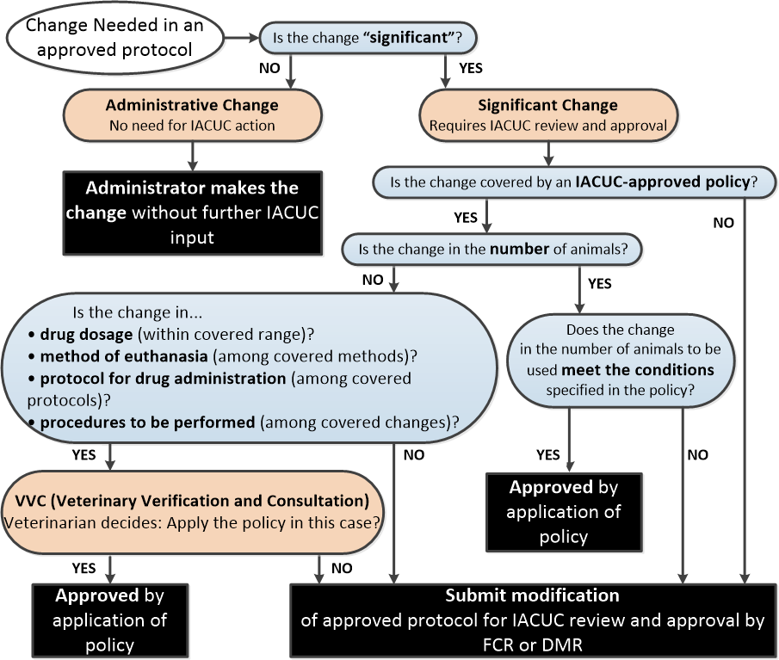
Use of Administrative, VVC, and Other IACUC Review Methods
Prepared by VA Office of the CVMO; reviewed by OLAW for consistency with The PHS Policy (2015).
Notes:
OFFICE OF RESEARCH AND DEVELOPMENT VETERANS HEALTH ADMINISTRATION
Mechanisms for Modifying Approved Protocols
(Flowchart prepared the Office of the CVMO)
Date: March 12, 2015 Guidance Document: AR2015-002

