Slide 1
Moving Targets:
What COVID has Taught Us
Alice Huang, ScB, PhD
Deputy for IACUC Guidance
Office of the CVMO

Slide 2
What Makes the Targets Move?
The research questions change
The procedures change
Veterinary medicine makes advances
Standards of clinical veterinary care change
Cultural standards about work with animals change
∴ Rules for overseeing appropriate care of animals involved in research change

Slide 3
Two Examples
Annual continuing reviews
Semiannual evaluations

Slide 4
Annual Continuing Review of Protocols
USDA AWAR (10/30/1989) §2.31(d)(5):
  Original requirement for USDA-regulated species
VHA Handbooks 1200.7 (5/27/2005) 8.e and 1200.07 (11/23/2011) 8.g:
  Expanded to all species
FAQs about COVID-19 and VA Animal Care and Use Programs (Spring 2020) FAQ 15.d:
  Rescinded VHA requirement for species not regulated by USDA

Slide 5
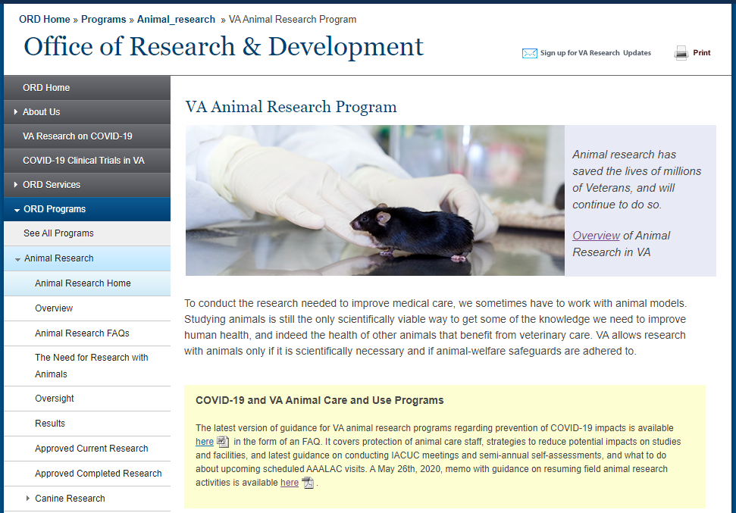
www.research.va.gov

Slide 6
FAQs about COVID-19 and
VA Animal Care and Use Programs
FAQ 15 – temporary changes in VA-specific requirements
FAQ 16 – intention to make the changes permanent

Slide 7
Annual Continuing Review of Protocols
USDA AWAR (10/30/1989) §2.31(d)(5):
  Original requirement for USDA-regulated species
VHA Handbooks 1200.7 (5/27/2005) 8.e and 1200.07 (11/23/2011) 8.g:
  Expanded to all species
FAQs about COVID-19 and VA Animal Care and Use Programs (Spring 2020) FAQ 15.d:
  Rescinded VHA requirement for species not regulated by USDA
New final rule from USDA APHIS (12/1/2021):
  Eliminates requirement for annual continuing review for USDA-regulated species

Slide 8
Semiannual Evaluations
VHA Handbook 1200.07 (11/23/2011) 8.f(1)(e):
  Send copy to CVMO within 60 days
FAQs about COVID-19 and VA Animal Care and Use Programs (Spring 2020) FAQ 15.f:
  Allows 120 days to send copy to CVMO
FAQs about COVID-19 and VA Animal Care and Use Programs (Spring 2020) FAQ 13:
  Reminder of existing flexibilities

Slide 9
FAQ 13: Existing Flexibilities in Conducting Semiannual Evaluations
VHA Handbook 1200.07 (11/23/2011) 8.f(1)(d)5:
  ≥3 IACUC members, except under “exceptional circumstances”
OLAW flexibilities (3/16/2020) NOT-OD-20-088:
  30-day grace period
  ≥ 1 qualified ad hoc consultant for inspections
  Request waivers from OLAW
IACUC remains responsible for evaluating findings

Slide 10
Making Changes
Role of the IACUC
  Propose changes
  Have the chance to raise concerns
  Know what is in effect
Document any changes
  Keep on file
  Acceptance by IACUC

Slide 11
FAQs about COVID-19 and
VA Animal Care and Use Programs
FAQ 15 – temporary changes in VA-specific requirements
FAQ 16 – intention to make the changes permanent
FAQ 17 – addresses the role of the IACUC and documentation for SOPs
FAQ 18 – addresses changes in PHS Assurance (local changes, and waivers approved by OLAW)

Slide 12
Questions?
Thoughts?
Concerns?

