Slide 1
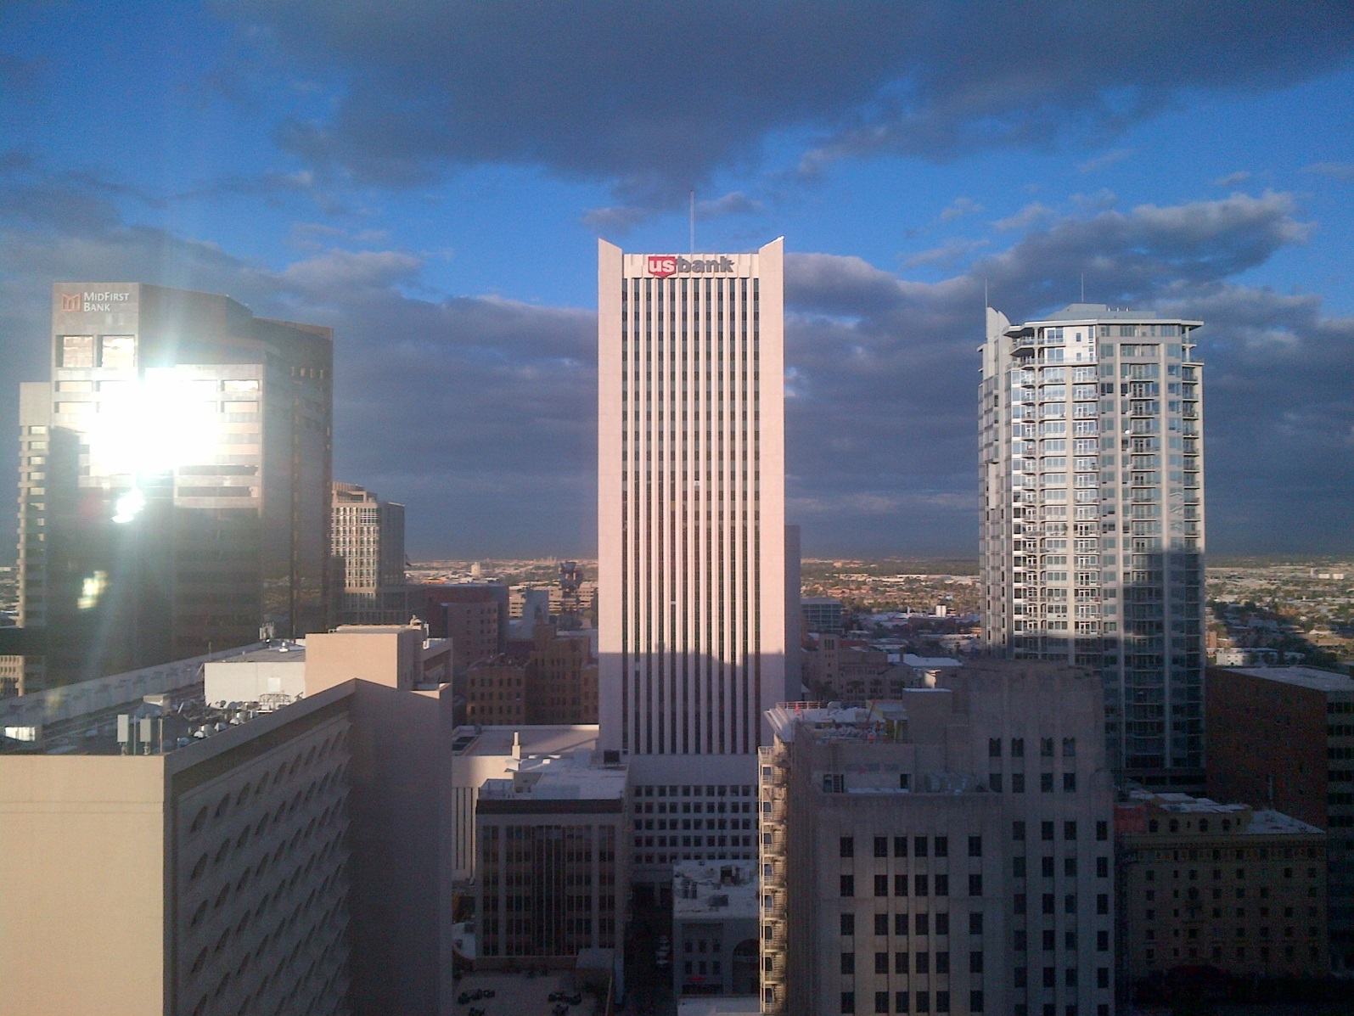
AVAVMO Meeting, 11/3/15
AALAS National Meeting, Phoenix, AZ
Encanta B Room, Sheraton Hotel

Slide 2
Agenda
General VA animal research issues, Mike Fallon
Understanding ACORP Appendix 9 (Guide Departures), Joan Richerson
Clarification of who can serve as the non-scientific member (NSM) and non-affiliated member (NAM) on VA IACUCs
Other questions and discussion

Slide 3
General Issues
Transitions
Sharing contract language for animal facility purchases
Use of agency contract to purchase Harlan food and bedding, and class J&A for other vendors
Dr. MA McCracken will be assisting with semi-annual IACUC reviews by our office
Mandatory web-based training will be required every 3 years instead of every 2 years, effective February, 2016
ShEEP and LAMb programs
Research Administration and Management System (“RAMS”) software development

Slide 4
Purchasing Harlan Feed/Bedding
VA now has an agency-wide contract for purchasing Harlan feed and bedding.
Instructions on how to utilize this contract are found on the ORD animal research website, at:
Http://www.research.va.gov/programs/animal_research/
Please begin using this contract instead of any local contracts, or the contract may be lost.

Slide 5
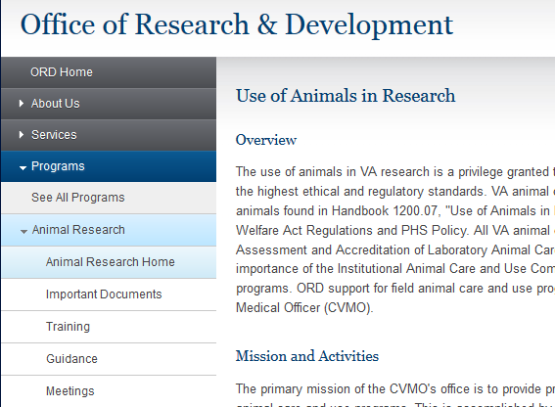

Slide 6
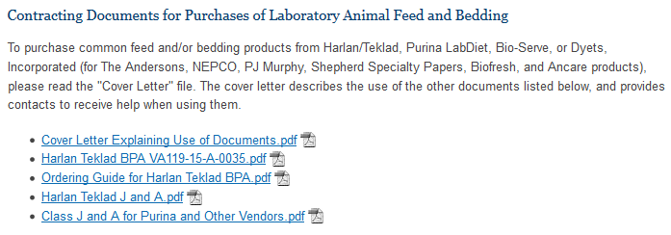
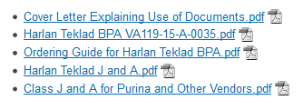

Slide 7
Purina LabDiet and others
A “Class J&A” for Purina LabDiet, Bio-Serve, or Dyets, Incorporated (for The Andersons, NEPCO, PJ Murphy, Shepherd Specialty Papers, Biofresh, and Ancare products) is available as well.
No contract was set up with these vendors, but the Class J&A will help justify purchases using these vendors.

