Slide 1
Virtual AAALAC Site Visit
Dr. Joan T Richerson
AALAS VA (non) Luncheon Mtg.
10/27/20

Slide 2
Is a virtual site visit right for your program?
Points to consider:
What is the size of your program?
What species of animals are maintained?
What is the nature of the work conducted?
What are the local COVID-19 requirements for staff and visitors to be on-site at your station?
If on-site access is allowed, what are the policies on maintaining social distancing?
What is your program’s recent history with AAALAC?

Slide 3
What to expect & how to prepare?
The number of site visitors may increase.
The virtual site visit may take a bit longer.
Far more documents will be requested in advance.
Requests for photographs, such as safety signage.
Decide who will operate the web-camera or similar device.
Decide who will narrate the virtual tour of the animal facility.
Plan the path the animal facility tour will take to ensure the narration is in sync with what is being shown.
Remember to stop and show a close-up of safety signage, biosafety cabinet certification, daily health checks logs, treatment records, etc.; these are all things of interest to the site visitors.
All least one practice run of a virtual animal facility tour is highly encouraged.

Slide 4
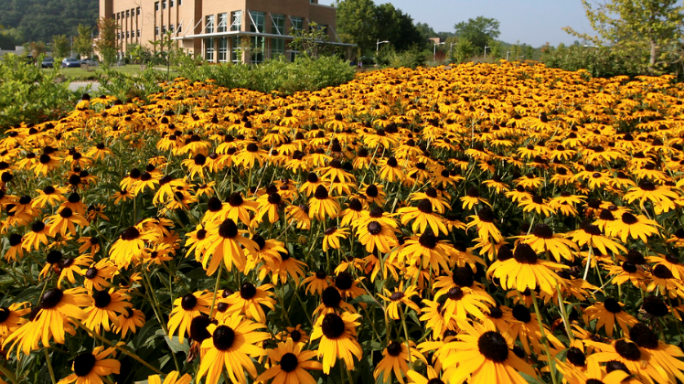
Thank you for your kind attention!

