Slide 1
For VA and Non-VA Alike:
Timing and Substance – How to Respond When Things Go Wrong
(Communications and Networking Track)
Tuesday, March 20, 2018

Slide 2
FACULTY
Joan T. Richerson, MS, DVM, MS, DACLAM, CPIA
Assistant Chief Veterinary Medical Officer
and
Alice Huang, PhD, CPIA
Staff Scientist and Deputy for IACUC Guidance
Office of the Chief Veterinary Medical Officer
Office of Research and Development
Department of Veterans Affairs

Slide 3
Content Copyright (breakout)
All content included in this session is the property of the presenter(s), and is protected by United States and international copyright laws. Certain materials are used by permission of their respective owners, and those are marked accordingly. The course content may not be copied, reproduced, republished, linked, uploaded, posted, transmitted, or distributed in any way without the prior written permission of the presenter(s).
Access to this presentation should not be construed as a license or right under any copyright, patent, trademark or other proprietary interest of PRIM&R or third parties.

Slide 4
Disclosure: Joan Richerson and Alice Huang
We have no relevant personal/professional/financial relationship(s) with respect to this educational activity

Slide 5
Part 1- Preliminary Report (PR)
A Hometown VAMC PI studies chronic obstructive pulmonary disorder in rats.
PI has 4 IACUC - approved protocols:
  Protocol 1001 – pharmacokinetics study
  Protocol 1016 – drug administration followed by a terminal procedure under anesthesia
  Protocol 1022 – cigarette smoke exposure followed by terminal procedure under anesthesia
  Protocol 1036 - cigarette smoke, drug administration, and survival surgical procedure
All are VA or NIH funded.

Slide 6
Part 1 - PR
The new RCO discovers 20 rats with healed skin incisions on their chest.
These rats are assigned to protocol 1016.
Survival surgery is not approved on this protocol.
The RCO knows a protocol violation is a reportable to OLAW.

Slide 7
Part 1 – PR
The PI and his research technician are unavailable.
The IACUC Chair is also unavailable; RCO leaves a voicemail.
The RCO also contacts the R&D Chair, who says please proceed.
The RCO prepares a PR email.

Slide 8
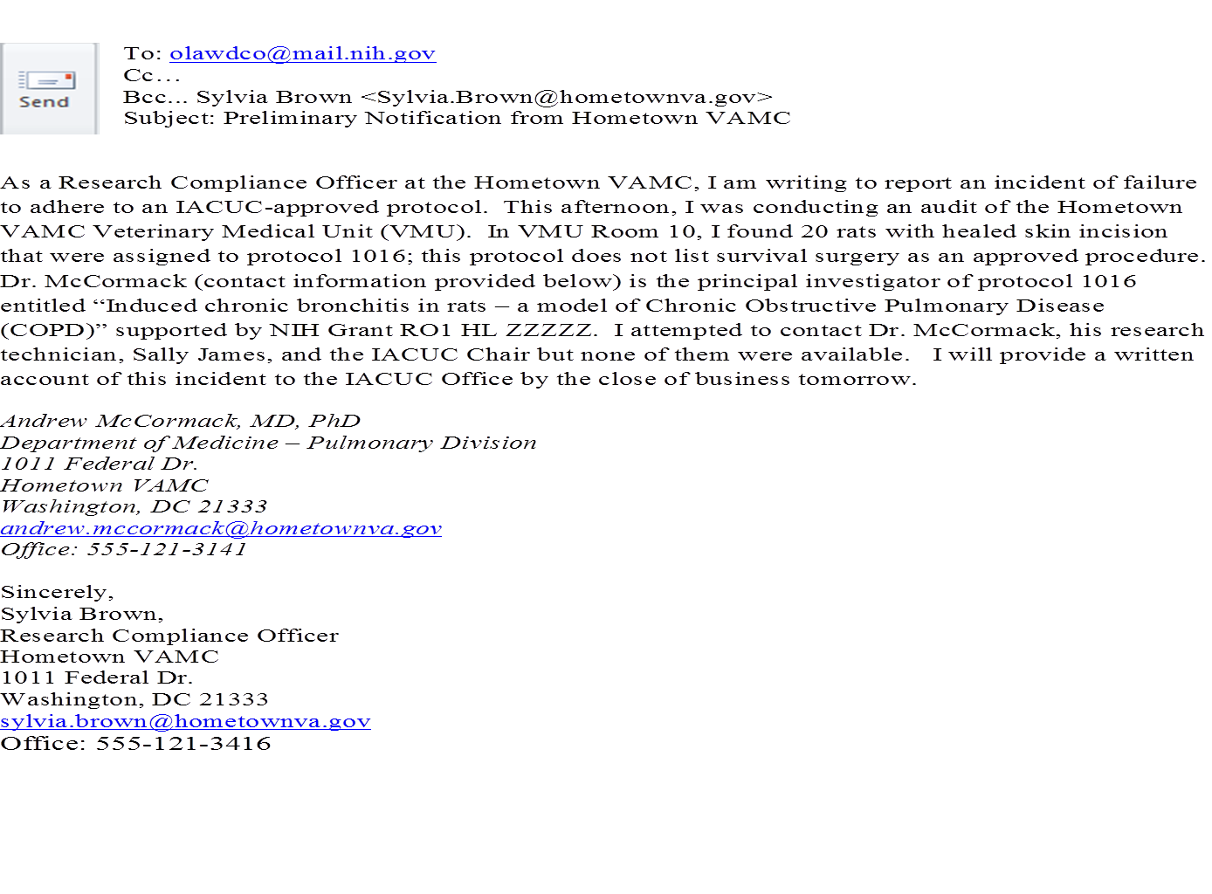

Slide 9
Part 1- PR
Does the RCO have the authority to file a preliminary report with OLAW?
Should the RCO wait for the IACUC Chair?
Do you have concerns about the preliminary report?

Slide 10
Part 1 – PR
VA policy is that anyone who becomes aware of any matter that is potentially reportable is responsible for promptly bringing the matter to the attention of the IACUC, so that the IACUC can investigate and determine how it is to be addressed.

Slide 11
Part 1-PR
The preliminary report should include:
The name and contact information of the person reporting
The institution’s Assurance number
The funding source

Slide 12
Part 1- PR
A concise description of the incident
The plan and schedule for correction and prevention, if known
The timeframe for the final report from the Institutional Official

Slide 13
Part 1- PR
The preliminary report should not contain the names or contact information of individuals referenced in the report.
All information reported to OLAW and any other federal agency is subject to FIOA and will be released when requested.

Slide 14
Part 1 - PR
Only pertinent factual information should be included in the report.
The original preliminary report should be forwarded to the office of the CVMO in ORD, VA Office of Research Oversight (ORO), and AAALAC International.

Slide 15
Part 1 – PR
The IACUC Chair returns the RCO’s call.
The RCO describes the potential incident of protocol noncompliance.
Following their phone conversation, the IACUC Chair emails a PR to OLAW. IACUC and IO informed and other agencies notified.

Slide 16
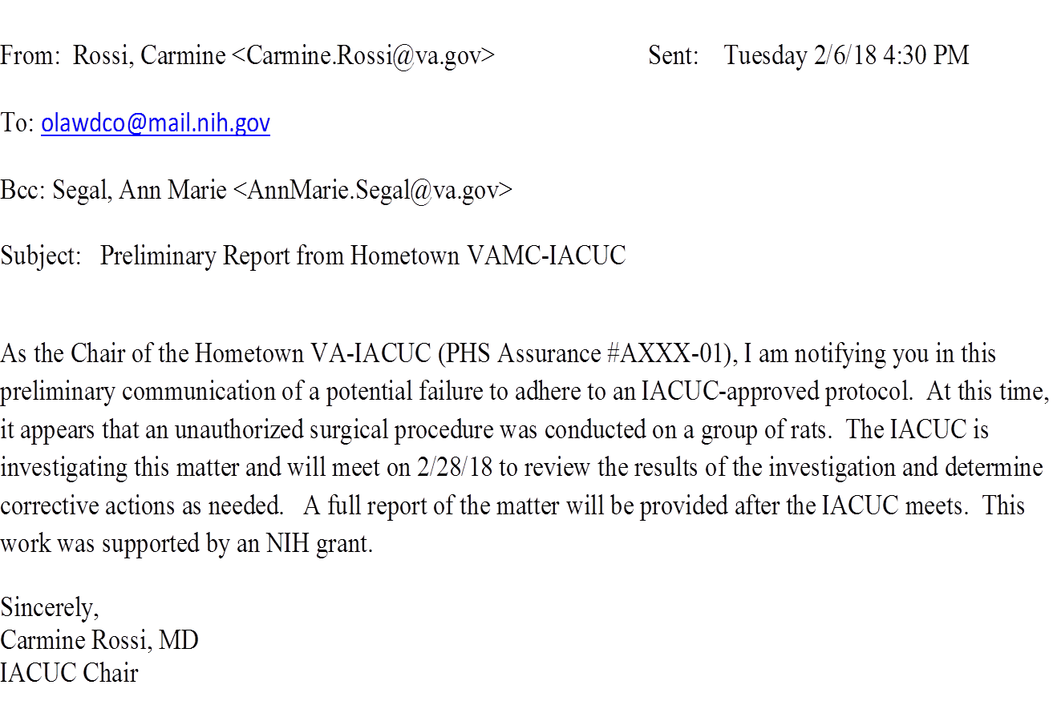

Slide 17
Part 1- PR
Take home points:
OLAW accepts preliminary reports in the form a fax, email, or phone call.
Preliminary reports should be submitted to OLAW as they occur.
The preliminary report merely indicates that a potential compliance issue has been identified; the outcome is unknown until the IACUC completes its investigation.

Slide 18
Part 2 – Final Report (FR)
An investigation must be conducted before the IACUC can make a determination and submit the final report.
The IACUC Chair appoints a subcommittee to investigate.
The subcommittee verifies the RCO’s observations, confirms with the AV that the rats are healthy, and conducts interviews.
The subcommittee reports its findings to the full committee.

Slide 19
Part 2 – FR
The subcommittee through their investigation learns:
The PI had an animal order showing the rats were purchased against protocol 1036, which is approved for survival surgery.
The research technician discovered the cage cards , listed the wrong protocol number, 1016 instead of 1036.

Slide 20
Part 2 - FR
The research technician verbally and by email informed the VMU supervisor as soon as the error was recognized.
The VMU Supervisor confirmed the research technician had reported the error as she described.

Slide 21
Part 2 – FR
The VMU Supervisor said a data entry error was the source of the problem, a one digit error.
Short staffing in the VMU due to the flu epidemic delayed correcting the cage cards.

Slide 22
Part 2- FR
The subcommittee reported their findings to the IACUC; a data entry error was the problem.
The IACUC approved a new VMU SOP to help correct data entry errors promptly.
The IACUC determined that this incident was not reportable.

Slide 23
Part 2- FR
OLAW requires the following be provided in a FR:
Name of institution
Assurance number
The type of noncompliance that occurred
Who provided the PR, when it was provided, and to whom it was provided

Slide 24
Part 2 - FR
Detailed description of the incident
Corrective actions
Grant/contract number
Impact on PHS-supported activities
Compliance with terms and conditions

Slide 25
Part 2 – FR
OLAW will only accept an institution’s final report electronically by email in PDF format to olawdco@mail.nih.gov or by fax to 301-480-3387.
The final report should be copied to the CVMO, ORO, AAALAC, and the funding agency.

Slide 26
Part 2- FR
OLAW requires the final report to be signed by the Institutional Official.
The IACUC Chair emailed the FR signed by the Medical Center Director to OLAW.

Slide 27
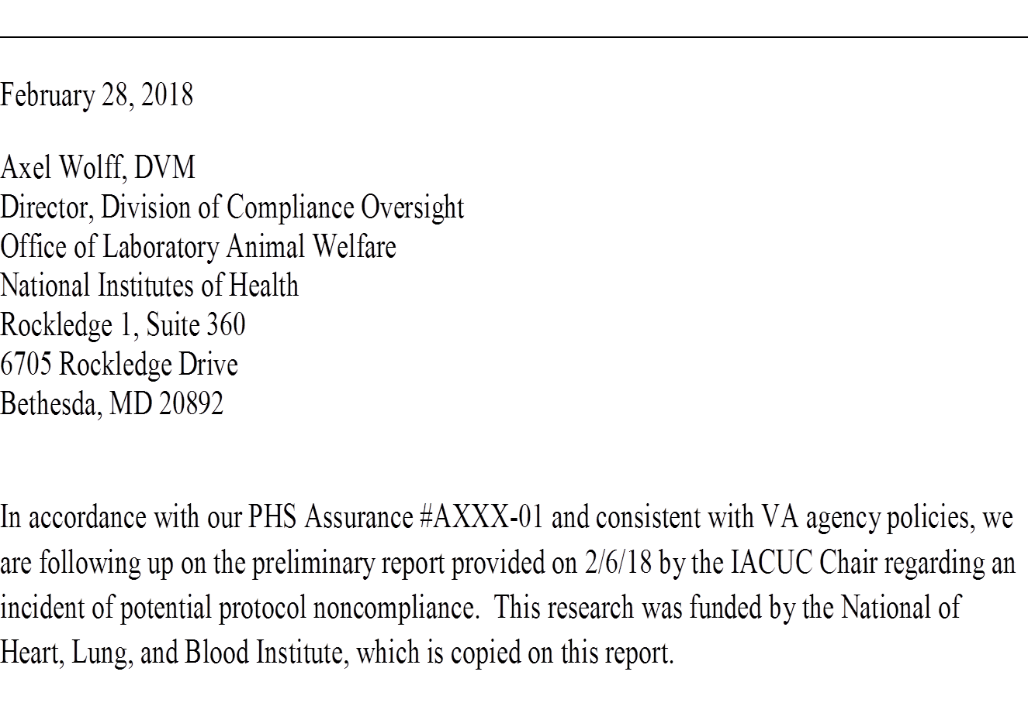

Slide 28
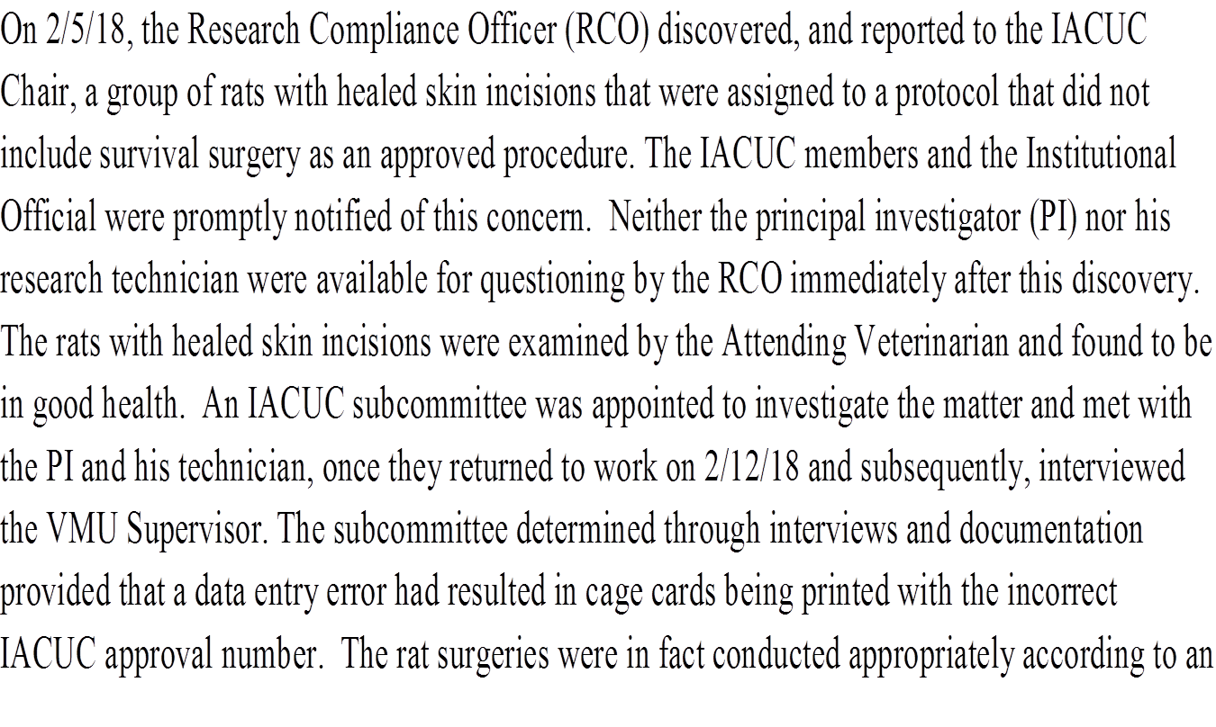

Slide 29
approved protocol, but not the protocol listed on the card. The research technician had notified the VMU Supervisor of the incorrect protocol number on the cards, but influenza had reduced staffing and delayed re-printing of the cage cards. A new SOP has now been approved that allows manual corrections on cage cards immediately upon discovery of any incorrect information and subsequent notification of the VMU Supervisor After reviewing the subcommittee’s report, the IACUC voted that this incident was not reportable.
Should you have further questions regarding this matter, please contact the IACUC Chair at 555-121-0123 ext. 4567.Sincerely,
Agnes Devonshire
Agnes Devonshire, FACHE
Medical Center Director

Slide 30
Part 2 – FR
Take home points:
A preliminary report is followed up with a final report after the IACUC conducts an investigation.
The preliminary report notifies OLAW that a potential problem has occurred.
The final report provides a factual account of the incident, what the IACUC determined and what corrective actions were taken (if applicable).

Slide 31
Part 2 – FR
If the IACUC concludes noncompliance has not occurred; the institution may wish to contact OLAW’s Division of Compliance Oversight for guidance or the institution may submit a final report that:
Provides the information OLAW requests
Is factually accurate and devoid of extraneous details
Is FOIA ready.

Slide 32
Part 2 - FR
OLAW guidance indicates that documents related to compliance oversight evaluations are usually exempt from the disclosure provisions of FOIA while the evaluation is in progress and are treated with confidentiality by OLAW. However, once OLAW issues its finding, these documents become publicly available under FOIA.

Slide 33
References:
VA guidance AR2018-00
https://grants.nih.gov/grants/guide/notice-files/NOT-OD-05-034.html
https://grants.nih.gov/grants/olaw/faqs.htm#611
https://grants.nih.gov/grants/olaw/reporting_noncompliance.htm
https://grants.nih.gov/grants/olaw/ComplianceOversightProc.pdf

Slide 34
Update
Why
We Do What We Do

Slide 35
Context Makes All the Difference
Transparency
vs.
“FOIA Ready”
includes

Slide 36
Why Bother?
Work is publicly funded – public’s right to know
Secrecy fuels suspicion
Lack of transparency = missing context
Less bother than the alternative

Slide 37
Organizations Promoting Transparency
The Basel Declaration
  http://www.basel-declaration.org/basel-declaration-en/assets/File/Declaration/Declaration_en_Zu%CC%88rich.pdf
Concordat on Openness on Animal Research in the U
  http://concordatopenness.org.uk/
European Animal Research Association (EARA)
  http://eara.eu/en/
Speaking of Research
  https://speakingofresearch.com/get-involved/statements-on-animal-research/

Slide 38
Lessons for VA
Benefit from natural group structure
Support/facilitation/coordination by office of CVMO
Don’t reinvent the wheel
Reach out to non-VA institutions

Slide 39
What We’ve Done So Far
You’ve
Lists of Investigators
Lists of what the public needs to find out about
List of publications

Slide 40
What Next?
Keep up the good work
Work with your leadership
Create or expand your website

Slide 41
An Example …

Slide 42
Questions?

Slide 43


