Slide 1
What’s New from the Office of the CVMO?
Tools to Facilitate Compliance with the
8th Edition of the Guide
Alice Huang, PhD, CPIA
Deputy for IACUC Guidance
Office of the CVMO
Presented at 2013 PRIM&R IACUC Conference
March 18, 2013

Slide 2
Check the R&D website often, especially any time anyone is getting ready to fill out
  an ACORP or
  a report of a semiannual evaluation
www.research.va.gov/programs/animal_research
Use the links under Important Documents

Slide 3
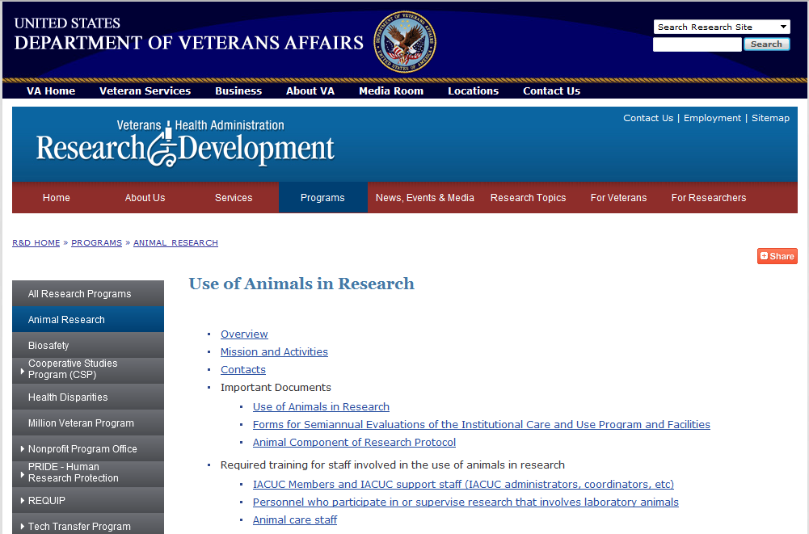
www.research.va.gov/programs/animal_research
Notes:
Clicking on the link for “Animal Component of Research Protocol” will take you to a table of the different versions of the ACORP that have been used

Slide 4
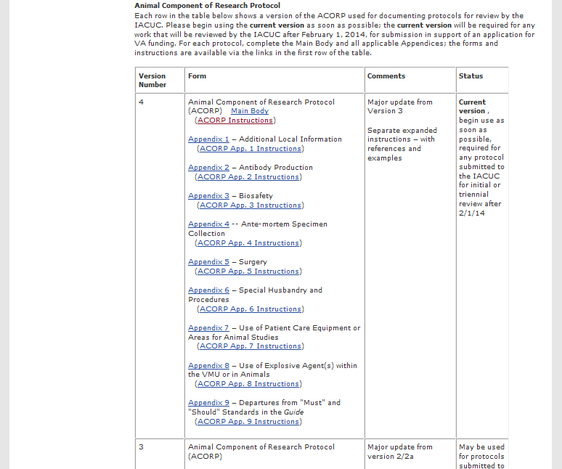
Notes:
The latest version (version 4) is at the top, with live links to the forms and instructions
Begin using this as soon as possible
Version 3 (most recent previous version) is in the next row down
Okay to continue with Version 3 for any protocol already in progress (no need to start over with Version 4)
As long as the protocol on Version 3 is submitted to the IACUC before 2/1/14
(There are no links to any of the earlier versions of the forms – use Version 4 if you don’t already have them)

Slide 5
Version 4 is major update over Version 3 – begin use as soon as possible (no need to start over on anything already in progress, as long as it gets submitted to the IACUC before 2/1/14)
Clarifications, corrections, and formatting changes
  Based on feedback we’ve received from the field
  Addressing common mistakes we’ve noticed
  To make it easier for investigators to provide the information that the IACUC needs, to be able to review effectively
Separate files for forms and instructions (instruction files include more detailed explanations, references, and examples)
Substantive updates to address new regulatory emphases
  Harm-benefit analysis
  Use of non-pharmaceutical agents
  Managing deviations/departures

Slide 6
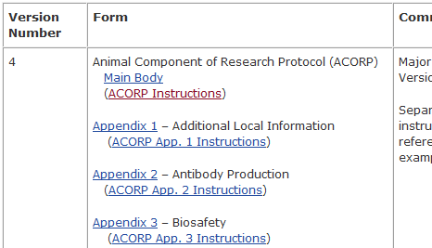
Notes:
Use the links in the table to access the forms

Slide 7
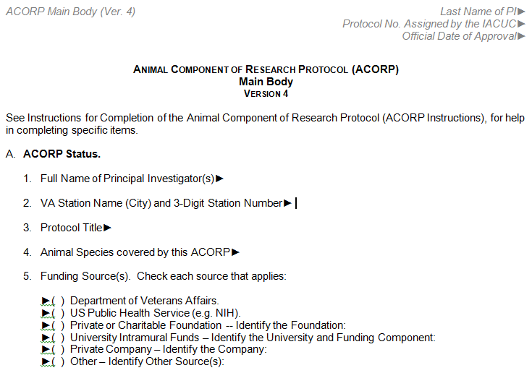
⁞
Notes:
New features:
Header identifying the protocol now appears on every page
“►” prompts entry of required text – place cursor after ► and type

Slide 8
Harm-Benefit Analysis
ACORP Main Body
Description of Relevance and Harm/Benefit Analysis. … describe how this research project is intended to improve the health of people and/or other animals, or otherwise to serve the good of society, and explain how these benefits outweigh the pain or distress that may be caused in the animals …
ACORP Instructions
Description of Relevance and Harm/Benefit Analysis. (US Government Principles, Principle II) … The IACUC is obligated to weigh the benefits to be gained from the work against potential concerns about animal welfare (AAALAC FAQs, C.3, Guide, p. 27), so it is important for the protocol to provide the information that the IACUC needs to assess this.
Notes:
Harm-Benefit Analysis is now explicitly addressed in Item B of Main Body
The concept is fundamental to IACUC oversight of the use of animals in research, so most IACUCs have been doing this analysis all along, although they may or may not have been using this terminology
(See Instructions for references)

Slide 9
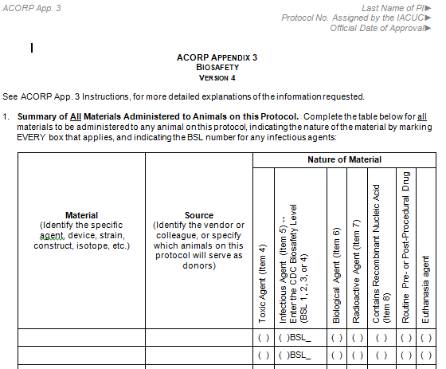
Non-Pharmaceutical Agents
Notes:
Non-pharmaceutical-grade agents are now addressed explicitly in Appendix 3
The table in Item 1 is one of the new tables in the ACORP forms (for materials that are to be administered to the animals)
Table format makes it easier to document all the materials that will be administered to the animals
This table is designed to make it easier to identify the materials that require special attention because of biosafety concerns
Every material that appears anywhere in the ACORP should be listed in item 1, regardless of whether there are any biosafety concerns
For some materials, there may be more than one type of biosafety concern – check all that apply
The entries in this table will guide entry of details elsewhere in the appendix
For some materials, there may be no biosafety concerns (e.g., saline administered for volume replacement after collection of blood sample)
The table prompts PI to document this, making it easier for the Biosafety official to confirm that concerns are correctly identified

Slide 10
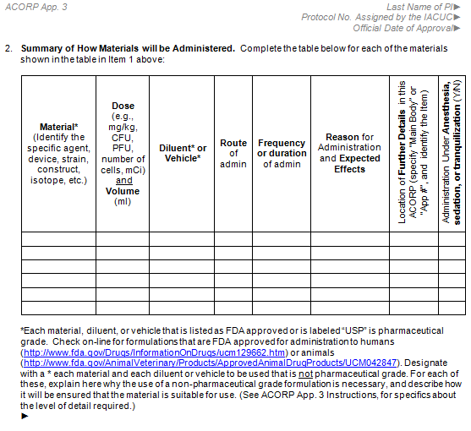
Notes:
The table in Item 2 expands on the information entered in Item 1 – Describe how and why each material will be administered
Use “*” to flag any non-pharmaceutical-grade material
“Pharmaceutical grade” is defined as “FDA approved” or labeled “USP”
Use the links to websites that list FDA-approved formulations – formulations for humans, and formulations for animals
Justify the use of each non-pharmaceutical-grade material at the ►

Slide 11
ACORP App. 3 Instructions (Ver. 4)
Summary of How Materials will be Administered. Provide the details …
  OLAW requires that only pharmaceutical grade compounds be administered to animals unless the use of non-pharmaceutical grade compounds is justified by scientific necessity and the lack of availability of an acceptable veterinary or human pharmaceutical grade compound (OLAW FAQs, F.4). … Mark with a * each material, diluent, or vehicle to be administered to the animals on this protocol that is not pharmaceutical grade. For each of these, provide the justification for using a non-pharmaceutical grade compound, and describe how it will be ensured that the grade, purity, sterility, pH, pyrogenicity, osmolality, stability, formulation, and pharmacokinetics of the material will be suitable for use in the animals (Guide, p. 31).
Notes:
Expanded instructions for the table in Item 2 of Appendix 3 are given in the Instructions file

Slide 12
Managing Deviations/Departures
ACORP Appendix 9
Departures from “Must” and “Should” Standards in the Guide (2011)
Version 4
ACORP App. 9 Instructions (Ver. 4)
… PHS Policy (IV.B.3) requires that IACUC-approved departures from PHS Policy, including the provisions of the Guide, be reported to the Institutional Official in the report of each semiannual evaluation of the institutional animal care and use program. This appendix is to document the departures that have been approved by the IACUC for this protocol. The completed appendix may be copied for inclusion in semiannual reports.
+
Test Questions and Flow Chart
for Determining Whether “Deviations” are “Departures”
Notes:
See the presentation, “The Continuing Saga of Deviations & Departures”, by Dr. Joan Richerson
for a discussion about how to decide whether a practice represents a deviation or departure
Appendix 9 is a new feature in Version 4 of the ACORP
designed to make it easier to document any approved departures that are part of a protocol
Copies of Appendix 9 may be copied for inclusion in Semiannual reports
The Instructions for Appendix 9 include test questions and a flow chart
for determining whether a deviation from PHS Policy (including the provisions of the Guide) is considered a “departure”

Slide 13
www.research.va.gov/programs/animals_research
Notes:
Clicking on the link for “Forms for Semiannual Evaluations of the Institutional Care and Use Program and Facilities” will take you to a table of the different versions of the forms that have been used for conducting and reporting the results of the semiannual evaluations.

Slide 14
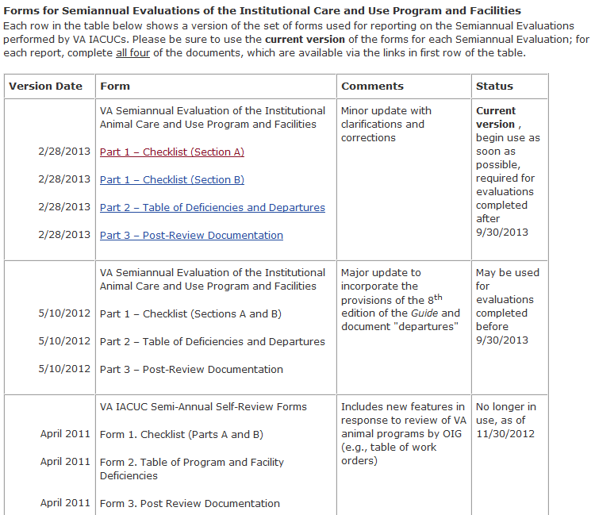
Notes:
The latest version (released 2/28/13) is at the top of the table, with live links to the forms
This version is a minor update, with clarifications and corrections
Includes a prompt in Part 2, to attach copies of Appendix 9 to document approved departures that appear in any active ACORP
OLAW requires that these be reported to the IO
The official date of approval by the IACUC (in the header) must show on the copy
Be sure to redact from the copy the name of the PI and the protocol number assigned by the IACUC
Enter the total number of Appendix 9 pages attached
Begin use as soon as possible
The previous version (5/10/12) is shown in the second row
No need to start over on any report already in progress with the 5/10/12 version, as long as it is completed before 9/30/13
(There are no links to any of the earlier versions of the forms – use 2/28/13 version if you don’t already have the forms)

