Slide 1
ACORPs
What to put in and what to leave out?
Joan T Richerson, DVM
Assistant Chief Veterinary Medical Officer
Notes:
The goal of this presentation is to increase awareness of what information should be put into the ACORP file and what should be left out. Including unnecessary information is time consuming to create (and review), makes the file excessively large, and may result in increased (unwanted) scrutiny.

Slide 2

SOPs/MSDSs
Include in ACORP | Do not include in ACORP
SOPs that are specifically referenced in the ACORP – Example: Endpoint criteria | SOPs for routine animal husbandry
SOPs for the handling of animals treated with hazardous agents | SOPs for routine carcass disposal
SOPs for unique experimental equipment – Example: Cigarette Smoking Machine | SOPs for animal adoption policy
MSDSs for experimental agents unique to the study | MSDSs for normal saline, isoflurane, ophthalmic ointment, etc.

Slide 3


Radiation
A brief outline of the radiation treatment is often given in item C.2 (Experimental Design) but it lacks detail.
Please complete an Appendix 6, which provides information that addresses:
  What is being performed?
  Where it is being performed?
  How it is being performed?
  Why it is being performed?
  Who is responsible?

Slide 4
OHSP
Item G – Occupational Health and Safety
G.1 – Enrollment in OHSP
G.2 - Are there any non-routine OHSP measures that would potentially benefit, or are otherwise required for, personnel participating in or supporting this protocol?
Most common and usually correct answer to item G.2 is “No”.
However, G.2 should be answered “Yes” with an explanation when the research involves:
    Nonhuman primates
    Sheep, especially pregnant sheep
    Antibiotic resistant infectious agents
    Known teratogens
Notes:
Bleomycin sulfate is a known reproductive toxin (mutagen). If the ACORP indicates that women of childbearing age are part of the participating personnel; the responses to item G.2 and Appendix 3 should reflect awareness of this issue as well as other hazards associated with the use of bleomycin.

Slide 5

OHSP
The information provided in item G and Appendix 3-subitem 10 (Protection of Animal Facility Staff from Hazardous Materials) should be congruent.

Slide 6
Appendix 9
Departures from "Must" and "Should" Standards in the Guide
The vast majority of “reported approved departures” are actually specifically established Guide exceptions.
Remember specifically established exceptions apply to deviations from must or should statements where certain exceptions are specifically described in the Guide and are considered acceptable when justified and approved by the IACUC. No reporting requirements.
Notes:
Differentiating specifically established exceptions from approved departures is challenging. Reporting any possible deviation from the Guide as an approved departure is not a wise approach. If you are uncertain as to which assignment is correct, I suggest you refer to: the flow diagram (slide 8), the six specifically established Guide exceptions that have been approved by OLAW (slides 9-13), and/or to OLAW’s “Departure from the Guide”
http://grants.nih.gov/grants/olaw/departures.htm. If you are still in doubt, please contact OLAW and ask for guidance.

Slide 7
Appendix 9
The two specifically established Guide exceptions commonly denoted as approved departures in Appendix 9 are:
  Single housing of animals with IACUC-reviewed scientific justification. Single housing exception may also be for social incompatibility or a veterinary-related concern.
  Use of non-pharmaceutical grade agents.

Slide 8
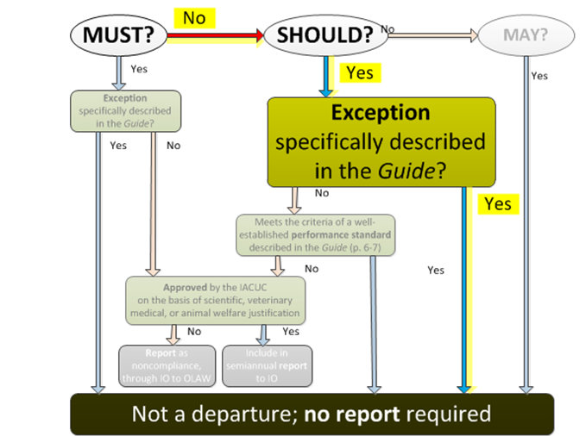

Slide 9
Specifically Established Exceptions
(OLAW approved)
Non-pharmaceutical–grade chemicals or substances
“The use of non-pharmaceutical–grade chemicals or substances should be described and justified in the animal use protocol and be approved by the IACUC (Wolff et al. 2003); for example the use of a non-pharmaceutical-grade chemical or substance may be necessary to meet the scientific goals of a project or when a veterinary or human pharmaceutical-grade product is unavailable. “ (pg. 31).

Slide 10
Specifically Established Exceptions
(OLAW approved)
Environmental Enrichment (Sounds)
The Guide states – “Radios, alarms, and other sound generators should not be used in animal rooms, unless they are part of an approved protocol or enrichment program” (pg. 50).

Slide 11
Specifically Established Exceptions
(OLAW approved)
Single Housing
“Social animals should be housed in stable pairs or groups of compatible individuals unless they must be housed alone for experimental reasons or because of social incompatibility (see also section on Behavioral and Social Management).” (pg. 51)
“If necessary to house animals singly – for example, when justified for experimental purposes, for provision of veterinary care, or for incompatible animals – this arrangement should be for the shortest duration possible. “ (pg. 60)

Slide 12
Specifically Established Exceptions
(OLAW approved)
Aseptic surgery
The Guide states “ Unless an exception is specifically justified as an essential component of the research protocol and approved by the IACUC, aseptic surgery should be conducted in dedicated facilities or spaces (pg. 116).

Slide 13
Specifically Established Exceptions
(OLAW approved)
Euthanasia method
“Unless a deviation is justified for scientific or medical reasons, methods should be consistent with the AVMA Guidelines on Euthanasia (AVMA 2007 or later editions).” (pg. 123)

Slide 14
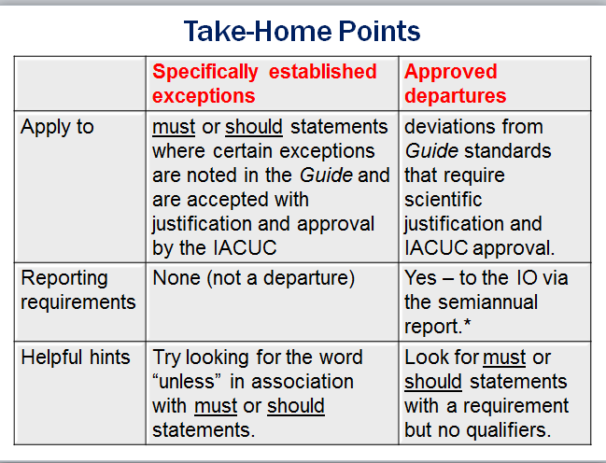

Slide 15

http://www.quickmeme.com/meme/3pk92b

