Slide 1
Guide
Deviations and Departures
“Reader’s Digest “ version
Joan T. Richerson, DVM
Assistant CVMO
Notes:
This presentation was originally given at the VA luncheon on November 6th at the Minneapolis National AALAS meeting. A number of scenarios were presented as examples, which have been added as notes below each slide. This file also includes new information that has recently become available.

Slide 2
OLAW Definitions
Paraphrased from OLAW- Departures From the Guide
Paraphrased from OLAW- Departures From the Guide
Term | Common Meaning | Specialized Meaning
Deviation | Divergent behavior | Divergent behavior that may or may not be a departure
Departure | Variation from a previous custom | Variation from the standards of the Guide that must be reported to IO and/or OLAW, depending on the circumstances.
Deficiency | Lack or insufficiency | Significant or minor deficiency
Exception | Case that does not conform to the general rule | Case that does not conform to the Guide
Notes:
All departures are deviations from the Guide but not all deviations are departures. Approved departures from “must” or “should” statements are reported in the semiannual to the IO. Deviation from a “must” or “should” statement without IACUC approval is noncompliance and should be promptly reported to OLAW through the IO. The subsequent slides elaborate on these points.
All departures are deviations but all deviations are not departures. This concept is explained in later slides.

Slide 3
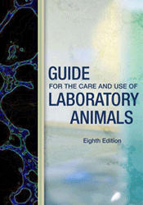
Deviations
Essentially means there is some straying from the Guide’s recommendations. Applies to a “must” or “should” statement where certain exceptions (acceptable non-conformation) are specified in the Guide:
Scientific justification
Social Incompatibility
Veterinary medical or animal welfare issue
Established performance standard (“should” only)
Report required to IO or OLAW?- None
* Note: Straying from a “may” statement is not a departure; no report is necessary.
Notes:
Specifically described Guide exceptions for which no report to the IO or OLAW is required:
Rats are singly housed in metabolic cages to collect urine to determine the
pharmacokinetics of drug 5a4b. The Guide states that “Social animals should be housed in
stable pairs or groups of compatible individuals unless they must be housed alone for
experimental reasons or because of social incompatibility (see also section on Behavioral
and Social Management).” (pg. 51) The IACUC approved single housing for experimental reasons
because this is a specifically described Guide exception to a “should” statement; therefore, no
report is required.
Male galagos in a breeding colony are housed singly due to fighting when not paired with a breeder female. Multiple attempts have been made to socially house male galagos but none have been successful (incompatibility was documented). The Guide states that “Social animals should be housed in stable pairs or groups of compatible individuals unless they must be housed alone for experimental reasons or because of social incompatibility (see also section on Behavioral and Social Management).” (pg. 51) The IACUC approved single housing for male galagos based on social incompatibility because this is a specifically described Guide exception to a “should” statement; therefore, no report is required.
The Attending Veterinarian determines a thin dog with a broken leg must be temporarily (estimated 4-6 weeks) housed separately from the other dogs due to this dog needing a special high calorie diet to gain weight, daily medications, and a well-padded resting board. The Guide states “If necessary to house animals singly – for example, when justified for experimental purposes, for provision of veterinary care, or for incompatible animals – this arrangement should be for the shortest duration possible. “ (pg. 60) This is a specifically described Guide exception based on the provision of veterinary care; therefore, no report is required.
An investigator has developed a new compound related to cisplatin, which in in vitro testing has superior ability to kill cancer cells and
may have less harmful side effects. At this point, the drug has only been synthesized in the investigator’s laboratory. In a new protocol submitted to the IACUC, the investigator proposes to conduct a small pilot study in 10 rhesus monkeys to determine whether the new compound compared to conventional cisplatin has fewer side effects at clinically relevant doses. The Guide states that “The use of non-pharmaceutical–grade chemicals or substances should be described and justified in the animal use protocol and be approved by the IACUC (Wolff et al. 2003); for example the use of a non-pharmaceutical-grade chemical or substance may be necessary to meet the scientific goals of a project or when a veterinary of human pharmaceutical-grade product is unavailable. “ (pg. 31). This is a specifically described Guide exception based on scientific justification that has been reviewed and approved by the IACUC; therefore, no report is required.

Slide 4

Approved Departures
An alteration from the Guide standards. May apply to “must” or “should” statements. Considered an IACUC-approved departure when based on:
Scientific justification
Veterinary medical/animal welfare issues
Report required to IO or OLAW? – Yes (to IO via semiannual report)
Notes:
IACUC-Approved Departures that are reported to the IO via the semiannual report:
An investigator submits a protocol to the IACUC to examine effects of weightlessness on bone density. The investigator plans to use a hind limb unloading model in rats to simulate weightlessness for 3 weeks. The Guide states that “Prolonged restraint, including the chairing of nonhuman primates, should be avoided unless, it is essential for achieving research objectives and is specifically approved by the IACUC (NRC 2003b).” (pg. 29) The IACUC approved the hind limb weightlessness model as essential to the study, which constitutes an approved departure from the Guide and was reported in the semiannual report to the IO.
2. The use of farrowing crates has come under fire because sows held in farrowing crates cannot turn around. An investigator wants to compare the behavior and physiologic responses of 10 sows housed in farrowing crates to those of 10 sows housed in open pens. Each group of sows will be maintained for one week prior to delivery and two weeks postpartum in their assigned housing system. The Guide states that “At a minimum, animals must have enough space to express their natural postures and postural adjustments without touching the enclosure walls or ceiling, be able to turn around, and have ready access to food and water.” (pg. 56). The investigator provided a sound rationale for using farrowing crates and described appropriate monitoring procedures and humane endpoints in his protocol. This is a deviation from a “must” statement that was scientifically justified by the investigator and reviewed and approved by the IACUC. Therefore, it is an approved departure from the Guide and was reported in the semiannual report to the IO.

Slide 5
Unapproved Deviation = Noncompliance
Deviation from a “must” or “should” statement without IACUC-approval.
Note: OLAW uses the term “deviation” as opposed to “departure” when referring to noncompliance (see next slide).
Report required to IO or OLAW?– YES! (promptly to IO and OLAW)
Notes:
Unapproved deviations from the Guide that require prompt reporting by IO to OLAW:
Dr. X studies wound healing in rabbits and has an IACUC approved protocol to conduct surgery in rabbits. During a post-approval monitoring visit, the IACUC monitoring team enters Dr. X’s lab and discovers Dr. X’s technicians performing a survival surgery on a rabbit on a lab bench top. The Guide states “Unless an exception is specifically justified as an essential component of the research protocol and approved by the IACUC, aseptic surgery should be conducted in dedicated facilities or spaces.” (pg. 116) Aseptic surgery was not performed in compliance with the Guide. The IACUC must develop a plan and schedule to correct this unapproved deviation from a “should” statement in the Guide and report this non-compliance promptly to the IO and OLAW.
2. While preparing the AAALAC Program Description, the AV learns that neither Student Health Services (SHS) or Employee Health Services (EHS) provide occupational health services to students exposed to laboratory animals or their products. The Guide states that “Each institution must establish and maintain an occupational health and safety program (OHSP) as an essential part of the overall Program of animal care and use (CFR 1984 a ,b ,c ; DHHS 2009; PHS 2002).” (pg. 17) The current OHSP plan does not include students and is therefore noncompliant. The IACUC must develop a plan and schedule to correct this unapproved deviation from a “must” statement in the Guide and promptly report this non-compliance to the IO and to OLAW.

Slide 6
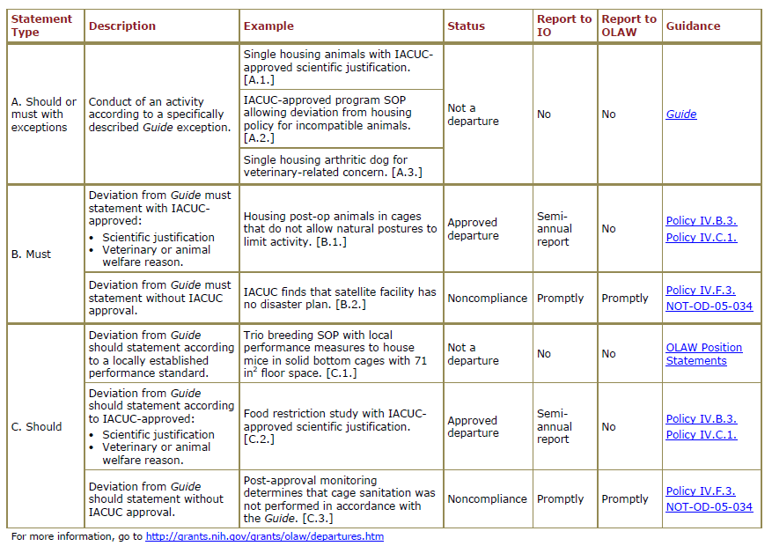
OLAW Comparison of Reporting Requirements
Notes:
In addition to the chart shown above, OLAW has also provided example scenarios at the link shown that correspond with each statement type.

Slide 7
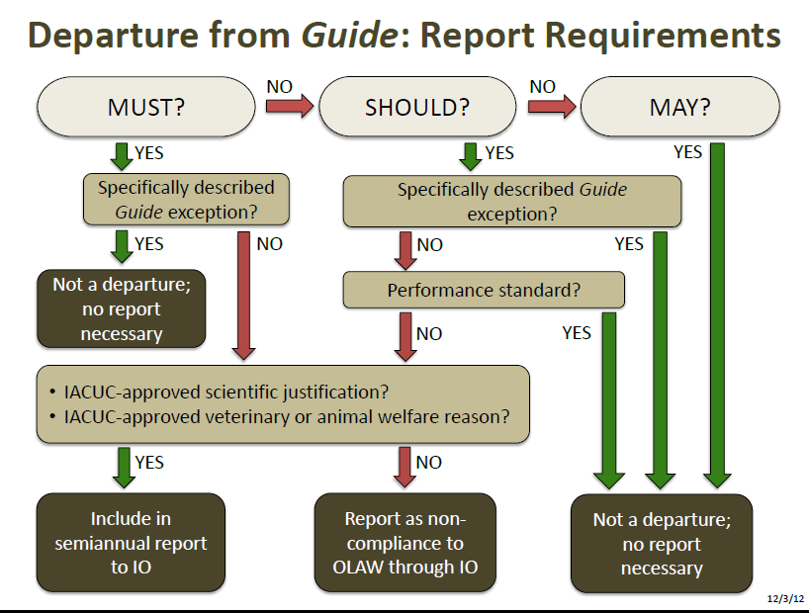
OLAW Flow Chart of Reporting Requirements
http://grants.nih.gov/grants/olaw/departures_table.pdf
Notes:
In the OLAW flowchart, the alignment of the “yes” and “no” arrows leading from the box about IACUC approval may be easily misread as to imply that the “yes” applies just to “must” statements, and the “no” applies only to “should” statements. The next slide was prepared by the Office of the CVMO to hopefully clarify this concern.

Slide 8
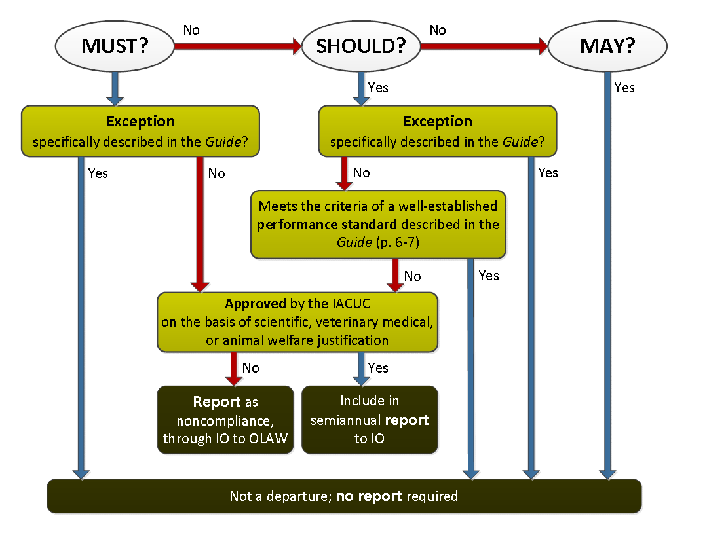
Office of CVMO modified OLAW flow chart
Notes:
In the Office of the CVMO modified OLAW flowchart shown above, the IACUC approval box has been narrowed and centered between the “must” and “should” columns, and the alignment of the arrows has been changed to clarify it applies to both.
CVMO version

Slide 9

Still confused?
Resources:
OLAW FAQ C 7
http://grants.nih.gov/grants/olaw/faqs.htm#c7
Departures From the Guide Webinar
http://grants.nih.gov/grants/olaw/121004_Brown_slides.pdf
Departures From the Guide
http://grants.nih.gov/grants/olaw/departures.htm
If you still have doubts, call OLAW and discuss your specific concern.
Notes:
If you elect to contact OLAW to discuss a specific concern, you are advised to summarize the discussion and then forward the summary to the OLAW representative you spoke with. Ask this individual to confirm that you have accurately summarized the conversation; once concurrence is obtained, the email correspondence should be kept in the IACUC files.

