Slide 1
What to Do When Something Goes Wrong
(A Practical Guide to Suspensions/Terminations/Stops and What to Report)
Alice Huang
Assistant to the CVMO
Deputy for IACUC Guidance

Slide 2
Who has the Authority to Interrupt Work and Prevent It from Proceeding?
suspend/terminate
The IACUC – can suspend/terminate IACUC approval or otherwise stop work
The Institutional Official (Medical Center Director) – can suspend/terminate IACUC approval or otherwise stop work
Anyone authorized by the Institutional Official – can suspend/terminate IACUC approval or otherwise stop work
Any VA veterinarian – can stop work
The PI – can stop work
suspend/terminate
suspend/terminate
Notes:
Suspension or termination of IACUC approval interrupts the work and prevents it from proceeding, because only work that IACUC approval may proceed.
The IACUC – The authority to suspend/terminate/stop work is integral to the IACUC’s function of reviewing and approving only work with animals that is compliant with regulatory requirements. Suspension or termination by the IACUC requires a majority vote at a convened meeting of the IACUC.
The IO -- The authority to suspend/terminate/stop work is integral to the IO’s authority and responsibility for ensuring regulatory compliance, so the IO has the authority to interrupt work and prevent it from proceeding, even if it was approved by the IACUC.
The IO can delegate the IO’s authority to others.
The veterinarian must have the authority to stop work if necessary to protect the animals (Guide, p. 114)
The PI can choose to stop work, because of concerns for animal welfare, or for other reasons (e.g., completion of work, vacation, retirement)

Slide 3
Suspend/Terminate vs Stop
Suspend/Terminate
Suspend/Terminate = = to take away the approval of the IACUC/Institution for work on a protocol to proceed (work done without approval is a reportable noncompliance)
  Suspend = temporary, the clock for continuing review continues to tick, work resumes when suspension is lifted
  Terminate = permanent, protocol is closed so continuing review no longer applies, work can only resume when a new protocol is approved
Stop = to cause the work not to proceed, even though IACUC approval may still be in place
  The clock continues to tick if IACUC approval remains in place
Suspend/terminate
Suspend
Terminate
Notes:
The IACUC is responsible for reviewing every instance of potential noncompliance with regulatory requirements, and making the determination as to whether it is reportable.
Reportable noncompliance must be reported by the IACUC to the IO and the MCD, with the report copied to the RCO, the ACOS for R&D, and any other relevant research review subcommittees.
The IO must in turn report to OLAW, to AAALAC, and to any non-VA funding sources. If suspension or termination of work with a USDA-regulated species is involved, the IO must also report it to USDA.
The MCD must report the matter to the CVMO, to ORO, and to any relevant affiliate entities.

Slide 4
Suspension must be reported
Suspension
A suspension is a temporary interruption of IACUC approval, with teeth – costs of work with animals may not be charged to an NIH grant during a suspension
The suspension itself must be reported, apart from any additional reporting that may be required for the cause of the suspension
If the suspension is because of concerns about animal welfare, the concerns may have to be reported anyway, but the IACUC/IO may elect to suspend as well, for the purpose of making a statement with regard to the level of concern
suspension
suspension
suspension
suspend
Notes:
Any suspension must be reported by the IACUC to the IO and the MCD, with the report copied to the RCO, the ACOS for R&D, and any other relevant research review subcommittees.
The IO must in turn report the suspension to OLAW, to AAALAC, and to any non-VA funding sources. If a USDA-regulated species is involved, the IO must also report the suspension to USDA.
The MCD must report the suspension to the CVMO, to ORO, and to any relevant affiliate entities.
Reporting is required because of the funding consequences of suspension. The Office of Management and Budget Cost Principles and the NIH Grants Policy Statement (NIHGPS) do not permit charges to grant awards for the conduct of animal activities during periods of time that IACUC approval has been suspended. Animal husbandry/veterinary care costs may be permissible (the institution must make arrangements with NIH funding component). See http://grants.nih.gov/grants/guide/notice-files/NOT-OD-07-044.html.
Reporting is required regardless of the reason for the suspension. If, for example, the IACUC suspends approval for a project involving treatment of animals with MPTP because of improper handling of the MPTP that does not impact animal welfare but places the personnel at unnecessary risk, this suspension would have to be reported by the IACUC, while the Research Safety Committee would be responsible for addressing the biosafety issue. If the IACUC suspends approval for a project because the PI refuses to complete the biannual training required by VA, the suspension would have to be reported, but there may be no concern about animal welfare to report if the PI has not carried out any of the work with animals.
The IACUC makes a statement by suspending approval (rather than stopping the work by any other mechanism)
– may be necessitated by lack of cooperation on the part of the PI (which raises concern to a higher level than the original initiating event, and warrants reporting, apart from any requirement to report the original initiating event)
– the IACUC or IO has broader concerns and determines that these should be addressed by revoking approval (even though the PI may be cooperating) – e.g., persistent or recurring problems, indications that training or oversight are inadequate, concerns about the animal care and use program – each of which warrants reporting
– may be to put other PIs on notice (calls in the “bad cop”)

Slide 5
Termination must be reported
Termination
A termination is a permanent stop, “for cause” implied – NIH funding stops
The termination itself must be reported, apart from any reporting that may be required for the cause of the termination
If the termination is due to concerns about animal welfare, the concerns have to be reported anyway, but ermination is additionally a statement of the level of concern
termination
termination
termination
termination
Notes:
Any termination must be reported by the IACUC to the IO and the MCD, with the report copied to the RCO, the ACOS for R&D, and any other relevant research review subcommittees.
The IO must in turn report the termination to OLAW, to AAALAC, and to any non-VA funding sources. If a USDA-regulated species is involved, the IO must also report the termination to USDA.
The MCD must report the termination to the CVMO, to ORO, and to any relevant affiliate entities.
Reporting is required because of the funding consequences of termination. The Office of Management and Budget Cost Principles and the NIH Grants Policy Statement (NIHGPS) do not permit charges to grant awards for the conduct of animal activities during periods of time when the work is not approved by the IACUC. See http://grants.nih.gov/grants/guide/notice-files/NOT-OD-07-044.html.
Reporting is required regardless of the reason for the termination. If, for example, the IACUC terminates approval for a project because the investigators persist in performing surgical procedures that have not been approved by the IACUC, both the work done without approval and the termination would have to be reported. If the IACUC terminates approval for a project because the PI refuses to complete the biannual training required by VA, the termination would have to be reported, but there may be no noncompliance to report if the PI has not carried out any of the work with animals.

Slide 6
No requirement to report Stops
A stop has no impact on NIH funding
Although there is no requirement to report a stop per se, any concerns about animal welfare that prompted the stop must be evaluated by the IACUC to determine whether those concerns reflect noncompliance that is reportable
The PI may decide to stop work for various reasons unrelated to animal welfare (e.g., to allow time for data analysis, for vacation, by closure of the protocol for retirement of the PI or because the work has been completed, etc.), none of which need be reported
Notes:
If a PI discovers that the member of his research staff who was responsible for monitoring the animals for evidence of pain or distress over the weekend has routinely neglected to check on the animals, the PI may decide to fire that individual and stop work on the project until he can hire a replacement. The IACUC may decide that there is no need to suspend or terminate approval of the protocol, but that the failure to provide analgesics according to the approved protocol is a reportable noncompliance.

Slide 7
Can We Choose to Stop Work Rather Than Suspend/Terminate It,
In Order to Avoid Having to Report?
Suspend/Terminate
This Doesn’t Work

Slide 8
Suspension/Termination, Stop, and Reporting
Suspension/Termination
If the PI refuses to cooperate when asked to stop, it will become necessary to suspend/terminate IACUC approval in order to interrupt the work and prevent it from proceeding
Even if the work is only stopped, if it was stopped because of concerns about the welfare of the animals, the concerns must be reported to the IACUC, and the IACUC must review the matter and determine whether the concerns reflect noncompliance that is reportable
suspend/terminate
Notes:
If the PI voluntarily stops the work to address potential noncompliance that compromises animal welfare, there may be no need for the IACUC to also suspend or terminate the approval of the protocol, so there will be no suspension or termination to report, but the IACUC must review the potential noncompliance and determine whether it is a reportable noncompliance.

Slide 9
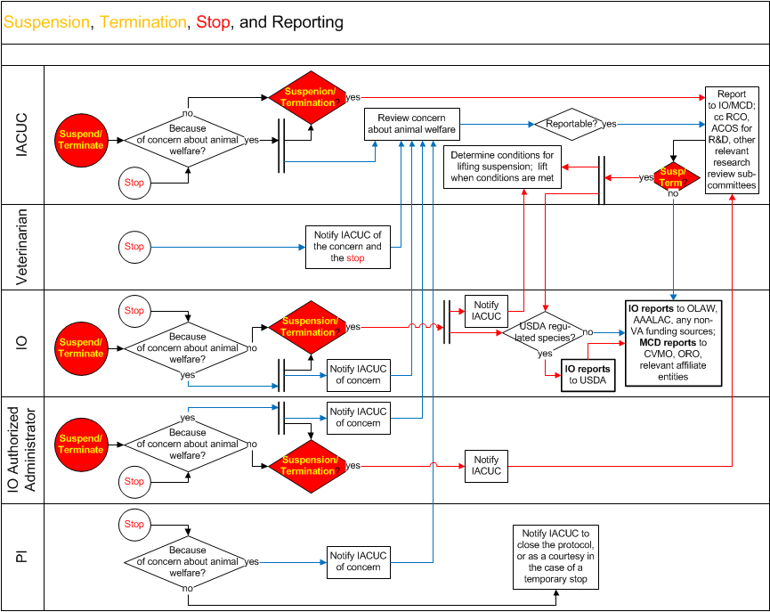
Notes:
This flow chart summarizes the processes to be followed in case IACUC approval for a protocol is suspended or terminated, or the work is otherwise stopped, and reflects the information presented on the preceding slides. Blue arrows indicate processes specific to concerns about animal welfare, red arrows indicate processes specific to suspensions and terminations, and black arrows indicate processes that apply in either case. If you have questions about this flow chart, please contact Alice Huang, alice.huang@va.gov.
The specific requirements for the IO to report to ”any non-VA funding sources” are established by those funding sources (e.g., the funding component for any NIH funding), generally to allow the funding sources to apply their own rules with regard to funding of suspended work. Reporting to Office of the CVMO addresses the requirements for “VA funding sources” – VA does not stop funding when work is suspended
Suspension of IACUC approval (by IO, anyone authorized by the IO, or the IACUC) can only be lifted by the IACUC subsequently approving resumption of work. There is no requirement that IACUC do this by majority vote at a convened meeting, but the conditions for lifting the suspension must be specified by the IACUC. The IO does not have the authority to lift a suspension. See PHS Policy IV.C.8.

