Slide 1

VA Animal Research Update at AALAS October 29, 2013, 12:45-1:50 PM Eastern
To join the Conference Call,
dial 1-800-767-1750, then press 63479 and the pound (#) key
Please place your phone on mute
…thanks!

Slide 2
For Conference Call Participants
Due to the large number of phone participants expected, we may not be able to take questions over the phone, but we will take questions by email (mary.proctor@louisville.edu) during the meeting.
We will respond to any questions not answered during the meeting later in the week.

Slide 3
Agenda
Thanks: Dr. Mary Proctor and the Robley Rex (Louisville) VAMC Clin Research Foundation
Travel challenges and the VANTS line
Material Transfer Agreements
Adoption of ACORP version 4- 2/1/14
National food and bedding contracts, others?
“Nuts and Bolts” guidance document
CRADA with Edstrom for IACUC tools
Guide scenario studies (not reviewed by OLAW)
Q&A

Slide 4
More about Guide Deviations and Departures
IACUC Training Exercise #3 -2013
Joan T Richerson, DVM
Assistant CVMO
Visio flowcharts prepared
by Dr. Alice Huang
4

Slide 5
Review of Terminology
Specifically established exceptions apply to deviations from must or should statements where certain exceptions are specifically described in the Guide and are considered acceptable when justified and approved by the IACUC. No reporting requirements.
Approved departures are deviations from Guide standards (must or should) that require scientific justification and IACUC approval. Must be reported in the semiannual report to the IO.
Noncompliance is a deviation from a must or should statement without IACUC approval and must be reported to OLAW through the IO.

Slide 6
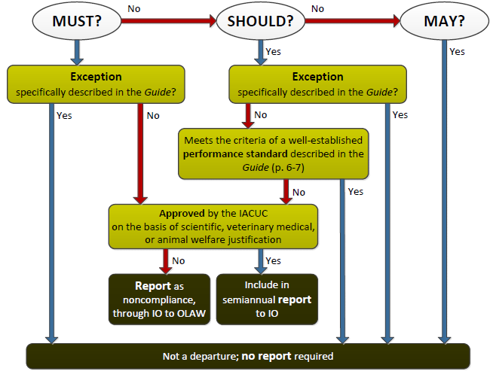
6

Slide 7
Guide Deviation/Departure Scenario Studies
Four scenarios are presented; each one illustrates either a specifically established Guide exception or an approved departure.
We will use the Guide language and the VA version of the Deviations and Departures flowchart to make a determination about the type of deviation illustrated in each scenario.
After the AALAS meeting, the entire presentation will be available at: http://www.research.va.gov/programs/animal_research/

Slide 8
Scenario #1
An investigator is conducting a study to determine if an increase in the number of Hantavirus infections is associated with wild cotton rats, a known Hantavirus carrier, foraging for food in residential areas. Cotton rats will be humanely trapped and then surgically implanted with tiny GPS devices to track their movements.
The investigator requests to perform the GPS implant surgery in the field because: (1) bringing the cotton rats into the animal facility could infect the resident rodent population and (2) minimal human contact is important so the rat’s behavior is altered as little as possible.

Slide 9
CVMO Office Opinion on Scenario #1
The issue is performing survival surgery under field conditions in cotton rats.
The Guide states “ Unless an exception is specifically justified as an essential component of the research protocol and approved by the IACUC, aseptic surgery should be conducted in dedicated facilities or spaces (pg. 116).
The investigator provided a protocol specific justification for survival surgery in a field setting, which was reviewed and approved by the IACUC.
This is a deviation from a should statement according to a specifically established exception in the Guide (not a departure) and has no reporting requirements.

Slide 10
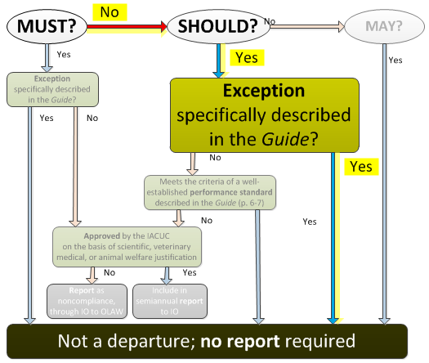
Scenario #1

Slide 11
Scenario #2
Trihalomethanes, a type of chlorinated byproduct, is added to municipal drinking water; however, they have been shown to increase the risk of cancer and birth defects. An investigator proposes to expose frogs to mildly elevated (non-lethal) chlorine and ammonia levels to simulate the combined effect of discharge from water treatment plants and run-off from intensive farming. The hypothesis is the progeny of the frogs exposed to these toxins will have a significantly higher incidence of cancer and birth defects than the control group.

Slide 12
CVMO Office Opinion on Scenario #2
The issue is maintaining frogs in water that has mildly elevated (non-lethal) chlorine and ammonia levels.
The Guide states “Chlorine and chloramines used to disinfect water for human consumption or to disinfect equipment are toxic to fish and amphibians and must be removed or neutralized before use in aquatic systems”(pg. 78).
This deviation is an approved departure from a must statement of the Guide that has been scientifically justified by the PI and reviewed and approved by the IACUC. Approved departures must be reported in the semiannual report to the IO.

Slide 13
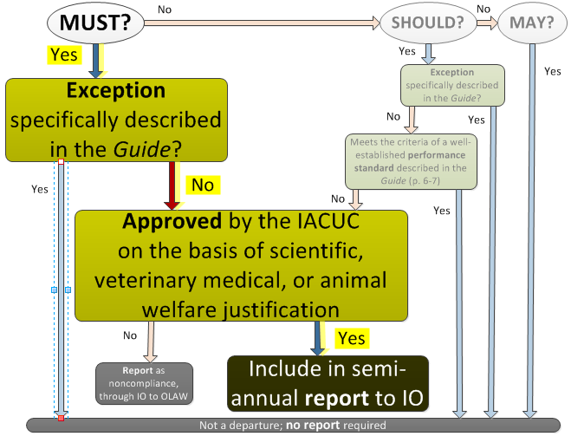
Scenario #2

Slide 14
Scenario #3
An investigator proposes to use a mouse model of autism to assess the effect of exposure to music on learning and memory performance. The autistic mice will be maintained under standard housing conditions for 4 weeks and then undergo a series of learning and memory tests.
In the second four weeks, housing conditions will be unchanged except the mice will be exposed to classical music for 8 hours/day, Monday through Friday. The mice will then undergo the same behavioral tests performed previously. Their performance on the tests pre- and post- music exposure will be compared.

Slide 15
CVMO Office Opinion on Scenario #3
The issue is exposing mice to music for 8 hours, 5 days/week in their animal holding room.
The Guide states – “Radios, alarms, and other sound generators should not be used in animal rooms, unless they are part of an approved protocol or enrichment program” (pg.50).
This is a deviation from a should statement according to a specifically established exception in the Guide (not a departure) and has no reporting requirements.

Slide 16
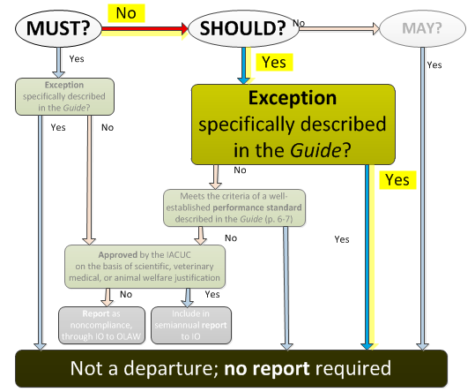
Scenario #3

Slide 17
Scenario #4
An investigator is studying the effect of chronic stress on the development of metabolic syndrome. Mild chronic stress will be induced by varying the housing conditions. Weaned littermate male rat pups will be housed two per cage. On Tuesdays and Thursdays, the rats will be housed on bedding heavily soiled by other rats. On Mondays, Wednesdays, and Fridays, the rats will be housed on wet bedding (sufficiently wet with water to soil the fur). On Saturday and Sunday, the rat pairs are housed in clean cages with fresh bedding.

Slide 18
CVMO Office Opinion on Scenario #4
The issue is housing rats on soiled or wetting bedding 5 out of 7 days.
The Guide states “Soiled bedding should be removed and replaced with fresh materials as often as necessary to keep the animals clean and dry and to keep pollutants, such as ammonia, at concentration below levels irritating to mucus membranes”(pg. 70).
This deviation is an approved departure from a should statement of the Guide that has been scientifically justified by the PI and reviewed and approved by the IACUC. Approved departures must be reported in the semiannual report to the IO.

Slide 19
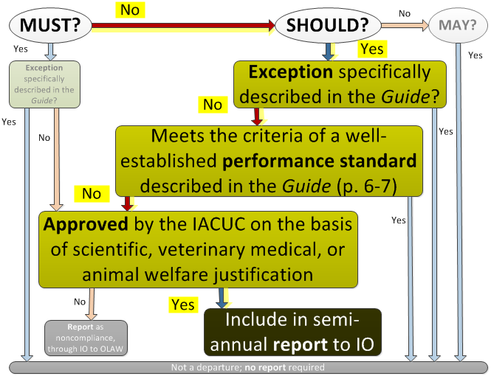
Scenario #4

Slide 20
Take-Home Points
 | Specifically established exceptions | Approved departures
Apply to | must or should statements where certain exceptions are noted in the Guide and are accepted with justification and approval by the IACUC | deviations from Guide standards that require scientific justification and IACUC approval.
Reporting requirements | None (not a departure) | Yes – to the IO via the semiannual report.*
Helpful hints | Try looking for the word “unless” in association with must or should statements. | Look for must or should statements with a requirement but no qualifiers.
*Note in Appendix 9 of the ACORP (version 4) and Part 2 Table of Deficiencies and Departures of the VA Semiannual Evaluation form

Slide 21
Another Way of Thinking About it…
Deviations from Guide
Exceptions
(in Guide language)
No action needed
Approved Departures
Report to IO
Unapproved Departures (non-compliance)
Report as deficiency

Slide 22

http://diylol.com/meme-generator/business-cat/memes/thank-you-for-your-attention

