Slide 1
Tracking Studies and Using IRBNet Reports
Jennifer Ordman, MPH, IRB Coordinator (Hines VA Hospital)
September 23, 2020

Slide 2


2018 Common Rule Transition
Research subject to the 2018 Common Rule, continuing review is not required for:
  Research eligible for expedited review/limited IRB review OR
  Research progressed to one or all:
    Data analysis
    Accessing follow-up clinical data
Rule of Thumb:
Transition eligible studies at time of continuing review

Slide 3
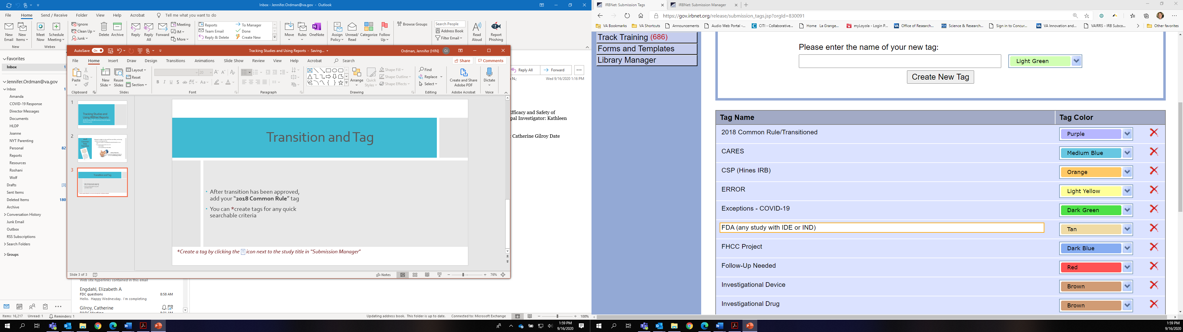
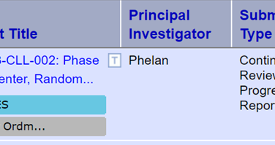
Transition and Tag
After transition has been approved, add your “2018 Common Rule” tag
You can *create tags for any quick searchable criteria
‘At-a-Glance’ review at common criteria
Global Tags vs. Individual Package tags
*Create a tag by clicking the icon next to the study title in “Submission Manager”

Slide 4
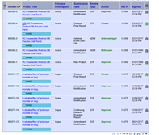
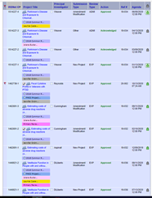
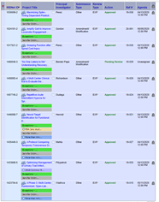
What To Search?
Non-Profit
2018 Common
Rule
Common Tags:
Name of IRB staff responsible for package (individual tag)
Follow-Up Needed
FDA/IDE/IND
Non-Profit (global tag)
More than Minimal Risk (global tag)
ISO/PO Needed
Primary Reviewer Assigned
COVID-19
Exceptions

Slide 5
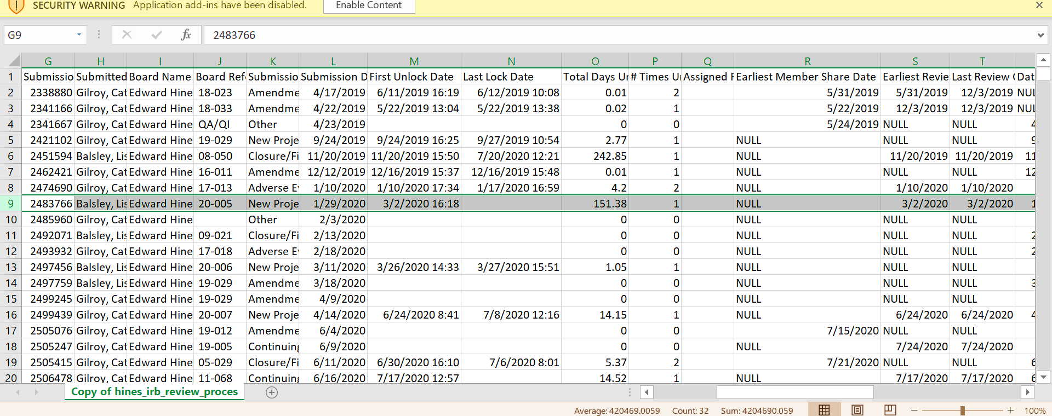

IRBNet Reports – How To Utilize/Tips
Request reports that benefit your subcommittee (don’t be overwhelmed)
Decide when and who will receive the reports (1st of the month, quarterly, etc.)
Designate an Outlook “folder” to have reports sent – this will allow you to view when needed
Always save your reports as .zip!

Slide 6
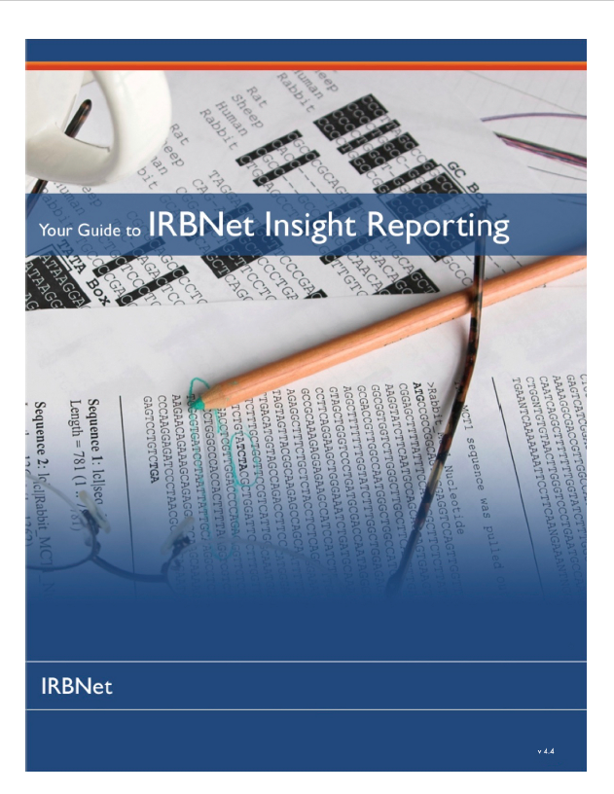
Common IRBNet Reports -
IRBNet “Insight Reporting Guide” is a helpful resource
Expiration Report
Review Process
Project Status
Active Studies
Unpublished Document Report
IRB “Scorecard”
Helpful for audits, RCO reporting, and QI/QA!

Slide 7
What kind of information can I get from the reports?
Review Process Report
  Latest package (-1,-19)
  Days unlocked
  Type of package (CR, Initial)
  First member shared (when was it assigned)
  Board docs published (have approval docs been published)
  Review details edited (discussion/remarks)
Project Status Report
  Latest package
  Submitted and agenda dates
  Risk level
  # of packages received
  Review details date
Active Studies
  Quick view on # of active studies

Slide 8
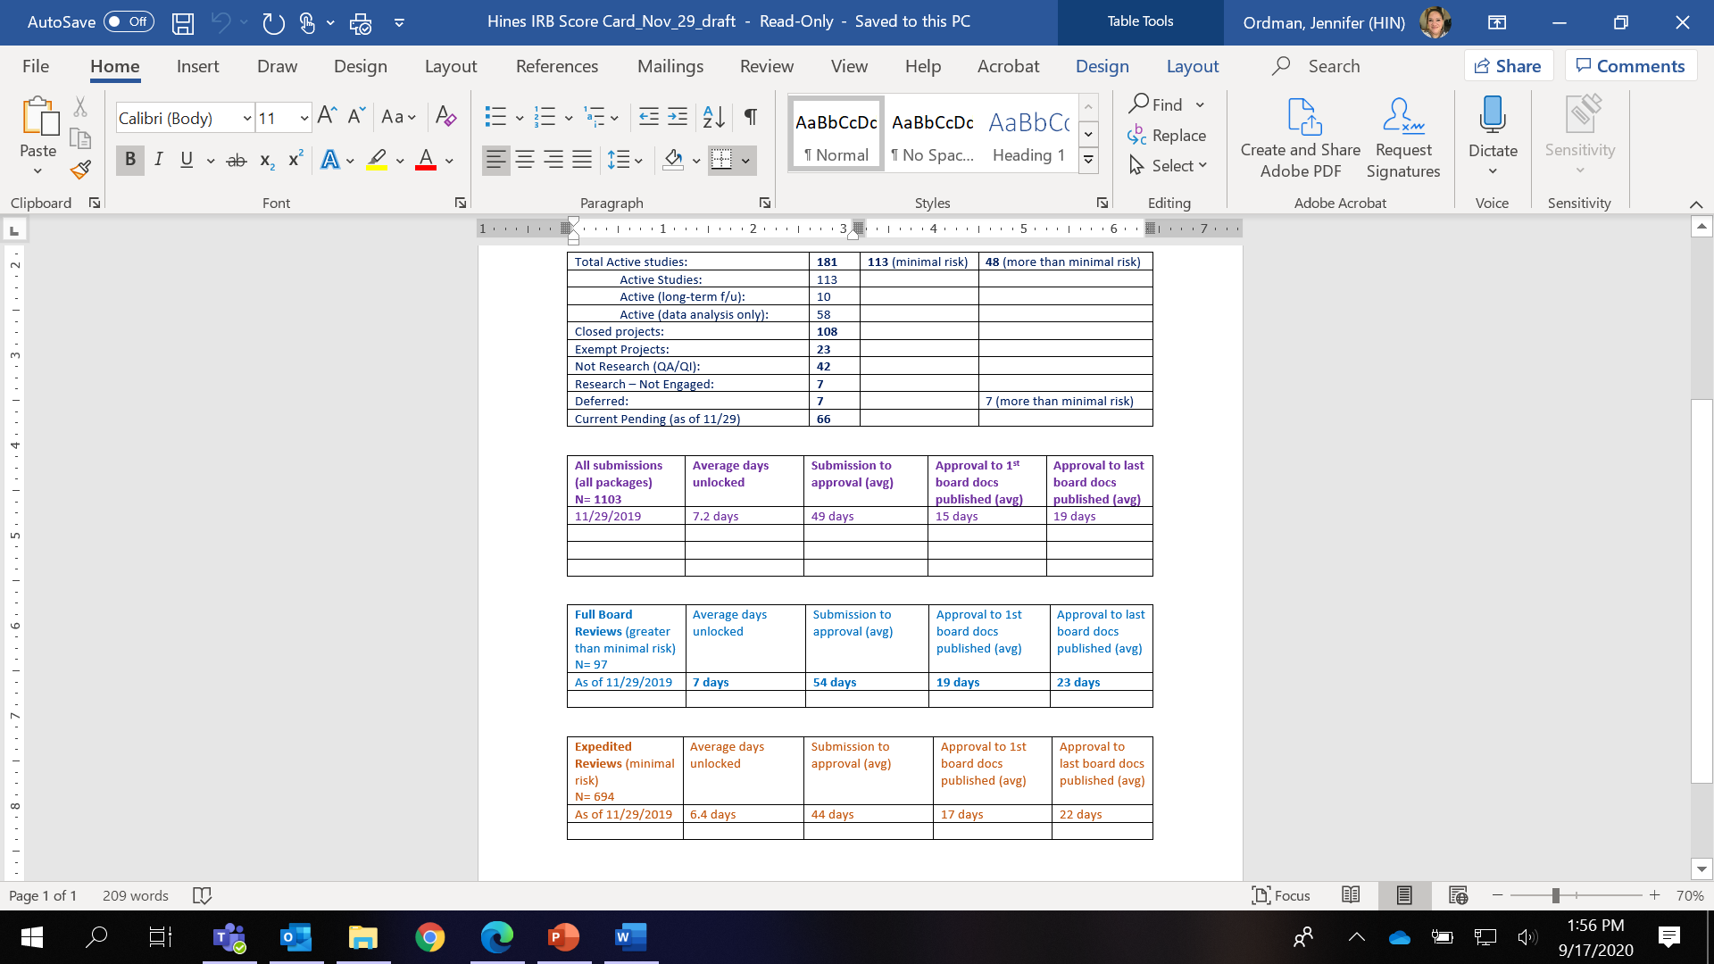
IRBNet Report: Board Scorecards
IRB Scorecard Report
  Snapshot of IRB workload
  Areas for improvement
  Helpful for R&D Report

Slide 9
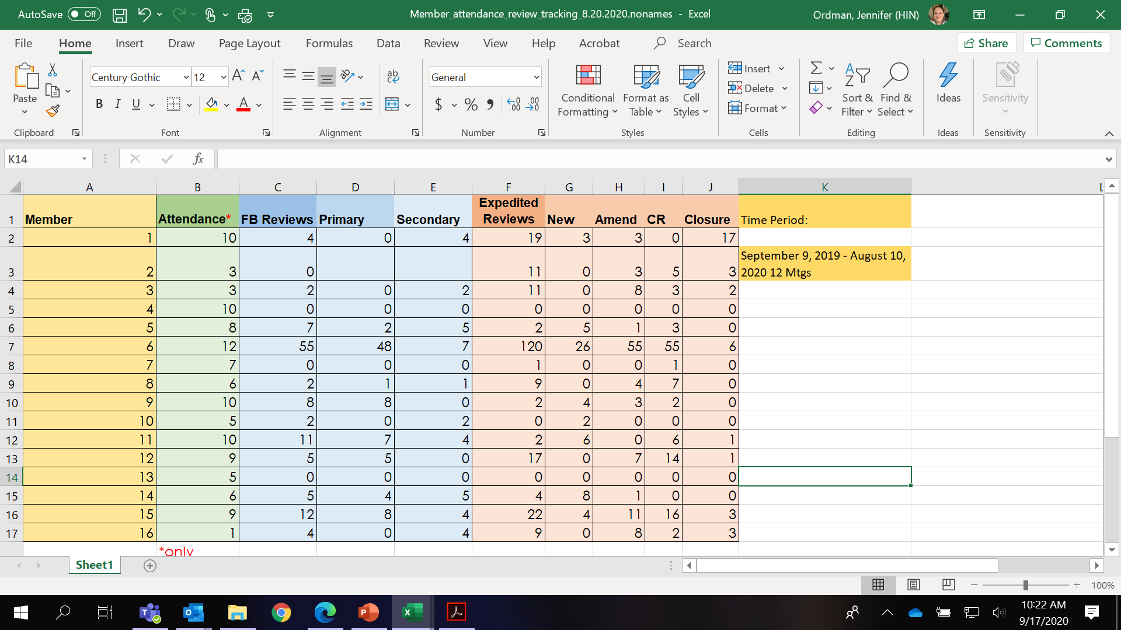
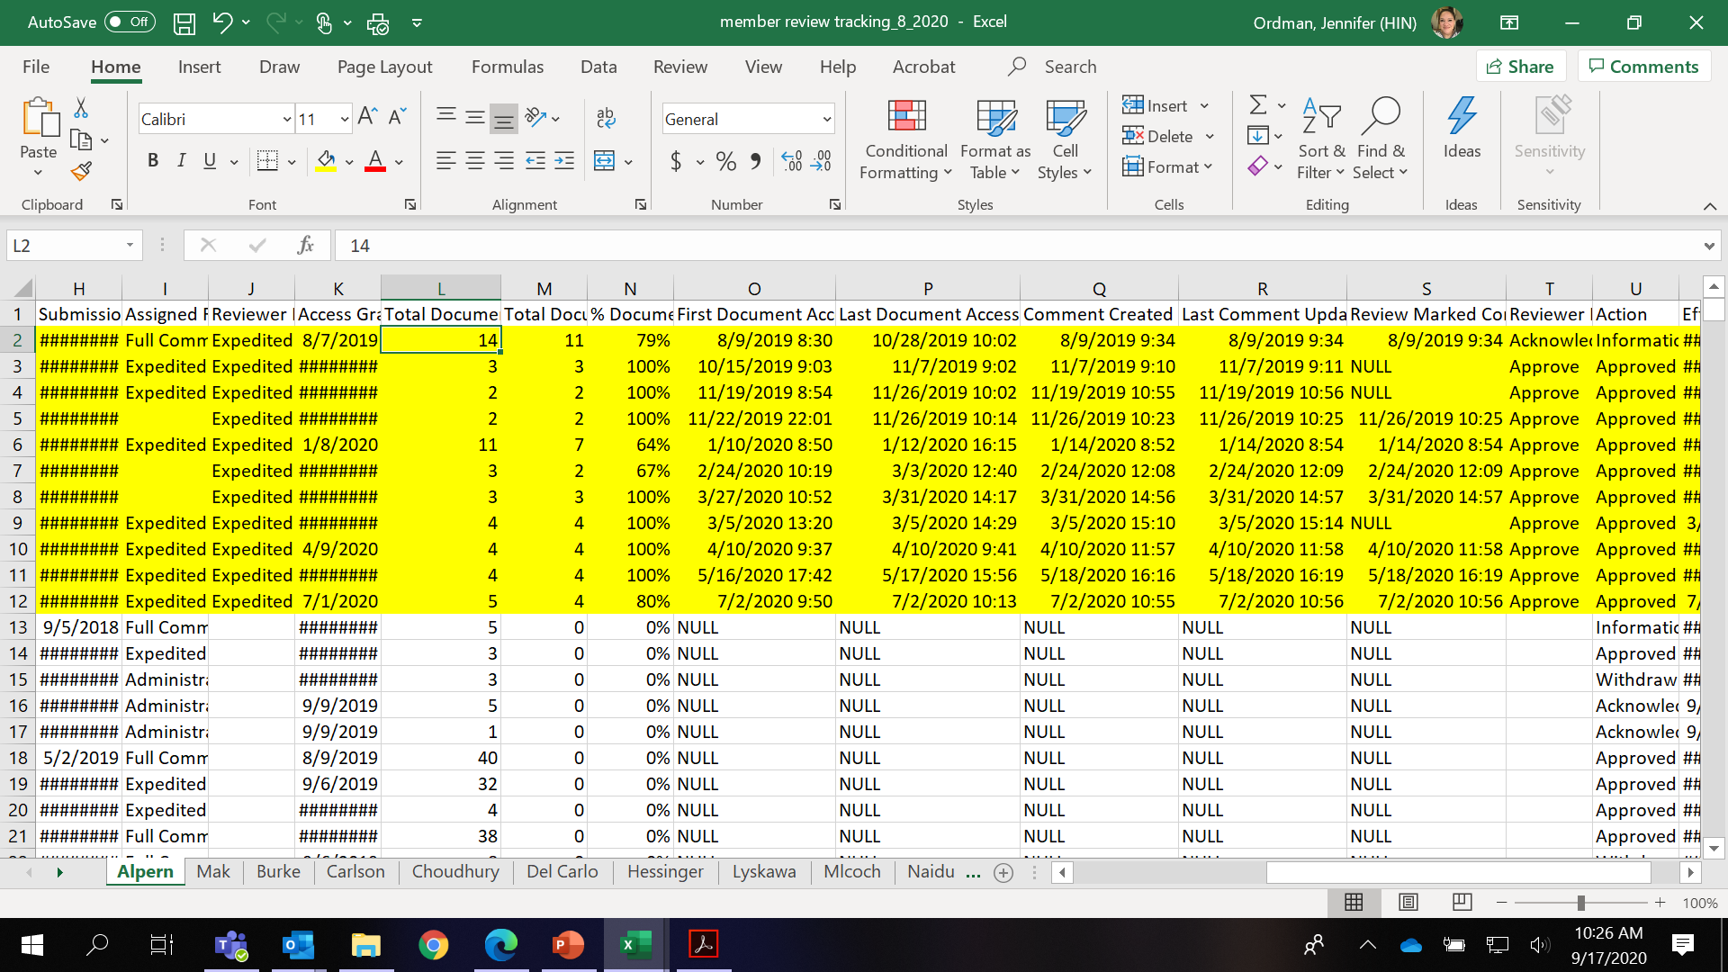
What Kind of IRB member Information from a Report?
IRB Scorecard – great way to audit members
  Type of review assigned
  Attendance
  # of Documents accessed
  Reviewer Comments/Action (& date)
  Access granted date (vs. date assigned)

Slide 10
Any Questions?
Jennifer.ordman@va.gov
708-202-7107

