Slide 1

Managing Budgets during a Continuing
Resolution and Status of Prior Year
January 23, 2025
Diane Murphy, ORD Finance
Erin Olson, ORD Finance
Kari Points, Advisor, Field Operations

Slide 2
Objectives – for today’s training
Training Section: | By the end of this section, you will:
Section 1: Managing your budget during a Continuing Resolution (CR) | Understand what it means to budget during a CR. Identify the challenges that occurred during the 1st CR and preventable measures to take during the 2nd CR.
Section 2: Status of Prior Year Funds | Understand the current status of prior year funds. Identify the challenges that are occurring with the execution of prior year funds. Understand the need to execute cost transfers and obligate only for amount of IPAs.
Section 3: Reminder: FY25 Carry-Over Guidance | How to operate the 2% carry-over and cc101 funds (if applicable)
Q&A
Notes:
John

Slide 3
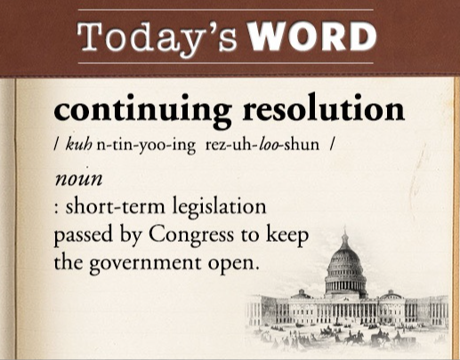
Section 1: How do we operate under a continuing resolution?
Yes, this will be on the exam!
ORD Finance Full FY 25 CR Guidance

Slide 4
Section 1: What do I need to know about Continuing Resolutions (CR)?
What do I need to know? | Answer
What is a CR? | CRs are short-term appropriations that bridge the gaps that arise between the end of appropriations for one fiscal year and the start of appropriations for the next.
What is the funding rate of CR? | CRs are funded at the rate of operations of the previous Fiscal Year.
What activities can be funded during a CR? | All Research activities (with limited exceptions for new major programs that are listed in the President’s Budget Request) should continue uninterrupted during a CR.
For further details consult our guidance, ORD Finance Full FY 25 CR Guidance.
Notes:
-Jason

Slide 5
Details on CR by Obligation Type
Obligation Type | Key Details
Payroll | Continue hiring actions for projects listed in the ITA and new starts that are approved.
Travel | Planned travel should utilize current year (0161A1 25-26) funding and not extend beyond the CR end- date.
Purchase Card | Execute required purchases to cover needs through the CR end date. All Purchase Card Orders must be charged to current year (0161A1 25-26).
IPAs/Subject Reimbursements | Research Stations should NOT obligate past the CR date. Incrementally fund the IPA amount at the % of the CR rate of operations. If needed, the following language can be added to the agreement: “Funds are not presently available to fund the agreement for the entire fiscal year. The Government’s obligation under this IPA is contingent upon the availability of appropriated funds from which payment for this IPA can be made.”
Contracts | If funds are available, contracts can be obligated past the CR date. The key is: funds need to be available.

Slide 6
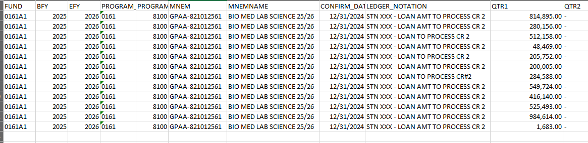
What happened during the first CR?
If you received a TDA that said LOAN in the ledger notation, this means that you had a deficit in the 0161A1 FY25/26 appropriation.
ORD sent your station funds so that you could continue to operate. If ORD wouldn’t have done this, your station would have had to stop all spending as you cannot operate with the appropriation in a deficit.

Slide 7
What happened during the first CR?
ORD had to loan $11,358,677 to 29 stations due to deficits in the 0161A1 FY25/26 appropriation.
If one station has a deficit, ORD is not able to send out the TDA’s for the next Continuing Resolution.
These loans are in the process of being pulled back as they were a loan and not funds for you to keep on station.
Need to avoid this situation on March 15th so the next round of funding can be sent out without providing these loans.
Bottomline: Stations need to operate within their CR budgets.

Slide 8
What caused the deficits?
Understandable Reasons:
  Funds had not been sent for Reimbursables or TEF so station could not execute cost transfers.
  Funds had not been sent for Special Purpose (SP) funds on Medical Center appropriation so station could not execute cost transfers.
  Deficit due to end of Continuing Resolution and delay in funds being sent out for 2nd CR.
  Fiscal did not process cost transfers to prior year or Medical Center appropriation as requested. Not a viable reason.

Slide 9
What caused the deficits?
Preventable Reasons:
  IPAs (1358s) have been obligated for amounts that exceed the amount needed through the CR date. (Example: 12 months of IPA = $60,000. Only $15,000 should have been obligated during the 1st CR. Once the 2nd CR was approved, another $15,000 should be obligated).
  Contracts/Task Orders have been obligated for more than you can afford. Station(s) obligated task orders for entire year but did not have the funds to do so.
  Special Purpose (SP) funds on the Medical Center appropriation are onsite, but station did not execute cost transfers from Research to the Medical Center.
  Station has balance in 0161R1 and 0161X2 reimbursables but cost transfers were not executed.

Slide 10
What caused the deficits?
Preventable Reasons (cont).
  Cost transfers from current year to prior year have not been completed. Site has unobligated balance in prior year, deficit in current year, executing a cost transfer will bring down balance in Prior Year and eliminate deficit in Current Year.
FY24/25 (PY) 1/2/2025 unobligated balance | Received Loan in FY25/26 (CY)
$ 1,290,114.91 | $ 280,156.00
$ 955,832.52 | $ 512,158.00
$ 667,292.36 | $ 100,000.00
$ 461,274.56 | $ 284,588.00
$ 414,436.96 | $ 200,000.00
$ 273,714.54 | $ 200,000.00
$ 103,270.17 | $ 25,000.00
In each of these cases, the station had more funds in Prior Year than what was loaned in Current Year. If the station had done cost transfers from Current Year to Prior Year, a loan would not have been needed.

Slide 11
Clarification on Overcommit
You may be thinking to yourself, "but ORD states that I should put my FCPs on overcommit during a CR."
Overcommit should only be used at the beginning of the fiscal year when waiting for the funds for the 1st CR to be sent out.
It should NOT be used to over obligate during the CR once funds are sent unless there is an unavoidable issue (can’t execute cost transfers due to delays in TEF, reimbursables or SP funds).

Slide 12
Tips for Managing within your Budget during a CR
Look at your unobligated balance on your SOA.
Subtract any committed (not obligated) items that are in IFCAP/VISTA pending. Note: If a 2237 or 1358 has been entered for an obligation that starts after April 1, it does not need to be included in committed amount.
Factor in salary costs for 5 pay periods (there are 4 pay periods between now and March 15th. By the time funds are sent out in next TDA, there will also be accruals).
Factor in any cost transfers that will be done.
The remaining amount is what you have left for 1358s, 2237s and purchase card orders.

Slide 13

Tips for Managing within your Budget during a CR (Example)
FMS Unobligated Balance = $2,403,779.65
IFCAP Pending = $281,905.75
Salary Costs - $300,000 per pay period x5 = $1,500,000
Cost Transfers from CY to PY = $150,000
$2,403,779.65
-$281,905.75
-$1,500,000
+$150,000
$771,873.90 = Amount left for all other obligations
There is a $750,000/year task order for a contract that starts on March 1st. Can this station go ahead and obligate full amount for one year? NO!
This will only leave $21,873.90 for all other expenses including payroll adjustments, cost of living increases and will put other PI projects in jeopardy if they are unable to purchase necessary supplies. Execute the task order for a shorter time.

Slide 14
Section 2: What is the current status of Prior Year?
There is currently $17.3M in prior year in the field.
Any Prior Year funds on station on April 15th will be pulled back. Any deobligations in prior year past this date will also be pulled.
Continue to execute cost transfers. Quarter 1 cost transfers should now be completed. Currently $16M have been completed so progress is being made.
Contact ORD Finance if you are having problems executing your cost transfers. We are here to help!

Slide 15
What are issues we are seeing in Prior Year?
There are stations that have increased their prior year amounts. Large amount of deobligations have occurred. This is something that ORD is monitoring.
FY 24 10/1 unobligate balance | FY24 1/2/2025 unobligated balance | Difference
$ 315,694.94 | $ 923,069.18 | $ 607,374.24
$ 929,591.44 | $ 1,290,114.91 | $ 360,523.47
$ 38,456.81 | $ 328,271.72 | $ 289,814.91
$ 173,820.65 | $ 422,246.94 | $ 248,426.29
$ 529,765.15 | $ 762,166.62 | $ 232,401.47
$ 163,744.08 | $ 341,290.56 | $ 177,546.48
$ 947,430.76 | $ 1,105,683.59 | $ 158,252.83
$ 11,356.02 | $ 99,351.93 | $ 87,995.91
$ 50,157.53 | $ 118,396.87 | $ 68,239.34
$ 162,190.27 | $ 214,511.19 | $ 52,320.92
This station did cost transfers in the amount of $467,517 but also had $1.118M in deobligations
1358s should only be obligated for the amount of the IPA agreement. Large amounts of deobligations gives the appearance of hiding funds to get to 2%. DO NOT do this!
This station did cost transfers in the amount of $855,107 but also had $1.99M in deobligations.

Slide 16
Section 3: Reminder: FY 25 Guidance
For prior year funds within your 2%, you do have flexibility but make informed decisions on when to obligate funds vs. executing cost transfers. Which option will spend your prior year funds first?
  Example – A contract will not be executed until April 1, 2025. Instead of using FY24/25 funds, conduct a salary cost transfer from FY25/26 to FY24/25. This will free-up funds in FY25/26 to be used for the contract.
  Note: Be careful if you obligate IPAs and contracts in PY funds that end late in the year. You may not have enough time to receive invoice and make adjustments to increase or decrease obligation prior to funds expiring. It is best to execute salary cost transfers to spend PY.

Slide 17
Reminder: FY 25 Guidance
For prior year funds being used for CC101, no new transactions (contracts, 1358s, purchase cards, travel) in FY 24/25 funding should be obligated. Salary cost transfers need to be done to spend the prior year funds.
Link to guidance on how to execute: 2 Percent Carry-Over and CC101 Cost Transfers FINAL.docx

Slide 18
Questions

