Slide 1
Welcome to the ePROS Webinar.
We will begin shortly.
Check the chat box for handouts that may have been uploaded by the presenters.
Please mute your mic and use the chat box or raise your hand to ask questions. Reactions are also encouraged.
Please complete the post-webinar evaluation survey, available here after the webinar. The presenter will post the link in chat.
If you experience sound issues– call in using the number included on the TEAMs calendar invitation.
Notes:
Presenters – Please do not make changes to this slide.
HOSTING THE WEBINAR
Join the webinar 10 minutes early
Start with a sound check of all speakers
Share the PowerPoint slides- ask if other speakers can see it
Begin Recording
At the end of the meeting, remind audience to fill out the survey. Add survey link to chat.
Q&A ASSISTANT ROLE
When questions are submitted, please respond in the chat “Thank you for your question.”
Copy and paste submitted questions into a PowerPoint document to share at the end during the last 15-ish minutes of the webinar. You will only need to share your screen. The presenter will read the questions aloud and answer the question.
Download attendance list of meeting. Send reminder to fill out survey if they haven't already, providing survey link. Test link before sending.

Slide 2
Monthly Webinar
VA INNOVATION AND RESEARCH REVIEW SYSTEM (VAIRRS)
January 28, 2024
PRESENTERS:
Alex Miller, Attorney Advisor, OGC – Ethics Specialty Team (EST)
Angela Foster, VAIRRS Program Manager

Slide 3
AGENDA
WELCOME
ANNOUNCEMENTS AND WEBINAR OBJECTIVE
FCOI TRAINING – OGC ETHICS AND OPERATIONALIZING FOR IRBNET
Q&A

Slide 4

WEBINAR HOUSEKEEPING
1
RECORDING
2
Q&A
This session is recorded, and the associated handouts will be available on ePROS Education and Training website within a week after the webinar.
Please use the chat box to submit questions.
Questions will be addressed at the end
of the webinar.
3
CLOSE CAPTIONING
4
WEBINAR ARCHIVE
Available on Teams. At the top menu bar select: “More,” “Record and transcribe,” and “Transcript.”
Most ePROS webinars can be found here: https://www.research.va.gov/programs/epros/education/webinars/archives.cfm

Slide 5
IMPORTANT ANNOUNCEMENTS
VAIRRS BEST PRACTICE SANDBOX (BPS)
DATA DICTIONARY WORKGROUP
FEBRUARY VAIRRS WEBINAR
You are invited to participate in the soft launch of the VAIRRS BPS, a collaborative platform designed to facilitate the sharing of local research-specific VAIRRS processes and best practices, as they relate to IRBNet, within the VA research community.
During the soft launch, participants are asked to submit best practices.
If you are interested and available, please email VAIRRS@va.gov with the subject line “Interested in BPS Testing” by Wednesday, January 29.
VAIRRS is establishing a standardized version of the VAIRRS Data Dictionary (current version is available through VAIRRS University).
We are requesting assistance from the field in this effort.
If you would like to participate in the workgroup, please email VAIRRS@va.gov as soon as possible.
Join the February installment of the VAIRRS Monthly Webinar series.
On February 19, 2025, learn about updates to the following wizards: Project Cover Sheet and IRB Information Sheet.
An invite will be sent closer to the webinar.

Slide 6
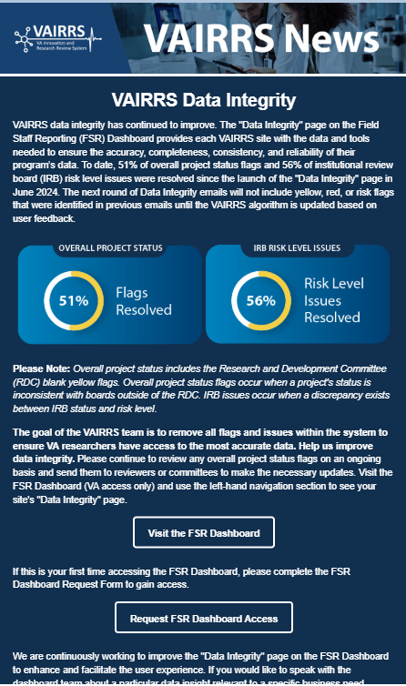
VAIRRS NEWSLETTER
Subscribe to the VAIRRS
Newsletter to keep up with important announcements
and program updates.
SUBSCRIBE
https://public.govdelivery.com/accounts/USVHA/subscriber/new?topic_id=USVHA_1952

Slide 7
FINANCIAL CONFLICT OF INTEREST (FCOI) TRAINING – OFFICE OF GENERAL COUNSEL (OGC) ETHICS AND OPERATIONALIZING FOR IRBNET
PRESENTERS:
Alex Miller, Attorney Advisor, OGC – Ethics Specialty Team (EST)
Angela Foster, VAIRRS Program Manager

Slide 8

FCOI TRAINING – OGC ETHICS AND OPERATIONALIZING FOR IRBNET
The purpose of this webinar is to provide additional insight into the Alt 450 submission and review process.
The objective of this webinar is to ensure all FCOI Administrators understand the process for submitting Alt 450s to OGC EST in IRBNet and what to expect during and after review.

Slide 9
OGC Ethics Specialty Team

Slide 10
OGC EST ALT 450 REVIEW – Common Questions
What is Technical Review?
What documents should researchers submit with their ALT-450?
How is communication handled during EST’s review?
What response times should researchers expect?
How are conclusions communicated?

Slide 11
WHAT IS THE TECHNICAL REVIEW?
FCOIA’s initial review of the form to answer two key questions:
  Did the Investigator provide all required information?
    Did they answer every question and adequately substantiate their responses?
  Do I understand what the Investigator is telling me? Can I understand the potential conflict?

Slide 12
DOCUMENTS SUBMITTED WITH ALT-450
The key documents, at least initially, are:
  The fully executed Alt-450;
  Other documents that describe the study, such as the study protocol, the statement of work, or any CRADA or subaward documentation.
However, other information may be needed, depending on the nature of the conflict.

Slide 13
WHAT OTHER INFORMATION MIGHT EST NEED?
The type of interest disclosed will determine whether and what types of additional information is needed.
  Ex: If intellectual property is disclosed, information regarding:
    Ownership interests/rights;
    Licensing/commercialization status;
    Source of royalties.
  Ex: For stocks and sector funds, documentation establishing the name of the fund/company and their present value could be helpful.
Ideally, this information would be represented on the Alt-450, before it is submitted to EST.

Slide 14
COMMUNICATION DURING THE REVIEW
Paralegal Assignment and Initial Review
Attorneys will direct follow-up inquiries to the appropriate parties
  E.g., the researcher, Tech Transfer, or the FCIOA as applicable.
In most cases, the attorney will communicate directly with the researcher if follow-up information is needed.
Communication may be executed verbally or in writing, as appropriate.

Slide 15
TIMELINE FOR REVIEW
Depends on a variety of factors:
  Complexity of the case/whether information is needed from the researcher;
  Whether researchers are responsive to information requests;
  Attorney case load;
  Etc.
Cases marked as “urgent” will be prioritized.

Slide 16
HOW ARE CONCLUSIONS COMMUNICATED?
Where no conflict issues arise, the attorney will send the signed ALT 450 (and any attending legal opinion) to the investigator, the FCOIA, and the ORD Central Administrator Inbox.
  EST personnel do not upload any documents directly to IRBNet.
If there is a conflict, the attorney will work with the investigator to see if it can be resolved. If it cannot, the attorney will notify the ORD Central Administrator Inbox.

Slide 17
Process Review

Slide 18
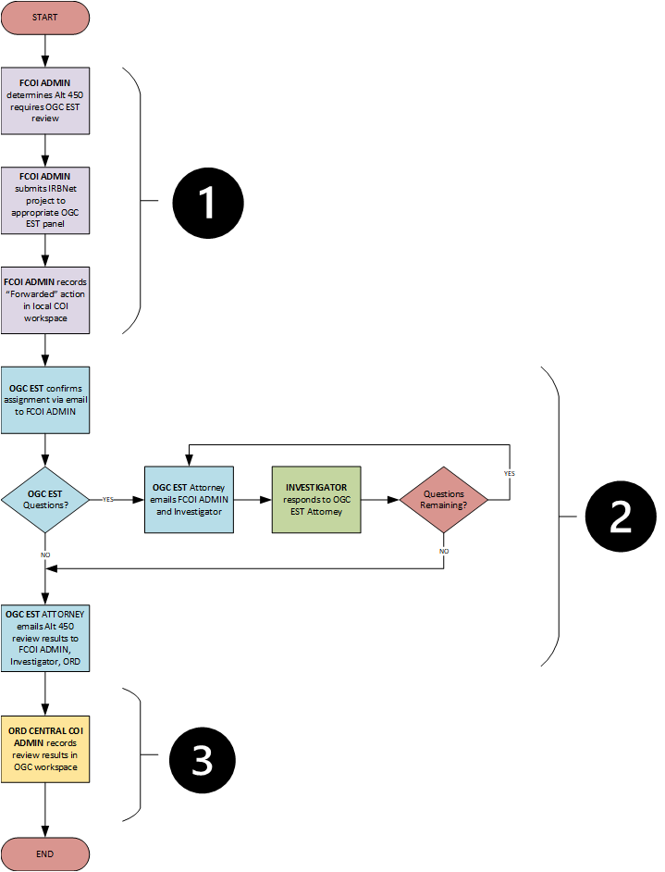
OGC ETHICS SUBMISSION AND REVIEW
Once the FCOI Administrator determines an Alt 450 requires review by OGC EST, the submission and review process consists of 3 primary phases:
Phase 1 – FCOI Administrator submits to OGC EST in IRBNet
Phase 2 – OGC EST conducts review and provides review results
Phase 3 – ORD Central COI Administrator closes out submission in OGC workspace
We will walk through the steps within each phase.

Slide 19
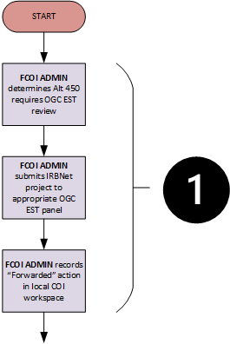

PHASE 1
The FCOI Administrator is responsible for ensuring the COI disclosure submission includes the completed Alt 450 wizard and the protocol document. OGC EST cannot conduct a review without the required documents.
The FCOI Administrator updates the Review Details in the submission package as follows:
  Review Type: Administrative
  Board Action: Forwarded
  Effective Date: Current Date
For submissions to OGC EST, the FCOI Administrator should not record Alt 450 review results (i.e., “No Conflict”, “Conflict of Interest”, etc.) in the local COI workspace.
Dummy Agenda Dates and Tags are great ways to organize the COI workspace and quickly locate submissions based on OGC EST review status.

Slide 20
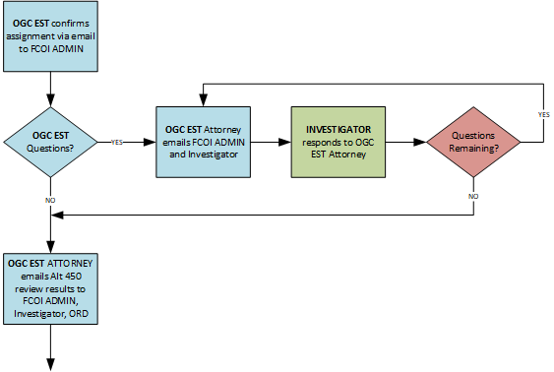
PHASE 2
Phase 2 steps are typically conducted outside of IRBNet.
OGC EST utilizes Outlook for all post-submission communication with FCOI Administrators and investigators.
OGC EST will confirm receipt and attorney assignment via email to the FCOI Administrator.
OGC EST will download required documents from IRBNet. Assignment and/or review may be delayed if required documents are not included with submission.
OGC EST will send all follow-up questions via email to FCOI Administrator and investigator. Timely responses will prevent delays.
OGC EST will provide review results via email to FCOI Administrator, investigator, and ORD Central COI Administrator.

Slide 21
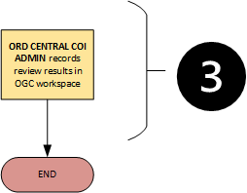
PHASE 3
The ORD Central COI Administrator is responsible for recording the Alt 450 review results, uploading the signed form in OGC EST’s IRBNet workspace, and recording the submission package review results. Disclosure review results are recorded separately from the submission package review results.
The Alt 450 review results and uploaded Alt 450 are immediately available to the FCOI Administrator and investigator.
For submissions to OGC EST, the FCOI Administrator should not record Alt 450 review results (i.e., “No Conflict”, “Conflict of Interest”, etc.) in the local COI workspace.
In event the ORD Central COI Admin is omitted from the final review results email, please forward a copy of the email, with attachments, to ordcentralcoiadministrator@va.gov.
The ORD Central COI Administrator aims to record review results within 24-hours of receiving final email.

Slide 22
RESOURCES
Resource Type | Resource Location
VAIRRS University, “Conflict of Interest (COI) Administrator” Role | https://dvagov.sharepoint.com/sites/VHAORPPE/VAIRRS/SitePages/Conflict-of-Interest-(COI).aspx
IRBNet Training Energizer – COI Review Process
IRBNet Training Energizer – Submitting COI Disclosures
Guidance document – Submitting an Annual or Interim COI Disclosure | In development
Previous COI Webinar Recordings | https://www.research.va.gov/programs/epros/education/webinars/archives.cfm
ORD Central COI Administrator | ordcentralcoiadministrator@va.gov

Slide 23
QUESTIONS?

Slide 24
THANK YOU FOR JOINING!
If you have any questions, please contact the VAIRRS Support Team at VAIRRS@va.gov.

