Slide 1
Resuming Normal Animal Facility Operations
Michael Fallon, DVM, PhD, DACLAM
Chief Veterinary Medical Officer
michael.fallon@va.gov; 404-732-5471
Alice Huang, PhD
Deputy CVMO for IACUC Support, Staff Scientist
alice.huang@va.gov
Joan Richerson, MS, DVM, MS, DACLAM
Assistant CVMO
joan.richerson@va.gov

Slide 2
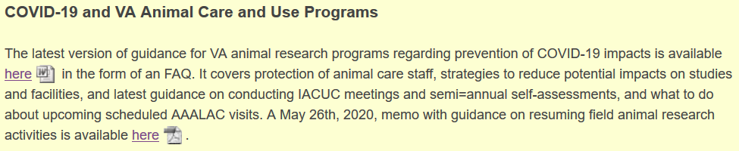
Animal Research Protection Resumption Memo and FAQs
Both documents available at https://www.research.va.gov/programs/animal_research/default.cfm.
The animal research resumption memo is more relevant at this time.

Slide 3
Resuming Normal Animal Facility Operations
The impact of SARS-CoV-2 pandemic has varied widely across the agency- some facilities were heavily impacted, others much less so.
Some local animal research programs were suspended and animal maintenance was the only ongoing activity; other programs had minimal disruptions
The resumption memo is intended as guidance to help programs think about how to resume normal research support operations, and does not require any particular approach or plan.

Slide 4
Goals- Past, Present, and Future
Ensure animal care.
Keep animal care staff healthy.
Note- in this presentation the important distinction is between the conduct of IACUC-approved research (“research support activities”) versus animal care activities (feeding, cleaning, providing medical care to the animals).

Slide 5
Maintaining these Goals
Separate animal care staff from research staff whenever possible
  Set aside time for animal care activities when research staff not present
  Alternate animal care and research activities in the same room so both activities are not happening concurrently
Social distancing: Reduce density of people in the animal facility, and manage the density of people working in the same room
  Stagger shifts to reduce contact between people
  Place limits on the number of people allowed in the facility or in a single room at the same time.

Slide 6
Maintaining these Goals
Require the use of PPE.
  Decide on surgical versus N95 mask usage- N95 recommended for close contact, for example during team-based surgical procedures.
  Is the supply of PPE adequate to support increased animal research support activities?
Decide if some more risky research activities that involve loss of social distancing and increased density can be supported at this time:
  Team-based procedures like surgery are higher risk
  Solo procedures like rodent blood collection are less risky

Slide 7
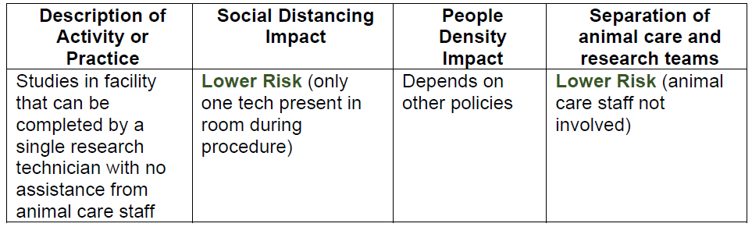
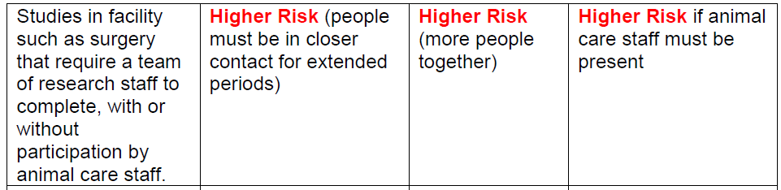
Putting it All Together- Resumption Memo Sections
Table of sample research activities and animal care activities, with sample risk determinations for each activity.

Slide 8
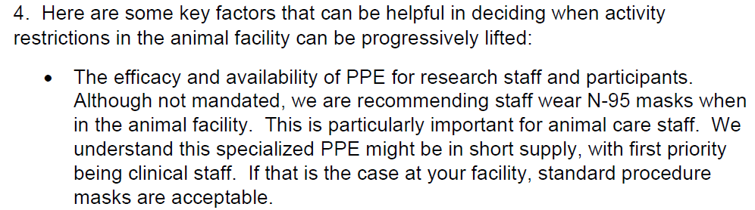
Putting it All Together- Resumption Memo Sections
Key factors to help in formulating a resumption plan

Slide 9
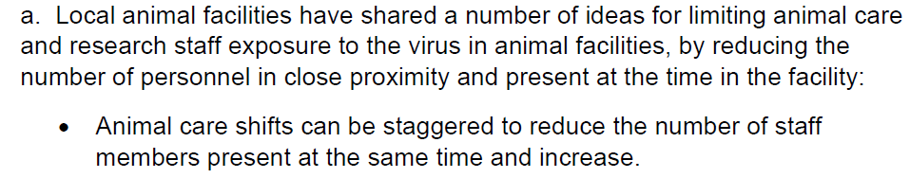
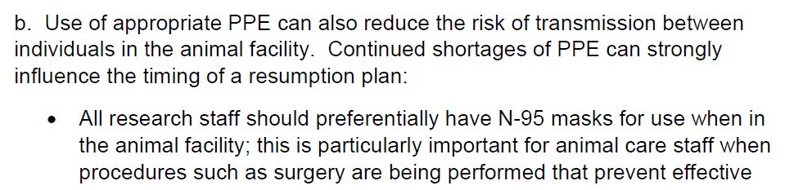
Putting it All Together- Resumption Memo Sections
Additional ideas on limiting interaction between animal care and research staff members, and some ideas on the use of masks:

Slide 10
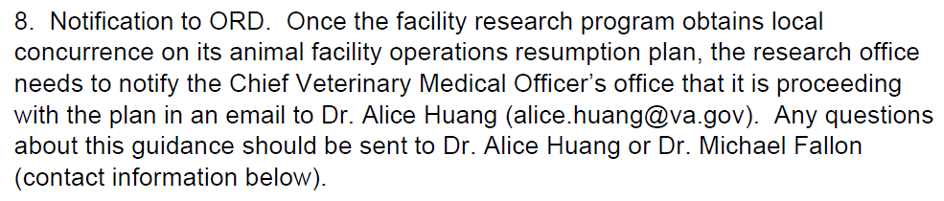
Request to notify ORD when a resumption plan is locally approved and in use (note- ORD does not need to review or approve these)

Slide 11
Putting it All Together- Resumption Memo Sections
Attached guidance algorithm- may be helpful in developing the resumption plan based upon minimizing risk factors.

Slide 12
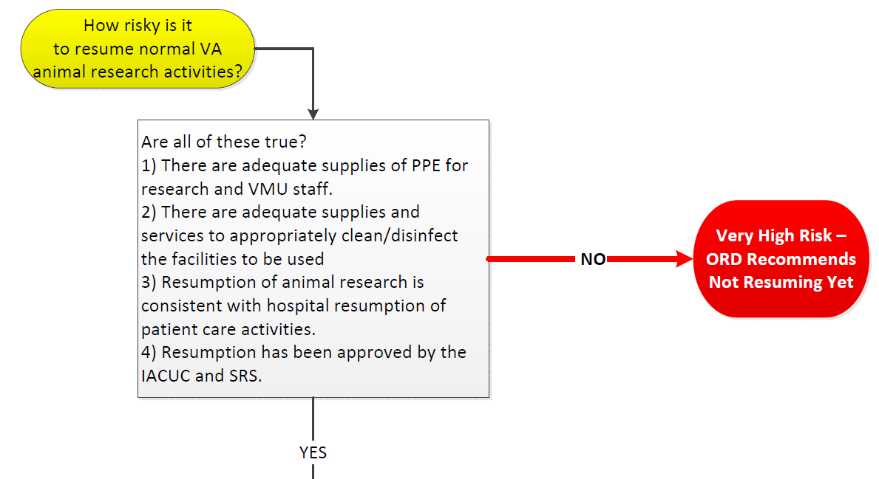
Credit- Alice Huang

Slide 13
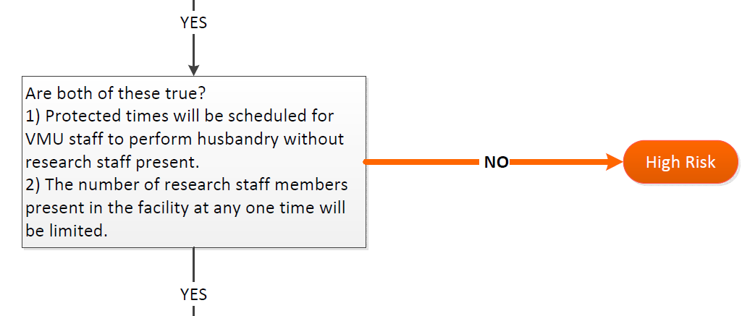

Slide 14
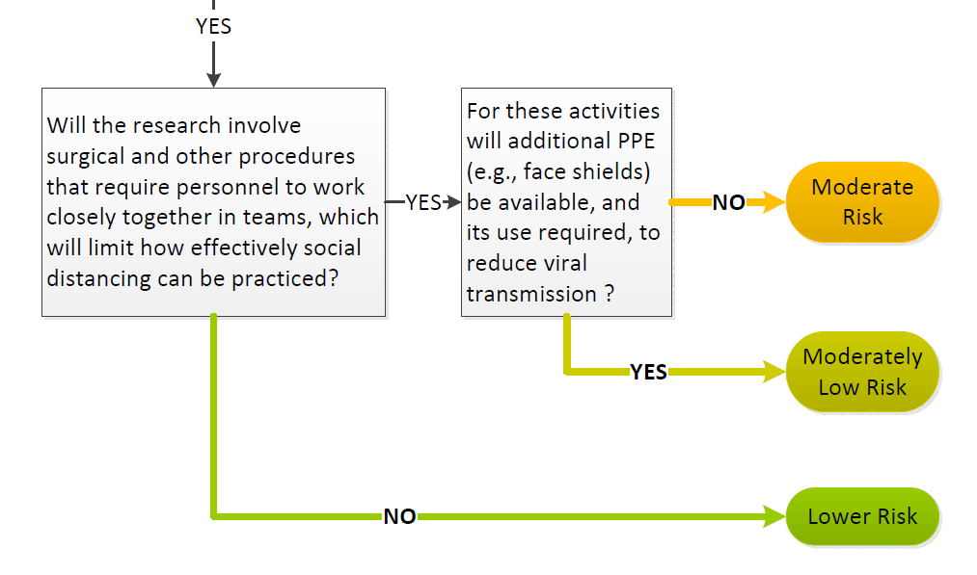

Slide 15
Any Problems or Questions….
We are here to help- contact anyone in the CVMO’s office using the contact information in the title slide. If you have a pressing matter to discuss, call Mike Fallon on his VA cell phone at 404-732-5471.

