Slide 1
Monthly Finance
Training Series:
Toxic Exposure Fund
February 27, 2024
Dr. Rudy Johnson
Dr. Karen Block
Jason Berlow
Erin Olson
Kari Points

Slide 2
Objectives for Today’s Training
Training Section: | By the end of this section, you will:
FY 24 CR Status: | Update on the FY 24 CR Status Link to key trainings on CRs and Lapse of Appropriations
Section 1: TEF Funding | Understand the PACT Act and impact on VA Research Understand TEF funding and research project eligibility for TEF
Section 2: TEF Projects | Understand if your station has projects now funded by the TEF appropriation Understand what to look for on Pink Sheets
Section 3: TEF Policy | Understand components of TEF policy Understand ORD role and station role
Section 4: Execution of TEF | Understand how to execute TEF funding in FY24 Understand what new fund control points you may need for this appropriation Understand the specific requirements for the Toxic Exposure Fund and Expense Transfers
Section 5: Refresher on Cost Transfers | Understand what information is necessary to provide Fiscal Understand when and how to transfer costs between Research programs for staff that work on more than one research project Understand when and how to transfer costs between a Research Appropriation and the Medical Center Appropriation
Q&A
Notes:
John

Slide 3
FY 24 CR Status
BLUF: The third CR for the Medical and Prosthetics Research Appropriation (0161A1) ends on Friday, March 1st 2024. For the remainder of FY 24, assume additional CR extensions.
  At this time, we cannot predict when/if we will receive a full-year budget.
  We also do no know how long the next CR will be (anticipate no more than 60 days).
  The next CR length will determine the next TDA Percentage for CC 101 (as a reminder, ORD has sent Q1/Q2).
Lapse of Appropriations: At present we do not anticipate a lapse of appropriation, but we are prepared should a lapse occur. Again, we would like remind everyone about the critical guidance training:
  If the Medical and Prosthetics and Research Appropriation experiences a lapse of appropriations, carryover funding will be utilized to sustain all operations for approximately two-pay periods. This guidance applies for all of FY 24 (linked).
  Monthly Finance Training (November 2023): Monthly Finance Training Understanding CR and Government Shutdowns
FY 24 ORD CR Guidance Final: The CR guidance applies until we receive a full-year appropriation (which will extend beyond March 1st). Link.

Slide 4
Section 1: TEF Funding – Research Eligibility Requirements
The PACT Act: Sergeant First Class Heath Robinson Honoring Our Promise to Address Comprehensive Toxics (PACT) Act of 2022 (P.L. 117-168). PACT includes the Toxic Exposure Fund for research on:
Toxic Military Exposures / Military Environmental Exposures
  Refers to contact with toxic agents, singly or in combination, acquired through ingestion, respiratory, or skin contact routes during military service (Deployment, Occupation, or Garrison).
Toxic agents
  Toxic agents are aligned with the VA Toxic Exposure Screen (TES) and include chemicals, toxins, particulates, and radiation.
Presumptive Conditions
  Health conditions that we assume (or “presume”) are caused by exposure to these substances.
  Presumptive conditions are critical to health benefits but do not encompass all research activities.

Slide 5
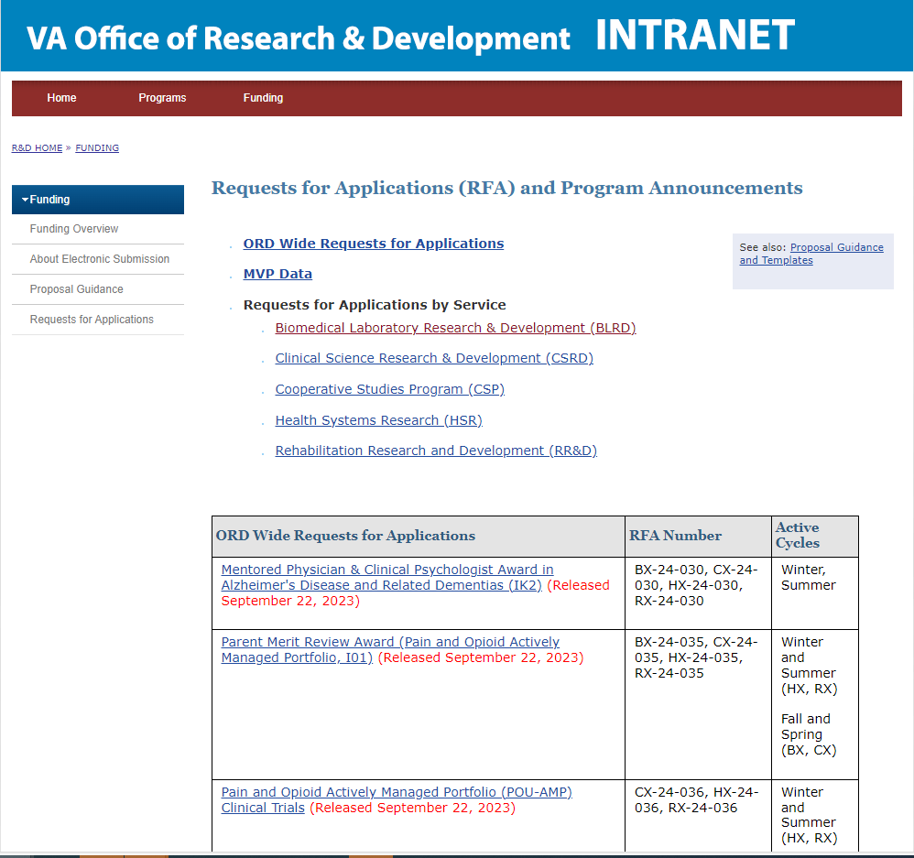
Section 1: TEF Funding Pathways
The Pathway to Use TEF:
Any peer reviewed project may be funded by TEF if it meets the research purview requirements.
  Example (1) : Respond to a specific RFA related to military exposures
  Example (2): Respond to a parent RFA in each of the services.
https://vaww.research.va.gov/funding/rfa.cfm

Slide 6
Section 1: TEF Funding
Key Questions | Key Answers
Is TEF a recurring appropriation? | TEF has been appropriated since FY 22. $46M has been appropriated for TEF in FY 24. TEF is NOT a supplemental appropriation and will continue. 38 USC 324 paragraph c Chapter 12 of the VA Financial Policy Manual provides guidance on TEF.
How does ORD receive TEF funding? | ORD receives a portion of the TEF under the Financial Management System (FMS) fund codes like the Research Appropriation.
What ORD documents should I read? | 18 Jan 2024: “Project Approval: Toxic Exposures Fund for Medical Research in the Office of Research and Development (ORD) Funding Approval Memorandum” 19 Jan 2024: “Guidance on Use of Toxic Exposure Funding for Medical Research in the Office of Research and Development (ORD)”

Slide 7
Section 1: TEF Funding
Key Questions | Key Answers
What is the TEF? | The PACT Act: Sergeant First Class Heath Robinson Honoring Our Promise to Address Comprehensive Toxics (PACT) Act of 2022 (P.L. 117-168) established many provision that impacted ORD. Section 805 of the PACT ACT established the Cost of War Toxic Exposure Fund (TEF) appropriation.
Is TEF a separate fund from the Medical and Prosthetics Research Appropriation? | Yes, TEF is a separate mandatory appropriation from ORD for necessary research expenses related to toxic military exposures.
How is ORD authorized to use TEF? | ORD is authorized to use TEF for medical research relating to exposure to environmental hazards as detailed in Section 805

Slide 8
Frequently Asked Questions about TEF Funding
Question | Answer
How does my project relate to Toxic Military Exposures, PACT? | Focus of research must be toxic military exposures. Refer to Slide 3 for more details. Pre-applications are very helpful.
Will my project be covered under TEF until it is completed? | Yes, TEF will cover approved projects until they are complete.
What happens if my project requires a cost modification or extension? | There is a mechanism for cost modifications and extensions.
Is there greater flexibility with this appropriation? | TEF research must meet the requirements of PACT.
Do all projects under TEF require peer review? | Yes.
Is a Letter of Intent or Pre-application required? | A pre-application is required starting Fall 2024.

Slide 9

Section 2: TEF Projects
Notes:
1126RD-ORD PACT P.L. 117-168 805 806

Slide 10
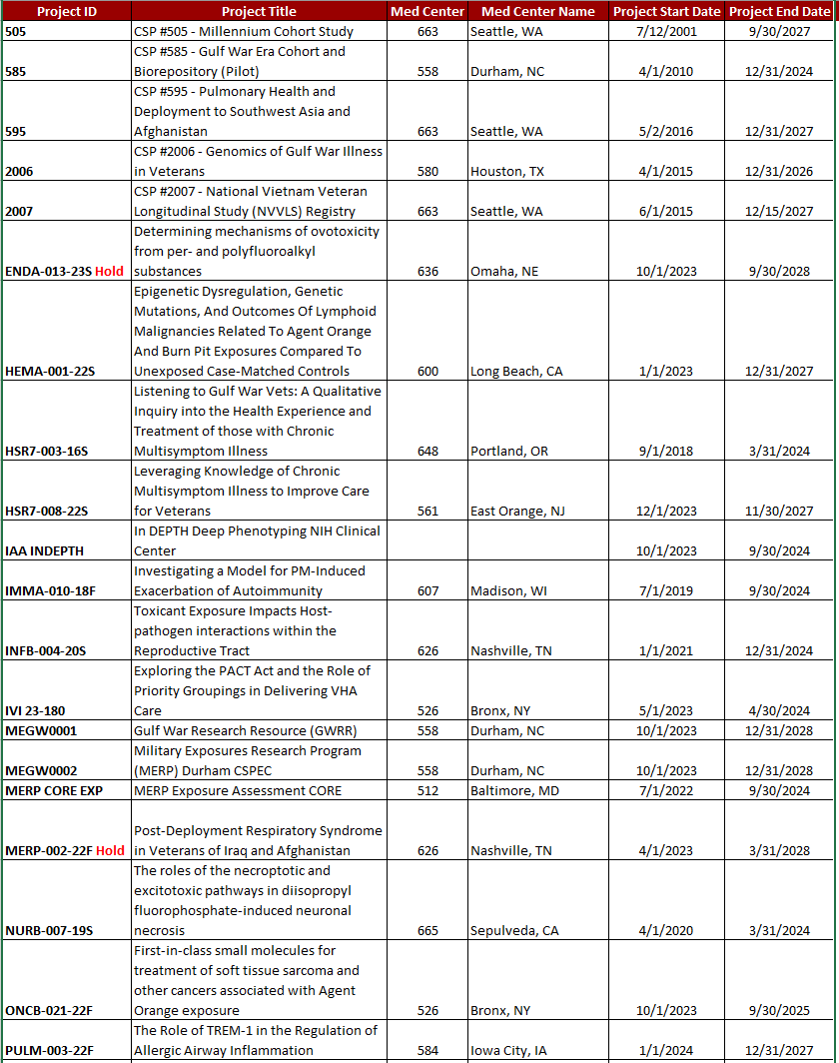
Section 2: TEF Projects
All projects approved for FY24 TEF funding are designated TEF in the FY24 TEF approval memo, Appendix A.

Slide 11
Section 2: TEF Projects
Initial Target Allowance Scenarios
Some FY24 TEF approved projects were funded with 0161A1.
FY24 TEF Mnemonic
Stations receive funding based on RAFT funding memos.
Full FY24 ORD Appropriation
When ORD receives the full FY24 Appropriation, 0161A1 funds will be pulled back.
Some FY24 TEF approved projects were funded with TEF but funds were not transmitted.
Some FY24 TEF approved projects were not TEF approved at the time of the ITA.
ALL FY24 TEF approved projects are pending funding with TEF.
These memos generate Transfers of Disbursement Authority (TDAs).
In order to send the correct TEF funding, ORD Finance must receive a new mnemonic from VHA Finance.
Once the mnemonic is loaded, stations will receive FY24 TDAs for TEF funds for each project listed in Appendix A
Stations Execute Cost Transfers
Since the costs for the TEF projects hit in the 0161A1 appropriation but are now funded with TEF, cost transfers from where the costs hit (0161A1) to the TEF appropriation are executed at each station.
Stations will be required to drop the full funding amount for the FY24 TEF projects into undistributed for pullback NLT one month after enactment.

Slide 12
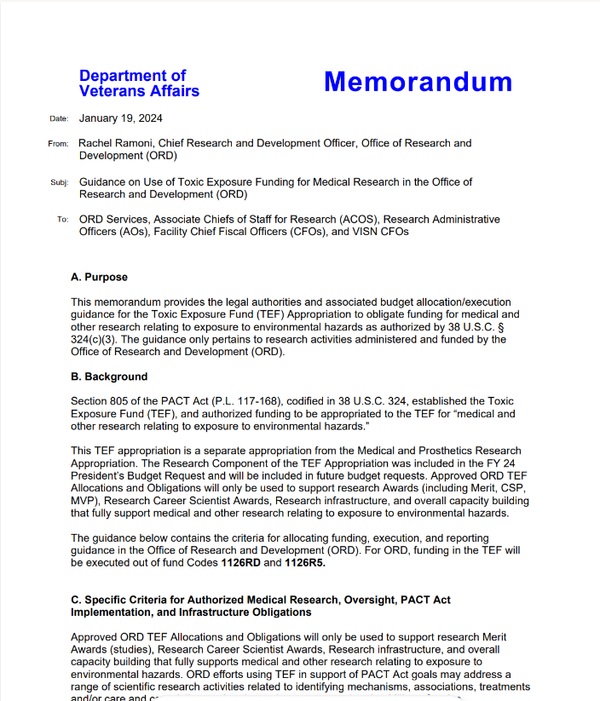
Section 3: TEF Policy
Link to FY24 TEF Policy: https://dvagov.sharepoint.com/:b:/r/sites/ORD-ToxicExposureFundTEF/Shared%20Documents/General/TEF%20Policy%20and%20Memos/FY24%20ORD%20Guidance%20Toxic%20Exposure%20Fund.pdf?csf=1&web=1&e=VAQGrh

Slide 13
Section 3: TEF Policy – ORD and Station Role
Action | ORD ROLE | STATION ROLE
Pre-award/application | Determines TEF eligibility | Investigators apply for funding via established mechanisms
Funding | Notifies Stations of TEF funding Distributes funding Maintains RAFT Review status of Expenditure Transfers | Establishes new fund control points Executes cost transfers Link to full cost transfer training: ORD Cost Transfer Training
Execution | Monitors Execution via quarterly RAFT Execution Reports Requires pullbacks as necessary | Monitors project expenditures 2% carryover requirement Requests PMOs and fund returns

Slide 14
Section 4: Execution of TEF
Initial Target Allowance Scenarios
Some FY24 TEF approved projects were funded with 0161A1.
FY24 TEF Mnemonic
Stations receive funding based on RAFT funding memos.
Full FY24 ORD Appropriation
When ORD receives the full FY24 Appropriation, 0161A1 funds will be pulled back.
Some FY24 TEF approved projects were funded with TEF but funds were not transmitted.
Some FY24 TEF approved projects were not TEF approved at the time of the ITA.
ALL FY24 TEF approved projects are pending funding with TEF.
These memos generate Transfers of Disbursement Authority (TDAs).
In order to send the correct TEF funding, ORD Finance must receive a new mnemonic from VHA Finance.
Once the mnemonic is loaded, stations will receive FY24 TDAs for TEF funds for each project listed in Appendix A
Stations Execute Cost Transfers
Since the costs for the TEF projects hit in the 0161A1 appropriation but are now funded with TEF, cost transfers from where the costs hit (0161A1) to the TEF appropriation are executed at each station.
Stations will be required to drop the full funding amount for the FY24 TEF projects into undistributed for pullback NLT one month after enactment.

Slide 15
Section 4: Execution
Action | Timing | ORD Training Link
Generate new Fund Control Points | Now | Introduction to Finance Resources Section 3 - Setting up and Managing Fund Control Points
Track costs by project | Now, ongoing | Monitor project expenditures 2% carryover requirement Recommend winRMS Balancing Project Budgets to Status of Allowance Using VSSC and Balancing to SOA
Cost transfers | Quarterly | Cost Transfer Training
PMO or funds return | As soon as needed | Request PMOs and fund returns

Slide 16

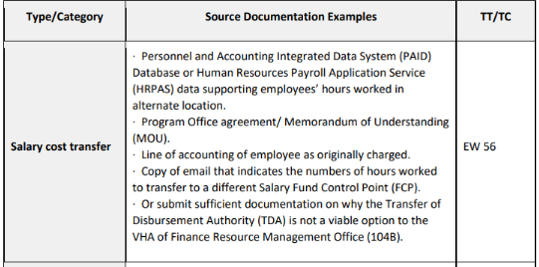
Section 5: Cost Transfer Refresher
“My fiscal is giving me a hard time about expenditure transfers. This is me trying.”
VHA Finance Operations and Support (104C) - JV Exp Transfer Documentation - All Documents (sharepoint.com)
Chapter 01A - VA Journal Vouchers - U.S. Department of Veterans Affairs

Slide 17

Section 5: Cost Transfer Refresher
It is best practice to place individuals within the appropriation where they are conducting most of their work and establish a Memorandum of Understanding
Reoccurring salary cost transfers should be completed at a minimum of quarterly, if not more often. You will need to track the salary for the individual(s) by pay period so that you can routinely request the cost transfer from Fiscal.
Example: Minnie Mouse is costed to the Research appropriation because she was hired to work on VA Research. She is working on a TEF project at 25% level of effort. The request would look like this:
  Fiscal,
  Please complete the following cost transfer for Quarter 1 expenses. This is for 25% salary that needs to be transferred from the Research Appropriation to the TEF Appropriation for Minnie’s work on a TEF project. The amount of costs that needs to be transferred from FCP 123 (0160A1 810010101) to FCP 456 (1126RD 810010101) is $3623.10. The attached Memorandum of Understanding justifies this transfer.

Slide 18
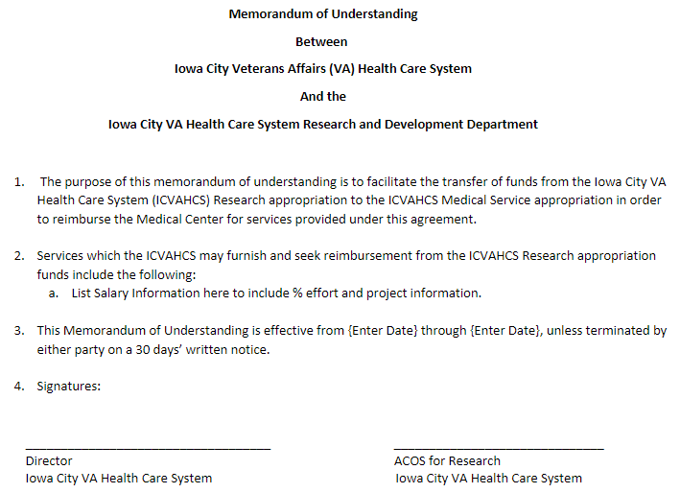
Section 4: Sample Memorandum of Understanding

Slide 19
Thank You

Slide 20
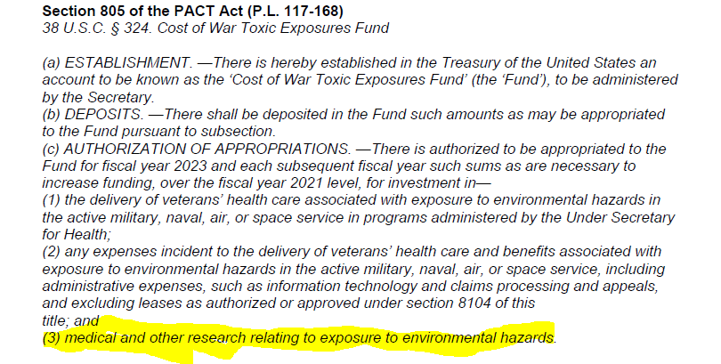
Section 805 of PACT ACT

