Slide 1

Budget Execution Guidance for FY 24 Close-Out
and critical updates on the FY 25 Budget
May 15, 2024
Jason Berlow, ORD Finance, Management Analyst
Tony Laracuente, Director of Field Operations, ORD
Kari Points, Administrative Officer, Iowa City
Diane Murphy, Budget Analyst, ORD Finance
Erin Olson, Budget Analyst, ORD Finance

Slide 2
Objectives of Today’s Presentation
Section | At the end of this Section you will understand…
Section 1: FY 24 Close Guidance | What are the key aspects of ORD’s close-out guidance. The changes in the end of year process. What is expected of the site
Section 2: Budget Outlook FY 25 and Beyond | Where the ORD budget is headed in FY 25 What are the implications of the current budget situation
Section 3: Implementing the changes from a field perspective | The tasks necessary to implement the end of year guidance. The strategies for year end
Notes:
Our current financial practices are reflective of our previous budget environment of increases

Slide 3

Section 1: FY 24 close out guidance

Slide 4
FY 24 Carryover Guidance
By 9/30/24 the follow criteria must be met:
  All stations must achieve a carryover target allowance of 2% of the total station Research (0161A1 24-25) appropriation/allocation.

Slide 5
What has changed for FY 25?
Questions | Answers
Will ORD Sweep 24/25 Funding below 2%? | No, funds below the 2% program/appropriation allocation will remain on station for on-going project needs.
Will ORD Sweep 24/25 Funding above 2%? | No, funds exceeding 2% will remain on-station. These funds will now be considered part of the FY 25 Cost Center (CC) 101 allocation. The FY 25 (25/26) CC 101 that will be reduced by the amount over 2%.
How will my station determine our status of where we fall with the 2%? | After October 1, 2024, ORD Finance will distribute a report to Research sites detailing the total funding by program in excess of 2% that should be utilized for CC 101 requirements.

Slide 6
What has changed for FY 25? (continued)
Questions | Answers
What happens if the CC 101 Allocation exceeds my stations carryover balance? | If the CC 101 allocation exceeds the carryover balance, then the remaining portion of the FY 25 CC 101 allocation will be incrementally funded during the CR and the remaining CC 101 allocation will be distributed upon the FY 25 enactment (the same practice as FY 24)
What happens if the CC 101 Allocation is below my stations carryover balance? | If the carryover balance exceeds the CC 101 allocation, you will not receive CC101 in 25/26 funds. A review will be completed to determine if COINS or other Centers can absorb the carryover. Please avoid this situation
Will funding sweeps still occur? | ORD Finance will only perform funding sweeps on a limited basis where funding on station cannot be offset as described above. This will require greater budget management. Sites in this situation will receive greater micromanagement from Finance.

Slide 7
How will this all work?

Slide 8
Other FY 24 Close-Out Matters
Activity | Deadline | Details
Toxic Exposure Fund (TEF) Execution | Expense transfer quarterly after the 10th business day following each quarter. | Impacted stations received a memo/guidance if they received TEF funds in FY 24. TEF costs for personnel, will need to be first paid out of the Research appropriation because personnel can only be funded out of one Fund Control Point (FCP). See TEF Guidance: ORD Guidance Toxic Exposure Fund.
Enhanced Tracking of Open Obligations | On-going | We are aware that some stations have performed deobligations on expired accounts (where a new obligation can no longer occur), which represents “a lost opportunity” that could have been redistributed to other activities related to Veterans Research. The ORD Finance contact for this is Diane Murphy (Diane.murphy3@VA.gov). We are requesting each station to work on closing out purchase orders which are past their end date to mitigate the circumstances above. Please refer to the ORD Finance Training on this topic: Monthly Finance Training-Undelivered Orders and Reporting.pptx
Notes:
TEF (ERIN)/Open obligations (Diane)

Slide 9
Other FY 24 Close-Out Matters (continued)
Activity | Deadline | Details
RAFT Execution Report | 7/15/24 | Research sites should begin preparing for the Q3 RAFT Execution Report upon receipt of this memo by evaluating what hiring/contract action/etc will not execute by 9/30/24. Reach out to ORD Service Budget Analysts to determine if any actions are necessary for the remainder of FY 24.
Purchase Cards | 9/15/24 | MINIMIZE your Accrual into FY 25 All FY 24 Purchase Card Orders need to be managed to reduce issues with back orders that cannot be reconciled by 9/30/24. Orders that are not received by 9/30/24, need to be adjusted to FY 25 funding (0161A1 25-26). Review the facility credit card open orders report in August and September to determine the impact.
Notes:
Erin (RAFT)/Diane (PC)

Slide 10
Other FY 24 Close-Out Matters (continued)
Activity | Deadline | Details
Reimbursable Accounts | 9/15/24 | Manage these funds as soon as you receive them. Continue to obligate/expense transfer funding in the 0161R1, 0161R3 and 0161X2 (NPCs) to reduce the unobligated balances in reimbursable accounts and reimburse for the expense generated in the 0161A1 accounts. Continue to use the Reimbursable Report, Trial Balance reports, and VSSC to track your reimbursable balances. Remember that VHA Finance will issue closeout guidance in August which will detail the cutoff deadlines for reimbursable TDAs (around 9/15/24). Collections received after this date will not be TDA’d to sites.
Notes:
Jason

Slide 11
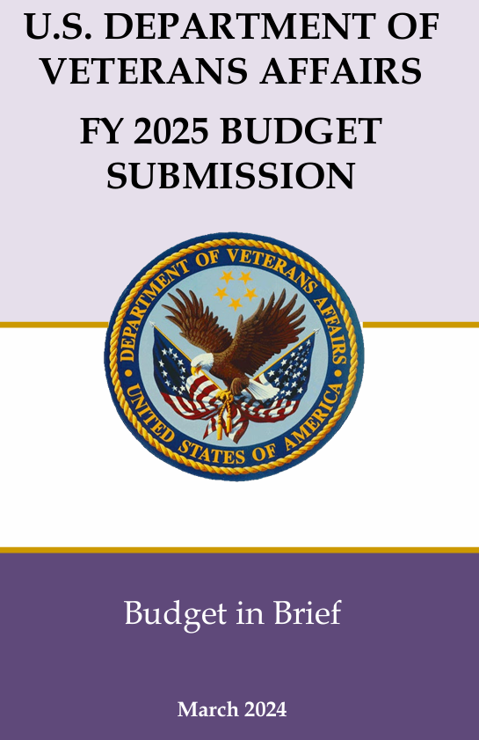
Section 2: Budget Outlook FY 25 and Beyond

Slide 12
Ensuring VA Research continues to make an impact on scientific discovery
Event | Details
FY 25 Budget Request | The FY 25 President’s Budget Request for the Medical Research Appropriation represents a substantial reduction below the FY 24 enacted amount. The requested appropriation amount for the Medical Research Appropriation is $868 Million, a $75 Million reduction from the FY 24 Enacted amount of $943 Million. These reductions are not targeted to VA Research alone but are part of reductions in FY 25 due to the impact of the Fiscal Responsibility Act of 2023.
Ensuring VA Research makes the largest impact with the available funding levels | Through required mitigations and adherence to Financial Management policies VA Research’s will continue to make largest impact of scientific discovery that improves Veterans’ health Military Environmental Exposure (MEE) Research represents an area of budget growth investing VA Research in areas where Budget growth exists, in the Toxic Exposure Fund (TEF). The FY 25 Budget, increases funding through TEF. This represents an increase of $13 Million above the FY 24 enacted amount of $46 Million.
Notes:
Our current financial practices are reflective of our previous budget environment of increases

Slide 13
2025 Request Overview
The requested funding level is based on where VA Research’s investment can make the largest impact of scientific discovery that improves Veterans’ health. Targeted investment is focused in areas where the research will make a difference in well-being as well as problems faced by Veterans, clinicians, and the entire healthcare system:
Appropriation Type | 2025 Request | 2025 Request – 2024 Enacted
Medical and Prosthetics Research | $868 million | -$75 million
Toxic Exposure Fund | $59 million | $13 million
Total Appropriated Resources | $927 million | -$57 million

Slide 14
Section 2: Mitigations due to reduced funding
Ensuring VA research continues to make an impact on scientific discovery in FY 25 is a key priority which will include the following strategies that ISRM and Enterprise Operations will utilize:
  Projects with end dates in FY 25 and beyond will take priority review during the FY 25 Initial Target Allowance (ITA) process.
  Program directors have the authority to reduce project budgets and/or funding lines to ensure the overall financial health of their program.
  Delayed new starts (projects in just-in-time)
  Limited funding for requests to exceed the budget cap and project modifications of merit awards.
Notes:
Our current financial practices are reflective of our previous budget environment of increases

Slide 15
FY 25 CR
  BEGIN PREPARATIONS FOR A FY 25 CONTINUING RESOLUTION (CR): Prepare for the FY 25 CR now, so you are ready on October 1^{s} by planning for the following:
    Plan to start FY 25 under one/multiple CRs for a significant portion of the fiscal year (like FY 24).
    Make sure that July 1st and October 1st project starts are implemented early in the fiscal year by hiring staff, purchasing supplies, and buying equipment.
    Ensure your acquisition packages are submitted to RPO East as early as possible and work with Fiscal to allow you to overcommit your FCP in VISTA.
    Refer to ORD FY 24 CR Guidance for complete guidance on executing funding during a CR (the FY 25 CR guidance will be issued in September).

Slide 16

Section 3: Implementing the changes from a field perspective

Slide 17
Section 3: Implementing the changes from a field perspective
Be working now to ensure that you are under the 2% carryover by:
  Look back at the April RAFT expenditure report. Are there accounts that were underspending? Have you reached out to the PI to discuss their spend plan for the year?
  Be sure that each PI is informed that they will not be able to carry-over more than 2% into next fiscal year. Use these slides and the ORD memorandum as your tool to demonstrate this. There is clear guidance on the 2% carry-over limit and you should ensure this is communicated to the PI's at your station.
  Be aware of what your 2% carry-over is and whether or not you are on pace to achieve it.

Slide 18
Section 3: Tracking your 2% carry-over as we get closer to the end of the fiscal year
Recommend starting an excel sheet to calculate 2% carryover no later than 8/1/24. It should be updated every couple days as you get closer to the end of the fiscal year.
The excel sheet example in this presentation is done for the overall appropriation. You should also do this for each individual Program (81, 82, 84, 85, 86) and roll the data up to the overall appropriation.
First step is to calculate 2% target.
0161A1 FY 24/25 Total from SOA | 14,304,810
2% | 286,096

Slide 19
Section 3: Salaries
For Salaries, you will need to project Pay Periods 15, 16, 17, and 18.
The accruals for this year is factored at .6 for the PP19 split (6/10 working days will hit this fiscal year).
Salaries
FMS Budget | 5,338,531
FMS Obligated as of 8/1 | -4,032,210 | As each PP hits, you remove that line item and update the obligated column with the new obligated balance.
PP 15 | -248,006
PP 16 | -248,006
PP 17 | -248,006
PP 18 | -248,006
Accruals (.6) | -148,803
Remaining | 165,494

Slide 20
Section 3: All Other
All Other Current Status |  |  | All Other With Pending Obligations
FMS Budget | 8,966,279 |  | FMS Budget | 8,966,279
FMS Obligated as of 8/1 | -6,752,745 |  | FMS Obligated as of 8/1 | -6,752,745
Remaining | 2,213,534 |  | Pending Credit Card | -66,392 | *These items are Committed and NOT Obligated.
 |  |  | Pending Contracts | -1,356,218
 |  |  | 4th Qtr IPAs to be Obligated | -698,254
 |  |  | Remaining | 92,670
The All-Other Current Status column shows the funds remaining if no other obligations were to be completed. The All- Other With Pending Obligations column shows the amount remaining if all pending/committed items would be obligated.
These numbers will change as purchase cards are reconciled, contracts are awarded/obligated and 1358's are completed for IPAs. Obligated items will move over to the Current Status column as this occurs. Any contracts that are not completed by contracting, IPA's that are not obligated by Fiscal and any credit cards that are not reconciled will remain in pending (committed but not obligated) and WILL count toward your 2%.
*Note: An invoice does not need to be submitted in IPPS for an item to be obligated. Once Fiscal has obligated the 1358 or 2237, it moves to the obligated column of the SOA and is no longer pending and will not count toward your 2%.

Slide 21
Section 3: Projecting Carry-Over Percentage
Current % Status |  |  | % With Pending Obligations
Salary Remaining | 165,494 |  | Salary Remaining | 165,494
All Other Remaining | 2,213,534 |  | All Other Remaining | 92,670
Total Remaining | 2,379,028 |  | Total Remaining | 258,164
% if no other items are obligated | 16.7% |  | % if everything was to be completed | 1.8%
This slide shows how you combine the salary and all other remaining to determine your percentage.
The allocated amount for this facility was: $14,304,810. The total remaining divided into the allocated amount gives the current percentage.
Therefore, it is important to work with Fiscal, Contracting, and Purchase Card agents to ensure that 1358s and 2237s are obligated and credit card purchases are reconciled. Just because an item is entered, it does not mean it is complete. In the above example, if nothing else is completed, the facility will be at 16.7%.

Slide 22
Section 3: All Other Committed Items
Remember the difference between Committed vs. Obligated. Items are committed but not obligated if:
  Credit Card charges not reconciled: It is a best practice to stop all credit card charges at the end of August. Notify PI’s well in advance of this deadline. This allows you the month of September to receive orders in and reconcile as much as possible. This will reduce the amount of credit card orders that have been carried into FY25. Once FY25 starts, you will only want to use FY25/26 funds for credit card orders. No prior year funds should be used for credit card charges.
  1358’s (IPAs) that have been sent to Fiscal but not obligated by your Fiscal Office.
  2237’s (Contracts) that have been sent to Contracting but have not been awarded.
Reminder: Committed items count towards your 2% carryover until they are obligated!

Slide 23
Section 3: Implementing the Changes from a field perspective
What happens if you tried but you just could not get your funds down to 2%?
  When allocating your prior year (FY24/25) remaining funds in FY25, investigators should not be allocated more than 2% carry-over for their project.
  The remaining funds above 2% need to be placed in your Admin cc101 account for usage.
  You may need to do cost transfers to utilize the funds for cc101 if carry-over is in other programs. For example, if you have more than 2% carry-over in Program 85 FCPs, you will need to cross transfer from Program 81 FCP where your cc101 expenses occur to Program 85 to spend the funds.

Slide 24
Questions

