Slide 1
Serious Adverse Event Reporting
VA NAVIGATE PROGRAM

Slide 2
Speakers
Maggie Spillers - SWOG mspiller@swog.org
Sara McCartney - NRG McCartneyS@nrgoncology.org
Cameron Salisbury - ECOG-ACRIN csalisbury@ecog-acrin.org

Slide 3
Agenda
Expectations – SWOG and NRG
RAVE Integration – ECOG-ACRIN
CTEP-AERS - SWOG
Practice Examples – NRG
Resources – SWOG
Q&A - All Groups

Slide 4
SWOG SAE Reporting Expectations
Maggie Spillers - SWOG

Slide 5
Serious Adverse Events
SAEs are a subset of all adverse events collected.
The reporting of SAEs is in addition to, and does not replace, the necessity of adequately reporting adverse events on the case report forms and in the final results of the clinical trial.

Slide 6
What is the deadline for submitting an SAE report to SWOG?
Reporting timeframes are found in the SAE reporting tables within the protocol. SAE tables are found in Section 8 or Section 16 of the protocol.
It is important to note that the ‘submission due dates’ in Rave or in the automated CTEP-AERS emails are not true deadlines; these dates only reflect the date after which CTEP-AERS will automatically delete unsubmitted reports.
SWOG makes every effort to notify sites if they have a pending report that will soon be deleted, but sites are responsible for reporting within protocol-specified timeframes.

Slide 7
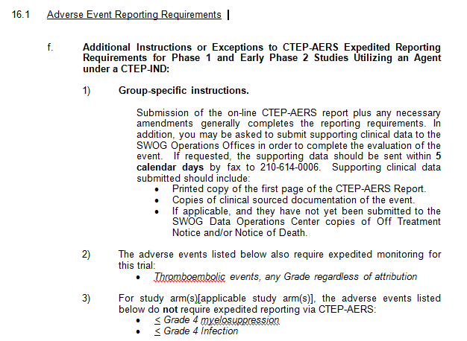
Additional Reporting Requirements
A subsection that may contain information on events that are exceptions to expedited reporting as well as events that require expedited reporting regardless (AESI)

Slide 8
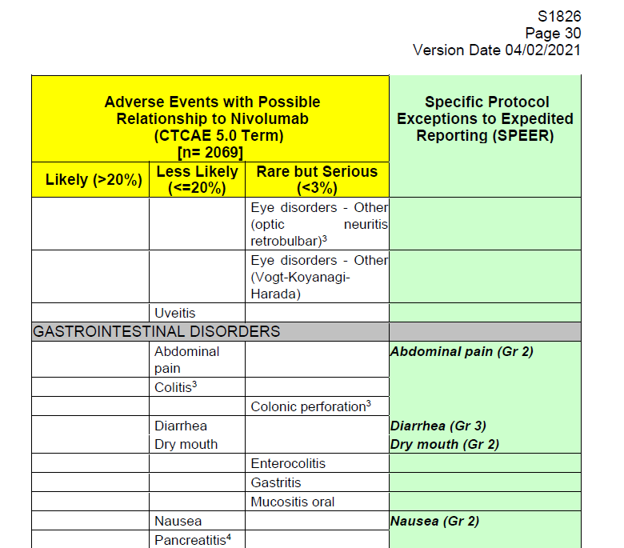
SPEER
SPEER = Specific Protocol Exceptions to Expedited Reporting
This subset of AEs (SPEER) is a list of events that are protocol-specific exceptions to expedited (SAE) reporting to NCI.
Report AEs on the SPEER as SAEs only if they exceed the grade noted in parentheses next to the AE in the SPEER.
If the protocol uses multiple investigational agents and has an AE listed on different SPEERs, use the lower of the grades to determine if expedited reporting is required.

Slide 9
SPEER
Reminder that the SPEER column only applies to SAE reporting.
It does not apply to routine AE reporting.

Slide 10
Helpful Reminders
All serious adverse events for patients on investigational treatment must include at least one seriousness criterion.
Rave recommendations are not always correct since they’re based on simple rules.
Be sure to complete all study agent dose information and ensure it matches data entered into Rave.
Attributions must match between CTEP-AERS and Rave.

Slide 11
SWOG SAE TEAM
Contact first with all SWOG SAE questions, including technical support issues.
    SAE Email: adr@swog.org
    SAE Phone: 210-614-8808

Slide 12
Adverse Event Reporting Expectations
Sara McCartney
NRG Oncology
June 21, 2024

Slide 13
Routine AE Reporting
AE collection starts with initiation of protocol treatment
  Including expedited reporting
During Treatment: all AEs; all grade
  regardless of attribution
In follow-up: related (possibly, probably definitely, AEs; all grades
NRG routine AE reporting guidelines: https://www.nrgoncology.org/Clinical-Trials/Clinical-Trial-Resources/Statistical-and-Data-Management-Center-SDMC-/Data-Management-Resources

Slide 14
Routine AE Reporting
NRG Routine AE Reporting Guidelines
  Laboratory abnormalities and changes in vital signs (outside of reference range) are considered adverse events if they result in discontinuation or interruption of study treatment, are clinically significant and require therapeutic medical intervention, meet protocol specific criteria (see toxicity management in protocol) and/or if the investigator considers them to be adverse events.
  Laboratory values and vital signs that are clearly attributable to another AE do not require discrete reporting
Understanding clinical significance
  Outside of reference range is not sufficient to be an AE

Slide 15
Expedited AE Reporting
IND studies use CTEP expedited reporting tables
  Note: SOC arm(s) will have limited expedited reporting requirements
IND-exempt studies
  Limited expedited reporting
  No expedited reporting; aggregate analysis sufficient for safety
Rave-CTEP-AERS Integration
  CTEP IND studies
  Registration intent studies

Slide 16
Streamlined Clinical Trials
Adverse Event Data Submission
During Protocol Treatment: report all >/= grade 3 AEs
  No start/end date
  No attribution
In Follow-up: possible scenarios
    Stop AE reporting, or
    follow defined late toxicities of interest for specified, finite timeframe (detail in analysis plan)

Slide 17
Expedited Reporting Evaluation for Integrated Studies
Cameron Salisbury
Adverse Events Team
ECOG-ACRIN
Cameron Salisbury
dverse Events Team
ECOG-ACRIN
Notes:
Hi, I’m Cameron, I’m a member of ECOG-ACRIN’s Adverse Events team. I’ve been asked to talk about Rave’s Expedited Reporting Evaluation engine. Many of you will be familiar with this already, if you’ve worked on a newer study, a CTEP-integrated study: this is the tool that syncs adverse event records in Medidata Rave with the data in CTEP-AERS, tells you whether or not you need to submit an AE ticket, and generates a link that sends you right to the ticket creation page. It’s pretty neat, and saves a lot of time, though it’s not infallible. I’m going to show you what the form looks like and how and when to use it.

Slide 18
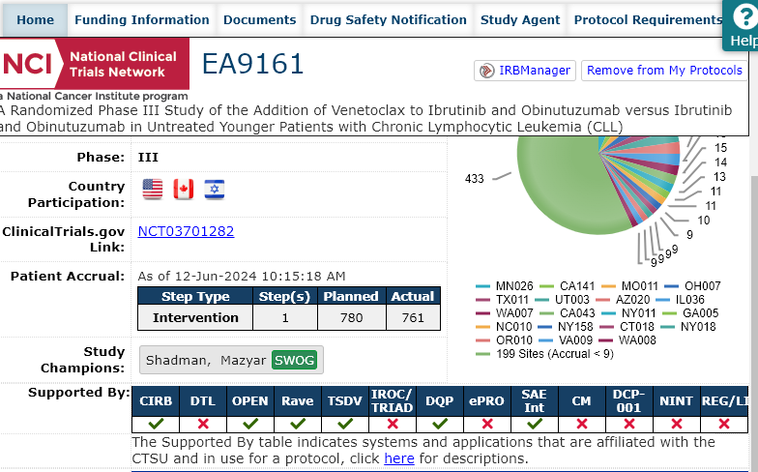
Is my study integrated?
Check the protocol home page on the CTSU website.
Or…
Notes:
First up: how do you know if your study is integrated? You can find this info in a couple places. The first is on your protocol home page on CTSU. Right on the Home tab, there’s a table labeled “Supported By” that tells you whether the study uses the CIRB, OPEN, Rave, etc., and here you can see that “SAE Int” is also checked off.

Slide 19
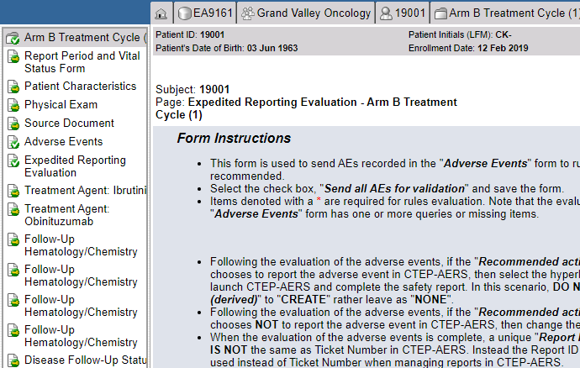
Is my study integrated?
In Rave, navigate to any treatment cycle for a subject on study. The Expedited Reporting Evaluation form appears right below the Adverse Events form in the sidebar.
Notes:
You can also find out just by logging in to Rave, going to any subject in your study, and clicking on any reporting period folder. If the study is integrated, you’ll see the Expedited Reporting Evaluation form right under the Adverse Events form in the left-hand sidebar.

Slide 20
Expedited Reporting Evaluation
Create CTEP-AERS tickets directly from RAVE in
three simple steps:
1. Enter an adverse event in RAVE
2. Select a checkbox to “run” the Rules Evaluation
3. Click a link to generate a CTEP-AERS ticket
Notes:
So now that you’ve found the form, you can use it to create a CTEP-AERS ticket. First, you enter your AEs on the Adverse Event Form in Rave, then you go to the Expedited Reporting form and tick a ticky box, and that generates a link.

Slide 21
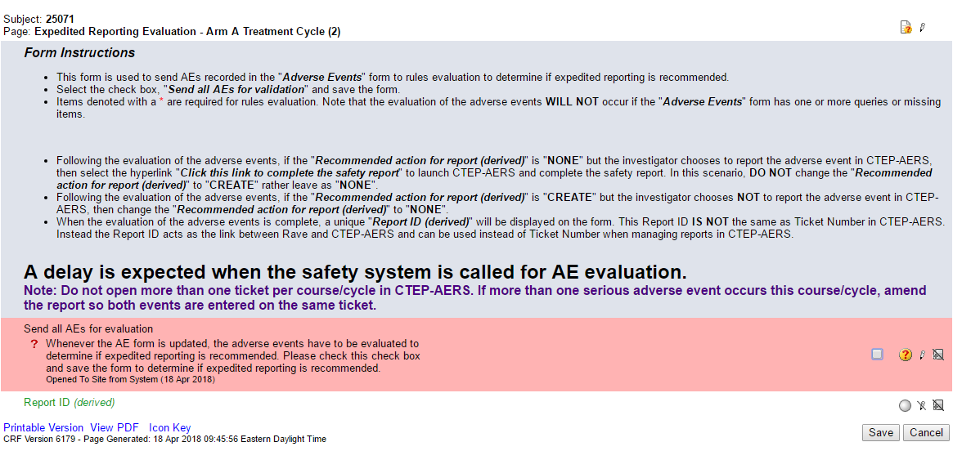
How it works: Step 2 – Run the Rules Evaluation
Check box to run rules evaluation, then save the form.
Notes:
It looks like this. You tick the little box over on the right, labeled, “Send all AEs for evaluation,” then, and this is crucial, save the form.

Slide 22
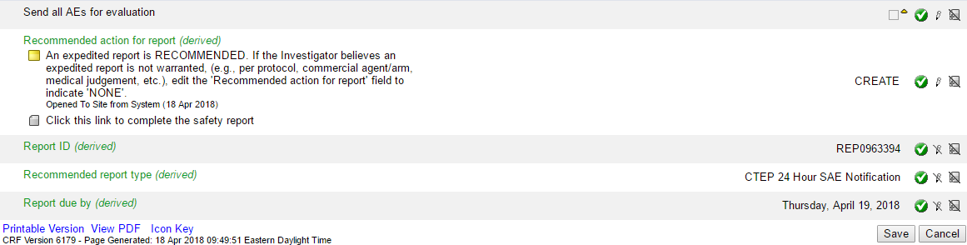
How it works: Step 3 – Create CTEP-AERS ticket
May override recommendations by following instructions
Click here to create CTEP-AERS report
Notes:
Then you’ll see a recommendation. In this case, it reads, “An expedited report is RECOMMENDED. If the Investigator believes an expedited report is NOT warranted, (e.g., per protocol, commercial agent/arm, medical judgment, etc.), edit the “Recommended action for report field to indicate ‘NONE.’” So: sometimes the engine gets it wrong. You still need to know your protocol section 5, and know whether any given event is reportable.
If the engine says it is, but you’re quite sure it’s not, you can edit this field by clicking the little pencil icon on the right, then save. The text will change to say, “The recommendation was OVERRIDDEN.”
If you do agree that you need an expedited report, then you click the link that says, “Clink this link to complete the safety report,” and it will direct you straight to CTEP-AERS’ ticket creation website and prepopulate some fields for you.
This page also lets you know what type of report is recommended: CTEP 24 Hour SAE Notification vs. 10-Day.

Slide 23
Considerations
Keep in mind:
  Recommendations may be overridden, but ONLY if a physician deems an event to be NOT serious.
  Not all studies include the integration – check the instructions on the AE Form in Rave.
  Must enter events as they occur – cannot wait until the end of the cycle.
Notes:
B. If the Expedited Evaluation form is there, you must use it instead of initiating a ticket directly on the CTEP-AERS website. The only exception—though this scenario is increasingly less common—is that if you did submit a ticket via the website and then you need to amend or withdraw it, you have to do that via the website as well. You have to finish the same way you started, you can’t mix and match, because that will trigger a duplicate assessment and all sorts of havoc in the FDA safety report submission process.
C. That’s because many SAEs require 24-hour or 10-day notifications. You can run the evaluation as many times as you want in a cycle, and in fact you must run it every time you update the AE form. If you’ve already generated a ticket, and you get a query saying the grade or attribution doesn’t match, or the data manager thinks it’s missing an AE that should be on there, you make your corrections and run the engine again, and the recommendation will say, “AMEND,” and direct you to back to your existing ticket so you can submit your amendment.
The same is true if you need to withdraw a ticket all together because, for e.g., you put an AE in the wrong cycle: you can edit the recommendation field to say, “WITHDRAW,” and save the form and go from there.

Slide 24

Notes:
And that is how you use the Expedited Reporting form! Thank you very much. Happy to take questions.

Slide 25
CTEP-AERS System Use
Maggie Spillers - SWOG

Slide 26
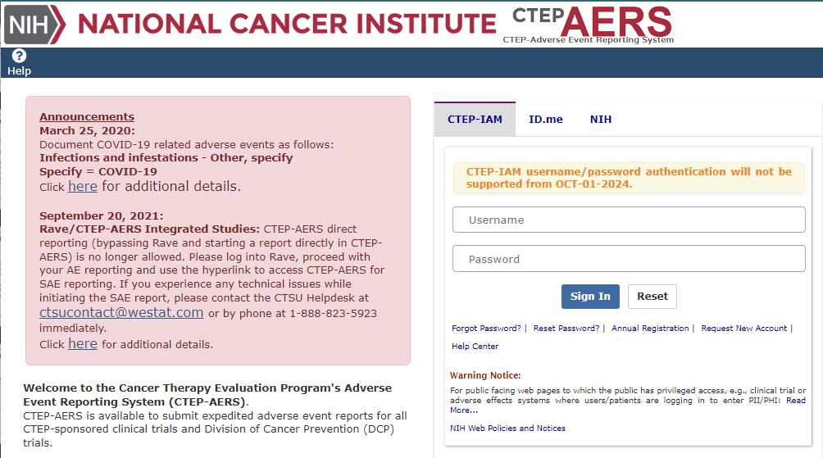
CTEP-AERS Home Page

Slide 27
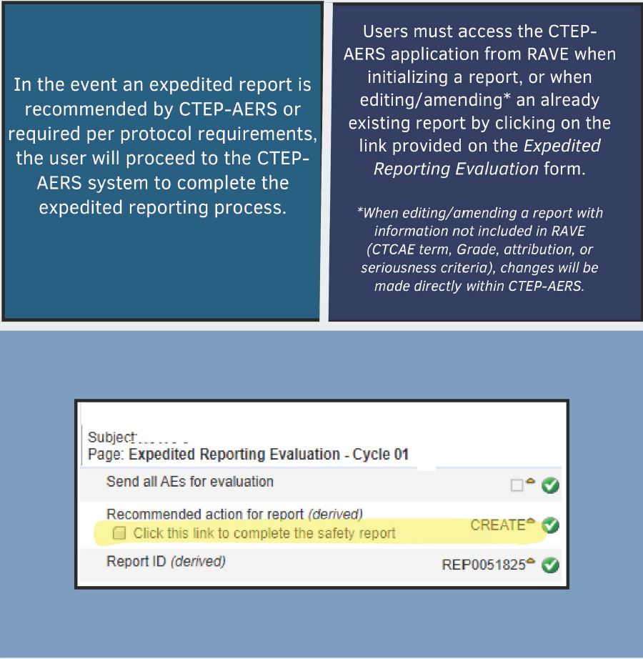
Navigating to
CTEP-AERS from RAVE

Slide 28
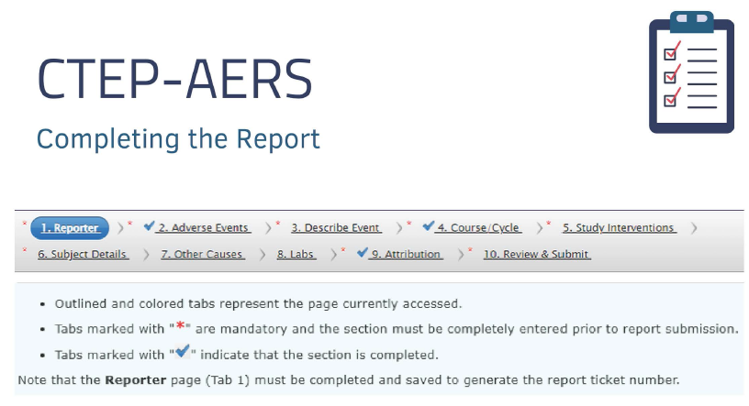

Slide 29
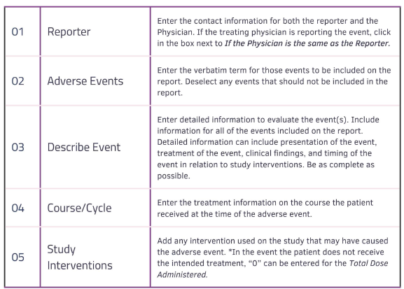
CTEP-AERS Sections

Slide 30
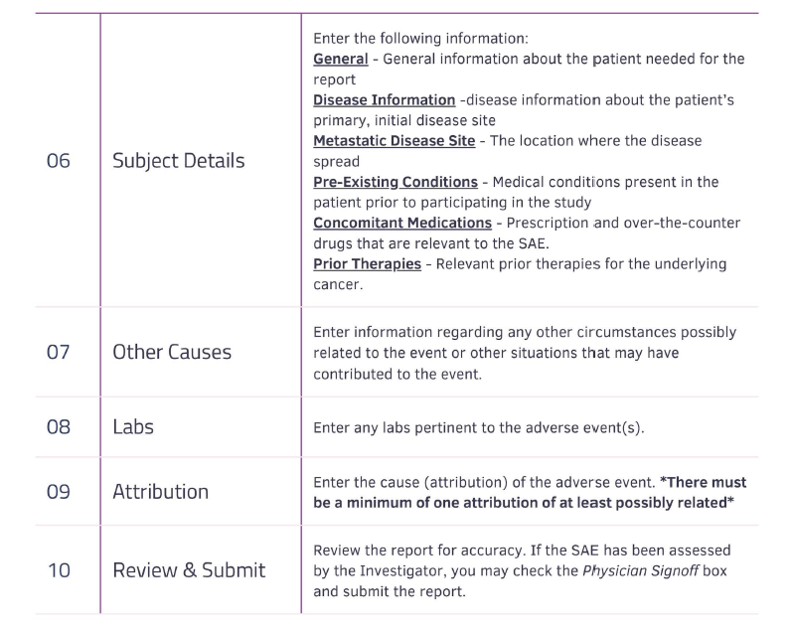
CTEP-AERS Sections

Slide 31
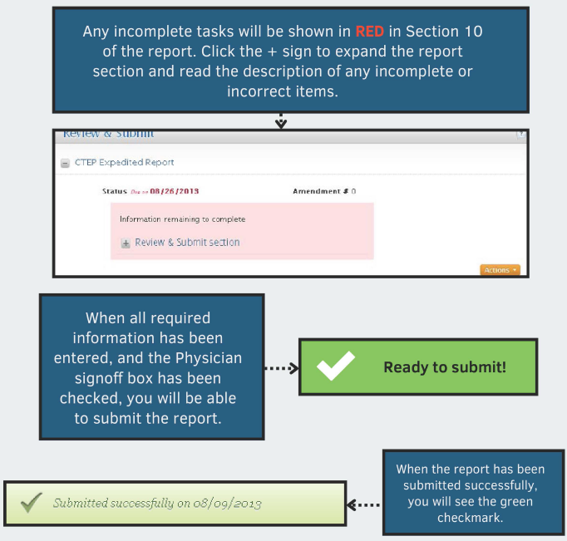
Submitting CTEP-AERS Reports

Slide 32
Expedited Adverse Event Reporting: Practice Scenarios
Sara McCartney
NRG Oncology
June 21, 2024

Slide 33
Assessment: Does an AE meet expedited reporting?
Define the adverse event(s): select CTCAE term(s) that most accurately describes the clinical scenario
Severity: CTCAE grade
Seriousness criteria
Protocol expedited reporting criteria
  Expedited reporting table(s): study phase, AE grade and seriousness criteria
  AEs of special interest
  Commercial agent/SOC arms
  CAEPR/SPEER

Slide 34
Expedited reporting pitfalls
Duplicative reporting
  Associated signs/symptoms
AE does not meet expedited reporting criteria
Over reporting of laboratory values (and vital signs)
  out of reference range is not sufficient to be an AE
  conflate severe with serious

Slide 35
Example 1
Phase III Study of IND Drug X versus SOC Chemotherapy
Patient admitted to the hospital with chest pain and shortness of breath.
  Laboratory assessments: elevated troponin
Assessment: what AE(s) requires expedited reporting?
  CTCAE term/grade, seriousness criteria, protocol specific expedited reporting criteria

Slide 36
What AE(s) Require Expedited Reporting?
Chest pain and dyspnea?
Myocardial infarction, grade 3
  Signs and symptoms versus definitive diagnosis
  Note, supporting laboratory assessments do not require discrete AE reporting
Is it serious?
  Yes, hospitalization
Does it meet protocol expedited reporting criteria?
  What treatment arm?

Slide 37
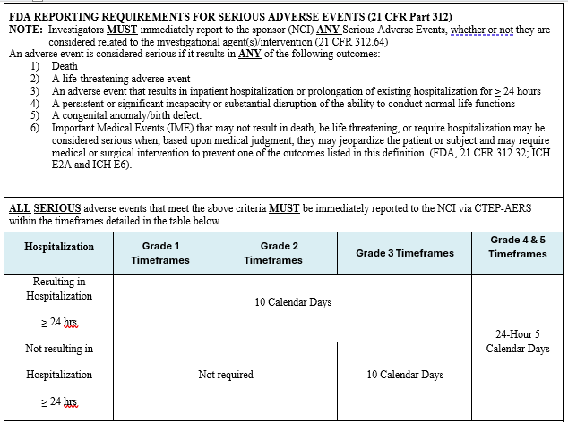
Phase III IND Arm Expedited Reporting

Slide 38
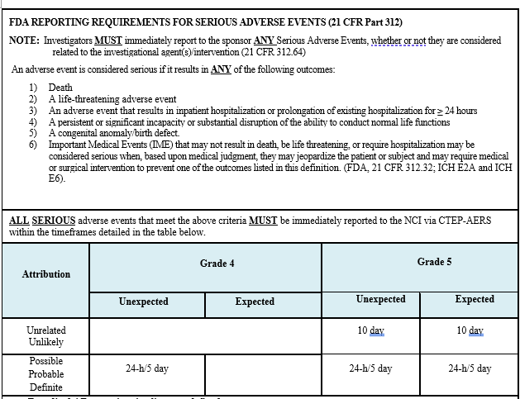
Control Arm Expedited Reporting
Notes:
No expedited reporting required; routine AE reporting is sufficient to fulfill safety reporting requirements

Slide 39
Example 2
Phase III Study of IND Drug X versus SOC Chemotherapy
Patient came to the ED after coughing up blood. On admission experienced syncope and hypotension; required urgent intervention
  Laboratory assessments: hemoglobin 5
Assessment: what AE(s) requires expedited reporting?
  CTCAE term/grade, seriousness criteria, protocol specific expedited reporting criteria

Slide 40
What AE(s) Require Expedited Reporting?
Cough; hypotension; syncope; and/or anemia?
Bronchial hemorrhage (grade 4)
  Signs/symptoms versus definitive diagnosis
  Note: hemoglobin decrease due to bleeding is not the same clinical condition as anemia
Is it serious?
  Yes, hospitalization and life threatening
Does it meet protocol expedited reporting criteria?
  What treatment arm?

Slide 41
Phase III IND Arm Expedited Reporting

Slide 42
Control Arm Expedited Reporting Table
Notes:
Depends: related or unrelated?
If related: expected or unexpected*?

Slide 43
Example 3
Phase III Study of IND Drug X versus SOC Chemotherapy
Routine interval lab work, dose held per protocol dose mods:
  Grade 3 Platelet Count Decrease
  Grade 3 WBC Decrease
  Grade 4 Neutrophil count decrease
  Grade 4 Lymphocyte Count Decrease
What AE(s) require expedited reporting?

Slide 44
What AE(s) Require Expedited Reporting?
Is it serious?
  No
Does it meet protocol expedited reporting criteria?
  What treatment arm?

Slide 45
Phase III IND Arm Expedited Reporting
Notes:
None

Slide 46
Control Arm Expedited Reporting Table
Notes:
None

Slide 47
Other Protocol Specific Expedited Reporting Requirements
CAEPR/SPEER
  Specific Protocol Exceptions to Expedited reporting
    CTCAE term (grade): excluded from expedited reporting regardless of seriousness criteria met
  E.g. Vomiting (Gr 3)
  Routine AE reporting is sufficient to fulfill safety reporting requirements
Adverse Events of Special Interest
  CTCAE term (grade): requires expedited reporting even if not serious

Slide 48
SAE Resources
NCI Guidelines for Investigators: Adverse Event Reporting Requirements
Information on the CTEP-AERS application
NRG Routine AE Reporting Guidelines (embedded below)
Right click → Document Object → Open

Slide 49
SAE Resources
CTEP-AERS Help Resources
CTSU Start/Stop Date Guidance
Information on the Rave/CTEP-AERS integration

Slide 50
Q & A
Maggie Spillers - SWOG mspiller@swog.org
Sara McCartney - NRG McCartneyS@nrgoncology.org
Cameron Salisbury - ECOG-ACRIN csalisbury@ecog-acrin.org
Proxy for Rombi Wade-Oliver - Alliance

