Slide 1
Welcome to the ePROS Webinar.
We will begin shortly.
Check the chat box for handouts that may have been uploaded by the presenters.
Please mute your mic and use the chat box or raise your hand to ask questions. Reactions are also encouraged.
Please complete the post-webinar evaluation survey, available here here after the webinar. The presenter will post the link in chat.
If you experience sound issues– call in using the number included on the TEAMs calendar invitation.
Notes:
Presenters – Please do not make changes to this slide.
HOSTING THE WEBINAR
Join the webinar 10 minutes early
Start with a sound check of all speakers
Share the PowerPoint slides- ask if other speakers can see it
Begin Recording
At the end of the meeting, remind audience to fill out the survey. Add survey link to chat.
Q&A ASSISTANT ROLE
When questions are submitted, please respond in the chat “Thank you for your question.”
Copy and paste submitted questions into a PowerPoint document to share at the end during the last 15-ish minutes of the webinar. You will only need to share your screen. The presenter will read the questions aloud and answer the question.
Download attendance list of meeting. Send reminder to fill out survey if they haven't already, providing survey link. Test link before sending.

Slide 2
VA Innovation and Research
Review System (VAIRRS)
Monthly Webinar
June 27, 2024

Slide 3

Webinar Housekeeping
Webinar
Housekeeping
Presentation - Slides are shared in the TEAMs chat at the beginning of the meeting.
Recording - This session is recorded, and the associated handouts will be available on ePROS Education and Training website within a week after the webinar.
Close Captioning – Available on Teams. To access, select “More” in the top menu bar, then “Record and transcribe,” and finally “Transcript.”
Q&A - Please use the chat feature to submit questions.
  Questions will be addressed at the end of the webinar
Webinar Archive - Most ePROS webinars can be found here: https://www.research.va.gov/programs/epros/education/webinars/archives.cfm
Survey - Please complete the post-webinar evaluation survey available here: ePROS Webinar Survey. We will also post this link in the chat.

Slide 4
Contents
01 Announcements
03 Multi-Site Projects and Packages
04 Objectives and Definitions
05 VA Central IRB Submission Process for Co-PIs at Different VA Facilities

Slide 5
Important Announcements
VAIRRS Distribution Subscription List
Field Staff Reporting (FSR) Dashboard
VAIRRS Mentor Program
VAIRRS has launched a new Distribution Subscription List, which will serve as the primary method to receive VAIRRS training announcements, surveys, and data-specific emails outside of the newsletters and program updates. VAIRRS is retiring the contact groups: VAIRRSAdministrators@va.gov and VAIRRSendusers@va.gov.
Note: This subscription list does not include subscriptions to VAIRRS newsletters or other ORD news.
VAIRRS just rolled out the "Data Curation" page on the FSR Dashboard. The Data Curation page includes data validation requirements for the project status of various boards, IRB project risk levels, and projects approaching an expiration date.
Secondly, the "Site Audit" page is now under review by several VAIRRS sites. It can be used to quickly find relevant information that may be required for a site audit.
The VAIRRS Mentor Program currently has four team members from various roles across VA providing mentorship, with the ability to support more mentees. If you are interested in getting help from a fellow VAIRRS user or becoming a VAIRRS mentor, access the mentee/mentor applications via the VAIRRS Mentor Program SharePoint page. Applications are accepted on an ongoing basis or until all slots are filled.
Subscribe to the VAIRRS Newsletter to keep up with important announcements and program updates: https://public.govdelivery.com/accounts/USVHA/subscriber/new?topic_id=USVHA_1952

Slide 6
VAIRRS Monthly Webinar Series: Standard "Multi-site" and "Co-investigator at a Different Site" Processes
Presenters:
Angela Foster, ePROS Program Manager
Jessica Kroll, VA Central IRB Administrator

Slide 7
Multi-Site Projects and
Packages
Presented by
Angie Foster, ePROS Program Manager

Slide 8

Mult-site Share Function
Correct IRBNet Number
Each site has a unique IRBNet number assigned to it. No two sites share the same number – not even in the case when the PI site also has an approved LSI at the same location.
Please be certain that the PI has shared the project with each LSI using the ‘multi-site’ share function and proper access is granted.
For questions regarding CIRB project shell numbers, you may contact VACentralIRB@va.gov.

Slide 9
Projects vs. Packages
Multi-site Projects
Approved PI Project
(Package – 1)
Amendment
(Package -2)
CR/Progress Report
(Package -3)
Amendment
(Package -4)
LSI Project
LSI Project
Approved LSI Project
(Package – 1)
Approved LSI Project
(Package – 1)
Amendment
(Package -2)
CR/Progress Report
(Package -3)
Amendment
(Package -4)
Amendment
(Package -2)
CR/Progress Report
(Package -3)
Amendment
(Package -4)

Slide 10
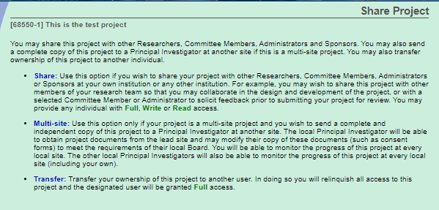
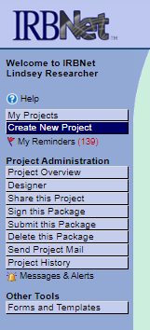
How to: Share Package
Share package with study team members
Multi-site share with local site/non-lead site investigator
Transfer ownership of project to another investigator

Slide 11
Objectives and Definitions
Presented by
Jessica Kroll, VA Central IRB Administrator

Slide 12
Objectives
The VA Central IRB (CIRB) will outline a new submission process for when a PI has multiple Co-PIs located at different VA facilities.
If all Co-PIs are located at the same VA facility, the submission process outlined in this webinar should NOT be followed.

Slide 13
Definitions
Principal Investigator (PI): The PI is the investigator responsible for the entire project. They oversee scientific, technical, and day-to-day management of the research conducted across engaged and non-engaged local sites. PI also refers to the application process for obtaining VA CIRB approval.
Local Site Investigator (LSI): The LSI is an investigator at a site participating in a multi-site research project. They oversee the scientific, technical, and day-to-day management of the research at the local site. The LSI also refers to the application process for obtaining CIRB approval for the investigator and the site where the study will be conducted, linked to the PI application but distinct from it.
Co-Principal Investigator (Co-PI): A Co-Principal Investigator shares equal oversight and responsibility with the other Co-PIs for conducting a research project, as detailed in the PI definition above.
Lead Co-Principal Investigator: For IRBNet purposes, one of the Co-PIs must assume the lead Co-PI role. The lead Co-PI will be responsible for creating the project in IRBNet, sharing it with the non-lead Co-PIs, and making all required submissions to the CIRB. The lead Co-PI will be the named recipient for all CIRB notifications and communications for the project.

Slide 14
VA Central IRB Submission Process for Co-PIs at Different VA Facilities
Presented by
Jessica Kroll, VA Central IRB Administrator

Slide 15
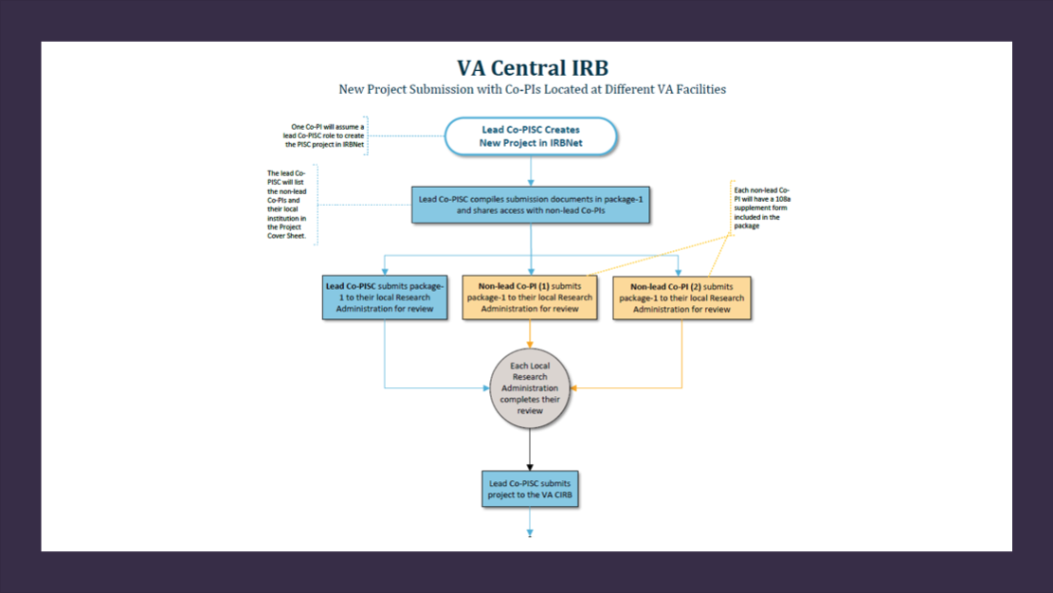
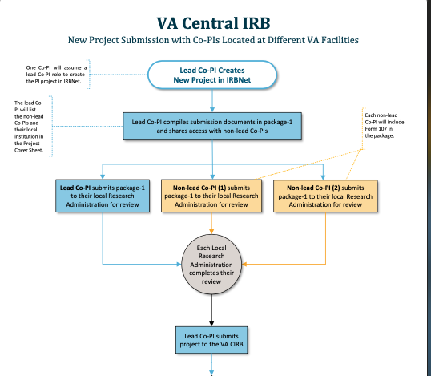

Slide 16

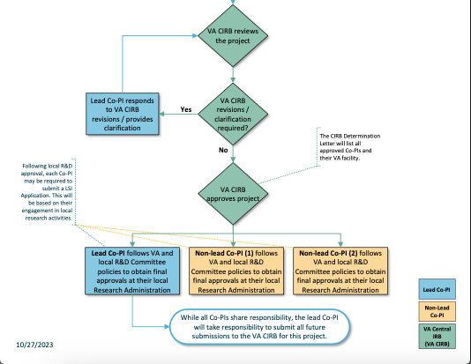

Slide 17
Important Notes
When Co-PIs are located at different VA facilities, one Co-PI must assume a lead role.
IRBNet allows only one lead Co-PI in the system, even if there are multiple Co-PIs.
The lead Co-PI is responsible for submitting the PI New Project Application to the CIRB.
All Co-PIs (lead and non-lead) must submit the PI Project to their local Research Administrations before submitting to the CIRB. This ensures local oversight of each investigator’s involvement in the project.
The CIRB cannot describe the review process at the local Research Administration, as each site’s process varies. Please contact your local Research Administration or Local Site Liaison for specific instructions.

Slide 18
Example
There are three Co-PIs on a PI New Project Application.
One is located at Atlanta VAMC, one at Boston VAMC, and one at Cincinnati VAMC.
All three Co-PIs have equal responsibility and oversight of the project.
In this example, all three Co-PIs will follow these instructions when creating and submitting the project in IRBNet.

Slide 19
Step 1
One of the three Co-PIs must assume the lead role for this project.
The lead Co-PI will create the PI New Project in IRBNet and compile all applicable submission forms according to the CIRB guidance document titled "INSTRUCTIONS - PI and LSI New Project Submission."
Required Forms:
Form 107 Co-PI Different VA Facility must be completed for each non-lead Co-PI and included in the New Project package.
Study Team Tracking Wizard must list each Co-PI and their primary VA location.

Slide 20
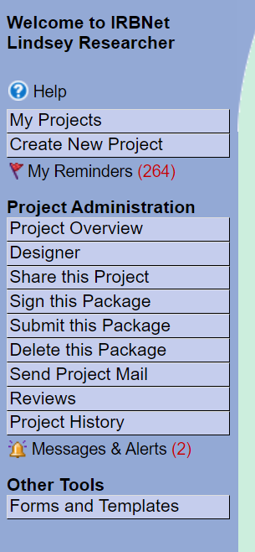
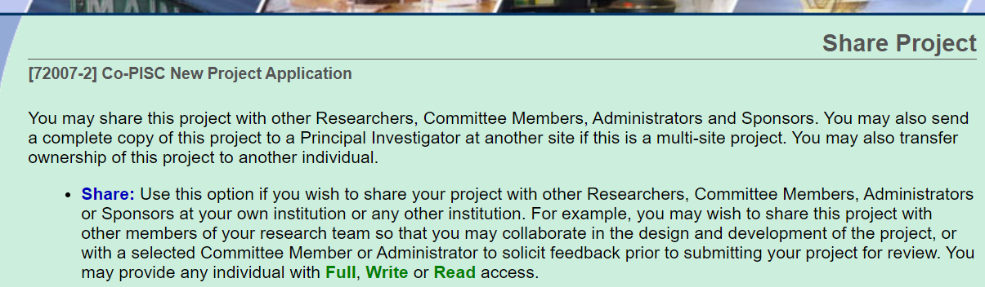
Step 2
The lead Co-PI will “Share this Project” with each non-lead Co-PI and assign each of them full access to the project.

Slide 21
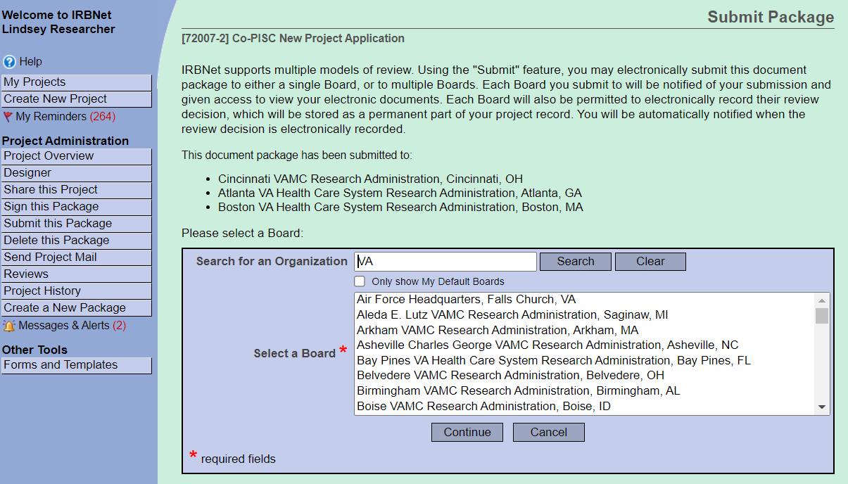
Step 3
The lead and non-lead Co-PIs will simultaneously submit the project (i.e., package -1) to each of their local Research Administrations.
*NOTE: A single package can be submitted to more than one board. In this instance, all Co-PIs can submit the same package to each of their local Research Administrations for review (see figure to the right).

Slide 22
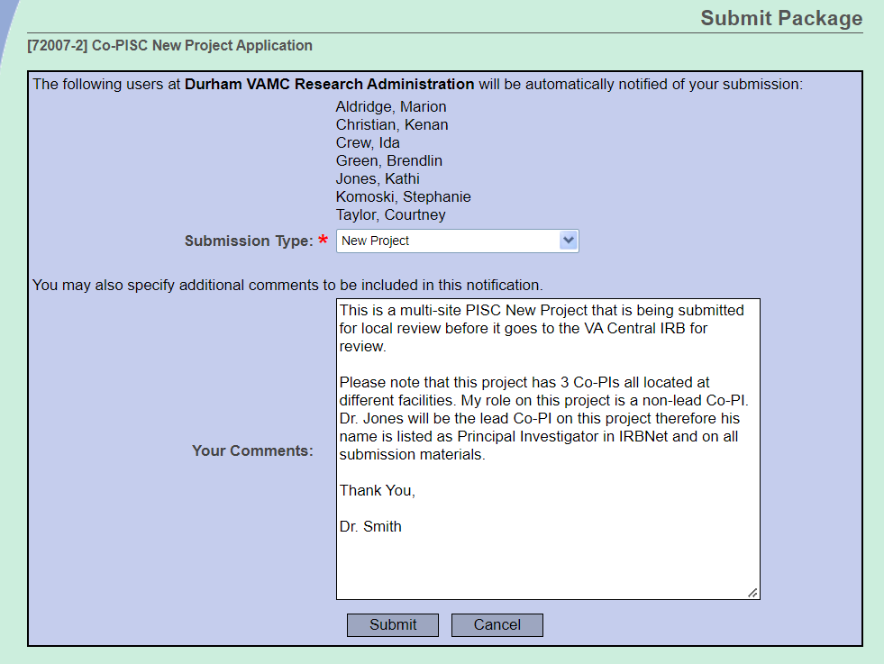
Step 3 Continued
When the lead and non-lead Co-PIs submit the package to their local Research Administrations, they need to include in the comments section that it is a project with Co-PIs located at different VA facilities, with the lead Co-PI being listed as the Principal Investigator in IRBNet and on the submission forms.
This is important for non-lead Co-PIs, as their information will not be listed as Principal Investigator when they submit to their local Research Administration. Non-lead Co-PIs can direct their local research administrations to review the Form 107 and Study Team Tracking Wizard where they are listed as Co-PIs.

Slide 23
Step 4
Each local Research Administration will complete their local review (i.e., COI Determination, ACOS signoff on Form 102, etc.)
A Form 102 with ACOS signoff for each Co-PI (lead and non-lead) must be uploaded into the package that is submitted to the CIRB.
*NOTE: This step allows local Research Administrations to have awareness and oversight of the Co-PIs role in the project.

Slide 24
Step 5
After all local Research Administration reviews are complete, the lead Co-PI will submit the project to the CIRB.
The package that is submitted to the CIRB should only include documents that are required by the CIRB. Do not include local forms.

Slide 25
Step 6
The CIRB will review the new project.
During the CIRB administrative review process revisions, clarification, or other requests may be made prior to the submission receiving CIRB review.
This process will occur utilizing IRBNet’s “Unlock and Lock” function so that you can add, remove, or revise documents within the same package.

Slide 26
Step 7
After final CIRB approval is received, each Co-PI will follow their local R&D Committee policies to obtain final approvals at their local Research Administration.

Slide 27
Additional Considerations
Will the Co-PIs have to submit an LSI application after final R&D Committee approval of the new project?
Following local R&D Committee approval, each Co-PI may be required to submit an LSI
application to the CIRB. This is the same as with any PI project and will be based on the Co-
PIs engagement in local research activities.
Our standard process outlined in the CIRB guidance document titled “INSTRUCTIONS - PI and
LSI New Project Submission” should be followed if an LSI application needs to be submitted.
If there is uncertainty on whether an LSI application needs to be submitted for a Co-PI, then
please consult with the CIRB manager overseeing the project.

Slide 28
Additional Considerations
Will all Co-PIs be named as Principal Investigators in IRBNet and on CIRB determination letters for the project?
IRBNet only allows for a single Principal Investigator to be listed on a project and in order to support this process, the Investigator to be named will be the lead Co-PI. Currently, there is no capability to name Co-PIs within IRBNet.
As a result, the lead Co-PI will be the named recipient on all CIRB determination letters and other official communication for the project. When necessary, the CIRB will document the name of each non-lead Co-PI and the name of their VA Facility within the body of the letter.

Slide 29
Additional Considerations
Who will be responsible for making future submissions to the CIRB?
While all Co-PIs share equal oversight and responsibility, the lead Co-PI will submit all future submissions to the CIRB for this PI project given the parameters within IRBNet.

Slide 30
Additional Considerations
Who will receive project notifications, for example project expiration notices?
All Co-PIs will receive IRBNet notifications for the project because each of them will have been granted Full Access to the project.

Slide 31








VAIRRS Resources
ePROS Webinars: https://www.research.va.gov/programs/epros/vairrs/training/webinars.cfm
ePROS Webinar Archive: https://www.research.va.gov/programs/epros/education/webinars/archives.cfm
VAIRRS University: https://www.research.va.gov/programs/epros/vairrs/training/vaiirs_university.cfm

Slide 32

Questions?

Slide 33
Survey
Please take 3 minutes to let us know how we did today.
ePROS Webinar Survey

Slide 34
Thank you for joining!
If you have any questions, please contact the VAIRRS Support Team at VAIRRS@va.gov.

