Slide 1

Preparing to Close the Fiscal Year
July 17, 2024
Antonio Laracuente, Director Field Operations
Kari Points, AO Research, Iowa City VAMC
Diane Murphy, ORD Finance
Erin Olson, ORD Finance

Slide 2
Please use the Q&A feature to submit questions.
  Please do not use Chat to send in questions.
  Be sure to send questions to “All panelists”.
Webinar Housekeeping
A recording of this session and the associated handouts will be available on ORPP&E’s Education and Training website approximately one-week post-webinar
We would be ever so grateful if you would complete the post-webinar evaluation survey that pops up once you exit the webinar.
An archive of all ORPP&E webinars can be found here: https://www.research.va.gov/programs/or ppe/education/webinars/archives.cfm
Experiencing sound issues – you can call in using the number included on the handouts and on your registration confirmation email that you received.
For questions, please use Q&A box and address to “All Panelists.” All Webinars will be recorded and posted within one week.

Slide 3
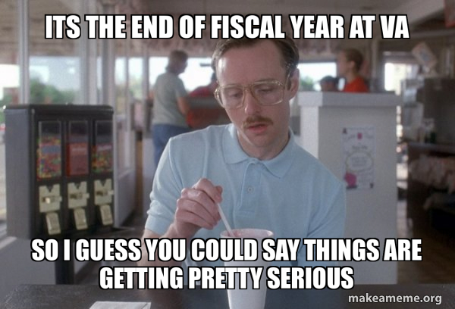
Objectives for today’s training
3

Slide 4
Objectives for today’s training
Training Section: | By the end of this section, you will:
Section 1: Understand the requirements for prior year and current year closeout. Deep dive training on CC101 is in August. | Be aware of key considerations for Prior-Year and Current-Year funds Understand the how, what and why of 2% Understand the amount greater than your 2% carryover is counting toward your station’s FY25 CC101 TEF closeout
Section 2: Committed vs. Obligated; Credit Cards and Travel | Understand Committed vs. Obligated and the impact on 2% Understand cutoff dates and why you need to move open orders on 24/25 funds to 25/26 funds
Section 3: Managing reimbursables, IAAs and collections | Understand what it means to close the loop/execute cost transfers
Section 4: What to expect in FY 25 | Plan for a CR to start the year Plan to continue to obligate until funds TDA’d to sites
Q&A
3

Slide 5

IMPORTANT! Read the guidance on FY 24 close out
FSC and VHA guidance is located on the ORD Field Finance Resource Center.
In addition, the ORD guidance is posted: FY24 ORD Closeout Guidance

Slide 6
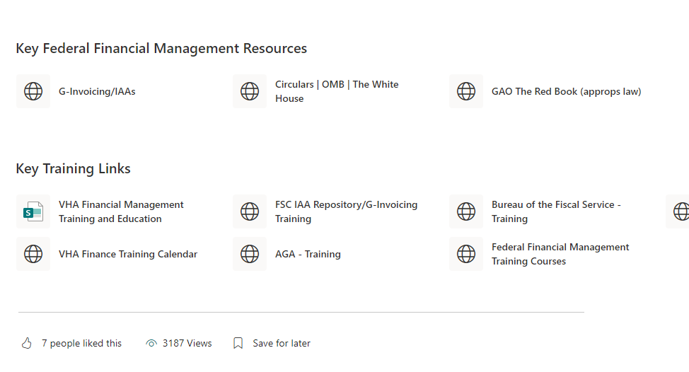

Bookmark the Link: Guidance is on the ORD Field Finance Resource Center
ORD Field Administrative Officer and Financial Management Resources (sharepoint.com)
ORD Finance handling low usage of SharePoint!

Slide 7
Section 1: FY24 Closing the Fiscal Year (Appropriated Funds)
Research Appropriations | Key Activities
Prior Year (0161A1 and 0161R1 23-24) | Do not let funds expire because a lapse potentially impacts future appropriations. Finance requested the field to obligate all prior year funding by Q2. This was not accomplished. As of 7/19/24 $5.8 Million (0161A) and $4.8 Million (0161R1) was still unobligated. Stations allowing Prior Year funding to lapse may receive a dollar for dollar decrease in FY25 CC101.
Current Year (0161A1 24-25) | Research Stations may not exceed 2% carryover. Unexecuted funds over 2% will be left on station to be used as FY25 CC101. All Purchase Card Orders that cannot be reconciled by 9/30/24 should be moved to current year FY 25 funding (0161A1 24-25). ORD will be working closely with Services and Stations to pull current year funds back by program.
TEF (1126RD) | Prior Year TEF is 3 year money Current Year TEF is 5 year money ORD expectation is to execute to 2% however we understand cost transfers cannot be executed until pay periods end, purchase card orders are reconciled, and contracts are paid in full. Therefore, work with the relevant services. THIS WILL NOT AFFECT YOUR CC101. TEF FUNDS DO NOT IMPACT CC101

Slide 8
Section 1: FY 2024: Key Date for Closing the Fiscal Year
KEY DATES
8/1/2024 | Do not enter any more bills or collect funds that impact 24/25. Bills impacting 23/24 funds should have stopped earlier this year. TDAs-Funding requests should only be for emergency funding situations or requirements that are ready to obligate.
9/23/24 | On the night of Monday, September 23, 2024, Charge Card System (CCS) will record the obligation/expenditure transactions for the billings in FMS. These transactions will include invoice billings submitted to US Bank as of close of business September 23
09/27/2024 | Ensure all commitments are obligated (remember commitments are not obligations)
10/01/2024 | FMS balance will be used to determine carryover. 2% based on total allocation in 0161A1. Example: Ceiling is 10,000,000. anything over 200,000 in the balance column is subject for use as CC101 funding and will be deducted from the FY 25 distribution

Slide 9
Section 1: Key Points regarding Prior Year Appropriation (PY) (0161A1 23-24)
All Prior Year Appropriation balances (23/24) must be $0 as soon as possible. Funds must be obligated by 9/30/24 to avoid the funds lapsing. Lapsed Prior Year 0161A1 23/24 funds may result in a dollar for dollar reduction in CC101 FY25 – we cannot stress enough how important it is to execute all funds.
If you have commitments in 23/24 funds that will cannot be obligated by 9/1, please let us know ASAP!
Do not leave this until the last minute, Funds that lapsed are frowned upon by Congress.
If your station has credit card orders (that used 0161A1 23/24 funds) that are not yet reconciled, take actions to close these transactions and move the transaction to current year (0161A1 24-25).
Run daily Status of Funds to track Prior Year execution daily (Monthly Training Series: Using VSSC and reading the Status of Allowance (SOA) (va.gov)).
We contacted stations who’ve continued to have large prior year balances and asked to move to undistributed in Q3 for pullback. We will continue to contact sites if we see large amounts pop up on the SOA – Finance reviews daily.

Slide 10
Section 1: Key Points regarding the Current Year Appropriation (CY) (0161A1 24-25)
All Research Stations have a target not to exceed 2% carryover, due to the risk of Congressional Recissions (recissions occurred in FY 21 and FY 22). Congress views an unobligated balance as available funding for re-appropriation outside of the VA. Past recissions have had negative consequences on the field because we were required to pull these funds back from stations that had prior plans for this funding. Always, consider funding as one-year. Reinforce this with your investigators early and often.
To meet this 2% target, stations need to execute 1358s, contracts, purchase card orders, and expense transfers as soon as possible or return funds when applicable (the deadline is 9/10/24).
Toxic Exposure Fund (TEF) appropriation funded projects should also execute to 2%. You should have been able
In August and September 2024, ORD will closely monitor execution and station progress to meeting this target.
Run daily Status of Funds to track Current Year execution starting September 1
Over the next 5 weeks, work actively with contracting to obligate/finalize contracting activities.
IF YOU NEED TO SEND MONEY BACK - DO SO NOW BY CONTACTING THE APPROPRIATE BUDGET ANALYST

Slide 11
Section 1: Follow-up from Q3 RAFT Report
The Q3 RAFT report was pivotal, since it provided you a good idea of projects that are not spending. Projects with less than 60% expenditures are at risk.
Over 67% in total obligations to date
Individually the data was all over the board and did not correlate well to the FMS status of allowance.
Still, clearly evident that individual project management is difficult and needs to be looked at for future training.
CC101 expenditure report revealed little correlation to the purpose of the allocation – will be updated for end of year report.
Work your way from Total Allocation to Program to Individual projects:
  Example 1: Appropriation is at 8%, program 81 and 82 are at 2%, program 84 is at 10% and program 85 is at 5%. Focus first on program 84 to see where the problem may be.
  Example 2: Appropriation is at 3%, program 81 and 82 are at 1%, program 84 at 2% and program 85 is at
7%. While you are not in danger you should look at projects in Program 85 to see where there may be continual problems.

Slide 12
Section 1: Looking at Appropriation, Program and Individual Project Data
Work your way from Total Allocation to Program to Individual projects:
  Example 1: Appropriation is at 8%, program 81 and 82 are at 2%, program 84 is at 10% and program 85 is at 5%. Focus first on program 84 to see where the problem may be.
  Example 2: Appropriation is at 2%, program 81 and 82 are at 1%, program 84 at 2% and program 85 is at 7%. While you are not in danger you should look at projects in Program 85 to see where there may be continual problems.

Slide 13
Section 1: Annual Close Review
Review outstanding obligations to determine if they meet the requirements of an obligation as defined in OFP Volume III, Chapter 2 Chapter 02 - Obligations - Financial Policy Documents (va.gov).
Estimated obligations are to be adjusted (increased or decreased) accordingly
The UDO report is critical in managing money. It tells you which obligations are open. Very useful when managing 1358 for subject reimbursement and IPAs. We do not want a large lapse in money as occurred last year at one station.

Slide 14
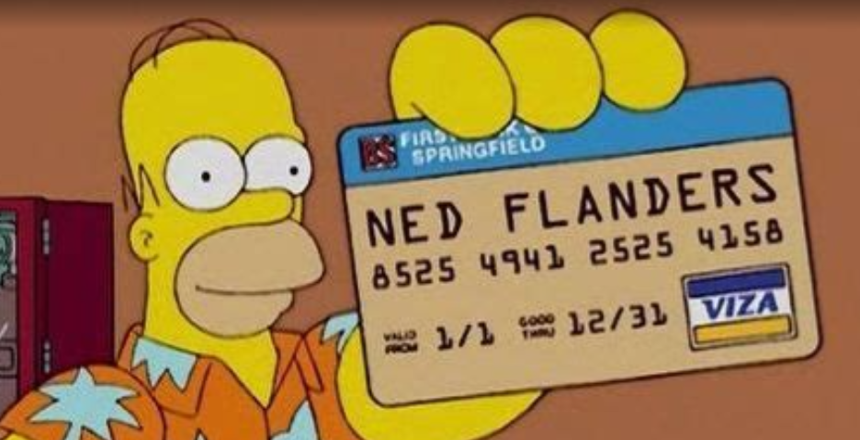
Section 2: Committed vs. Obligated, Credit Cards and Travel

Slide 15
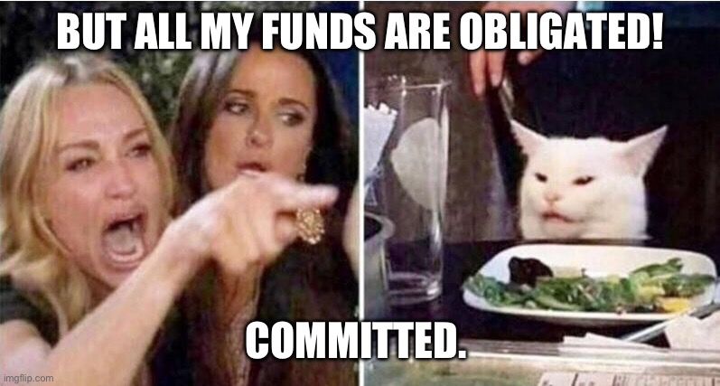
Section 2: Reminder: Committed vs. Obligated
You may think that you’ve reached the 2% carryover threshold because you’ve entered a 2237 for equipment, a 1358 for IPAs, or placed a credit card order.
However, taking the action to enter the funding documents in VISTA only commits the funds.
Funds hit the fund control point and come off your balance when those transactions are obligated by fiscal.
For a 2237 supporting a contract, obligation occurs only after the contract is completed and signed.
For a 1358 for IPAs, you may need to follow up with your fiscal until you see the obligation hit your fund control point.
For credit cards, the purchase order is not obligated until the order has been reconciled.

Slide 16
Section 2: Helpful tips on credit card open orders
Credit Card charges not reconciled: It is a best practice to stop all credit card charges at the end of August. Notify PIs well in advance of this deadline. Check your monthly spend limit and request an increase if needed since PIs will likely have additional orders to get them through end of year. This allows you the month of September to receive orders in and reconcile as much as possible. This will reduce the amount of credit card orders that are carried into FY25. Once FY25 starts, you will only want to use FY25/26 funds for credit card orders. No prior year funds should be used for credit card charges.
If expected reconciliation date is after November 1st, 2024, you are required to cancel the order and reorder in FY25/26 as these prior year funds will be swept as detailed in Section 1.
Following are different options to obtain credit card open orders:
  Fiscal Office can provide the accrual reports for open credit card orders.
  You can pull the Running Balance report in VISTA to determine what orders are open. Any orders with a “@” next to the order are open.
  If you have the unreconciled menu by cardholder menu in VISTA, you can pull the open orders for each cardholder.
  Ask your cardholder(s) and work with them to see what can be reconciled.
14

Slide 17
Section 2: Travel/Concur
Note: The slide is from FY23 FSC News Flash as the FY24 has not been issued yet. Expect similar timelines for closing this year. FSC News Flash 8.24.23
VA’s Temporary Duty (TDY) Travel System, ConcurGov, will be unavailable from 5:00pm Eastern Standard Time (EST) Friday, September 15, 2023 through 6:00am EST Monday, September 18, 2023 to allow time for the loading of the FY 2024 FMS Lines of Accounting (LOA) and iFAMS Accounting Templates.
      While ConcurGov is down, Emergency Travel Procedures will be in effect and travelers requiring reservations or immediate booking during this time should contact the Travel Management Center (TMC) directly at (866) 779-6612. Please note that the TMC will charge the full-service fee for this support.
Be cognizant of deadlines and consider choosing travel dates when possible outside of these critical time periods.
14

Slide 18

Section 3: Reimbursables

Slide 19
Section 3: Biggest Issue with Reimbursables
See our training from March on our SharePoint: Monthly Finance Training, Reimbursable Process_Final.pptx (sharepoint.com)
Stations are not closing the loop.
  Reimbursables are meant to offset expenditures made in the 0161A appropriation (be careful though as this will increase balances in 0161A1).
  Stations are billing and receiving the TDAs but are not cost transferring the expense from the 0161A to 0161R1 or X2.
Problem is cumulative as you do not close the loop, the balances grow and Fiscal will offset expenditures in previous years per the bill, thus making Research lose buying power.
  Example: Bill was made, paid and TDA received June 2024 in X2. Cost incurred in 22/23 funds. Cost transfer is now done from 0161A1 22/23 to 0161X2, those funds in A1 are not accessible for use. Closing the loop took too long, and the funds are not available for use anymore!
Work with Fiscal to cost transfer to 24/25 to reduce R1 balance to “0”.
16

Slide 20
Section 3: Managing Reimbursable Funding
Research Appropriations | Current Balance as 7/16/2024 | Key Activities
No-Year (0161X2) | $6.5 M | Continue to obligate funding that is unobligated. The no-year fund is intended to reimburse VA Research from the NPCs, thus it’s critical to obligate these balances quicky after they are earned.
Prior Year (0161R1 23-24) | $4.8 M | Run daily Status of Funds to track Prior Year 0161R1 available funds are obligated starting on August 1 Run CALT tables (weekly through August; daily in September) to ensure all Reimbursable advances have been earned. We always send the R report from Raju Rama so you can see the status of reimbursables, and they can all be found on our SharePoint for FY 24.
Current Year (0161 24-25) | $2.9 M | Run daily Status of Funds to track Prior Year 0161R1 available funds are obligated starting on August 1 (Please see June 2022 Monthly training that provided instructions on how to use VSSC: Finance Monthly Training Series: Using VSSC and reading the Status of Allowance (SOA) (va.gov). Run CALT tables (weekly through August; daily in September) to ensure all Reimbursable advances have been earned.

Slide 21
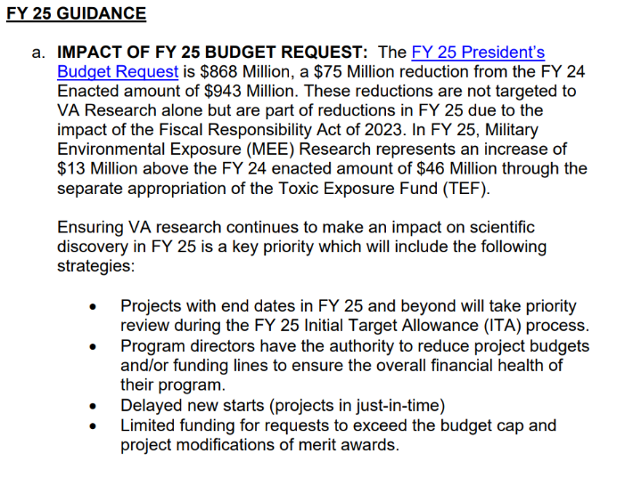
Section 4: Planning for FY 25
FY25 House mark and Senate mark both provide more funding than the FY25 President’s budget but until enactment, we will not have a final FY25 number to execute.
VA Research has been through times of plenty and leaner years – we will persevere however be aware that mitigation strategies used in the past will again be in place.
Remember during a FY25 CR we will be operating with the FY24 Enacted amount, which is greater than the FY25 President’s budget request.
17

Slide 22
Section 4: Planning for FY 25
• Plan to start FY 25 under one/multiple CRs for a significant portion of the fiscal year.
Meet early with your investigators to develop spend plan. Schedule now if time permits; Pink sheets provide funds for FY25.
• Make sure that July 1st and October 1st project starts are implemented early in the fiscal year by hiring staff, purchasing supplies, and buying equipment. You can and should start personnel actions while projects are in JIT.
• Ensure your acquisition packages are submitted to RPO East as early as possible and work with Fiscal to allow you to overcommit your FCP in VISTA.
• Refer to FY24 ORD CR Guidance on executing funding during a CR. FY25 CR guidance will release in September.
Notes:
When annual appropriations acts are not enacted by the beginning of the fiscal year (i.e., by October 1), one or more continuing resolutions may be enacted to provide temporary funding to continue certain programs and activities until action on the annual appropriation is completed. This means, you can obligate and spend money on October 1st, 2024.

Slide 23

Questions

Slide 24
Useful Resources
Past ORD Finance Training (sharepoint.com)
20

