Slide 1
IRBNet 101 for Central IRB Coordinators and Investigators
Don E. Workman, Ph.D., VA IRB Network Director
Jessica Kroll, VA Central IRB Administrator
January 13, 2022
Dial in (Main): (404) 397-1596
Attendee Access Code: 199-219-1720
Slides available on SharePoint:
See link in Q&A Box

Slide 2
Topics
  VAIRS? IRBNet?
  What is unique about submitting to VA CIRB?
  CIRB Submission Process
  Viewing review results
  Returned Packages
  Unlocked Packages
  Subsequent Packages
  Live Demonstration

Slide 3
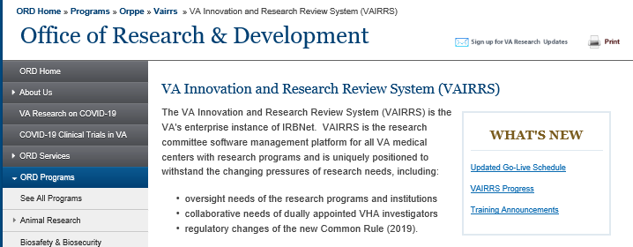
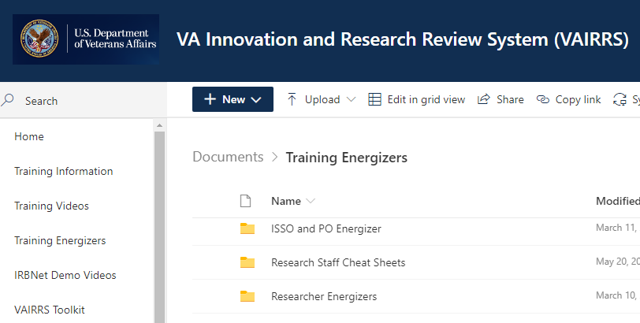
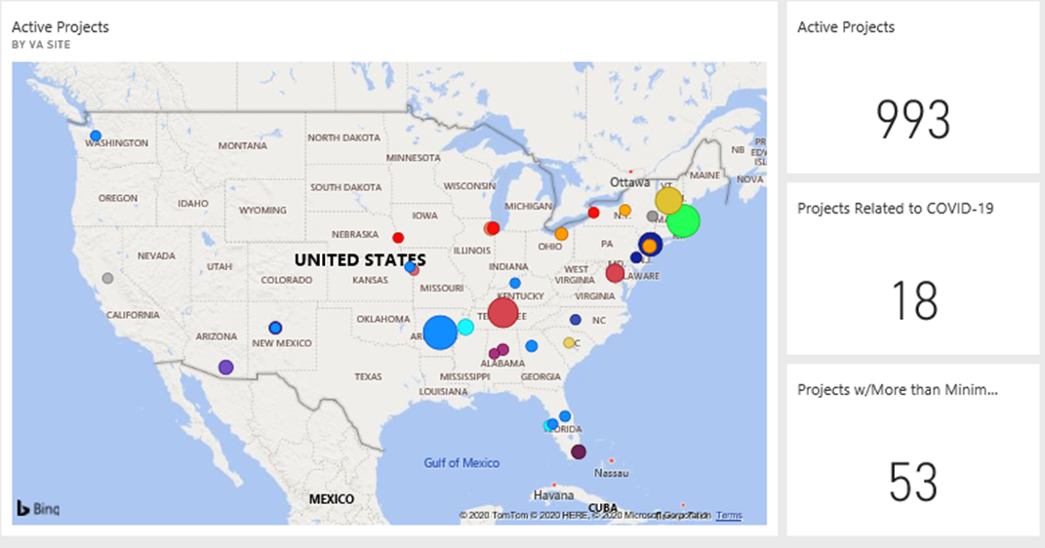
What is VAIRRS? IRBNet?
VA Innovation and Research Review System
  Includes IRBNet
  VAIRRS Website: https://www.research.va.gov/programs/orppe/vairrs/default.cfm
  VAIRRS SharePoint Portal: https://dvagov.sharepoint.com/sites/VHAORPPE/vairrs
  Optimization Dashboards

Slide 4

Polling Question
Have you already submitted to the VA CIRB?
  Yes
  No
What is your role in working with IRBNet (check all that apply)?
  RDC Member
  IRB Member
  Research Office/AO/ACOS
  Study Coordinator
  Investigator
  RCO
  Other

Slide 5
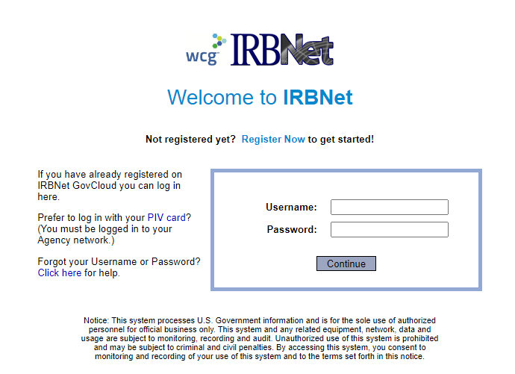
Accessing IRBNet
Website address: gov.irbnet.org
  PIV Login
  Accessible from outside the VA network

Slide 6
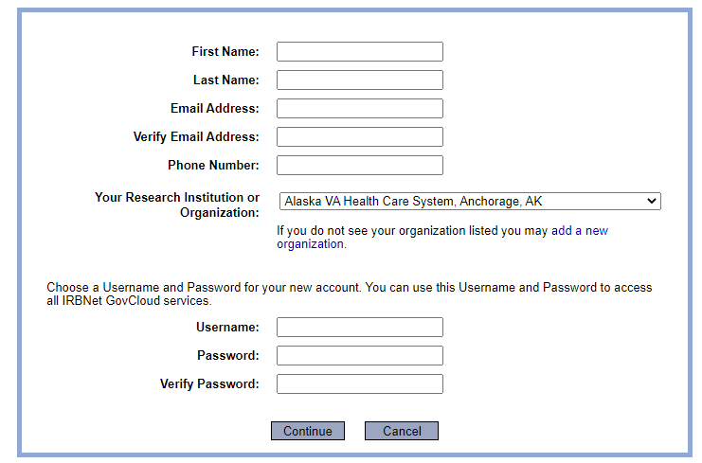
Enrolling in IRBNet
All VA facilities are listed in affiliation section

Slide 7
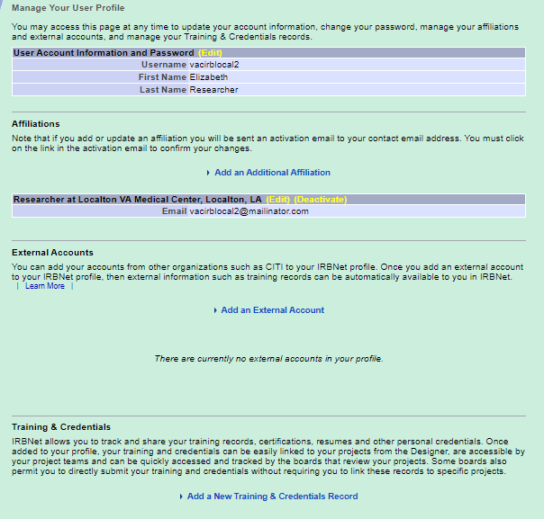

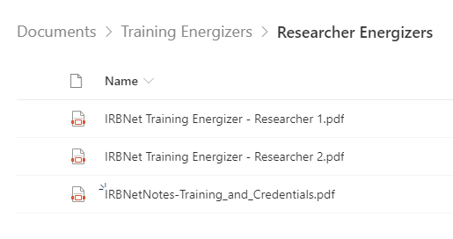
User Profile
Add additional affiliations
VAIRRS SharePoint Portal
-Training Energizers
-Researcher Energizers

Slide 8
Unique Processes for CIRB
PISC and LSI applications
Unique Forms in Forms Library
Sharing of Packages across Facilities
Multi-Site Exemption applications

Slide 9
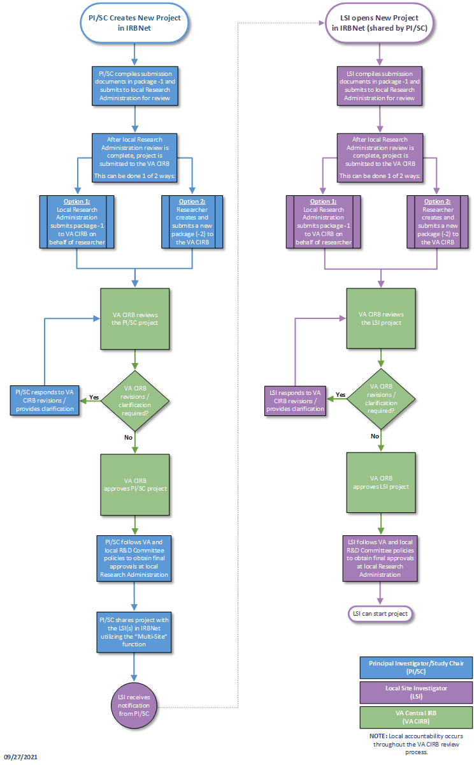
VA CIRB
PI/SC and LSI
New Project
Submission Process

Slide 10
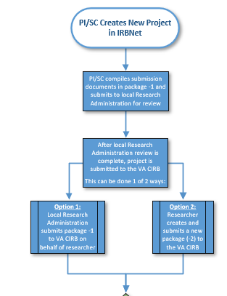
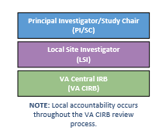

Slide 11
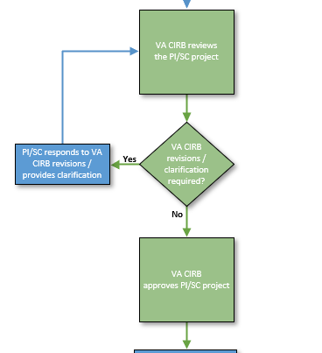

Slide 12
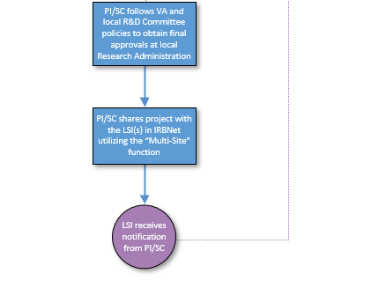

Slide 13
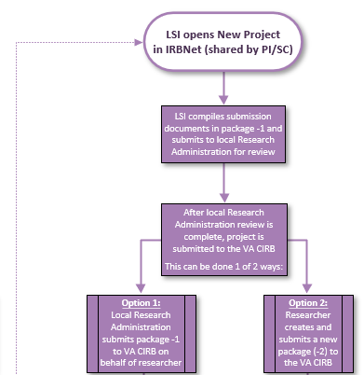

Slide 14
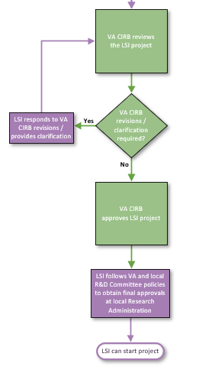

Slide 15

Reminder: Important Process to Follow
All new Principal Investigator/Study Chair (PI/SC) and Local Site Investigator (LSI) study applications must be routed through the local research administration
  In place of the previous 15-day waiting period for local context reviews after PI/SC approval
  What is required from this Research Office Review
    Depends on your local SOPs
    We would recommend a review at least for input about the local context including facility, equipment, personnel availability
All post-approval actions are to be submitted directly to the CIRB

Slide 16
Live Demonstration

Slide 17
New Process for Exempt Applications to VA CIRB
Prior guidance:
  Submit one PISC application
  Share approved package with participating sites
    They can share with local Research Office for RDC approval
    They can take Board Documents and create a new package and send to local Research Office for RDC approval
Upcoming guidance:
  VA CIRB will require PISC application and then LSI applications for each engaged research site

Slide 18
Contents for PISC and LSI packages
PISC
LSI
Project Cover Sheet – IRBNet Wizard
IRB Information Sheet – IRBNet Wizard
CIRB Form 102 (and, if needed, additional FCOI documentation)
Form 105: Request for Exemption
Protocol
Enterprise Research Data Security Plan (ERDSP)
CV/ Biosketches – Study team members in the Investigator Role
Form 103: Waiver of HIPAA Authorization – if applicable
Form 10-0493: MODEL HIPAA Authorization Form – if applicable
MODEL Information Sheet or Consent Scripts – if applicable
Project Cover Sheet – IRBNet Wizard
IRB Information Sheet – IRBNet Wizard
CIRB Form 102 (and, if needed, additional FCOI documentation)
Enterprise Research Data Security Plan (ERDSP)
CV/ Biosketches – Study team members in the Investigator Role
Local Information Sheet or Consent Scripts – if applicable

Slide 19
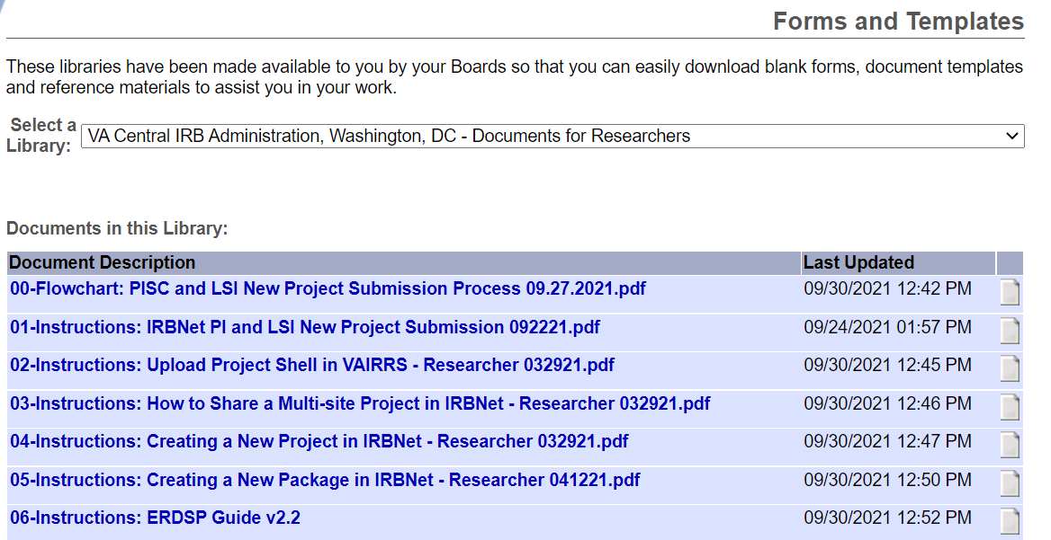
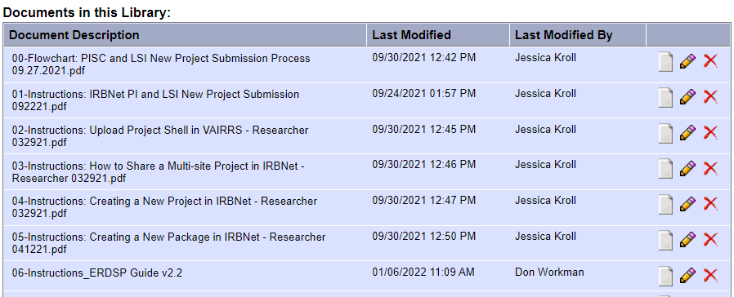
Additional Guidance
All guidance documents for the VA CIRB are posted in the Forms and Templates library

Slide 20
Additional Guidance
VAIRRS SharePoint Portal: https://dvagov.sharepoint.com/sites/VHAORPPE/VAIRRS
VAIRRS Website: https://www.research.va.gov/programs/orppe/vairrs/default.cfm
For questions regarding local submission procedures:
  Contact your local research office
For questions related to CIRB processes:
  Contact the Central IRB mailbox VACentralIRB@va.gov
For questions related to the VAIRRS program:
  Contact VAIRRS@va.gov
For technical issues with IRBNet:
  Contact IRBNet Support at govsupport@irbnet.org

Slide 21
Questions?

Slide 22
IRBNet Terms
Institution/Organization – Each VAMC and the Central IRB are considered ‘Organizations’ in IRBNet
Package – Package and submission are used interchangeably. A package represents the individual submissions (Initial Review, CR, Amendments, etc.) for a project
Multiple Packages – Sometimes there are multiple packages for a single submission (e.g., an amendment when changes are required)
Submission Manager – The Submission Manager is the primary user interface (like a workspace) for all user roles. The submissions viewable in your Submission Manager are dependent on your role, permission level, shared submissions, and selected (manual or default) filters
IRBNet ID – The IRBNet ID is the unique identifier for every Project and Package. The numbers before the dash represent the Project and the number after the dash represent the package
VA CIRB Study Number – Two-digit year – Two-Digit Sequence

Slide 23
Availability of Recording
A recording of this session and the associated handouts will be available on ORPP&E’s Education and Training website approximately one-week post-webinar
An archive of all ORPP&E-hosted webinars can be found here: https://www.research.va.gov/programs/orppe/education/webinars/archives.cfm

