Slide 1



VAIRRS Monthly Webinar
OFFICE OF RESEARCH AND DEVELOPMENT
VA Innovation Research and Review System (VAIRRS)
January 31, 2022

Slide 2
CONTENTS
01
WELCOME
02
MONTHLY WEBINAR OVERVIEW
03
IMPORTANT ANNOUNCEMENTS
04
FEASIBILITY, ALIGNMENT, AND SCIENTIFIC REVIEW(FA/SR) Presented by Dr. Molly Klote

Slide 3


MONTHLY WEBINAR OVERVIEW
The purpose of the VAIRRS Monthly Webinar series is to provide expert advice, training, demonstration, and/or direction to the VA research community regarding the various topics around the VA Innovation Research and Review System (VAIRRS) transition
*Upcoming* VAIRRS February webinar – Best Practices for conducting Continuing Review in IRBNet, Mary Eckart, VA Central IRB Manager

Slide 4
IMPORTANT ANNOUNCEMENTS
Add Project Cover Sheet Campaign next steps
  Project Status Update email sent to VAIRRS Administrators today
  Please validate your institution’s data in IRBNet by February 11, 2022
Draft version of the project cover sheet wizard guide available for review on VAIRRS SharePoint
  Link: https://dvagov.sharepoint.com/:f:/r/sites/VHAORPPE/VAIRRS/VAIRRS%20Toolkit/Wizard%20Guides?csf=1&web=1&e=ZUgHP
  Send your feedback by February 11, 2022

Slide 5

FEASIBILITY and ALIGNMENT, AND SCIENTIFIC REVIEW(FA/SR)
Presented by Dr. Molly Klote
Director, Office of Research, Protections, Policy, and Education

Slide 6
WHAT IS A FEASIBILITY, ALIGNMENT, AND SCIENTIFIC REVIEW(FA/SR)?
Definitions
Feasibility review – the initial and subsequent process of deciding whether the institution and the study team has the appropriate resources and expertise to complete the study if approved.
Alignment review – the initial and subsequent process of deciding whether the nature of the research is appropriate to be conducted at a given institution considering other, perhaps, similar studies occurring at the institution.
Scientific Review – initial and ongoing peer/expert review process of applying knowledge of acceptable criteria to determine whether a research protocol is sufficiently meritorious to proceed.
Importance
Ensures the likely completion of a study that will contribute to the scientific literature and Veteran health and healthcare.

Slide 7
VAIRRS ROUTING OVERVIEW NEW PROTOCOL SUBMISSION
PROCESS MAP

Slide 8
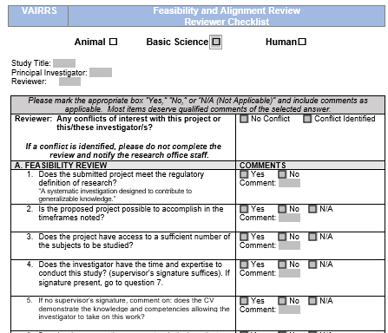
1.0R FEASIBILITY AND ALIGNMENT REVIEWER CHECKLIST

Slide 9
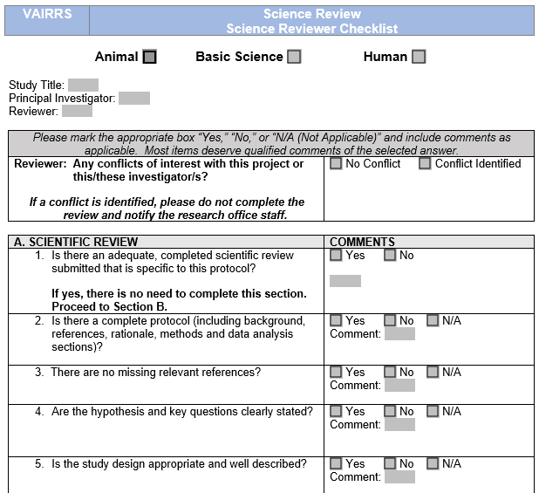
1.1R SCIENCE REVIEWER CHECKLIST

Slide 10
EXISTING FAQs
If the project does not meet the definition of research does the FA or SR evaluation stop?
Yes, the research service is not responsible for projects that do not meet the definition of research, unless your facility is requiring your review. The quality office is responsible for projects that involve quality improvement/assurance or evidence-based practice, etc.
Can the FA/SR reviewer checklists be completed after submission to sub-committees or is the expectation that R&D provides this review first and then repeat the eval after approval from the other committee?
The review needs to be completed by someone (not necessarily an R&D members, though they likely have the best grasp of the projects happening across the facility) who can assess whether the project can be accomplished in the proposed time frame, by the provider submitting it, and if it will interfere with other studies happening at the facility. A statement from the investigator’s supervisor stating he/she has the time to conduct the project and is qualified to conduct the project would go a long way in helping the person reviewing the form. The review is intended to be done before it is assigned to any committee for review as to reduce burden on the committees of studies that are not feasible or scientifically valid.

Slide 11
POLLS
Does your site conduct Feasibility and Alignment? Yes/No/Other
If your site conducts Feasibility and Alignment reviews, who conducts the review: A. ACOS or AO, B. research office staff, C. R&DC member, D. other
Does you site conduct scientific reviews independent of the IRB/R&DC (i.e., you have a separate scientific review process)? Yes/No/Other

Slide 12

QUESTIONS?

Slide 13
NEXT STEPS
Please attend the February webinar: Best Practices for conducting Continuing Review in IRBNet on February 22nd at 2 PM ET

Slide 14
THANK YOU FOR JOINING!
To learn more about VAIRRS visit the VAIRRS Website at https://www.research.va.gov/programs/orppe/vairrs/default.cfm.
To access additional knowledge-based materials and resources, visit the VAIRRS SharePoint at https://dvagov.sharepoint.com/sites/VHAORPPE/VAIRRS.
If you have any questions contact the VAIRRS Support Team at VAIRRS@va.gov.

