Slide 1

Appropriations Law in Research
February 15, 2023
Jason Berlow, Management Analyst, Finance
Tony Laracuente, Director of Field Operations

Slide 2

Housekeeping Notes
Webinar
Housekeeping
Recording - This session is being recorded and the associated handouts will be available on ORPP&E’s Education and Training website within one-week post-webinar.
Close Captioning - Now available in the new Webex platform. Click the “CC” button at the bottom left of the Webex screen.
Experiencing Sound Issues? – Call in using the number in your Webex chat box or in your registration confirmation email.
Q&A - Please use the Q&A feature to submit questions.
  Be sure to send questions to “All panelists”.
  Questions will be addressed at the end of the webinar.
Webinar Archive - Most ORPP&E webinars can be found here: https://www.research.va.gov/programs/orppe/education/webinars/archives.cfm
Post-Webinar Evaluation Survey - We are grateful to all that complete the post-webinar evaluation survey. It will automatically pop up once the webinar is exited.
For questions, please use Q&A box and address to “All Panelists.”
All Webinars will be recorded and posted within one week.

Slide 3
Objectives – for today’s training
Training Section: | By the end of this section, you will:
Finance Initiative Website and Survey | Provide update on Finance Initiative website Provide information about a field finance survey
Section 1: Introductory Concepts | Understand the basic framework of appropriation and GAO Redbook Understand Appropriations Language
Section 2: Purpose | Understand Purpose Statue, Necessary Expense Rule, and pick and stick rule.
Section 3: Time | Understand Bona Fide Need and the concepts of Severable and Non-Severable
Section 4: Amount and the Antideficiency Act | Understand amount and the antidefiency act
Section 5: Personal Expenses | Understand when Personal Expenses are permitted
Section 6: Food (the most popular topic) | Understand when food can/cannot be purchased
Q&A
Notes:
John

Slide 4

ORD Finance Resource Center
Link: ORD Field Administrative Officer and Financial Management Resources (sharepoint.com)

Slide 5
FY 23: Research AO, Budget Analyst, and Financial Management Field Training Survey
As we start the second year of the ORD Enterprise Finance Initiative, the ORD Office of Finance/Field Operations would like to assess your experience, overall satisfaction with the previous trainings provided, and request feedback on future training requirements.
Please note: Responses are anonymous and providing your name and station is optional.
Survey deadline: Friday, February 24th
Link: FY 23 Survey Link

Slide 6
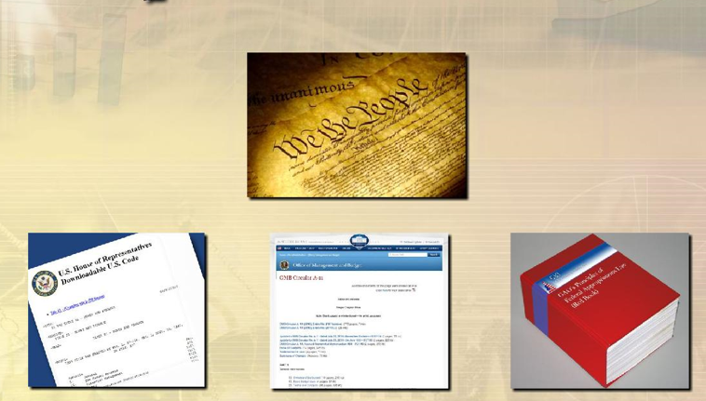
Section 1: What is Appropriations Law?

Slide 7
What is Appropriation Laws?
Article I, Section 9, of the U.S. Constitution, “no money shall be drawn from the Treasury, but in Consequence of Appropriations made by Law.”
There are some basic concepts, that are fundamental for your understanding of how you can obligate/expend funding from the Medical and Prosthetics Research Appropriation in your program or station. Most of these references are codified in the: Principles of Federal Appropriations Law, also known as the Red Book (GAO’s multi-volume treatise concerning federal fiscal law).
GAO updates the Red Book’s content with new laws, federal court rulings, and appropriations law decisions.

Slide 8
The GAO Redbook
Principles of Federal Appropriations Law, also known as the Red Book, is GAO’s multi-volume treatise concerning federal fiscal law. The Red Book provides text discussion with reference to specific legal authorities to illustrate legal principles, their application, and exceptions. These references include GAO decisions and opinions, judicial decisions, statutory provisions, and other relevant sources.
The Red Book consists of the following key sections:
Section | Topic | Link
Edition, Chapter 1 | Introduction | 4th Edition, Chapter 1 (pdf)
4th Edition, Chapter 2 | The Legal Framework | 4th Edition, Chapter 2 (pdf)
4th Edition, Chapter 3 | Availability of Appropriations: Purpose | 4th Edition, Chapter 3 (pdf)
4th Edition, Chapter 4 | Coming soon!
3rd Edition, Chapter 5 | Availability of Appropriations: Time | 3rd Edition, Volume 1 (pdf) Annual Update (pdf)
3rd Edition, Chapter 6 | Availability of Appropriations: Amount | 3rd Edition, Volume 2 (pdf) Annual Update (pdf)
3rd Edition, Chapter 7 | Obligation of Appropriations
3rd Edition, Chapter 8 | Continuing Resolutions
3rd Edition, Chapter 9 | Liability and Relief of Accountable Officers
3rd Edition, Chapter 10 | Federal Assistance: Grants and Cooperative Agreements
3rd Edition, Chapter 11 | Federal Assistance: Guaranteed and Insured Loans

Slide 9
Appropriations Law Training
This training is not intended as a replacement for a full appropriations law class but is intended to provide a general overview of appropriations law. For specific legal guidance/question, please reach out to our office to consult the GAO Redbook or VA OGC (Appropriations Law).
Below are some resources where you can find training on the subject:
  Management Concepts: Browse Appropriations Law Courses, Dates, & More from Management Concepts
  Graduate School: Federal Appropriations Law (FINC7100) | Graduate School USA
  Review the Volumes of the GAO Redbook

Slide 10
What is an obligation?
Obligation: is some action that creates a legal liability or definite commitment on the part of the government or creates a legal duty that could mature into a legal liability by virtue of an action that is beyond the control of the government. Payment may be made immediately or in the future.
GAO, A Glossary of Terms Used in the Federal Budget Process, GAO-05-734S

Slide 11
Purpose/Time/Amount: The most critical concept in appropriations law)
Congress controls the Government’s money and determines how the Government uses money and what amounts are available via the Appropriation's clause in the US Constitution: No Money shall be drawn from the Treasury, but in Consequence of Appropriations made by Law; and a regular Statement and Account of the Receipts and Expenditures of all public Money shall be published from time to time.
This legal authority to control funds is codified in the following three statutes:
Legal Requirements for an Appropriation | Key Considerations
Purpose (31 U.S.C. 1301)/ Necessary Expense Doctrine: | Section 1301 of the U.S. Code – called the “Purpose” Statute prohibits Federal officials from using appropriated funds for purposes other those for which the funds were appropriated.
Time/Bona fide needs (BFN) rule (31 USC, 1502): | The Bona Fide Needs Rule (BFN) requires that the need for which the funds are appropriated exists during the period for which the appropriation is made.
Amount (Antideficiency Act , 31 USC 1341 and 1517): | The Antideficiency (ADA) Act prohibits the following: Making or authorizing an obligation exceeding an amount available in an appropriation Involving the government in a contract or obligation before an appropriation is made Making or authorizing an obligation exceeding an apportionment Making or authorizing an obligation exceeding an amount permitted by agency regulations (sometimes referred to as an allotment), and accepting voluntary services

Slide 12
What is an Appropriation and how does it related to Purpose/Time/Amount?
An appropriation is a provision or law (typically an appropriations act) authorizing the obligation/expenditure of any amount of funds for a given purpose over a specified time period. This can include the annual appropriation, continuing resolutions (CRs), and supplemental appropriations.
Below is the Medical and Prosthetic Research’s FY 2023 Appropriation:
Program Authority
Purpose
MEDICAL AND PROSTHETIC RESEARCH (FY 23 Appropriation)
For necessary expenses in carrying out programs of medical and prosthetic research and development as authorized by chapter 73 of title 38, United States Code, $916,000,000, plus reimbursements, shall remain available until September 30, 2024: Provided, That the Secretary of Veterans Affairs shall ensure that sufficient amounts appropriated under this heading are available for prosthetic research specifically for female veterans, and for toxic exposure research.
Amount
Time

Slide 13

Section 2: Purpose
What can we fund with the Research Appropriation?

Slide 14
Purpose Law Requirements
The purpose law states: Appropriations shall be applied only to the objects for which the appropriations were made except as otherwise provided by law (Title 31 of the United States Code).
We do however have reasonable discretion in determining how to carry out the objects of the appropriation, meaning that an obligation is a necessary expense, this means that it is necessary or “will contribute materially to” the authorized appropriation purpose.
The necessary expense tests questions are the following:
  Question 1: Is it logically connected to the appropriation or an authorized agency function?
  Question 2: Is it not prohibited by another law or agency policy?
  Question 3: Is it not otherwise provided for as in another appropriation?

Slide 15
The necessary expense rule and the three-step analysis/rules
The necessary expense rule embodies a three-step analysis:
  The obligation/expenditure must bear a logical relationship to the appropriation sought to be charged. In other words, it must make a direct contribution to carrying out either a specific appropriation or an authorized agency function for which more general appropriations are available.
    a. Application of the necessary expense rule frequently requires an agency to determine whether a particular expenditure constitutes an official expense of the government or a personal expense of its employees (see section 5 for more on personal expenses).
  The expenditure must not be prohibited by law.
  The expenditure must not be otherwise provided for, that is, it must not be an item that falls within the scope of some other appropriation or statutory funding scheme (Pick and Stick Rule).

Slide 16
Necessary Expense Rule 1: Must have logical connection to the appropriation or an authorized agency function
Appropriation | Authorization: (as authorized by chapter 73 of title 38, United States Code)
Medical Research Appropriations Language: For necessary expenses in carrying out programs of medical and prosthetic research and development as authorized by chapter 73 of title 38, United States Code | The appropriations language references the authority about what type of activities Research can perform. Link: 38 U.S. Code § 7303 - Functions of Veterans Health Administration: research programs Critical Section of authority: In order to carry out more effectively the primary function of the Administration and in order to contribute to the Nation’s knowledge about disease and disability, the Secretary shall carry out a program of medical research in connection with the provision of medical care and treatment to veterans.

Slide 17
Necessary Expense Rule 2: Not prohibited by another law or agency policy
The Second test under the purpose analysis is that the obligation/expenditure must not be prohibited by law. As a general proposition, neither a necessary expense rationale nor the “necessary expense” language in an appropriation act can be used to overcome a statutory prohibition.
Below is a list of items that typically prohibited (without specific statutory authority): Lobbying, insurance, volunteer work, compensation restrictions, taxes (sales tax on TDY is permitted), membership fees, food, coffee, alcohol, etc.
For a full list, please see: GAO-17-797SP, PRINCIPLES OF FEDERAL APPROPRIATIONS LAW: Chapter 3, Availability of Appropriations: Purpose, Fourth Edition, 2017 Revision

Slide 18
Necessary Expense Rule 2: Exceptions to Prohibited Items
Membership Fee: Federal Appropriation law does not allow direct payment of memberships see Payment of Membership Dues | U.S. GAO
  However, it is our understanding that if a membership is secondary to a journal or conference that is allowable per appropriation and the cost is embedded and cannot be distinguished from that journal or conference then that is allowable.
Without Compensation (WOC) Appointments: Title 5 C.F.R. 304.102(h)- “Employment “without compensation” means unpaid service that is provided at the agency’s request and is to perform duties that are unclassified. VA can accept services without compensation under 38 U.S.C. 7405(a)(1). See VHA Handbook 5005 Part II Chapter 3 Section G Paragraph 7.

Slide 19
Necessary Expense Rule 3: Not available in another appropriation
Other VHA Appropriations | Appropriations Language Permits the following activity (selected sections), thus we can’t use Research appropriation for these activities and vice-versa.
Medical Services (0160) | For necessary expenses for furnishing, as authorized by law, inpatient and outpatient care and treatment to beneficiaries of the Department of Veterans Affairs and veterans described in section 1705(a) of title 38, United States Code, including care and treatment in facilities not under the jurisdiction of the Department, and including medical supplies and equipment, bioengineering services, food services, and salaries and expenses of healthcare employees hired under title 38, United States Code….
Medical Support and Compliance (0152) | For necessary expenses in the administration of the medical, hospital, nursing home, domiciliary, construction, supply, and research activities, as authorized by law; administrative expenses in support of capital policy activities; and administrative and legal expenses of the Department for collecting and recovering amounts owed the Department as authorized under chapter 17 of title 38…
Medical Facilities (0162) | For necessary expenses for the maintenance and operation of hospitals, nursing homes, domiciliary facilities, and other necessary facilities of the Veterans Health Administration; for administrative expenses in support of planning, design, project management, real property acquisition and disposition, construction, and renovation of any facility under the jurisdiction or for the use of the Department; for oversight, engineering, and architectural activities not charged to project costs; for repairing, altering, improving, or providing facilities in the several hospitals and homes under the jurisdiction of the Department…

Slide 20
Necessary Expense Rule 3: Pick and Stick Rule
Under the pick & stick rule, where two appropriations are available for the same purpose, the agency must “pick” only one account to cover expenses related to that purpose and “stick” with that account – unless it notifies Congress of its desire to change the funding mechanism through the annual:
Running out of money is not an excuse for using another appropriation. If two appropriations are reasonably valid for a specific expenditure, the agency may choose either appropriation. However, once that selection is made, the agency must continue using the chosen appropriation, to the exclusion of any other - unless/until it notifies Congress of a change in the annual budget submission.
The “pick & stick” rule only applies where two appropriations are available for the same purpose and the agency picks one account. We cannot use the pick & stick rule as an excuse for failing to fund an expense with the more specifically-phrased appropriation or a justification for continuing to fund an expense with the wrongly “picked” account.

Slide 21
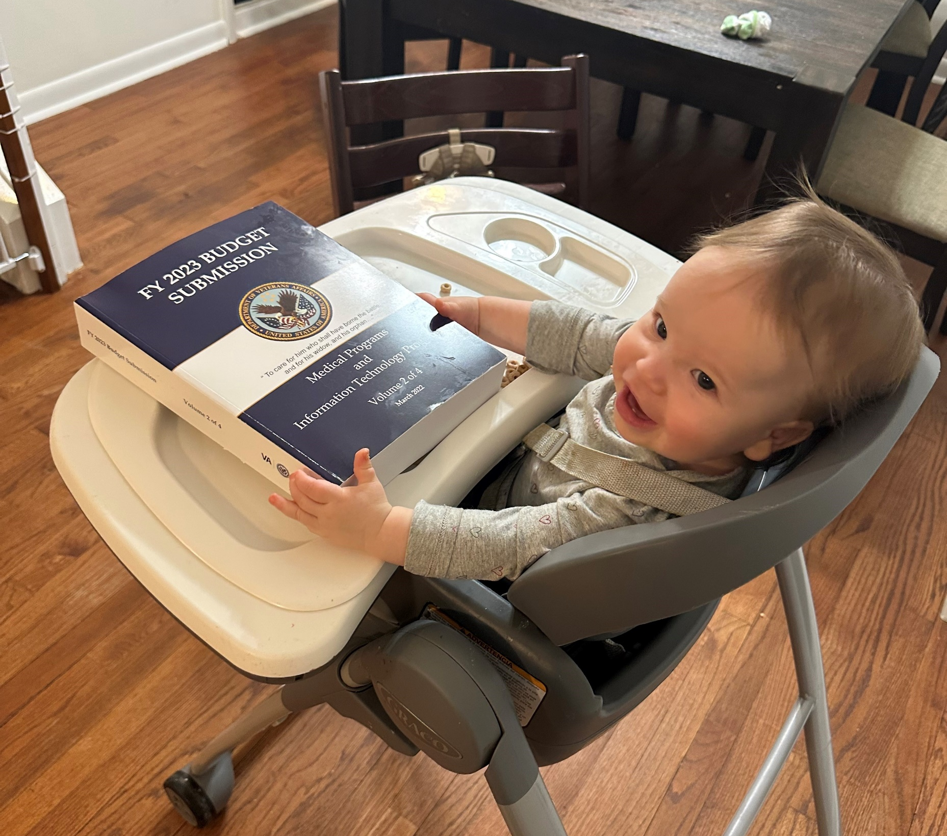
Section 3: Time
I might be 13 months old, but I know what a bona fide need is! –Ella Berlow

Slide 22
Time - Bona Fide Needs Rule (BFN)
The bona fide needs (BFN) rule (Title 31 of the United States Code (U.S.C.), section 1502(a) states that: The balance of an appropriation or fund limited for obligation to a definite period is available only for payment of expenses properly incurred during the period of availability or to complete contracts properly made within that period of availability…
Per chapter 5, section B (page 5-11) of Principles of Federal Appropriations Law (the Red Book),the bona fide needs rule states that: A fiscal year appropriation may be obligated only to meet a legitimate, or bona fide, need arising in, or in some cases arising prior to but continuing to exist in, the fiscal year for which the appropriation was made.

Slide 23
Time - Bona Fide Needs Rule and the Research Appropriation
Bona Fine Needs Rule (two-year appropriation) | Research Appropriation
BFN Rule applies to multiple year appropriations and obligations that are chargeable to first year of a multiple year appropriation also chargeable to remaining years (68 Comp. Gen. 170). Goods or materials purchased in one year may be delivered in whole or in part in a subsequent year (the need matches the year of obligation) for a reasonable inventory of supplies/materials. | For necessary expenses in carrying out programs of medical and prosthetic research and development as authorized by chapter 73 of title 38, United States Code, $916,000,000, plus reimbursements, shall remain available until September 30, 2024: TWO YEARS.

Slide 24
Time – Severable and Non-Severable (contracts and IAAs)
Severable | Non-Severable
The task can be separated into components, each of which can be independently performed to meet a separate need of the government. A severable service is a recurring service or one that is measured in terms of hours or level of effort rather than work objective (Equipment maintenance is a good example) It is permissible for severable service contracts of up to 12 months to cross fiscal years. Agencies should charge to the fiscal year in which the obligation occurs (as determined by the BFN Rule) even though some of the services are performed in the next fiscal year. | Nonseverable services cannot be separated into components but instead must be performed as a single undertaking to meet a need of the government. These contracts are often longer than 12 months (e.g., a computer program that takes two years to write). As with severable contracts, charge to the fiscal year in which the obligation occurs, as determined by the BFN Rule. Non-severable services contracts may not be incrementally funded. Examples of nonseverable services include a system implementation, software project, repairing equipment or structure, or research study.

Slide 25
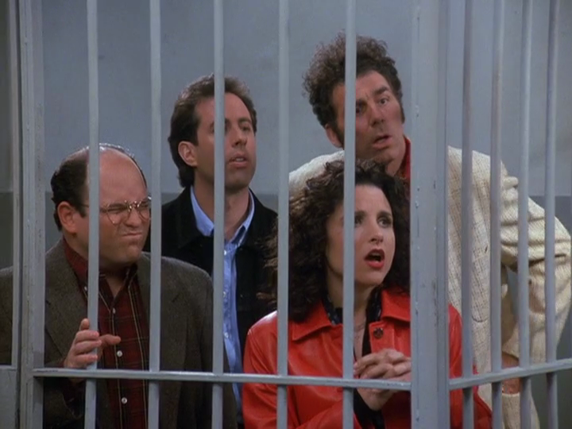
Section 4: Amount and the Antideficiency Act
Stay out of jail!

Slide 26
Amount
Congress determines in an appropriations act how much funding will be available for a particular agency program/activity.
The Antideficiency Act (31 U.S.C. 1341-1342, 1349-1350, 1351-1514, 1517-1518, and 1519) provides that obligations shall not exceed amounts appropriated or apportioned or amounts allotted for administrative control.
The act makes individual Government officers and employees personally responsible for the authorizing or creating of any obligation or the authorizing or making of any expenditure in excess of available funds.

Slide 27
Amount and the AntDeficiency Act (ADA)
This act prohibits federal agencies from obligating or expending federal funds in advance or in excess of an appropriation, and from accepting voluntary services.
The Antideficiency Act (ADA) prohibits federal employees from:
  Making or authorizing an expenditure from, or creating or authorizing an obligation under, any appropriation or fund in excess of the amount available in the appropriation or fund unless authorized by law. 31 U.S.C. § 1341(a)(1)(A).
  Involving the government in any obligation to pay money before funds have been appropriated for that purpose, unless otherwise allowed by law. 31 U.S.C. § 1341(a)(1)(B).
  Accepting voluntary services for the United States, or employing personal services not authorized by law, except in cases of emergency involving the safety of human life or the protection of property. 31 U.S.C. § 1342.
  Violation of the Purpose (Title 31 Section 1301)

Slide 28
Penalties for ADA Violations
There are two types of penalties for ADA violations:
Administrative (more common), where possible penalties include:
  A removal or suspension of duties
  A letter of reprimand
Criminal (less common), knowingly and willfully committing an offense:
  Fines of not more than $5,000
  Imprisonment for up to two years
  Or both
Employees most prone to ADA Violations:
  Program and budget officials involved with the obligation life cycle
  Certifying officers of funds or fund holders
  Those who accept free or personal services from employees and contractors
  Contracting officers, the contracting officer's representative (COR), etc.

Slide 29
Antideficiency Act Reporting
Once it is determined that there has been a violation, of the, Antideficiency Act (ADA) the agency head (SECVA) shall report immediately to the President and Congress all relevant facts and a statement of actions taken.
OMB has issued further instructions on preparing the reports. OMB Circular No. A-11, Preparation, Submission, and Execution of the Budget, § 145 (July 10, 2020).
GAO Provides the details of each ADA Violation by Fiscal Year on its website: Antideficiency Act Resources | U.S. GAO

Slide 30
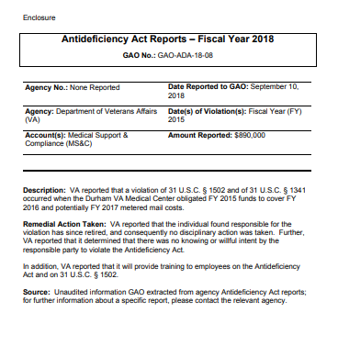
Section 4: Past VHA ADA Violations

Slide 31
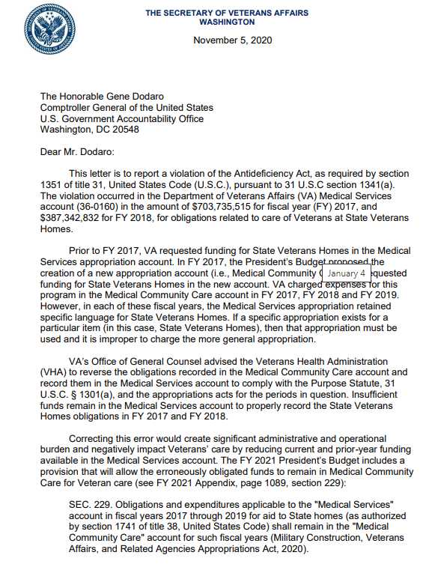
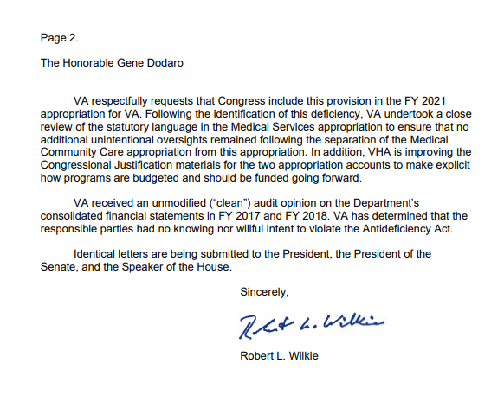
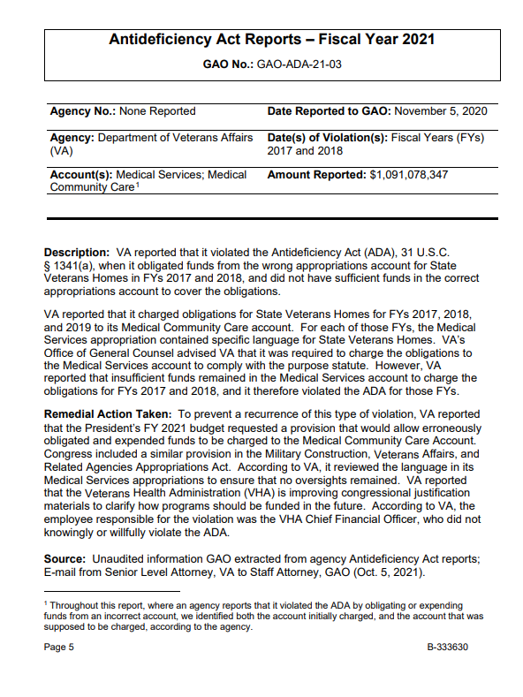
Section 4: Past VHA ADA Violations (example)

Slide 32


Section 5: Personal Expenses
Donna and Tom, you can both “treat yo self” if you use your salary for your personal expenses from your labors as public employees from the City of Pawnee Park’s Department!

Slide 33
Personal expenses must primarily benefit the government
The general rule is that appropriated funds are not available for personal expenses. In exchange for their labors, the federal government pays its employees a salary. In the absence of contrary statutory authority, employees are expected to use this salary, rather than appropriations, to satisfy their personal needs.
  Occasionally appropriations are available for personal expenses because Congress has enacted specific statutory authority. Examples include some childcare costs, some commuting expenses, and some apparel.
  In the absence of such authority, the expense may be permissible under the necessary expense rule (but not prohibited by other another law).
  Application of the necessary expense rule in these cases involves a determination in the absence of express statutory authority, an agency’s appropriation is available for personal expenses only upon a documented legal determination that the expense is an essential, constituent part of the effective accomplishment of a statutory responsibility, notwithstanding the collateral benefit to the individual/employee.
Link: GAO-17-797SP, PRINCIPLES OF FEDERAL APPROPRIATIONS LAW: Chapter 3, Availability of Appropriations: Purpose, Fourth Edition, 2017 Revision

Slide 34
Personal Expenses Examples
Item | General Rule | When permitted
Apparel | Every employee of the U.S. government is required to present themselves at work capable of performing their duties | Legally, the government may pay for the apparel when it meets any of the following criteria: hazardous duty, uniform, occupational health and safety.
Personal Qualification Expenses | Professional credentials, along with occupational licenses, have long been considered a personal expense. | However, a law in December of 2001 loosened the boundaries considerably by allowing appropriated funds to pay for professional credentials, licenses, and examinations to get professional credentials and licenses. (5 USC 5757) There are some allowances for licensure etc. Scope of Professional Credentials Statute | U.S. GAO
Telework | Cannot fund operating expense (i.e., Internet, electricity). | Generally, when someone is assigned or allowed to work at home, the government may pay for equipment.
Gifts | The government may not pay for gifts. | Most of the exceptions require the item to be of nominal: Stimulating interest in charity campaign, recruiting, information, retirement, memento.

Slide 35

Section 6: Food
In 20 minutes, you must prepare an appetizer that is compliant with 31 U.S.C. § 1301(a), (the purpose statue), good luck!

Slide 36
Food: Generally, not permissible
Food is an example of the quintessential personal expense: “Feeding oneself is a personal expense which a Government employee is expected to bear from his or her salary.”
Therefore, as a general rule, appropriated funds are not available to pay subsistence or to provide free food to government employees at their official duty stations unless specifically authorized by statute.
The “no free food” rule applies to snacks and refreshments as well as meals. It also applies to the use of appropriations to provide food to persons other than federal employees.

Slide 37
When is food permitted to be purchased?
Travel Status: The government may pay for the meals of civilian personnel in travel status because there is specific statutory authority to do so.
Employees working at official duty station under unusual conditions: This is because even under unusual circumstances, employees would still have to eat and incur the expense of meals
Training: GAO determined that food could be a proper training expense for federal civilian employees and military members where the food was necessary for the employees and members to obtain the full benefit (requires reasonable discretion).
Employees’ food at meetings organized by a federal entity: General rule: no use of appropriations for food at meetings organized by a federal entity. Some exception apply that are in: GAO-17-797SP, PRINCIPLES OF FEDERAL APPROPRIATIONS LAW: Chapter 3, Availability of Appropriations: Purpose, Fourth Edition, 2017 Revision
Awards ceremonies: Agencies may use appropriations to provide light refreshments at awards ceremonies under the Government Employees’ Incentive Awards Act.
Notes:
For example, GAO determined that food could be a proper training expense for federal civilian employees and military members where the food was necessary for the employees and members to obtain the full benefit of an antiterrorism training exercise conducted by the U.S. Army Garrison Ansbach. B-317423, Mar. 9, 2009. The purpose of the training was to simulate realistic antiterrorism scenarios, which could very well require nonstop participation through mealtimes in order to protect life and property. Id. See also B-244473, Jan. 13, 1992; 50 Comp. Gen. 610 (1971); 39 Comp. Gen. 119 (1959); B-247966, June 16, 1993; B-193955, Sept. 14, 1979. The government may also furnish meals to nongovernment speakers as an expense of conducting the training. 48 Comp. Gen. 185 (1968)

Slide 38
When is food permitted to be purchased?
Cafeterias and kitchen appliances: GAO approved an agency’s purchase of kitchen appliances, ordinarily considered to be personal in nature, for common use by employees in an agency facility (43 B-302993, June 25, 2004).
Cultural awareness program: If the food a sample of the food of the culture, and is it being offered as part of the larger program to serve an educational function it is permitted.
Bottled water: Appropriations are available to federal agencies so they may provide their employees with safe, clean drinking water. However, an agency may purchase bottled water where a building’s water supply is unpotable.
Food for persons other than government personnel: Usually, the purchase of food for persons other than government personnel is permissible only pursuant to specific statutory authority.
Notes:
For example, GAO determined that food could be a proper training expense for federal civilian employees and military members where the food was necessary for the employees and members to obtain the full benefit of an antiterrorism training exercise conducted by the U.S. Army Garrison Ansbach. B-317423, Mar. 9, 2009. The purpose of the training was to simulate realistic antiterrorism scenarios, which could very well require nonstop participation through mealtimes in order to protect life and property. Id. See also B-244473, Jan. 13, 1992; 50 Comp. Gen. 610 (1971); 39 Comp. Gen. 119 (1959); B-247966, June 16, 1993; B-193955, Sept. 14, 1979. The government may also furnish meals to nongovernment speakers as an expense of conducting the training. 48 Comp. Gen. 185 (1968)

Slide 39
When is food permitted to be purchased?
Employees’ food while attending nonfederal meetings:
  Non-federal entities frequently organize meetings, and official agency business often requires federal employees to attend these meetings. Appropriations are available to pay for food at a meeting only if the food is incidental to the meeting. Generally, the meal must be “part of a formal meeting or conference that includes not only functions such as speeches or business carried out during a seating at a meal, but also includes substantial functions that take place separate from the meal.
  If a separate charge is made for meals, the government may pay for the meals if the above criteria are met and if (1) attendance of the employee at the meals is necessary to full participation in the business of the meeting; and (2) the employee is not free to take the meals elsewhere without being absent from essential formal discussions, lectures, or speeches concerning the purpose of the meeting.
  Where the government is authorized to pay for meals under the above principles, the employee normally cannot be reimbursed for purchasing alternate meals.
Notes:
For example, GAO determined that food could be a proper training expense for federal civilian employees and military members where the food was necessary for the employees and members to obtain the full benefit of an antiterrorism training exercise conducted by the U.S. Army Garrison Ansbach. B-317423, Mar. 9, 2009. The purpose of the training was to simulate realistic antiterrorism scenarios, which could very well require nonstop participation through mealtimes in order to protect life and property. Id. See also B-244473, Jan. 13, 1992; 50 Comp. Gen. 610 (1971); 39 Comp. Gen. 119 (1959); B-247966, June 16, 1993; B-193955, Sept. 14, 1979. The government may also furnish meals to nongovernment speakers as an expense of conducting the training. 48 Comp. Gen. 185 (1968)

Slide 40
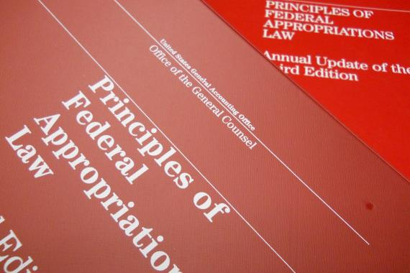
Questions?
Link to the
BIG RED Book!
The Red Book | U.S. GAO
We will answer questions to the best of our ability, but any specific examples may require the help of OGC Appropriations Law

Slide 41
Key Resources
Key Links
VA Financial Policy Manual, Appropriations Law
A Glossary of Terms on the Federal Budget Process
The Red Book | U.S. GAO
SECTION 145—REQUIREMENTS FOR REPORTING ANTIDEFICIENCY ACT VIOLATIONS (whitehouse.gov)
Antideficiency Act Resources | U.S. GAO
Search Decisions | U.S. GAO
GAO-17-797SP, PRINCIPLES OF FEDERAL APPROPRIATIONS LAW: Chapter 3, Availability of Appropriations: Purpose, Fourth Edition, 2017 Revision

