Slide 1
Office of Research and Development
VA Innovation Research and Review System (VAIRRS)
Monthly Webinar
February 22, 2022
For questions, please use Q&A box and address to “All Panelists.”
All Webinars will be recorded and posted within one week.

Slide 2

Webinar
Housekeeping
Please use the Q&A feature to submit questions.
  Please do not use Chat to send in questions.
  Be sure to send questions to “All panelists”.
We would be ever so grateful if you would complete the post-webinar evaluation survey that pops up once you exit the webinar.
Experiencing sound issues – you can call in using the number included on the handouts and on your registration confirmation email that you received.
A recording of this session and the associated handouts will be available on ORPP&E’s Education and Training website approximately one-week post-webinar
An archive of all ORPP&E webinars can be found here:
https://www.research.va.gov/programs/orppe/education/webinars/archives.cfm
• Call in #: 1 404 397 1596
• Event Number: 2763 760 2302
• Event Password: ORPP&EWebinars1

Slide 3
Contents
Welcome
Announcements
Best Practices for Conducting Continuing Review in IRBNet
Presented by Mary Eckart, VA Central IRB Manager
For questions, please use Q&A box and address to “All Panelists.” All Webinars will be recorded and posted within one week.

Slide 4


IMPORTANT ANNOUNCEMENTS
Committee Administrators, if you have not already, please verify your sites active project status within IRBNet as soon as possible.
Attend upcoming March Webinar - Tracking A Project Across Multiple Subcommittees
For questions, please use Q&A box and address to “All Panelists.” All Webinars will be recorded and posted within one week.

Slide 5
Central IRB Continuing Review – Best Practices
Presented by Mary Eckart
VA Central IRB Manager
For questions, please use Q&A box and address to “All Panelists.” All Webinars will be recorded and posted within one week.

Slide 6
BLUF
Today you will learn everything you need to know for successful Continuing Review Submission to the VA Central IRB (CIRB)
Remember the 5 C’s
  Correct IRBNet number
  Current version date for required form
  Content; complete and accurate
  Conflict of interest alternative documentation of review
  Contact information for use by National Coordinator/Project Manager
For questions, please use Q&A box and address to “All Panelists.” All Webinars will be recorded and posted within one week.

Slide 7

Remember the 5 C’s
Correct IRBNet Number
Each site has a unique IRBNet number assigned to it. No two sites share the same number – not even in the case when the Principal Investigator Study Chair (PISC) site also has an approved local site investigator (LSI) at the same location
Please be certain that the PISC has shared the project with each LSI using the ‘multi-site’ share function and proper access is granted
For questions regarding CIRB project shell numbers, you may contact VACentralIRB@va.gov
For questions, please use Q&A box and address to “All Panelists.” All Webinars will be recorded and posted within one week.

Slide 8

Remember the 5 C’s
Current Version Date for Required Form
The current version of the forms are in IRBNet in the VA Central Library of Documents for Researchers.
Please use only these forms
For questions, please use Q&A box and address to “All Panelists.” All Webinars will be recorded and posted within one week.

Slide 9

Remember the 5 C’s
Conflict of Interest Alternative Documentation of Review
If there is no local Memo/Correspondence currently in use to capture the required annual review, form 115c may be used
For questions, please use Q&A box and address to “All Panelists.” All Webinars will be recorded and posted within one week.

Slide 10

Remember the 5 C’s
Contact Information for Use by National Coordinator/Program Manager
Please contact me at Mary.Eckart@va.gov well in advance of the submission due date to review the process and address any questions. This will facilitate accurate information for dissemination to all local sites
For questions, please use Q&A box and address to “All Panelists.” All Webinars will be recorded and posted within one week.

Slide 11

Remember the 5 C’s
Content; Complete and Accurate
Coming Up:
  Common errors requiring revisions that necessitate unlocking the package
For questions, please use Q&A box and address to “All Panelists.” All Webinars will be recorded and posted within one week.

Slide 12
Required Forms and Documents
For questions, please use Q&A box and address to “All Panelists.” All Webinars will be recorded and posted within one week.

Slide 13
Principal Investigator/Study Chair
Form 115a Continuing Review Application
Form 115c
Abstract
DSMB Summary
Audits not already reviewed by the CIRB
Publications (when available)
For questions, please use Q&A box and address to “All Panelists.” All Webinars will be recorded and posted within one week.

Slide 14
Local Site Investigator (LSI)
115b Continuing Review Application for LSI
115c Alternative Documentation of COI Review for Continuing Review
Audits not already reviewed by the CIRB
AE/PD Summary (if not reported in the 115b)
For questions, please use Q&A box and address to “All Panelists.” All Webinars will be recorded and posted within one week.

Slide 15
Common Errors
Content; Complete and Accurate
These are some of the common content errors that require revision before sending on for CIRB review
For questions, please use Q&A box and address to “All Panelists.” All Webinars will be recorded and posted within one week.

Slide 16
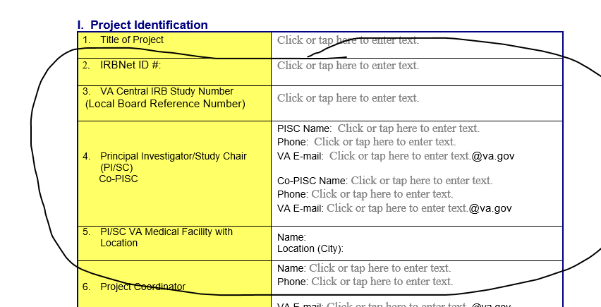
For questions, please use Q&A box and address to “All Panelists.” All Webinars will be recorded and posted within one week.

Slide 17
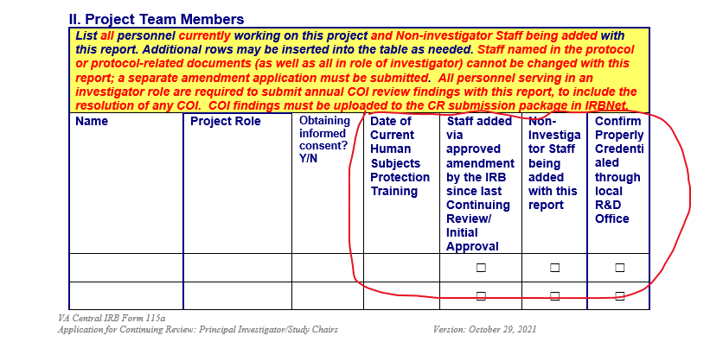
For questions, please use Q&A box and address to “All Panelists.” All Webinars will be recorded and posted within one week.

Slide 18
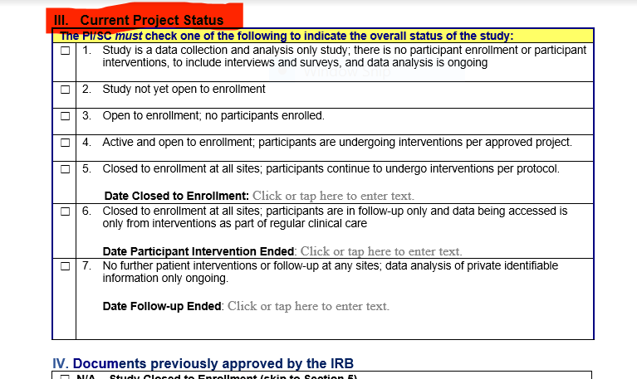
For questions, please use Q&A box and address to “All Panelists.” All Webinars will be recorded and posted within one week.

Slide 19
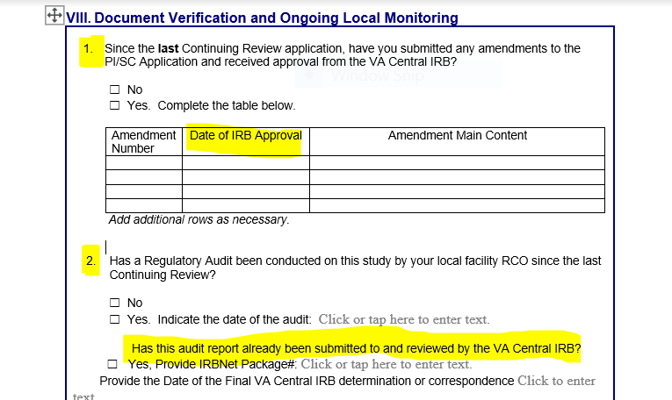
For questions, please use Q&A box and address to “All Panelists.” All Webinars will be recorded and posted within one week.

Slide 20
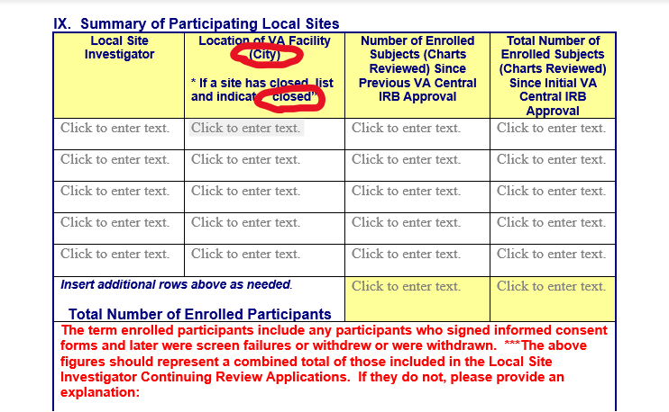
For questions, please use Q&A box and address to “All Panelists.” All Webinars will be recorded and posted within one week.

Slide 21
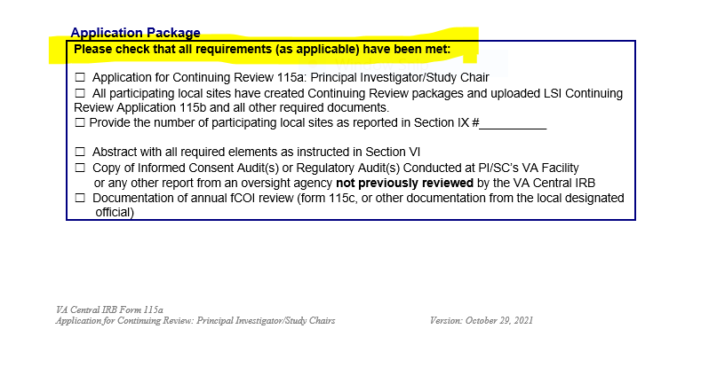
For questions, please use Q&A box and address to “All Panelists.” All Webinars will be recorded and posted within one week.

Slide 22
Common Errors
115b LSI CR Application
Along with the previous errors, these are some of the common errors specific to the 115b
For questions, please use Q&A box and address to “All Panelists.” All Webinars will be recorded and posted within one week.

Slide 23
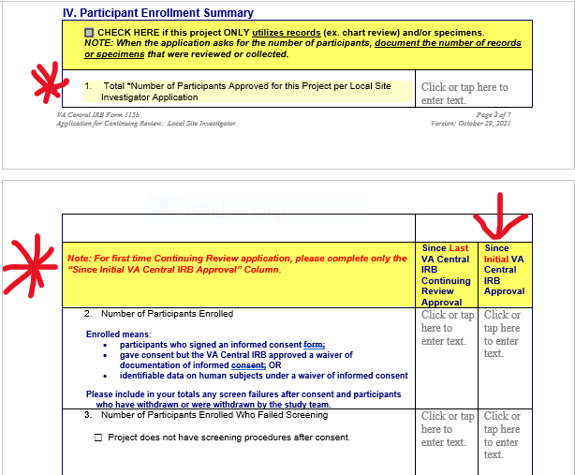
For questions, please use Q&A box and address to “All Panelists.” All Webinars will be recorded and posted within one week.

Slide 24
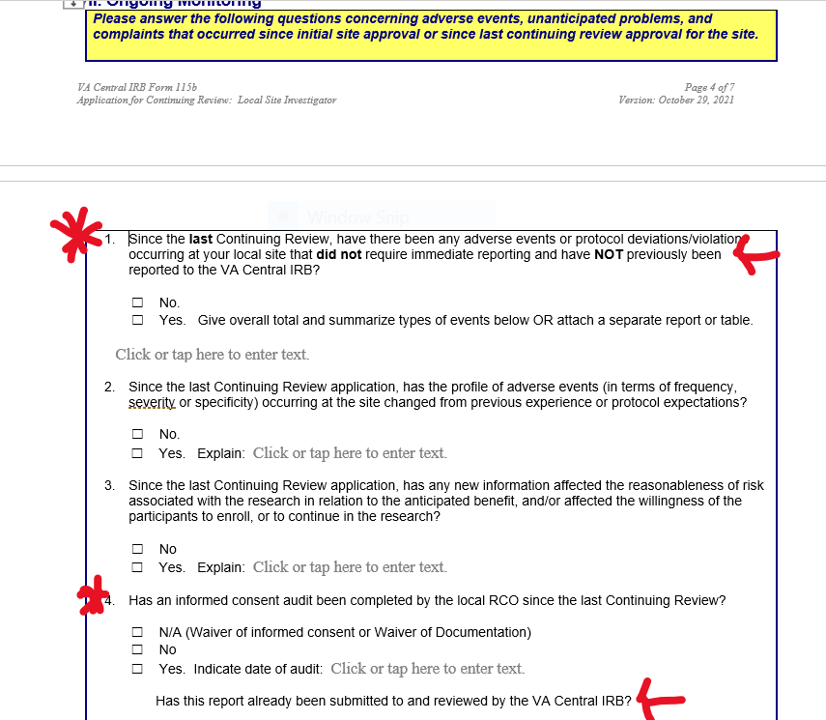
For questions, please use Q&A box and address to “All Panelists.” All Webinars will be recorded and posted within one week.

Slide 25
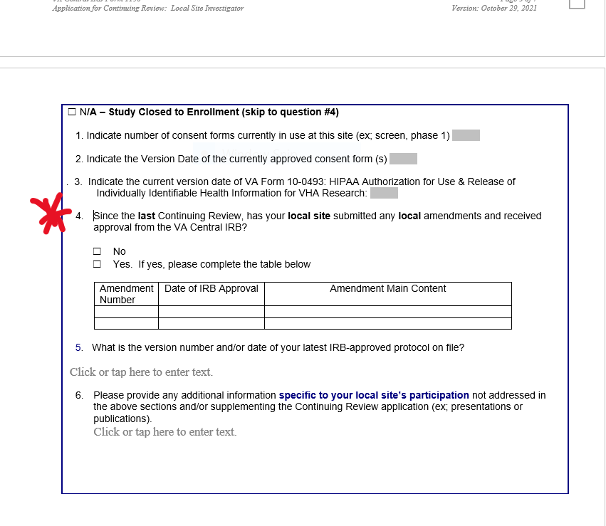
For questions, please use Q&A box and address to “All Panelists.” All Webinars will be recorded and posted within one week.

Slide 26
Wrap-Up
Each site creates a continuing review package and uploads to a unique IRBNet number
There is no specific order in which the packages need to be submitted, just all due by the CIRB established deadline as stated in the CR reminder notices sent out by IRBNet
Only documents listed in the 115a and 115b are required if currently approved documents are already in IRBNet
Revisions required packages are unlocked so that the existing document can be edited as applicable
For questions, please use Q&A box and address to “All Panelists.” All Webinars will be recorded and posted within one week.

Slide 27
Questions?
For questions, please use Q&A box and address to “All Panelists.” All Webinars will be recorded and posted within one week.

