Slide 1

Research Budget Training
Lessons Learned from the Sweep and FY 22 Guidance
Feb 28, 2022
Matthew Verna, Director Finance, ORD
John Verwiel, Assistant Director Finance, ORD
Jason Berlow, Management Analyst, Finance
Antonio Laracuente, Director, Field Operations

Slide 2

Webinar
Housekeeping
Please use the Q&A feature to submit questions.
  Please do not use Chat to send in questions.
  Be sure to send questions to “All panelists”.
We would be ever so grateful if you would complete the post-webinar evaluation survey that pops up once you exit the webinar.
Experiencing sound issues – you can call in using the number included on the handouts and on your registration confirmation email that you received.
A recording of this session and the associated handouts will be available on ORPP&E’s Education and Training website approximately one-week post-webinar
An archive of all ORPP&E webinars can be found here:
https://www.research.va.gov/programs/orppe/education/webinars/archives.cfm
• Call in #: 1 404 397 1596
• Event Number/Access Code: 2764 253 1909
• Event Password: ORPP&EWebinars1

Slide 3
Commitment to the Enterprise
ORD relies on each station to independently manage the budgets allocated to facilities. One major factor to consider is how effective management of funding at the local facility impacts the overall appropriation.
We understand the constant pressures on spending and the limitations from hiring and executing the budget.
However, we need to continue the message: “SPEND the MONEY you GET in the Year you get it!”
For questions, please use Q&A box and address to “All Panelists.” All Webinars will be recorded and posted within one week.
Notes:
Matt

Slide 4
ORD Expectations of the field
Honesty and Integrity: Once you lose that relationship, it is very hard to re-establish
We expect you to know the basics of fiscal law and act accordingly. Know Purpose, Time, and Amount (PTA); You have funds for a specific purpose to be obligated during a particular time not to exceed a certain amount.
Return money in a timely manner
We try to have open communications with the field. We will attempt to answer your questions as quickly possible. When we ask for information, we expect a response.
ORD has tried to foster a closer relationship with your VISN CFOs. We understand the dynamics of working with over 100 different fiscal offices and officers. We will try to give you information and guidance to help you in this relationship. Bottom line however is that your local CFO will dictate various interpretations of policy and regulation. We encourage you to build a trusting and supportive relationship with this individual.
No matter what we say today, we know – you are where the rubber meets the road
For questions, please use Q&A box and address to “All Panelists.” All Webinars will be recorded and posted within one week.
Notes:
Matt

Slide 5
Prior Trainings
Prior training can be located at the ORPP&E Archive Training
  https://www.research.va.gov/programs/orppe/education/webinars/archives.cfm
For questions, please use Q&A box and address to “All Panelists.” All Webinars will be recorded and posted within one week.
Notes:
Matt

Slide 6
Goals of Today’s Session
Provide you with information regarding the outcome of the PY Carryover Reduction Project
  Review what went right (sustain) and what went not so right (avoid), and lessons learned
Provide guidance on use of the remaining 21/22 funding
Provide guidance for 22/23 funding
  Expenditure reports
  Contracts
  Purchase cards
Discuss 0161R1 and X2 funding
Upcoming data call and trainings
For questions, please use Q&A box and address to “All Panelists.” All Webinars will be recorded and posted within one week.
Notes:
Tony

Slide 7
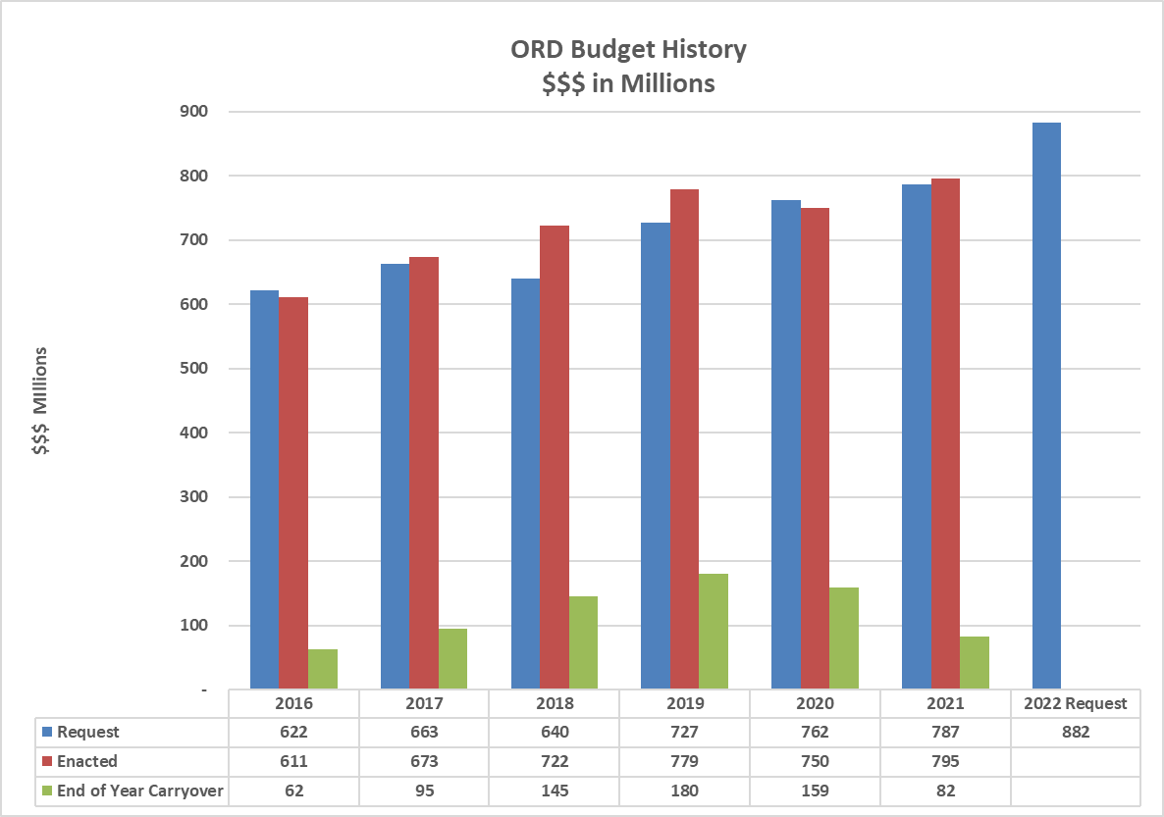
How did we get here
In FY 2018 and FY 2019 ORD’s request was lower than enactment the final enactment which leads to higher carryover amounts.
For questions, please use Q&A box and address to “All Panelists.” All Webinars will be recorded and posted within one week.
Notes:
Tony

Slide 8
Recap the FY 22 Prior Year Carryover Project
Goal provided mid year 2021 was 4% Carryover in the field from 21 to 22 and to reduce the chance of a recission
Memo sent out 10/6/2021 outlining expectations and providing guidance
4th Quarter RAFT Expenditure Reports were used to track project expenditures.
  Data Correlated to VSSC
Balances used after PP 20 was expensed
Training held on Friday October 22
Collection of data through sharepoint site
Many many emails and calls with stations
For questions, please use Q&A box and address to “All Panelists.” All Webinars will be recorded and posted within one week.
Notes:
Tony

Slide 9
Plans – Required for >4%
Facilities carrying over >4% of the total 0161A1 FY 21/22 allocation must provide ORD Finance a budget plan by 11/1/2021 outlining the following (via SharePoint form):
  Amount of carryover by Program (820, 821, 822, 824, 825, 826, 829)
  Amount of carryover by Service ID
  Plan by program to obligate funds
    Projected Payroll cost by program for PP 21
    Number of Pay Periods required to utilized funding
    Amount projected to be obligated through 1358s
    List of Contracts that were not obligated by 9/30/2021 that were rolled into 1st quarter using PY funds as long as the contract can be executed by 12/31/2021.
  Service ID specific data will be requested for projects carrying over a balance of >$15,000.
For questions, please use Q&A box and address to “All Panelists.” All Webinars will be recorded and posted within one week.
Notes:
Tony

Slide 10
Recap the FY 22 Prior Year Carryover Project
Goal was 4% Carryover from 21 to 22. Achieved 11%
  19 out of 94 stations achieved 4% goal (20%)
  30 out of 94 stations carried over more than 30%
ORD Carried over $98 Million (October 15, 2021)
January 15 – approximately $14 Million
  Most is committed for contracts and IPAs
Total amount swept - <$4 Million
Met overall ORD goal of 1% by end of month January
SUCCESS!!!!!!!!
For questions, please use Q&A box and address to “All Panelists.” All Webinars will be recorded and posted within one week.
Notes:
tony

Slide 11
What went right
Compared to Jan 2021, PY amount reduced by $80 Million (Jan 2022)
Stations were proactive and communicated with the Finance Team
Many stations were responsive and executed Cost Transfers
Built relationships with Fiscal Service
Stations Develop carryover plans that made sense and could be executed
  Plans were provided by Program and Service ID.
  Service ID plans allowed ORD Services to contact stations/investigators
ORD program directors had visibility on funds
Many programs close to zero
Struggling programs were able to discuss concerns and create a plan
For questions, please use Q&A box and address to “All Panelists.” All Webinars will be recorded and posted within one week.
Notes:
John

Slide 12
What did not go so well
Some stations did not respond timely or at all!
  Did not understand instructions of data call
Some stations did not know how to interpret VSSC reports and were not aware of balances
Individual program balances offset by other programs
Purchase card accruals were not taken into consideration
Purchase cards were used without being able to reconcile
Contracting did not fully execute
Contracts not returned timely
  Resources limited
Confusion on what PY funds could be used for
Communication overload by ORD –
  Different people contacting different folks
For questions, please use Q&A box and address to “All Panelists.” All Webinars will be recorded and posted within one week.
Notes:
John

Slide 13
Lessons Learned
Clear Guidance on RAFT expenditure submissions
  Only report against allocation in FY and use cumulative numbers
Streamline Data call to not require duplicate reporting by Program and Service ID
Reconcile Credit Cards as soon as possible prior to end of year
  Hold orders, cancel backlog order or convert to current year
Plan contracts to be submitted earlier
  RPO will send clear guidance out regarding deadlines
Understand the difference between funds committed and obligated
  Words used interchangeably – Obligated is what hits FMS not Committed
Balancing control points is critical
ACOS/AO Directory needs updating
For questions, please use Q&A box and address to “All Panelists.” All Webinars will be recorded and posted within one week.
Notes:
John

Slide 14
Lessons Learned
Lack of access to appropriate resources – RAFT, VSSC, VISTA, RTS
Cross program transfers – needs better explanation
Individual program balances offset by other programs – Cannot Happen!
  staff need to be costed correctly
Meet with investigators sooner (March/April) to plan PMOs and redistribute funds accordingly
Review project start dates to ensure that execution can occur.
  Do not accept funding until investigator is on board or has on-board date
For questions, please use Q&A box and address to “All Panelists.” All Webinars will be recorded and posted within one week.
Notes:
John

Slide 15
What can you expect in FY 22
Expenditure execution Report will be required April 15, July 15 and October 15
  Each quarter cumulative FY expenditures will be reported into RAFT
  This will be one lump sum per project – only CY funds reported
  ORD will review to determine if projects are under executing and may request additional information
Research Offices will be the POC for these discussions.
  Centers and COINS will be involved as well
Carryover >4% will have to submit a plan
For questions, please use Q&A box and address to “All Panelists.” All Webinars will be recorded and posted within one week.
Notes:
John

Slide 16
FY 22 Current Year Funding
We are still in a CR (through March 11).
We anticipate a full year appropriation by March 11th.
Need to be ready once funding is released.
  Continue to hire personnel and execute IPAs during the continuing resolution.
  Utilize current year funding (2022/2023) for Contracting purposes
  Develop packages for equipment and other infrastructure needs that can be obligated in FY 22.
  Work with investigator to understand their spend plans
For questions, please use Q&A box and address to “All Panelists.” All Webinars will be recorded and posted within one week.
Notes:
Jason

Slide 17
Late Enactment of FY22
Funding Type | Continuing Resolution | FY 22 Enactment
Funding Type | October 1-March 11 (est.) | March 11 (est.) September 30th
Prior Year (21-22) | ORD's unobligated balance at the start of FY 22 was $98.9 Million. ORD Leadership aggressively pursued a strategy to obligate the majority of carryover by the end of the 1st Quarter. As of 2-18-22, approximately $15.7 Million is remaining in prior year funding (a reduction of 84%). This represented a major shift for the field and required a lot of effort. | With the majority of Prior Year Funding Obligated prior to enactment, VACO and Field Stations can concentrate obligating current year.
Current Year (22-23) | Operate under annualized CR amount of $795 Million until FY 22 Enactment. | FY 2022 Enactment will be either $882 M (Senate) or $902 M (House), resulting in an increase of up to $107 Million to obligate in the middle of the FY (it will take 30-60 days to receive full funding after enactment).
For questions, please use Q&A box and address to “All Panelists.” All Webinars will be recorded and posted within one week.
Notes:
Jason

Slide 18
End of FY 22 Expectations
Spend the money you get
Very little carryover – plan on 4% but may be less
Get your contracts in early
Process your Purchase Cards so there is little accrual
Initiate the hiring process as soon as you get your intent to award email
Meet with the PI to see how progress is going. May have to include portfolio managers
For questions, please use Q&A box and address to “All Panelists.” All Webinars will be recorded and posted within one week.
Notes:
Jason

Slide 19
Project Modifications
If you need to redistribute funds from FY 22 to later in the project and have not done so already, create a PMO.
Follow the guidance at Criteria and Instructions for Requesting an Administrative Project Modification (va.gov)
Form Request for Administrative Project Modification (va.gov)
Submit Request for Redistribution by dates:
  BLRD 7/15
  CSRD, HSRD and RRD 4/29
For questions, please use Q&A box and address to “All Panelists.” All Webinars will be recorded and posted within one week.
Notes:
TOny

Slide 20
Contracting
New Director of RPO Contracting Team – Brent Goe
  Have met several times to get updated report.
Enter requirement into FORCE as soon as possible so they can plan a
  Include the 2237 number.
    If you cannot approve it due to CR limitations, enter it and keep until you can approve
Deadlines - Drop Dead so sooner the better
  Greater than $7M – April 1
  Between $500k - $7M – May 1
  Between $250k - $500k – June 15
  Between $25k - $250k – June 30
For questions, please use Q&A box and address to “All Panelists.” All Webinars will be recorded and posted within one week.
Notes:
Tony or John Introduce Brent and give him a few minutes

Slide 21
Reimbursable funding
Reminder that reimbursable funds are collected to reimburse the appropriation
  Currently have $4 M 0161R1 21/22 and $4.7 M 0161X2
Many are missing the final step
  Cost transfer from where the cost was incurred to the 0161R1 or X2 fund
For Advance Collections from Interagency Agreements, work with fiscal to record the collection of revenue in FMS prior to end of fiscal year.
Stations are carrying over the balance
Need the 0161A funds made whole for use in FY 22
For questions, please use Q&A box and address to “All Panelists.” All Webinars will be recorded and posted within one week.
Notes:
Tony

Slide 22
Upcoming Data Call (RAFT Q2 Expenditure Report)
The RAFT Q2 Expenditure Report will open April 1 and is due April 15th.
  It will request expenditures by SERVICE ID and a Narrative (in one request).
  ORD Finance will not be sending a second data to be completed via SharePoint (as we did in October 2021).
  More formal guidance and training will be held at end of March
ORD Finance will take the submission and distribute them to the ORD Services to review statuses of under-executing project with further contact to the field regarding these projects.
For questions, please use Q&A box and address to “All Panelists.” All Webinars will be recorded and posted within one week.
Notes:
Jason

Slide 23
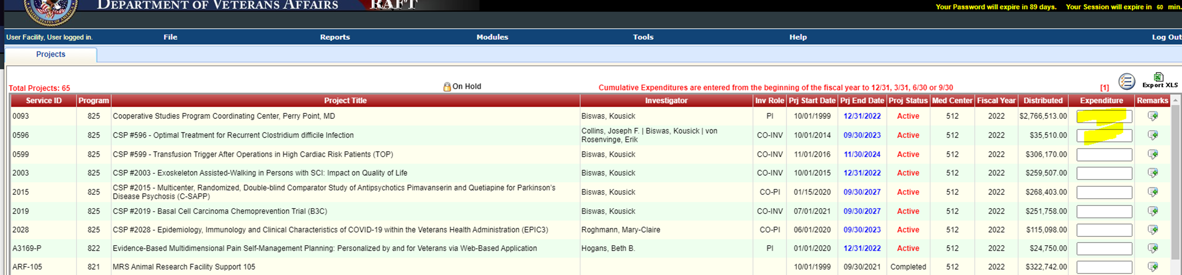
Upcoming Data Call (RAFT Q2 Expenditure Report)
For questions, please use Q&A box and address to “All Panelists.” All Webinars will be recorded and posted within one week.

Slide 24
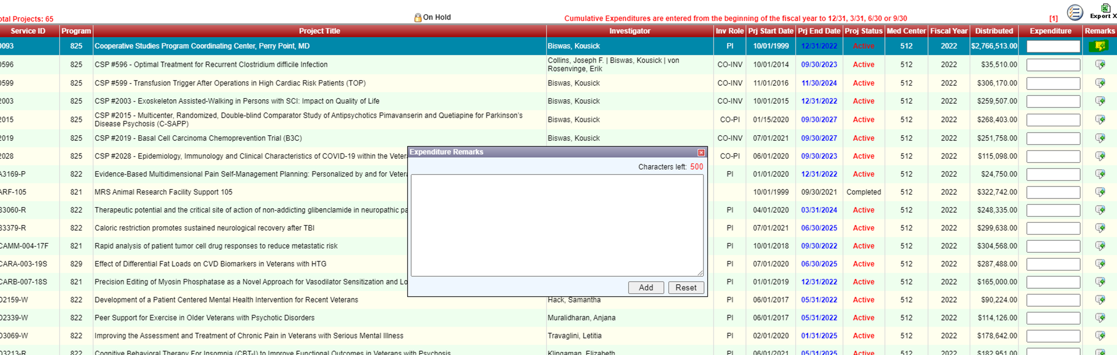
RAFT Q2 Expenditure Report: Narrative
For Service IDs below 30% Obligated list:
    Number of Pay Periods required to utilized funding (FY 22 and FY 23)
    Amount projected to be obligated through 1358s
    Any other important details to explain under execution
    List of Contracts to be obligated by 9/30/2022.
For questions, please use Q&A box and address to “All Panelists.” All Webinars will be recorded and posted within one week.

Slide 25
Research Finance-Training Course
ORD Finance is planning to schedule monthly calls (45 minutes) to conduct field training on Financial issues
Preliminary topics include:
  Excel – track IPAs, download and integrate data across systems, produce reports
  FMS – produce Status of Allowance reports, cost transfers by Fiscal
  IFCAP/VistA – place and track orders (1358s), manage and track contracts (2237s)
  RAFT – download pink sheets and report obligations to ORD
  RDIS and ePromise – validate and submit project reports
  RMS/WinRMS – download and analyze FMS and VSSC data, produce reports
  VSSC – track non-IPA salaries
  IPPS
For questions, please use Q&A box and address to “All Panelists.” All Webinars will be recorded and posted within one week.
Notes:
Jason – emphasize short courses 45 minutes

Slide 26
Availability of Recording
A recording of this session and the associated handouts will be available on ORPP&E’s Education and Training website approximately one-week post-webinar
An archive of all ORPP&E webinars can be found here: https://www.research.va.gov/programs/orppe/education/webinars/archives.cfm.
For questions, please use Q&A box and address to “All Panelists.” All Webinars will be recorded and posted within one week.

Slide 27
Questions ????????
For questions, please use Q&A box and address to “All Panelists.” All Webinars will be recorded and posted within one week.

