Slide 1
VA Innovation and Research
Review System (VAIRRS)
Monthly Webinar
February 28, 2023

Slide 2

Webinar Housekeeping
Webinar
Housekeeping
Recording - This session is recorded, and the associated handouts will be available on ORPP&E’s Education and Training website within a week after the webinar.
Close Captioning - Now available in the new Webex platform. Click the “CC” button at the bottom left of the Webex screen.
Experiencing Sound Issues? - Call in using the number in your Webex chat box or in your registration confirmation email.
Q&A - Please use the Q&A feature to submit questions.
  Be sure to send questions to “All Panelists”
  Questions will be addressed at the end of the webinar
Webinar Archive - Most ORPP&E webinars can be found here: https://www.research.va.gov/programs/orppe/education/webinars/archives.cfm
Post-Webinar Evaluation Survey - We are grateful to everyone who completes the post-webinar evaluation survey, which will automatically pop up once the webinar is exited.

Slide 3
Contents
01 Welcome
02 Announcements
03 VA Central IRB Quality Assurance Process in IRBNet
Presented by: Jessica Kroll, MA, CIP – VA Central IRB Administrator
Lindsey Martin, BS – VA Central IRB Program Specialist

Slide 4
Important Announcements
IRB Information Sheet Wizard Update
VAIRRS Mentor Program
VAIRRS
University
IRB Information Sheet is currently under revision to improve clarity and response options. The draft wizard outline is currently available for review on the VAIRRS SharePoint portal under the VAIRRS Change Control Board menu option.
Thank you to everyone who has applied to be a mentor or mentee—there is still time to apply! You can access the mentor/mentee applications via the VAIRRS Mentor Program SharePoint page. Mentors and mentees will be paired over the next several weeks. The program is scheduled to launch in April 2023.
VAIRRS University is live! VAIRRS University is a revised training library designed to promote self-education and independent learning. This new platform helps VA research employees easily locate and access VAIRRS-specific training resources.
Subscribe to the VAIRRS Newsletter to keep up with important announcements and program updates: https://public.govdelivery.com/accounts/USVHA/subscriber/new?topic_id=USVHA_1952

Slide 5
VA Central IRB Quality Assurance Process in IRBNet
Jessica Kroll, MA, CIP – VA Central IRB Administrator
Lindsey Martin, BS – VA Central IRB Program Specialist

Slide 6
Objectives
The VA Central IRB (CIRB) will share the development of our Quality Assurance (QA) process in IRBNet.
This webinar will cover the following topics:
  Importance of QA
  Identifying opportunities for improvement
  Standardizing processes with the development of Internal Workflows
  Developing a QA process in IRBNet

Slide 7

Importance of QA
Strengthen the quality of IRB reviews
Identify opportunities for improvement
Increase standardized use of IRBNet by staff
Ensure data are entered consistently in IRBNet
Ensure data integrity in order to support reports and dashboards
IRBNet implementation has required adopting new processes

Slide 8
Identify Opportunities for Improvement
Met with staff to identify where there were processing inconsistencies in IRBNet
Reviewed IRBNet Insight Reports to evaluate metrics
  Review Process
  Project Status
Identified the need to standardize practices in order to validate data within the VAIRRS Dashboard

Slide 9
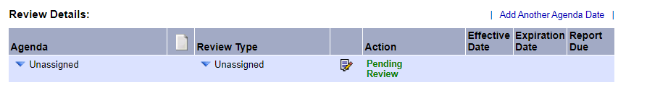
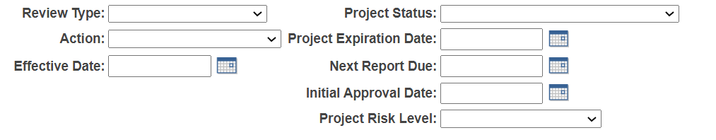
Opportunity –
IRBNet Review Details
Information entered in the Review Details is directly linked to:
IRB Determination Letters
IRB Minutes
IRBNet Reports
VAIRRS Dashboards
Future Packages

Slide 10





Standardize Processes in IRBNet
Define Terms
Internal Workflows
Checklists
Training & Education
Time to Learn
Define common terms in IRBNet to ensure all staff are using them consistently when documenting reviews.
i.e., Approval with Conditions vs Modifications Required
Develop internal workflows for staff to follow when processing a submission.
i.e., How to Complete Review Details
Develop checklists for staff to ensure all required steps have been taken when documenting a review.
Provide regular training and education on internal workflows and how to use checklists.
Allow time for staff to learn and implement new workflows before beginning QA process.

Slide 11
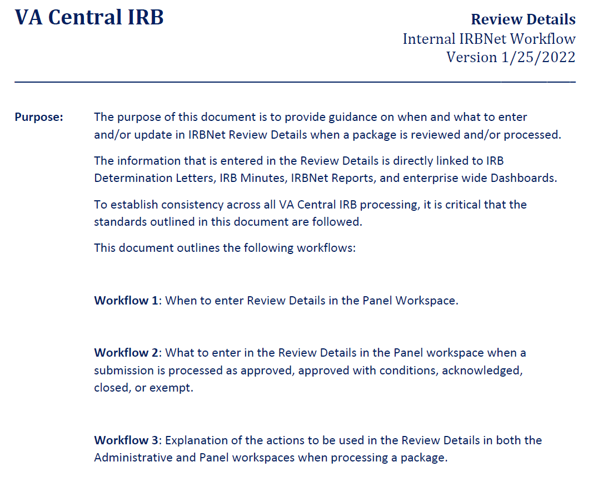
Sample Internal Workflow
IRBNet
Review Details

Slide 12
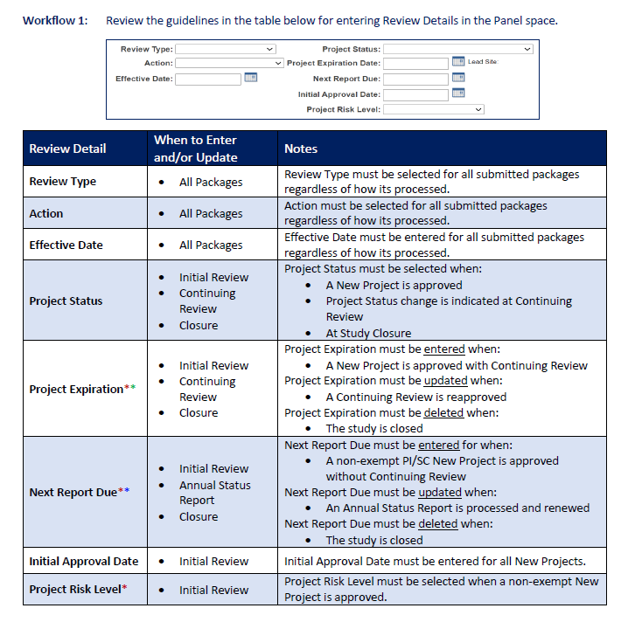
Sample Internal Workflow
IRBNet
Review Details

Slide 13
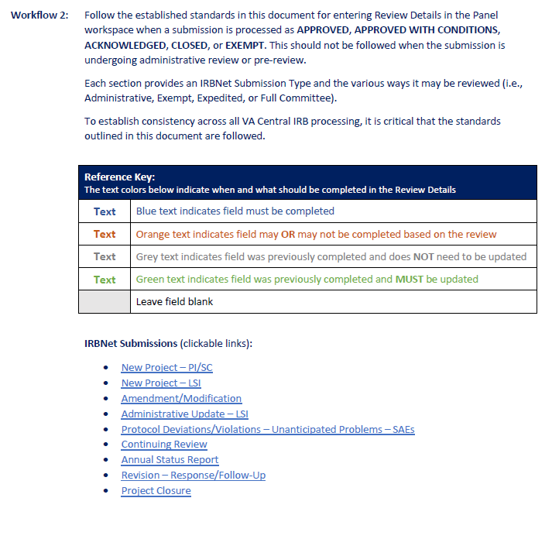
Sample Internal Workflow
IRBNet
Review Details

Slide 14
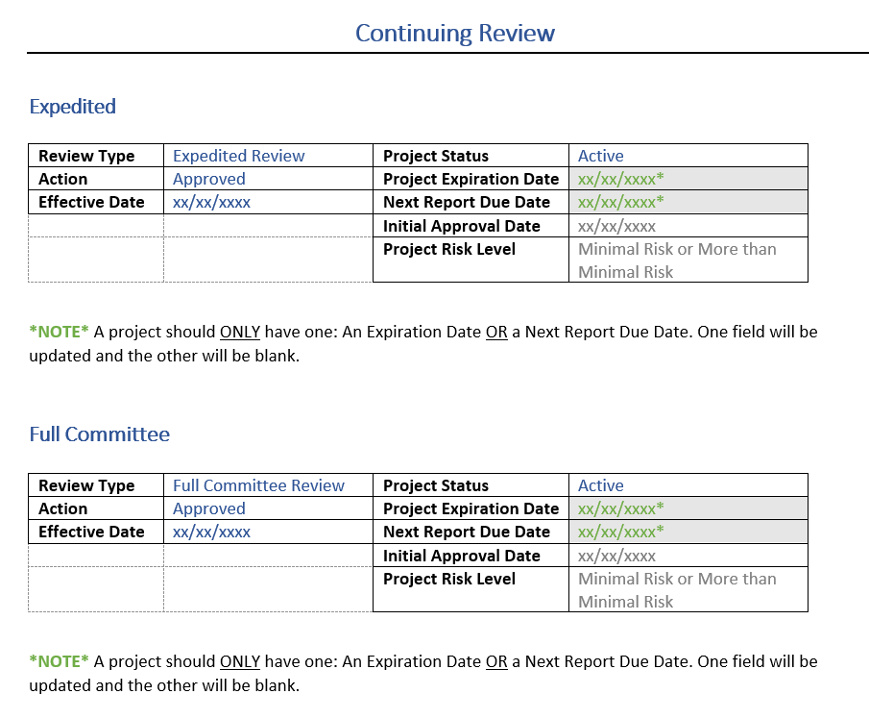
Sample Internal Workflow
IRBNet
Review Details

Slide 15
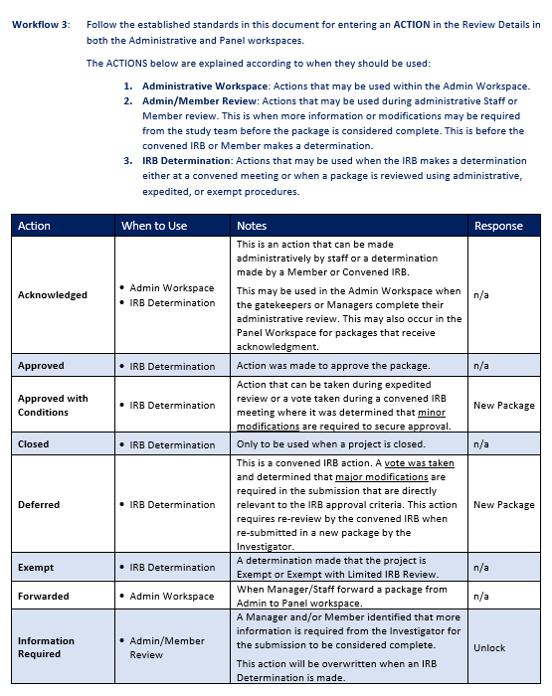
Sample Internal Workflow
IRBNet
Review Details

Slide 16
Developing the QA Process

Slide 17



Plan
Define objectives and goals
Identify content to be reviewed
Determine frequency
Tools
IRBNet Insight Reports
QA Checklist (Excel template)
Evaluation
Establish percentage of compliance
Report summary of findings
Develop corrective action plan

Slide 18
Plan
Area of Focus
Frequency
Content Selection
IRBNet Review Details and Submission Details
Operational review of processes in IRBNet, not a regulatory review
Review data and processing of submission packages according to VA CIRB Internal Workflows
QA on a quarterly basis
Include every IRB Panel Meeting
Expedited items reported on a full board agenda
Random selection of submission packages
20% of each Submission Type

Slide 19
Tools
IRBNet Insight Reports
  Used to randomly select submission packages
Created a QA Checklist using an excel spreadsheet
  Covers all required fields of Review Details
  Used to verify missing or incorrect data
  Identify percentage of compliance
  Report on summary of findings
Tested the QA Checklist first before implementing

Slide 20

IRBNet Insight Report – Review Process
Provides a list of every submission with key data points to assess review performance.
Report may be filtered to specific operational activities, characterize committee workload and monitor office output.
Report includes information such as:
  Submission date
  Submission type
  Review type
  Agenda date
  Effective date of the action on the submission
  When the first and last board documents were published.
IRBNet Insight Report
Review Process (filtered)

Slide 21
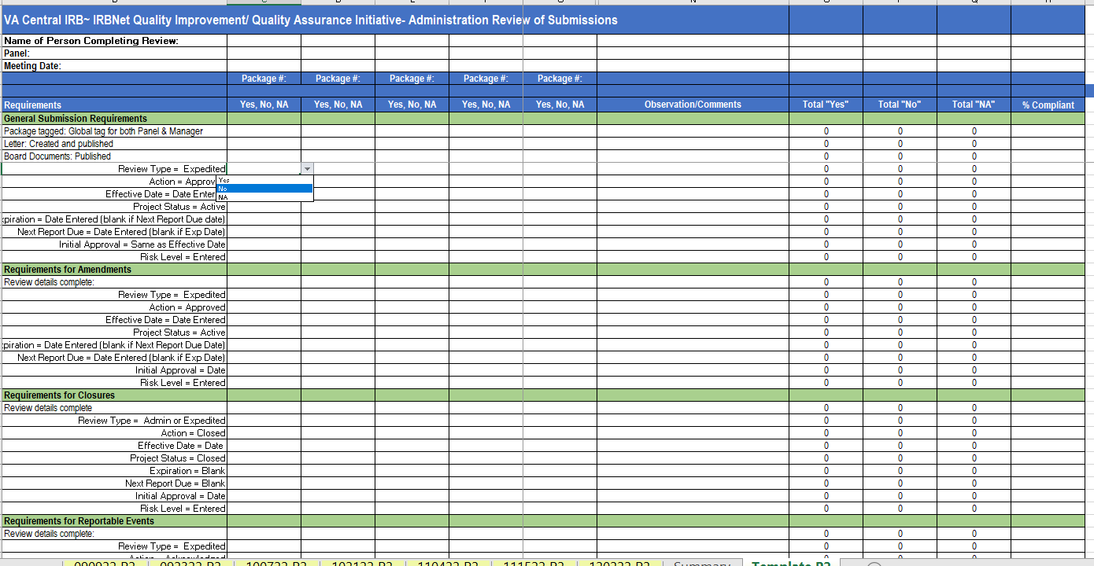
QA Checklist Template

Slide 22
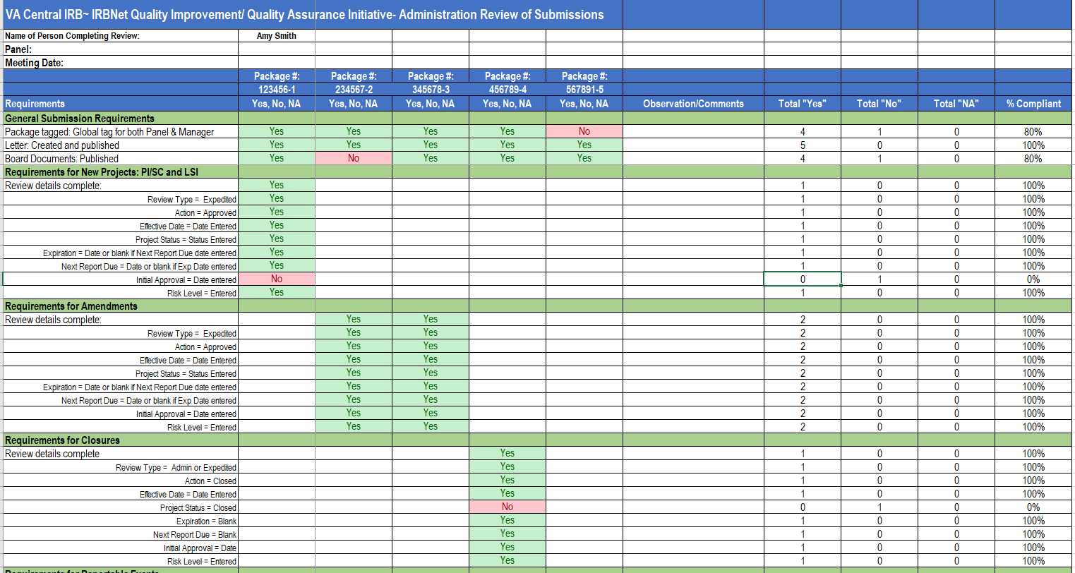
QA Checklist Template
*Data in graphics are for illustration purposes

Slide 23
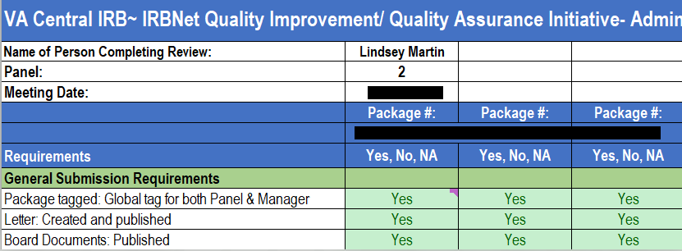
Sample
QA Checklist
Submission Details
*Data in graphics are for illustration purposes

Slide 24
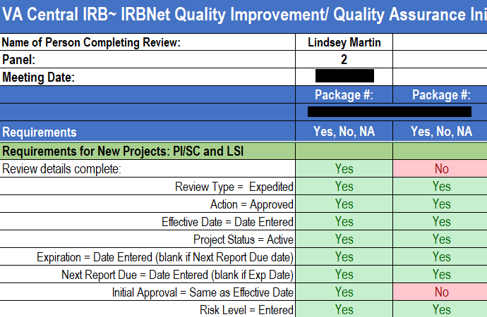
Sample
QA Checklist
Review Details
*Data in graphics are for illustration purposes only

Slide 25
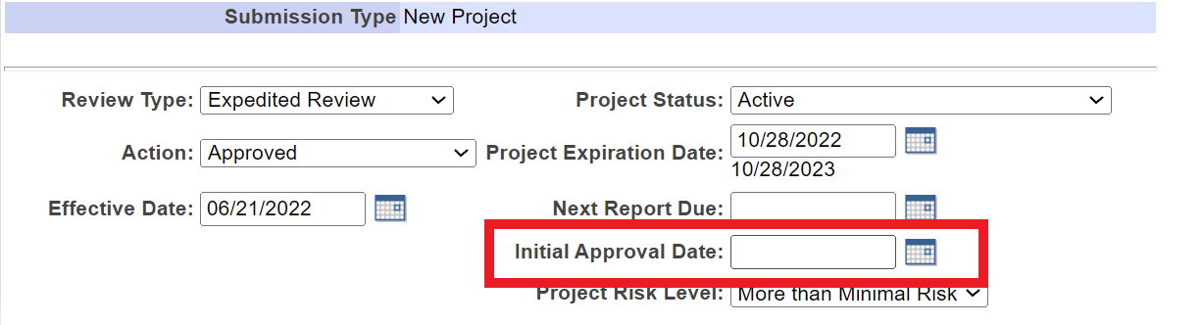
Sample
QA Checklist
Review Details

Slide 26
Evaluation
Established a percentage of compliance
  100%
  76% to 99%
  Below 75%
QA Checklist has built in formulas to summarize findings
  Findings can be generated into graphs and charts
Shared findings with staff
Developed corrective action plans
Conducted additional training and education
Compared results over each quarter

Slide 27
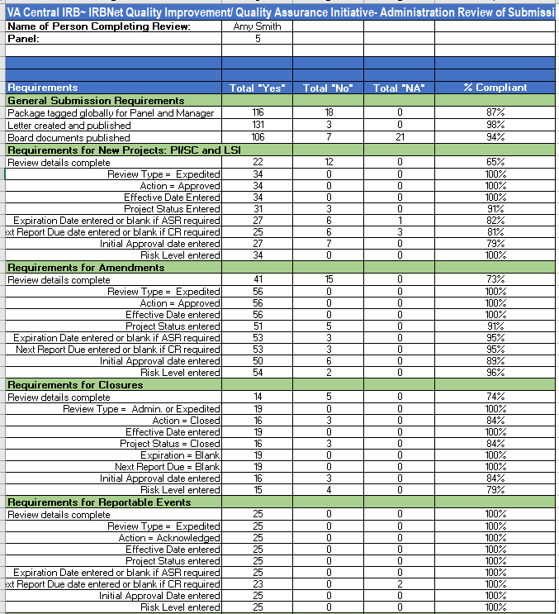
Sample
QA Summary
Summary of Findings
*Data in graphics are for illustration purposes

Slide 28
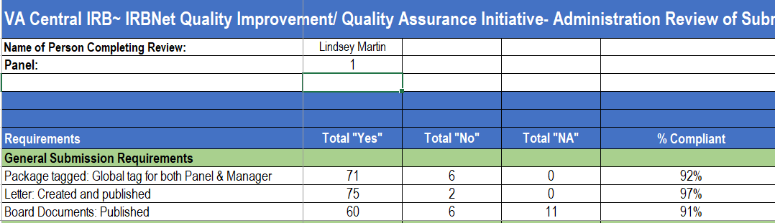
Sample
QA Summary
Summary of Findings
*Data in graphics are for illustration purposes

Slide 29
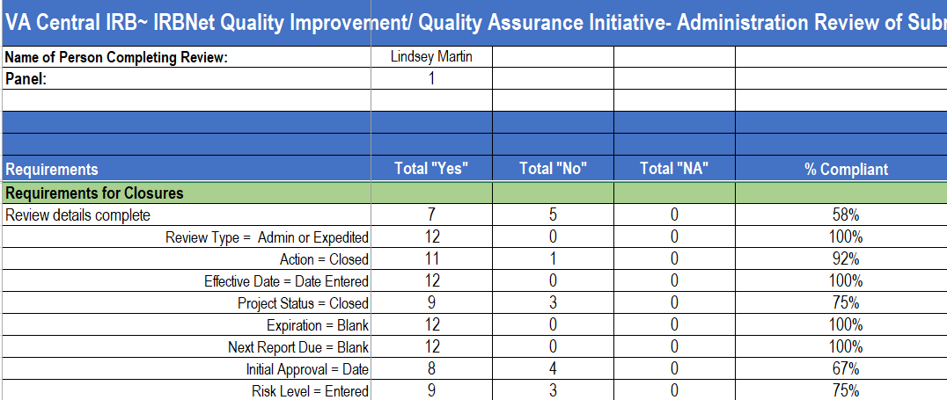
Sample
QA Summary
Summary of Findings
*Data in graphics are for illustration purposes

Slide 30
Sample
QA Summary
Summary of Findings
*Data in graphics are for illustration purposes

Slide 31
Outcomes of QA
Reductions in inconsistencies and errors in IRBNet
Started with a focus on Review Details and have expanded to other areas
Created beneficial uses of IRBNet Insight Reports
Standardized processes and Internal Workflows supported the measurement of IRB staff performance
Mechanism to evaluate performance as an IRB
Foster a system of accountability within the team
Confidence in data to support metrics and reporting

Slide 32
Questions?

Slide 33
Contact Information
Jessica Kroll
VA Central IRB Administrator
Jessica.kroll@va.gov
Lindsey Martin
VA Central IRB Program Specialist
lindsey.martin2@va.gov
For general VAIRRS support, please contact VAIRRS@va.gov

