Slide 1

The Reimbursable Process in Research
March 15, 2023
Jason Berlow, Management Analyst, Finance
Diane Murphy, Budget Analyst, Finance
Tony Laracuente, Director of Field Operations

Slide 2

Housekeeping
Webinar
Housekeeping
Recording - This session is being recorded and the associated handouts will be available on ORPP&E’s Education and Training website within one-week post-webinar.
Close Captioning - Now available in the new Webex platform. Click the “CC” button at the bottom left of the Webex screen.
Experiencing Sound Issues? – Call in using the number in your Webex chat box or in your registration confirmation email.
Q&A - Please use the Q&A feature to submit questions.
  Be sure to send questions to “All panelists”.
  Questions will be addressed at the end of the webinar.
Webinar Archive - Most ORPP&E webinars can be found here: https://www.research.va.gov/programs/orppe/education/webinars/archives.cfm
Post-Webinar Evaluation Survey - We are grateful to all that complete the post-webinar evaluation survey. It will automatically pop up once the webinar is exited.
For questions, please use Q&A box and address to “All Panelists.”
All Webinars will be recorded and posted within one week.

Slide 3
Objectives – for today’s training
Training Section: | By the end of this section, you will:
Section 1: What is reimbursable work? | Understand the government wide requirements for Reimbursable Activity Understand Direct vs. Reimbursable
Section 2: The process of billing | When is a collection required Understand the billing process
Section 3: The accounting process | Understand the key accounting transactions that occur with Bills of Collections and available VSSC reports
Section 4: The VHA Finance TDA Process | Understand how will receive your TDA
Section 5: Year End Considerations | Understand key deadlines
Q&A
Notes:
John

Slide 4
Appropriations Law and Swag (follow-up)
It is not permissible to purchase promotional items, such as mementos, gifts, keepsakes, prize items, and other VA “logo” or “message” items, for distribution to VA and other federal employees.
The VA may however, continue to purchase promotional items intended for the Veterans, such as informational and educational materials that directs Veterans to services (e.g., Veteran Crisis Lines, benefits services counseling) and have a clear connection with VA’s mission.
OGC’s advice (based on Comptroller General opinions) has always been that VA could not purchase mementos with “intrinsic value” for distribution, i.e., no value or use outside the workplace, such as t-shirts, jackets, mugs, water bottles, lunch totes, smartphone accessories, and the other items in the SWAG definition in the policy.
Reference: Volume II, Chapter 4 - Awards, Ceremonies, Food or Refreshments, Gifts or Mementos (va.gov)

Slide 5
Acronyms
Term | Definition
TAS | Treasury Account Symbol - The legal basis for establishing a TAS in the Treasury Department and in VA’s financial system is enacted legislation, e.g., an Appropriations Act. The TAS includes codes for agency, main account, and period of availability that correspond to statutory language.
Fund | Fund is a sub-division of TAS established by VA and used to record financial transactions.
Buyer | Fund that buys goods or services (Direct obligations) from a different TAS called the Seller. The buyer is sometimes called the Ordering agency.
Standard General Ledger (US SGL) | The United States Standard General Ledger (USSGL) provides a uniform chart of accounts and technical guidance for standardizing federal agency accounting.
MOU | Memorandum of Agreement

Slide 6

Section 1: What is reimbursable work?

Slide 7
What is a reimbursable?
Reimbursable activity are funded collected into an appropriation from sources typically other than an appropriation by Congress (called a direct appropriation).
It is the funding source, however, that determines whether spending is direct (an appropriation) or reimbursable.
By contrast to direct spending, which is appropriated by Congress, Reimbursable obligations in a Fund are financed from collections received in exchange for goods or service from one of three sources:
  Fund within a different Treasury Account Symbol at VA, another Federal agency, and the public.

Slide 8
What is reimbursable work?
OMB A-11 (Section 20.12) states that:
Agencies can perform reimbursable work for the public or other Federal agencies. The types of laws that allow you to use advances or reimbursements in return for providing others with goods and services are:
  Provisions in appropriations or substantive laws that allow agencies to use the amounts they collect.
  The Economy Act (31.U.S.C. 1535)/Interagency Agreements.
Reimbursable authority is estimated in the annual budget justification and requires an OMB apportionment.

Slide 9
What triggers a reimbursement?
Executing an Inter-Agency Agreement (IAA) with another agency or a different TAS within VA in which the other agency or appropriation will later provide collections in exchange for goods or services. Note: VA uses G-Invoicing (7600A/B).
Recording collections from an IPAC transaction or via internal voucher transactions for collections from other VA TASs.
Recording collections from buy-sell transactions with the public (i.e., Universities and NPCs).

Slide 10
Reimbursements are authorized in the Medical Research Appropriations language
MEDICAL AND PROSTHETIC RESEARCH (FY 23 Appropriation)
For necessary expenses in carrying out programs of medical and prosthetic research and development as authorized by chapter 73 of title 38, United States Code, $916,000,000, plus reimbursements, shall remain available until September 30, 2024: Provided, That the Secretary of Veterans Affairs shall ensure that sufficient amounts appropriated under this heading are available for prosthetic research specifically for female veterans, and for toxic exposure research.
Reimbursements

Slide 11
Reimbursements and Appropriations Law
Reimbursements/Collections are still subject to appropriations law (purpose/time/amount).
Any potential obligations with collected funds that are taken into a reimbursable appropriation fund must:
  Purpose: Be a necessary expense of the Research Appropriation
  Time: must be obligated during the same period of availability of the original appropriation and be a necessary expense during that time.
  Amount: Must not exceed the amount of the collected authority.

Slide 12
FY 24 ORD Budget Justification
Reimbursable estimate

Slide 13
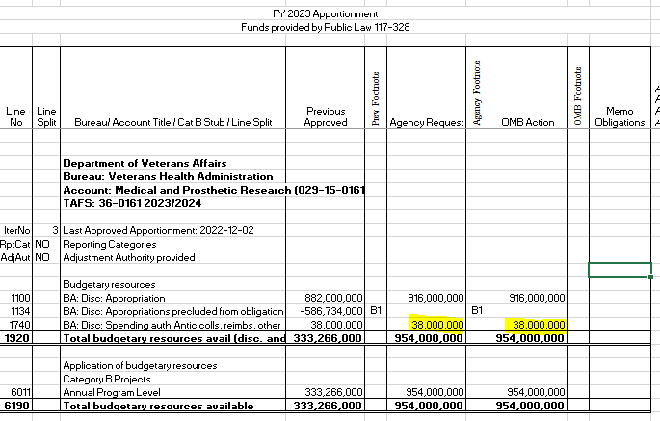
OMB SF-132 (Apportionment)
Reimbursable spending authority require a signed OMB apportionment

Slide 14

Section 2: The Process for Billing/Collecting

Slide 15
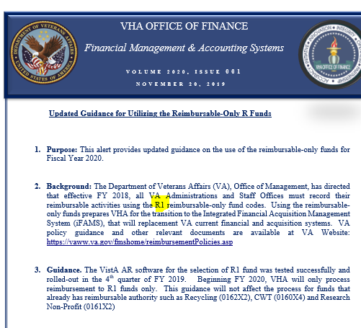
Where do I collect my reimbursable funds?
Effective FY 2018, all VA Administrations and Staff Offices must record their reimbursable activities using the R1 reimbursable-only fund codes. For Research, this is fund code 0161R1 and 0161X2.

Slide 16
When is a collection required?
Required | Not Required
Purchasing a service or supplies from another department at your VAMC, such as pharmacy, MRI, X-Ray or laboratory tests. Collections from Affiliated Non-Profit Corporations (NPCs). Collections from University Affiliates. Interagency Agreements (see IAA Training). | Splitting Salary Cost between Research and Clinical, should be done by cost transfers and NOT an IAA/G-Invoicing. Cost transfers are the appropriate method when salary is involved for employees that would otherwise be split in appropriations and no tangible services are involved. VHA Finance and FSC have instructed ORD that this activity does not represent an exchange of supplies or services (buy/sell transaction) which would require an IAA.

Slide 17
Working with the NPCs/Foundations (0161X2)
When reimbursing research use 0161X2.
All other NPC Reimbursements should go back directly to the other appropriation 0161R1 accounts:
  The medical care appropriation (0160R1)
Required backup documentation.
  MOU outlining the need for reimbursement and the authority will be required when auditing bill
Fund control point should be established in the 0161X2 appropriation as no year funding.

Slide 18
University Bills (0161R1)
A Bills of Collection when the Research appropriation requires reimbursement from a University affiliate for costs incurred.
  Examples include salary, animal per diems, core services, etc.
To initiate a bill of collection, you must have the billing menu in ViSTA. The entity being billed must be vendorized in the VA system.
If you are billing to the University, be sure to bill your 0161R1 fund control point.
All reimbursements from your affiliate should come through the 0161R1 fund (not 0161X2). These are sent through a TDA each month. You should not be depositing checks from the affiliate directly into a fund control point.

Slide 19
Reimbursement (0160R1)
Bill of Collections when the Medical Services appropriation requires reimbursement from an outside entity including the VA NPC for costs incurred.
  Examples include pharmacy or clinical costs incurred which need to be billed to an outside entity.
  A Bill of Collection is created using the pharmacy or clinical FCP

Slide 20
Determine Collections Type
FMS Transaction | Agreement Type/Process | General Ledger Posting | TDA
IAA/Reimbursable Agreement (RA) | Anticipated Collection | Debit: 4221 Credit: 4210 | VHA Finance will process an automatic TDA to reimburse the stations for the amounts earned in the month following the collection, the amount earned is determined by the balances in the 425* general ledgers. For advance collections IAAs please refer to IAA training, as it is not an automatic TDA.
Bill of Collection Transaction | Billing Document (BD) – established receivable for billed amounts for services from other VHA Offices, Universities, and NPCs. | Debit: 1310/425G Credit: 5200/4221 | VHA Finance will process an automatic TDA to reimburse the stations for the amounts earned in the month following the collection. The amount earned is determined by the balances in the 425* general ledgers
See October 2022 Training on IAAs

Slide 21
The Billing Process (for non-governmental entities)
Determine if this is salary or product reimbursement.
Create an MOU with the entity - NPC or University Affiliate (in most cases).
If Affiliate, have the person requesting the MOU provide an administrative contact at Affiliate to route the MOU. Get signatures at affiliate by sending to the admin. Then route internally.
If NPC, contact NPC staff to complete.
Once MOU is in place, give it an MOU number if Fiscal has not already.
Create the bill in the VISTA billing system.

Slide 22
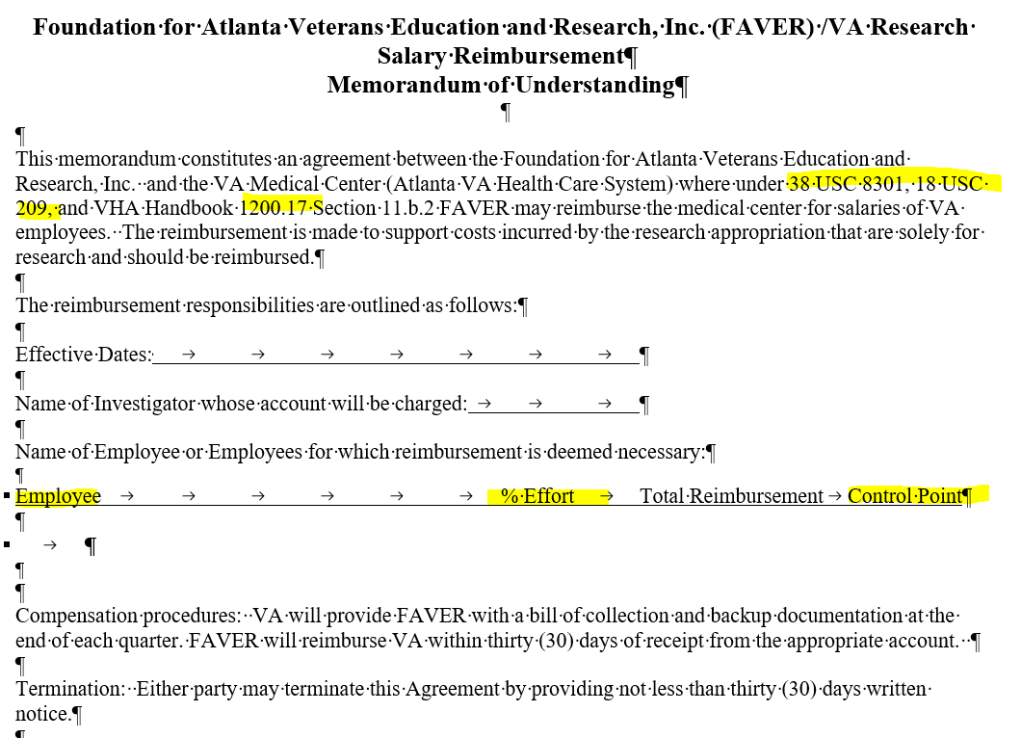
Example of MOU

Slide 23
Setting up the Bill in VISTA Steps
Select Control Point Official's Menu Option: billing
Select Billing Option: new Bill (Enter)
SITE: ATLANTA VAMC// GA VAMC 508
BILL NO. : n ... Bill Number '508 -K######' assigned
FORM TYPE: 1114 (vendor)
CATEGORY: VENDOR V – (vendor)
CONTROL POINT: 280 (this is the X2 FCP)

Slide 24
Setting up the bill
DATE BILL PREPARED: enter date
VOUCHER NUMBER:
BILLING AGENCY: DVA Medical Center
BILLING AGENCY DEBTOR (PAYER): 8049 for FAVER (Varies by Station)

Slide 25
Setting up the bill
Select DATE OF CHARGES: t JUL 08, 2009 DESCRIPTION OF CHARGES:
No existing text Edit? NO// y YES
  (Reimbursement) for work performed by X for the period of date to date. Per the Memorandums of Understanding between the VA NPC and the VA Medical Center where VA NPC may reimburse the VA Medical Center for salaries of VA employees. The reimbursement is made to support costs incurred in support of the project X under the direction of PI Name .
MOU number:
    Fund 0161X2
    FCP (Enter the Reimbursable FCP)
    BFY: Enter the Fiscal Year
    BOC 1031

Slide 26
Setting up the bill
QUANTITY (UNITS): Enter number of units (for effort use 1)
UNIT COST: enter amount to reimburse
UNIT: for effort enter JB, for Units do a ? and use appropriate
TOTAL AMOUNT: 19672// (No Editing hit enter) Select DATE OF CHARGES: (hit enter)
Select FISCAL YEAR: hit enter
FY ORIGINAL AMOUNT: 19672// hit enter
Select FISCAL YEAR: hit enter
Display/Print Bill:? Yes// (Yes)
DEVICE: HOME // HOME Right Margin: 80//

Slide 27
What happens next
Bill is approved by FCP Approving Official.
Accounting Reviews the bill and may ask questions, send back or approve.
  Question may include:
    What BFY is the bill to be collected in? Use the year that the expense was made
    What is the revenue code? Usually, it will be one of the following 3
      8000 – Non-medical reimbursements
      8004 - ANCILLARY MED SVC, MED RES
      8020 - FED INTERAGENCY AGR - MED RES
Accounting approves the bill, and the clock starts ticking.
The NPC or Affiliate will deposit check through Agent Cashier.
TDA is then processed once the collection is completed (see later sections)

Slide 28
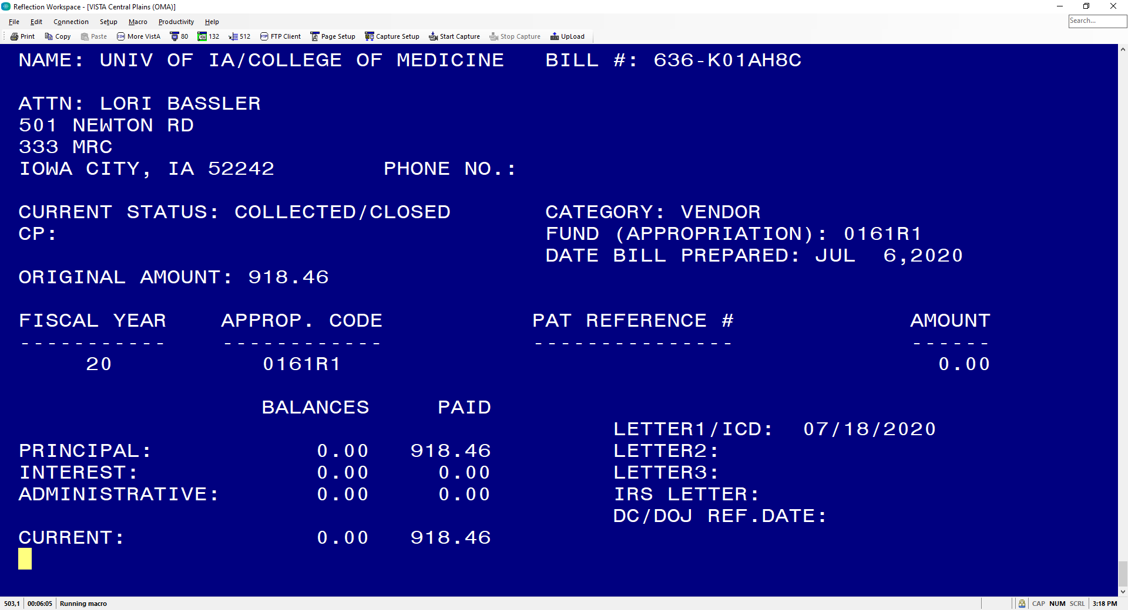
VISTA Bill of Collection

Slide 29
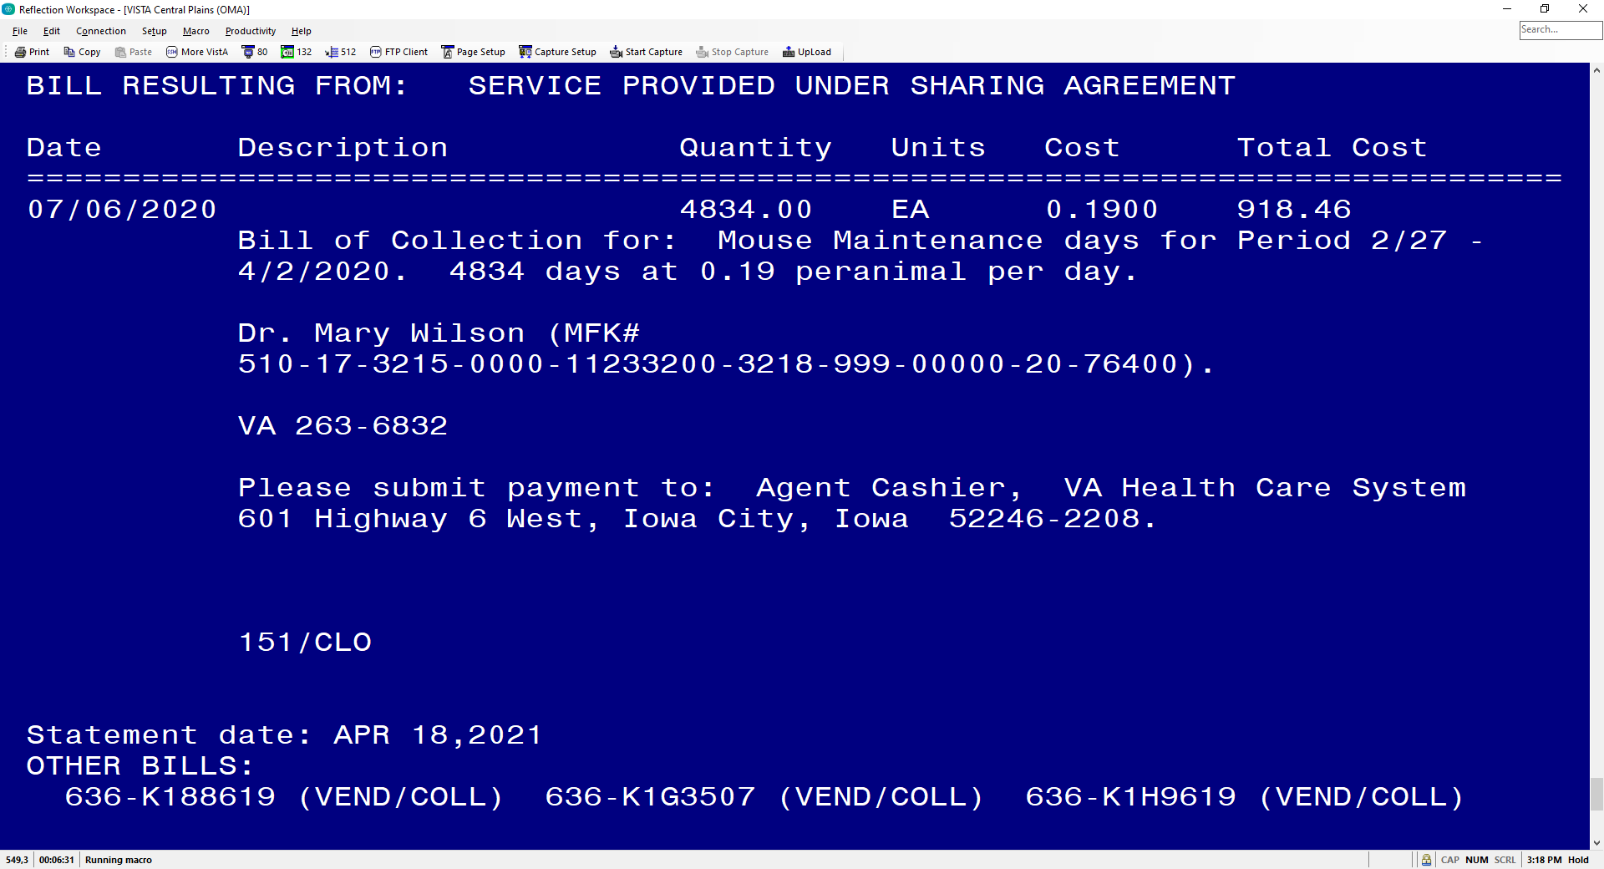
VISTA Bill of Collection

Slide 30

Section 3: The Accounting Process
Where is my TDA?

Slide 31
Collections Activity
Every collecting activity must be recorded in an accounting transactions in the Standard General Ledger (US SGL), this means that that each time an approved transaction is recorded, it will generate appropriate general ledger accounts for posting the transaction according to the rules defined in the USGL, with the following USGL Codes:
USGL Code | Action
4221 | Establish Reimbursable Agreement (IAA)
425F | Record Reimbursable, No Advance
425G | Reimbursable Earned (Federal)
425P | Reimbursable Earned (non-federal)

Slide 32
VSSC and Checking Reimbursable Activity at the Station Level
VSSC Monthly Earnings Report: Reports monthly reimbursable earnings by USGL.
  Benefit: Easier to use
  Con: Only monthly
  Link: REIMB_EARNINGS - Report Viewer (va.gov)
General Ledger Trial Balance Report: Daily report showing balance of general ledger account (might be more helpful to get report from Fiscal).
  Benefit: Daily Report
  Cons: Harder to Use
  Link: GLTS Report - Report Viewer (va.gov)

Slide 33
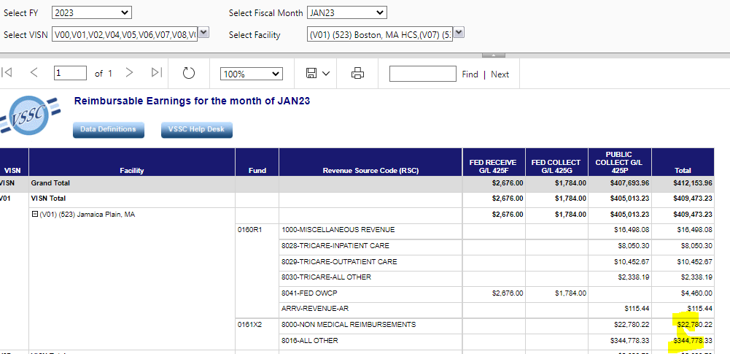
VSSC Reimbursable Monthly Earnings Report

Slide 34
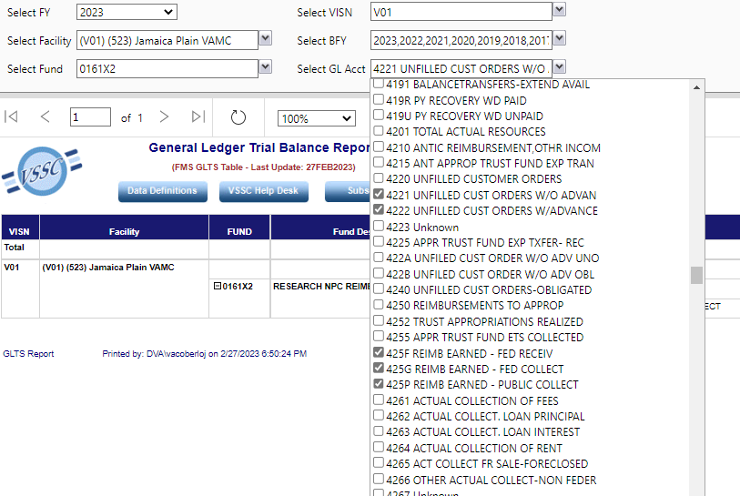
General Ledger Trial Balance Report (daily report)

Slide 35
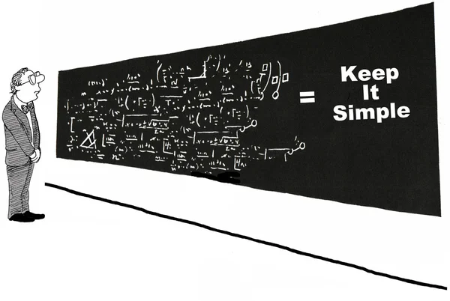
Section 4: The Reimbursable Process at VA/VHA

Slide 36
VHA Finance Process
Effective FY 2018, all VA Administrations and Staff Offices must record their reimbursable activities using the R1 reimbursable-only fund codes. For Research, this is fund code 0161R1 and 0161X2.
This information was provided in: VHA Finance Alert Volume 2020, Issue 001
This required because of the following requirements:
  Statutory requirement established in Federal Financial Management Improvement Act of 1996 (FFMIA)
  OMB implementing guidance for FFMIA was issued as Memorandum M-13-23, Appendix D to Circular No. A-123, Compliance with the Federal Financial Management Improvement Act of 1996.
  Treasury implementing guidance is issued in the Treasury Financial Manual (TFM), Part 2, Section IV: USSGL Account Attributes
  VA policy guidance issued September 1, 2017, in memorandum from Acting Assistant Secretary for Management and Interim Chief Financial Officer
  The FSC Intragovernmental Reimbursement Guide includes detailed operational procedures regarding reimbursable agreements.
More information can be found here: https://vaww.va.gov/fmshome/reimbursementPolicies.asp
VA policy guidance and other relevant documents are available at VA Website: https://vaww.va.gov/fmshome/reimbursementPolicies.asp

Slide 37
VHA Finance/Reimbursable Process
As bills of collection are processed within the R Funds by stations and their associated reimbursements are received and processed within FMS against any of the 425 General Ledger accounts.
Reimbursements received in one month are first balanced to end of month Trial Balances in the subsequent month, before the TDAs are released to stations.
VHA Finance downloads the US General Ledger 425F, 425G and 425P as of Close of Business (COB) the second Thursday.
Stations will typically receive their TDAs by the third week of the subsequent month.
Once the funds are received by the station, stations will record obligations to support their agreements.
Facilities can either obligate directly out 0161R1 fund or cost transfer into the R fund to execute these dollars. All cost transfers must be processed before the end of each month. SALT and ALLW tables will be created, and stations will be able to utilize any appropriate ACC, Cost Center or Budget Object Code (BOC) that support their agreement.
  https://www.va.gov/finance/docs/VA-FinancialPolicyVolumeIChapter11.pdf

Slide 38
VHA Finance Distributes Reimbursements Report
Research should only be concerned with the rows in yellow

Slide 39
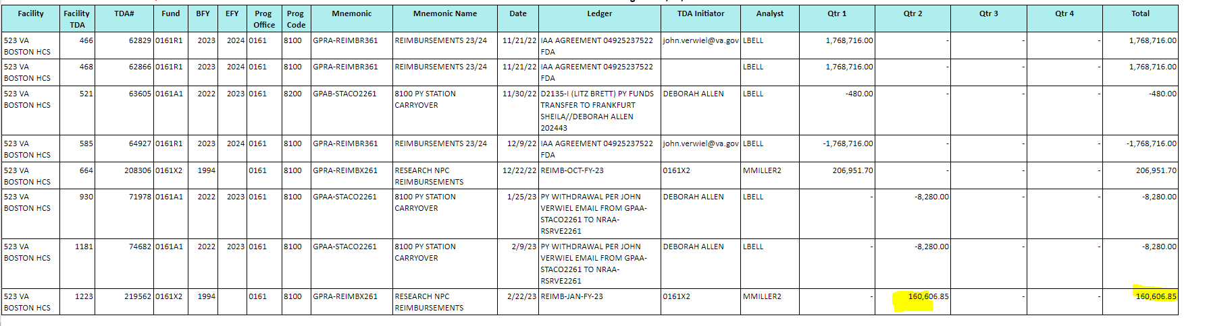
TDAs in AACS

Slide 40
Processing the TDA
The TDA will inform you of the amount that you received in 0161R1 and 0161X2 funds for that month.
Request Fiscal provide you with the F827 General Ledger Report. This report will provide you with the billing numbers for the reimbursables.
Match the billing numbers with the bills that you have created to determine which bills were paid and the expenses that were reimbursed.
Once reimbursements are deposited into the 0161R1 or 0161X2 fund, you need to request a cost transfer to move those funds into the FCP where the expenses originally occurred. This should be done throughout the fiscal year, so you are not doing one cost transfer at the end. Watch your 0161X2 balances!

Slide 41
End of Year Processing Requirements
The VHA Office of Finance will download September data and process TDAs as follows:
  First download from the General Ledger 425F, 425G and 425P as of Close of Business (COB) the second Thursday in September of each year. TDAs will be processed on the second Friday of September.
  Second download from the General Ledger 425F, 425G and 425P as of COB the third Friday in, September of each year and TDA’s processed following Monday.
  Reimbursements after the third Friday of September will be kept in the National Reserve.
  All uncollected or unearned reimbursable agreements must be adjusted to a zero balance and any advances returned prior to September 28th.

Slide 42


Section 5: End of Year Processing Requirements

Slide 43
VHA End-of-Year Financial Close-Out Guidance
Please watch for the reimbursement guidance as part of the VHA End-of-Year Financial Close out Guidance (will distribute this guidance as usual).
For example, in FY 2022 any reimbursement earned after September 16th will be held in the National Reserve. We are currently working with VHA Finance to get these funds to Research Station, but we highly recommend you try your best to ensure all reimbursements are earned by the cut-off date.

Slide 44

Questions

Slide 45
Links
Reimbursable Policies - Financial Management System Services (va.gov)
Departmental Guidance R Fund (FY 2018)
VHA Finance Alert (R-fund) Volume 2020, Issue 001
https://vaww.va.gov/fmshome/reimbursementPolicies.asp
https://www.va.gov/finance/docs/VA-FinancialPolicyVolumeIChapter11.pdf
Intragovernmental Reimbursement Guide
REIMB_EARNINGS - Report Viewer (va.gov)
FY 23 ORD IAA Training 120422.pptx

