Slide 1
Bi-Monthly Updates in Human Research Protections
Office of Research Protections, Policy, & Education (ORPP&E) VHA Office of Research and Development (ORD)
April 5, 2023

Slide 2

Please use the Q&A feature to submit questions.
  Please do not use Chat to send in questions.
  Be sure to send questions to “All panelists”.
We would be ever so grateful if you would complete the post-webinar evaluation survey that pops up once you exit the webinar.
Experiencing sound issues – you can call in using the number included on the handouts and on your registration confirmation email that you received.
Webinar
Housekeeping
A recording of this session and the associated handouts will be available on ORPP&E’s Education and Training website approximately one-week post-webinar
An archive of all ORPP&E webinars can be found here:
https://www.research.va.gov/programs/orppe/education/webinars/archives.cfm
For questions, please use Q&A box and address to “All Panelists.”
All Webinars will be recorded and posted within one week.

Slide 3
Purpose
The purpose of this bi-monthly webinar is to update the VA research community on the following April topics:
  Procedures to follow with the CDC IRB if a VA Facility wishes to close the Tecovirimat (TPOXX) expanded access (EA) program for Mpox at their site;
  Key differentiating characteristics of consultants vs. investigators in the conduct of VA studies;
  Common issues when making research vs. non-research determinations; and
  Commercial (Independent) IRB issues, including:
  (a) revised requirements for endorsement letters for submissions, and
  (b) revised informed consent and HIPAA authorization tools for use when submitting informed consents and written HIPAA authorizations.

Slide 4
VA Facility Implementation of the CDC Expanded Access Program (EAP) for Use of Tecovirimat (TPOXX®) for Mpox
Eighty-one (81) VA Facilities are currently approved to participate in the CDC EAP for Tecovirimat using CDC’s Investigational New Drug Application (IND) for the Program.
  Seventy-nine (79) VA Facilities are relying upon the CDC IRB.
  Two (2) VA Facilities are relying upon their own internal IRBs.
This EA-IND protocol allows access to and use of TPOXX for treatment of orthopoxvirus infections, including Mpox.
The name of the CDC Protocol: Expanded Access IND Protocol: Use of Tecovirimat (TPOXX®) for Treatment of Human Non-Variola Orthopoxvirus Infections in Adults and Children.

Slide 5
CDC Expanded Access Program for Use of Tecovirimat (TPOXX®) for Mpox
No modifications in the protocol or informed consent document have occurred since October, 2022.
  Current CDC IRB-approved protocol is Version 6.2 (October 24, 2022)
  Current CDC IRB-approved informed consent document is Version 6.1 (August 10, 2022).
CDC IRB approval of the EAP IND protocol will expire on July 23, 2023.
There is no indication that the program will not continue; the CDC EAP IND program is expected to undergo IRB continuing review prior to expiration.
The CDC EAP IND Program for Mpox does not have high-volume use at most VA Facilities.

Slide 6

What is Required If Your VA Facility Wishes to Voluntarily Close the CDC Tecovirimat EAP for Mpox at Your Site?

Slide 7
Closure Procedures for VA Facilities Using the CDC IRB for the CDC Tecovirimat EAP for MPOX If Your Site Chooses to Close
Email the CDC Regulatory Affairs Office at regaffairs@cdc.gov and include the answers to these questions:
  How many patients have been treated with Tecovirimat at your site?
  Does your pharmacy have any Tecovirimat at your site?
Please copy the following on your email to the CDC Regulatory Affairs Office:
  Irbrelianceandsirbexceptions@va.gov
  Priscilla.Craig@va.gov
  Elizabeth.Clark3@va.gov
Close the program with your VA Facility’s Research and Development (R&D) Committee after the CDC Regulatory Affairs office acknowledges the VA Facility’s email notifying them of closure.

Slide 8

Investigators vs. Consultants
Investigator vs. Consultant?

Slide 9
Investigators and Consultants
“Investigators” and “Consultants” are not interchangeable terms.
ORD policy does not define “consultant”, nor do Federal human subjects regulations.
Confusion arises when
  “Consultants” are not included as part of a study team when they are conducting research based upon the label of “Consultant,” or
  “Consultants” are included as part of a study team when they are not conducting research based upon the label of “Consultant”.
Consultants are traditionally not involved in the conduct of research.
Asking what the “Consultant” is doing determines whether that individual is conducting research.

Slide 10
Poll Question #1: Authorship
True or False
Question:
If a Consultant is to be listed as an author on a research publication, the Consultant must be part of the study team.

Slide 11
Poll Question with Answer #1: Authorship
True or False
Question:
If a Consultant is to be listed as an author on a research publication, the Consultant must be part of the study team.
Answer: False.
Rationale: Having author status on a publication or manuscript does not automatically make that individual part of a study team and vice versa.

Slide 12
Poll Question #2: Training Requirements
Select YES or NO
Question:
A VA Facility’s IRB is reviewing a study stating that a Consultant from another VA Facility will provide advice to the study on statistical methods to analyze the data as part of study planning. The Consultant will not be interacting with any subjects, nor have access to any study data. However, the individual is a Consultant.
Is the Consultant required to complete ORD training in ethical principles of human subjects protection required for VA employees who are conducting human subjects research?

Slide 13
Poll Question with Answer #2 : Training Requirements
Select YES or NO
Question:
A VA Facility’s IRB is reviewing a study stating that a Consultant from another VA Facility will provide advice to the study on statistical methods to analyze the data as part of study planning. The Consultant will not be interacting with any subjects, nor have access to any study data. However, the individual is a Consultant. Is the Consultant required to complete ORD training in ethical principles of human subjects protection required for VA employees who are conducting human subjects research?
Answer: No.
Rationale: In the above scenario, the Consultant is not participating or involved in any activities that would make the Consultant an individual who is part of the study team; the Consultant is not involved in the conduct of human subjects research. Therefore, ORD required training for VA employees conducting human subjects research does not apply.

Slide 14

Most Important Take Home Message:
Evaluate what the individual is doing rather than the label.

Slide 15

Common Issues When Making Research vs. Non-Research Determinations

Slide 16
Research vs. Non-Research Determinations
Making research and non-research determinations are not always easy.
  Some subjectivity within the definition of research.
  Individuals or groups providing the information may not have sufficient information.
  Individuals or groups making the determinations may not have sufficient information.
  Different reviewing groups may have different opinions.

Slide 17
Definition of “Research”: Key Phrases
“Research means a systematic investigation, including research development, testing and evaluation, designed to develop or contribute to generalizable knowledge. Activities that meet this definition constitute research for purposes of this directive, whether or not they are conducted or supported under a program that is considered research for other purposes. For example, some demonstration and service programs may include research activities. Clinical investigations, including clinical investigations as defined under FDA regulations in 21 CFR 50.3, 312.3(b), and 812.3(h), are considered research for purposes of this directive. . . .”
Source: VHA Directive 1200.05(2): Requirements for the Protection of Human Subjects in Research (January 7, 2019; amended January 8, 2021).

Slide 18
Key Phrases: Simplifying the Words
Systematic investigation:
  An activity that is planned in advance and that uses data collection and analysis to answer a question. Although research must include systematic investigation, non-research operations activities also include systematic investigation to ensure reliable outcomes. Systematic investigation does not, in and of itself, define research.
    Source: VHA Program Guide 1200.21, Paragraph 4.e.
Generalizable knowledge:
  Information that expands the knowledge base of a scientific discipline or other scholarly field of study. Systematic investigations designed to develop or contribute to generalizable knowledge constitute research.
    Source: VHA Program Guide 1200.21, Paragraph 4.a.

Slide 19
Breaking it Down: Some Key Questions ORD Considers When Making Research Determinations
Is the activity producing “new knowledge”?
How are the results going to be used?
Is the activity a pilot study?
Is the activity is conducted by a student, is it a dissertation?
How is the proposed activity funded?

Slide 20
Case Studies
A case study/case report is a retrospective analysis of clinical cases.
Case studies/case reports can consist of different numbers of clinical cases.
Neither ORD policies nor the Common Rule define what “number” of cases place the activity into human subjects research vs. non-research.
ORD’s general guidance is that if more than three cases are involved in the analytical activity, the activity almost always is human subjects research under the Common Rule.

Slide 21
Key Characteristics of Non-Research Activities: ORD Program Guide 1200.21:
VHA Operations Activities That May Constitute Research
Issued by ORD on January 9, 2019 that includes criteria to assist in determining whether a VHA operations activity constitutes research.
  Replacement for VHA Handbook 1058.05 “VHA Operations Activities that May Constitute Research,” dated October 28, 2011.
  Establishes procedures for verifying and documenting the non-research status of certain operations activities prior to publication of findings outside the Department of Veterans Affairs.
Primary purpose of quality assessment and quality improvement is for internal VA purposes.
  The activity is designed and implemented for internal VA operational purposes (i.e., its findings are intended to be used by VA or by entities responsible for overseeing VA).
Not designed for generalizability beyond VA.
  The activity is not designed to produce information that expands the knowledge base of a scientific discipline (or other scholarly field).
  However, this does not mean that a research activity done solely within VA is not research if it is only conducted within VA.

Slide 22
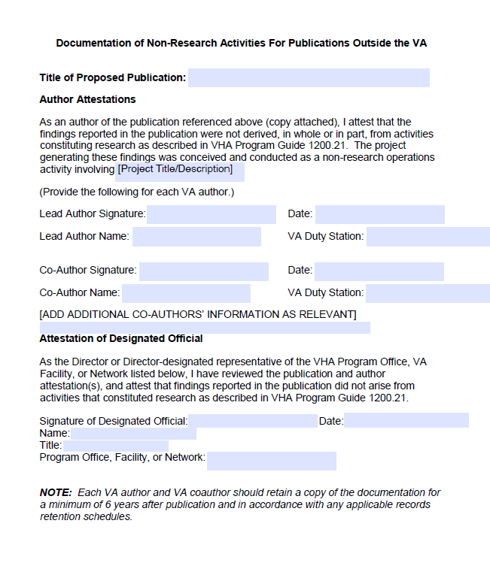
Fillable Form: Documentation of Non-Research Activities for Publications Outside the VA

Slide 23



Commercial (Independent) IRB Issues

Slide 24
Commercial IRB Issues:
Changes in:
  VA Facility responsibilities for including VA specific informed consent document (ICD) elements and select Common Rule 2018 Requirements into informed consent documents when the study is industry funded.
  Endorsement letter uploaded with study submission to Commercial IRBs.
New:
  Internal checklist to aid study teams when preparing informed consent documents and combined consent/authorization documents

Slide 25
Inclusion of VA and Select 2018 Common Rule Requirements into VA Informed Consent Documents
All of ORD’s approved Commercial IRBs expect VA Facilities to add VA-specific informed consent requirements into the model informed consents prior to submission to the IRB.
All VA research requiring IRB-approved ICDs is required to include the applicable 2018 Common Rule ICD elements. However, the majority of VA studies overseen by ORD-approved Commercial IRBs are sponsored by industry.
Studies sponsored by industry, unlike studies sponsored by the National Institute of Health (NIH) do not routinely include the 2018 Common Rule Requirements in model informed consent forms.

Slide 26
Inclusion of VA and Select 2018 Common Rule Requirements into VA Informed Consent Documents (cont.)
To facilitate review of VA studies sponsored by industry, new tools and checklists have been developed.
Revised procedures have also been incorporated when applicable by ORD’s approved Commercial IRBs.
New tools have been developed to assist VA Facilities and their study teams:
  VA Specific and Selected 2018 Common Rule Informed Consent Requirements When Using an Independent-Commercial IRB (Revised 04/03/2023)
  VA HIPAA Authorization Requirements When Using an Independent (Commercial) IRB (Revised 04/03/2023)
  Checklist for VA Facilities Using Independent Commercial IRBs-ICDs and Combined ICD-HIPAA Authorizations (New 04/03/2023)

Slide 27
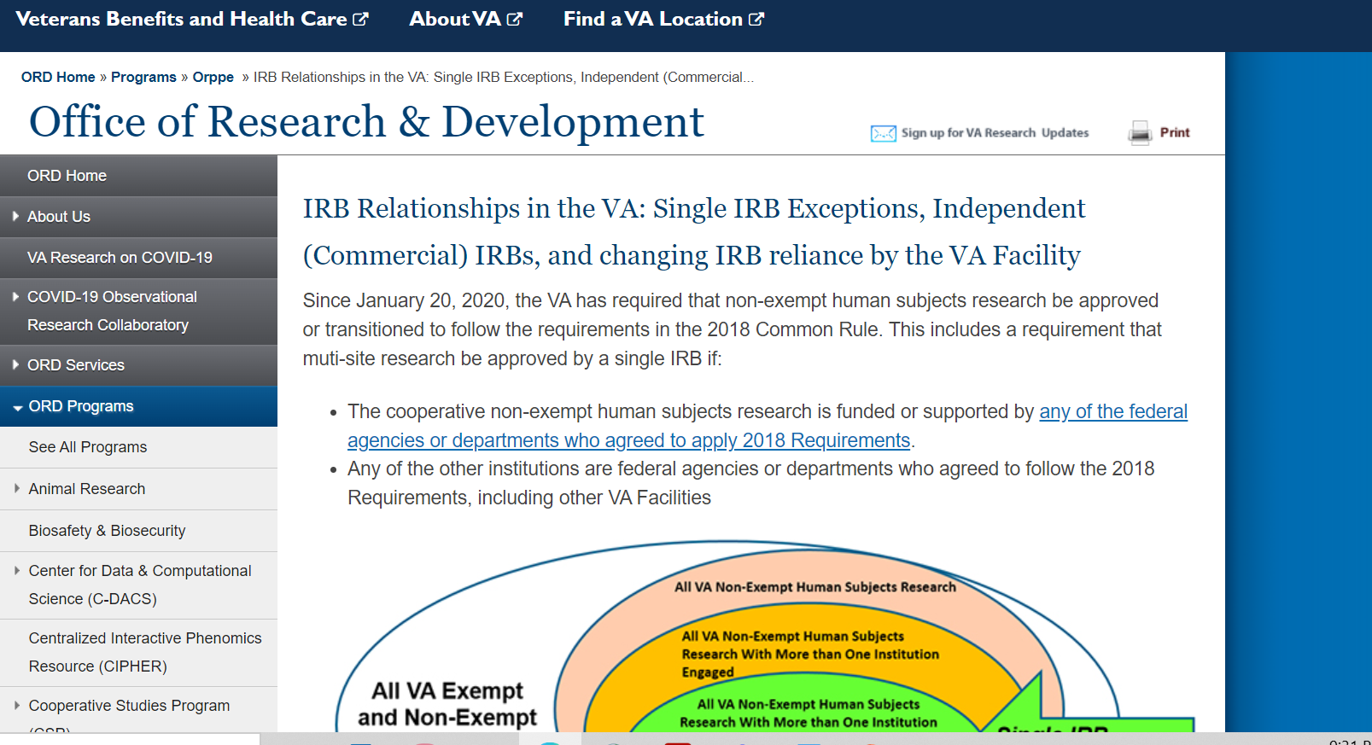
Tools: Inclusion of VA and Select 2018 Common Rule Requirements into VA Informed Consent Documents
All Tools/Checklists Available on ORD’s webpage at IRB Relationships in the VA: Single IRB Exceptions, Independent (Commercial) IRBs, and changing IRB reliance by the VA Facility

Slide 28
Tool: VA Specific and Selected 2018 Common Rule Informed Consent Requirements When Using an Independent-Commercial IRB
Tool revised to expand on five elements listed as VA specific informed consent requirements which may or may not be applicable depending upon the study:
  VA Treatment for Research-Related Injuries
  Costs for Study Participation Paragraph
  Consent for Photographs, Video, or Audio Recordings
  Certificates of Confidentiality (CoCs)
  PREP ACT

Slide 29
Tool: VA Specific and Selected 2018 Common Rule Informed Consent Requirements When Using an Independent-Commercial IRB (cont.)
Tool includes a section on selected 2018 Common Rule Requirements (not in FDA regulations) to be evaluated for inclusion when submitting an industry-sponsored study for initial review to an ORD-approved Commercial IRB:
  Key Information presented up front
  Future use of specimens and/or biospecimens
  Biospecimens and future profit
  Return of research results to subjects
  Statement that research involves Whole Genome Sequencing

Slide 30
Tool: VA HIPAA Authorization Requirements When Using an Independent (Commercial) IRB
Revised and split into a separate tool.
Provides clarification on topics involving HIPAA authorization documents.
If the study involves a standalone written HIPAA authorization (VA Form 10-0493) do not submit the VA Form 10-0493 to the Commercial IRB.
  IRBs are not responsible for reviewing or approving a standalone HIPAA authorization document for research.
  IRBs are responsible for reviewing (and approving) combined research informed consent/HIPAA authorization documents.

Slide 31
New Checklist For VA Facilities Using Independent (Commercial) IRBs
New 2-page checklist developed for use by study teams submitting studies to ORD-approved Commercial IRBs, but is useful for any study team.
Checklist titled: Checklist for VA Facilities Using Independent (Commercial) IRBs: Inclusion of Required Language into Informed Consent Documents (ICDs) and Combined ICD/HIPAA Authorization Documents
Designed to be used in combination with the revised Tools.
Not required to be submitted with the submissions to the Commercial IRBs.

Slide 32
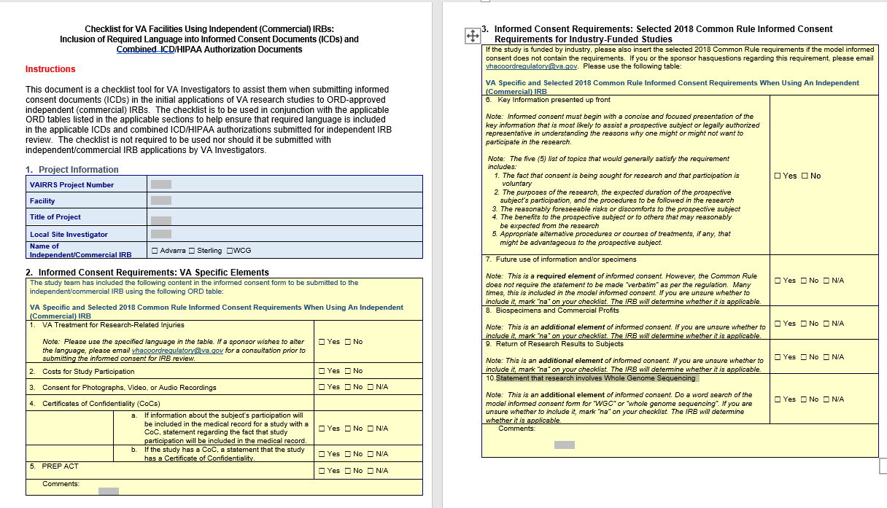
Checklist For VA Facilities Using Independent (Commercial) IRBs
IRB Relationships in the VA: Single IRB Exceptions, Independent (Commercial) IRBs, and changing IRB reliance by the VA Facility

Slide 33
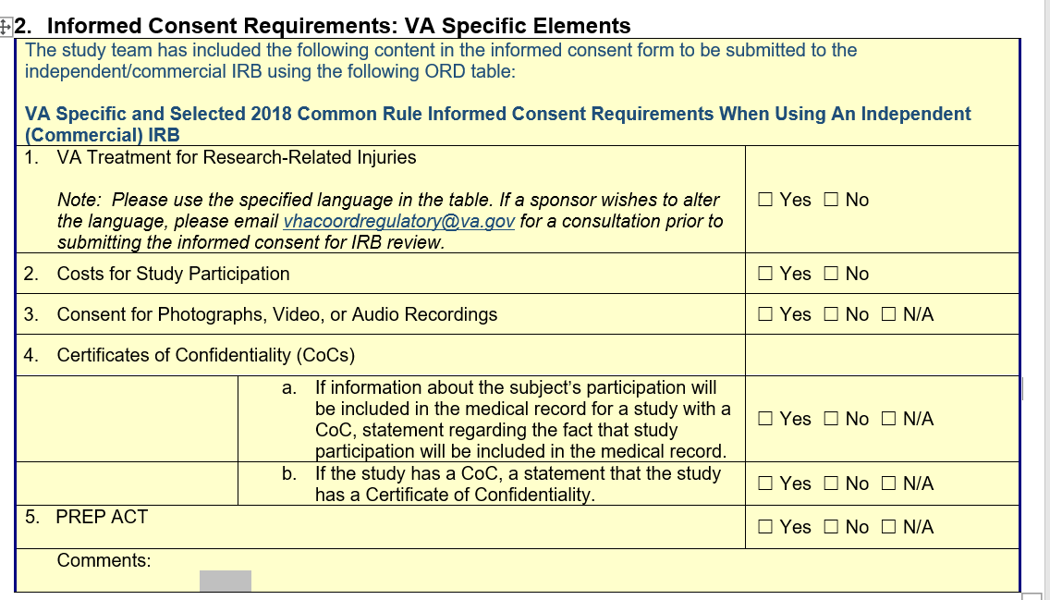
Excerpt of Checklist: VA Specific Elements

Slide 34
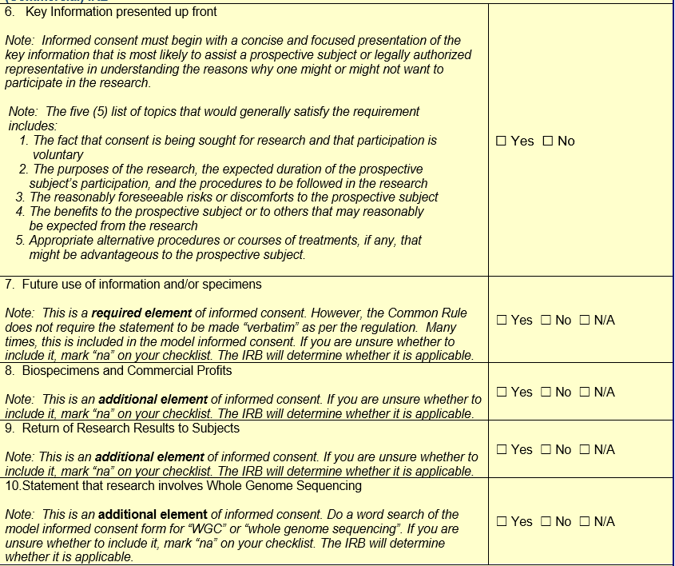
Excerpt of Checklist: Select 2018 Common Rule Informed Consent Elements

Slide 35
Revision in Endorsement Letter
Endorsement Letter submitted with submissions to ORD-approved Commercial IRBs revised to include:
  A statement that the VA Investigator has included applicable VA required language and Common Rule requirements in the informed consent document (ICD) with the VA required HIPAA authorization for research language if combined with the ICD.
Template is available on ORD’s website at IRB Relationships in the VA: Single IRB Exceptions, Independent (Commercial) IRBs, and changing IRB reliance by the VA Facility.

Slide 36
Role of ORD-Approved Commercial IRBs With Submission Informed Consent/HIPAA Authorization Language
ORD-approved Commercial IRBs are responsible for compliance checks during the intake to verify that the applicable VA specific elements and specific 2018 Common Rule Requirements are present.
The ORD-approved Commercial IRBs will turn back the submission if the submission is not complete (e.g., applicable VA specific elements are not present in the submitted ICD).
The applicability of some of the specific 2018 Common Rule requirements may require IRB determination and cannot be ascertained by the submitting VA study team.

Slide 37
ORPP&E Workshop: Tools and Checklist for Facilitating Submission of Informed Consent Documents to Commercial IRBs
ORPP&E will be sending out an announcement tomorrow (04-06-2023) with registration links for a workshop on April 19th from 2:30 p.m. to 3:30 p.m. EST providing a detailed review of the following tools and checklist:
  VA Specific and Selected 2018 Common Rule Informed Consent Requirements When Using an Independent (Commercial) IRB;
  VA HIPAA Authorization Requirements When Using an Independent (Commercial) IRB; and
  Checklist for VA Facilities Using Independent (Commercial) IRBs – ICDs and Combined ICD HIPAA Authorization.

Slide 38
New Optional VA IBC Member CITI Training Course
ORD is now providing an optional training course for VA Institutional Biosafety Committee (IBC) members in the CITI (Collaborative Institutional Training Initiative) Program.
The IBC member training course consists of 12 CITI modules covering topics on:
  research with recombinant or synthetic nucleic acid molecules,
  common hazards,
  hazard mitigation strategies, and
  biosafety program elements.
No charge to VA Facilities.
VA Facilities can make this optional IBC training course available to learners by submitting a request by email from the ACOS/R&D or AO/R&D to Dr. Alice Huang at alice.huang@va.gov.

Slide 39
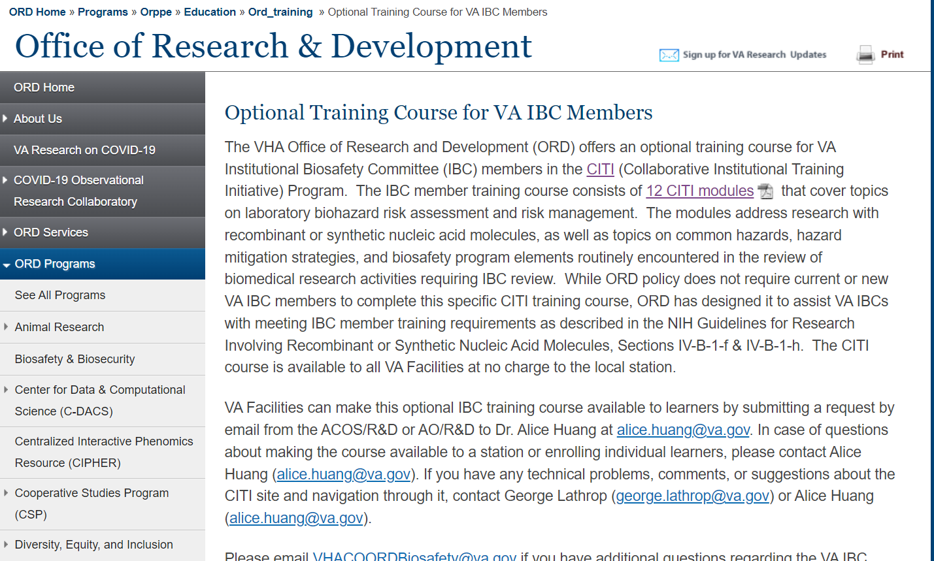
New Optional VA IBC Member CITI Training Course (cont.)
Additional Information Can be Accessed at Optional Training Course for VA IBC Members.
Please email VHACOORDBiosafety@va.gov if you have questions about this new training.

Slide 40
Summary
ORD continues to work on guidance and tools to support VA Facilities.
ORD continues to communicate with the Commercial IRBs to address issues and develop solutions and disseminate the information to the VA research community.

Slide 41
Availability of Recording
A recording of this session and the associated handouts will be available on ORPP&E’s Education and Training website approximately one-week post-webinar.
An archive of all ORPP&E webinars can be found here: https://www.research.va.gov/programs/orppe/education/webinars/archives.cfm.

Slide 42
Contact Information
ORD Regulatory Box: VHACOORDREGULATORY@VA.GOV
For questions about the VA IBC Member Optional CITI Training Modules: VHACOORDBiosafety@va.gov

Slide 43
References
CDC webpage: Information for Healthcare Providers on Obtaining and Using TPOXX (Tecovirimat) for Treatment of Monkeypox | Monkeypox | Poxvirus | CDC
ORPP&E webpage: IRB Relationships in the VA: Single IRB Exceptions, Independent (Commercial) IRBs, and changing IRB reliance by the VA Facility
  VA Specific and Selected 2018 Common Rule Informed Consent Requirements When Using an Independent-Commercial IRB (Revised 04/03/2023)
  VA HIPAA Authorization Requirements When Using an Independent (Commercial) IRB (Revised 04/03/2023)
  Checklist for VA Facilities Using Independent Commercial IRBs-ICDs and Combined ICD-HIPAA Authorizations (New 04/03/2023)
  VA Facility Endorsement Letter Template for Commercial IRB Submission

Slide 44
References (cont.)
ORPP&E Webpage: Optional Training Course for VA IBC Members
PROGRAM GUIDE: 1200.21 VHA Operations Activities That May Constitute Research (va.gov)
ORD’s Policies and Guidance Documents webpage at https://www.research.va.gov/resources/policies/
VAEDA Tool: https://vhacdwdwhvda01.vha.med.va.gov/vaeda/home#/
VHA Directive 1200.05(2): Research and Development Committee (January 7, 2019) at VHA Publications

