Slide 1
Checklist and Tools for Submission of Informed Consent Documents to
ORD-Approved Commercial IRBs
Office of Research Protections, Policy, & Education (ORPP&E) VHA Office of Research and Development (ORD)
April 19, 2023

Slide 2

Please use the Q&A feature to submit questions.
  Please do not use Chat to send in questions.
  Be sure to send questions to “All panelists”.
We would be ever so grateful if you would complete the post-webinar evaluation survey that pops up once you exit the webinar.
Experiencing sound issues – you can call in using the number included on the handouts and on your registration confirmation email that you received.
Webinar
Housekeeping
A recording of this session and the associated handouts will be available on ORPP&E’s Education and Training website approximately one-week post-webinar
An archive of all ORPP&E webinars can be found here:
https://www.research.va.gov/programs/orppe/education/webinars/archives.cfm
For questions, please use Q&A box and address to “All Panelists.”
All Webinars will be recorded and posted within one week.

Slide 3
Purpose
The purpose of this webinar is to review revised and new ORD tools and processes to facilitate informed consent submissions to ORD-approved commercial IRBs, including review of the following located on VA’s webpage for use of Commercial IRBs: https://www.research.va.gov/programs/orppe/irb_relationships.cfm:
  Specific and Selected 2018 Common Rule Informed Consent Requirements When Using an Independent-Commercial IRB
  Checklist for VA Facilities Using Independent Commercial IRBs: Informed Consent Documents (ICDs) and Combined ICD-HIPAA Authorizations
  VA HIPAA Authorization Requirements When Using an Independent (Commercial) IRB
  VA Facility Endorsement Letter Template for Commercial IRB Submission

Slide 4




Why is ORD Revising its Tools and Deploying a New Checklist for VA Facilities to Use for Commercial IRB Submissions?

Slide 5
Inclusion of VA-Specific Elements and Select 2018 Common Rule Requirements into VA Informed Consent Documents
It has always been an expectation/requirement as part of commercial IRB submission for VA Facilities to add VA-specific informed consent elements/requirements into the model ICDs prior to submission to the ORD-approved commercial IRB of Record for the study.
Issues are currently occurring with some VA ICDs being submitted and/or approved by the applicable commercial IRB for the study without the required VA specific elements.

Slide 6
ORD-Approved Commercial IRB ICD Model: Inclusion of Applicable VA Specific Elements into VA Participating Sites’ ICDs
VA Participating Site Receives
Model Informed Consent Document (ICD)
VA Participating Site Inserts Applicable VA Specific Elements into VA ICD and Submits to Commercial IRB
Commercial IRB reviews and returns to VA site for resubmission of ICD if applicable VA Specific Elements not Present
Commercial IRB reviews
VA Participating Site ICD
Commercial IRB approved ICD sent to VA Participating Site with inclusion of applicable VA Specific Elements

Slide 7
Inclusion of 2018 Common Rule Requirements into VA Informed Consent Documents
  All VA research requiring IRB-approved ICDs are required to include the applicable 2018 Common Rule informed consent elements,
    Studies sponsored by federal agencies, such as the National Institute of Health (NIH), routinely include the 2018 Common Rule Requirements in model informed consent forms.
    However, the majority of VA studies overseen by ORD-approved Commercial IRBs are sponsored by industry, which does not include the 2018 Common Rule requirements into their ICDs.
  Some VA ICDs for industry-sponsored studies are being approved by the IRBs without the required 2018 Common Rule ICD elements.
  It has not been a prior expectation/requirement as part of commercial IRB submissions for VA Facilities to include applicable 2018 Common Rule ICD elements for industry-sponsored studies.

Slide 8
Revised Commercial IRB ICD Submission Model: Inclusion of Applicable VA Specific Elements and 2018 Common Rule Requirements
VA Participating Site Receives
Model Informed Consent Document (ICD)
VA Participating Site Inserts Applicable VA Specific Elements into VA ICD and Submits to Commercial IRB
Commercial IRB reviews and returns to VA Participating site for resubmission of ICD if applicable VA Elements not Present
Commercial IRB reviews
VA Participating Site ICD
Commercial IRB approved ICD sent to VA Participating Site with inclusion of applicable Elements
NEW!
If Industry-Funded, VA Participating Site adds Applicable 2018 Common Rule Elements if not Present

Slide 9
Role of ORD-Approved Commercial IRBs – IRB Review Responsibilities
ORD-approved Commercial IRBs are responsible for compliance checks during the intake to verify that the applicable VA specific elements and specific 2018 Common Rule Requirements are present.
The ORD-approved Commercial IRBs will turn back the submission if the submission is not complete.
The applicability of some of the specific 2018 Common Rule requirements may require IRB determination and cannot be ascertained by the submitting VA study team.
Bottom line: The IRB of Record for any VA study is responsible for ensuring that the applicable IRB requirements are met, including ICD approval.

Slide 10
Inclusion of VA and Select 2018 Common Rule Requirements into VA Informed Consent Documents
To facilitate review of VA studies sponsored by industry and facilitate inclusion of VA specific elements of informed consent into the ICDs during submission to commercial IRBs, revised tools and a new checklist have been published by ORD.
Revised procedures have also been incorporated when applicable by ORD’s approved Commercial IRBs.
Tools have been revised and a new checklist developed to assist VA Facilities and their study teams:
  VA Specific and Selected 2018 Common Rule Informed Consent Requirements When Using an Independent-Commercial IRB (Revised 04/03/2023)
  VA HIPAA Authorization Requirements When Using an Independent (Commercial) IRB (Revised 04/03/2023)
  Checklist for VA Facilities Using Independent Commercial IRBs-ICDs and Combined ICD-HIPAA Authorizations (New 04/03/2023)

Slide 11
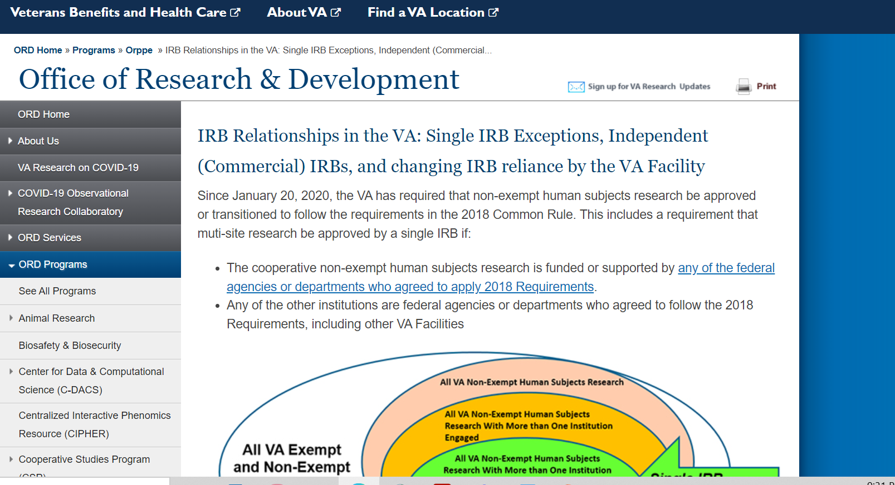
Revised Tool to Facilitate Inclusion of VA Specific and Select 2018 Common Rule Requirements into VA Informed Consent Documents
All Tools/Checklists Available on ORD’s webpage at IRB Relationships in the VA: Single IRB Exceptions, Independent (Commercial) IRBs, and changing IRB reliance by the VA Facility

Slide 12
Revised Tool: VA Specific and Selected 2018 Common Rule Informed Consent Requirements When Using an Independent-Commercial IRB
Tool revised to expand on five (5) elements listed as VA specific informed consent requirements which may or may not be applicable depending upon the study:
  VA Treatment for Research-Related Injuries
  Costs for Study Participation Paragraph
  Consent for Photographs, Video, or Audio Recordings
  Certificates of Confidentiality (CoCs)
  PREP ACT

Slide 13
Tool: VA Specific and Selected 2018 Common Rule Informed Consent Requirements When Using an Independent-Commercial IRB (cont.)
Revised Tool includes a section on selected 2018 Common Rule Requirements (not in FDA regulations) to be evaluated for inclusion when submitting an industry-sponsored study for initial review to an ORD-approved Commercial IRB:
  Key Information presented up front
  Future use of specimens and/or biospecimens
  Biospecimens and future profit
  Return of research results to subjects
  Statement that research involves Whole Genome Sequencing

Slide 14
New Checklist For VA Facilities Using Independent (Commercial) IRBs
Designed to be used in combination with the revised Tools.
New 3-page checklist developed for use by study teams submitting studies to ORD-approved Commercial IRBs, but is useful for any study team.
Checklist titled: Checklist for VA Facilities Using Independent (Commercial) IRBs: Inclusion of Required Language into Informed Consent Documents (ICDs) and Combined ICD/HIPAA Authorization Documents
It is a tool/worksheet. It is not a regulatory document.
Not required to be submitted with the submissions to the Commercial IRBs.

Slide 15
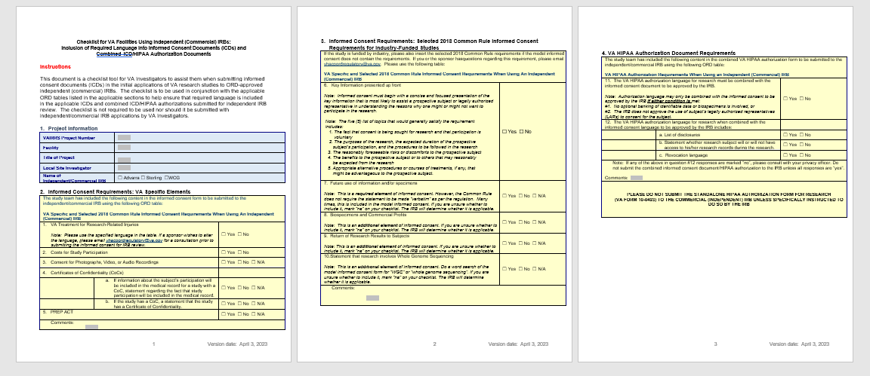
Checklist For VA Facilities Using Independent (Commercial) IRBs
IRB Relationships in the VA: Single IRB Exceptions, Independent (Commercial) IRBs, and changing IRB reliance by the VA Facility

Slide 16
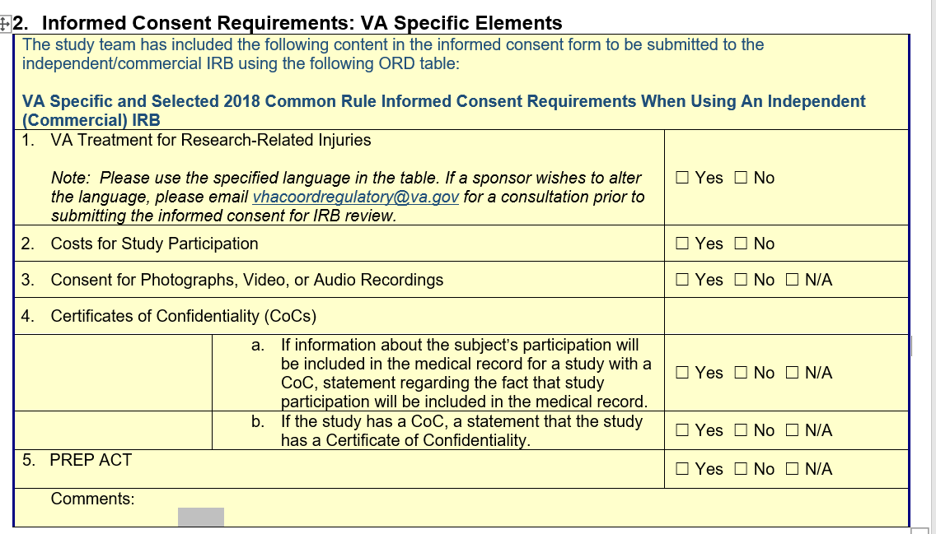
Excerpt of Checklist: VA Specific Elements of Informed Consent

Slide 17
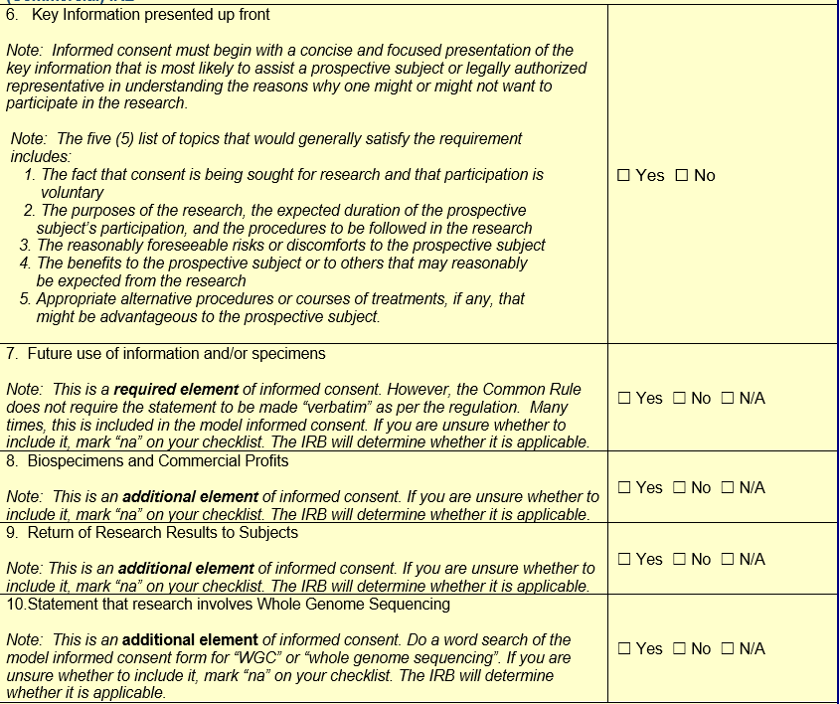
Checklist: Select 2018 Common Rule Informed Consent Elements

Slide 18
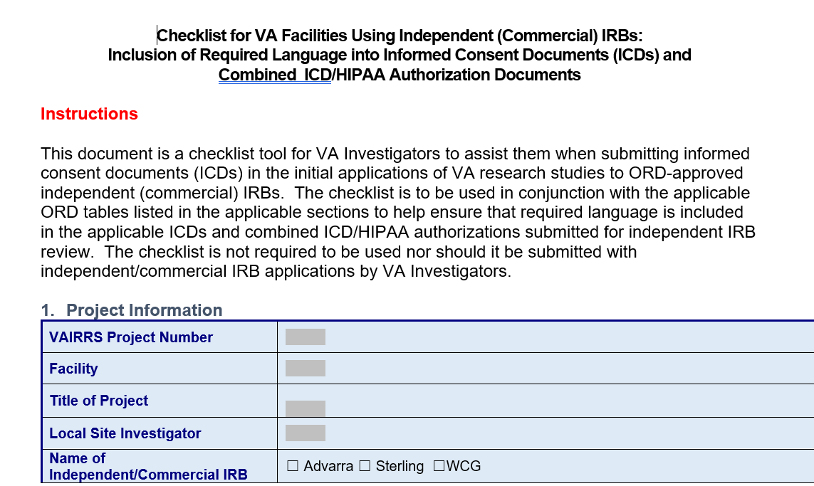
Using the New Checklist for Commercial IRBs:
Section 1: Project Information
Remember that this is not required to be submitted with the study team documents.

Slide 19
Section 2: VA Specific Elements of ICD
All VA ICD Specific Elements will not be applicable to every study.
However, two VA ICD Specific Elements of Consent will always be applicable:
  VA Treatment for Research-Related Injuries and
  Costs for Study Participation
The three remaining VA Specific Elements will be dependent upon the study:
  Consent for Photographs, Video, or Audio Recordings,
  Certificates of Confidentiality (CoCs), and
  PREP ACT.

Slide 20
New Checklist: Section 2.0: VA Specific Elements

Slide 21
New Checklist: Section 2.0: VA Specific Elements
Always Required
Always Required

Slide 22
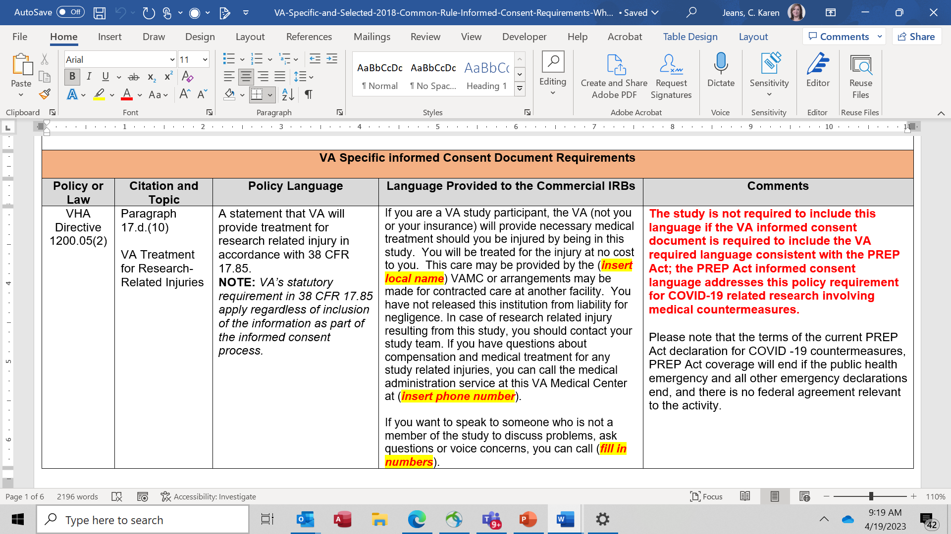
VA Treatment for Research Related Injuries

Slide 23
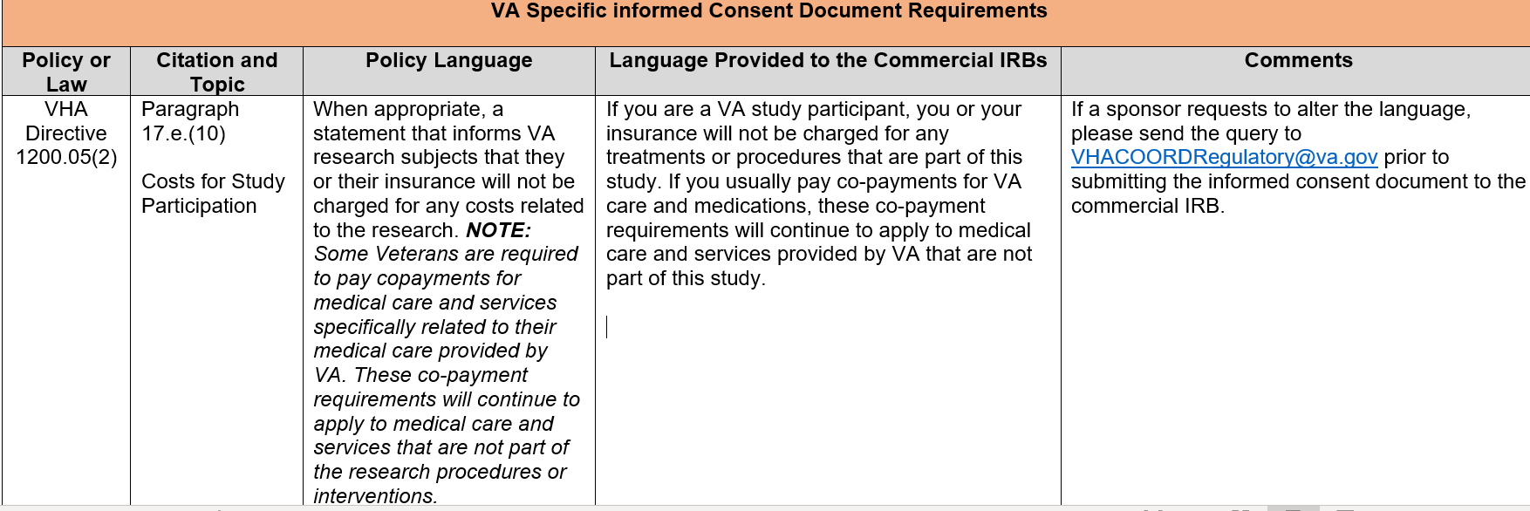
Costs for Study Participation
It is not uncommon for sponsors to request alterations in the language – please email vhacoordregulatory@v.gov if the sponsor wishes to alter the language.

Slide 24
New Checklist: Section 2.0: VA Specific Elements

Slide 25
Consent for Photographs, Audio, or Video Recordings
VA requires informed consent language to be included when photographs, video, and/or audio recordings are taken exclusively for research purpose on the following areas:
  A description of any photographs, video, and/or audio recordings to be taken or obtained for research purposes;
  How the photographs, video, and/or audio recordings will be used for the research; and
  Whether the photographs, video, and/or audio recordings will be disclosed outside VA.

Slide 26
Consent for Photographs, Audio, or Video Recordings
It is not common for a clinical trial to utilize photographs, audio, or video recordings only for research purposes, but it can occur as part of a protocol requirement.
If your VA participating site is seeking use of photographs, video, and/or audio recordings for research purposes only when it is not required by protocol, your site must submit a site-specific amendment for the reviewing IRB to evaluate.
  The IRB will determine whether the site-specific amendment can be approved.

Slide 27
New Checklist: Section 2.0: VA Specific Elements

Slide 28
Certificates of Confidentiality (CoC)
Any NIH-sponsored study submitted to an ORD-commercial IRB will have a CoC.
It will not be common for an industry-sponsored clinical trial to have a CoC, but it can happen.
If your site is participating in an industry-sponsored clinical trial and the information is not conveyed to you that the study has a CoC (and it is not stated in the ICF supplied to your site), do not include the VA ICD Specific Element’s requirements for CoC. It is the responsible of the reviewing IRB.
An individual VA participating site cannot apply for a CoC in an industry-sponsored study.

Slide 29
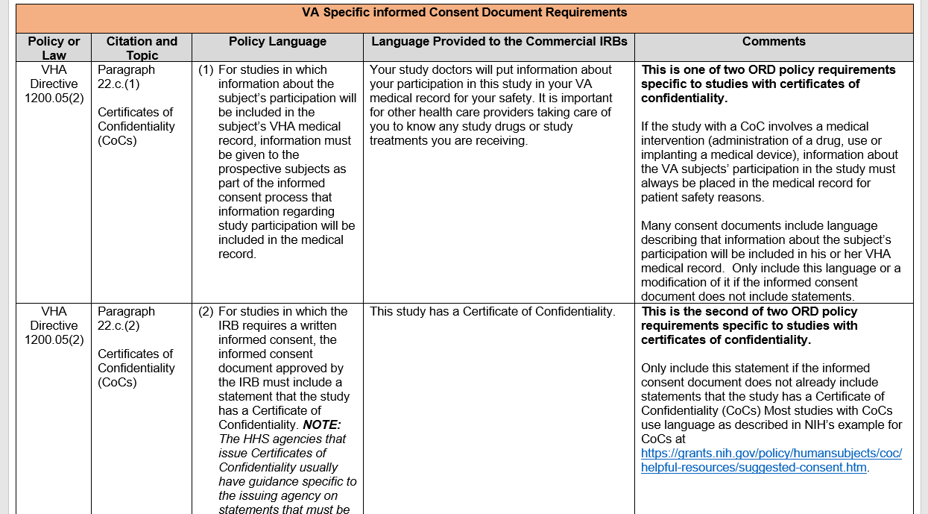
Certificates of Confidentiality (CoC)

Slide 30
New Checklist: Section 2.0: VA Specific Elements

Slide 31
VA ICD Specific Element: PREP Act
The PREP Act language for informed consents is only to be used when the VA study involves a medical countermeasure (e.g., drug, device, or vaccine) designed to treat, diagnose, cure, or prevent COVID-19.
The terms of the current PREP Act declaration for COVID -19 countermeasures, PREP Act coverage will end if the public health emergency and all other emergency declarations end, and there is no federal agreement relevant to the activity.
Some sponsors of industry-sponsored clinical trials for VA participating sites are including both PREP Act language and the VA required language for costs of research-related injury in their consents. This is acceptable if approved by the IRB.

Slide 32
Tool: VA Specific and Selected 2018 Common Rule Informed Consent Requirements When Using an Independent-Commercial IRB
Tool includes a new section on selected 2018 Common Rule Requirements (not in FDA regulations) to be evaluated for inclusion when submitting an industry-sponsored study for initial review to an ORD-approved Commercial IRB:
  Key Information presented up front
  Future use of specimens and/or biospecimens
  Biospecimens and future profit
  Return of research results to subjects
  Statement that research involves Whole Genome Sequencing
The majority of these elements must be evaluated by the IRB for applicability with the exception of key information presented up front.

Slide 33
Checklist: Section 3.0: Informed Consent Requirements: Selected 2018 Common Rule Informed Consent Requirements for Industry-Funded Studies for Select 2018 Common Rule Informed Consent Elements

Slide 34
Section 3.0: Key Information Presented Up Front
Informed consent must begin with a concise and focused presentation of the key information that is most likely to assist a prospective subject or legally authorized representative in understanding the reasons why one might or might not want to participate in the research. This part of the informed consent must be organized and presented in a way that facilitates comprehension.
Neither the 2018 Common Rule regulations nor ORD policy define what specifically must be included as key information; it an IRB evaluation/determination.

Slide 35
General Guidance on What Constitutes “Key Information Presented Up Front”
The five (5) list of topics that would generally satisfy the requirement includes:
1. The fact that consent is being sought for research and that participation is voluntary
2. The purposes of the research, the expected duration of the prospective subject’s participation, and the procedures to be followed in the research
3. The reasonably foreseeable risks or discomforts to the prospective subject
4. The benefits to the prospective subject or to others that may reasonably be expected from the research
5. Appropriate alternative procedures or courses of treatments, if any, that might be advantageous to the prospective subject.
It is the IRB that makes the ultimate determination (and approval) of the content in the IRB-approved informed consent document for what constitutes “key information presented up front”.

Slide 36
Checklist: Section 3.0: Informed Consent Requirements: Selected 2018 Common Rule Informed Consent Requirements for Industry-Funded Studies for Select 2018 Common Rule Informed Consent Elements

Slide 37
Section 3.0: Future Use of Information and/or Specimens
One of the following statements about any research that involves the collection of identifiable private information or identifiable biospecimens:
(i) A statement that identifiers might be removed from the identifiable private information or identifiable biospecimens and that, after such removal, the information or biospecimens could be used for future research studies or distributed to another investigator for future research studies without additional informed consent from the subject or the legally authorized representative, if this might be a possibility; or
(ii) A statement that the subject’s information or biospecimens collected as part of the research, even if identifiers are removed, will not be used or distributed for future research studies.

Slide 38
Section 3.0: Future Use of Information and/or Specimens
This is a required element of informed consent under the 2018 Common Rule.
The Common Rule does not require the statement to be made “verbatim” as per the regulation. Many times, this is included in the model informed consent.
If you are unsure whether to include it, mark “na” on your checklist.
The IRB will determine whether it is applicable

Slide 39
Checklist: Section 3.0: Informed Consent Requirements: Selected 2018 Common Rule Informed Consent Requirements for Industry-Funded Studies for Select 2018 Common Rule Informed Consent Elements

Slide 40
Section 3.0: Biospecimens and Commercial Profits
A statement that the subject’s biospecimens (even if identifiers are removed) may be used for commercial profit and whether the subject will or will not share in this commercial profit.
This is an additional element of informed consent under the 2018 Common Rule requirements.
If you are unsure whether to include it, mark “na” on your checklist.
The IRB will determine whether it is applicable

Slide 41
Checklist: Section 3.0: Informed Consent Requirements: Selected 2018 Common Rule Informed Consent Requirements for Industry-Funded Studies for Select 2018 Common Rule Informed Consent Elements

Slide 42
Section 3.0 Return of Research Results to Subjects
A statement regarding whether clinically relevant research results, including individual research results, will be disclosed to subjects, and if so, under what conditions.
This is an additional element of informed consent under the 2018 Common Rule requirements.
If you are unsure whether to include it, mark “na” on your checklist.
The IRB will determine whether it is applicable

Slide 43
Checklist: Section 3.0: Informed Consent Requirements: Selected 2018 Common Rule Informed Consent Requirements for Industry-Funded Studies for Select 2018 Common Rule Informed Consent Elements

Slide 44
Section 3.0 Statement that Research Involves Whole Genome Sequencing
For research involving biospecimens, whether the research will (if known) or might include whole genome sequencing (i.e., sequencing of a human germline or somatic specimen with the intent to generate the genome or exome sequence of that specimen).
This is an additional element of informed consent under the 2018 Common Rule requirements.
Do a word search of the model informed consent form for “WGC” or “whole genome sequencing”. If you are unsure whether to include it, mark “na” on your checklist.
The IRB will determine whether it is applicable.

Slide 45
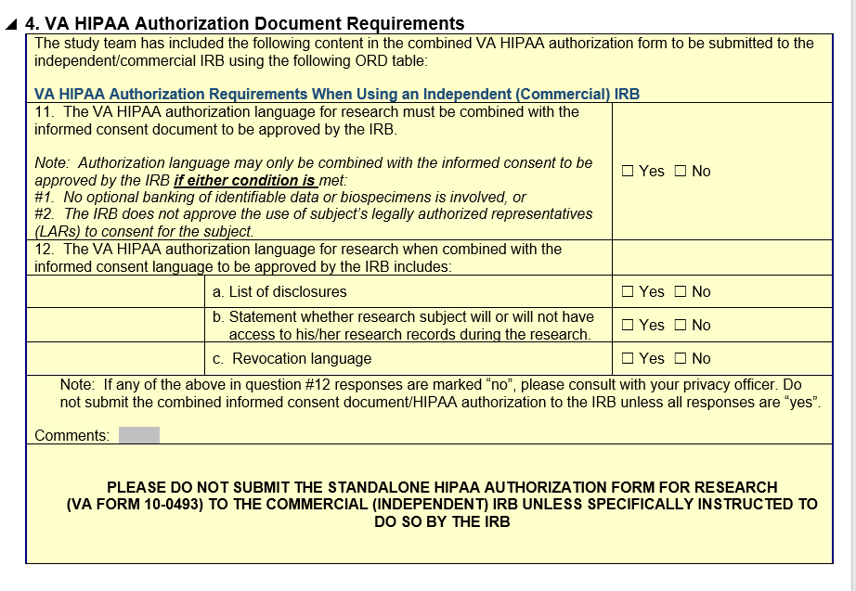
Section 4.0: VA HIPAA Document Requirements

Slide 46
Tool: VA HIPAA Authorization Requirements When Using an Independent (Commercial) IRB
Revised and split into a separate tool.
Provides clarification on topics involving HIPAA authorization documents.
If the study involves a standalone written HIPAA authorization (VA Form 10-0493) do not submit the VA Form 10-0493 to the Commercial IRB.
  IRBs are not responsible for reviewing or approving a standalone HIPAA authorization document for research.
  IRBs are responsible for reviewing (and approving) combined research informed consent/HIPAA authorization documents.

Slide 47
Revision in Endorsement Letter
Endorsement Letter submitted with submissions to ORD-approved Commercial IRBs revised to include:
  A statement that the VA Investigator has included applicable VA required language and Common Rule requirements in the informed consent document (ICD) with the VA required HIPAA authorization for research language if combined with the ICD.
Will be required to be used by VA Facilities for submissions to ORD approved commercial IRBs by May 31, 2023.
Template is available on ORD’s website at IRB Relationships in the VA: Single IRB Exceptions, Independent (Commercial) IRBs, and changing IRB reliance by the VA Facility.

Slide 48
Summary
A new checklist has been created to help facilitate ICD submissions to ORD-approved commercial IRBs for inclusion of VA specific elements and select 2018 Common Rule ICD elements; these checklists are not required to be submitted to the commercial IRBs.
VA participating sites are requested to include the 2018 Common Rule requirements in the ICDs for industry-sponsored studies if the elements are not already present. The one 2018 Common Rule element that VA sites need to target is inclusion of key information present up front.
The IRB is responsible for the review and approval of ICDs, including ensuring that applicable VA and federal regulatory requirements are met.

Slide 49
Availability of Recording
A recording of this session and the associated handouts will be available on ORPP&E’s Education and Training website approximately one-week post-webinar.
An archive of all ORPP&E webinars can be found here: https://www.research.va.gov/programs/orppe/education/webinars/archives.cfm.

Slide 50
How to Search for Relevant Information and
Submit Questions to ORD?
Search for information in FINDpro (within VA network)
If you cannot find the information you want, you can submit a question to ORD through FINDpro
If you are external to VA and have a policy related question, please fill out this form for a response from the correct subject matter expert.

Slide 51
References
ORD’s Policies and Guidance Documents webpage at https://www.research.va.gov/resources/policies/
VHA Directive 1200.05(2): Research and Development Committee (January 7, 2019) at VHA Publications
ORPP&E webpage: IRB Relationships in the VA: Single IRB Exceptions, Independent (Commercial) IRBs, and changing IRB reliance by the VA Facility
  VA Specific and Selected 2018 Common Rule Informed Consent Requirements When Using an Independent-Commercial IRB (Revised 04/03/2023)
  VA HIPAA Authorization Requirements When Using an Independent (Commercial) IRB (Revised 04/03/2023)
  Checklist for VA Facilities Using Independent Commercial IRBs-ICDs and Combined ICD-HIPAA Authorizations (New 04/03/2023)
  VA Facility Endorsement Letter Template for Commercial IRB Submission

