Slide 1
VA Innovation and Research
Review System (VAIRRS)
Monthly Webinar
May 30, 2023

Slide 2

Webinar Housekeeping
Webinar
Housekeeping
Recording - This session is recorded, and the associated handouts will be available on ORPP&E’s Education and Training website within a week after the webinar.
Close Captioning - Now available in the new Webex platform. Click the “CC” button at the bottom left of the Webex screen.
Experiencing Sound Issues? - Call in using the number in your Webex chat box or in your registration confirmation email.
Q&A - Please use the Q&A feature to submit questions.
  Be sure to send questions to “All Panelists”
  Questions will be addressed at the end of the webinar
Webinar Archive - Most ORPP&E webinars can be found here: https://www.research.va.gov/programs/orppe/education/webinars/archives.cfm
Post-Webinar Evaluation Survey - We are grateful to everyone who completes the post-webinar evaluation survey, which will automatically pop up once the webinar is exited.

Slide 3
Contents
01 Welcome
02 Announcements
03 Data Integrity Series: Data Availability
Presented by: Angela Foster, ORPP&E Program Manager; Alex Devine, VAIRRS Dashboard Manager and Nana Bamfo, VAIRRS Dashboard Senior Consultant

Slide 4
Important Announcements
IRB Information Sheet Wizard Update
VA Central IRB
VAIRRS
Strategic Advisory Council
Have you checked your sites' IRB Information Sheet wizard completion rate recently? There are currently more than 20 sites with a completion rate of 50% or less. As a reminder, all human research projects must complete the IRB Information Sheet wizard. Projects under the oversight of an affiliate or external IRB are also expected to complete this wizard. Please continue to work with your investigator community to ensure awareness of the IRB Information Sheet requirement.
The VA Central IRB (CIRB) is currently updating all submission forms. The new submission forms will provide improved instructions, better usability and have also eliminated redundant questions in order to provide a more efficient experience for the research team. In addition, the VA CIRB is making minor changes to some of its processes as well as the respective forms. The new VA CIRB submission forms and process changes will be released in two scheduled phases in June. Please keep an eye out for future updates and webinars!
The VAIRRS Strategic Advisory Council (VSAC) recently met to review current personnel tracking processes. The VSAC determined personnel tracking should occur separately from project coversheet tracking. This will provide a more efficient means of updating study personnel and associated training requirements. The VAIRRS team is working on a draft personnel tracking form. Further updates will be provided as development progresses.
Subscribe to the VAIRRS Newsletter to keep up with important announcements and program updates: https://public.govdelivery.com/accounts/USVHA/subscriber/new?topic_id=USVHA_1952

Slide 5
Data Integrity Series:
Data Availability
Angela Foster, ORPP&E Program Manager
Alex Devine, VAIRRS Dashboard Manager
Nana Bamfo, VAIRRS Dashboard Senior Consultant
Notes:
Good afternoon everyone, and thank you for joining the VAIRRS Monthly webinar series. Today, we will discuss the proper utilization of the Research Administration workspace. My name is Angela Foster, VAIRRS Program Manager, and I will be leading today’s discussion.

Slide 6
Objectives
This webinar will cover the following topics:
  VAIRRS Data Platforms
  IRBNet Insight Reporting
  VAIRRS Dashboard Overview
  Demonstration
Notes:
The objectives for today’s webinar are to review the purpose and features of the research administrative workspace, and the proper utilization of the workspace. We will have a demonstration at the end of the presentation, followed by Q&A.

Slide 7
VAIRRS Data Platforms
IRBNet Insight Reports
VAIRRS Dashboards

Slide 8
IRBNet Insight Reports Overview
Insight Reports are formatted a .csv files
Viewable in Microsoft Excel and other data manipulation tools (MS Access)
Requested by local IRBNet Power User
Available at any cadence (nightly, weekly, monthly)

Slide 9

Review Process
All packages and key dates
Pending Review
All packages pending review
Reviewer Activity
Detailed activity report for each reviewer
Meeting Attendance
Detailed listing of meeting attendees
Effective date
Share Dates
Review completion dates
Agenda date
Submission date
Share date
Agenda date
Share date
Reviewer comment date
Reviewer completion date
Agenda date
Attendee list

Slide 10
VAIRRS Dashboards Overview
Requirements provided by field-based workgroups
Available to all sites using IRBNet to manage submissions and committee activity
Dashboards are based on IRBNet Insight Report data
Data completeness is dependent on researchers completing the Project Cover Sheet and IRB Information Sheet wizards
Future updates include the addition of training records and Central IRB studies

Slide 11

VAIRRS Dashboard Stakeholders
1
2
3
4
5
CRADO Active
Projects
Project Cover Sheet Completion Campaign
ORO Safety Protocols Report
Research Support Division (RSD) Dashboard
Field Dashboards
6
7
8
9
10
10
Privacy Compliance Assurance (PCA)
Dashboard
National Researcher Dashboard
Electronic Health Record Modernization (EHRM)
VHA COVID-19 Research
Chief Veterinary Medicine Office (CVMO)*
11
12
13
14
ORD Eligibility*
ORD Active Managed Portfolios*
Sec VA ‘Travel Packs’
Technology Transfer Program*

Slide 12
VAIRRS Dashboard Pages and Metrics
Active Project Detail Page
Active Project Overview Page
  PI Name, Title, Risk Level
  Funding Code
  Initial Approval Date/Expiration Date
  Keyword searches
  Local Reference Number
  TAGs/Filter by TAGS
  Total number of active projects
  Total number of projects (all statuses)
  Total number of active project by risk level
  Total number of active projects by submission type
  Number of investigators per site
  Total number of active projects by committee
  Projects managed by nonprofit
  Total number of active projects (funding/admin code, merit award)
Human Subjects Research Page
Additional Pages
  Drug or Device
  Number of planned subjects
  Vulnerable populations
  Informed Consent
  HIPAA Authorization/Waiver
  Repository Information
  List the Protocol Compliances (Waivers, Consents, HIPAAs, etc.)
  Human or Animal contact
  Project Cover Sheet Completion Page
  Project Personnel
  Animal Research
  Safety Research
  Closed Project Detail
  Data Dictionary
  Single Project Detail

Slide 13
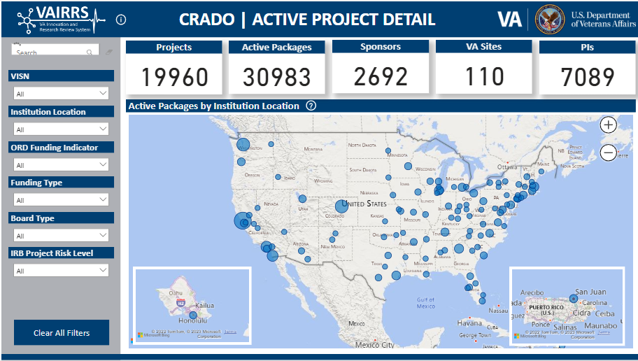
CRADO Dashboard

Slide 14
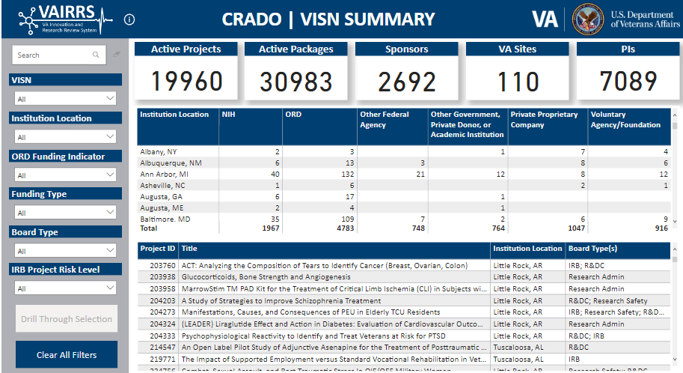
CRADO Dashboard

Slide 15
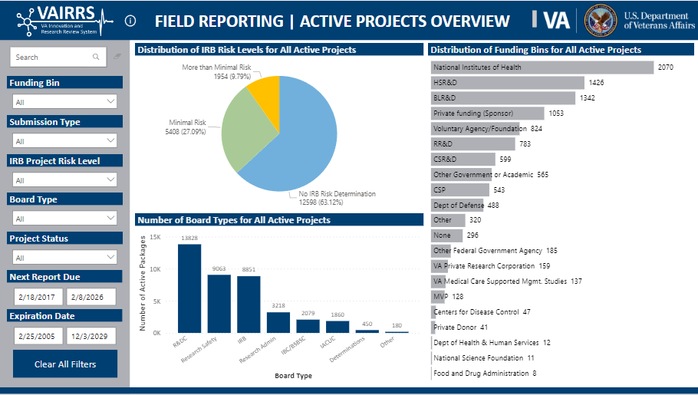
Field Dashboard

Slide 16
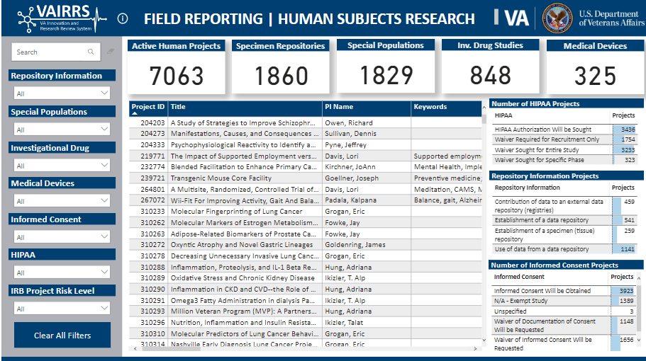
Field Dashboard

Slide 17
References
VAIRRS Dashboard Requests: https://dvagov.sharepoint.com/sites/VHAORPPE/VAIRRS/SitePages/VAIRRS-Field-Staff-Dashboard-Request.aspx
VAIRRS Website: https://www.research.va.gov/programs/orppe/vairrs/default.cfm
VAIRRS SharePoint: https://dvagov.sharepoint.com/sites/VHAORPPE/VAIRRS
VAIRRS Webinar Archive: https://www.research.va.gov/programs/orppe/education/webinars/archives.cfm
VAIRRS Support Team: VAIRRS@va.gov
VAIRRS Newsletter Subscription: https://public.govdelivery.com/accounts/USVHA/subscriber/new?topic_id=USVHA_1952
ORPP&E SharePoint Site: https://dvagov.sharepoint.com/sites/VHAORPPE/Field/SitePages/Welcome!.aspx

Slide 18
Thank you for joining!
If you have any questions, please visit our revised training platform, VAIRRS University, and/or contact the VAIRRS Support Team at VAIRRS@va.gov

