Slide 1

Introduction to ORD Financial Management Resources
July 19, 2023
Jason Berlow, Management Analyst, Finance
Erin Olson, Budget Analyst, ORD Finance
Kari Points, Director Research Operations, Iowa City

Slide 2

Housekeeping Notes
Webinar
Housekeeping
Recording - This session is being recorded and the associated handouts will be available on ORPP&E’s Education and Training website within one-week post-webinar.
Close Captioning - Now available in the new Webex platform. Click the “CC” button at the bottom left of the Webex screen.
Experiencing Sound Issues? – Call in using the number in your Webex chat box or in your registration confirmation email.
Q&A - Please use the Q&A feature to submit questions.
  Be sure to send questions to “All panelists”.
  Questions will be addressed at the end of the webinar.
Webinar Archive - Most ORPP&E webinars can be found here: https://www.research.va.gov/programs/orppe/education/webinars/archives.cfm
Post-Webinar Evaluation Survey - We are grateful to all that complete the post-webinar evaluation survey. It will automatically pop up once the webinar is exited.
For questions, please use Q&A box and address to “All Panelists.”
All Webinars will be recorded and posted within one week.

Slide 3
Objectives for Today’s Training
Training Section: | Presenter | By the end of this section, you will:
Introduction: | Jason Berlow | Understand where to begin and where to find resources Understand your critical role in research operations.
Section 1: Day one: where to begin? | Erin Olson | Understand the budget tasks that must be accomplished. Understand the tools needed and where to find/access those tools.
Section 2: Overview of Trainings linked to Competencies Skills for Budget Analyst/Technicians | Kari Points | Understand where to find all the onboarding materials and video recordings (from past trainings). Understand where to find all the material on the ORD Finance Resource Center.
Section 3: External Training | Jason Berlow | Understand key external trainings available.
Section 4: Survey on managing accounts | Erin Olson/Jason Berlow | Survey to see what systems you use to track allocations, expenditures and balances by project
Q&A
Notes:
John

Slide 4
Introduction
The objective of today’s training is to provide an overview of helpful on-boarding resources for those new to the job or those that want a refresher for budget related duties in the Research Office.
The ORD Field Administrative Officers and Financial Management Resource Page is a great resource for you to start learning about your new position!
Also, we send out key financial announcements to the email distro group: VHACOORDFinancePOCs@va.gov.
  If you need to be added send Jason Berlow or Maria Negrete a note.

Slide 5

The ORD Field Administrative Officers and Financial Management Resource Page
This is the amount of views on the SharePoint page, the combined distro between the AO and Finance POCs List is over 500 email address.
What % of these views are Erin Olson, Jason Berlow, and Kari Points.
  Probably over 50%!

Slide 6

"So, what would you say you do here?"
Position | Budget Roles (Budget Analyst/Budget Tech)
Key Responsibilities | Supports the Research mission by applying budget analysis concepts Methods and procedures connected with the budget formulation Execution of VA's particular programs, systems, procedures, functions, and structure of the supported organizational component.
Key Skills Required | Budget Concepts Budget Execution Analysis, knowledge of Financial Management Systems Fundamentals and Operations of Budget Effective Time Management skills and ability to prioritize.

Slide 7

Section 1: Congrats! You got the job! Now what?
Can you go ahead and manage the Research budget? I think you can find some dusty binders from the 90s in the bookshelf to figure everything out!

Slide 8
All in a Day's Work
Position | Budget Roles (Budget Analyst/Budget Tech)
Day to day translation of duties Keep in mind, roles will vary station to station but you must understand what your role is in the overall financial management process | POST-AWARD & RESEARCH OFFICE EXECUTION Distribute Transfer Disbursing Authority (TDA) appropriately to projects and fund control points Ensuring Principal investigators (PIs) VA paid staff are paid appropriately on the research salary Fund Control Point Cost/Expenditure transfers Entering 1358s (IPAs, patient reimbursements) Bills of Collection Drafting paperwork and executing contracts for research services (2237s) Purchase Card duties Invoice Payment Processing System (IPPS) Duties WinRMS downloads (if applicable) Balancing to the Status of Allowance Executing IAAs/managing G-Invoicing Reporting to fiscal on aged orders, communicating with vendors regarding invoicing, delivery, issues

Slide 9
Tasks and Tools
Task | Tool | Timing | Training Recording
Distribute funding Transfer Disbursing Authority (TDA) | RAFT Pink Sheets: https://raft.research.va.gov/RAFT/ AACS: Home (va.gov) WinRMS | When new projects are funded, throughout continuing resolution, beginning of fiscal year and monthly reimbursements. | Allocation Training Research Admin 101
VA Research Salary Tracking | Status of Allowance (SOA) VSSC SOA F20 Daily Activity Report F20D_Daily_rpt - Report Viewer (va.gov) PAID report WinRMS | Each Pay Period | Salary Training
Cost/Expenditure Transfers | Status of Allowance (SOA) SOA F20 Daily Activity Report F20D_Daily_rpt - Report Viewer (va.gov) - check for EWs | Each Pay period for salaries, regularly | Cost Transfer Training
Bills of Collection | IFCAP/VISTA AACS: Home (va.gov) F827 General Ledger Reports (Obtained from Fiscal) | Tempo outlined in agreement | Reimbursment Training

Slide 10
Tasks and Tools
Task | Tool | Timing | Training
Contracting paperwork & 2237s | RPO East Sharepoint Link Home - R&D Contracting Division - Customer Center (sharepoint.com) - use this link to use current documents FORCE - vaww.ecms.va.gov/FORCE/ IFCAP/VISTA | July 1 (4th Quarter) deadline | Contracting Training from RPO East
Purchase Card Duties | VISTA, US Bank | Daily, NLT 30 days post PO creation | VISN Provided
Review and certify invoices in IPPS | VA IPPS, Excel | As needed | VA Research Budget Management (IPPS)
WinRMS Downloads and Account Maintenance | WinRMS – ORD provided. Contact Kari Points if interested in establishing WinRMS for your site (recommend if over 10 funded VA projects) | Daily Downloads Account Statuses to communicate to PIs (recommend monthly) | WinRMS 1 TDAs WinRMS 2: Salary WinRMS 3: Downloads WinRMS: Accounts/Expense Transfers
Aged Order Reporting/Fiscal duties | F851 Payables and F850 Undelivered Orders – sent by Fiscal Open Documents Report in VSSC - OBLL_OpenDocuments - Report Viewer (va.gov) | Monthly | VA Research Budget Managemt (Aged Order)

Slide 11
Tasks and Tools
Task | Tool | Timing | Training Reordings
Balancing to the Status of Allowance | Status of Allowance (SOA) VSSC SOA Or SOA can be obtained from Fiscal. | Regularly (daily or weekly) | Using VSSC and Balancing to SOA Research Admin 101
Entering 1358s (IPAs, patient reimbursements) | IFCAP/VISTA, Excel | As needed | VA Research Budget Management (Aged Order)
G-Invoicing & IAAs | IAA Forms and Instructions | must be established BEFORE work begins | IAA Training
Intergovernmental Personnel Agreements (IPAs) | Intergovernment Personnel Act (opm.gov) | As needed by project. IPA can be for 2 years but can only obligate for one year at a time. | IPAs (and WOCs) Training

Slide 12
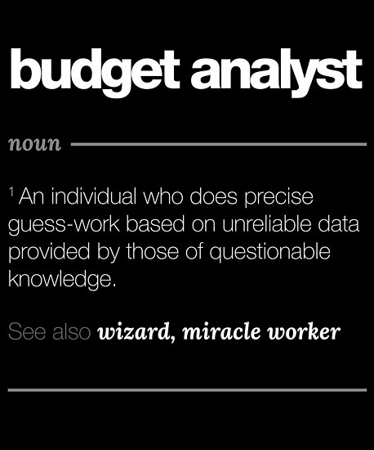
Section 2: Overview of ORD’s Financial Management Training Curriculum

Slide 13
Monthly Finance Training Series
We offer Monthly Financial Training webinars for the Research Field Financial Management Community on a number of Financial Management Topics to assist in your positions in Research.
Trainings are based on current issues facing field and known deficiencies in federal financial management.
The slides ahead are intended to serve as syllabus for your onboarding that contain links to the training materials and video recordings (from past trainings). All the material is on the ORD Finance Resource Center.
If there is a topic you would like, please let us know.

Slide 14

ORD Finance Resource Center
Link: ORD Field Administrative Officer and Financial Management Resources (sharepoint.com)
Bookmark me please!

Slide 15
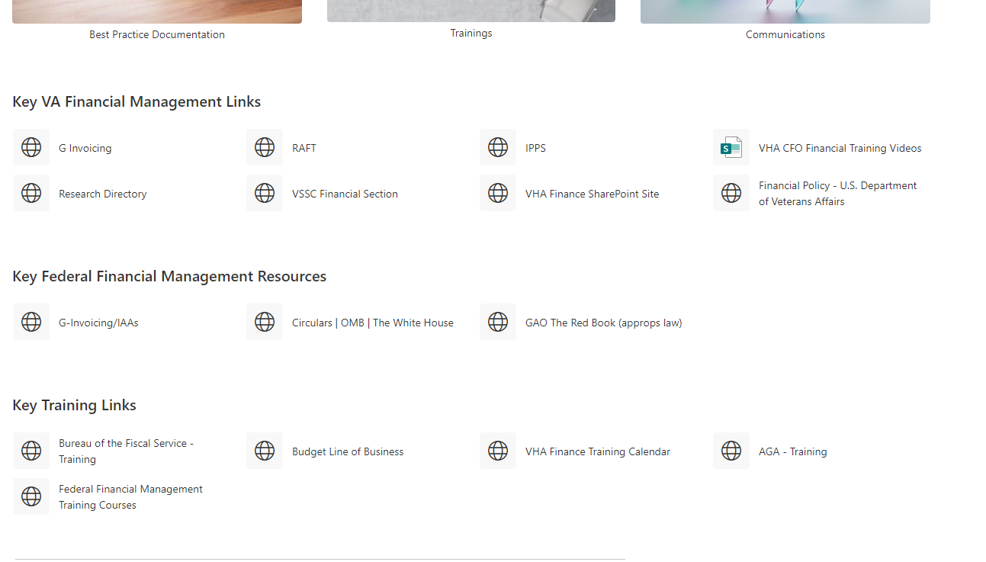
ORD Finance Resource Center (helpful links)
Link: ORD Field Administrative Officer and Financial Management Resources (sharepoint.com)
Bookmark me please!

Slide 16
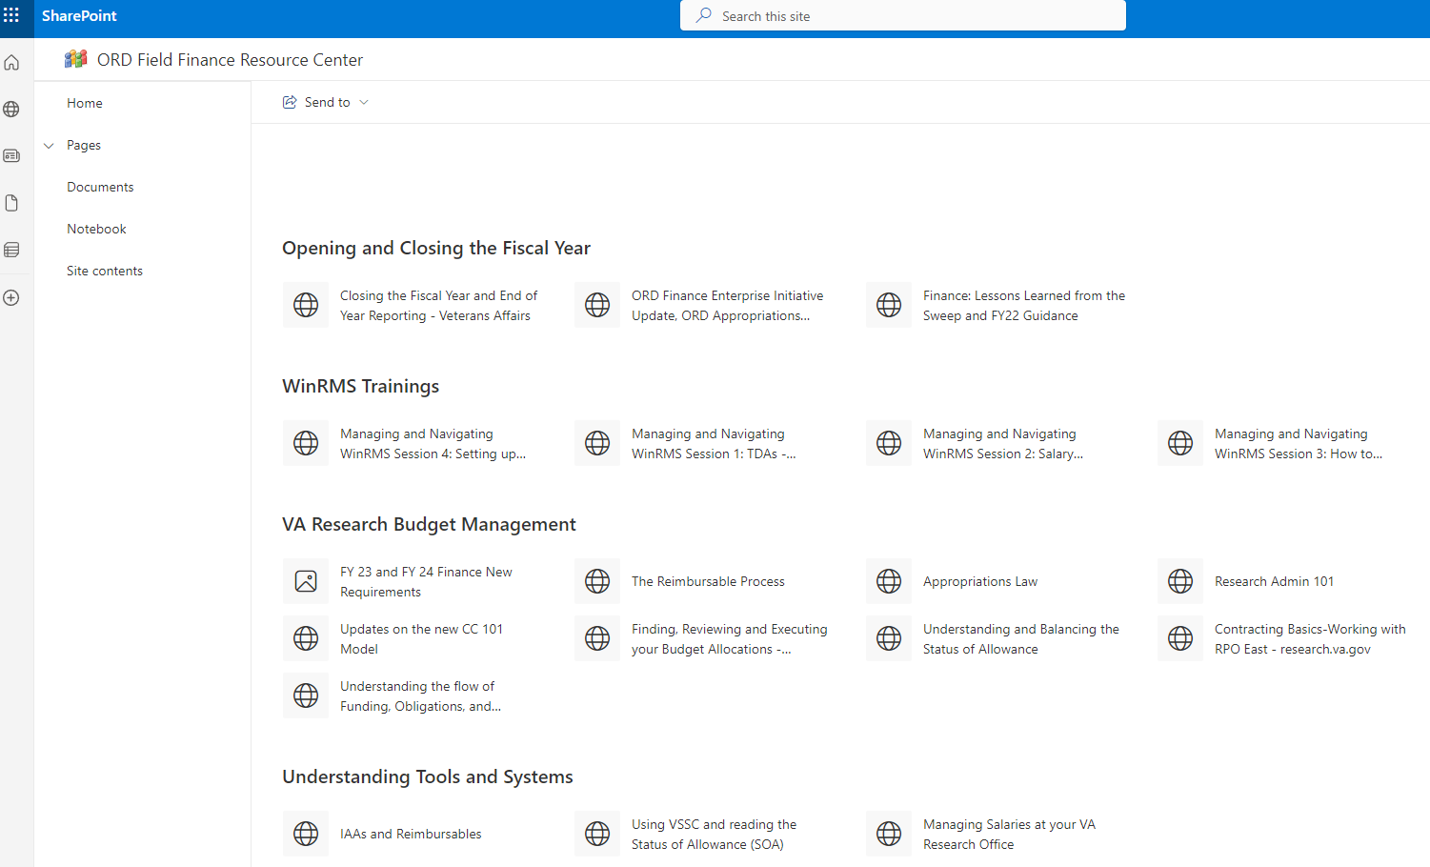
ORD Finance Resource Center
Check the trainings and best practices when you have a question
We include examples and screenshots of the financial management systems to walk you through execution
If you have reviewed these resources and still have questions, contact ORD finance for 1:1

Slide 17
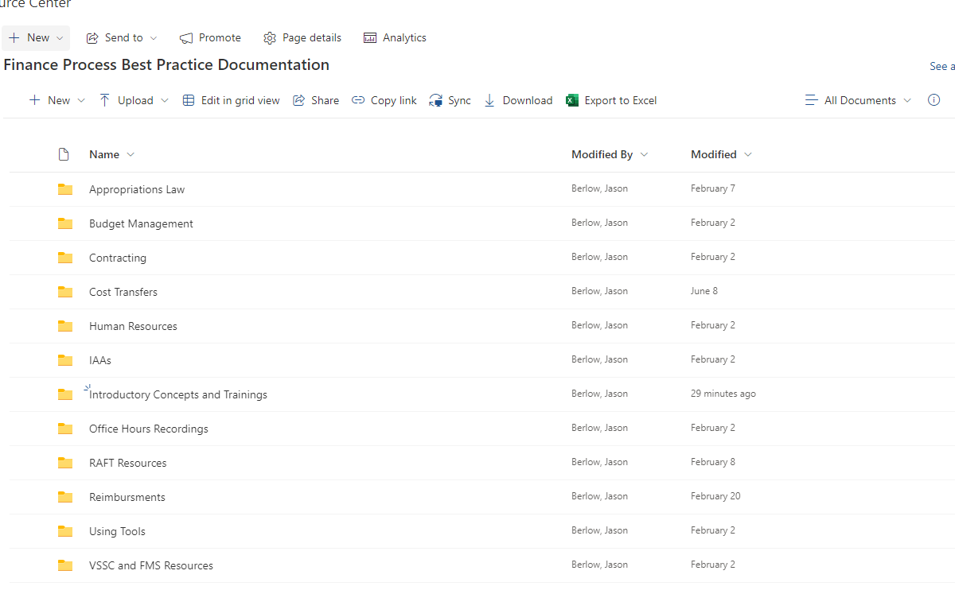
ORD Best Practices Library

Slide 18
Appropriations Law
Key Items to Remember | Description
Competency | Budget Concepts, Policies and Principles Financial Stewardship
Why is this necessary for my job? | There are some basic concepts, that are fundamental for your understanding of how you can obligate/expend funding from the Medical and Prosthetics Research Appropriation in your program or station. Most of these references are codified in the: Principles of Federal Appropriations Law, also known as the Red Book (GAO’s multi-volume treatise concerning federal fiscal law). ​
Best Practices Folder Link | Appropriations Law Best Practices and Training
Link to Recorded Training | Finance Monthly Training Series: Appropriations Law (va.gov)

Slide 19
Budget Management
Key Items to Remember | Description
Competency | 1. Budget Concepts, Policies and Principles 2. Budget Execution 3. Financial Stewardship
Why is this necessary for my job? | Like Appropriations Law these trainings provide basic concepts, that are fundamental for your understanding of how you can obligate/expend funding from the Medical and Prosthetics Research Appropriation in your program or station.
Best Practices Folder Link | Budget Management Best Practices
Links to Recorded Training | 1. ORD Finance Enterprise Initiative Update, ORD Appropriations Structure, Closing FY22 2. Finance Monthly Training Series: Research Admin 101 3. Finance Monthly Training Series: Finding, Reviewing and Executing your Budget Allocations 4. Finance Monthly Training Series: New Financial Requirements for FY 23/24 5. Updates on the new CC 101 Model 6. Finance Monthly Training Series: Cost Transfers

Slide 20
Contracting
Key Items to Remember | Description
Competency | 1. Financial Stewardship 2. Budget Execution 3. Decision Support
Why is this necessary for my job? | Contracts are a key method of how Research offices obligate funding in the field thus it is critical to learn the basics.
Best Practices Folder Link | Contracting Best Practices
Links to Recorded Training | 1. Finance Monthly Training Series: Contracting Basics-Working with RPO East

Slide 21
Using Tools: VSSC, Status of Allowance, Expenditure Tracking
Key Items to Remember | Description
Competency | 1. Financial Stewardship 2. Budget Execution 3. Decision Support 4. Financial Management Analysis 5. Financial Management Systems
Why is this necessary for my job? | Understanding the key financial management tools and resources is critical for the performance of your role.
Best Practices Folder Link | Best Practice Documentation Using Tools
Links to Recorded Training | Finance Monthly Training Series: Using VSSC and reading the Status of Allowance Finance Monthly Training Series: Managing Salaries at your VA Research Office Understanding and Balancing the Status of Allowance Finance Monthly Training Series: Understanding the flow of Funding, Obligations, and Common Financial Reports

Slide 22
Interagency agreements (IAA) Resources
Key Items to Remember | Description
Competency | 1. Budget Execution 2. Financial Management Systems
Why is this necessary for my job? | You may need to enter into an Interagency agreements (IAA), meaning your Research Office might need to need supplies or services from another Department at your VAMC or agency’s resources.​
Best Practices Folder Link | IAA Best Practices
Links to Recorded Training | Finance Monthly Training Series: IAAs and Reimbursables

Slide 23
Reimbursable Resources
Key Items to Remember | Description
Competency | 1. Budget Execution 2. Financial Management Systems 3. Financial Management Analysis
Why is this necessary for my job? | Your station might bill the NPC or University and need to recoup this funding. You may be the individual generating the MOUs, entering the Bills of Collection, and then processing the cost transfers.
Best Practices Folder Link | Reimbursement Best Practices
Links to Recorded Training | Reimbursables Training

Slide 24
Section 3: External Trainings
We also offer external trainings (multi-day) in the following courses:
  Appropriation Law
  Budget and Accounting
  Federal Financial Management/Certified Government Financial Managers Certification
We will plan on offering more courses when FY 24 starts.

Slide 25
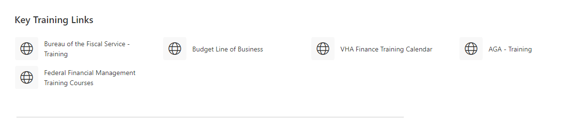
Section 3: External Trainings
External Trainings on SharePoint Page:

Slide 26
Section 3: External Trainings
Training | Link | Description
VHA Finance Training | VHA Finance Training Calendar | VHA Finance provides a number of trainings on VHA Budget/Accounting Management.
Management Concepts-Financial Management Training | Federal Financial Management Training Courses | Management Concepts provides a number of courses on Federal Financial Management (offered in-person or virtual).
Dept of Education-Budget Line of Business (BFELOB) | Budget Line of Business | BFELOB offers collaborative community bringing fresh ideas and innovation to budget offices across the Federal Government and training.
FSC-IAA Training | FSC IAA Repository Training | The FSC IAA repository has a number of helpful trainings on G-Invoicing

Slide 27

Section 4: Survey Says!

Slide 28
Survey to the Field
What system or systems do you use to track allocations, expenditures and balances by project:
  winRMS
  Access
  Excel
  Database such as Access
  Other (free text) __________
  None-Our station does not track by Project

Slide 29
Survey to the Field
2. How frequently do you monitor or reconcile expenditures and balances to FMS/VISTA?
  Daily
  Weekly
  Monthly
  Other ________

Slide 30
Survey to the Field
3. How accurate do you feel you are in reconciliation
  Right on the money!
  Good enough for government work.
  We need help.

Slide 31
Appendix
CFO Council Guidance to Federal Financial Management Careers: MYCAREER - FEDERAL FINANCIAL MANAGEMENT: YOUR GUIDE TO A CAREER IN FEDERAL FINANCIAL MANAGEMENT (cfo.gov)
CFO Council Guide on Key Competencies on Federal Financial Management: CFOC FM Career Roadmap.pdf

