Slide 1
2023 Biosafety and Biosecurity
VA Institutional Biosafety Committee (IBC)
Key Administrative Document Requirements
July 25, 2023
John Balog, BS, RBP (ABSA)
VA Office of Research & Development
Biosafety and Biosecurity Program
For questions, please use Q&A box and address to “All Panelists.”
All Webinars will be recorded and posted within one week.

Slide 2

Webinar
Housekeeping
Recording - This session is being recorded and the associated handouts will be available on ORPP&E’s Education and Training website within one-week post-webinar.
Close Captioning - Now available in the new Webex platform. Click the “CC” button at the bottom left of the Webex screen.
Experiencing Sound Issues? – Call in using the number in your Webex chat box or in your registration confirmation email.
Q&A - Please use the Q&A feature to submit questions.
  Be sure to send questions to “All panelists”.
  Questions will be addressed at the end of the webinar.
Webinar Archive - Most ORPP&E webinars can be found here: https://www.research.va.gov/programs/orppe/education/webinars/archives.cfm
Post-Webinar Evaluation Survey - We are grateful to all that complete the post-webinar evaluation survey. It will automatically pop up once the webinar is exited.
For questions, please use Q&A box and address to “All Panelists.”
All Webinars will be recorded and posted within one week.

Slide 3
Purpose and Objectives
Identify and discuss IBC administrative documents needed for a VA IBC to demonstrate compliance with the NIH Guidelines and VHA Directive 1200.08(1).
Describe the steps of the NIH IBC-RMS registration process.
For questions, please use Q&A box and address to “All Panelists.”
All Webinars will be recorded and posted within one week.

Slide 4
Review of Selected Previous Webinar Objectives
The Biosafety and Biosecurity webinars series began in 2022 with presentations in April, June, and September
Webinar 1
  Introduced the biosafety and biosecurity program;
  Summarized program activities, data calls, and program assistance visits;
  Described educational tools published on the ORD webpage
Webinar 2
Presented the foundations of the program:
  Risk identification,
  Risk assessment,
  Risk management.
Webinar 3
Defined what an IBC is;
What an IBC does;
Discussed common IBC challenges;
Proposed solutions to common IBC challenges
For questions, please use Q&A box and address to “All Panelists.”
All Webinars will be recorded and posted within one week.

Slide 5
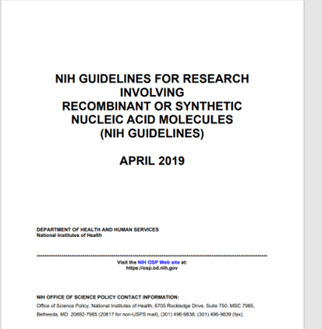
NIH Guidelines IBC Document Requirements
NIH Guidelines Sections IV-B, IV-B-1, IV-B-2, IV-B-2a, & IV-2b describe:
Institutional requirements
General Information
IBC Membership, Procedures, and Functions
For questions, please use Q&A box and address to “All Panelists.”
All Webinars will be recorded and posted within one week.

Slide 6
IBC Requirements for VA Facilities
VHA Directive 1200.08(1), Paragraph 7.a.
If a VA station intends to permit the conduct of any research that falls under the scope of the NIH Guidelines For Research Involving Recombinant or Synthetic Nucleic Acid Molecules (NIH Guidelines), it must establish its own IBC (internally administrated IBC) or obtain the services of another VA facility’s IBC or an academic affiliate IBC (externally administrated IBC).
ORD policy does not permit the use of commercial IBCs.
For questions, please use Q&A box and address to “All Panelists.”
All Webinars will be recorded and posted within one week.

Slide 7

IBC Requirements: VA Nonprofit Corporations
Is an NPC required to have IBC approval when the associated VA Facility conducts VA research requiring IBC approval according to the NIH Guidelines?
For questions, please use Q&A box and address to “All Panelists.”
All Webinars will be recorded and posted within one week.

Slide 8


IBC Requirements: VA Nonprofit Corporations (cont.)
VA NPC Is Administrator of Federal Funding
VA NPC As Awardee Institution
The VA NPC is administering federal funds for the VA research requiring IBC approval.
The VA NPC is the awardee of a federal award (grant) for the VA research requiring IBC approval.
For questions, please use Q&A box and address to “All Panelists.”
All Webinars will be recorded and posted within one week.

Slide 9
IBCs: Internal and External Options
A VA Facility can establish administer its own internal IBC
OR
  A VA Facility can rely upon an external IBC:
    Another VA Facility’s IBC, or
    An Affiliated University’s IBC
For questions, please use Q&A box and address to “All Panelists.”
All Webinars will be recorded and posted within one week.

Slide 10
Internal VA IBC Membership and Registration
  The VA Station appoints at least 5 voting members and designates:
    IBC Chair
    NIH Contact Person
    Biosafety Officer (BSO) when working with large volumes and if the Station has a BSL-3 laboratory
    Animal containment expert when using r/sDNA in animal models
These appointees comprise the IBC roster.
The IBC roster and the CVs/Resumes/Biosketches of members are used to register the IBC in the NIH IBC-Records Management System (NIH IBC-RMS).
For questions, please use Q&A box and address to “All Panelists.”
All Webinars will be recorded and posted within one week.

Slide 11
IBC Responsibilities and Requirements
VHA Directive 1200.08(1), Paragraph 7.b.
An internal IBC may share membership with the SRS or be constituted as a separate subcommittee of the R&D Committee.
The IBC is responsible for reviewing research that involves recombinant and synthetic nucleic acid molecules if the research is covered under Section I-C “General Applicability” of the NIH Guidelines.
The IBC must meet all requirements for membership, review of research, and other activities as outlined by the NIH Guidelines.
For questions, please use Q&A box and address to “All Panelists.”
All Webinars will be recorded and posted within one week.

Slide 12

IBC Documentation, Process and Procedures
IBC governing documents (Charter, SOP, or other) requirements for membership and review of research.
Documentation of review and vote on research proposals involving biohazards; and
  Notification to PIs of review outcome, including
    Approval date,
    Biosafety level, and
    Classification under Section III of the NIH Guidelines for work with recombinant or synthetic nucleic acids.
For questions, please use Q&A box and address to “All Panelists.”
All Webinars will be recorded and posted within one week.

Slide 13
External Academic Affiliate IBC
VHA Directive 1200.08(1), Paragraph 7.f.
A VA research program may use an academic affiliate IBC under the following conditions:
MOU: IBC services are obtained through an MOU that outlines the responsibilities of the VA facility and the academic affiliate.
NIH-OSP Registration: The VA facility establishes and maintains registration with NIH-OSP naming the affiliate IBC as its IBC-of-record
Compliance with VA Policies: The external IBC must review research in accordance with all VA policies and other Federal requirements.
For questions, please use Q&A box and address to “All Panelists.”
All Webinars will be recorded and posted within one week.

Slide 14
External Academic Affiliate IBC (cont.)
Documentation: IBC meeting minutes and documents related to the review, approval, and oversight of VA research must be provided to the SRS, R&D Committee, or the facility Research Office within a reasonable amount of time, as described in the MOU.
IBC Membership: At least one voting member of the external IBC must be a VA-compensated employee.
For questions, please use Q&A box and address to “All Panelists.”
All Webinars will be recorded and posted within one week.

Slide 15
External VA IBC Requirements
VHA Directive 1200.08(1), Paragraph 7.e.
A VA research program may use another VA facility’s IBC subject to the following:
  The IBC must be an internal VA IBC which meets NIH requirements for community representation.
  The IBC must be knowledgeable regarding the requesting VA’s facilities.
  IBC Membership: A VA-compensated employee from the requesting facility must be appointed as a voting IBC member.
NIH-OSP Registration: The requesting VA facility establishes and maintains registration with NIH-OSP naming the VA IBC as its IBC-of-record.
For questions, please use Q&A box and address to “All Panelists.”
All Webinars will be recorded and posted within one week.

Slide 16
NIH Preferred IBC Roster Format
Example of a Roster Listing:
John Balog, BS, National Biosafety Officer
VHA Office of Research and Development
810 Vermont Ave, Washington, DC 20002
John.Balog2@va.gov
(202) 215-3918
Expertise: Biosafety principles and practices, IBC administration
1. Name
2. Academic Credential
3. Title
4. Affiliation (VA staff, non-affiliated member)
5. Contact information
Role on the IBC (Chair, NIH contact person, non-affiliated community
member, and if applicable animal containment expert and biosafety officer)
7. Scientific and biosafety expertise i.e., cell or tissue culture at BSL-1
BSL-2, or BSL-3, molecular techniques, use of laboratory animal models,
assay development/optimization, other techniques, or if applicable, none
For questions, please use Q&A box and address to “All Panelists.”
All Webinars will be recorded and posted within one week.

Slide 17
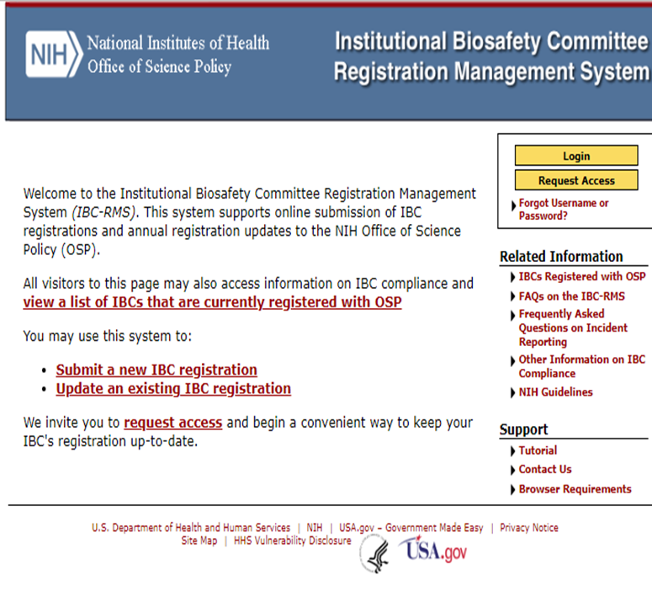
Registering and Updating the IBC
https://ibc-rms.od.nih.gov/Contents/ibc_home.aspx
The NIH IBC Contact person for VA IBCs uses the request access link to create an account to submit the initial registration and annual update reports.
Infrequent users should use the tutorial re-familiarize themselves with the system.
Use “Contact Us” to document all communications about your IBC registration.
For questions, please use Q&A box and address to “All Panelists.”
All Webinars will be recorded and posted within one week.

Slide 18

NIH IBC RMS TIPS
NIH OSP does not require the IBC Charter, SOP or other governing document be submitted as part of IBC registration.
The IBC-RMS user password expires after three years and can be reset by the user upon expiration provided that the user email address has not changed.
Otherwise, click on “Forgot Username or Password” to reset the password.
The IBC RMS Administrator will respond to all inquiries submitted via the “Contact Us” link.
For questions, please use Q&A box and address to “All Panelists.”
All Webinars will be recorded and posted within one week.

Slide 19
NIH Guidelines: IBC Governing Documents
Per Section IV-B-1-a, the institution must establish and implement policies that provide for the safe conduct of recombinant or synthetic nucleic acid molecule research and that ensure compliance with the NIH Guidelines.
The institution may establish additional procedures as needed.
Note: The NIH Guidelines do not require an IBC Charter.
For questions, please use Q&A box and address to “All Panelists.”
All Webinars will be recorded and posted within one week.

Slide 20

VA Directive 1200.08(1): IBC Governing Documents
VHA Directive 1200.08(1) does not specify or mandate the exact format of the local guidelines to be established.
However the Directive does state that, “Procedures for a VA IBC review and approval of VA research must be described in local guidelines.”
For questions, please use Q&A box and address to “All Panelists.”
All Webinars will be recorded and posted within one week.

Slide 21

VA: IBC Governing Documents
The facility determines the type of the IBC governing document(s) it will use, an IBC Charter or an IBC Administration Procedure (SOP), or both.
  Larger and more complex biomedical research programs will usually have more administrative documents than smaller programs.
  For example, multiple protocols using a different viral vectors in an animal model involves a greater number of risks to be assessed than multiple protocols for conducting genetic analysis of a human blood specimen.
For questions, please use Q&A box and address to “All Panelists.”
All Webinars will be recorded and posted within one week.

Slide 22
VA: IBC Governing Documents (cont.)
Do include:
An expression of support from the Station Leadership about the IBC oversight and approval of VA biomedical research that promotes the safe and responsible conduct of VA biomedical research.
A description of the VA charge to the committee to conduct reviews of r/sDNA research under the NIH Guidelines, and VHA Directive 1200.08(1).
The need to comply with safety program elements applicable to the research reviewed by the IBC, i.e., laboratory inspections, worker training, or medical surveillance of workers.
For questions, please use Q&A box and address to “All Panelists.”
All Webinars will be recorded and posted within one week.

Slide 23
VA: IBC Governing Documents (cont.)
Define the scope of research reviewed by the IBC as only r/sDNA research covered by the NIH Guidelines or per Section IV-B-2-b-(9), performing other functions delegated to the Institutional Biosafety, i.e., pathogens, infectious agents, and toxins.
Directing that the IBC coordinate its review processes with the Institutional Review Board (IRB) and/or the Institutional Animal Care and Use Committee (IACUC) when review by those committees is required.
For questions, please use Q&A box and address to “All Panelists.”
All Webinars will be recorded and posted within one week.

Slide 24

IBC Member Training
NIH Guidelines, Section IV-B-1-h
Ensure appropriate training for the IBC Chair and members, BSO and other containment experts (when applicable), PIs, and laboratory staff regarding laboratory safety and implementation of the NIH Guidelines.
For questions, please use Q&A box and address to “All Panelists.”
All Webinars will be recorded and posted within one week.

Slide 25

IBC Member Training (cont.)
ORD has created an optional VA IBC member on-line training course on the Collaborative Institutions Training Initiative platform (CITI). https://www.research.va.gov/programs/orppe/education/ord_training/va_ibc.cfm
The facility ACOS or AO/RD may contact Dr. Alice Huang via email at alice.huang@va.gov to make this IBC training course available to learners at their facility. Dr. Huang will also help with general questions about the course availability.
For questions, please use Q&A box and address to “All Panelists.”
All Webinars will be recorded and posted within one week.

Slide 26
Additional IBC Documents
Administrative documents required under the NIH Guidelines:
  A copy of the VA IBC registration submission, NIH OSP email notice of acceptance, and the initial and annual report.
  A copy of each member’s letter or notice of appointment, initial member training, and current roster of IBC members.
  Copies of NIH-reportable incidents, occupational exposure, or environmental releases involving r/sDNA, if any.
  NOTE: Terms for obtaining documents from externally administrated IBCs are included in the VA-Affiliate and VA-VA IBC MOU.
For questions, please use Q&A box and address to “All Panelists.”
All Webinars will be recorded and posted within one week.

Slide 27
IBC Meeting Records - Agenda
IBC Meeting Agenda Components include:
  The meeting date, start and end times.*
  List of members in attendance or absent, and guests, if any.*
  List of protocol title/number and the member declaring a financial or professional conflicts of interest with review of that protocol.
  The list of protocols and amendments to be reviewed with the PI name, project title, primary IBC reviewer (if assigned).*
  Old Business and New Business, if any.
*indicates required component
For questions, please use Q&A box and address to “All Panelists.”
All Webinars will be recorded and posted within one week.

Slide 28

IBC Meeting Records - Minutes
Minutes of IBC Meetings must include:
  The date, location (remote or in-person) and start and end times for the meeting.
  Members present, members absent and guests in attendance.
  Statement that a quorum of members is present.
  The Protocol title, the PI name, primary reviewer name.
  A brief summary of the proposed work, a summary of the IBC discussion, the motion to vote or table the protocol.
  The record of the vote to approve, disapprove or table the protocol.
Note: It is optional to include New business, and Old Business, if any.
For questions, please use Q&A box and address to “All Panelists.”
All Webinars will be recorded and posted within one week.

Slide 29

IBC Research Protocol Review Considerations
The IBC may deem certain methods and materials eligible for administrative review.
  The administrative review procedure must not conflict with VHA Handbooks or Directives.
  Eligibility of a protocol for administrative review must account for worker training and annual laboratory survey requirements.
  Non-exempt r/sDNA protocols are ineligible for administrative review.
  The IBC protocol review procedure must not conflict with established SRS or R&D Committee practices.
For questions, please use Q&A box and address to “All Panelists.”
All Webinars will be recorded and posted within one week.

Slide 30
IBC Research Protocol Review Considerations (cont.)
Suggested review items include:
  The annual survey of the laboratory and support spaces, OSHA safety training records for the PI and laboratory workers.
  The description of the proposed research: assess the risks associated with the biohazards and methods proposed for use in the research protocol.
  The PI-proposed facility biosafety level and the work practices biosafety level and for r/sDNA, the classification under Section III of the Guidelines.
For questions, please use Q&A box and address to “All Panelists.”
All Webinars will be recorded and posted within one week.

Slide 31
Summary
Use of internally administered VA IBCs or externally administered IBCs is permitted under ORD Policies in VHA Directive 1200.08(1), but the IBCs must adhere to the NIH Guidelines.
There is flexibility in how IBC governing documents are developed, but required IBC administrative documents include the IBC roster, meeting agenda, meeting minutes, member training records and locally generated governing documents.
For questions, please use Q&A box and address to “All Panelists.”
All Webinars will be recorded and posted within one week.

Slide 32
Updates & Reminders
ORD has published an IBC meeting minutes template on the Biosafety and Biosecurity Program web page located at Biosafety & Biosecurity Program (va.gov).
Please email VHACOORDBiosafety@va.gov for questions regarding VA research biosafety or biosecurity or to request to join the Biosafety and Biosecurity email distribution list.
You may request a hard copy of the CDC/NIH Biosafety in Microbiological and Biomedical Laboratories (BMBL) 6th Edition here: https://wwwn.cdc.gov/pubs/CDCInfoOnDemand.aspx. Please use your home mailing address as CDCInfoOnDemand limits 1 copy sent per address.
For questions, please use Q&A box and address to “All Panelists.”
All Webinars will be recorded and posted within one week.

Slide 33
References
The NIH Office of Science Policy, Biosafety and Biosecurity Policy
https://osp.od.nih.gov/policies/biosafety-and-biosecurity-policy/
NIH Guidelines for Research Involving Recombinant or Synthetic Nucleic Acid Molecules, April 2019
https://osp.od.nih.gov/wp-content/uploads/2019_NIH_Guidelines.htm#_Toc3457037
VHA ORD Biosafety and Biosecurity Policy and Guidance: VHA Directive 1200.08(1) located at VHA Publications at VHA Publications (va.gov)
VHA ORD Biosafety and Biosecurity Program Web page: Biosafety & Biosecurity Program (va.gov)
For questions, please use Q&A box and address to “All Panelists.”
All Webinars will be recorded and posted within one week.

Slide 34
QUESTIONS?
For questions, please use Q&A box and address to “All Panelists.”
All Webinars will be recorded and posted within one week.

