Slide 1
VA Central IRB
Revised MOU, Version 07/20/2023
Office of Research Protections, Policy, & Education (ORPP&E) VHA Office of Research and Development (ORD)
August 1, 2023

Slide 2

Webinar
Housekeeping
Recording - This session is being recorded and the associated handouts will be available on ORPP&E’s Education and Training website within one-week post-webinar.
Close Captioning - Now available in the new Webex platform. Click the “CC” button at the bottom left of the Webex screen.
Experiencing Sound Issues? – Call in using the number in your Webex chat box or in your registration confirmation email.
Q&A - Please use the Q&A feature to submit questions.
  Be sure to send questions to “All panelists”.
  Questions will be addressed at the end of the webinar.
Webinar Archive - Most ORPP&E webinars can be found here: https://www.research.va.gov/programs/orppe/education/webinars/archives.cfm
Post-Webinar Evaluation Survey - We are grateful to all that complete the post-webinar evaluation survey. It will automatically pop up once the webinar is exited.
For questions, please use Q&A box and address to “All Panelists.”
All Webinars will be recorded and posted within one week.

Slide 3
Purpose
Timeframe and requirement for updating
To review the major changes to the MOU
Modified VA Central IRB SOPs
Revised VA CIRB Table of Reporting Requirements
Revised RCO Information Sheet
Processing the modified MOU
Questions and/or Feedback

Slide 4
Timeframe and requirement for updating
Requesting to have these endorsed and returned by September 1, 2023
Important updates to VA CIRB process changes
  Process for reviewing multi-site exemptions
  New forms, process for verifying CITI training and annual FCOI completion
  New Continuing Review Process
  New RCO reporting processes
Clarification of several new responsibilities

Slide 5
To review the major changes to the MOU
Agreement only applies to Panels 1 and 2
  What is Panel 3?
Recognizes a change in VA CIRB SOPs:
  We will no longer ask for documentation of Investigator FCOI review, or of Investigator and Study Team updated CITI training, but will ask only for verification that they are both in compliance with national policy.
  The Facility and its Research Office continue to exercise oversight of the FCOI process and continuing education in human subject protections and,
  is required to provide the VA CIRB with a copy of any approved FCOI management plan for the VA CIRB to ensure the terms of the management plan are included in the IRB requirements.

Slide 6
To review the major changes to the MOU
All VA Central IRB findings will be communicated to the Investigator and to the Facility by means of VAIRRS (IRBNet).
  SharePoint archives remain for accessing documentation prior to IRBNet implementation (March-May 2021)
4. The VA Central IRB will also provide initial written notifications of findings of Serious or Continuing Noncompliance or Unanticipated Problems involving Risks to Subjects or Others by email to the Investigator, Medical Facility Director, the Research Compliance Officer (RCO, with a courtesy copy to OROHRP@va.gov) and to the VACO HRPP Institutional Official, in addition to providing the written notifications in VAIRRS.

Slide 7
To review the major changes to the MOU
5. Notification will continue to be made to Liaisons when approved minutes (no longer signed minutes) are uploaded to the SharePoint site as well as when the Annual Report is uploaded for RDC review.
6. The updated MOU reflects the change in process for multi-site exemption determinations, including those requiring limited IRB review. The VA Central IRB has adopted the PI/LSI model for these reviews to make submission to multiple RDCs more convenient and recognizable (same process as for non-exempt research).

Slide 8
To review the major changes to the MOU
7. The MOU now clarifies processes for RCOs to submit audit reports for VA CIRB review:
  RCO audit reports with no findings or findings not required to be reported within a specified timeframe may be submitted by the RCO directly to the VA Central IRB using the IRBNet RCO Audit Workspace or the RCO may provide the report to the Investigator who will in turn submit the audit report to the VA Central IRB as part of the study continuing review application or, if continuing review approval is not required for a project, as part of an annual status report, or at project closure.
  RCO audits that have findings of Apparent Serious or Continuing Noncompliance or Unanticipated Problem Involving Risks to Subjects or Others will be submitted by the RCO to the Investigator who will in turn submit the audit report and Form 124 Reportable Events to the VA Central IRB as part of a Reportable Event Package in IRBNet. Alternatively, RCOs may submit findings of these reportable events by email to the Investigator with the VA Central IRB included using VACentralIRB@va.gov. In the email, the RCO is requested to remind the Investigator of the prompt reporting timeframe and to submit the findings as a Reportable Event Package in IRBNet with Form 124 Reportable Events.

Slide 9
To review the major changes to the MOU
The revised MOU clarifies that the local context review, conducted by the Facility is done before any new submission (initial submission). This review is intended to ensure the project is within the scope of the facility’s research mission, that it is feasible to conduct the research at the facility, that the site has the necessary resources to support the research and that the investigators are appropriately credentialed and are current in all human subjects training requirements.
The MOU has been modified to clarify the central role of VAIRRS in VA CIRB submissions and documentation, and to utilize electronic signatures for the form itself.

Slide 10
Modified VA Central IRB SOPs
All VA Central IRB SOPs have been combined into a single document
Initial Version 10.1, dated March 30, 2023
Updated Version 10.2, dated July 20, 2023
  Modified to match the terms of the new MOU, Version July 20, 2023
Posted online: VA Central IRB: Standard Operating Procedures (SOPs)

Slide 11
Revised VA CIRB Table of Reporting Requirements
Updated to provide specific information about numerous types of reports, in compliance with Directive 1058.01 timeframes.
Posted online: CIRB-Table-of-Reporting-Requirements.pdf (va.gov)

Slide 12
Revised RCO Information Sheet
Specific information for RCOs on the processes to be used for reporting to the VA Central IRB
Posted online: bottom bullet on: Facility Information (va.gov)

Slide 13
Processing the modified MOU
1. Select the correct Word versions of the VA Central IRB MOU (with and without NPC) from the Site Liaison folder:
Protections Policy and Education - MOU Information and Templates - All Documents (sharepoint.com)
Note: only appointed Site Liaisons have permission to access this folder
2. Modify site specific information (e.g., name of your local facility and the NPC, if applicable). Change “{NAME OF LOCAL VETERANS AFFAIRS (VA) FACILITY}” to the name of your Medical Center or Healthcare System (whatever name is on your FWA). Use the “Find and Replace” feature (Ctrl-H).

Slide 14
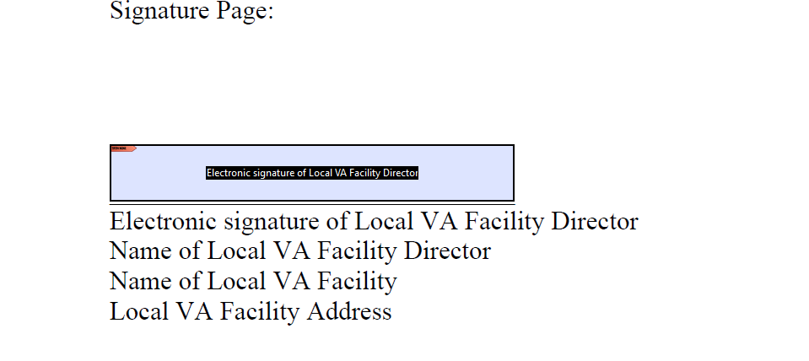
Processing the modified MOU
3. Once the Word file has been modified, “save as Adobe pdf file”. Then open the pdf using Adobe Acrobat or Adobe Acrobat Pro, and “Enable all features.” Go to the Tools menus and select “Prepare Form” and “Start.” After the document is processed, scroll to the last page and you should have it ready for electronic signatures, like this:

Slide 15
Processing the modified MOU
4. Once signed by the Facility Director and the NPC Director (if applicable), return the file to the VA Central IRB Office by email to Lindsey.Martin2@va.gov. Lindsey will verify the signatory officials are consistent with the persons listed on the FWAs and will assign an expiration date for the MOU. The file will be forwarded to the VA Central Office HPA who will sign the file and it will be returned to the VA Central IRB Liaison and to ORO by email.
Please do not hesitate to send questions about the MOU process to Lindsey Martin at Lindsey.Martin2@va.gov

Slide 16


Questions
Feedback

