Slide 1

Webinar
Housekeeping
Recording - This session is being recorded and the associated handouts will be available on ORPP&E’s Education and Training website within one-week post-webinar.
Close Captioning - Now available in the new Webex platform. Click the “CC” button at the bottom left of the Webex screen.
Experiencing Sound Issues? – Call in using the number in your Webex chat box or in your registration confirmation email.
Q&A - Please use the Q&A feature to submit questions.
  Be sure to send questions to “All panelists”.
  Questions will be addressed at the end of the webinar.
Webinar Archive - Most ORPP&E webinars can be found here: https://www.research.va.gov/programs/orppe/education/webinars/archives.cfm
Post-Webinar Evaluation Survey - We are grateful to all that complete the post-webinar evaluation survey. It will automatically pop up once the webinar is exited.
For questions, please use Q&A box and address to “All Panelists.”
All Webinars will be recorded and posted within one week.

Slide 2
Box-Qualtrics ORD Demo
Office of Information and Technology
August 2023
FOR INTERNAL USE ONLY

Slide 3
Agenda
BOX.COM Overview
Qualtrics Overview
Box/Qualtrics Integration Demo
Next Steps
Q&A

Slide 4
Box.Com overview

Slide 5





What to leverage Box For?
Get away from email as a collaboration tool
Meet VA compliance & security requirements
Retention policy enforcement of 7 years for content stored in Box at the VA
Auditable event stream
Compliance certifications
Access your content from multiple applications
Current integrations enabled at the VA:
Microsoft Office 365
Qualtrics
Collaborate internally
Create and collaborate
Access your folders, files and metadata
Search & Preview content
Real-time notes and annotations
Access stats
Power business processes
Self-serve, no-code workflow tooling
Collaborate externally
Secured method to ingest and deliver files from and to external teams
Share with external teams via ID.me authenticated users
Collaborate on moderate level data in near real time
Define clear access rights to enable team collaboration on folders of content

Slide 6



Box – Qualtrics Integration Data Flow
Secure Collaboration with Internal and External Partners
Surveys sent to Box Folder
Research Partners
Veterans
VA Employee
Creates Survey
External VA partners responds to survey
Via the Box–Qualtrics Integration, Box will:
Act as the secure content repository for the surveys
Enable secure collaboration of these surveys with internal and external partners
VA Employees
Enterprise-grade security and compliance

Slide 7
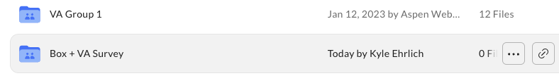


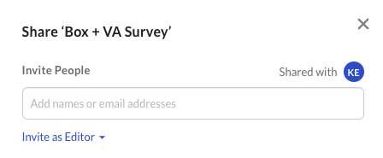
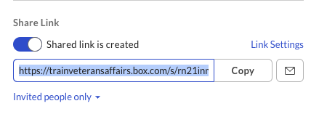
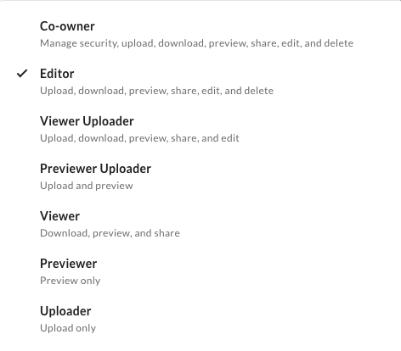

Inviting Collaborators v. Shared Links
Inviting Collaborators
Sharing Links
A collaborator is an individual who has been invited to a file or folder
A shared link is a unique URL that gives the recipient access to a specific file or folder.

Slide 8
Qualtrics overview

Slide 9
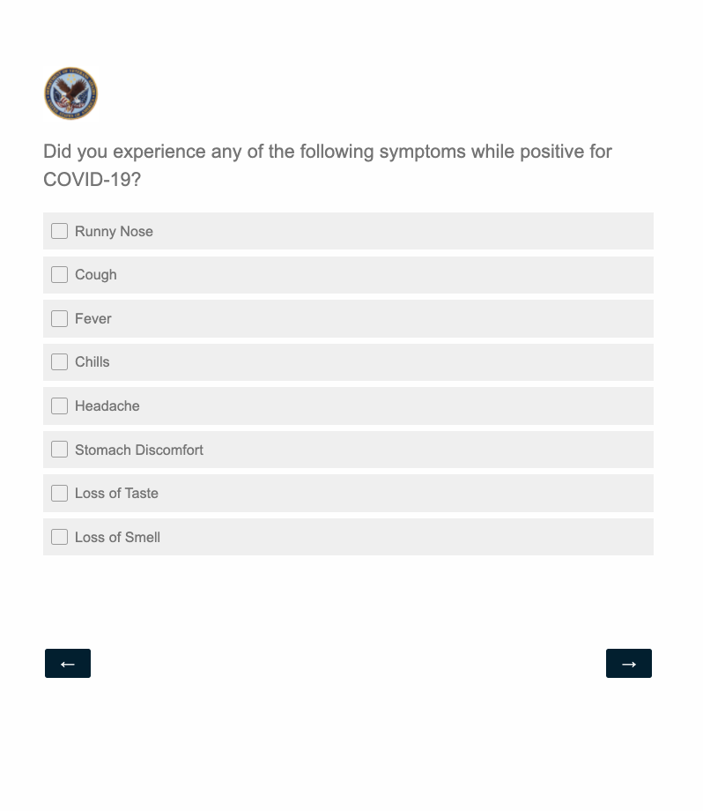

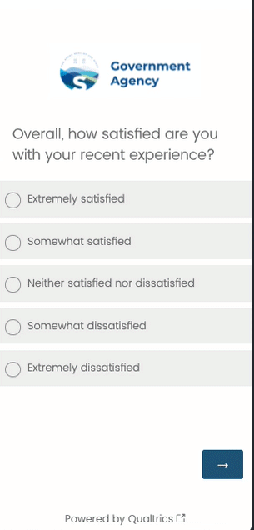





Facilitate nimble research studies
Capture targeted feedback through flexible forms and pre-built solutions
Gather feedback from various stakeholders by leveraging 100+ question types, in an accessible and responsive format.
Avoid survey fatigue with dynamic logic, personalization, frequency controls, and methodology reviews.
Distribute across a variety of channels, including email, SMS, QR codes, and links

Slide 10
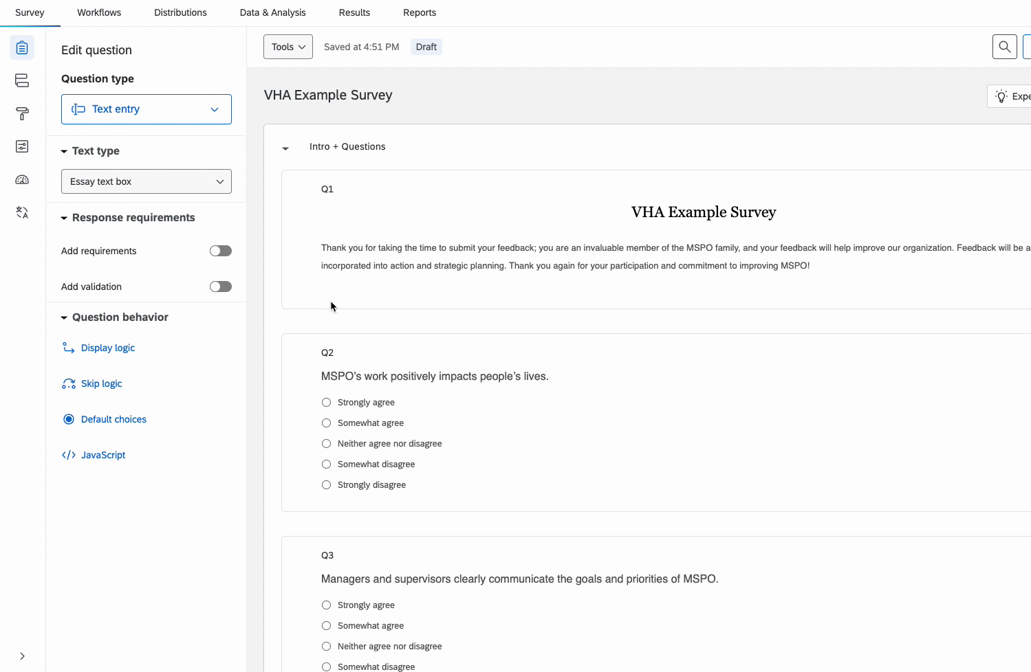
Flexible, user-friendly configuration
Onboard and enable researchers quickly, with limited learning curve, through a user-friendly interface.
Leverage pre-built, expert-crafted solutions and question libraries to drive standardization and accelerate research.
User-friendly point-and-click setup, with guided suggestions and pre-built content.
Evaluate effectiveness of projects before publishing, through machine-learning powered recommendations.

Slide 11
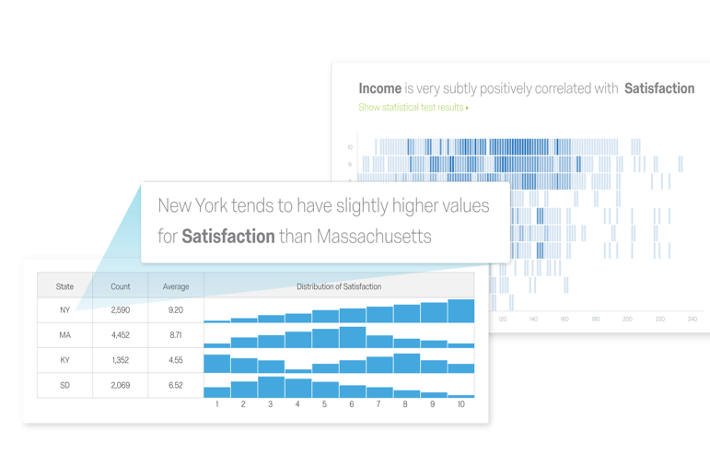
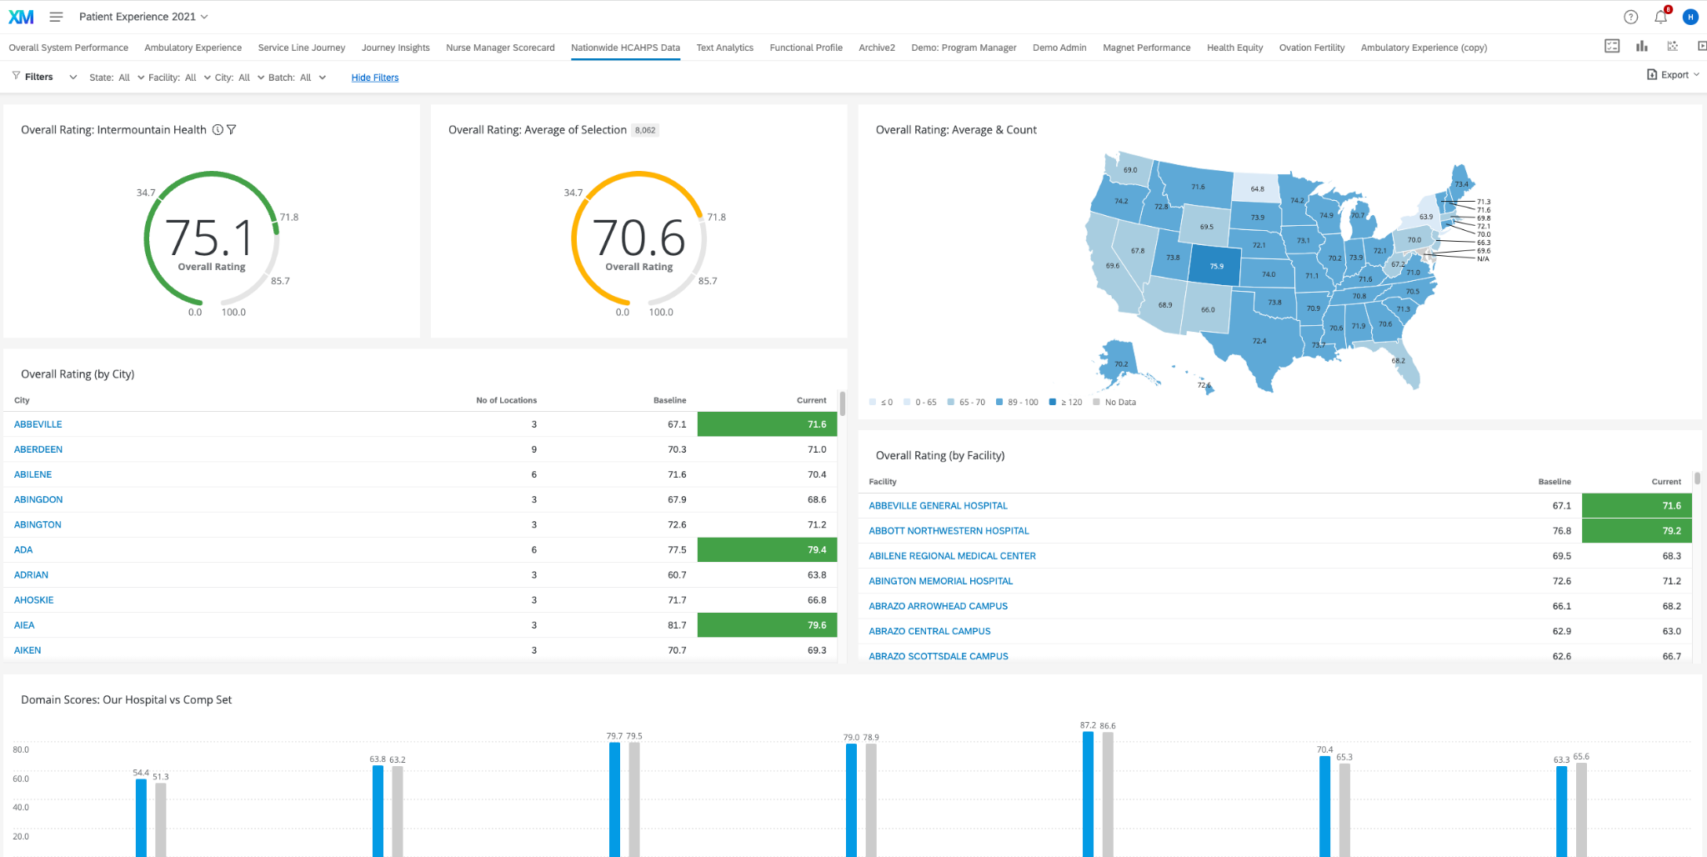
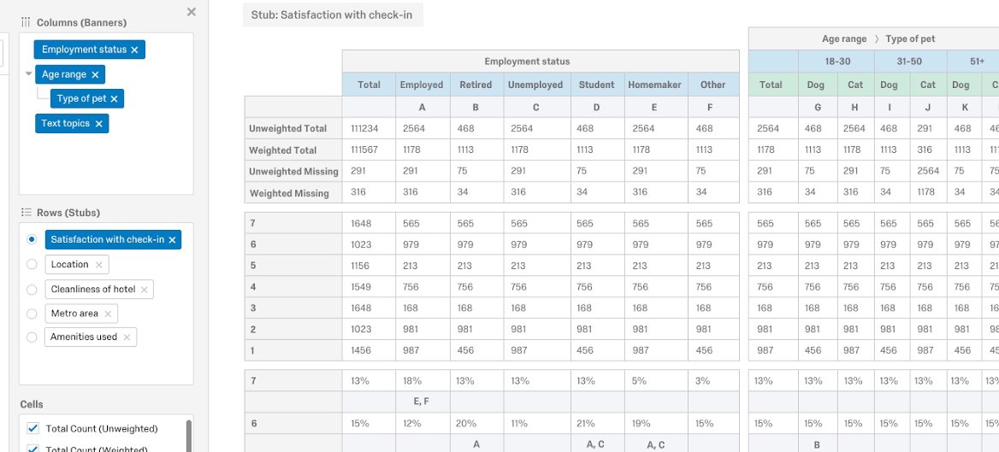
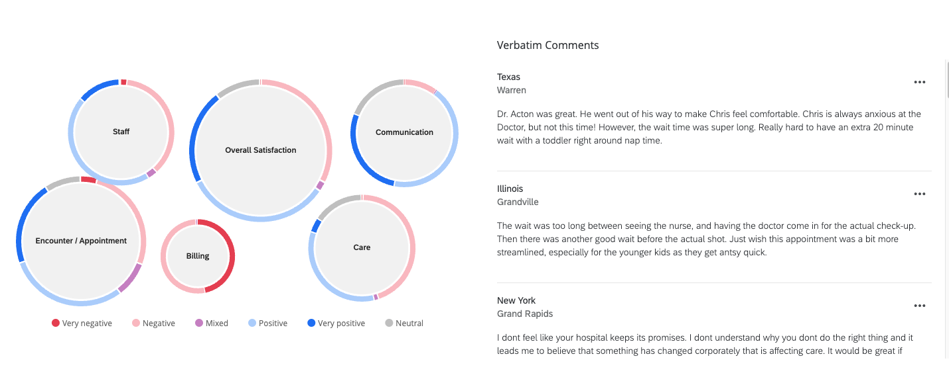
Surface insights through analysis tools
Quickly visualize results and derive insights through dashboards, statistical analysis, and text analytics.

Slide 12
Box.com-Qualtrics Integration
DTC Mulesoft Team

Slide 13
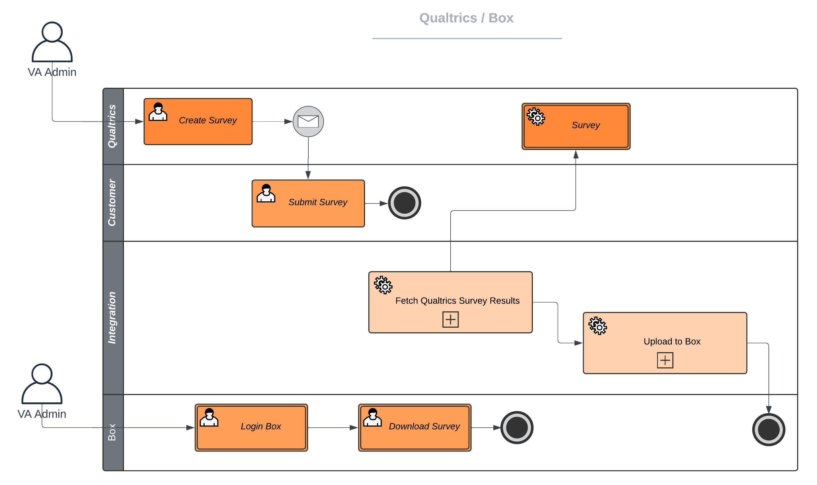
Box-Qualtrics Integration Process Diagram

Slide 14
Demo Presentation
Witness the simplicity of:
Generating a survey using a template
Configuring seamless sharing of survey responses to Box
Accessing and downloading responses directly within Box

Slide 15
Demo

Slide 16
Next Steps
Refer to the ORD training recording (Link)
Be on the lookout for additional information on how to move forward with Box and Qualtrics

Slide 17
Need Help?
For VA Box questions, utilize the VA Box Support Form (Link)
For Qualtrics specific questions, contact: VHAORDQualtricsSupport@va.gov

Slide 18
Q & A

Slide 19
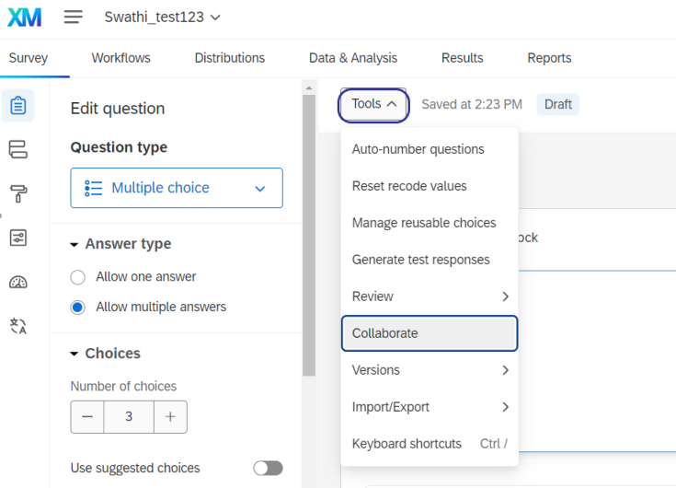
Setting your survey to “Collaborate”

Slide 20
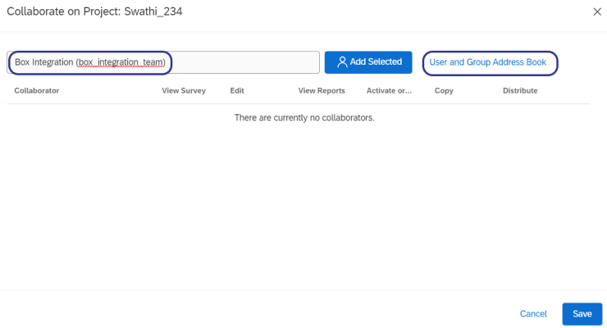
Select box_integration_team as a collaborator

Slide 21
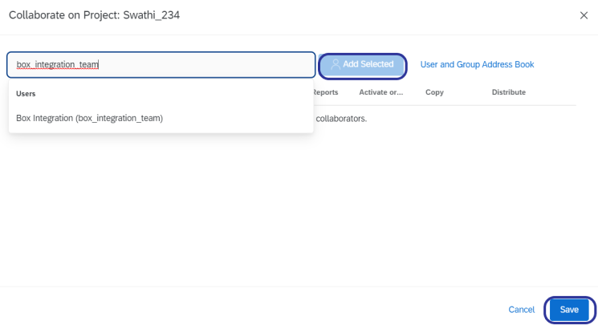
Select box_integration_team as a collaborator

Slide 22
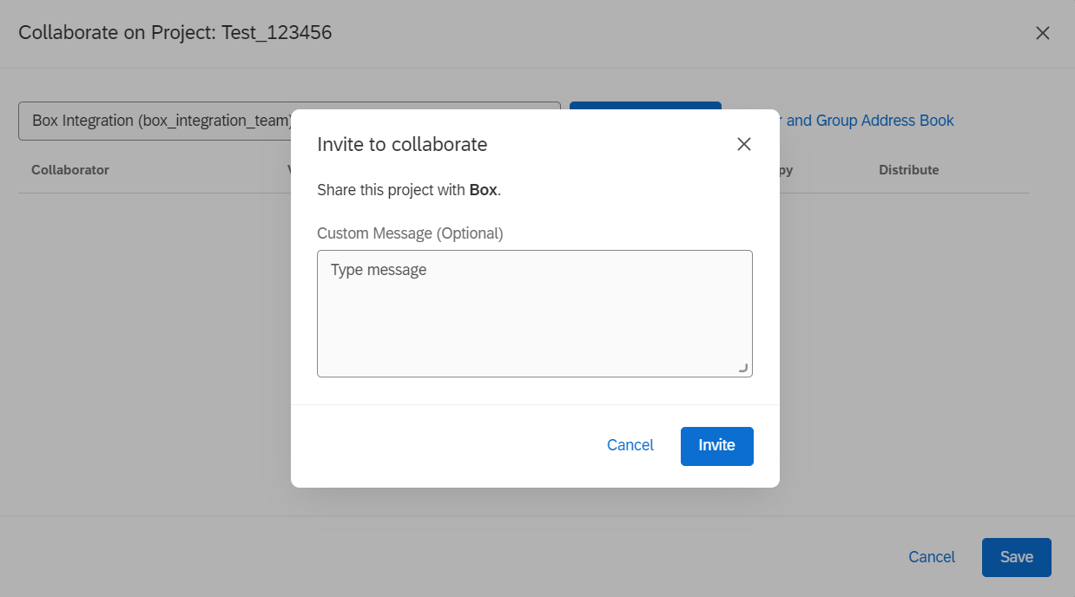
Select box_integration_team as a collaborator

Slide 23
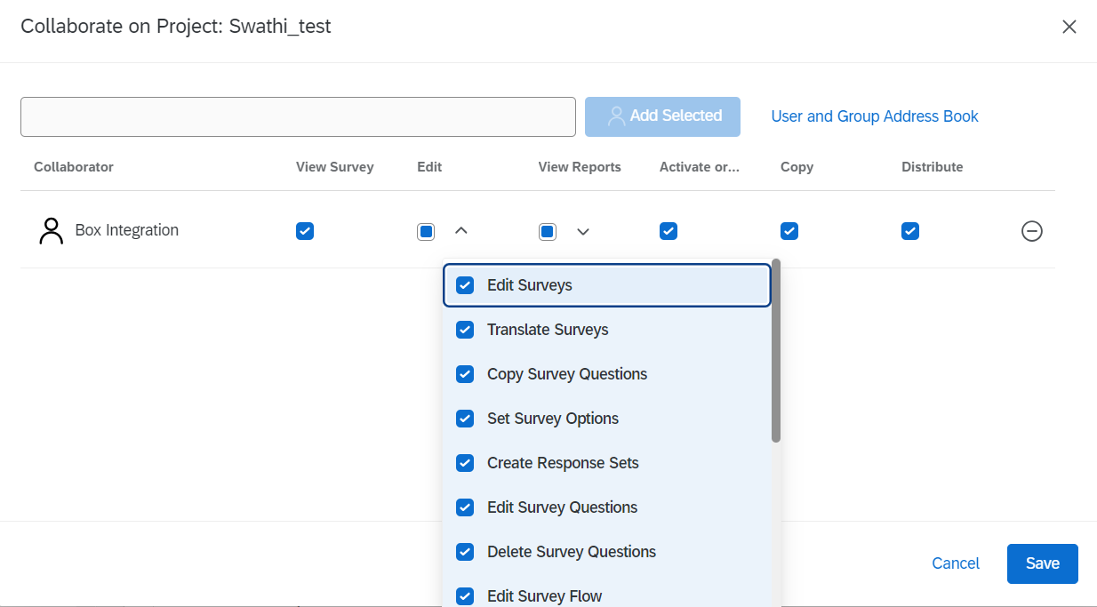
Set box_integration_team API settings

Slide 24
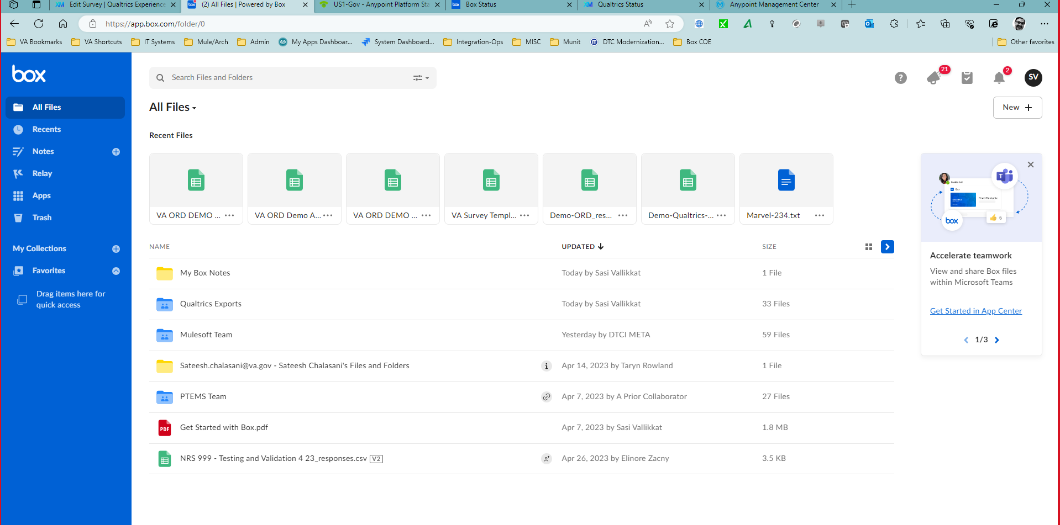
Find survey export folder within Box

Slide 25
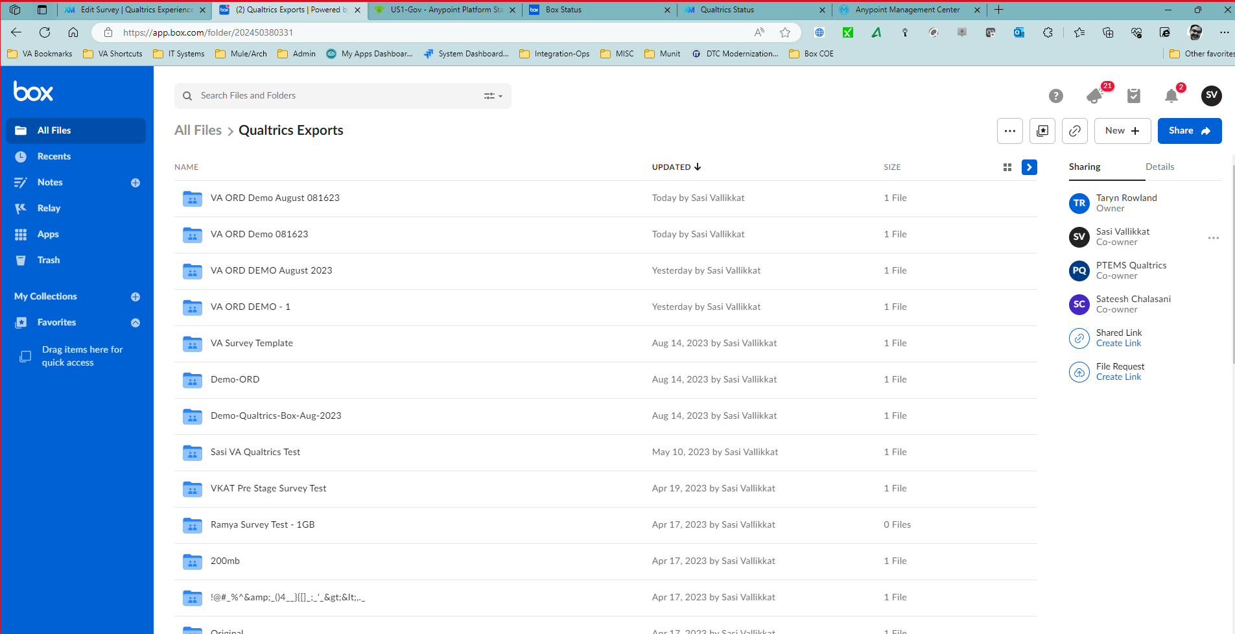
Find survey export folder within Box

Slide 26
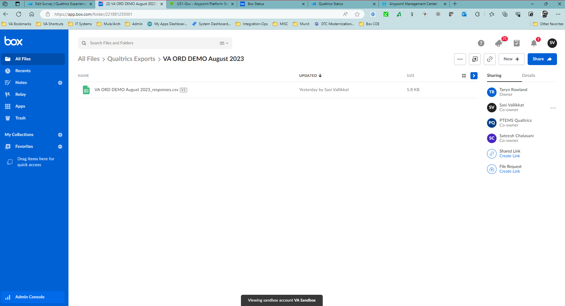
Find survey export file within Box export folder

Slide 27
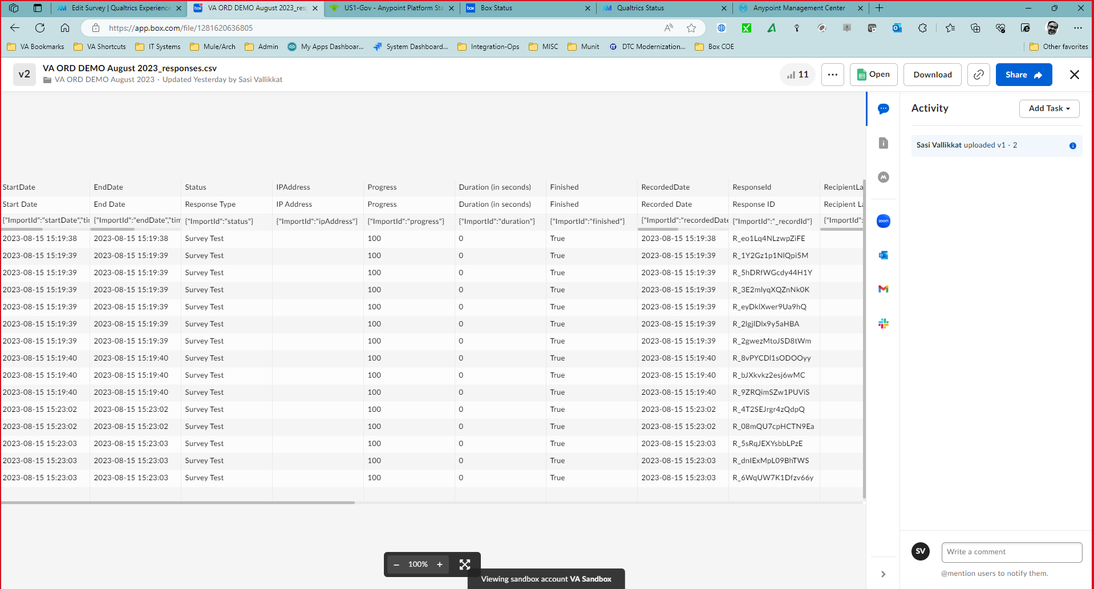
Preview survey responses within Box

