Slide 1

Preparing to Close the Fiscal Year
August 30, 2023
Erin Olson, CGFM, Finance Budget Analyst
Kari Points, AO Research, Iowa City VAMC
Jason Berlow, CGFM, Management Analyst, Finance Antonio Laracuente, Director, Field Operations

Slide 2
Please use the Q&A feature to submit questions.
  Please do not use Chat to send in questions.
  Be sure to send questions to “All panelists”.
Webinar Housekeeping
A recording of this session and the associated handouts will be available on ORPP&E’s Education and Training website approximately one-week post-webinar
We would be ever so grateful if you would complete the post-webinar evaluation survey that pops up once you exit the webinar.
An archive of all ORPP&E webinars can be found here: https://www.research.va.gov/programs/or ppe/education/webinars/archives.cfm
Experiencing sound issues – you can call in using the number included on the handouts and on your registration confirmation email that you received.
For questions, please use Q&A box and address to “All Panelists.” All Webinars will be recorded and posted within one week.

Slide 3
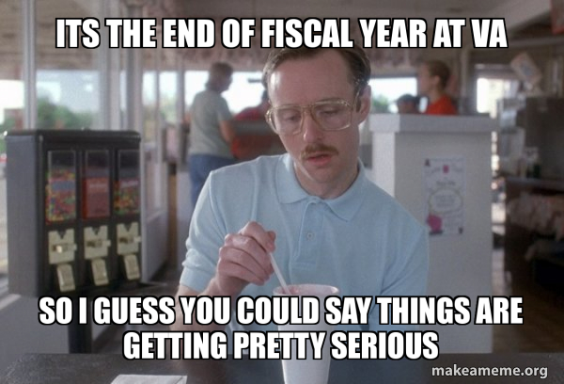
Objectives for today’s training
3

Slide 4
Objectives for today’s training
Training Section: | By the end of this section, you will:
Section 1: Understand the requirements for prior year and current year closeout (Tony L) | Be aware of key considerations for Prior-Year and Current-Year funds Understand the how, what and why of 2% Follow-up from Q3 RAFT Report
Section 2: How to look at the SOA to support the 2% target (Kari P). | Know how to setup Spreadsheet to track all expenses to see progress towards 2% carryover
Section 3: Credit cards and Travel Cards (Erin O.) | Understand cutoff dates and why you need to move open orders on 22/23 funds to 23/24 funds
Section 4: Managing reimbursables, IAAs and collections (Jason B.) | Understand why you must close the loop
Section 5: What to expect in FY 24 (Jason B.) | Plan for a CR to start the year Plan to continue to obligate until fund is TDA’d to sites.
Q&A
3

Slide 5

IMPORTANT! Read the guidance on FY 23 close out
All the FSC and VHA guidance is located on the ORD Field Finance Resource Center.
In addition, the ORD guidance is posted. Share with your facility fiscal!
  FY 23 FMS Annual Close Memo.doc (sharepoint.com)
  VHA Office of Finance Comprehensive End of Year Guidance for VHA (FY 2023)

Slide 6
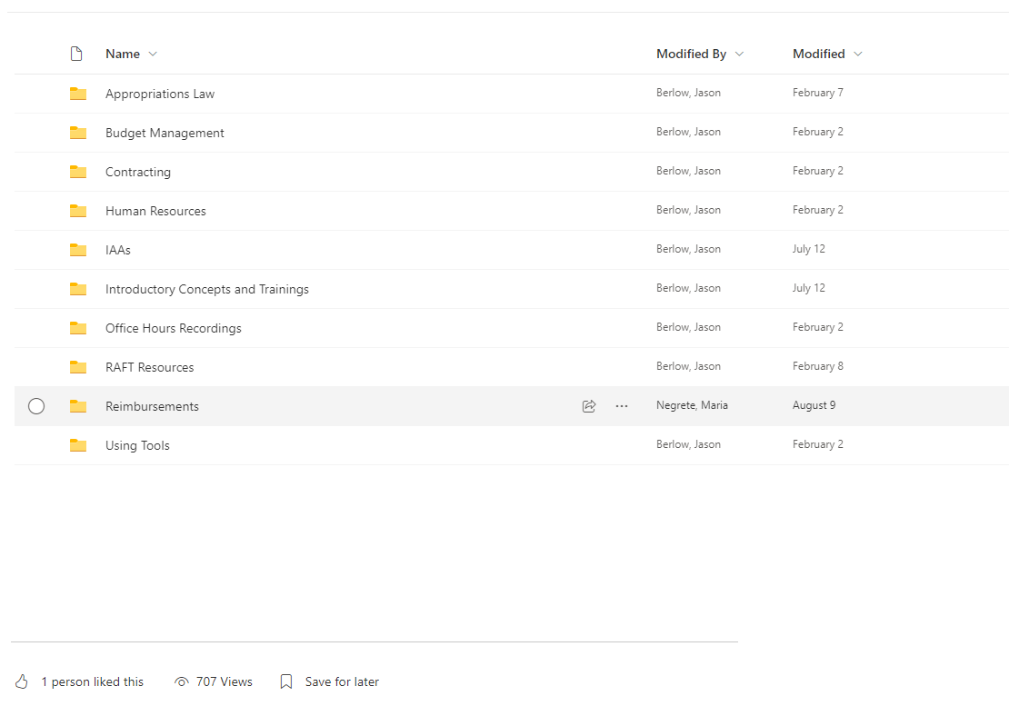

Bookmark the Link: Guidance is on the ORD Field Finance Resource Center
ORD Field Administrative Officer and Financial Management Resources (sharepoint.com)
ORD Finance handling low usage of SharePoint!

Slide 7
Section 1: FY23 Closing the Fiscal Year (Appropriated Funds)
Research Appropriations | Key Activities
Prior Year (0161A1 and 0161R1 22-23) | Please Do not let Funds expire. This looks bad on ORD and is subject to unitended consequences. On several occasions, Finance requested the field to obligate all prior year funding by Monday, August 1st . This was not accomplished. As of 8/29/23 $3.1 Million (0161A) and $4.3 Million (0161R1) was still unobligated balances. Stations allowing Prior Year funding to lapse will receive a dollar for dollar decrease in FY24 CC101.
Current Year (0161A1 23-24) | All Research Stations have a target not to exceed 2% carryover. Please see memo distributed in May. As communicated at the AO conference we are requiring all stations to achieve a carryover target of 2% of the total allocation by Program by 10/1/2023. This means that all remaining funds (above the 2% allocation) will be pulled back around October 23, 2023 (after the payroll hits and accruals reverse) All FY 23 Purchase Card Orders that cannot be reconciled by 10/15/23 should be moved FY 24 funding (0161A1 24-25). ORD will be working closely with Services and Stations to pull funds back by program.

Slide 8
Section 1: FY 2023: Key Date for Closing the Fiscal Year
KEY DATES
9/1/23 | Do not enter any more bills or collect funds that impact 22/23 or 23/24. TDAs-Funding requests should only be for emergency funding situations or requirements that are ready to obligate.
9/27/23 | On the night of Monday, September 25, 2023, Charge Card System (CCS) will record the obligation/expenditure transactions for the billings in FMS. These transactions will include invoice billings submitted to US Bank as of close of business September 24
09/27/2023 | Ensure all commitments are obligated (remember commitments are not obligations)
10/23/23 | Prior Year Pullback (0161A1 23-24).

Slide 9
Section 1: Key Points regarding Prior Year Appropriation (PY) (0161A1 22-23)
All Prior Year Appropriation balances (22/23) must be $0, and funding must be obligated by 9/30/23 to avoid the funds lapsing.
Do not leave this until the last minute, Funds that lapsed are frowned upon by Congress.
If you have open obligations are unobligated balances that you cannot fully obligate by 9/30, please let us know ASAP!
Lapsed Prior Year 0161A1 22/23 funds will result in a dollar for dollar reduction in CC101 FY24 – we cannot stress enough how important it is to execute all funds. We will review VSSC through October to watch for changes in unobligated balances.
If your station has credit card orders (that used 0161A1 22/23 funds) that are not yet reconciled, take actions to close these transactions and move the transaction to current year (0161A1 23-24).
Run daily Status of Funds to track Prior Year execution daily (Monthly Training Series: Using VSSC and reading the Status of Allowance (SOA) (va.gov)).
We have flagged stations that continue to carry large prior year balances.

Slide 10
Section 1: Key Points regarding the Current Year Appropriation (CY) (0161A1 23-24)
All Research Stations have a target not to exceed 2% carryover, due to the risk of Congressional Recissions (recissions occurred in FY 21 and FY 22). Congress views an unobligated balance as available funding for re-appropriation outside of the VA. Past recissions have had negative consequences on the field because we were required to pull these funds back from stations that had prior plans for this funding. Always, consider funding as one-year. Reinforce this with your investigators early and often.
To meet this 2% target, stations need to execute 1358s, contracts, purchase card orders, and expense transfers as soon as possible or return funds when applicable (the deadline is 9/15/23).
In August and September 2023, ORD will closely monitor execution and station progress to meeting this target.
Run daily Status of Funds to track Current Year execution starting September 1
Over the next 5 weeks, work actively with contracting to obligate/finalize contracting activities.
IF YOU NEED TO SEND MONEY BACK - DO SO NOW BY CONTACTING THE APPROPRIATE BUDGET ANALYST

Slide 11
Section 1: Follow-up from Q3 RAFT Report
The Q3 RAFT report was pivotal, since it provided you a good idea of projects that are not spending. Projects with less than 60% expenditures are at risk.
Data was all over the board and did not correlate well to the FMS status of allowance.
Projects with end dates after the quarter appeared to have spent the full allocation but there was still 1 quarter left (ex. RCS salary for year reported as spent down).
Clearly evident that individual project management is difficult and needs to be looked at for future training.
CC101 expenditure report revealed little correlation to the purpose of the allocation – will be updated for end of year report.
Work your way from Total Allocation to Program to Individual projects:
  Example 1: Appropriation is at 8%, program 81 and 82 are at 2%, program 84 is at 10% and program 85 is at 5%. Focus first on program 84 to see where the problem may be.
  Example 2: Appropriation is at 3%, program 81 and 82 are at 1%, program 84 at 2% and program 85 is at
7%. While you are not in danger you should look at projects in Program 85 to see where there may be continual problems.

Slide 12
Section 1: Annual Close Review
Review outstanding obligations to determine if they meet the requirements of an obligation as defined in OFP Volume II, Chapter 5 http://www.va.gov/finance/docs/VA-FinancialPolicyVolumeIIChapter05.pdf.
Estimated obligations are to be adjusted (increased or decreased) accordingly
The UDO report is critical in managing money. It tells you which obligations are open. Very useful when managing 1358 for subject reimbursement and IPAs. We do not want a large lapse in money as occurred last year at one station.

Slide 13
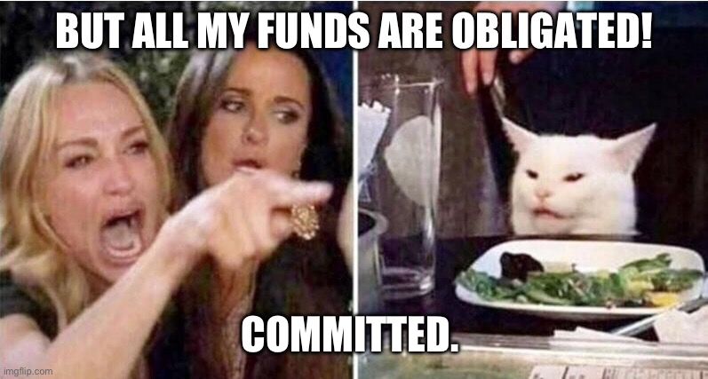
Section 2: How to look at SOA: Activities to support 2% target
You may think that you’ve reached the 2% carryover threshold because you’ve entered a 2237 for equipment, a 1358 for IPAs, or placed a credit card order.
However, taking the action to enter the funding documents in VISTA only commits the funds.
Funds hit the fund control point and come off your balance when those transactions are obligated by fiscal.
For a 2237 supporting a contract, obligation occurs only after the contract is completed and signed.
For a 1358 for IPAs, you may need to follow up with your fiscal until you see the obligation hit your fund control point.
For credit cards, the purchase order is not obligated until the order has been reconciled.

Slide 14
Section 2: How to look at SOA: Activities to support 2% target
Recommend starting an excel sheet to calculate 2% carry-over no later than 8/15/23. It should be updated every couple days as you get closer to the end of the fiscal year.
The excel sheet example in this presentation is done for the overall program. You should also do this for each individual Program (81, 82, 84, 85, 86) and roll the data up to the overall program.
First step is to calculate 2% target.
0161A1 FY 23/24 Total from SOA |  | 14,304,810
 | 2% | 286,096
8

Slide 15
Section 2: Salaries
For Salaries, you will need to project Pay Periods 17, 18, and 19.
The accruals for this year is factored at .5 for the PP20 split (5/10 working days will hit this fiscal year).
Salaries
FMS Budget | 5,338,531
FMS Obligated as of 8/15 | -4,280,216 | As each PP hits, you remove that line item and update the obligated column with the new obligated balance.
PP 17 | -248,006
PP 18 | -248,006
PP 19 | -248,006
Accruals (.5) | -124,003
Remaining | 190,295
9

Slide 16
Section 2: All Other
All Other Current Status |  |  | All Other With Pending Obligations
FMS Budget | 8,966,279 |  | FMS Budget | 8,966,279
FMS Obligated as of 8/15 | -6,752,745 |  | FMS Obligated as of 8/15 | -6,752,745
Remaining | 2,213,534 |  | Pending Credit Card | -66,392 | *These items are Committed and NOT Obligated.
 |  |  | Pending Contracts | -1,356,218
 |  |  | 4th Qtr IPAs to be Obligated | -698,254
 |  |  | Remaining | 92,670
The All-Other Current Status column shows the funds remaining if no other obligations were to be completed. The All- Other With Pending Obligations column shows the amount remaining if all pending/committed items would be obligated.
These numbers will change as purchase cards are reconciled, contracts are awarded/obligated and 1358's are completed for IPAs. Obligated items will move over to the Current Status column as this occurs. Any contracts that are not completed by contracting, IPA's that are not obligated by Fiscal and any credit cards that are not reconciled will remain in pending (committed but not obligated) and WILL count toward your 2%.
*Note: An invoice does not need to be submitted in IPPS for an item to be obligated. Once Fiscal has obligated the 1358 or 2237, it moves to the obligated column of the SOA and is no longer pending and will not count toward your 2%.

Slide 17
Section 2: Projecting carryover Percentage
Current % Status |  |  | % With Pending Obligations
Salary Remaining | 190,295 |  | Salary Remaining | 190,295
All Other Remaining | 2,213,534 |  | All Other Remaining | 92,670
Total Remaining | 2,403,829 |  | Total Remaining | 282,965
% if no other items are obligated | 16.8% |  | % if everything was to be completed | 1.9%
This slide shows how you combine the salary and all other remaining to determine your percentage.
The allocated amount for this facility was: $14,304,810. The total remaining divided into the allocated amount gives the current percentage.
Therefore, it is important to work with Fiscal, Contracting, and Purchase Card agents to ensure that 1358s and 2237s are obligated and credit card purchases are reconciled. Just because an item is entered, it does not mean it is complete. In the above example, if nothing else is completed, the facility will be at 16.8%.
12

Slide 18
Section 2: Spreadsheet with All Items
End of Year Plan
0161A1 FY 23/24 Total from SOA |  | 14,304,810
 | 2% | 286,096
Salaries |  |  | All Other Current Status |  |  | All Other With Pending Obligations
FMS Budget | 5,338,531 |  | FMS Budget | 8,966,279 |  | FMS Budget | 8,966,279
FMS Obligated as of 8/15 | -4,280,216 | As each PP hits, you remove that line item and update the obligated column with the new obligated balance. | FMS Obligated as of 8/15 | -6,752,745 |  | FMS Obligated as of 8/15 | -6,752,745
PP 17 | -248,006 |  | Remaining | 2,213,534 |  | Pending Credit Card | -66,392 | These items are Committed and NOT Obligated.
PP 18 | -248,006 |  |  |  |  | Pending Contracts | -1,356,218
PP 19 | -248,006 |  |  |  |  | 4th Qtr IPAs to be Obligated | -698,254
Accruals (.5) | -124,003 |  |  |  |  | Remaining | 92,670
Remaining | 190,295
 |  |  | Current % Status |  |  | % With Pending Obligations
 |  |  | Salary Remaining | 190,295 |  | Salary Remaining | 190,295
 |  |  | All Other Remaining | 2,213,534 |  | All Other Remaining | 92,670
 |  |  | Total Remaining | 2,403,829 |  | Total Remaining | 282,965
 |  |  | % if no other items are obligated | 16.80% |  | % if everything was to be completed | 1.9%
 |  |  | *Note: These numbers will change as purchase cards are reconciled, contracts are awarded/obligated and 1358's are completed for IPAs. Obligated items will move over to the Current Status of your % column as this occurs. Any contracts that are not completed by contracting, IPA's that are not obligated by Fiscal and any credit cards that are not reconciled will remain in pending (committed but not obligated) and WILL count toward your 2%.
13

Slide 19
Section 2: All Other Committed Items
Credit Card charges not reconciled: It is a best practice to stop all credit card charges at the end of August. Notify PI’s well in advance of this deadline. This allows you the month of September to receive
orders in and reconcile as much as possible. This will reduce the amount of credit card orders that have been carried into FY24. Once FY24 starts, you will only want to use FY24/25 funds for credit card orders. No prior year funds should be used for credit card charges.
1358’s (IPAs) that have been sent to Fiscal but not obligated by your Fiscal Office.
2237’s (Contracts) that have been sent to Contracting but have not been awarded.
10

Slide 20
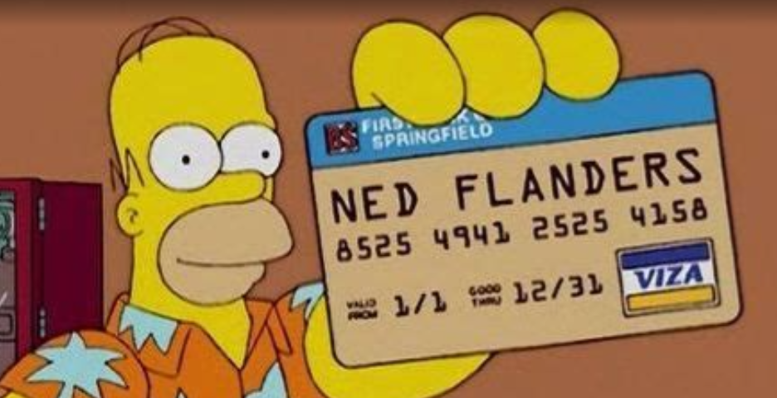
Section 3: Purchase Cards and Travel/Concur

Slide 21
Section 3: Helpful tips on credit card open orders
Credit Card charges not reconciled: It is a best practice to stop all credit card charges at the end of August. Notify PIs well in advance of this deadline. Check your monthly spend limit and request an increase if needed since PIs will likely have additional orders to get them through end of year. This allows you the month of September to receive orders in and reconcile as much as possible. This will reduce the amount of credit card orders that have been carried into FY24. Once FY24 starts, you will only want to use FY24/25 funds for credit card orders. When we get to No prior year funds should be used for credit card charges.
If expected reconciliation date is after November 1st, 2023, you are required to cancel the order and reorder in FY24/25 as these prior years will be swept as detailed in Section 1.
Following are different options to obtain credit card open orders:
  Fiscal Office can provide the accrual reports for open credit card orders.
  You can pull the Running Balance report in VISTA to determine what orders are open. Any orders with a “@” next to the order are open.
  If you have the unreconciled menu by cardholder menu in VISTA, you can pull the open orders for each cardholder.
  Ask your cardholder(s) and work with them to see what can be reconciled.
14

Slide 22
Section 3: Travel/Concur
As presented in FSC News Flash (FY 2021 Issues 31):
VA’s Temporary Duty (TDY) Travel System, ConcurGov, will be unavailable from 5:00pm Eastern Standard Time (EST) Friday, September 15, 2023 through 6:00am EST Monday, September 18, 2023 to allow time for the loading of the FY 2024 FMS Lines of Accounting (LOA) and iFAMS Accounting Templates.
      While ConcurGov is down, Emergency Travel Procedures will be in effect and travelers requiring reservations or immediate booking during this time should contact the Travel Management Center (TMC) directly at (866) 779-6612. Please note that the TMC will charge the full-service fee for this support.
Travelers who have travel starting in FY 2023 that crosses over into FY 2024, (i.e., September 30, 2023 to October 1, 2023), and traveling on a single year LOA should review the Fiscal Year 2023/2024 Rollover Procedures Job Aid prior to processing their documents. TDY travel that ends before October 1, 2023, or travel on multi-year LOAs or no-year LOAs are not affected.
14

Slide 23
Section 3: Travel Cards
Concur: (FY) 2023/2024 Rollover Procedures
Travelers who have travel starting in FY 2023 that crosses over into FY 2024, September 30, 2023 to October 1, 2023, and traveling on a single year LOA/Accounting Template are impacted. Travelers who have travel that ends before October 1, 2023 or traveling on multi- year LOAs or no-year LOAs are not affected. Both FY23 and FY24 LOAs/Accounting Templates will be available in ConcurGov. Documents created on or after Monday, September 18, 2023.
As for travel occurring in FY24 shall not be created before Monday, September 18, 2023. FY24 LOAs/Accounting Templates will be available in ConcurGov after 6:00 am EDT, Monday, September 18, 2023. The Funds Certifier or Approver must verify that the FY24 LOA(s)/Accounting Templates are populated during the approval process for trips occurring in FY24.
14

Slide 24

Section 4: Reimbursables

Slide 25
Section 4: Biggest Issue with Reimbursables
See our training from march on our SharePoint: Monthly Finance Training, Reimbursable Process_Final.pptx (sharepoint.com)
Stations are not closing the loop.
  Reimbursables are meant to offset expenditures made in the 0161A appropriation (be careful though as this will increase balances in 0161A1).
  Stations are billing and receiving the TDAs but are not cost transferring the expense from the 0161A to 0161R1 or X2.
Problem is cumulative as you do not close the loop, the balances grow and Fiscal will offset expenditures in previous years per the bill, thus making Research lose buying power.
  Example: Bill was made, paid and TDA received June 2022 in X2. Cost incurred in 21/22 funds. Cost transfer is now done from 0161A121/22 to 0161X2, those funds in A1 are not accessible for use. Closing the loop took too long, and the funds are not available for use anymore!
Work with Fiscal to cost transfer to 23/24 to reduce R1 balance to “0”.
16

Slide 26
Section 4: Managing Reimbursable Funding
Research Appropriations | Current Balance as 8/29/23 | Key Activities
No-Year (0161X2) | $6.8 M | Continue to obligate funding that is unobligated. The no-year fund is intended to reimburse VA Research from the NPCs, thus it’s critical to obligate these balances quicky after they are earned.
Prior Year (0161R1 22-23) | $4.3 M | Run daily Status of Funds to track Prior Year 0161R1 available funds are obligated starting on August 1 Run CALT tables (weekly through August; daily in September) to ensure all Reimbursable advances have been earned. We always send the R report from Raju Rama so you can see the status of reimbursables, and they can all be found on our SharePoint for FY 23.
Current Year (0161 23-24) | $2.8 M | Run daily Status of Funds to track Prior Year 0161R1 available funds are obligated starting on August 1 (Please June Monthly training that provided instructions on how to use VSSC: Finance Monthly Training Series: Using VSSC and reading the Status of Allowance (SOA) (va.gov)). Run CALT tables (weekly through August; daily in September) to ensure all Reimbursable advances have been earned.

Slide 27
Section 4:Key VHA Finance Reimbursement Deadlines
Below are the key deadlines from VHA Finance on reimbursements (page 5):
Deadline | Details
9/1/23 | Disbursement TDAs for August reimbursement will be processed after the first download from the General Ledger 425F, 425G, and 425P.
9/11/23 | Disbursement TDAs for reimbursement earned as of 9/8/23
9/18/23 | Disbursement TDAs for reimbursement collected between September 8 –15. Please note: Any reimbursement earned after September 15th will be held in the National Reserve. These funds will be distributed to the stations that need funding or will be exchanged with no-year or un-expiring multi-year funds. In FY 23, we were not successful in getting this funding to stations.

Slide 28
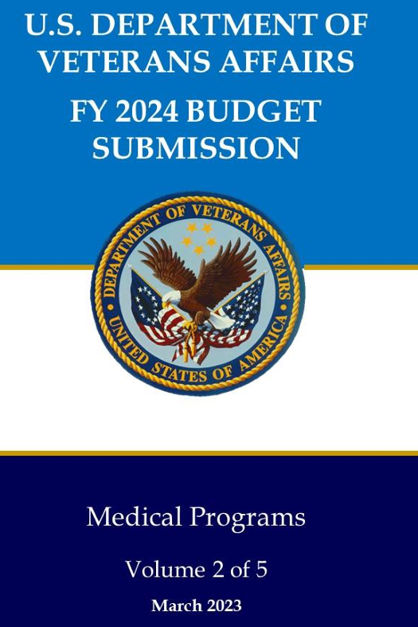
Section 5: Planning for FY 24

Slide 29
Section 5: Considerations for FY 24
Do not place credit cards orders with PY funds, instead use current year.
Do not execute contracts or purchases with PY funds (except ShEEP and LaMB).
Cost transfer or obligate 1358s timely and regularly.
Meet early with your investigators to develop spend plan. Schedule now if time permits; Pink sheets provide funds for FY24.
17

Slide 30
Section 5: Planning for FY 24
Plan to start FY 24 Under a CR
  Leaders in both parties agree to pursue a stopgap to avoid shutdown - Government Executive (govexec.com)
  Please see the FY 23 ORD CR Guidance (FY 23): FY 23 Continuing Resolution Guidance on Budget Execution
  When annual appropriations acts are not enacted by the beginning of the fiscal year (i.e., by October 1), one or more continuing resolutions may be enacted to provide temporary funding to continue certain programs and activities until action on the annual appropriation is completed. This means, you can obligate and spend money on October 1st, 2023.
    There is no suspension on the use of the purchase card provided an appropriation or continuing resolution has been enacted for FY 24.
    Please remember if you look in FMS/VSSC you will not see your funding loading at the Station/fund level, but funding is still available at the appropriation level for station to obligate payroll, travel, purchase card, contracts, etc.
    Time is required for VHA Finance to setup AACS for FY 24, we anticipate funding will be loaded in early November.
    We will send out a report of the FY 24 CR TDAs in order for you to understand your balances and be assured you are NOT in a negative.

Slide 31

Questions

Slide 32
Useful Resources
Past ORD Finance Training (sharepoint.com)
20

